Slide 1


BORN FRAGRANCE / ARCHITECTURE + INTERIOR DESIGN
Retail interior / coordinated design
Design intent, measured geometry and assembly strategies
PROJECT
2400 × 3106 internal
2600 ceiling
Black steel / plaster / stone-look floor
ISSUE PURPOSE
Client review and consultant coordination. Detailed strategies are preliminary pending the stated confirmations.
DRAWING PRIORITY
Geometry follows approved Rev A. Render conveys material and lighting character only.
READING SEQUENCE
Layout → elevations → materials → assembly details → coordination decisions.
REFERENCE RENDER · NOT TO SCALE · styling props excluded from technical scope
FOR COORDINATION · SITE ITEMS OPEN · REV D
06 OCT 2026 / SOURCE REV A
NTS @ A3 · DIMENSIONS mm
SPEC SNAPSHOT eeccbde1cd
AP-01

Slide 2
BORN FRAGRANCE / ARCHITECTURE + INTERIOR DESIGN
Overall plan / setting-out
Setting-out / coordinated interfaces · 1:20 · finish-face dimensions; site verification pending
SET-OUT DATUMS
FRAME + SETTING-OUT
A 0 / 0
B 2400 / 0
C 2400 / 3106
D 0 / 3106
250
1900
250
250 deep side units. Four 664 modules from y=450 to 3106. 25 main uprights shown; shelf/support lines distinguished.
D
C
N ↓ STOREFRONT
ASSUMED #23
664
700
COUNTER + REAR
1000
COUNTER FRAME
20 × 20 black steel
1000 × 450 counter; x=700–1700, y=1706–2156. 700 to rear-unit face. Side routes remain 450 / 450.
664
250 DEEP DISPLAY
450
1000 × 450 COUNTER
3106
450
450
GLAZED ENTRANCE
664
#16
450 side routes
Access / escape unresolved
488 fixed pane + 1000 pivot leaf + three 4 gaps = 1500. Pivot 100 from right edge; inward sweep shown.
STREET-FACING DISPLAY
Dashed line: shelf above
Solid return toward interior
664
Wall bands graphic only
Thickness TBC #26
Envelope TBC #4
COORDINATION STATUS
LOD 350 development target: interfaces shown, not certified complete. Anchors, hardware, substrate and access remain TBC #16/#26.
450
A
B
PIVOT GLASS DOOR
450
1500
450
2400
0 1000 mm | 1:20
FOR COORDINATION · SITE ITEMS OPEN · REV D
06 OCT 2026 / SOURCE REV A
06 OCT 2026 / SOURCE REV A
1:20 @ A3 · DIMENSIONS mm
SPEC SNAPSHOT eeccbde1cd
AP-03

Slide 3
BORN FRAGRANCE / ARCHITECTURE + INTERIOR DESIGN
Ceiling / lighting coordination
Reflected ceiling plan · lighting, display footprints and dimensional coordination
TRACK LIGHTING
650
1100
650
Two matte-black tracks, four cylindrical adjustable heads each. 3000 K. Track coordinates dimensioned directly.
BLACK TRACK
Adjustable spot heads
ENTRANCE DOWNLIGHTS
Three downlights at x=700 / 1200 / 1700; y=225. Symbol sizes indicative, not cut-out sizes.
SHELF LEDs BELOW
3000 K concealed light
3106
2206
DISPLAY LIGHTING
Concealed LEDs beneath shelves, and two 2656-long plinth runs. Dashed joinery footprint coordinates the ceiling with displays below.
TBC #16
Head stations / aiming indicative.
Confirm MEP, fixings, drivers
and ceiling access on site.
CEILING / SERVICES
ENTRANCE DOWNLIGHTS
Three approved positions
Warm off-white gypsum at 2600. No invented fire devices, wiring circuits or access panels. Consultant to coordinate under TBC #16.
2400
0 1000 mm | 1:20
FOR COORDINATION · SITE ITEMS OPEN · REV D
06 OCT 2026 / SOURCE REV A
06 OCT 2026 / SOURCE REV A
1:20 @ A3 · DIMENSIONS mm
SPEC SNAPSHOT eeccbde1cd
AP-05

Slide 4
BORN FRAGRANCE / ARCHITECTURE + INTERIOR DESIGN
Storefront / external elevation
Developed storefront · street-facing displays, glazed entrance and halo-lit brand
DISPLAY COLUMNS
450 wide, 450 deep; shelf depth 250. Black frame and folded trays; warm concealed LEDs. Bottles indicate use only.
HALO-LIT BRAND
1000 wide; 25 stand-offs
600
CLEAR GLASS ENTRANCE
488 fixed pane, 1000 pivot leaf; 12 toughened glass. Faint rear joinery is visible through glass, not applied to it.
FOLDED BLACK SHELF
Warm concealed light
3200
BRANDING / FINISH
CLEAR TOUGHENED GLASS
12 mm; interior visible beyond
600-high plaster fascia. 1000-wide native logo; black halo-lit letters on 25 stand-offs. Supports remain TBC #16.
TBC #16
Handle / fittings schematic.
10 + 2580 + 10 height split
requires glazier confirmation.
GLAZING COORDINATION
Door fittings are indicative only. Handle, pivots, patch fittings, structural support and glass procurement require supplier confirmation.
450
1500
450
2400
0 1000 mm | 1:20
FOR COORDINATION · SITE ITEMS OPEN · REV D
06 OCT 2026 / SOURCE REV A
06 OCT 2026 / SOURCE REV A
1:20 @ A3 · DIMENSIONS mm
SPEC SNAPSHOT eeccbde1cd
AP-06

Slide 5
BORN FRAGRANCE / ARCHITECTURE + INTERIOR DESIGN
Rear focal wall / internal elevation
Rear focal wall · developed shelving + owner-directed counter front
REAR DISPLAY
500 / 900 / 500 zones between side units. 25 main posts, 3 mm folded trays, 25 downstands and warm concealed LEDs. No rear mesh.
250
500
900
500
250
UNLIT BLACK LOGO
600 wide; centre 1900
COUNTER / RENDER DIRECTION
Left mesh panel, larger light-neutral right panel, light top and black perimeter frame. Replaces the small central mesh graphic at owner request.
BLACK TRAY / WARM LED
25 downstand; 250 depth
2600
DIMENSIONS RETAINED
Counter 1000 × 450 × 900 high, 20 × 20 black frame. Location and 450 side gaps unchanged. Revised front panel split is not a cutting schedule.
COUNTER REVISION / TBC #16
Owner visual direction: mesh left,
solid panel right. Panel split, top
thickness and connections TBC.
Supersedes central insert depiction.
900
BRAND / FINISH
600-wide native black logo, centre 1900 AFFL, unlit. Raw light plaster backdrop. Product silhouettes indicative only.
1000
2400
0 1000 mm | 1:20
FOR COORDINATION · SITE ITEMS OPEN · REV D
06 OCT 2026 / SOURCE REV A
06 OCT 2026 / SOURCE REV A
1:20 @ A3 · DIMENSIONS mm
SPEC SNAPSHOT eeccbde1cd
AP-07

Slide 6
BORN FRAGRANCE / ARCHITECTURE + INTERIOR DESIGN
Left display / internal elevation
Developed display elevation · interfaces + material codes · bottles indicative only
BLACK STEEL / NEUTRAL PPC / EXPANDED MESH / 3000 K LED
STEEL FRAME
25 × 25 × 1.6 main SHS; 20 × 20 × 1.6 secondary supports. 664 module is not a fabrication cut size.
400
EXPANDED METAL MESH
SHELF + LIGHT
400
3 mm tray / 25 downstand / 250 depth. Concealed 3000 K LED behind front edge; see section inset.
SOLID
COLUMN
RETURN
DISPLAY
FACES
STREET
400
BLACK TRAY / WARM LED
2600
BASE + MESH
400
600 base includes 100 recessed plinth. 1.5 PPC doors. Mesh at 2200–2600; approximate 20 × 40 diamonds.
250
400
SHELF SECTION 1:5
500
3 mm tray · 25 downstand
20 × 20 support · LED below
INDICATIVE CONTENT
RECESSED PLINTH / BASE
Fragrance silhouettes show scale and use. Fixings and cable routing #16 remain open. The solid column return has street-facing displays around the corner.
664
664
664
664
100
3106
INDICATIVE BOTTLES · NOT A STOCK / CAPACITY SCHEDULE
0 1000 mm | 1:20
FOR COORDINATION · SITE ITEMS OPEN · REV D
06 OCT 2026 / SOURCE REV A
06 OCT 2026 / SOURCE REV A
1:20 @ A3 · DIMENSIONS mm
SPEC SNAPSHOT eeccbde1cd
AP-08

Slide 7
BORN FRAGRANCE / ARCHITECTURE + INTERIOR DESIGN
Right display / internal elevation
Developed display elevation · interfaces + material codes · bottles indicative only
BLACK STEEL / NEUTRAL PPC / EXPANDED MESH / 3000 K LED
STEEL FRAME
25 × 25 × 1.6 main SHS; 20 × 20 × 1.6 secondary supports. 664 module is not a fabrication cut size.
400
EXPANDED METAL MESH
SHELF + LIGHT
400
3 mm tray / 25 downstand / 250 depth. Concealed 3000 K LED behind front edge; see section inset.
SOLID
COLUMN
RETURN
DISPLAY
FACES
STREET
400
BLACK TRAY / WARM LED
2600
BASE + MESH
400
600 base includes 100 recessed plinth. 1.5 PPC doors. Mesh at 2200–2600; approximate 20 × 40 diamonds.
250
400
SHELF SECTION 1:5
500
3 mm tray · 25 downstand
20 × 20 support · LED below
INDICATIVE CONTENT
RECESSED PLINTH / BASE
Fragrance silhouettes show scale and use. Fixings and cable routing #16 remain open. The solid column return has street-facing displays around the corner.
664
664
664
664
100
3106
INDICATIVE BOTTLES · NOT A STOCK / CAPACITY SCHEDULE
0 1000 mm | 1:20
FOR COORDINATION · SITE ITEMS OPEN · REV D
06 OCT 2026 / SOURCE REV A
06 OCT 2026 / SOURCE REV A
1:20 @ A3 · DIMENSIONS mm
SPEC SNAPSHOT eeccbde1cd
AP-09

Slide 8
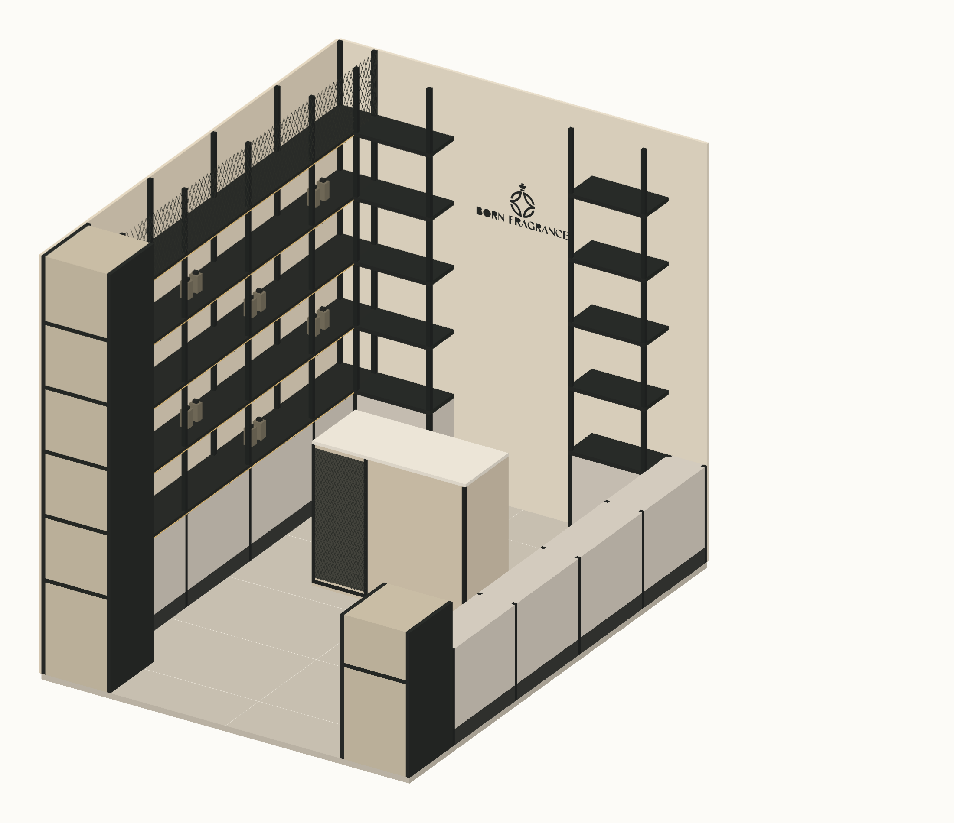
BORN FRAGRANCE / ARCHITECTURE + INTERIOR DESIGN
Spatial assembly / cutaway axonometric
Shaded cutaway / approved geometry + render material language · near wall and ceiling removed
SPATIAL CHARACTER
Warm plaster, black frames, mesh, neutral cabinetry and warm shelf lighting follow the reference render.
GEOMETRIC BASIS
2400 × 3106 × 2600 envelope. Four 664 modules; centred 1000 × 450 counter; 500 / 900 / 500 rear zones.
CUTAWAY
Near-side upper units and ceiling removed to expose the room. Their full extent remains on the plans and elevations.
ACCURACY LIMIT
Visual fidelity target, not a measurable 80% certification. Approved dimensions override the render. Bottles are indicative; hardware and fixings remain TBC.
CUTAWAY AXONOMETRIC · NTS · ceiling and near-side upper joinery omitted
FOR COORDINATION · SITE ITEMS OPEN · REV D
06 OCT 2026 / SOURCE REV A
06 OCT 2026 / SOURCE REV A
NTS @ A3 · DIMENSIONS mm
SPEC SNAPSHOT eeccbde1cd
AP-10

Slide 9
BORN FRAGRANCE / ARCHITECTURE + INTERIOR DESIGN
Material palette / visible finishes
AP-11 · sample-led specification; colours are indicative
BLACK STEEL
CABINET STEEL
PLASTER
25 × 25 × 1.6 main SHS
20 × 20 × 1.6 secondary SHS
Matte black powder coat
1.5 mm PPC doors
Light-neutral finish
Flush, handleless
Raw light textured plaster
Approve physical sample
Substrate / buildup #26
PORCELAIN
CLEAR GLASS
EXPANDED MESH
1200 × 600 rectified
2 grout / 5 perimeter joint
Stone-look, sample approval
12 mm toughened door
Hardware / gaps #16
Fixed pane specification TBC
Approx. 20 × 40 diamond
Black finish / framed edges
Gauge and fixing #16
FOR COORDINATION · SITE ITEMS OPEN · REV D
06 OCT 2026 / SOURCE REV A
NTS @ A3 · DIMENSIONS mm
SPEC SNAPSHOT eeccbde1cd
AP-11

