Slide 1


BORN FRAGRANCE / ARCHITECTURE + INTERIOR DESIGN
Retail interior / coordinated design
Design intent, measured geometry and assembly strategies
REFERENCE RENDER · DESIGN INTENT

Slide 2
BORN FRAGRANCE / ARCHITECTURE + INTERIOR DESIGN
Overall plan / setting-out
Setting-out / coordinated interfaces · 1:20 · finish-face dimensions; site verification pending
SET-OUT DATUMS
REAR / SIDE JUNCTION
LOCAL PLAN 1:5
A 0 / 0
B 2400 / 0
C 2400 / 3106
D 0 / 3106
250
1900
250
250
D
C
N ↓ STOREFRONT
ASSUMED #23
664
250
1000
700
COUNTER FRAME
20 × 20 black steel
664
250 DEEP DISPLAY
450
1000 × 450 COUNTER
3106
450
450
664
STREET-FACING DISPLAY
Dashed line: shelf above
Solid return toward interior
250
25 × 25 × 1.6 SHS / 250-deep units
Rear bay continues right; no overlap
664
Wall bands graphic only
Thickness TBC #26
Envelope TBC #4
DOOR EDGE / PIVOT
450
LOCAL PLAN 1:2
A
B
PIVOT GLASS DOOR
450
1500
450
100
2400
0 1000 mm | 1:20
4
12 glass / 4 gap / 25 SHS · pivot fittings TBC #16

Slide 3
BORN FRAGRANCE / ARCHITECTURE + INTERIOR DESIGN
Ceiling / lighting coordination
Reflected ceiling plan · lighting, display footprints and dimensional coordination
UNIT HEAD / CEILING
650
1100
650
SECTION 1:5
250
BLACK TRACK
Adjustable spot heads
400
SHELF LEDs BELOW
3000 K concealed light
3106
2206
2600 ceiling / frame datum
Mesh zone 2200–2600 at front
Wall fixings TBC #16; no gypsum fixing
ENTRANCE DOWNLIGHTS
Three approved positions
FOLDED TRAY / LIGHT
SECTION 1:2
2400
250
0 1000 mm | 1:20
3 mm folded tray · 25 front downstand
20 × 20 × 1.6 support · LED profile TBC #16

Slide 4
BORN FRAGRANCE / ARCHITECTURE + INTERIOR DESIGN
Storefront / external elevation
Developed storefront · street-facing displays, glazed entrance and halo-lit brand
HALO-LIT BRAND
1000 wide; 25 stand-offs
BLACK SHS FRAME
600
25 × 25 × 1.6 main steel
FOLDED BLACK SHELF
Warm concealed light
3200
CLEAR TOUGHENED GLASS
12 mm; interior visible beyond
HALO LETTER / BACKING
STAND-OFF SECTION 1:2
25
450
1500
450
2400
25 stand-off · halo behind black letters
Backing / wall support / drivers TBC #16
0 1000 mm | 1:20

Slide 5
BORN FRAGRANCE / ARCHITECTURE + INTERIOR DESIGN
Rear focal wall / internal elevation
Rear focal wall · developed shelving + owner-directed counter front
REAR SHELF / FRAME
SECTION 1:2
250
500
900
500
250
UNLIT BLACK LOGO
600 wide; centre 1900
250
BLACK TRAY / WARM LED
25 downstand; 250 depth
3 mm folded tray · 25 front downstand
20 × 20 × 1.6 support · LED profile TBC #16
2600
900
COUNTER / FOOTPRINT
COUNTER MESH / SOLID
PLAN 1:10
Owner render direction
Panel split / top thickness TBC #16
1000
1000
2400
450
0 1000 mm | 1:20
20 × 20 frame · front split TBC #16

Slide 6
BORN FRAGRANCE / ARCHITECTURE + INTERIOR DESIGN
Left display / internal elevation
Developed display elevation · interfaces + material codes · bottles indicative only
BLACK STEEL / NEUTRAL PPC / EXPANDED MESH / 3000 K LED
SHELF / FRONT EDGE
SECTION 1:2
400
EXPANDED METAL MESH
250
400
3 mm folded tray · 25 front downstand
20 × 20 × 1.6 support · LED profile TBC #16
SOLID
COLUMN
RETURN
DISPLAY
FACES
STREET
400
BLACK TRAY / WARM LED
2600
400
400
CABINET / PLINTH
SECTION 1:5
500
RECESSED PLINTH / BASE
664
664
664
664
100
3106
INDICATIVE BOTTLES · NOT A STOCK / CAPACITY SCHEDULE
100
0 1000 mm | 1:20
50
100 high · 50 recess · warm toe-kick LED

Slide 7
BORN FRAGRANCE / ARCHITECTURE + INTERIOR DESIGN
Right display / internal elevation
Developed display elevation · interfaces + material codes · bottles indicative only
BLACK STEEL / NEUTRAL PPC / EXPANDED MESH / 3000 K LED
SHELF / FRONT EDGE
SECTION 1:2
400
EXPANDED METAL MESH
250
400
3 mm folded tray · 25 front downstand
20 × 20 × 1.6 support · LED profile TBC #16
SOLID
COLUMN
RETURN
DISPLAY
FACES
STREET
400
BLACK TRAY / WARM LED
2600
400
400
CABINET / PLINTH
SECTION 1:5
500
RECESSED PLINTH / BASE
664
664
664
664
100
3106
INDICATIVE BOTTLES · NOT A STOCK / CAPACITY SCHEDULE
100
0 1000 mm | 1:20
50
100 high · 50 recess · warm toe-kick LED

Slide 8
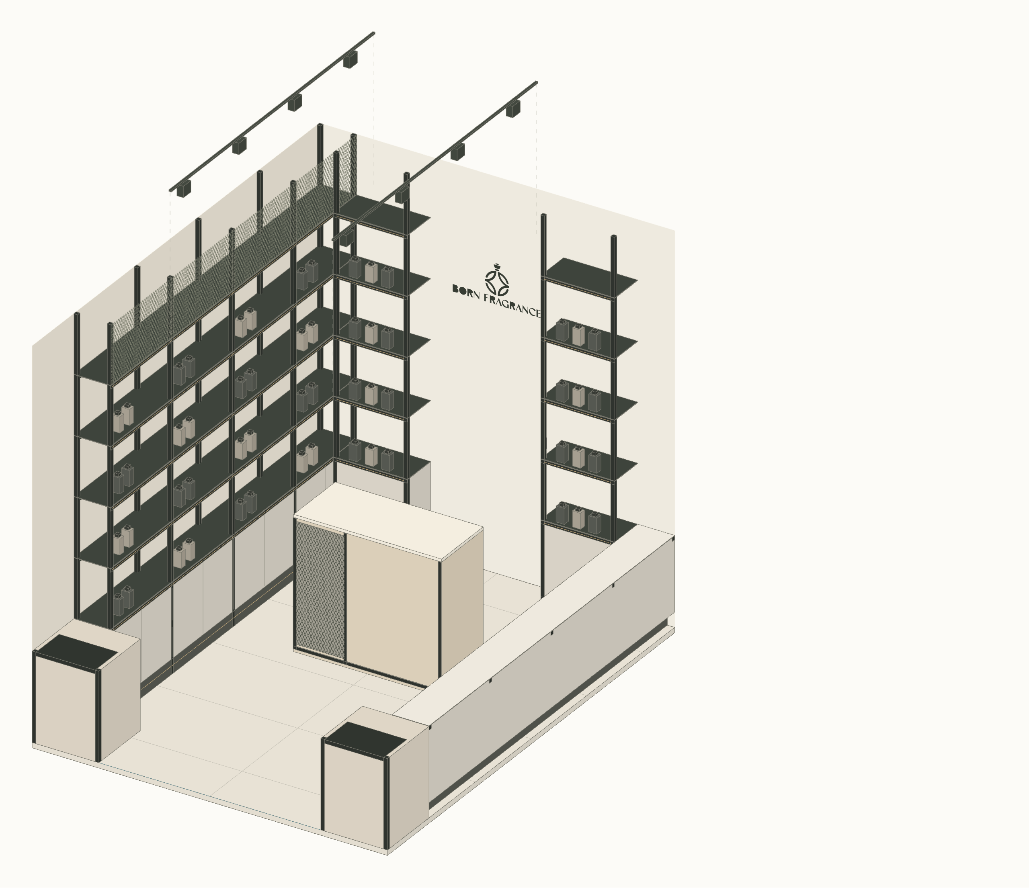
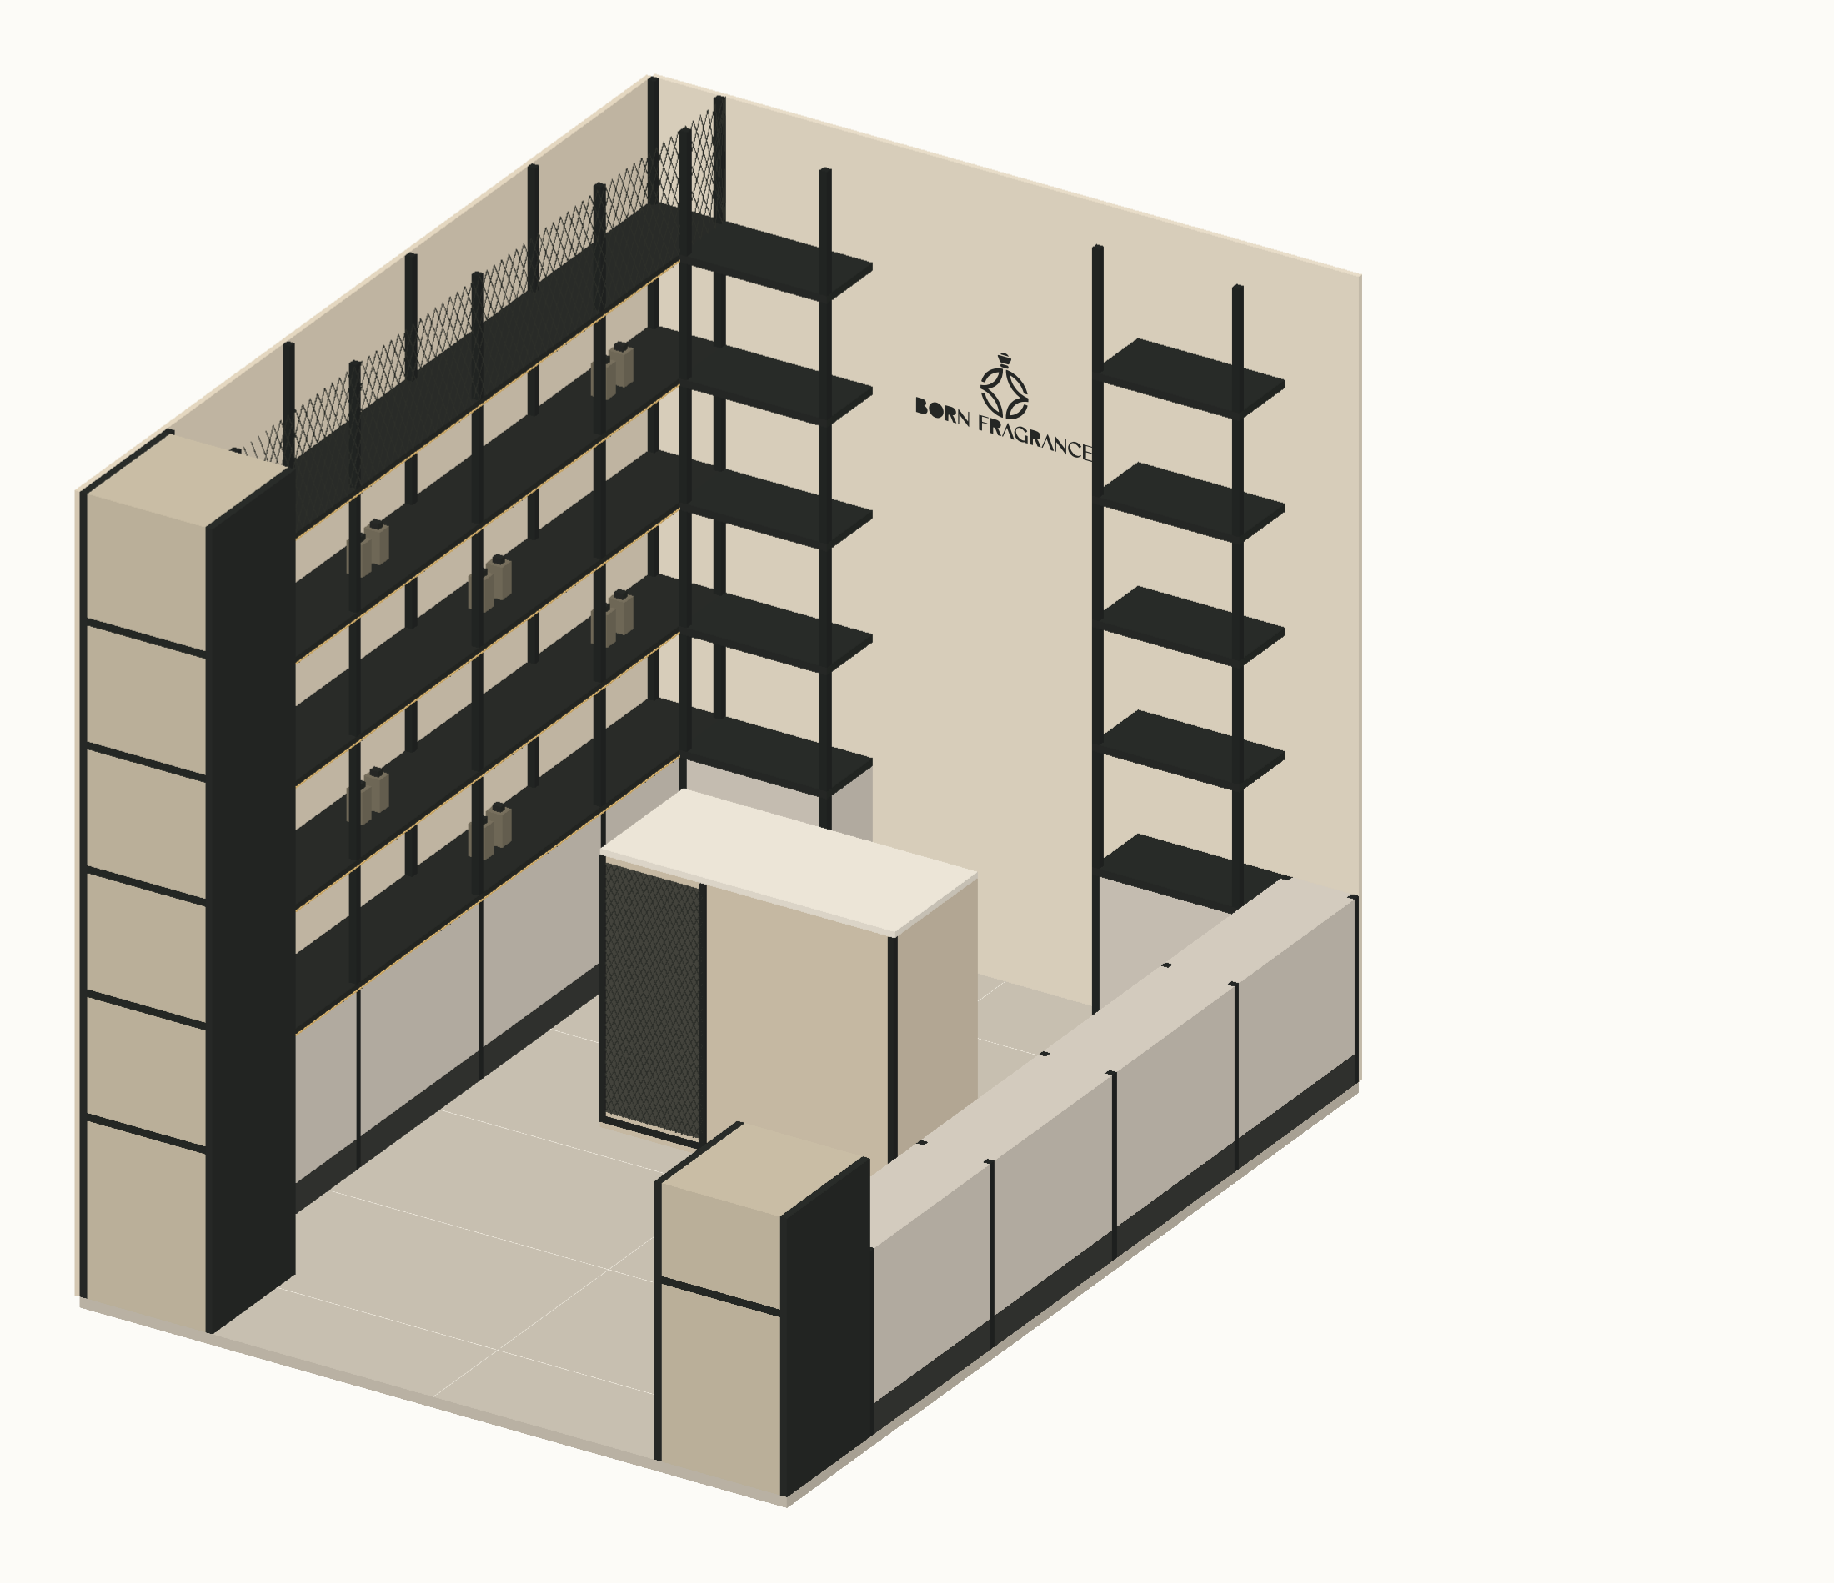
BORN FRAGRANCE / ARCHITECTURE + INTERIOR DESIGN
Spatial assembly / cutaway axonometric
Spatial cutaway · orthographic projection · direct material and interface annotations
CEILING TRACKS
EXPANDED MESH
Exploded above room
Installed at 2600 · 3000 K
Two tracks / four spots each
Upper infill 2200–2600
Approx. 20 × 40 diamonds
REAR BRAND WALL
BLACK STEEL TRAYS
Raw light plaster
600-wide unlit native logo
250 depth · 3 mm steel
25 folded front downstand
NEUTRAL BASE DOORS
COUNTER
1.5 mm PPC steel
600 base incl. 100 plinth
1000 × 450 × 900
Mesh left / neutral panel right
STREET DISPLAY CUT
NEAR-SIDE CUTAWAY
Upper column removed
1500 clear entrance
Upper joinery omitted at 600
Full run shown in elevations
ORTHOGRAPHIC CUTAWAY · NTS · ceiling plane removed

Slide 9
BORN FRAGRANCE / ARCHITECTURE + INTERIOR DESIGN
Material palette / visible finishes
AP-11 · sample-led specification; colours are indicative
BLACK STEEL
CABINET STEEL
PLASTER
25 × 25 × 1.6 main SHS
20 × 20 × 1.6 secondary SHS
Matte black powder coat
1.5 mm PPC doors
Light-neutral finish
Flush, handleless
Raw light textured plaster
Approve physical sample
Substrate / buildup #26
PORCELAIN
CLEAR GLASS
EXPANDED MESH
1200 × 600 rectified
2 grout / 5 perimeter joint
Stone-look, sample approval
12 mm toughened door
Hardware / gaps #16
Fixed pane specification TBC
Approx. 20 × 40 diamond
Black finish / framed edges
Gauge and fixing #16

