Slide 1

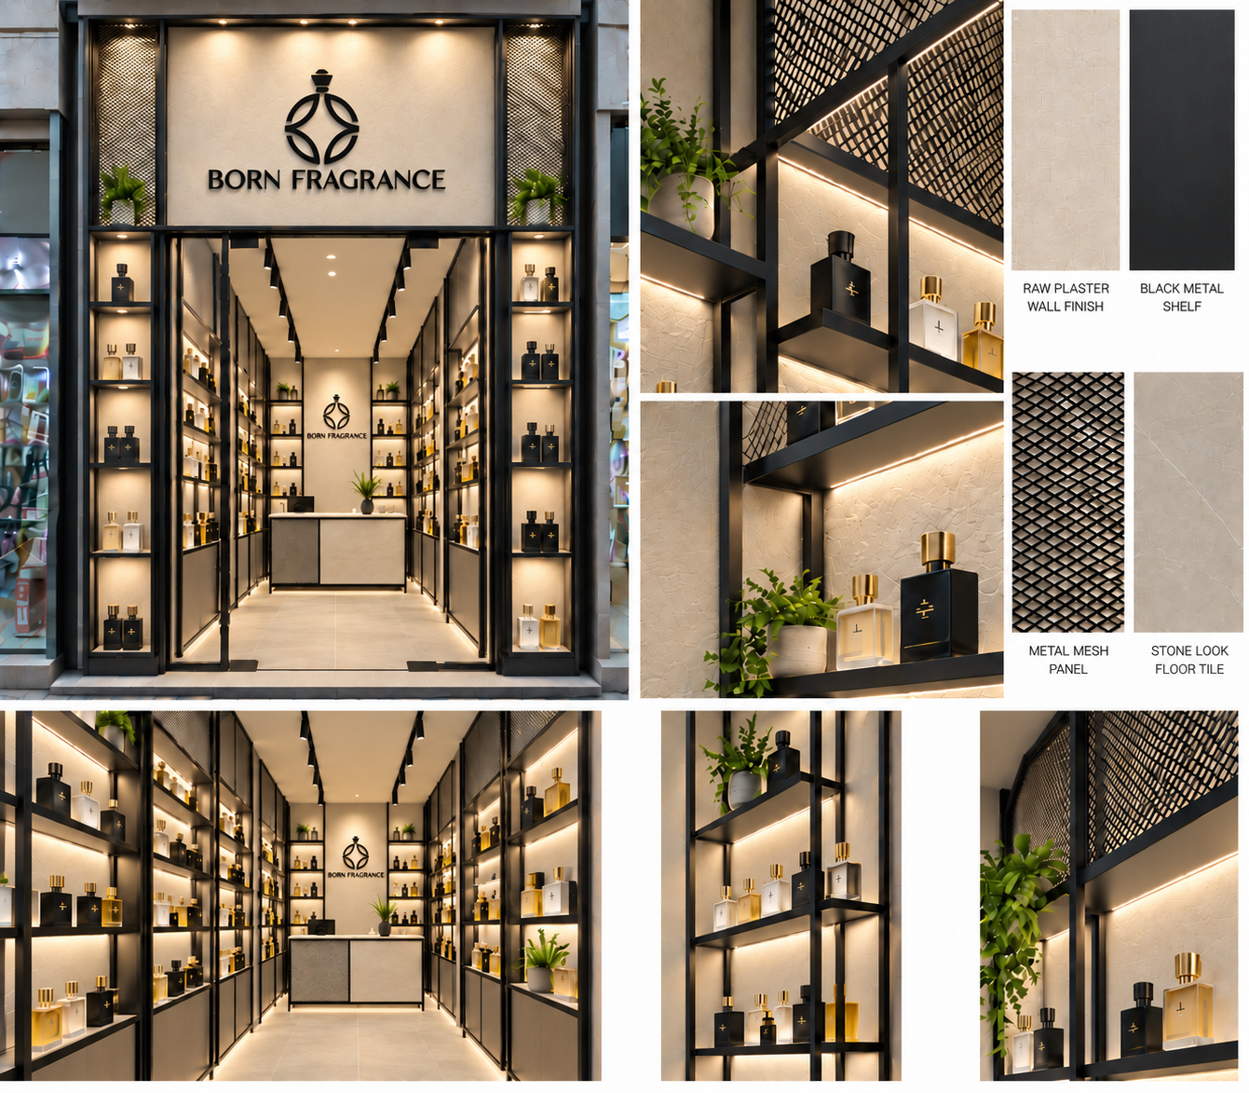

RETAIL INTERIOR / COORDINATED DESIGN
Storefront, interior and display details · neutral material tones
INTERIOR / DISPLAY AND COUNTER
STOREFRONT / DESIGN INTENT
MESH / LIGHT
DISPLAY FRAME
PLASTER / SHELF

Slide 2
OVERALL PLAN / SETTING-OUT
Setting-out / coordinated interfaces · 1:20 · finish-face dimensions; site verification pending
SET-OUT DATUMS
REAR / SIDE JUNCTION
LOCAL PLAN 1:5
A 0 / 0
B 2400 / 0
C 2400 / 3106
D 0 / 3106
250
1900
250
250
D
C
N ↓ STOREFRONT
ASSUMED #23
664
SIDE DISPLAY
250
1000
700
250 deep shelving
25 × 25 main steel frame
664
450
COUNTER / STEEL FRAME
450
450
1000 × 450 footprint
20 × 20 black steel
3106
664
STREET-FACING DISPLAY
Dashed line: shelf above
Solid return toward interior
250
25 × 25 × 1.6 SHS / 250-deep units
Rear bay continues right; no overlap
664
Wall bands graphic only
Thickness TBC #26
Envelope TBC #4
DOOR EDGE / PIVOT
450
LOCAL PLAN 1:2
A
B
PIVOT GLASS DOOR
450
1500
450
1000-wide leaf · 12 glass
Inward opening
100
2400
0 1000 mm | 1:20
4
12 glass / 4 gap / 25 SHS · pivot fittings TBC #16

Slide 3
CEILING / LIGHTING COORDINATION
Reflected ceiling plan · lighting, display footprints and dimensional coordination
UNIT HEAD / CEILING
650
1100
650
SECTION 1:5
250
BLACK CEILING TRACK
Adjustable spot heads
3000 K warm white
400
3106
2206
CONCEALED SHELF LIGHT
LEDs below shelving
Shown dashed in ceiling plan
2600 ceiling / frame datum
Mesh zone 2200–2600 at front
Wall fixings TBC #16; no gypsum fixing
FOLDED TRAY / LIGHT
ENTRANCE DOWNLIGHTS
SECTION 1:2
Three approved positions
Final aiming on site
2400
250
0 1000 mm | 1:20
3 mm folded tray · 25 front downstand
20 × 20 × 1.6 support · LED profile TBC #16

Slide 4
STOREFRONT / EXTERNAL ELEVATION
Developed storefront · street-facing displays, glazed entrance and halo-lit brand
HALO-LIT BRAND
600
1000 wide · 25 stand-offs
BLACK STEEL FRAME
400
25 × 25 × 1.6 main SHS
400
3200
400
FOLDED DISPLAY TRAY
Warm concealed shelf light
HALO LETTER / BACKING
400
STAND-OFF SECTION 1:2
25
CLEAR TOUGHENED GLASS
400
1000 × 2580 leaf · 12 mm glass
500
450
1500
450
100
2400
25 stand-off · halo behind black letters
Backing / wall support / drivers TBC #16
0 1000 mm | 1:20

Slide 5
REAR FOCAL WALL / INTERNAL ELEVATION
Rear focal wall · developed shelving + owner-directed counter front
REAR SHELF / FRAME
SECTION 1:2
250
500
900
500
250
400
250
UNLIT BLACK LOGO
400
600 wide · centre at 1900
400
3 mm folded tray · 25 front downstand
20 × 20 × 1.6 support · LED profile TBC #16
BLACK TRAY / WARM LED
2600
400
250 deep · 25 downstand
400
COUNTER FRONT
Mesh left / neutral solid right
Panel split and top TBC #16
900
COUNTER / FOOTPRINT
500
PLAN 1:10
1000
1000
100
2400
450
0 1000 mm | 1:20
20 × 20 frame · front split TBC #16

Slide 6
LEFT DISPLAY / INTERNAL ELEVATION
Developed display elevation · interfaces + material codes · bottles indicative only
BLACK STEEL / NEUTRAL PPC / EXPANDED MESH / 3000 K LED
SHELF / FRONT EDGE
SOLID COLUMN RETURN
Display faces street
SECTION 1:2
EXPANDED MESH
Upper infill
2200–2600
250
400
400
3 mm folded tray · 25 front downstand
20 × 20 × 1.6 support · LED profile TBC #16
400
BLACK STEEL TRAY
2600
25 folded downstand
Concealed warm LED
400
400
CABINET / PLINTH
SECTION 1:5
500
RECESSED PLINTH
100
100 high · 50 recess
Warm toe-kick light
664
664
664
664
3106
0 1000 mm | 1:20
100
50
INDICATIVE BOTTLES · NOT A STOCK / CAPACITY SCHEDULE
100 high · 50 recess · warm toe-kick LED

Slide 7
RIGHT DISPLAY / INTERNAL ELEVATION
Developed display elevation · interfaces + material codes · bottles indicative only
BLACK STEEL / NEUTRAL PPC / EXPANDED MESH / 3000 K LED
SHELF / FRONT EDGE
SOLID COLUMN RETURN
Display faces street
SECTION 1:2
EXPANDED MESH
Upper infill
2200–2600
250
400
400
3 mm folded tray · 25 front downstand
20 × 20 × 1.6 support · LED profile TBC #16
400
BLACK STEEL TRAY
2600
25 folded downstand
Concealed warm LED
400
400
CABINET / PLINTH
SECTION 1:5
500
RECESSED PLINTH
100
100 high · 50 recess
Warm toe-kick light
664
664
664
664
3106
0 1000 mm | 1:20
100
50
INDICATIVE BOTTLES · NOT A STOCK / CAPACITY SCHEDULE
100 high · 50 recess · warm toe-kick LED

Slide 8
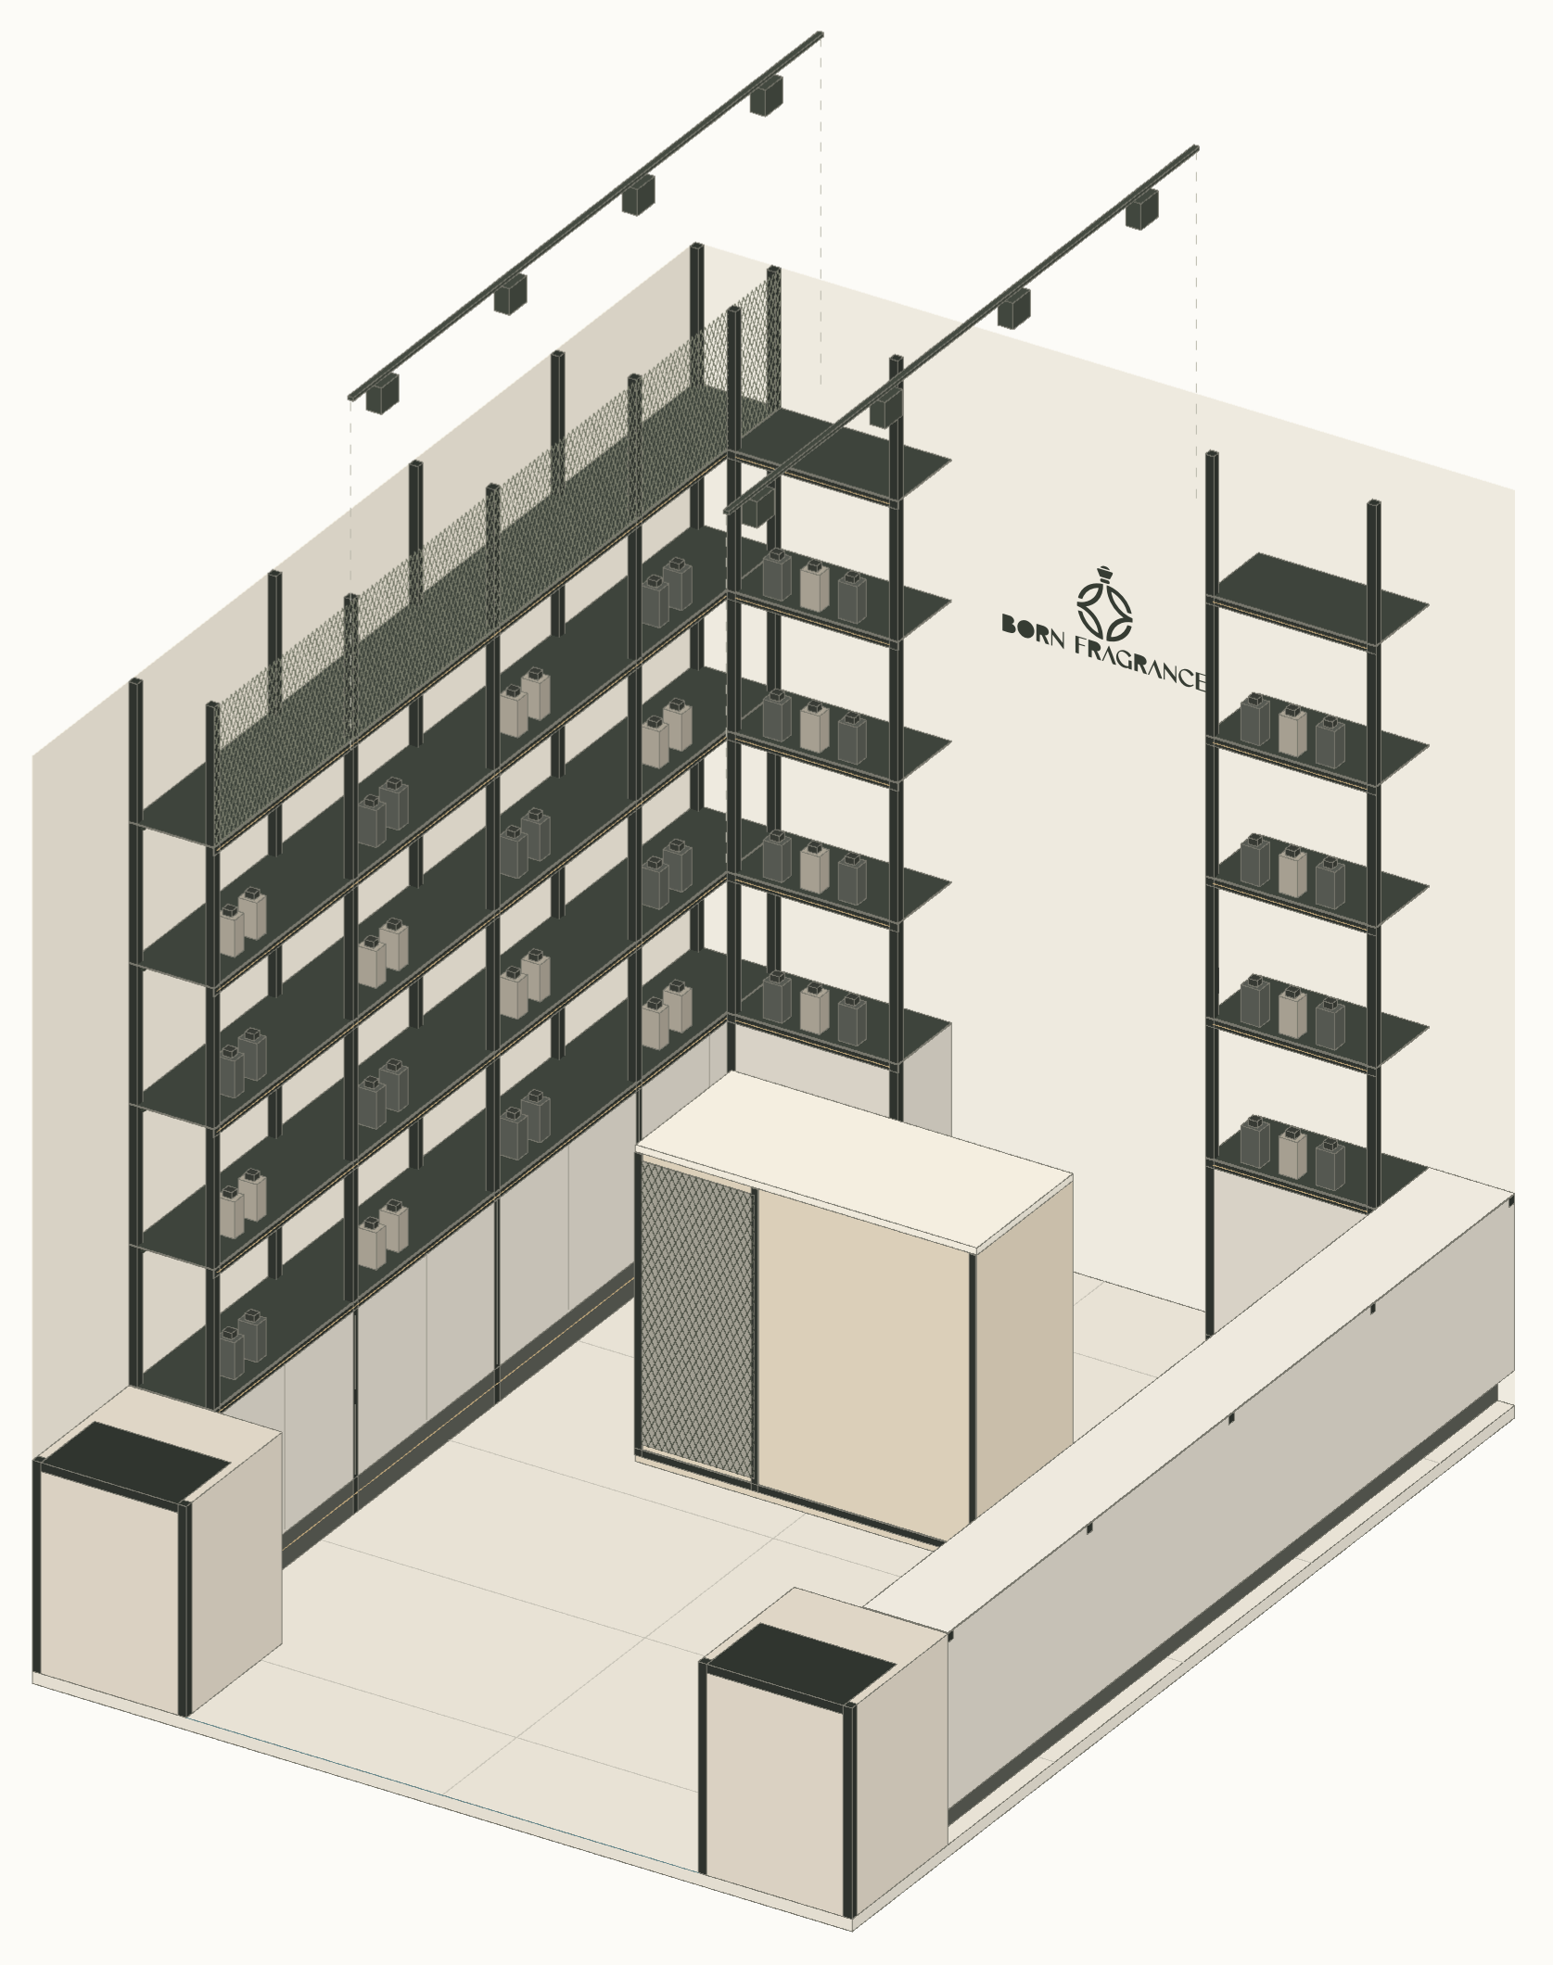
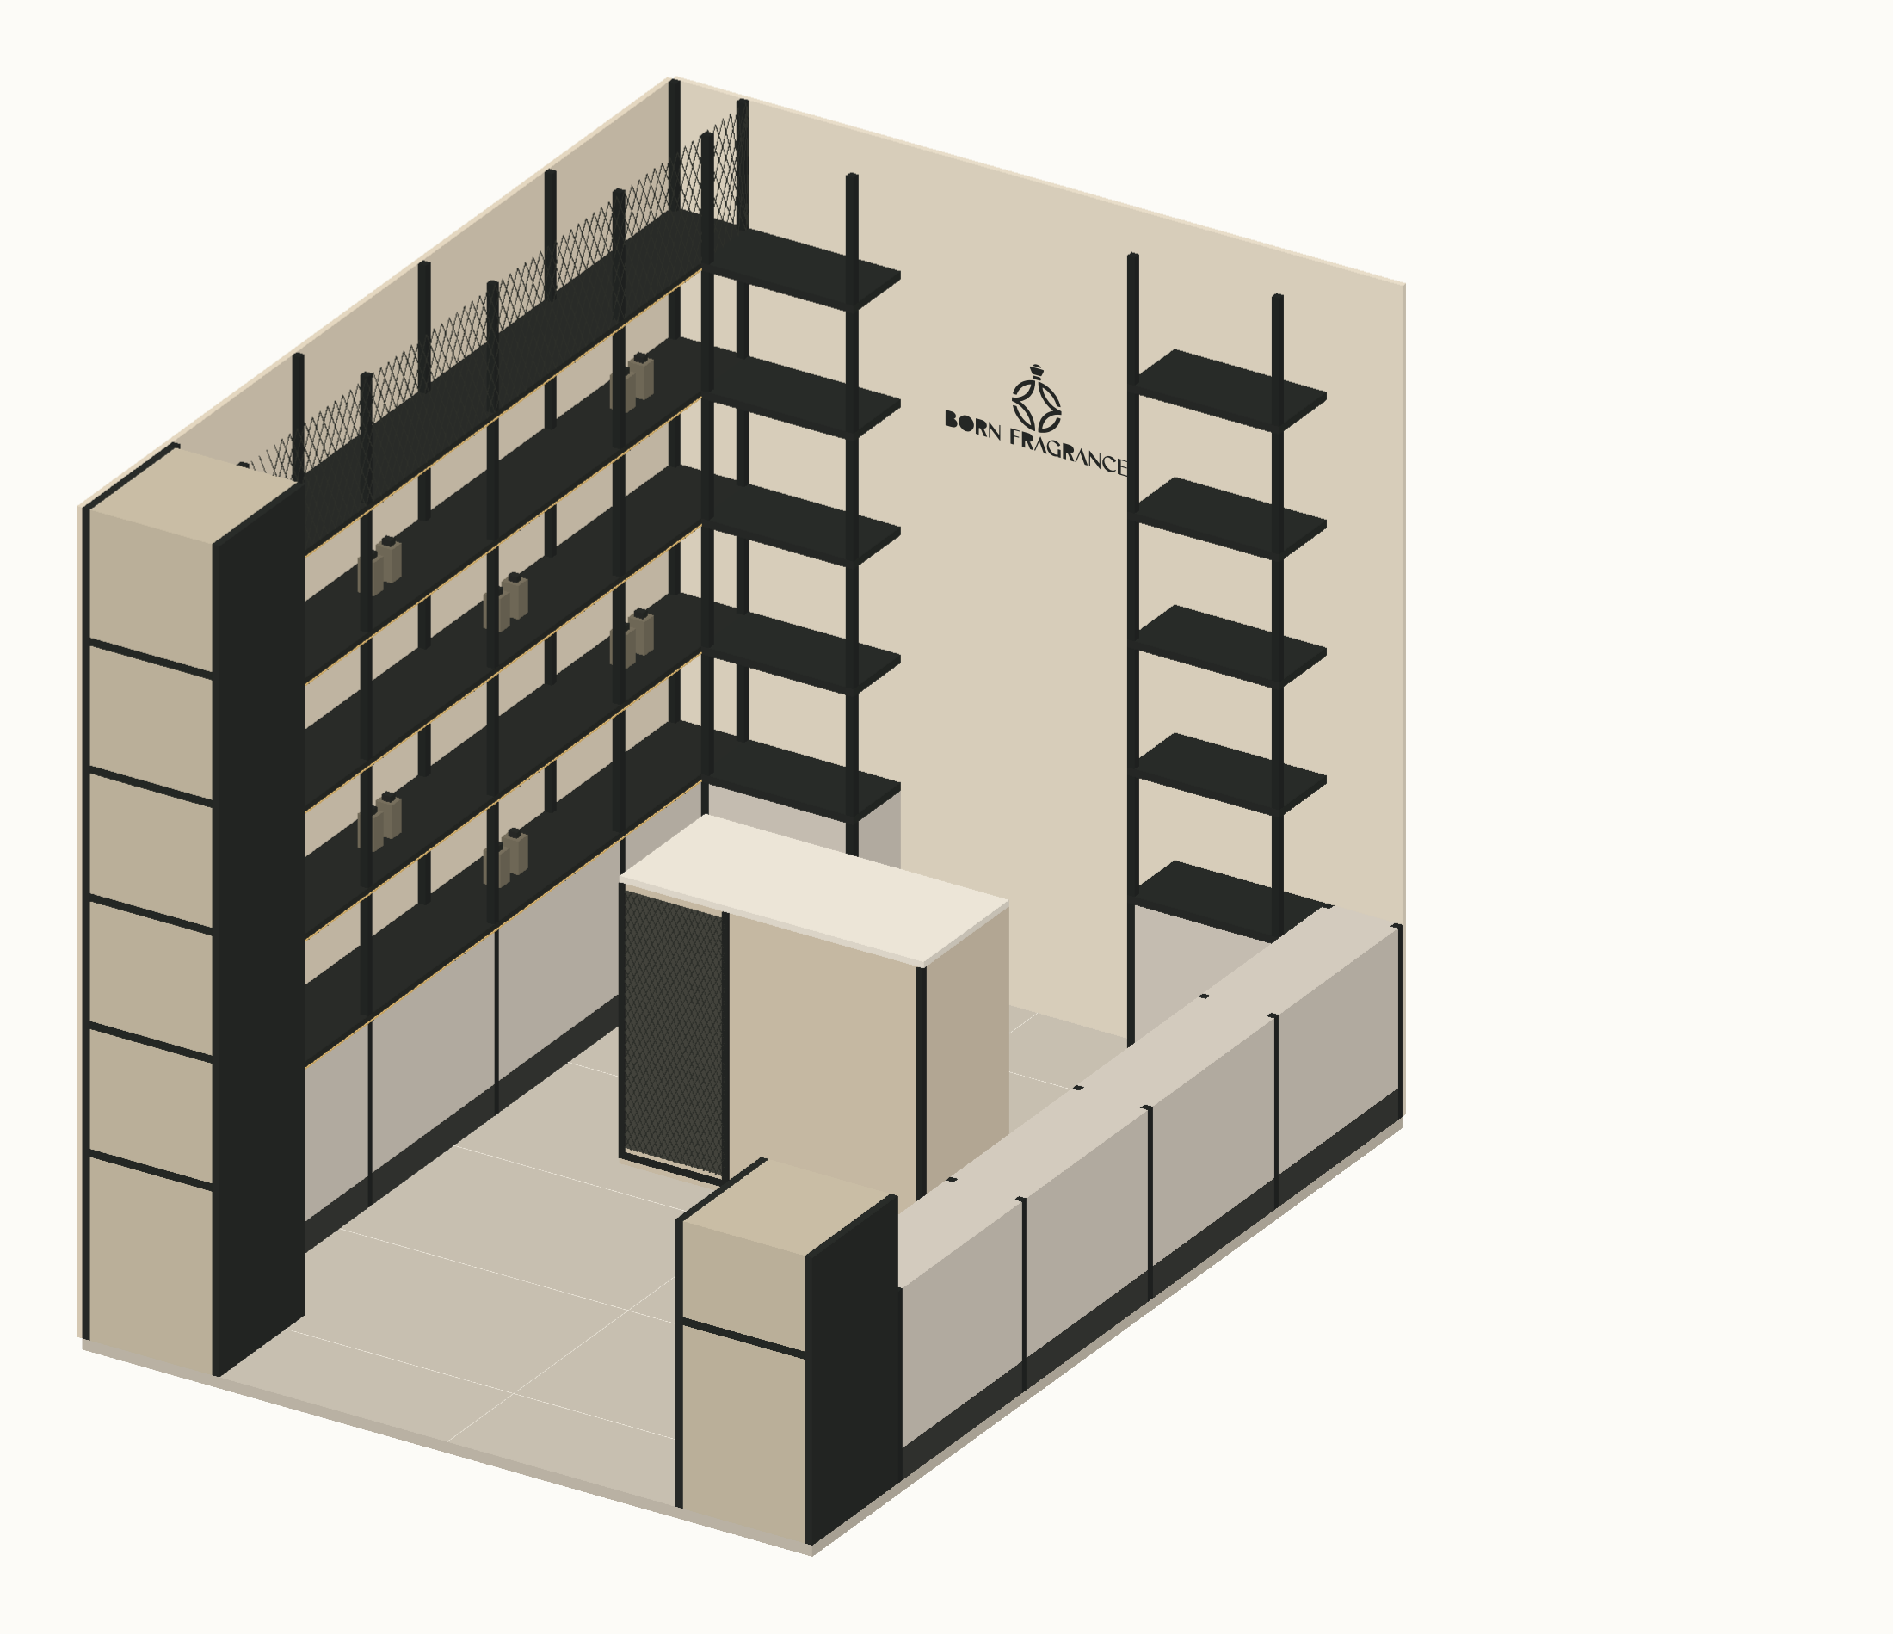
SPATIAL ASSEMBLY / CUTAWAY AXONOMETRIC
Spatial cutaway · orthographic projection · direct material and interface annotations
CEILING TRACKS
Exploded above room
Installed at 2600 · 3000 K
EXPANDED MESH
Upper infill 2200–2600
Approx. 20 × 40 diamonds
REAR BRAND WALL
Light plaster finish
600-wide unlit native logo
BLACK STEEL TRAYS
250 deep · 3 mm steel
25 folded front downstand
COUNTER
1000 × 450 × 900
Mesh left / neutral panel right
NEUTRAL BASE DOORS
1.5 mm PPC steel
600 base incl. 100 plinth
STREET DISPLAY CUT
NEAR-SIDE CUTAWAY
Upper column removed
1500 clear entrance
Upper joinery omitted at 600
Full run shown in elevations
ORTHOGRAPHIC CUTAWAY · NTS · ceiling plane removed

