Slide 1
Transformers
Eng : Mohammed Sayed Hemed

Slide 2

Eng : Mohammed S. Hemed

Slide 3
Who I am ?
AI Engineer love the field , and enjoy to teach and simplify it to the others
BSc of Computer Engineering – Suez Canal university
Post Graduate Diploma in CS – Cairo university

Slide 4
Course Objectives
Digest Transformers , HF , HF Hub.
How to search for model and use it ?
How to make your own model if it isn’t exist ?
How to search for dataset ?
How to make your own dataset if it isn’t exist ?
How to run any model (audio – image - text) with just two lines of Code?
What happened behind the scenes ?
What are Transformer different Architectures?
How to Finetune pretrained model ?
How to Finetune LLMs ?
How to understand model learning curves ?
Mainly, this course is tailored to your interests,
Depending on you, we will determine the depth and breadth of what we dive.

Slide 5
Prerequisites
What is the building block of DL Model ? Tensors
Familiarity with Python language , Pytorch DL framework.

Slide 6
What is Hugging Face look like ?
It’s look like the Arduino platform which make embedded system and electronics available to anyone with no pre-requisites.
It give a strong tool at any field to non specialist in the AI to get the most benefit from these models to help them in other fields like medicine , industry , … etc.
Just make an account on HF you enjoy millions of free models you can use and deploy it , huge number of datasets , and a space through it you can host and display your own model.

Slide 7

Hugging Face turn Transformers into LEGO !!

Slide 8
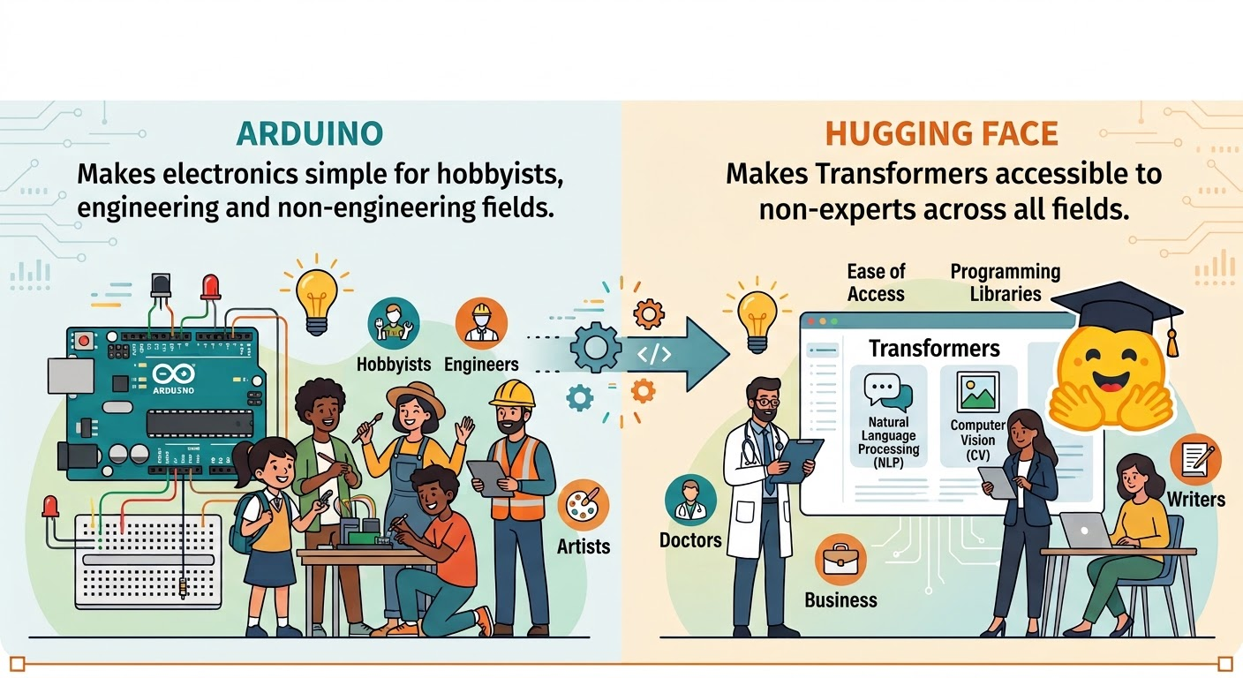
This is The AI Arduino platform !

Slide 9
What is Hugging Face ?
The GitHub for Machine Learning & AI Collaboration
Centralized AI Repository
  Hosts open-access Models, Datasets, and ML Applications (Spaces) in one place.
Core Pillar Assets
  Model Hub: over 3M pre-trained models (LLMs, Computer Vision, Audio, Multimodal).
  Dataset Hub: Thousands of curated, community-driven datasets for training and benchmarking.
  Spaces: Interactive web applications and demos built with Streamlit or Gradio to showcase models.
Version Control & Collaboration
  Powered by Git & Git LFS to manage large model weights, tracks changes, and enable branch-based collaboration.
Seamless Ecosystem Integration
  Natively integrates with major ML libraries (transformers, diffusers, PyTorch, TensorFlow, vLLM).

Slide 10
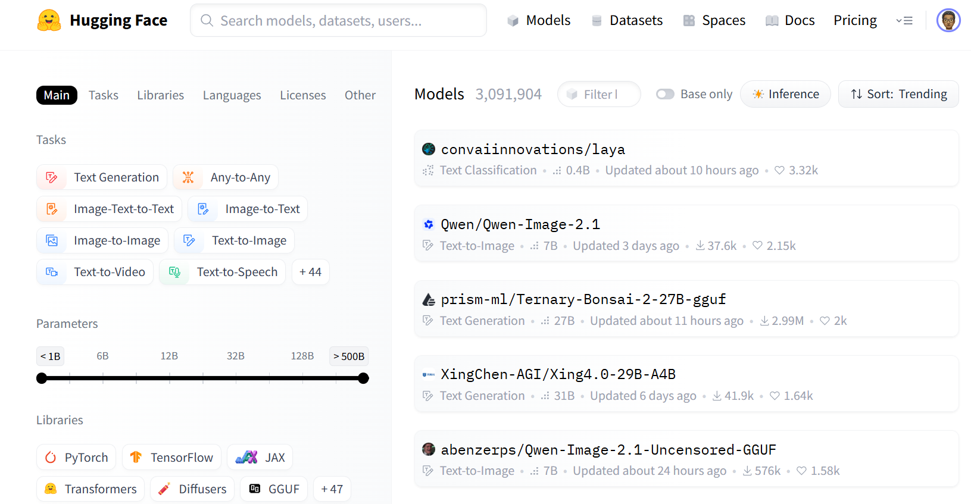
What is Hugging Face HUB

Slide 11
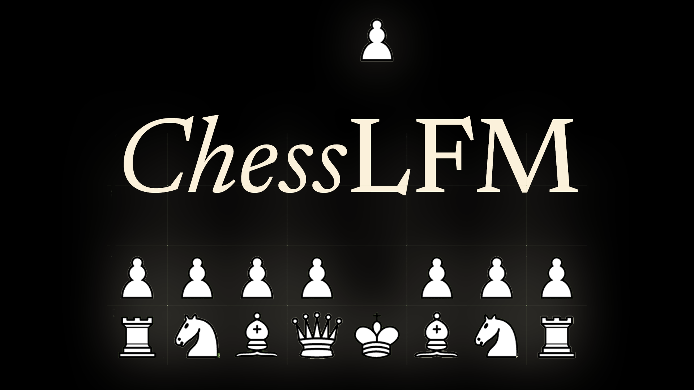
Chess AI Model !!

Slide 12
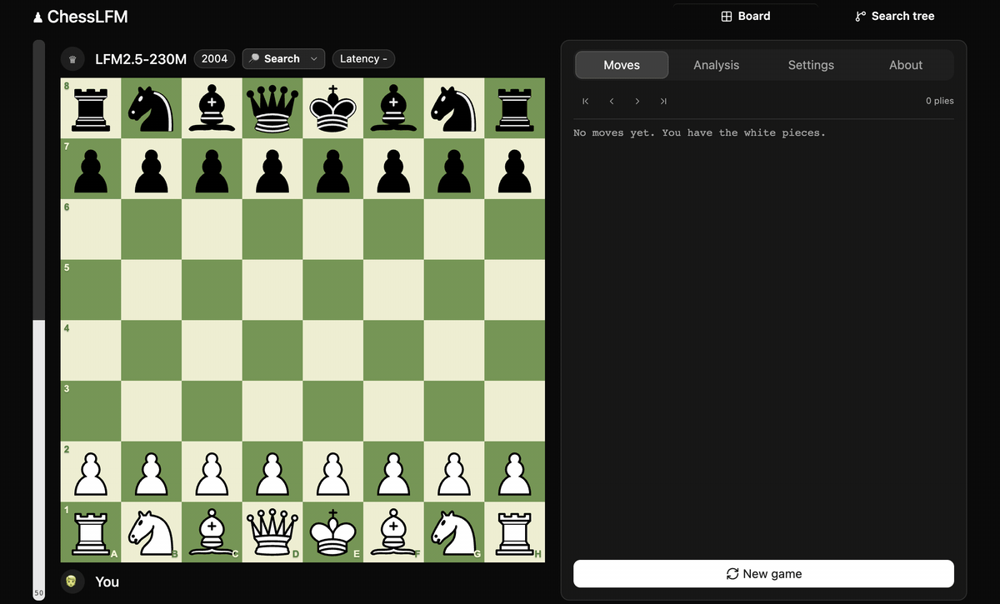
Chess AI Model !!
This Model plays like 2000+ rating player which is difficult to beat.
The model size is 230M !!
You can play vs this model in this Hugging Face space : https://huggingface.co/spaces/mlabonne/ChessLFM
It uses transformer.js library from HF , this library allows you to run models locally in web browser using your GPU , you can the speed and performance in the gif.

Slide 13
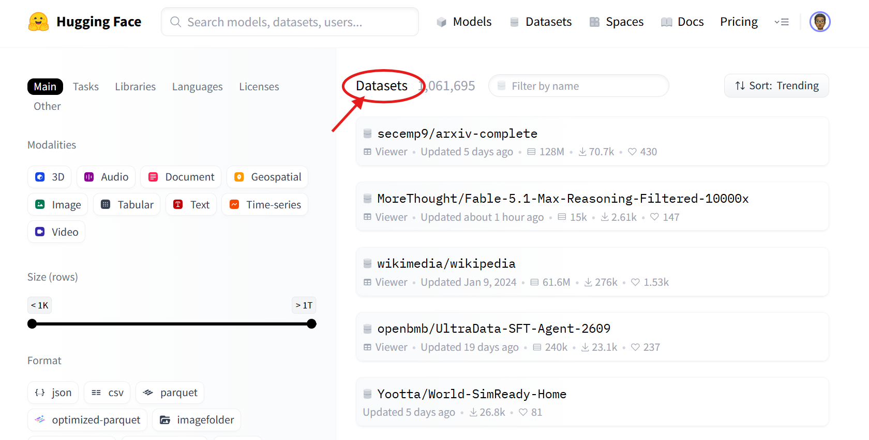
What is Hugging Face HUB

Slide 14
Setup
!pip install transformers[sentencepiece]
Cache model to google drive instead of every time download model weights and lost time

Slide 15
Transformers, what can they do?

Slide 16
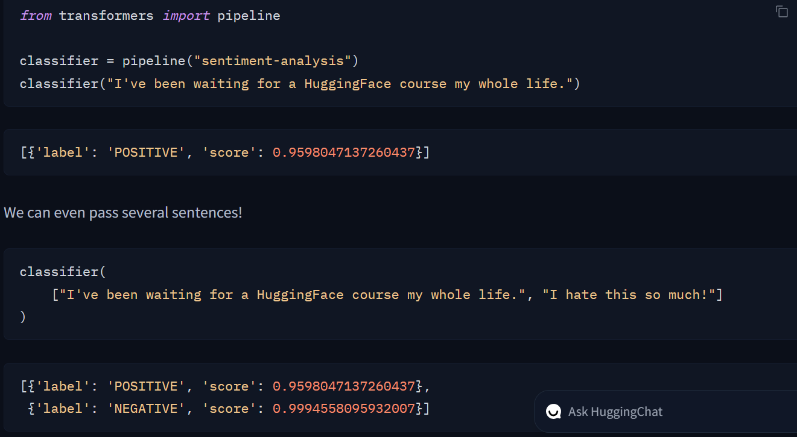
The most basic object in the 🤗 Transformers library is the pipeline() function. It connects a model with its necessary preprocessing and postprocessing steps, allowing us to directly input any text and get an intelligible answer:
By default, this pipeline selects a particular pretrained model that has been fine-tuned for sentiment analysis in English. The model is downloaded and cached when you create the classifier object. If you rerun the command, the cached model will be used instead and there is no need to download the model again

Slide 17
Steps when pass a text to a pipeline
The text is preprocessed into a format the model can understand.
The preprocessed inputs are passed to the model.
The predictions of the model are post-processed, so you can make sense of them.

Slide 18
Available pipelines for different modalities
Text pipelines :
text-generation - text-classification – summarization – translation
zero-shot-classification : Classify text without prior training on specific labels- feature-extraction : Extract vector representations of text
Image pipelines :
image-to-text - image-classification - object-detection
Audio pipelines :
automatic-speech-recognition - audio-classification - text-to-speech TTS
Multimodal pipelines
image-text-to-text: Respond to an image based on a text prompt

Slide 19
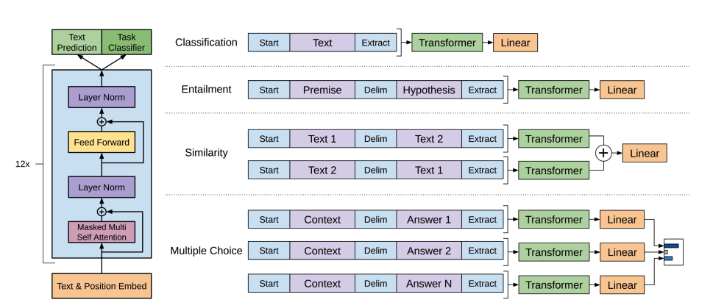
How transformers Solve Tasks ?

Slide 20

Zero-shot classification
a more challenging task where we need to classify texts that haven’t been labelled.
This is a common scenario in real-world projects because annotating text is usually time-consuming and requires domain expertise.
For this use case, the zero-shot-classification pipeline is very powerful: it allows you to specify which labels to use for the classification,
so you don’t have to rely on the labels of the pretrained model. You’ve already seen how the model can classify a sentence as positive or negative using those two labels — but it can also classify the text using any other set of labels you like.
This pipeline is called zero-shot because you don’t need to fine-tune the model on your data to use it. It can directly return probability scores for any list of labels you want!

Slide 21
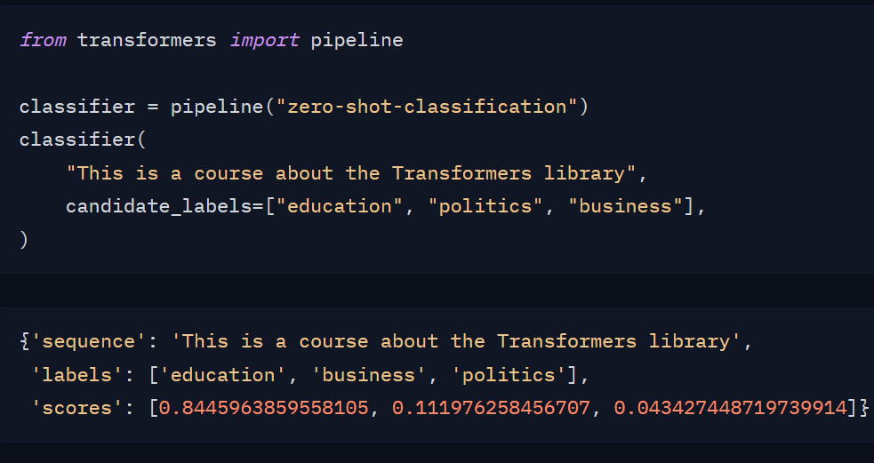

Slide 22
Text generation
Text generation involves creating coherent and contextually relevant text based on a prompt or input.
GPT-2 is a decoder-only model pretrained on a large amount of text. It can generate convincing (though not always true!) text given a prompt and complete other NLP tasks like question answering despite not being explicitly trained to.

Slide 23
Transformer models for language
The Transformer was initially designed for machine translation, and since then, it has become the default architecture for solving all AI tasks. Some tasks lend themselves to the Transformer’s encoder structure, while others are better suited for the decoder. Still, other tasks make use of both the Transformer’s encoder-decoder structure.
Language models are at the heart of modern NLP. They’re designed to understand and generate human language by learning the statistical patterns and relationships between words or tokens in text.

Slide 24
Transformers are language models
All the Transformer models mentioned above (GPT, BERT, T5, etc.) have been trained as language models. This means they have been trained on large amounts of raw text in a self-supervised fashion.
Self-supervised learning is a type of training in which the objective is automatically computed from the inputs of the model. That means that humans are not needed to label the data!
This type of model develops a statistical understanding of the language it has been trained on, but it’s less useful for specific practical tasks. Because of this, the general pretrained model then goes through a process called transfer learning or fine-tuning. During this process, the model is fine-tuned in a supervised way — that is, using human-annotated labels — on a given task.

Slide 25
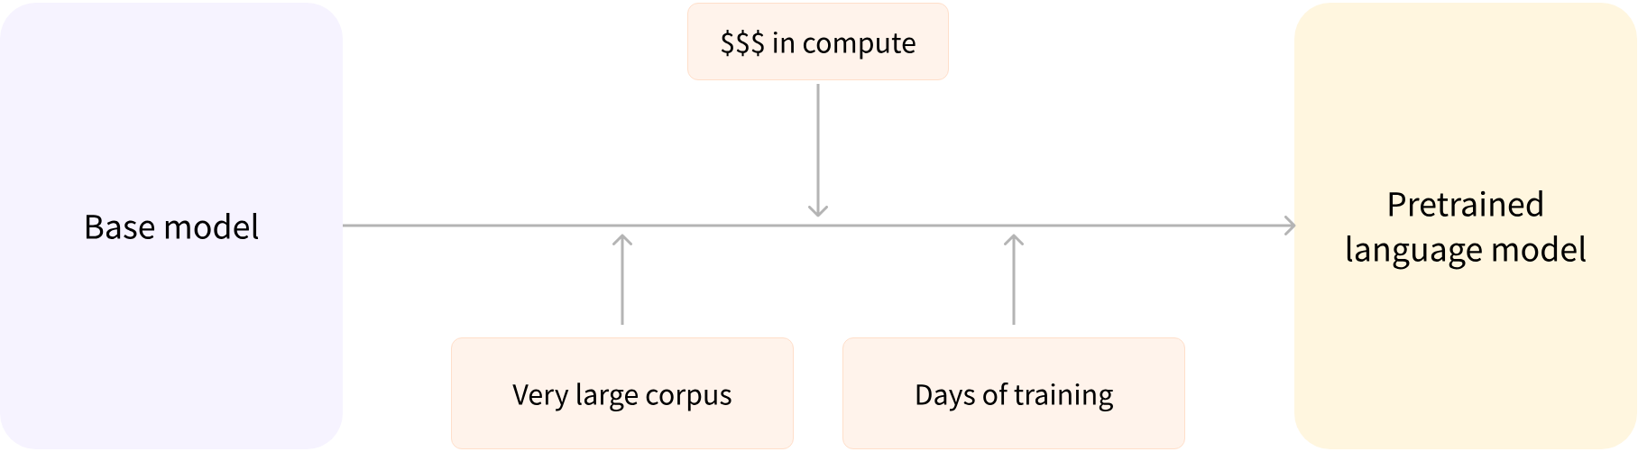
Ways of training Transformers
Pretraining
is the act of training a model from scratch: the weights are randomly initialized, and the training starts without any prior knowledge.

Slide 26
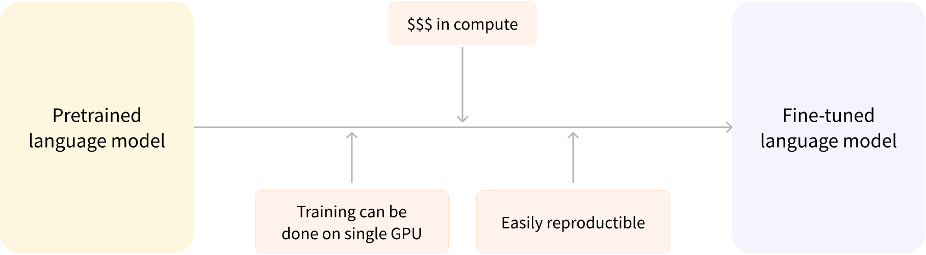
Ways of training Transformers
Fine-tuning, on the other hand, is the training done after a model has been pretrained. To perform fine-tuning, you first acquire a pretrained language model, then perform additional training with a dataset specific to your task.

Slide 27
Wait — why not simply train the model for your final use case from the start (scratch)?
The pretrained model was already trained on a dataset that has some similarities with the fine-tuning dataset.
The fine-tuning process is thus able to take advantage of knowledge acquired by the initial model during pretraining (for instance, with NLP problems, the pretrained model will have some kind of statistical
understanding of the language you are using for your task).
Since the pretrained model was already trained on lots of data, the fine-tuning requires way less data to get decent results.
For the same reason, the amount of time and resources needed to get good results are much lower

Slide 28
How language models work
Language models work by being trained to predict the probability of a word given the context of surrounding words. This gives them a foundational understanding of language that can generalize to other tasks.

Slide 29
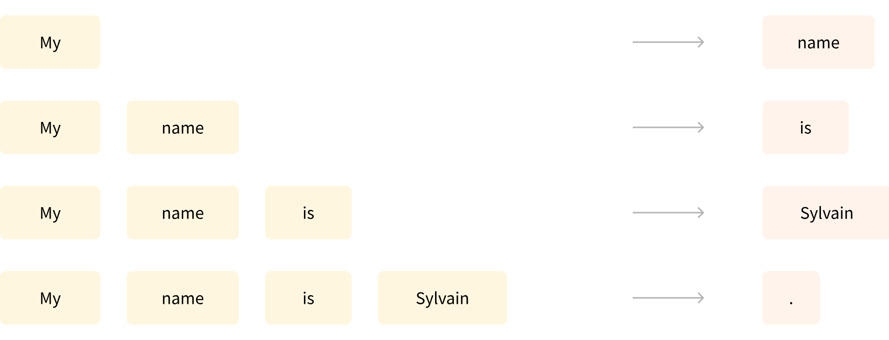
How language models work
There are two main approaches for training a transformer model:
Causal language modeling (MLM):
Used by decoder models like GPT, this approach predicts the next token based on all previous tokens in the sequence. The model can only use context from the left (previous tokens) to predict the next token

Slide 30
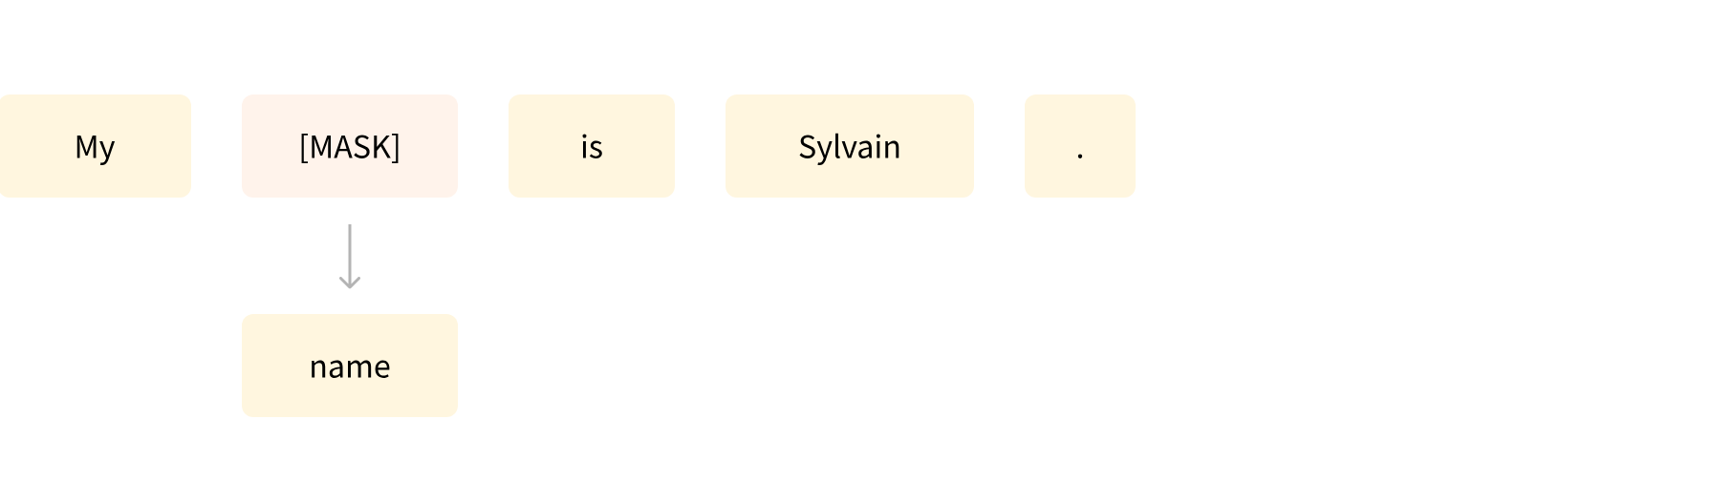
How language models work
(2) Causal language modeling (CLM):
Used by encoder models like BERT, this approach randomly masks some tokens in the input and trains the model to predict the original tokens based on the surrounding context. This allows the model to learn bidirectional context (looking at words both before and after the masked word).

Slide 31
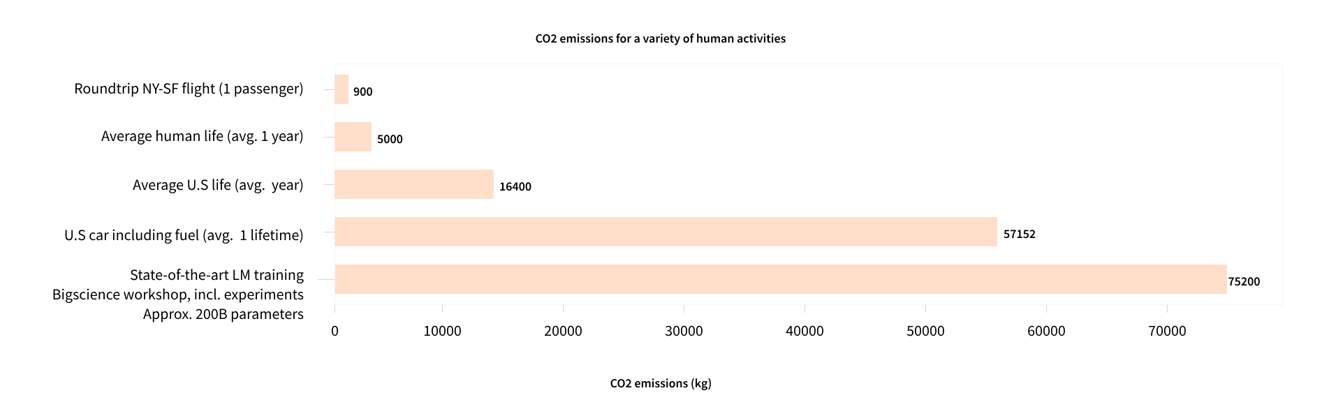
Environmental Effect

Slide 32
Types of language models
In the Transformers library, language models generally fall into three architectural categories:
Encoder-only models (like BERT): These models use a bidirectional approach to understand context from both directions. They’re best suited for tasks that require deep understanding of text, such as classification, named entity recognition, and question answering.
Decoder-only models (like GPT, Llama): These models process text from left to right and are particularly good at text generation tasks. They can complete sentences, write essays, or even generate code based on a prompt.
Encoder-decoder models (like T5, BART): These models combine both approaches, using an encoder to understand the input and a decoder to generate output. They excel at sequence-to-sequence tasks like translation, summarization, and question answering.

Slide 33
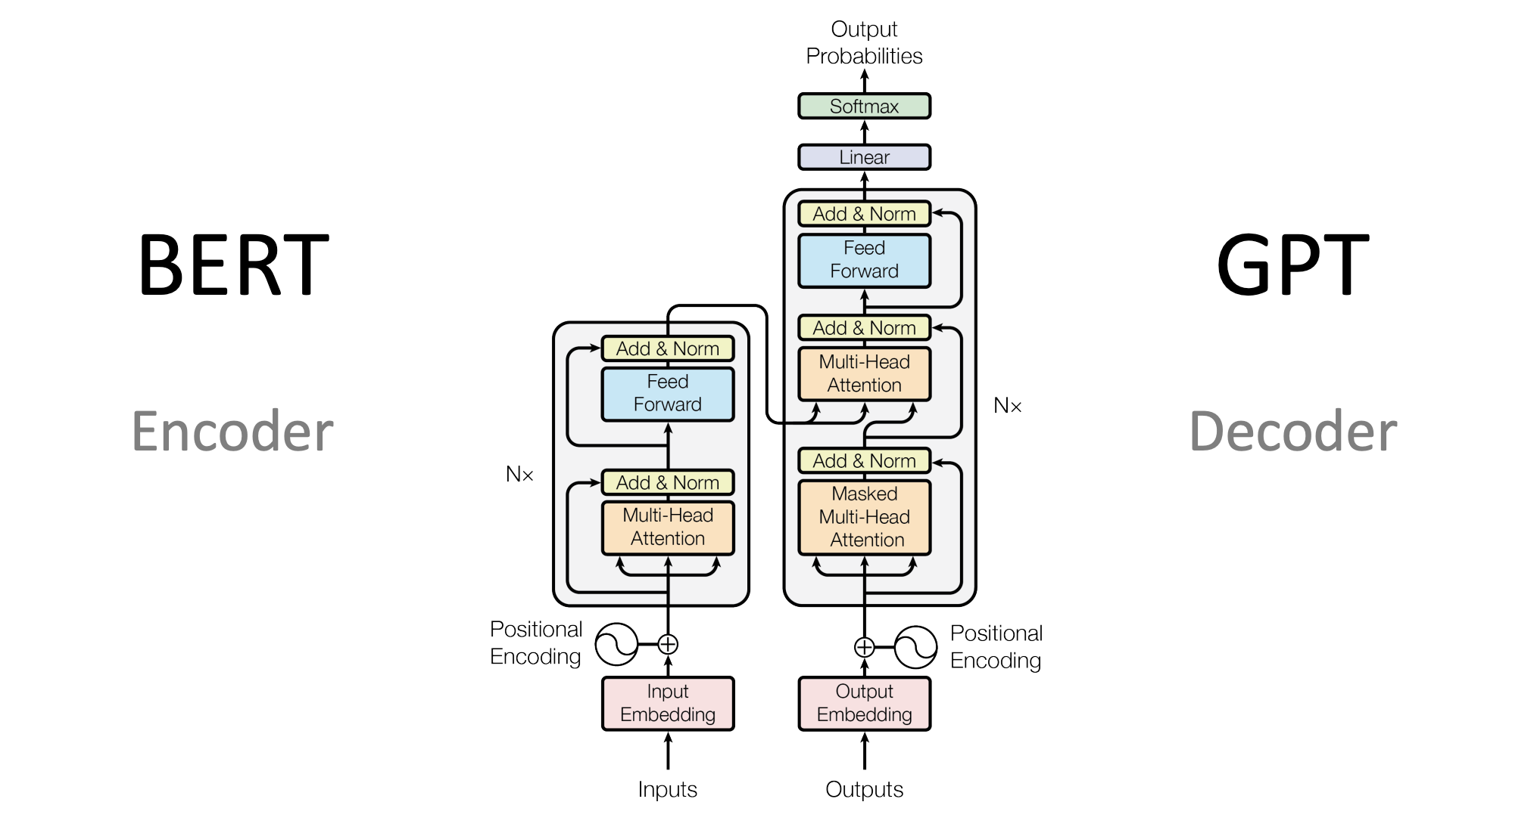

Slide 34
Choosing the right model
Understanding which part of the Transformer architecture (encoder, decoder, or both) is best suited for a particular NLP task is key to choosing the right model.
Generally :
tasks requiring bidirectional context use encoders,
tasks generating text use decoders,
tasks converting one sequence to another use encoder-decoders.

Slide 35
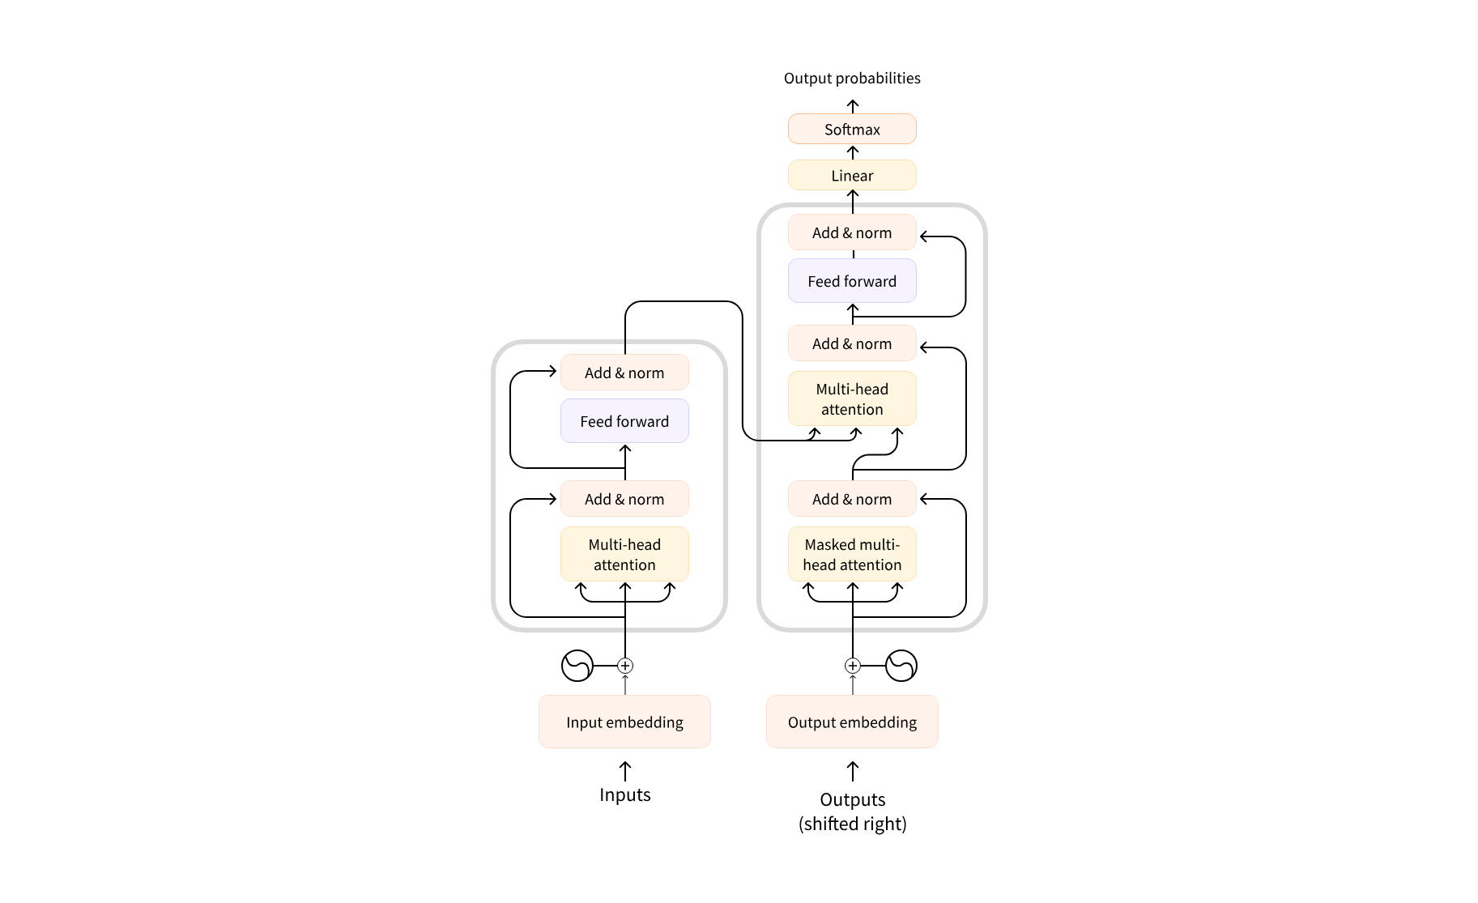
Transformer Archeticture

Slide 36
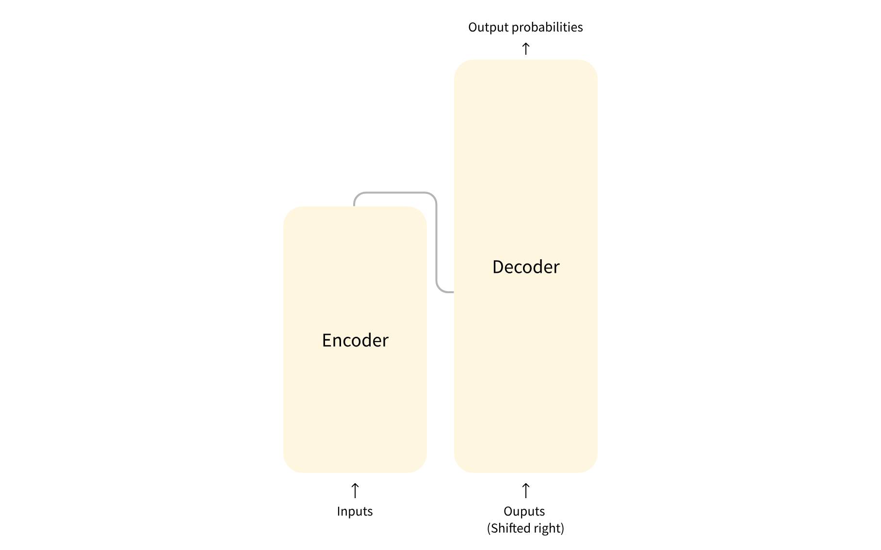
Transformer Archeticture

Slide 37
Modern Large Language Models (LLMs)
Most modern Large Language Models (LLMs) use the decoder-only architecture. These models have grown dramatically in size and capabilities over the past few years, with some of the largest models containing hundreds of billions of parameters.
Modern LLMs are typically trained in two phases:
Pretraining: The model learns to predict the next token on vast amounts of text data
Instruction tuning: The model is fine-tuned to follow instructions and generate helpful responses
This approach has led to models that can understand and generate human-like text across a wide range of topics and tasks.

Slide 38
Modern decoder-based LLMs have demonstrated impressive capabilities:
Capability | Description | Example
Text generation | Creating coherent and contextually relevant text | Writing essays, stories, or emails
Summarization | Condensing long documents into shorter versions | Creating executive summaries of reports
Translation | Converting text between languages | Translating English to Spanish
Question answering | Providing answers to factual questions | “What is the capital of France?”
Code generation | Writing or completing code snippets | Creating a function based on a description
Reasoning | Working through problems step by step | Solving math problems or logical puzzles
Few-shot learning | Learning from a few examples in the prompt | Classifying text after seeing just 2-3 examples

Slide 39
Encoder-Decoder (Seq2Seq) models excel at tasks that require transforming one form of text into another while preserving meaning. Some practical applications include:
Application | Description | Example Model
Machine translation | Converting text between languages | Marian, T5
Text summarization | Creating concise summaries of longer texts | BART, T5
Data-to-text generation | Converting structured data into natural language | T5
Grammar correction | Fixing grammatical errors in text | T5
Question answering | Generating answers based on context | BART, T5

Slide 40
Choosing the right architecture
When working on a specific NLP task, how do you decide which architecture to use? Here’s a quick guide:
Task | Suggested Architecture | Examples
Text classification (sentiment, topic) | Encoder | BERT, RoBERTa
Text generation (creative writing) | Decoder | GPT, LLaMA
Translation | Encoder-Decoder | T5, BART
Summarization | Encoder-Decoder | BART, T5
Named entity recognition | Encoder | BERT, RoBERTa
Question answering (extractive) | Encoder | BERT, RoBERTa
Question answering (generative) | Encoder-Decoder or Decoder | T5, GPT
Conversational AI | Decoder | GPT, LLaMA

Slide 41
When in doubt about which model to use, consider:
What kind of understanding does your task need? (Bidirectional or unidirectional)
Are you generating new text or analyzing existing text?
Do you need to transform one sequence into another?
The answers to these questions will guide you toward the right architecture.

Slide 42
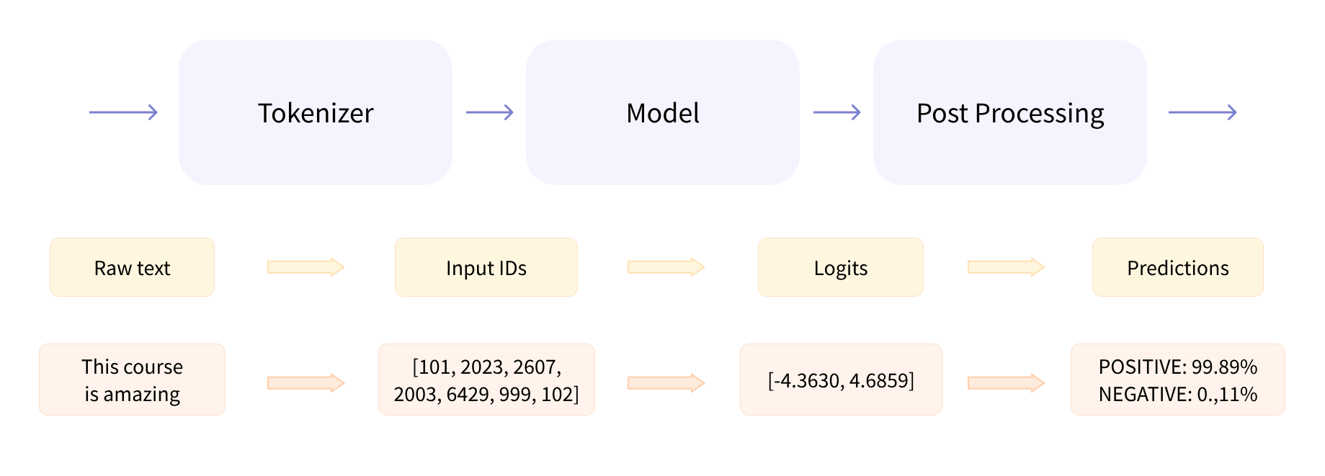
Behind pipeline()

Slide 43
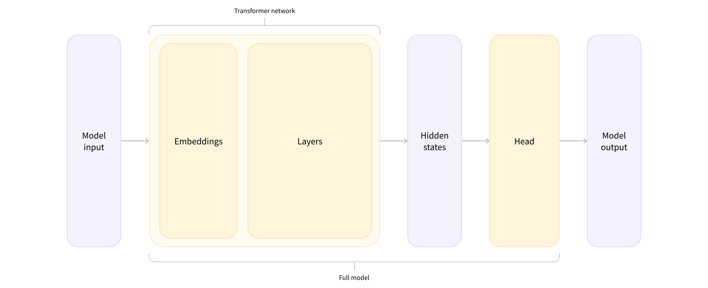

Slide 44
Model

Slide 45
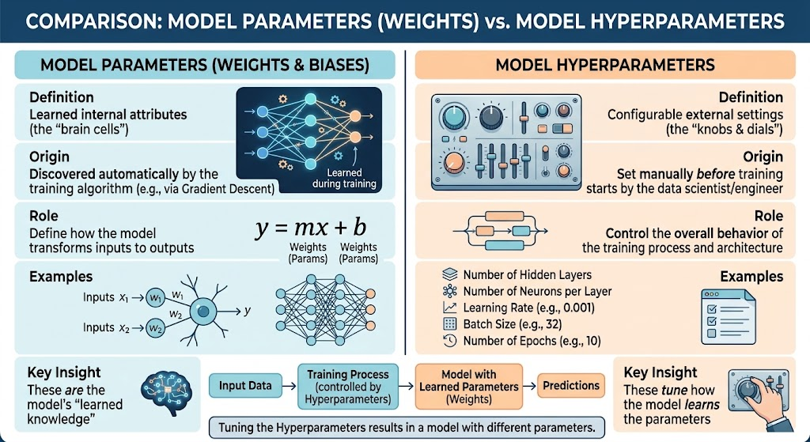
Model parameters(Weights) vs Model Hyperparameters

Slide 46
Keywords
Keyword | Simple Definition
Epoch | One complete pass where the AI reads through the entire training dataset from start to finish.
Training | The process of teaching a model by letting it process data, make mistakes, and adjust its internal math to get better over time.
Inference | The phase when a fully trained model is put to work making actual predictions on brand new, unseen data.
Checkpoint | A saved snapshot of a model's weights and configuration at a specific point during or after training.
Weights / Parameters | The internal numbers (the model's "brain wiring") that are adjusted during training to determine how the model turns inputs into outputs.
Hyperparameters | Settings configured before training starts (e.g., learning rate, batch size) that control how the model learns.
Tokenizer | A tool that converts raw text into numbers (and vice versa) so the mathematical model can process it.
Tokens | The smaller pieces (words, subwords, or punctuation) that a tokenizer breaks text into before processing.
Logits | The raw, unnormalized numerical scores output by a model's final layer before they are converted into percentage probabilities.
Padding | Adding dummy filler tokens (like zeros) to shorter text inputs so all sequences in a batch are the exact same length.
Truncation | Cutting off long text sequences so they fit within the model's maximum allowed context window.
Attention Mask | A list of 1s and 0s that tells the model which tokens are real text (1) and which are filler padding (0) to ignore.
Encoder | The part of a Transformer that reads the full input text in both directions to build a rich contextual understanding.
Decoder | The part of a Transformer that generates output text word-by-word sequentially using causal masking to prevent looking ahead.
Distillation | Training a smaller, faster "student" model to mimic the outputs and performance of a larger "teacher" model.
Zero-Shot Learning | Getting a model to perform a task correctly without giving it any specific training examples for that exact task beforehand.
Few-Shot Learning | Giving a model a few examples inside the prompt to guide its understanding before asking for a new prediction.
Fine-Tuning | Taking a pre-trained model that already understands general language and training it further on a specific dataset for a custom task.
Pipeline | A high-level, easy-to-use Hugging Face wrapper that handles tokenization, model execution, and post-processing in a single line of code.
Backbone | The primary core layers of a Transformer that extract patterns and meanings from raw text, without making a final task prediction.
Head | An extra layer added to the top of a backbone model designed for a specific task (e.g., a classification head or text generation head).
KV Caching | Storing past Key and Value matrices in RAM/VRAM during generation so the model doesn't recompute earlier tokens at every step.
Loss | A single number measuring how wrong the model's predictions are compared to the true labels (lower loss means better performance).

Slide 47
References
Mainly LLM HF Course (Adapted).
Repository of this course

Slide 48
Further Readings:
Pytorch :
1- https://sebastianraschka.com/teaching/pytorch-1h/
2- https://www.youtube.com/watch?v=I9_gp4tErHY
python :
pythonRev_important_Libs
python cheatsheet
Book : python for programmers ,Dietel

