Slide 1
CLOUD COMPUTING COURSE • PROJECT 7
Disk Failure Prediction
in Cloud Data Centres
Under Extreme Class Imbalance | Backblaze Q1 → Q2 2023
Measured AWS experiment results • CPU-based ML • 7-day early warning
MSA UNIVERSITY | Mohammed Hossam (247713) • Ahmed Tamer (244749)
Ahmed Mohamed (242679) • Hamza Belal (243387)
PROJECT 7 | AWS • BACKBLAZE • 7-DAY DISK FAILURE PREDICTION
01

Slide 2
RESEARCH PROBLEM
Why hard-drive failure prediction is difficult
Operational risk
Rare events
False-alarm burden
Storage hardware can fail without reliable advance warning. A useful detector must catch failures early enough to act.
Healthy drive-days vastly outnumber failures. Accuracy can look high even when a model catches nothing.
An alarm on a healthy disk may require checks, migration or replacement. We must report alert load.
Target: a confirmed failure in the next 7 calendar days using SMART features known at prediction time.
PROJECT 7 | AWS • BACKBLAZE • 7-DAY DISK FAILURE PREDICTION
02

Slide 3
DATA EVIDENCE
Dataset: a pilot for fitting, then a realistic holdout
Q1 ORIGINAL DRIVE-DAYS
Q1 POSITIVE-ENRICHED PILOT
Q2 ELIGIBLE TEST DRIVE-DAYS
21,454,992
140,512
2,327,260
Q1 pilot
Q2 later-period holdout
Two selected HDD models. Test: 13,946 drive-days; 145 positives (1.0397%). Outcome-enriched sampling for low RAM.
All eligible drive-days of those two models; 1,317 positives (0.05659%). No failure-based sampling.
Caution: pilot precision and Q2 population precision are not directly comparable.
PROJECT 7 | AWS • BACKBLAZE • 7-DAY DISK FAILURE PREDICTION
03

Slide 4
METHODOLOGY
How the seven-day prediction label is constructed
1 Positive
0 Negative
? Exclude
A confirmed failure happens on any calendar day t+1 through t+7. Current-day failure is excluded.
All next seven daily outcomes are observed with no confirmed failure.
Unknown future outcome, missing follow-up or right-censoring: do not automatically mark healthy.
Protection against leakage: past-only rolling SMART features, chronological splits, and a 7-day gap between Q1 partitions.
PROJECT 7 | AWS • BACKBLAZE • 7-DAY DISK FAILURE PREDICTION
04

Slide 5
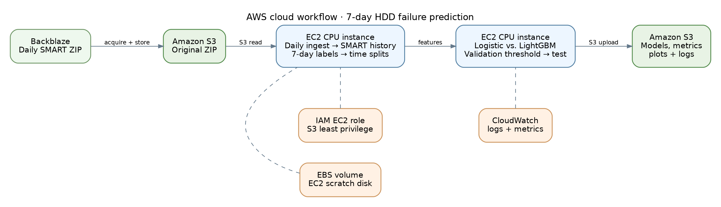
AWS ARCHITECTURE
Cloud computing is part of the implementation
AWS Region: Stockholm (eu-north-1) | EC2 Amazon Linux 2023 t3.micro | S3 + IAM + EBS + CloudWatch
Source: project source diagram, corroborated by S3 uploads, EC2 terminal sessions, and CloudWatch evidence.
PROJECT 7 | AWS • BACKBLAZE • 7-DAY DISK FAILURE PREDICTION
05

Slide 6
MODELS
Baseline and improvement experiments
BASELINE • Logistic regression
STATIC • Weighted LightGBM
SMART attributes, preprocessing and class weights.
Tree ensemble tests nonlinear decision boundaries.
TEMPORAL • Unweighted LightGBM
TEMPORAL • Weighted LightGBM
Adds history-derived SMART changes and rolling signals.
Combines history features with cost-sensitive weighting.
Four models were fitted on the Q1 pilot, then evaluated without retraining on Q2.
PROJECT 7 | AWS • BACKBLAZE • 7-DAY DISK FAILURE PREDICTION
06

Slide 7
MEASURED PILOT RESULT
Q1 pilot: all four models trained on EC2
Model
Precision
Recall
FPR
F1
Avg. precision
Logistic Regression
1.78%
91.72%
53.19%
3.49%
28.34%
Static weighted LightGBM
2.50%
91.72%
37.53%
4.87%
24.46%
Temporal LightGBM
3.34%
89.66%
27.26%
6.44%
29.12%
Temporal weighted LightGBM
1.76%
90.34%
52.95%
3.46%
23.93%
Lowest Q1 pilot FPR: temporal unweighted LightGBM (27.26%), with 89.66% recall.
Pilot test: 13,946 drive-days, 145 positives; enrichment changes the alert precision estimate.
PROJECT 7 | AWS • BACKBLAZE • 7-DAY DISK FAILURE PREDICTION
07

Slide 8
INDEPENDENT TEMPORAL EVALUATION
Q2: fixed Q1 thresholds on later-period real data
Model
Precision
Recall
FPR
F1
Avg. precision
Logistic Regression
0.0876%
85.04%
54.94%
0.175%
4.33%
Static weighted LightGBM
0.1355%
87.09%
36.35%
0.271%
2.82%
Temporal LightGBM
0.1214%
91.50%
42.64%
0.242%
5.88%
Temporal weighted LightGBM
0.0744%
95.82%
72.92%
0.149%
4.36%
Best Q2 false-positive rate: static weighted LightGBM 36.35% at 87.09% recall.
Q2 test: 2,327,260 drive-days, 1,317 positives (0.05659%); precision remains extremely low.
PROJECT 7 | AWS • BACKBLAZE • 7-DAY DISK FAILURE PREDICTION
08

Slide 9
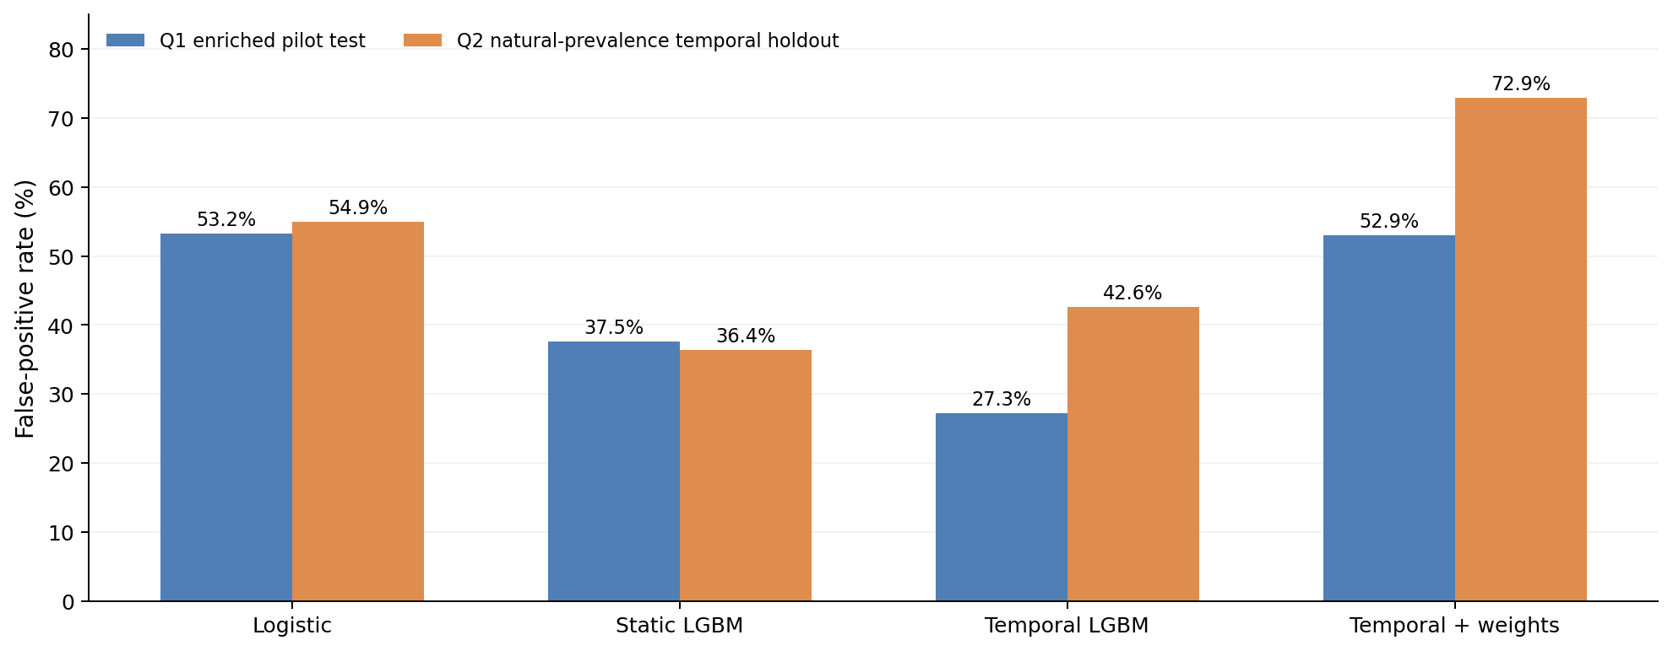
MODEL COMPARISONS
Pilot and natural-prevalence false-positive rates
Q1 and Q2 have different prevalence. Neither curve justifies changing thresholds after viewing Q2.
PROJECT 7 | AWS • BACKBLAZE • 7-DAY DISK FAILURE PREDICTION
09

Slide 10
Q2 OPERATIONAL TRADE-OFF
What improved? What did not?
BASELINE Q2 FPR
BEST Q2 FPR
RELATIVE FPR REDUCTION
54.94%
36.35%
33.83%
Improvement
Operational limitation
Static weighted LightGBM raises recall from 85.04% to 87.09% and reduces FPR.
It still yields 845,541 false-positive drive-day predictions; precision is only 0.1355%.
PROJECT 7 | AWS • BACKBLAZE • 7-DAY DISK FAILURE PREDICTION
10

Slide 11
MODEL-SPECIFIC Q2 ANALYSIS
Drive-model shift: one threshold, very different errors
HDD model
Q2 recall
Q2 precision
Q2 FPR
False-positive predictions
ST12000NM0008
87.09%
0.105%
54.01%
803,097
ST14000NM001G
87.11%
0.711%
5.06%
42,444
Evidence of heterogeneity
Static weighted LightGBM: 54.01% FPR on ST12000NM0008 but 5.06% on ST14000NM001G. This is not a model-disjoint generalization test.
PROJECT 7 | AWS • BACKBLAZE • 7-DAY DISK FAILURE PREDICTION
11

Slide 12
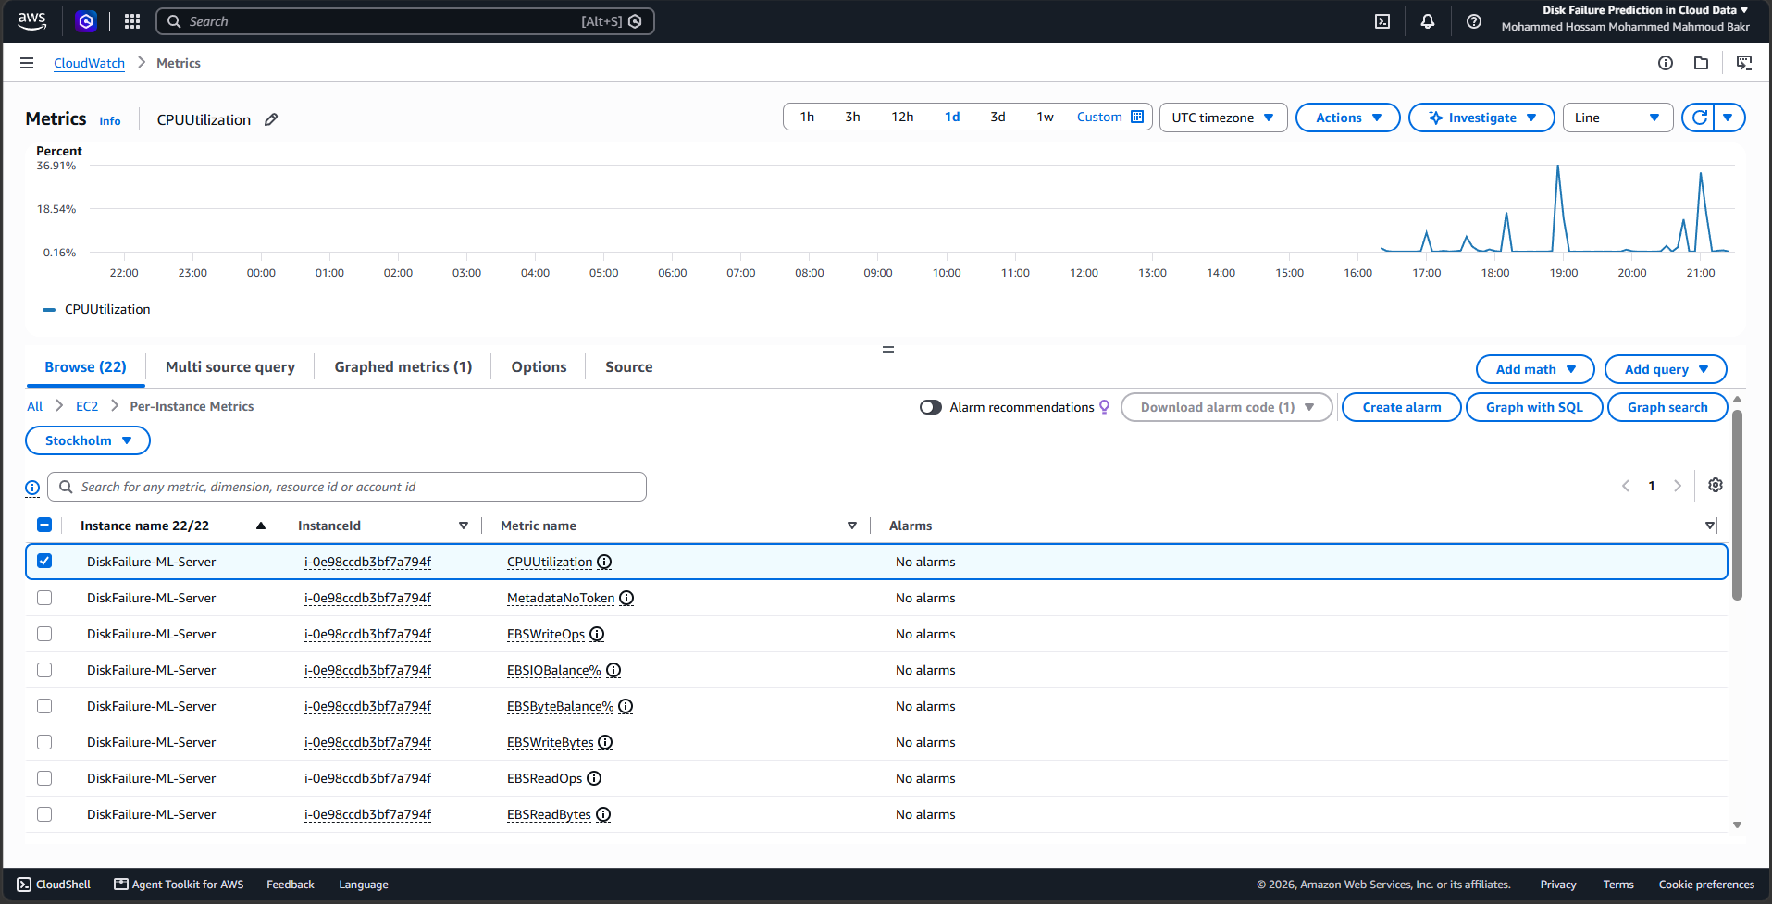
ACTUAL EXECUTION
CloudWatch: direct AWS monitoring evidence
CloudWatch Classic Metrics • EC2 CPUUtilization • Stockholm • one-day window. Not a per-job profiler.
PROJECT 7 | AWS • BACKBLAZE • 7-DAY DISK FAILURE PREDICTION
12

Slide 13
LIMITATIONS & RESEARCH GAP
What the experiments can and cannot claim
SUPPORTED
NOT YET SUPPORTED
• Real cloud processing & stored artifacts
• Temporal Q2 evaluation at fixed Q1 thresholds
• False-positive counts and PR-oriented metrics
• Differences across two HDD models
• Production-ready alert precision
• Independent unseen-drive-model generalization
• Calibrated failure probability
• Causal attribution of CloudWatch CPU spikes
Future work: true unseen-model split, pre-quarter feature history, probability calibration and alert-cost curve.
PROJECT 7 | AWS • BACKBLAZE • 7-DAY DISK FAILURE PREDICTION
13

Slide 14
TECHNICAL HANDOVER
Reproduce the cloud experiments
DATA + COMPUTE
PIPELINE + ARTIFACTS
1. Private S3 bucket in eu-north-1
2. Amazon Linux 2023 EC2, Python 3.11
3. Attach scoped EC2 IAM role
4. Download Q1/Q2 Backblaze ZIPs
5. Q1 pilot labeling, train & validate
6. Freeze Q1 decision thresholds
7. Evaluate all eligible Q2 drive-days
8. Upload CSV, JSON, models and figures to S3
Source repository: https://github.com/mohammedhossam740-oss/cloud-project.git
Upload code, scripts and README before submission; keep Backblaze archives and credentials private.
PROJECT 7 | AWS • BACKBLAZE • 7-DAY DISK FAILURE PREDICTION
14

Slide 15
TAKEAWAYS
Conclusion: cloud experiment completed; deployment not ready
The project demonstrates genuine AWS-based HDD failure prediction — and why extreme imbalance makes false alarms the key barrier.
BEST Q2 FPR
KEY LIMITATION
Static weighted LightGBM: 36.35% FPR / 87.09% recall
Very low precision: 0.1355% for this model.
MSA University • Team: Mohammed Hossam, Ahmed Tamer, Ahmed Mohamed, Hamza Belal • GitHub upload pending
PROJECT 7 | AWS • BACKBLAZE • 7-DAY DISK FAILURE PREDICTION
15

