Slide 1
G9-IPTS
Integrated Payment Transformation System
Demo Walkthrough & Live System Tour
Mohamad Idriss | Rohit Jacob Isaac | Sriram Acharya Mudumbai Walid Elmahdy | Vibin Chandrabose
Version 6.0 | April 2026

Slide 2
Demo Agenda
1
The Problem
Why cross-border settlements need transformation
2
Architecture Overview
7-Layer Convergent Architecture
3
Live Dashboard
KPIs, multi-account, ledger, notifications
4
Payment Hub
Settlement, P2P, ACH/Wire/SEPA, Scheduled, QR Pay
5
DeFi Suite
AMM Swap, Staking, Escrow HTLC, Liquidity Pools
6
AI Risk Scoring
5-model ensemble with SHAP explainability
7
Account & Beneficiaries
Multi-account, beneficiary management, spending 360
8
Card Services
Virtual cards, freeze/unfreeze, digital wallet
9
Security & KYC
E-KYC verification, fraud alerts, biometrics
10
Compliance & Cases
Four-eyes, HITL, SLA, sanctions, case mgmt
11
Support & Documents
AI chat bot, notification center, statements
12
Key Differentiators
What makes IPTS unique

Slide 3
The Problem
Cross-Border Settlement Today

Slide 4
Why Settlements Need Transformation
⏱
T+2 to T+5 Settlement
💰
$27T Trapped Liquidity
Cross-border payments take 2-5 business days through correspondent banking chains
Nostro/Vostro accounts lock capital globally, creating massive opportunity costs
⚠️
$10.2M Compliance Cost
🔒
Black Box AI
Annual AML/KYC compliance with 15-25% false positive rates
Legacy ML systems cannot explain why transactions are blocked
🌐
Fragmented Infrastructure
📊
$190T Market
$25-$65 per transaction across multiple intermediaries
The cross-border payments market is at an inflection point

Slide 5
Architecture
7-Layer Convergent Architecture

Slide 6
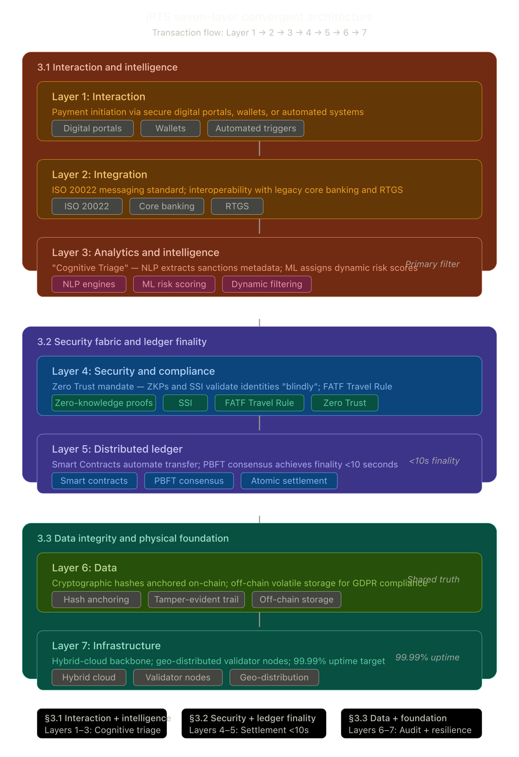
IPTS 7-Layer Convergent Architecture
Layer 1
Presentation
SPA, SHAP charts, SLA, health
Layer 2
Security
JWT, RBAC, four-eyes approval
Layer 3
Intelligence
5 ML models, 16 features, SHAP
Layer 4
Compliance
HITL, cases, SLA, sanctions, FX
Layer 5
Blockchain
7 smart contracts, atomic swaps
Layer 6
Data
GDPR vault, hash anchoring
Layer 7
Infrastructure
Ganache, Flask, health monitoring

Slide 7
Technology Stack
Blockchain
AI/ML
Security
Backend
7 Solidity Contracts
Web3.py 6.15 | Ganache
py-solc-x 2.0
5-Model Ensemble
16-Feature Vector | SHAP
VelocityTracker | SMOTE
Zero Trust JWT
RBAC (5 roles) | Four-Eyes
Rate Limiting | HSTS
Flask 3.0 | SQLite
22 Database Tables | 75+ APIs
SSE Streaming | REST API
Frontend
Compliance
DeFi
Tailwind CSS | Chart.js
D3.js Network Graph
12 Tabs | Dark Theme
HITL + SLA Tracking | E-KYC
SAR Filing | SWIFT GPI
13-Currency FX | Fraud Alerts
AMM Swap | Liquidity Pools
Staking Rewards | Escrow HTLC
Proof of Reserve

Slide 8
Live Demo
Dashboard & Real-Time Monitoring

Slide 9
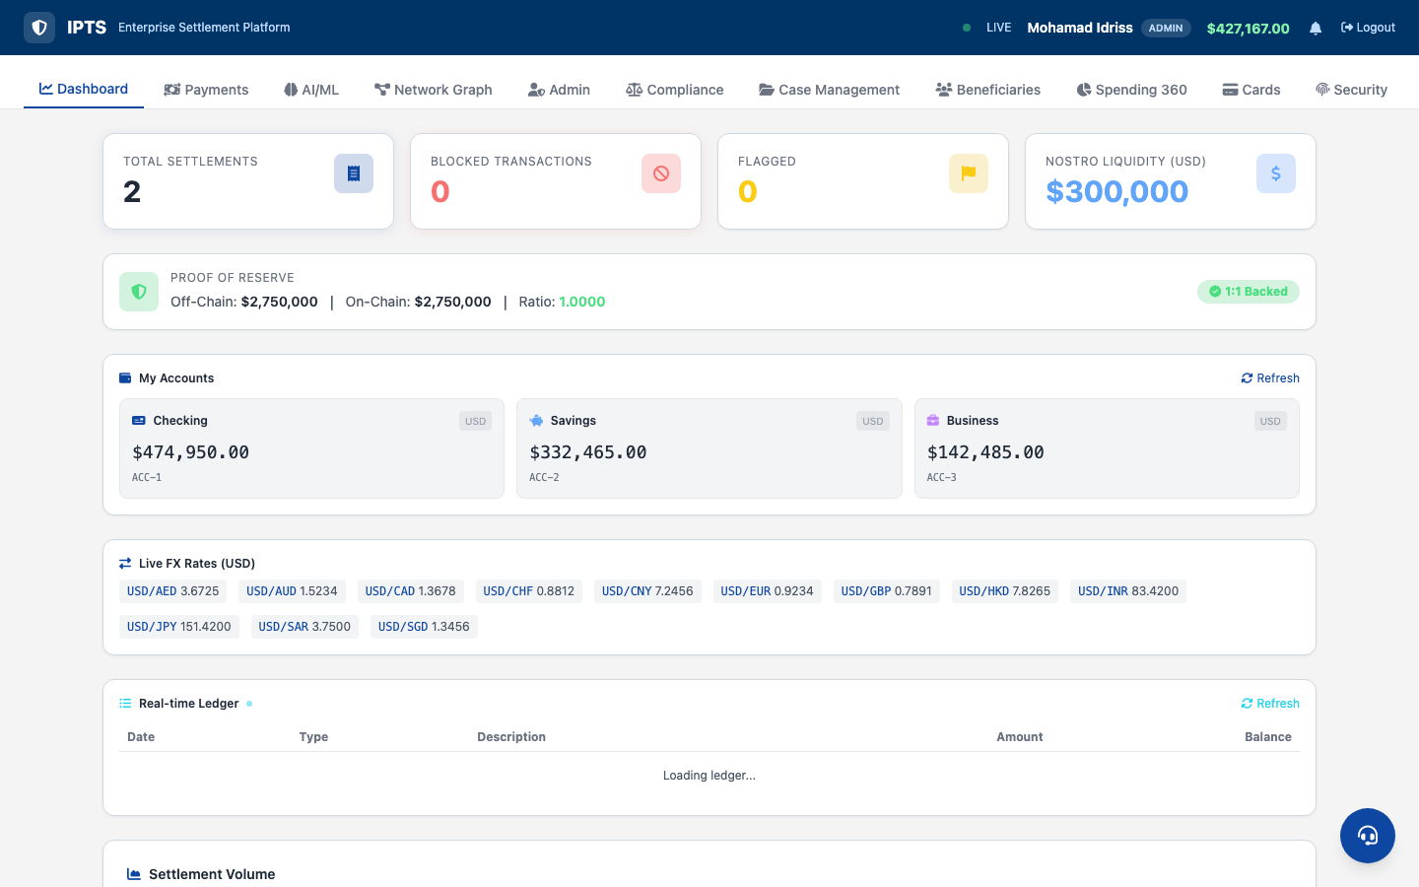
Dashboard — Multi-Account, KPIs & Notifications
• Real-time KPI cards
• Multi-account cards
• Checking / Savings / Business
• Notification bell + badge
• Live FX rates ticker
• Health status dot (30s poll)
• SSE auto-refresh (6s)

Slide 10
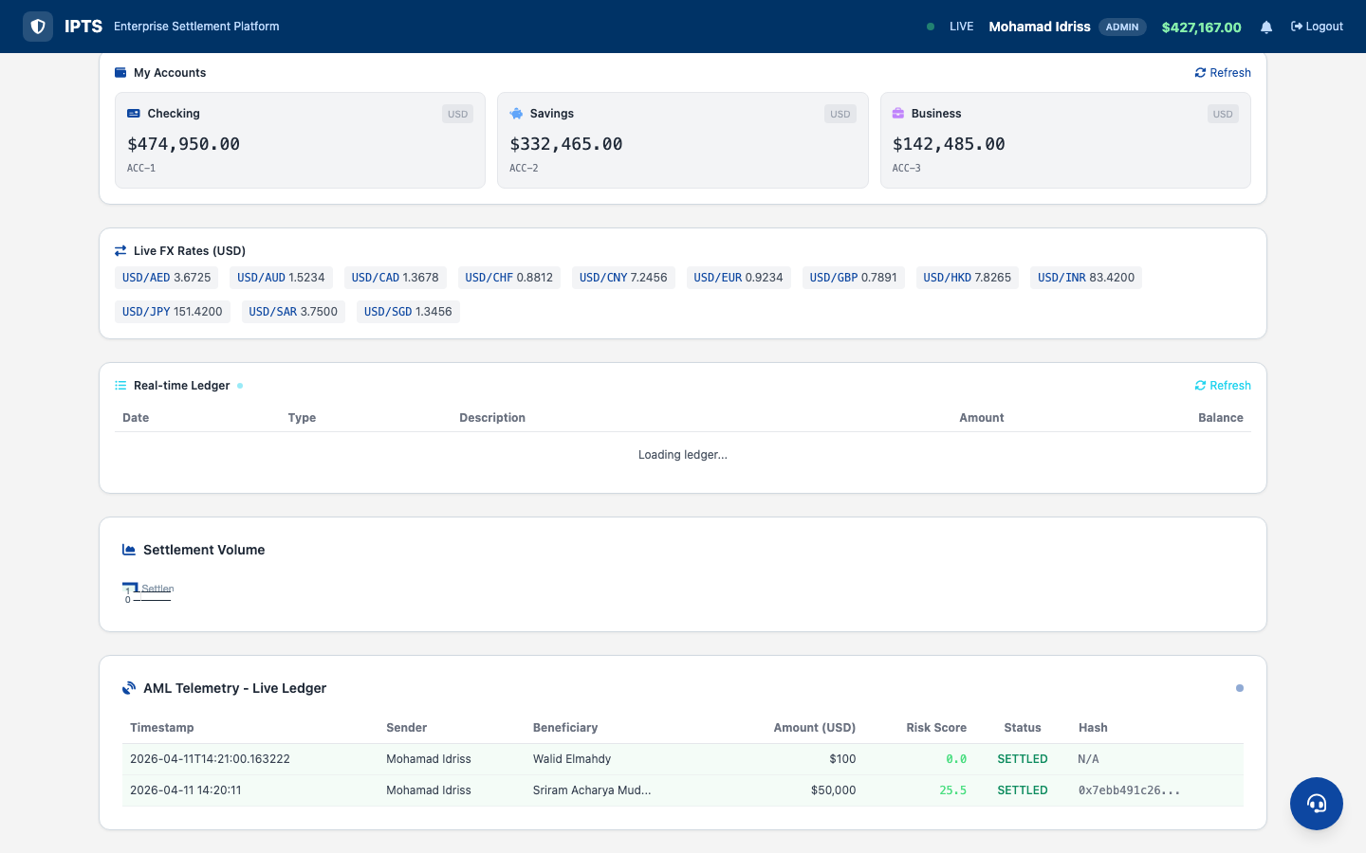
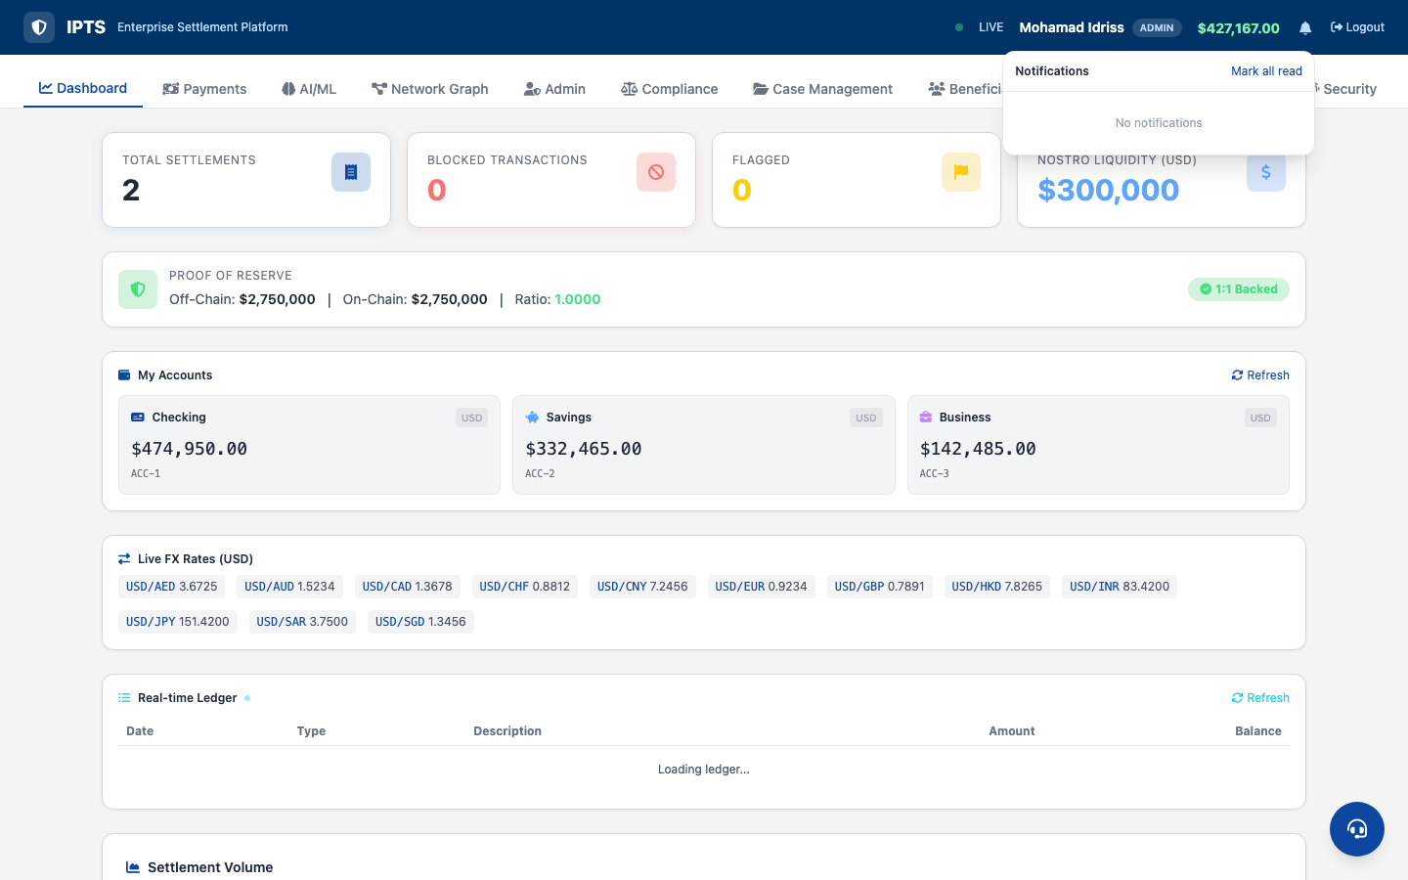
Dashboard — Real-Time Ledger & Notifications

Slide 11
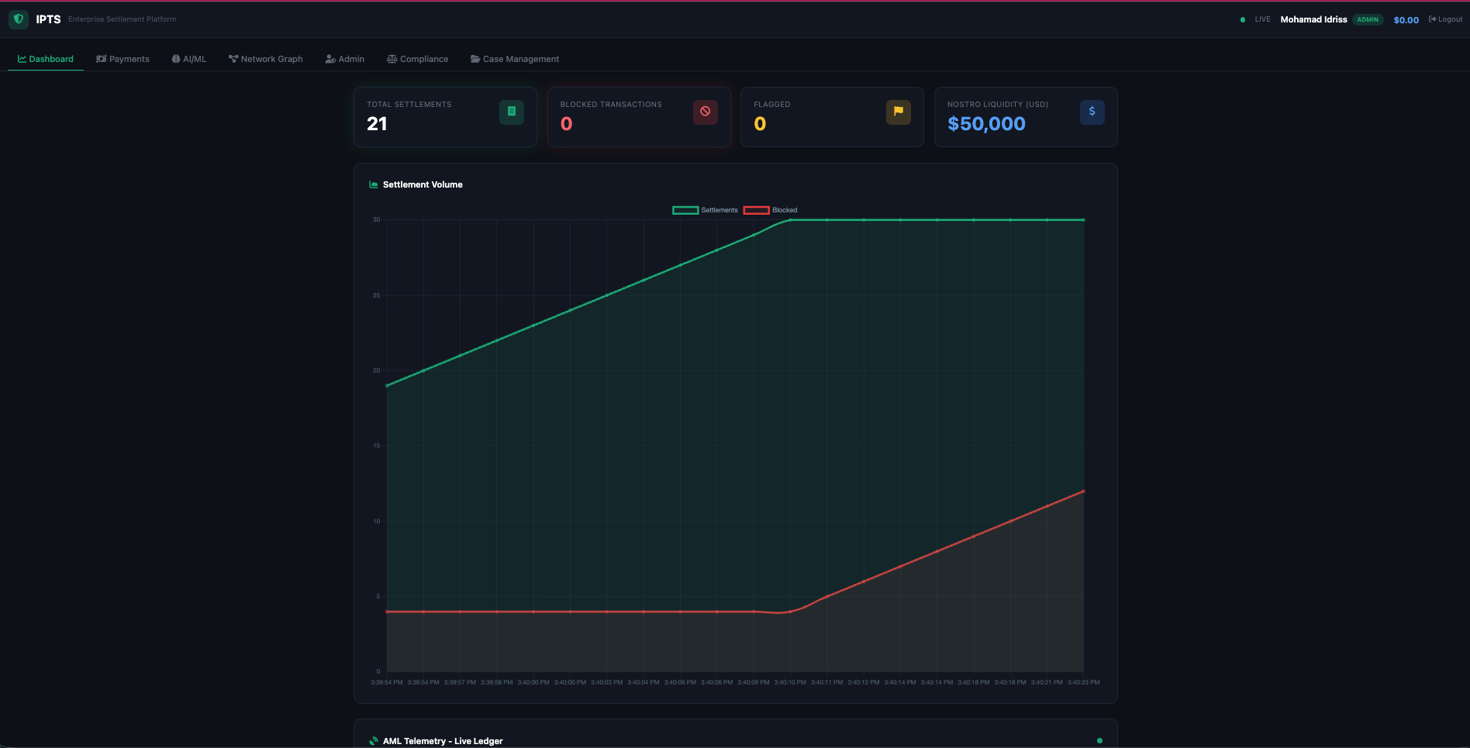
Dashboard — Settlement Volume & AML Telemetry

Slide 12
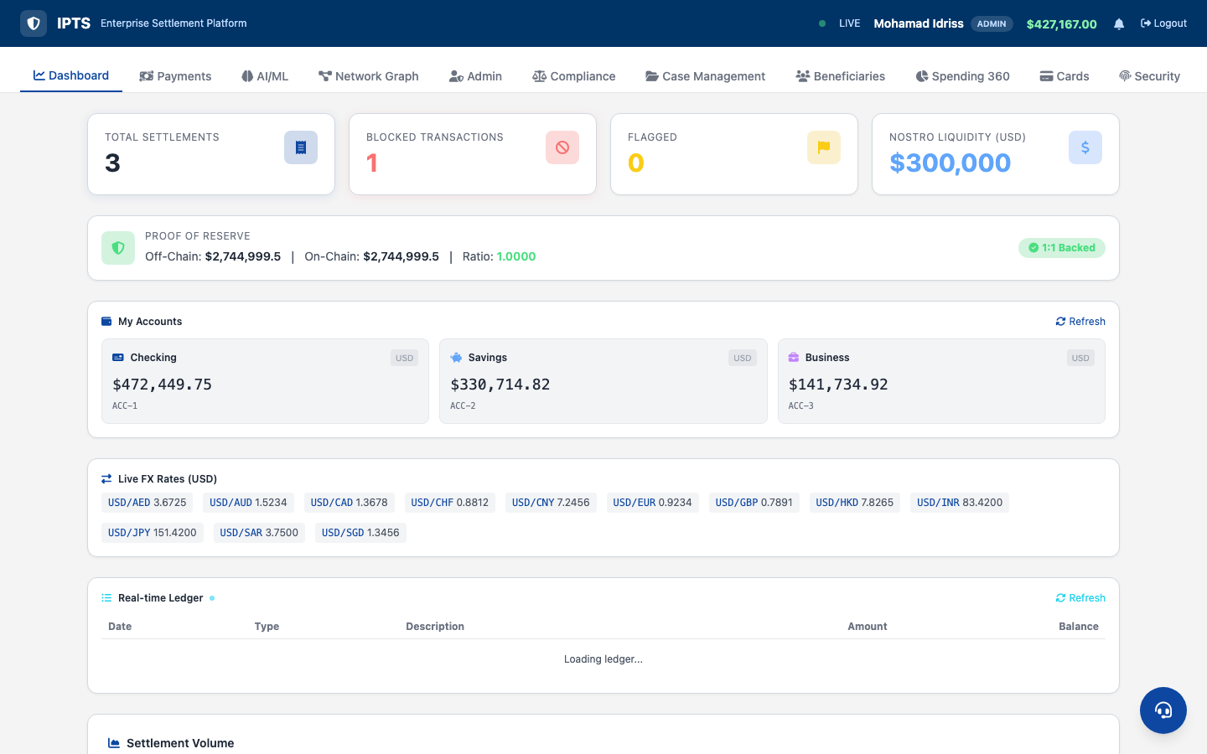
Dashboard — Proof of Reserve

Slide 13
Payment Hub
5 Payment Channels: Settlement, P2P, ACH/Wire/SEPA, Scheduled, QR

Slide 14
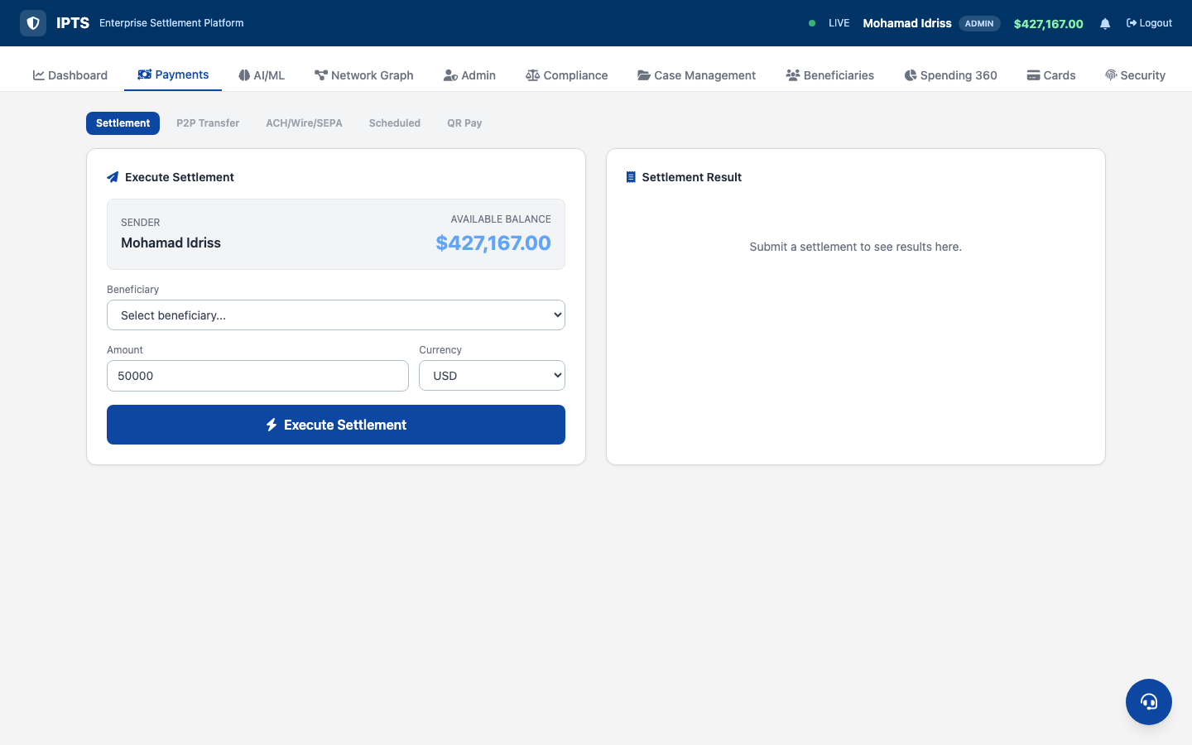
Settlement — Multi-Currency with AI Risk Scoring
• 13-currency selector
• FX preview (USD equivalent)
• AML jurisdiction warnings
• Risk score + breakdown
• SHAP values inline
• Blockchain tx hash
• Balance auto-update

Slide 15
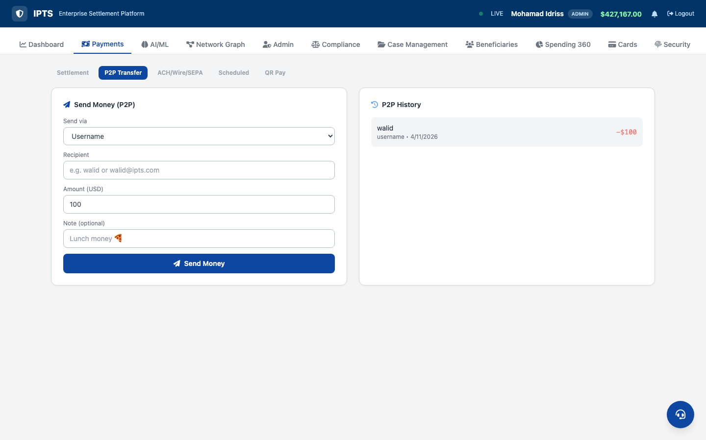
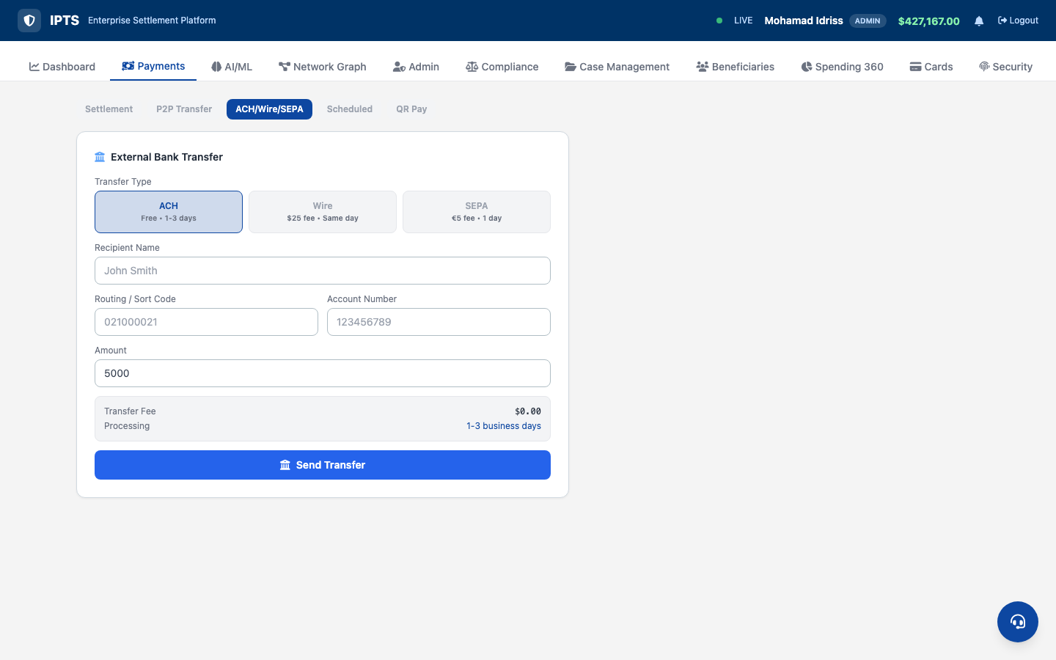
P2P Transfer & ACH/Wire/SEPA

Slide 16
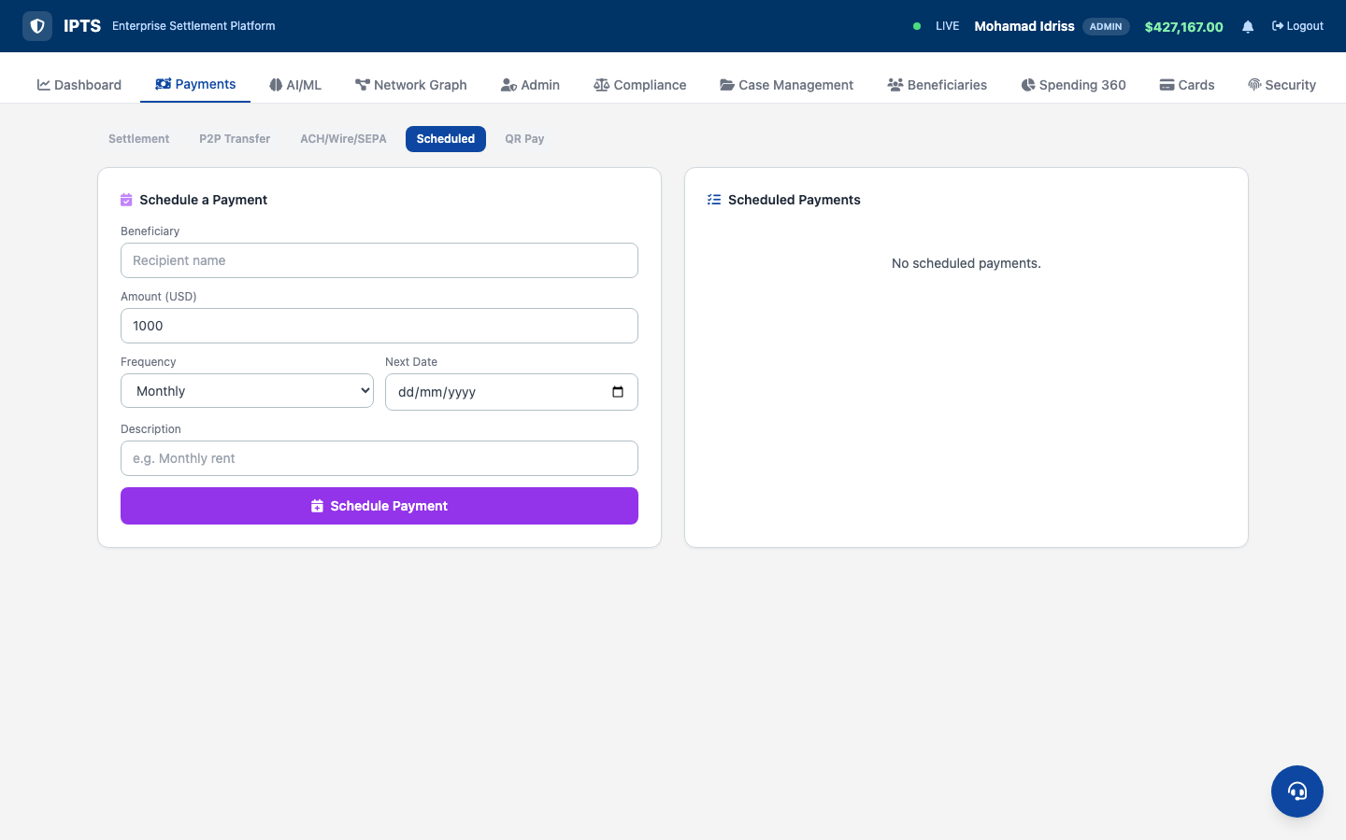
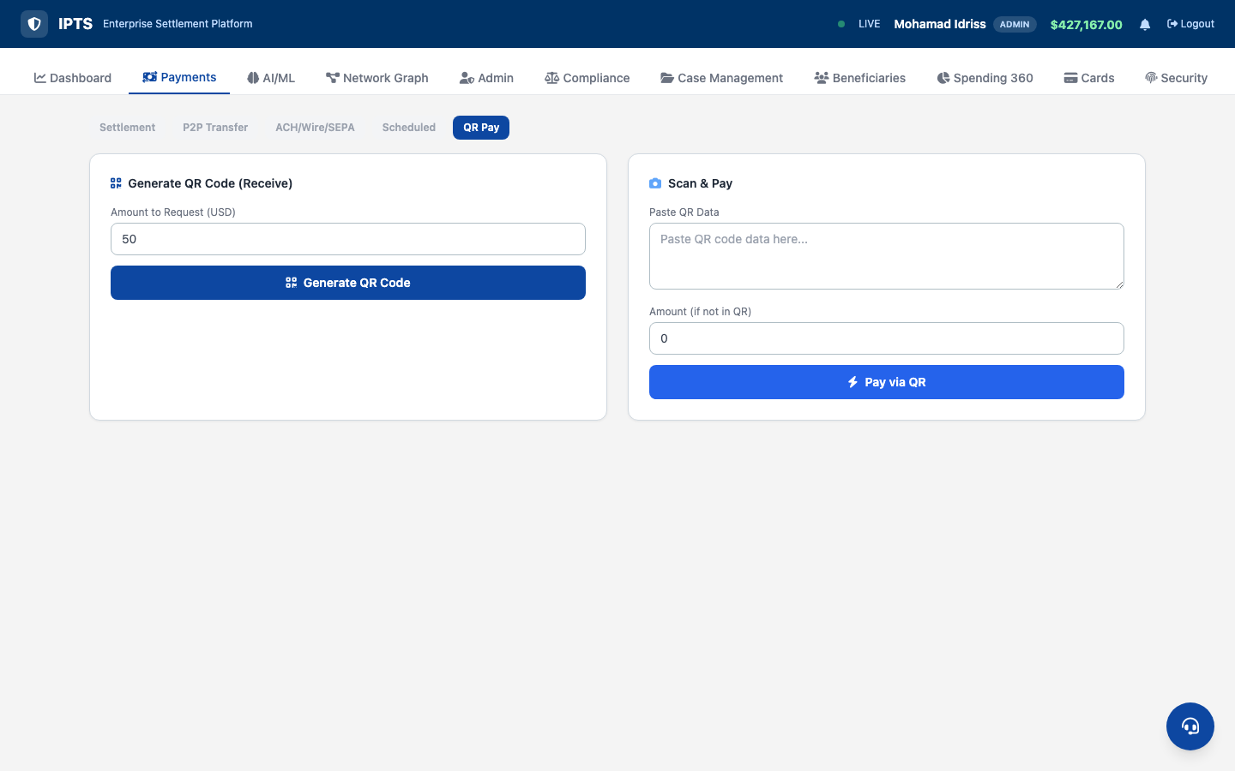
Scheduled Payments & QR Pay

Slide 17
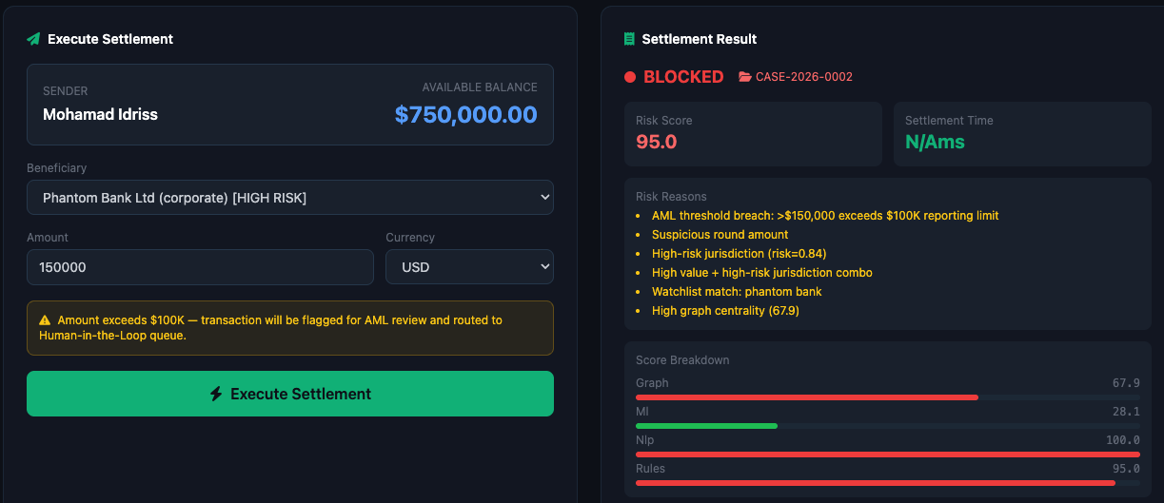
Settlement — $700K High-Value Transaction (Blocked)

Slide 18
DeFi Suite
AMM Swap, Staking, Escrow HTLC, Liquidity Pools

Slide 19
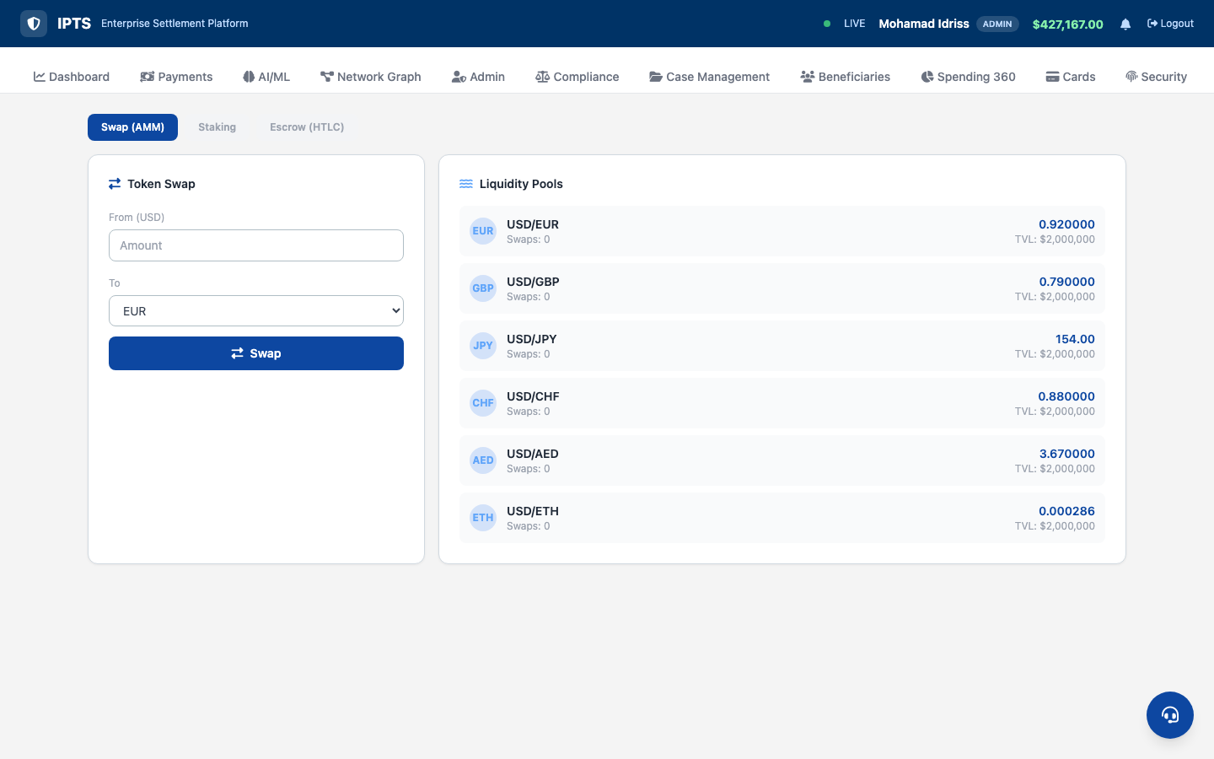
DeFi — AMM Swap & Liquidity Pools
• Automated Market Maker
• Token-to-token swaps
• Slippage protection
• Liquidity pool balances
• Price impact preview
• On-chain settlement
• Real-time pricing

Slide 20
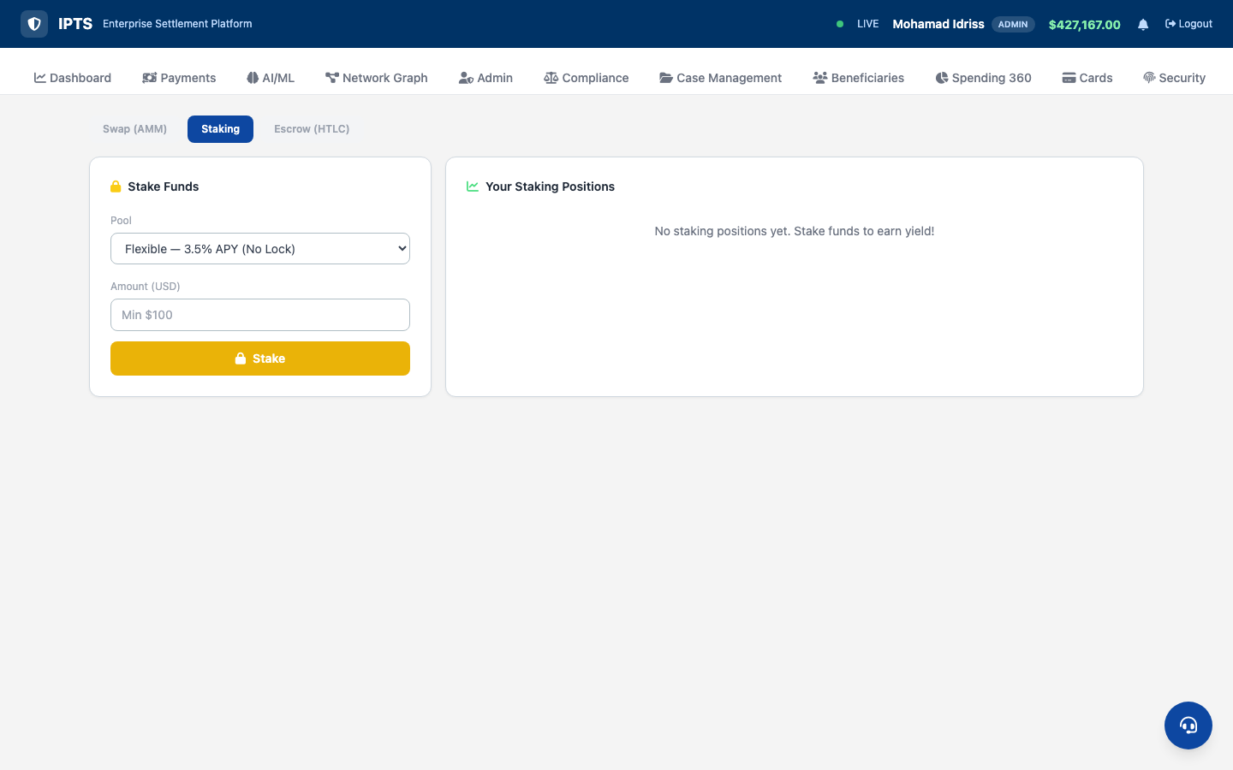
DeFi — Staking Rewards

Slide 21
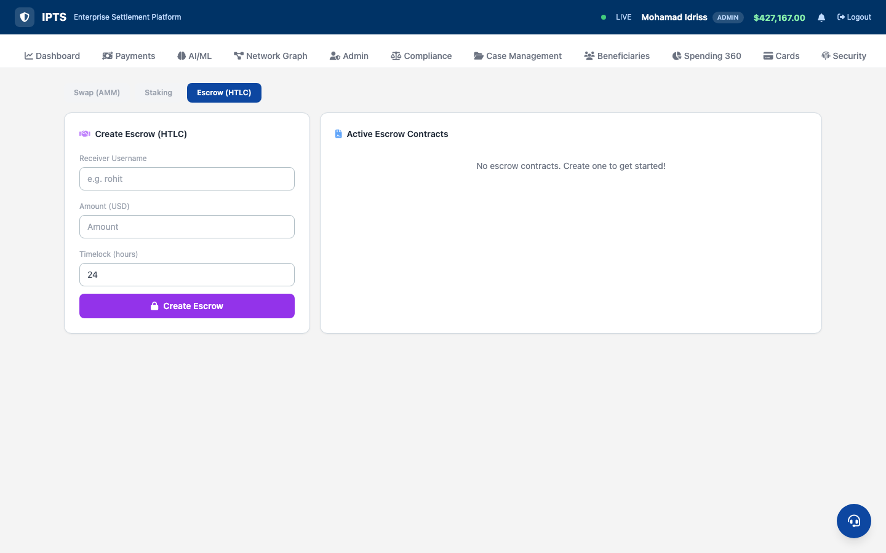
DeFi — Escrow HTLC (Hash Time-Locked Contracts)

Slide 22
SHAP Explainability
Every AI Decision is Fully Transparent

Slide 23
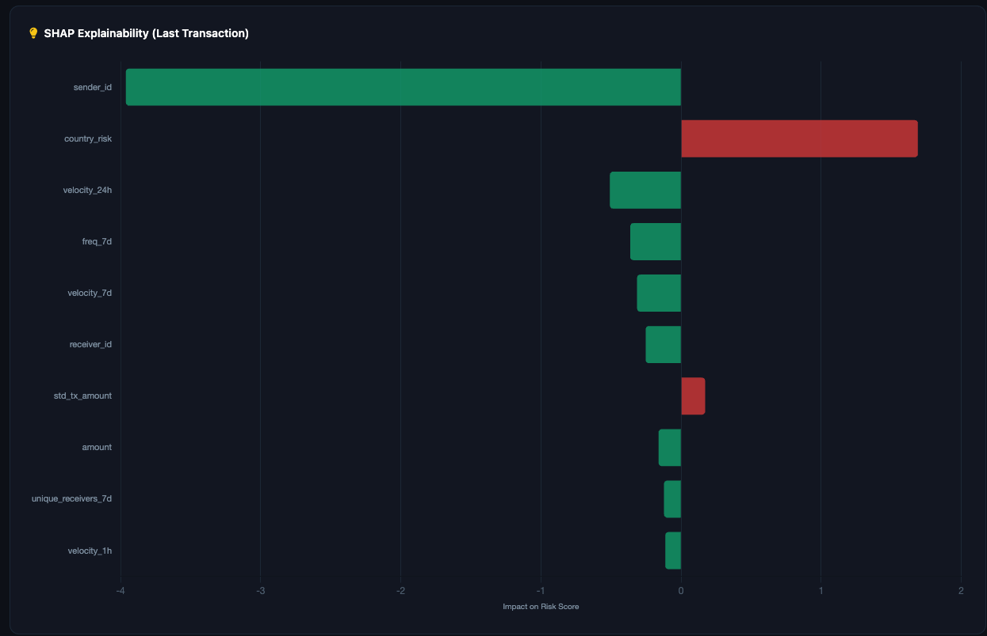
SHAP — Per-Transaction Feature Contributions
How SHAP Works
• 16 features scored per transaction
• TreeExplainer on XGBoost model
• RF feature_importances_ fallback
• Positive = increases risk (red)
• Negative = decreases risk (green)
• Satisfies EU AI Act requirements
• Full audit trail for regulators

Slide 24
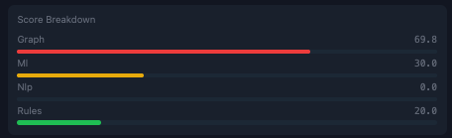
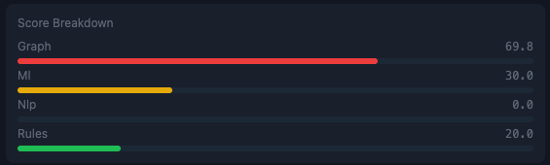
Risk Score Breakdown — 4-Component Composite Scoring
Rules (30%)
ML Ensemble (40%)
NLP Watchlist (15%)
Graph Risk (15%)
Deterministic threshold checks
5-model weighted prediction
Fuzzy entity matching
PageRank centrality analysis

Slide 25
AI/ML Engine
5-Model Ensemble with 16-Feature Vector

Slide 26
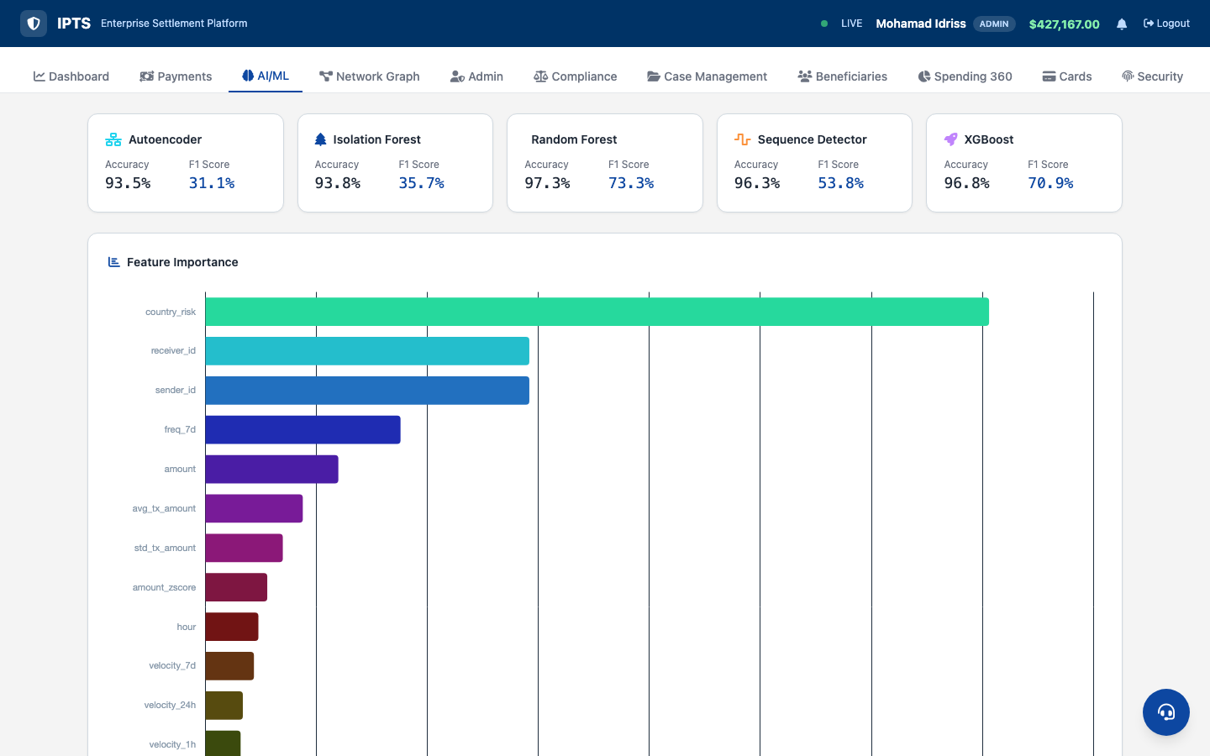
AI/ML — 5 Model Performance Cards

Slide 27
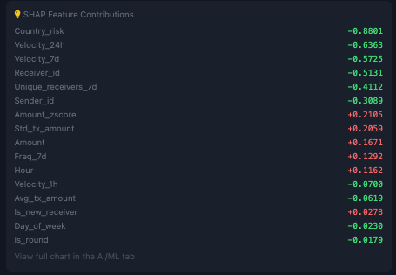
SHAP Explainability Chart — Feature Impact on Risk

Slide 28
16-Feature Vector — Static + Real-Time Velocity
Static Features (1-8)
Real-Time Velocity Features (9-16)
1. amount
2. hour
9. velocity_1h
10. velocity_24h
3. day_of_week
4. freq_7d
11. velocity_7d
12. avg_tx_amount
5. is_round
6. country_risk
13. std_tx_amount
14. amount_zscore
7. sender_id
8. receiver_id
15. unique_receivers_7d
16. is_new_receiver
VelocityTracker — Real-Time Behavioral Analytics
The VelocityTracker maintains a per-sender sliding window of transaction history, computing real-time features that capture behavioral anomalies invisible to static analysis. This enables detection of sudden volume spikes, amount deviations, and receiver diversification patterns that indicate fraud, structuring, or money laundering.

Slide 29
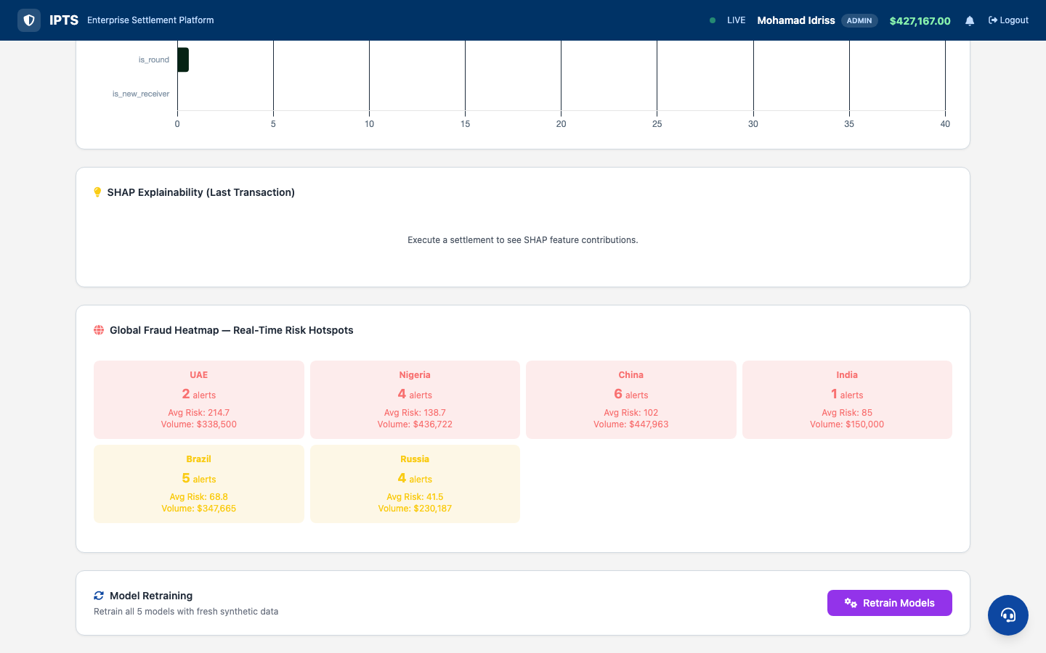
Fraud Heatmap — Geographic & Temporal Analysis

Slide 30
Four-Eyes Approval
Dual-Approval for High-Value Transactions ($100K+)

Slide 31
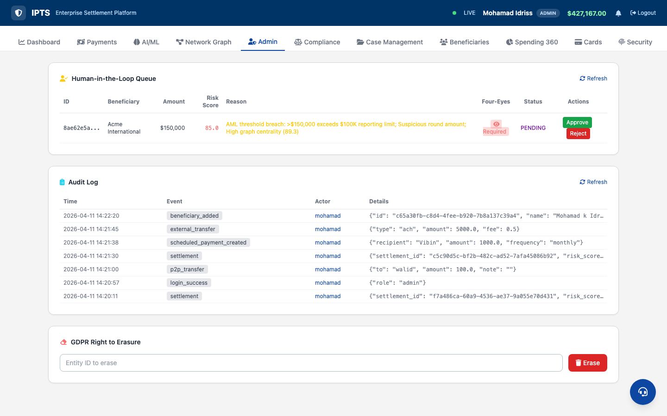
HITL Queue — Four-Eyes Approval Badges
Four-Eyes Workflow
Required
Transaction >= $100K blocked
1 of 2
First officer approves
Enforced
Same user cannot approve twice
2 of 2
Second officer confirms
Settled
Released to blockchain

Slide 32
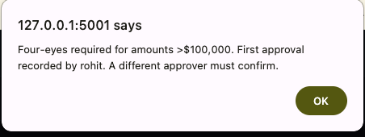
Four-Eyes Enforcement — Second Approver Required
The system enforces that the second approval must come from a different compliance officer.
No single individual can unilaterally approve high-value transactions.

Slide 33
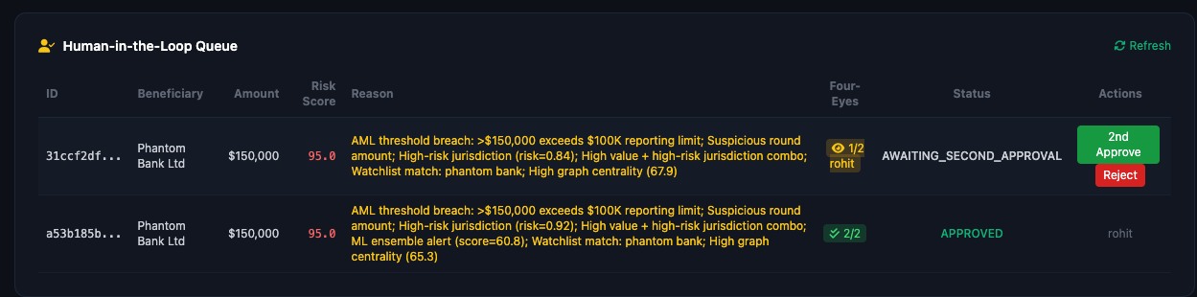
HITL Queue — Detailed Case View

Slide 34
Case Management
SLA Tracking & Compliance Workflows

Slide 35
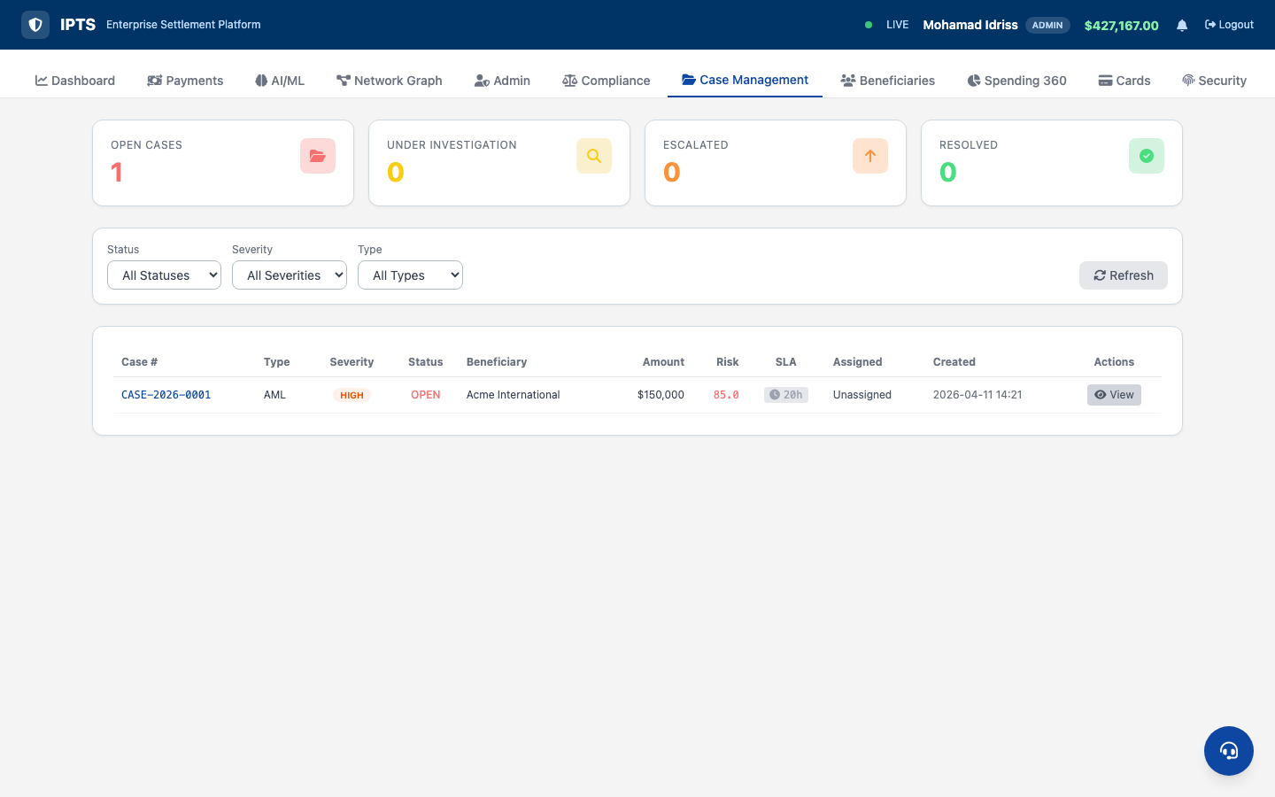
Case Management — SLA Countdown Tracking
SLA Thresholds
CRITICAL
4 hours
HIGH
24 hours
MEDIUM
72 hours
LOW
7 days
Cases approaching SLA breach
are highlighted in red

Slide 36
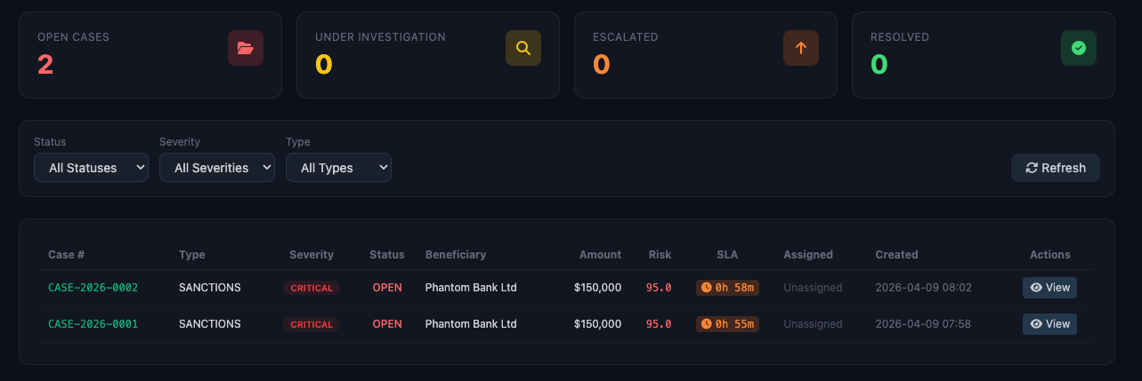
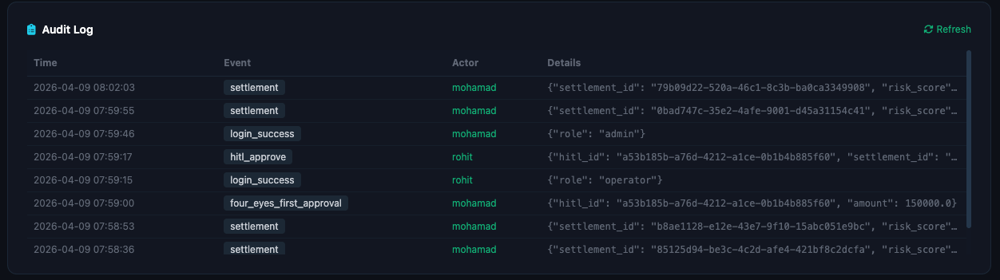
Case Detail — SANCTIONS Case (CRITICAL)

Slide 37
Account Management
Beneficiaries, Spending 360 Analytics

Slide 38
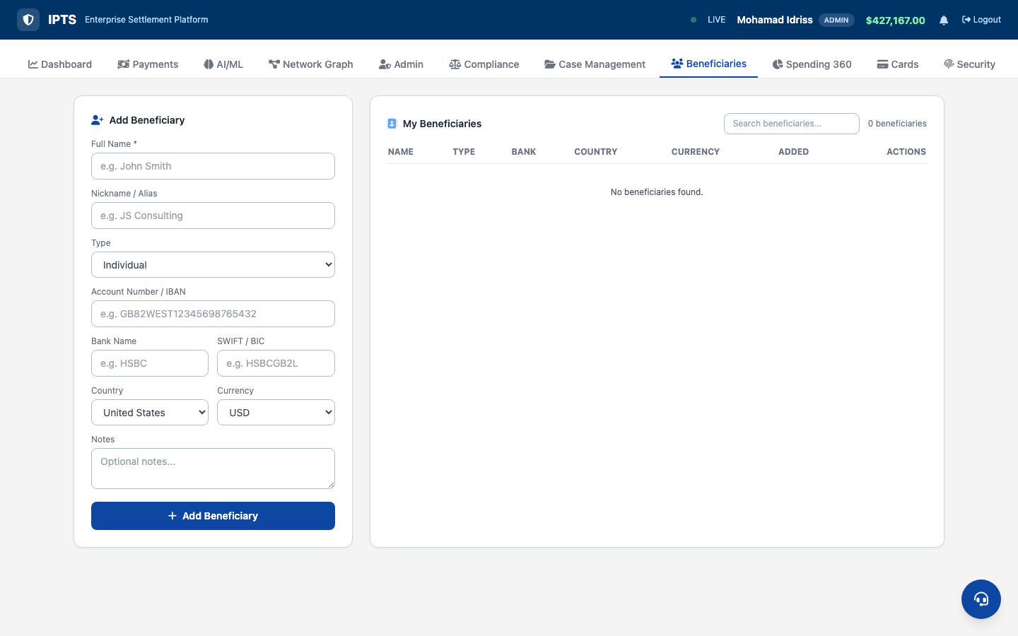
Beneficiary Management — Add, Edit, Delete
• Add beneficiaries with full details
• Account number + SWIFT code
• Country + Currency selection
• Risk level assignment
• Auto-populates payment dropdown
• Edit & delete controls
• Individual / Corporate types

Slide 39
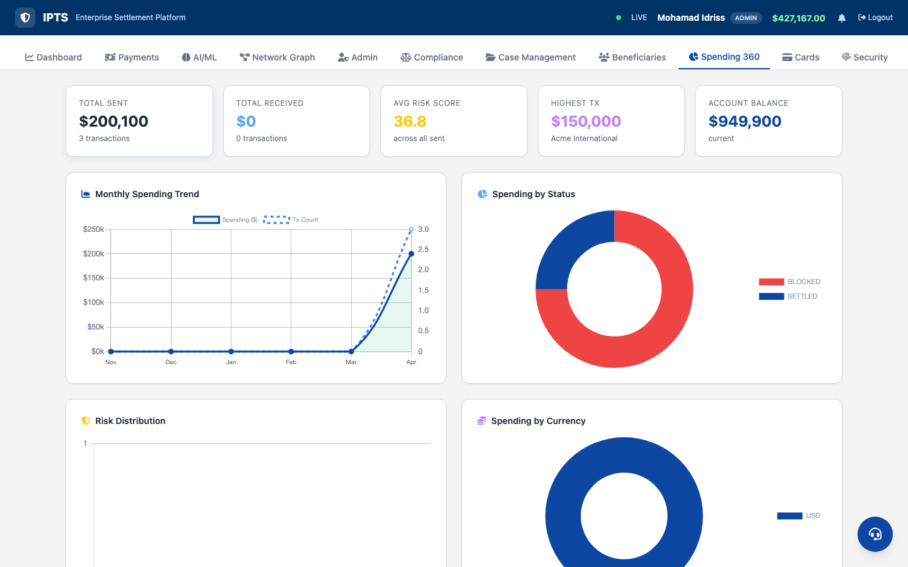
Spending 360 — Comprehensive Analytics Dashboard

Slide 40
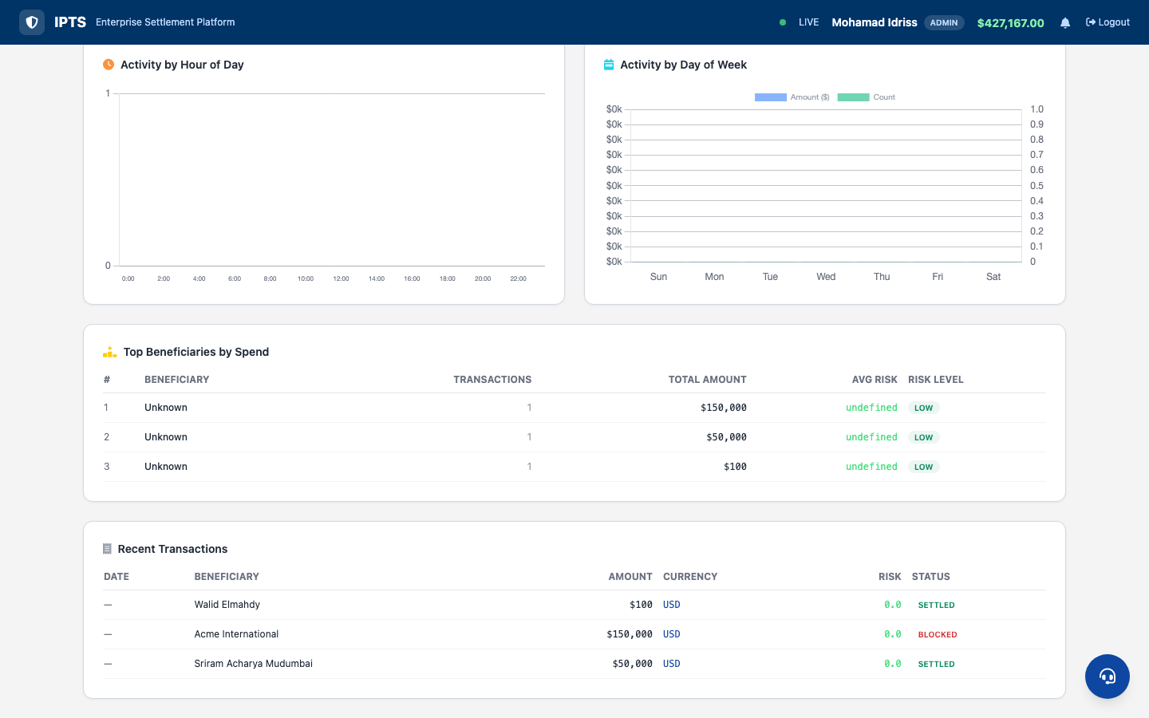

Spending 360 — Charts & Transaction History

Slide 41
Card Services
Virtual Cards, Digital Wallet, Spending Controls

Slide 42
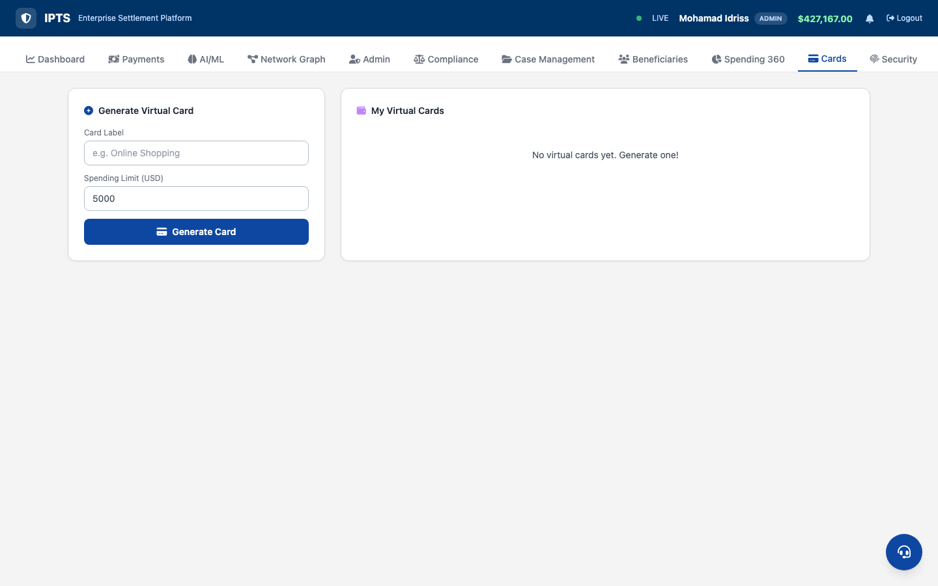
Virtual Cards — Generate, Freeze, Provision
• Visa / Mastercard generation
• Masked card numbers
• Gradient card styling
• Freeze / Unfreeze toggle
• Apple Pay provisioning
• Google Pay provisioning
• Samsung Pay provisioning
• Card cancellation

Slide 43
Security & KYC
E-KYC Verification, Fraud Alerts, Biometric Controls

Slide 44
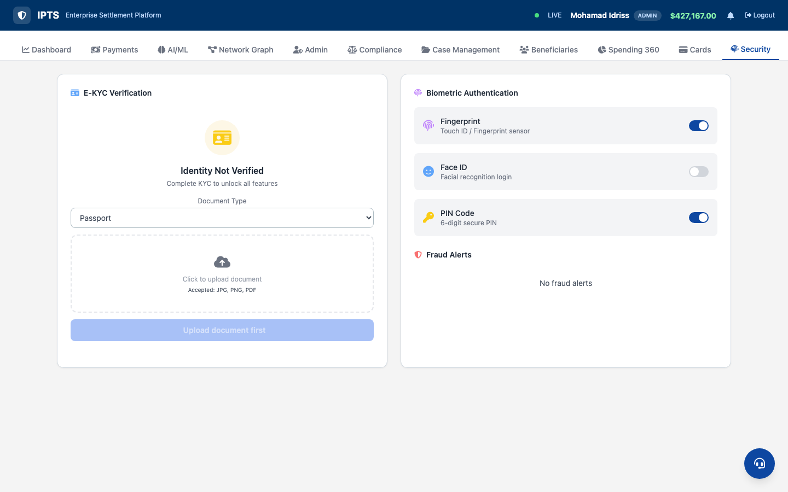

E-KYC & Fraud Monitoring

Slide 45
Support & Documents
AI Chat Bot, Notification Center, Document Hub

Slide 46
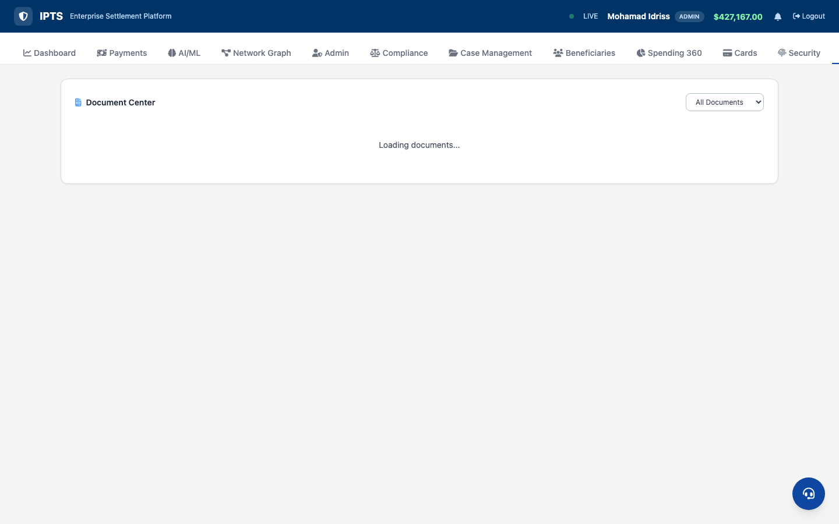
Documents & Notification Center

Slide 47
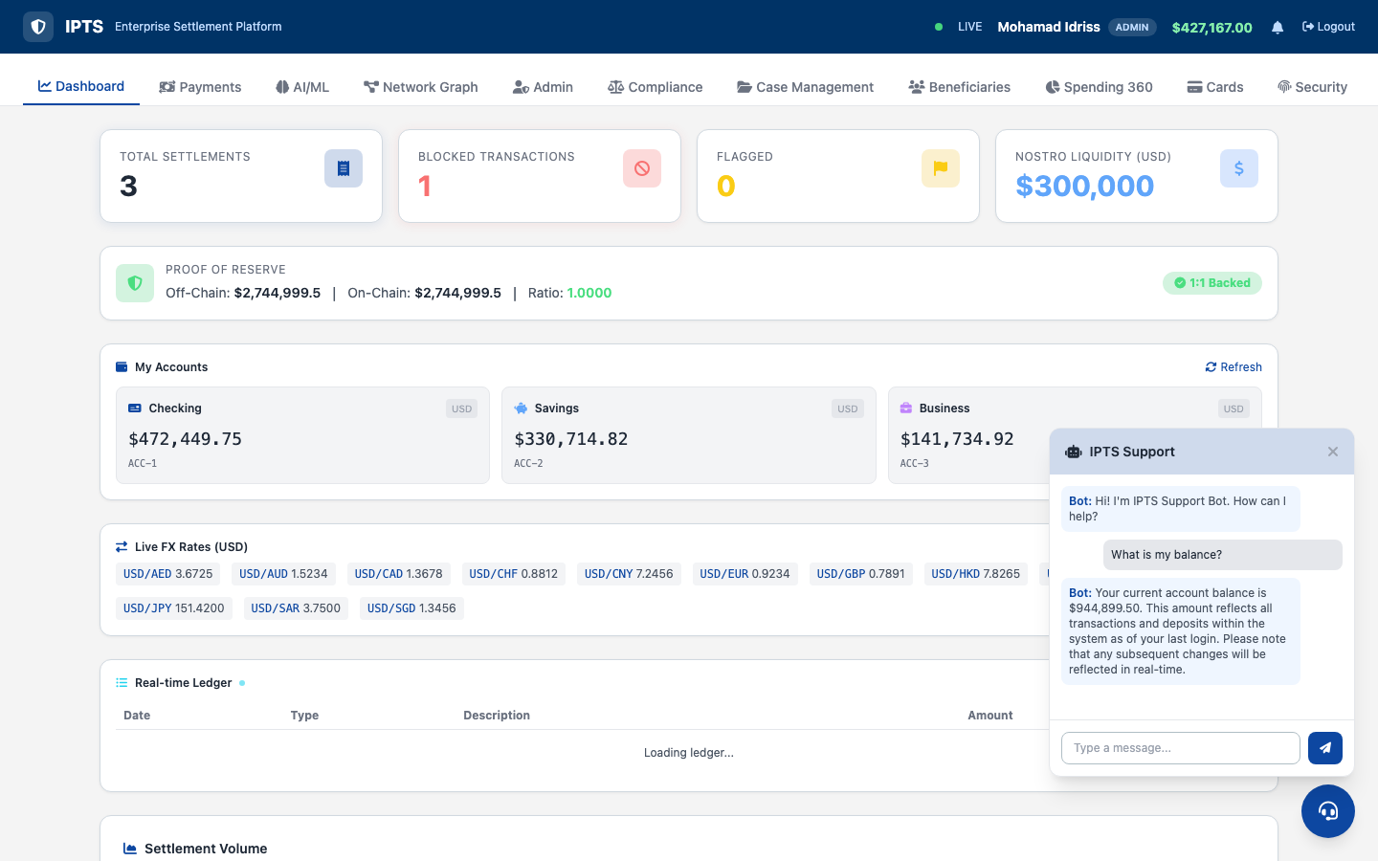
Support Chat — LLM-Powered AI Assistant

Slide 48
Compliance Tools
Sanctions, SWIFT GPI, FX Converter, Nostro

Slide 49
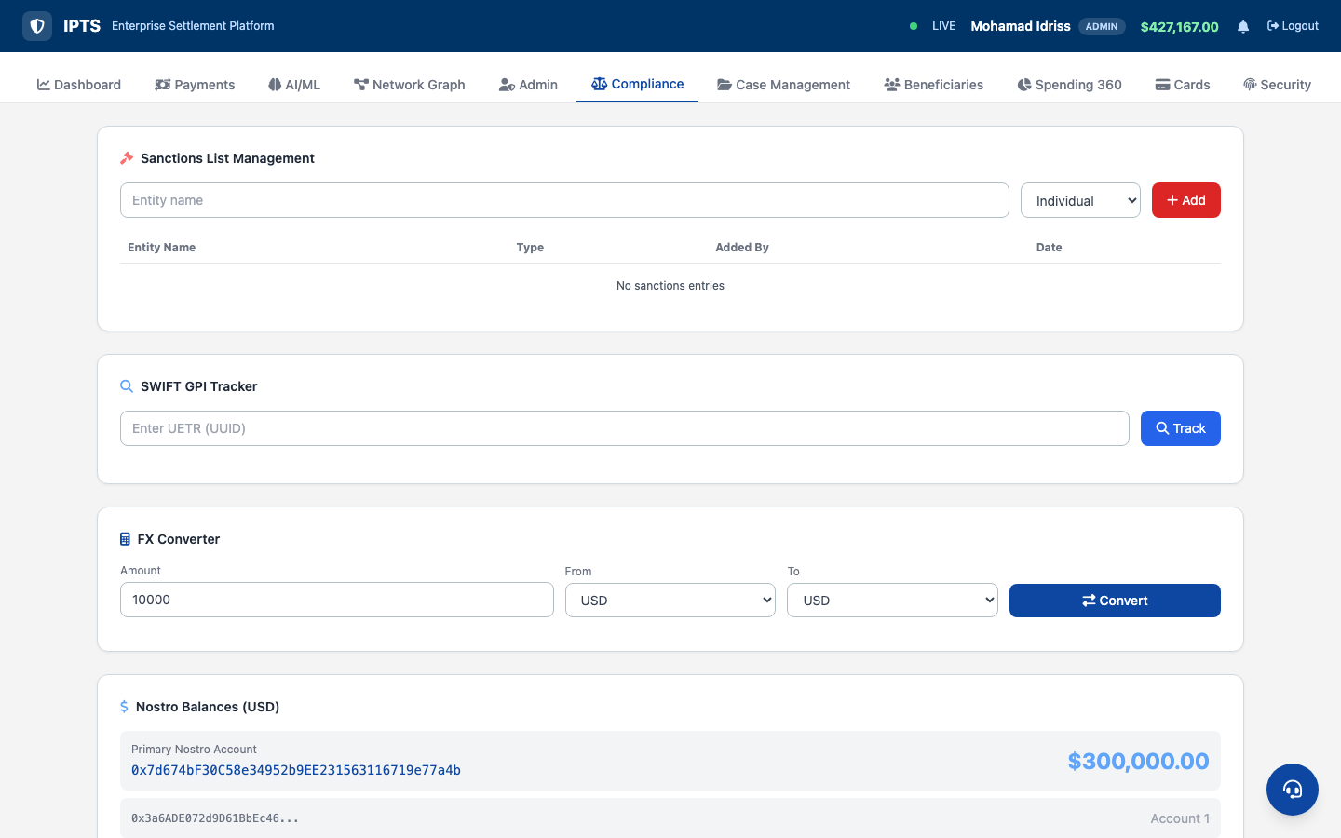
Compliance — Overview & Tools

Slide 50
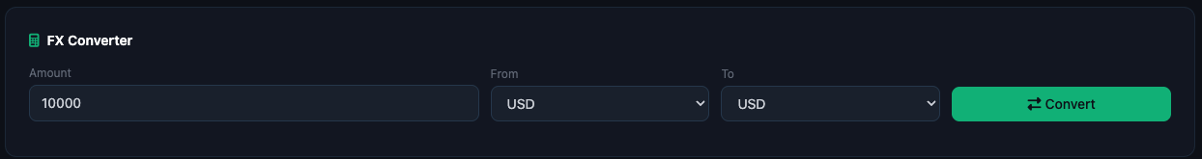
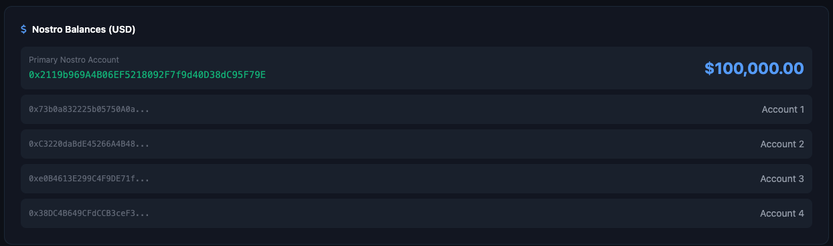
FX Converter & Nostro Balances
13 Supported Currencies
Nostro Account Positions
USD EUR GBP JPY CHF AUD CAD
CNY INR SGD AED SAR BRL
Real-time liquidity monitoring across
blockchain-backed Nostro accounts

Slide 51
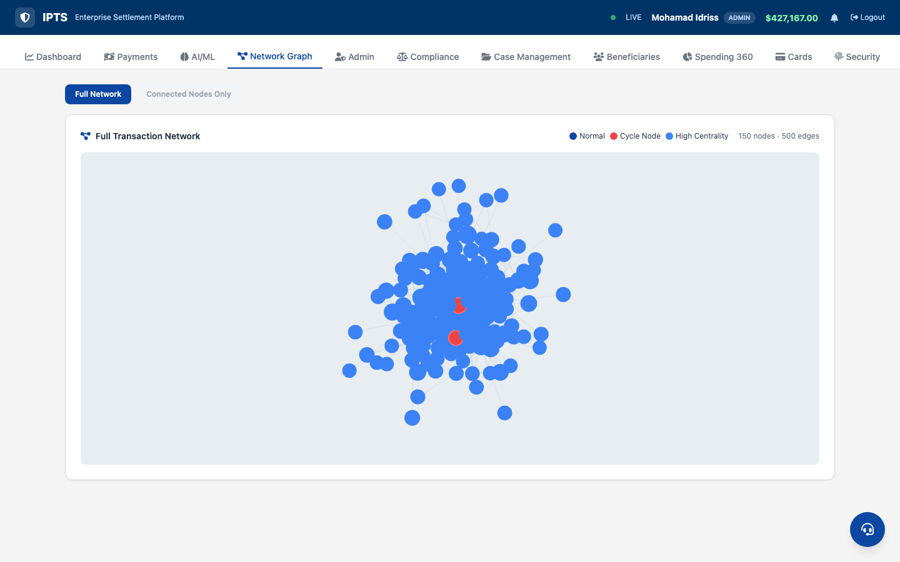
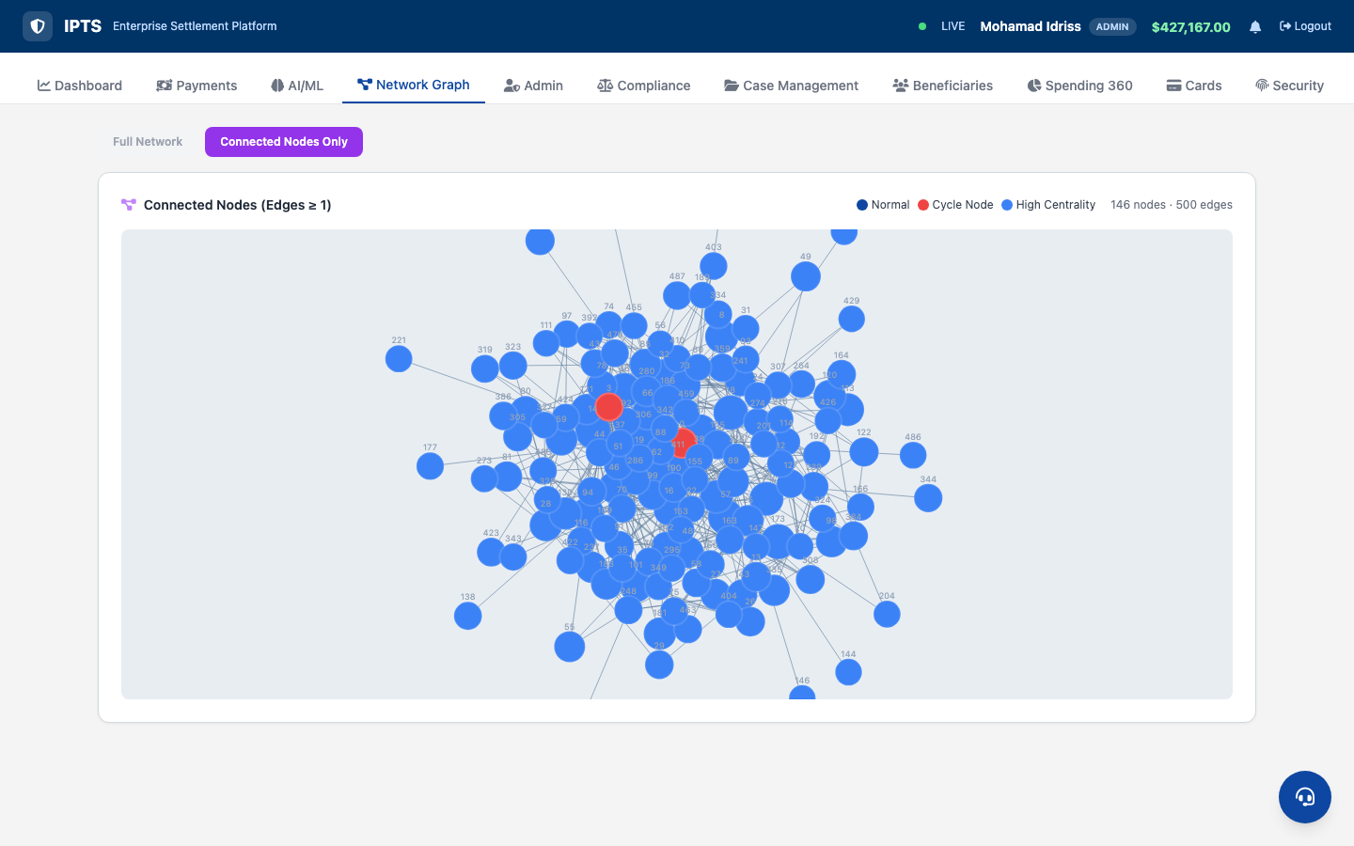
Network Graph — Transaction Relationship Analysis

Slide 52
Key Differentiators
🧠
Explainable AI
💳
5 Payment Channels
🤖
5-Model Ensemble
💳
Virtual Card Services
Per-transaction SHAP values with 16-feature decomposition. Every risk decision is transparent and auditable — EU AI Act compliant.
Settlement, P2P, ACH/Wire/SEPA, Scheduled, QR Pay — all in one unified Payment Hub with sub-tab navigation.
Isolation Forest + Random Forest + XGBoost + Autoencoder + Sequence Detector. 98-100% detection, < 3% false positives.
Visa/MC generation, freeze/unfreeze, spending controls, and one-click provisioning to Apple Pay, Google Pay, Samsung Pay.
📊
Spending 360
🔒
E-KYC + Notifications
🔗
DeFi / AMM Suite
Comprehensive analytics with monthly trends, risk distribution, currency breakdown, activity heatmaps, and top beneficiary rankings.
3-phase animated identity verification, real-time notification center with SSE push, and AI-powered support chat bot.
On-chain AMM swaps, staking rewards, escrow HTLC, liquidity pools, and Proof of Reserve — bridging TradFi and DeFi.

Slide 53
Transformation Impact
KPI Metric
Before IPTS
After IPTS v6.0
Settlement Time
T+2 to T+5
< 10 seconds
Fraud Detection
45-60%
98-100%
False Positives
15-25%
< 3%
AI Explainability
None (black box)
Full SHAP (16 features)
Payment Channels
1 (wire only)
5 (Settlement/P2P/ACH/Sched/QR)
Currency Support
USD only
13 currencies
Card Services
Physical only
Virtual Visa/MC + digital wallet
Identity (KYC)
Manual paper
E-KYC with AI scoring
Tabs / Features
3-5 screens
12 tabs, 75+ API endpoints
DeFi Liquidity Pools
None
AMM swap + pool management
Staking
None
On-chain staking with rewards
Escrow
None
HTLC smart contract escrow

Slide 54
Thank You
Questions & Discussion
G9-IPTS v6.0 7-Layer Architecture | 5 AI Models | SHAP Explainability 12 Tabs | 5 Payment Channels | DeFi Suite | Virtual Cards | E-KYC AMM Swap | Staking | Escrow HTLC | Support Chat | 75+ APIs
Mohamad Idriss | Rohit Jacob Isaac | Sriram Acharya Mudumbai Walid Elmahdy | Vibin Chandrabose

