Slide 1
International Youth Math Challenge
2024

Slide 2
What is IYMC?
“Mathematics is essential for the understanding of the world, scientiffc achievements, and progress, and for engineering and prosperity in our society.”
Where?
International Opportunity
Benefits
Prizes and Certificates
Eligibility
Structure
3x Rounds
Since 2018
12,500+ Participants
Open for High School and University Students

Slide 3
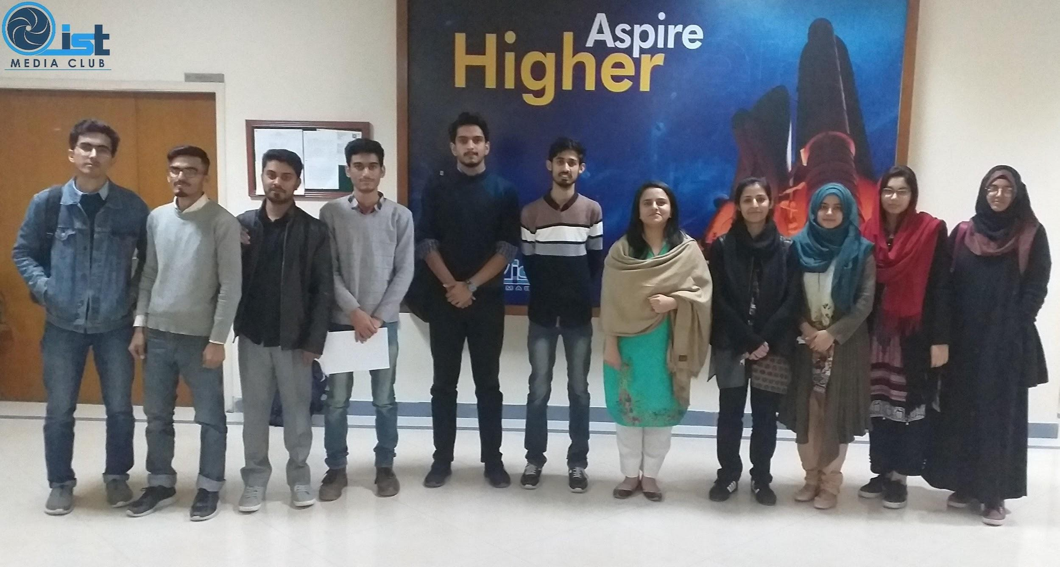
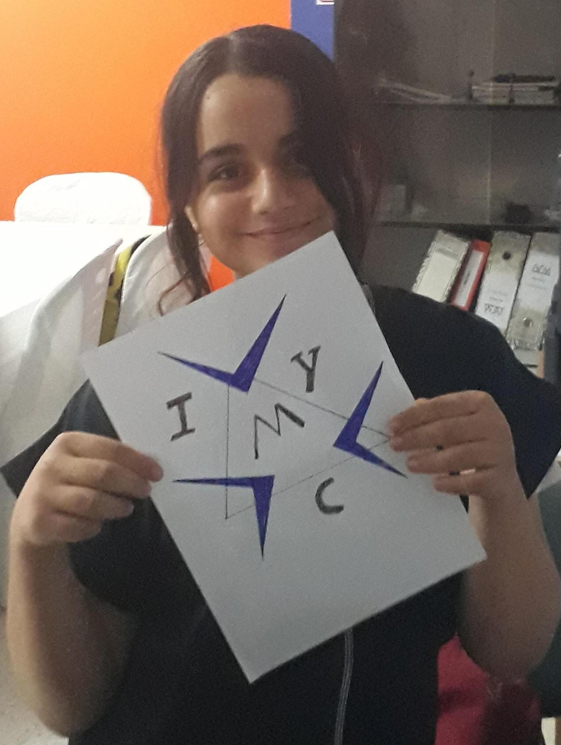
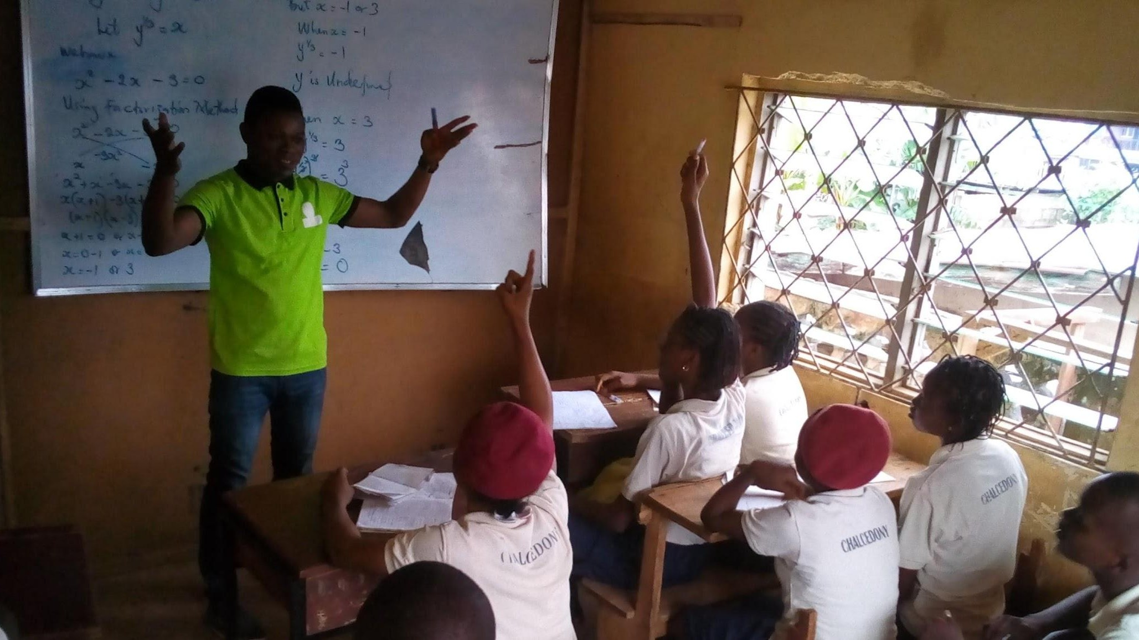
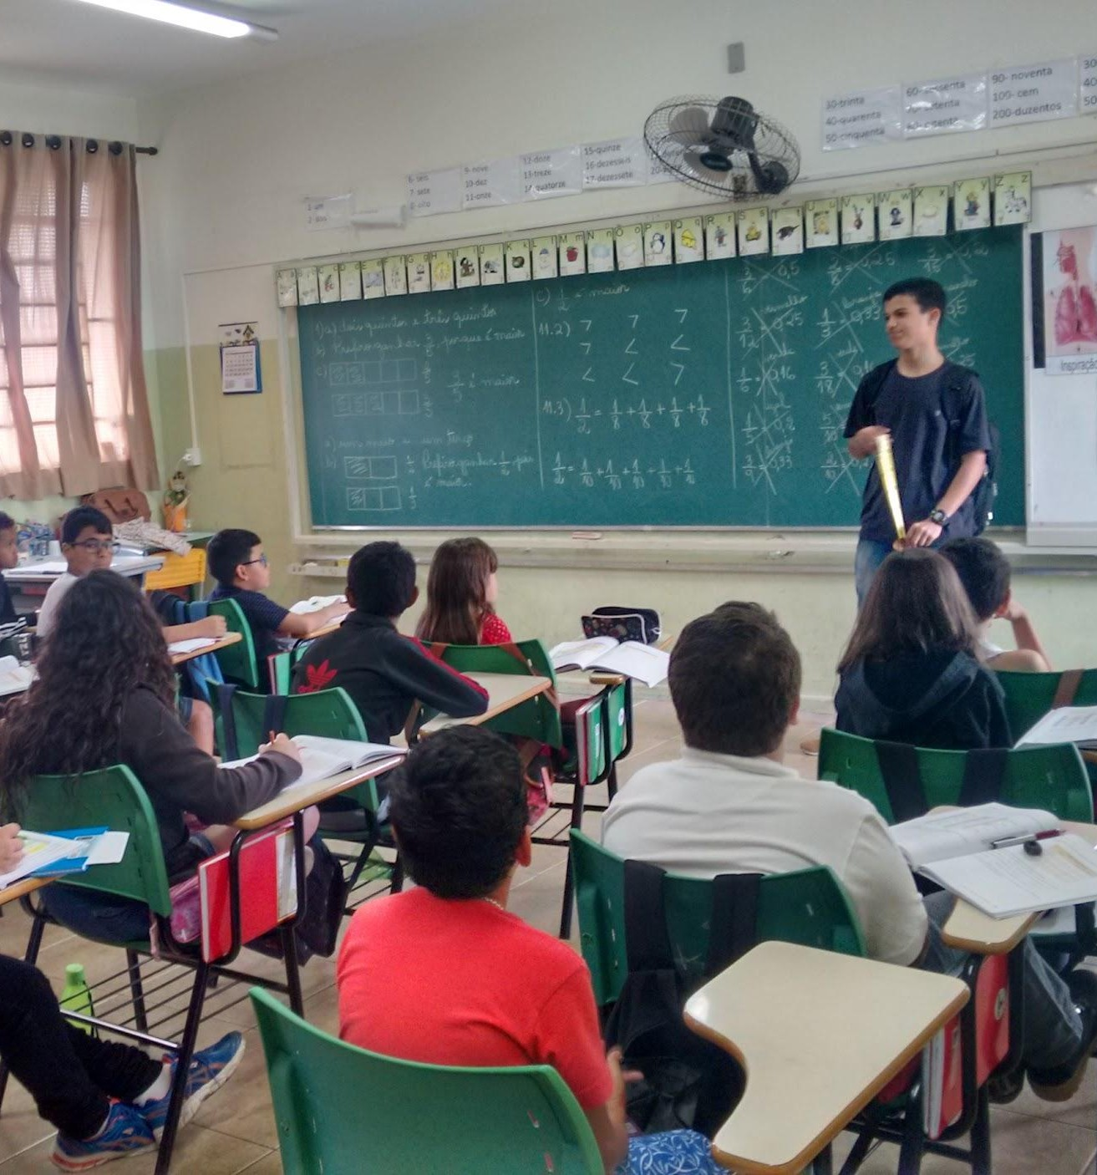
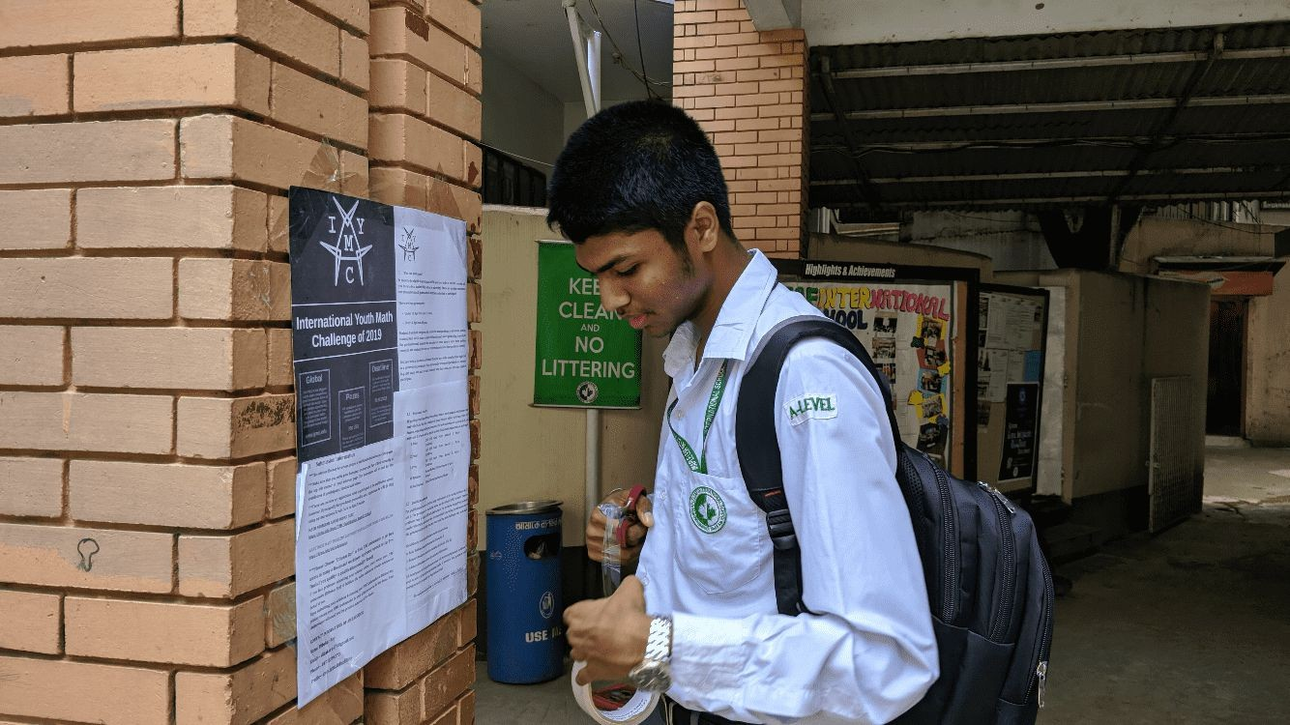
Features of IYMC
Online Availability
→ International, Online, Login Page, Support
Accessibility
→ Related to Education, Learn while Participating
Special Problems
→ Scientific Papers
Student Interaction
→ Certificates, Experience, Ambassador Program

Slide 4
Rounds of IYMC
1. Ǫualification Round
5 Problems, Submission Deadline: 15. Dec 2024
6x Problems, 2x Special-Creativity Problems, Four Days, 8 EUR Registration Costs
2. Pre-Final Round
Online Exam with 20 MC-Ǫuestions,
~20 Minutes, Teacher Supervision OR Recording
3. Final Round

Slide 5
Prizes and Awards
All Participants
Official Participation Certificates + Performance Report
All Finalists
Bronze Honour
Silver Honour
Gold Honour
International Awards
1. Prize, Youth (150 USD)
1. Prize, Junior (150 USD)
2. Prize, Youth (100 USD)
2. Prize, Junior (100 USD)
3. Prize, Youth (50 USD)
3. Prize, Junior (50 USD)
Special Awards
National Awards
School Awards
Ambassador Awards
...

Slide 6
How to participate?
1. Download Sheet
www.iymc.info
2. Solve Problems
→ Work alone or as a group
→ Handwritten or computer typed
www.iymc.info/submission
Solve at least 3 or 4 (under/over 18 years) problems.
3. Submit Solution
Submission Deadline
Sunday fi5. December 2024

Slide 7
Further Information
Further Links
Training Problems
Official Website
→ www.iymc.info
Participant Login
→ www.iymc.info/login
Facebook Page
→ facebook.com/theIYMC
Instagram Page
→ @iymc.info
www.iymc.info/training
Contact Email
submission@iymc.info
Submission Deadline
Sunday fi5. December 2024

Slide 8

W W W . I Y M C . I N F O

