Slide 1

Food Delievering App
Bhujbal Knowledge City
MET’s Institute of Technology
Presented By:
Shyam Nair
Kaif Khan
of Computer Science and Design Department
Guided By:
Prof. M.B Sonje

Slide 2
Contents
Bhujbal Knowledge City
MET’s Institute of Technology
Abstract
Introduction
Literature review
Proposed System Architecture
Proposed Methodology
Applications
Advantages & Disadvantages
Conclusion
References

Slide 3
Abstract
Bhujbal Knowledge City
MET’s Institute of Technology
An Online Food Ordering System is proposed here which simplifies the food ordering process.
The proposed system shows an user interface and update the menu with all available options so that it eases the customer work.
Customer can choose more than one item to make an order and can view order details before logging off. The order confirmation is sent to the customer. .
The order is placed in the queue and updated in the database and returned in real time.
This system assists the staff to go through the orders in real time and process it efficiently with minimal errors.

Slide 4
Introduction
Bhujbal Knowledge City
MET’s Institute of Technology
The food industry is highly labour intensive and the biggest expense in the food industry is the cost of employing the right kind of people to do the work.
One of the ways to reduce this expense is to use modern technology to replace some of the jobs done by human beings and make machines do the work.
Here we propose an “Online Food Ordering System” that has been designed for Fast Food restaurant, Take-Out or College Cafeterias.
The system can also be used in any food delivery industry. This simplifies the process of food ordering for both the customer and the restaurant, as the entire process of taking orders. The apps are geared to search for local restaurants and the cuisine types.
Entire menu is displayed on the app and the customer has to choose from the menu with a click of a button.

Slide 5
Literature Review
Bhujbal Knowledge City
MET’s Institute of Technology
Ref.No. | Title | Implementation / Problem statement | Results
1 | Literature Review on Food Delivery Apps: Addressing Challenges and Analyzing Outcomes | Analyzing the Challenges Faced by Food Delivery Apps: Operational, Technological, and User Experience Perspectives | Impact Assessment of Food Delivery Apps on Consumer Behavior, Business Models, and the Food

Slide 6
Proposed System Architecture
Bhujbal Knowledge City
MET’s Institute of Technology
User-Friendly Interface:
Intuitive design for seamless navigation.
Minimalistic yet visually appealing layout.
Extensive Restaurant Network:
Partnerships with a diverse range of restaurants.
Regular updates to include trending or popular eateries.
Efficient Ordering Process:
Streamlined order placement with a minimal number of steps.
Customizable order options (special instructions, dietary preferences).
Real-Time Order Tracking:
GPS integration for precise tracking.
Estimated delivery times and notifications.

Slide 7
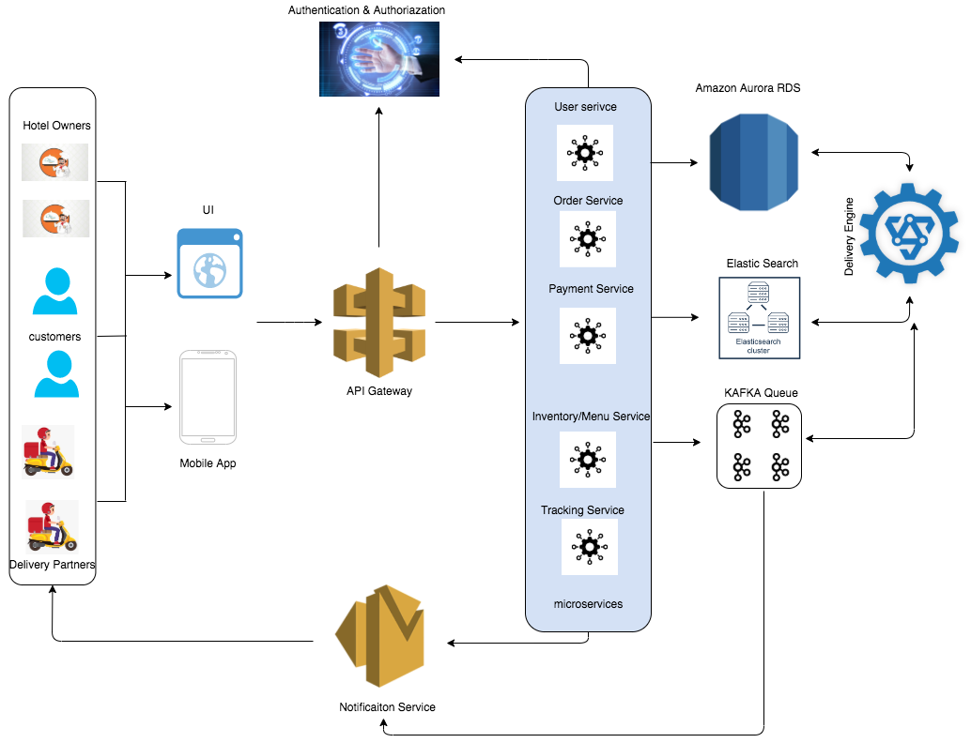
Proposed System Architecture
Bhujbal Knowledge City
MET’s Institute of Technology

Slide 8
Proposed Methodology
Bhujbal Knowledge City
MET’s Institute of Technology
The simulation first starts with the customer entering his/her credentials (name, ID and password).
Once that has been verified, the customer can place an order specifying the quantity of the food required.
Now we get a window that displays the order number, customer ID, food name, price and quantity.
Once the customer finalizes his/her order, they are redirected to the payment window where the total price is displayed and the customer can select the payment method of their choice and then the customer gets a message of confirmation of order.

Slide 9
Application
Bhujbal Knowledge City
MET’s Institute of Technology
Applications:
Describe the practical applications and use cases of your mini project.
Highlight how your project can be directly applied in real-world scenarios or industries.
Emphasize how it addresses the problem or need you identified in the project's introduction.

Slide 10
Advantages and Disadvantages
Bhujbal Knowledge City
MET’s Institute of Technology
Advantages:
. Convenience:
Users can browse and order from a variety of restaurants without leaving their homes.
Easy and quick order placement, reducing the time and effort required for meal acquisition.
2. Wide Restaurant Selection:
Access to an extensive network of restaurants, offering diverse cuisines.
Users can explore new eateries or choose their favorite establishments.
3. Real-Time Order Tracking:
Enhanced user experience with GPS-enabled real-time tracking of orders.
Increased transparency, allowing users to monitor the delivery progress.
4. Customization and Personalization:
Customizable orders to accommodate dietary preferences or special instructions.
AI-driven recommendations based on user preferences for a personalized experience.

Slide 11
Disadvantages:
1. Delivery Delays:
External factors such as traffic, weather, or high demand can lead to delays in food delivery.
Delays may impact the overall customer satisfaction and experience.
2. Quality Assurance:
Ensuring the quality of the delivered food can be challenging.
Food may not always arrive as fresh or as hot as it would in a restaurant.

Slide 12
Conclusion
Bhujbal Knowledge City
MET’s Institute of Technology
The proposed food delivery app presents a dynamic solution to the evolving demands of modern lifestyles, offering unparalleled convenience and a diverse culinary experience.
The advantages, ranging from user-friendly interfaces to real-time tracking and secure payments, showcase the app's potential to revolutionize the way individuals access and enjoy their favorite meals.
In essence, while the proposed food delivery app offers a host of advantages, it is crucial to approach its implementation with a comprehensive understanding of potential drawbacks and a commitment to addressing them.
By doing so, the app has the potential to not only meet but exceed user expectations, becoming a transformative force in the way people experience and enjoy food in the digital age.

Slide 13
References
Bhujbal Knowledge City
MET’s Institute of Technology
Awojide, Simon, I. M. Omogbhemhe, O. S. Awe, and T. S. Babatope, “Towards the digitalization of Restaurant Business Process for Food Ordering in Nigeria Private University: The Design Perspective. A Study of Samuel Adegboyega University Edo State Nigeria,” Int. J. Sci. Res. Publ., vol. 8, no. 5, pp. 46–54, 2018.
. O. I. Mike and A. Simon, “Towards the Digitalization of Hotel Business in Nigeria: The Design Perspective,” vol. 8, no. 2, pp. 1175–1178, 2017. 3. Adithya. R., A. Singh, S. Pathan, and V. Kanade, “Online Food Ordering System,” Int. J. Comput. Appl., vol. 180, no. 6, pp. 22–24, 2017.
. Varsha Chavan, Priya Jadhav, Snehal Korade, Priyanka Teli, ”Implementing Customizable Online Food Ordering System Using Web Based Application”, International Journal of Innovative Science, Engineering Technology(IJISET)

