Slide 1
CANCER DATA ANALYSIS
Exploratory Summary Presentation
BY : kaif momin

Slide 2
Dataset Overview
Key details about this dataset:
3,000 patients with 25 features
14 Categorical Columns
6 Numerical Columns
3 Date & Time Columns
1 Geographical columns

Slide 3
Objectives of Analysis
The main objectives of this analysis are:
1. To explore the demographic, regional, and clinical distribution of cancer patients.
2. To identify treatment patterns across cancer types and stages.
3. To analyze the relationship between lifestyle factors and survival.
4. To perform multivariate analysis combining demographic, clinical, and treatment data.
5. To derive actionable insights for improving cancer treatment strategies.

Slide 4
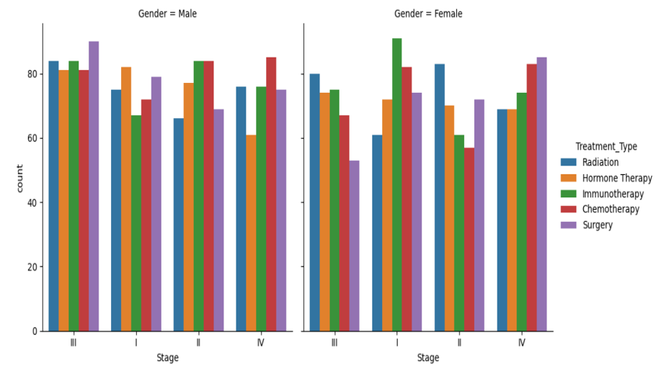
Treatment types differ by cancer stage and patient gender.
There are 5 types of Treatment Type:
Immunotheraphy
Chemotheraphy
Hormone Theraphy
Radiation
Surgery
Four types of cancer stage;
StageI,StageII,StageIII,StageIV.
Patients Gender | Most Common treatment type | Most common Cancer Stage
Female | Immunotheraphy | I
Male | Surgery | III

Slide 5
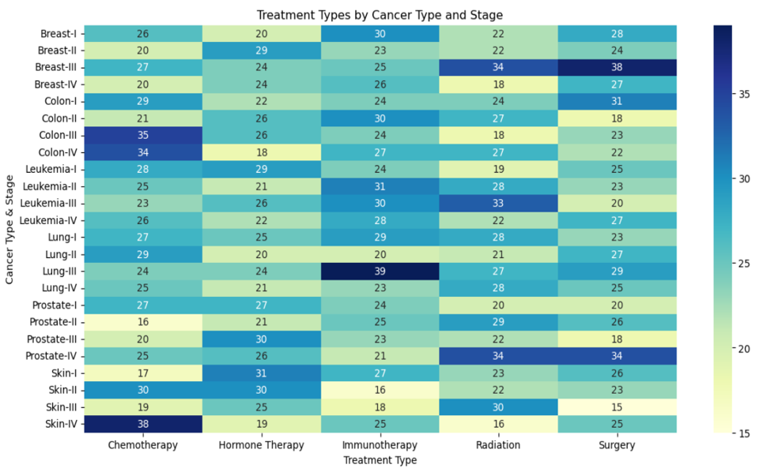
To identify treatment patterns across cancer types and stages.
Chemotherapy : Strongest in Skin-IV (38), weakest in Prostate-II (16).
Hormone Therapy : Strongest in Skin-II (30), weakest in Colon-IV (18).
Immunotherapy : Strongest in Lung-III (39), weakest in Skin-II (16).
Radiation : Strongest in Prostate-IV (34), weakest in Skin-IV (16).
Surgery : Strongest in Breast-III (38), weakest in Skin-II (15).

Slide 6
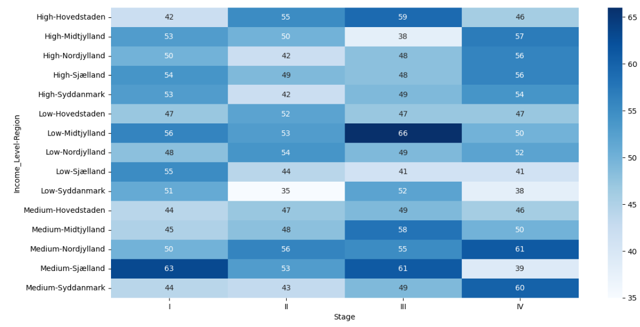
Income level, region, and cancer stage show variation.
Stage I : Highest in Medium-Sjælland (63), lowest in Low-Syddanmark (35).
Stage II : Highest in Low-Nordjylland (54) & Medium-Nordjylland (56), lowest in Low-Syddanmark (35).
Stage III : Highest in Low-Midtjylland (66), lowest in High-Midtjylland (38).
Stage IV : Highest in Medium-Nordjylland (61) & Medium-Syddanmark (60), lowest in Low-Syddanmark (38).

Slide 7
Lifestyle factors like smoking with Alcohol impact survival.
Smoking Effects
Current smokers have an average survival of 59.5 months.image.jpg
Former smokers have an average survival of 59.3 months.image.jpg
Never smokers have the highest average survival at 59.6 months.image.jpg
Alcohol Effects
Heavy or no alcohol drinkers have the highest average survival at 60.1 months.image.jpg
Moderate drinkers have the lowest average survival at 58.2 months.image.jpg
Overall, differences in survival between categories are small, but moderate alcohol use is linked to the lowest average survival in this data
Factors | Category | Avg_survival(months)
Smoking | Current | 59.5
Smoking | Former | 59.3
Smoking | Never | 59.6
Alcohol | Heavy | 60.1
Alcohol | Moderate | 58.2
Alcohol | none | 60.1

Slide 8
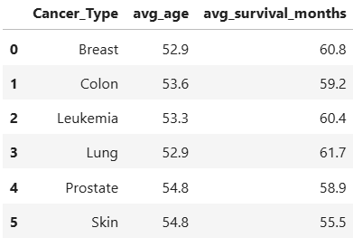
Does Cancer Type vary by Survival, and patients age
Age range: 18–89 years (avg ≈ 54)
Survival range: 1–119 months (avg ≈ 53).
There are 6 Cancer Types:
Prostate and Skin Cancer has the highest avg age(54.8) and least avg age is Breast cancer(52.9).
Avg_survival_months has the highest in lung cancer(61.7) and lowest in skin cancer(55.5).

Slide 9
Key Insights
Summary of findings:
Age range: 18–89 years (avg ≈ 54)
Balanced gender distribution (males=51% , females=49%).
Stage III is the most frequent diagnosis stage with 769 patients.
Lung cancer is the most common cancer type.
Immunotherapy is the most common treatment type with 612 patients.
Regional distribution shows concentration in Midtjylland.
Half of patients present with metastasis.
High and medium income level patients are most in our dataset.
Lifestyle factors like smoking and alcohol affect survival.
Survival is strongly affected with Smoking,Relapse and metastasis.

Slide 10
Conclusion
This dataset not only highlights the medical challenges of cancer but also emphasizes the importance of lifestyle and socioeconomic conditions in survival. These insights can help in designing better screening programs, targeted treatments, and awareness campaigns.

