Slide 1
Bank Loan Analytics : Insights for Smarter Lending Decisions
Exploring customer behavior and loan performance using multivariate analysis

Slide 2

Dataset Overview
Key details about this dataset:
  👥 2.3 Lakh Customers with 🧩 22 Features
  📊 10 Categorical Columns
  🔢 9 Numerical Columns
  1 Date & Time Columns
  🗺️ 2 Geographical Columns
  👶 Age range: 18–70 years (avg ≈ 44)

Slide 3
Objectives of Multivariate Analysis
To Understand how multiple factors jointly impact loan outcomes.
To understand the relationship between Occupation, Gender, and Loan Status.
To analyze the combined impact of Age, Annual Income, and Loan Amount.
To study how Credit Score and Interest Rate jointly affect Repayment Status.
To identify customer segments showing strong repayment behavior across multiple factors.

Slide 4
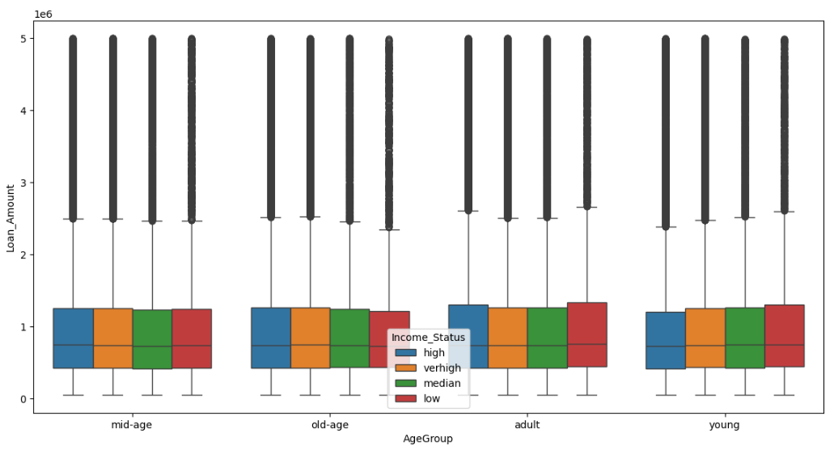
Age, Income & Loan_Amount combined?
“Loan amount distribution shows that income level significantly impacts borrowing capacity, while age group differences are minimal.
Higher-income customers have wider loan ranges and higher medians, but all groups include outliers with very large loans.”
Higher income → Higher loan capacity, Age effect minimal.

Slide 5
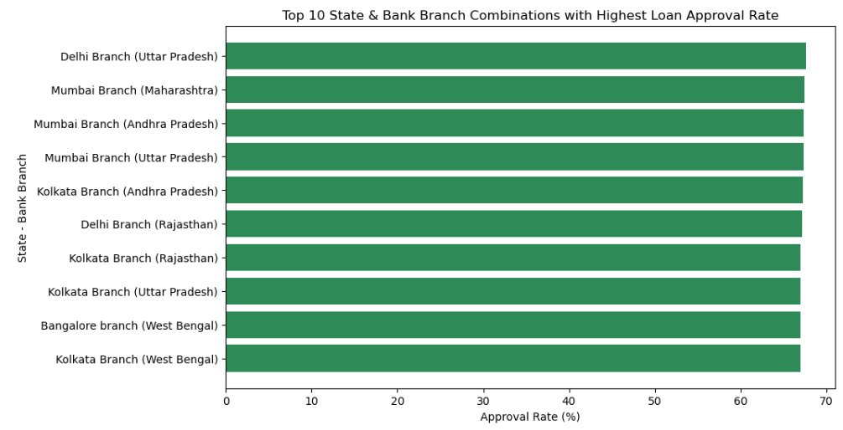
State and Bank Branch combinations have the best Loan Approval Rate?
The analysis shows that metropolitan branches such as Delhi, Mumbai, Kolkata, and Bangalore achieve the highest loan approval rates, with Uttar Pradesh (Delhi Branch) leading at 67.64%. Approval performance remains consistent across top branches, suggesting a uniform policy and efficient processing system. Major urban centers dominate loan approvals, reflecting stronger financial literacy and improved documentation practices in these regions.

Slide 6
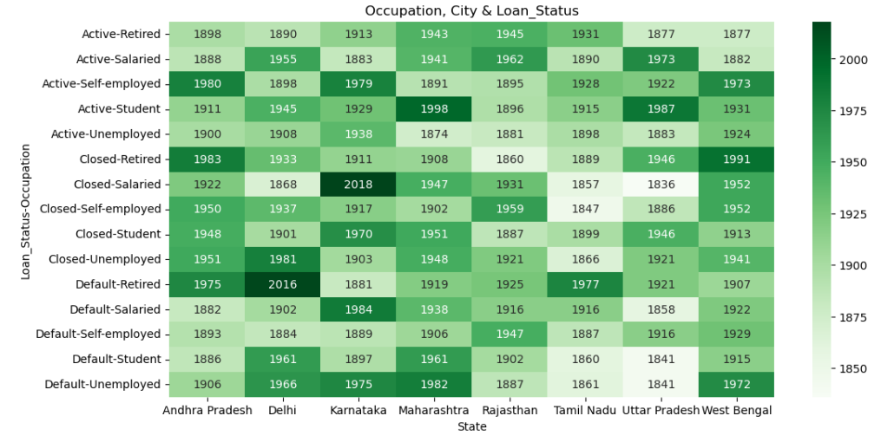
Occupation, City & Loan_Status.
“The heatmap highlights regional and occupational trends in loan performance.
Salaried customers in Karnataka and Delhi show strong loan activity, while retired customers in Delhi face higher default tendencies.
Students and self-employed individuals maintain steady participation across most states, indicating diverse lending patterns.”

Slide 7
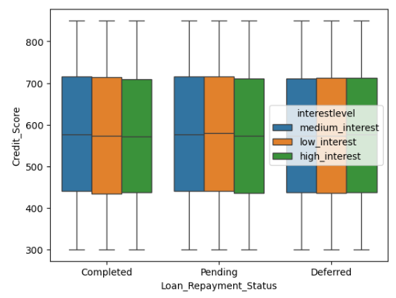
Credit_Score, Interest_Rate & Repayment_Status
“The analysis shows that higher credit scores are generally linked to completed repayments, though the difference among interest levels remains moderate.
Borrowers with high interest rates typically have lower credit scores, reflecting accurate risk-based loan pricing.
Overall, the data indicates balanced credit distribution and consistent lending behavior across repayment categories.”

Slide 8
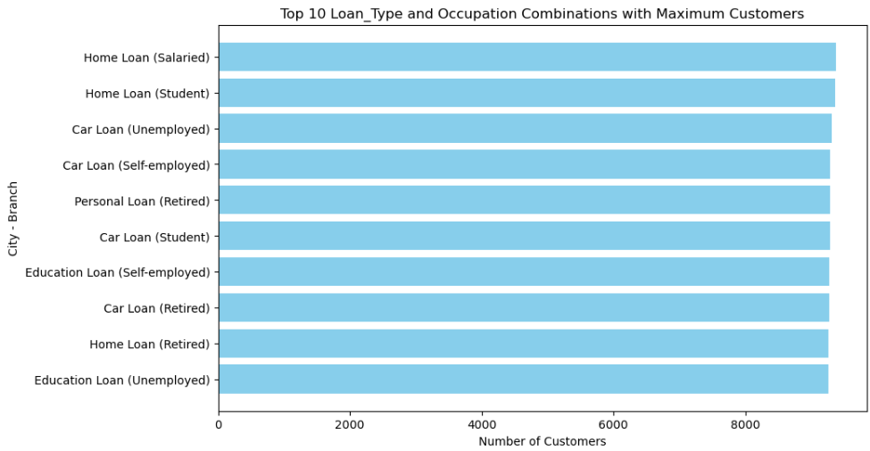
Loan_Type and Occupation combination has the maximum number of customers
The analysis reveals that Home and Car Loans are the most preferred across different occupations, especially among salaried and student groups.
A consistent customer count across categories indicates balanced loan demand across age and work profiles.
Notably, even retired and unemployed customers show significant loan activity, proving that banks serve a broad and inclusive customer base.

Slide 9
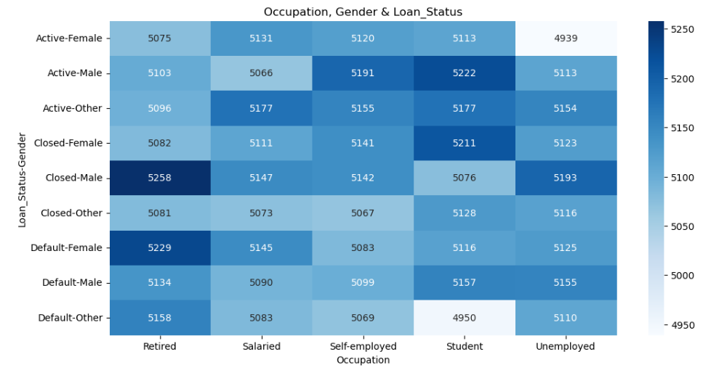
Gender and Occupation together affect Loan Status
This multivariate analysis explores the relationship between occupation, gender, and loan status. The heatmap reveals that male customers, particularly those who are retired or salaried, have a higher number of closed loans, indicating stronger repayment behavior. Salaried and self-employed individuals show higher loan activity overall, reflecting financial stability, while students and unemployed groups have lower engagement. These insights suggest opportunities for the bank to expand lending toward active income groups and design supportive programs for lower-engagement segments

Slide 10
Analysis Key Insights
Gender distribution is equally balanced among Male, Female, and Others.
Salaried and self-employed customers dominate across most loan categories.
Higher income and better credit scores contribute to successful loan approvals.
Higher credit scores generally lead to lower interest rates.
Defaulted loans often have lower credit scores.
Certain States and Branches show high loan disbursements.
Annual income and age together influence loan amount.
Regional trends impact loan performance and approval rates.
Urban Loan Branches have better Loan Disbursement and Repayment Performance.
Multivariate analysis reveals strong correlations between Occupation, Gender, and Loan Status.
These insights support better targeting for financial products and credit risk management.

Slide 11
Conclusion
Helps the bank identify risk profiles and profitable regions.
Supports credit policy improvement and interest rate optimization.
Highlights opportunities for financial inclusion and targeted product strategies.
Risk-prone profiles that may need stricter evaluation, and
Opportunities to refine lending and credit policies.
These findings can assist the bank in improving its credit strategy, enhancing
customer targeting, and optimizing interest rate decisions.

Slide 12
Thank You
Prepared by: Md Kaif Momin
Data Analyst Course Project

