Slide 1



SMART INDIA HACKATHON 2026
TITLE PAGE
  Problem Statement ID – 26238
  Problem Statement Title - Unified Scholarship Mobile Application for Tribal Students
  Theme- Smart Automation
  PS Category- Software
  Team ID -DCSIH1141
  Team Name - INFINOVA

Slide 2
TRIBAL SCHOLAR
INFINOVA
PROPOSED SOLUTION AND HOW IT SOLVES THE PROBLEM
CHALLENGES AND PROBLEMS
  Scholarship information is fragmented across multiple portals/schemes.
  Students face repeated form filling and document uploads.
  Difficulty in understanding eligibility, deadlines and application status.
  One platform for tribal scholarships.
  One student profile with reusable information and documents.
  Find scholarships, apply, and track the application in one place.
  AI assistant for guidance and multilingual support.
  Real-time notifications for deadlines and application updates
  Secured document verification to reduce errors and fraud
INNOVATIONS AND UNIQUENESS
  Smart scholarship matching
  Reusable documents & profile
  AI-powered assistance
  Single application dashboard
2

Slide 3





TECHNICAL APPROACH
INFINOVA
SIMPLE.SECURE.SCALABLE
Demo video :
Click Here
Flutter
Cross-platform
mobile app
Node.js+Express
Backend &
APIs
0
Firebase/MySQL
Secure data
storage
Role-basedLogin
Student &
Admin access
Real-Time Notification
Application & status updates
3

Slide 4
FEASIBILITY AND VIABILITY
INFINOVA
TECHNICAL FEASIBILITY:
POSSIBLE CHALLENGES AND SOLUTIONS:
Uses commonly available web/mobile technologies, databases and APIs.
The system can be connected with existing scholarship and digital-document services.
Student information and documents can be stored and managed securely.
Challenge | Our Approach
Different Government Systems | Connect through APIs
Document/Verification mismatch | Manual Verification Mismatch
Data Security | Secure storage & access control
Different Languages | Multilingual AI assistance
Poor internet connectivity | Lightweight , mobile-friendly design
Implementation Plan:
IMPLEMENTATION PLAN:
Phase 1 — Build: Develop the student profile, scholarship search, document management and application tracking.
Phase 2 — Integrate: Connect with relevant government services and verification systems through authorized APIs.
Phase 3 — Test & Deploy: Test with students and institutions, fix issues, and gradually expand the platform.
4

Slide 5



IMPACT AND BENEFITS
INFINOVA
Centralized scholarship data and monitoring.
Improving transparency in scholarship distribution.
Reduce delays and duplicate applications.
FOR STUDENTS
FOR INSTITUTIONS
FOR GOVERNMENT
Easy access to multiple tribal scholarships from one platform.
Less repeated form filling and document uploading.
Clear information about eligibility, application status and deadlines.
  Easier application and verification management.
  Reduces repetitive manual work.
  Better tracking of student applications.
5

Slide 6
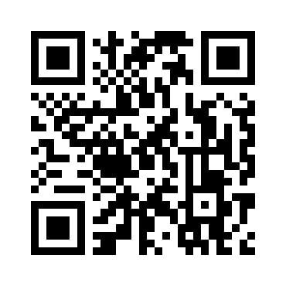
RESEARCH AND REFERENCES
INFINOVA
Ministry of Tribal Affairs – Scholarship Schemes Overview
https://tribal.nic.in/scholarshiP.apsx
National Overseas Scholarship Portal
https://overseas.tribal.gov.in
DBT Tribal Portal (Pre/Post Matric Scholarships)
https://dbttribal.gov.in
Discover our solution
National Fellowship Portal
https://fellowship.tribal.gov.in
National Scholarship Portal (NSP)
https://scholarships.gov.in
6

