Slide 1


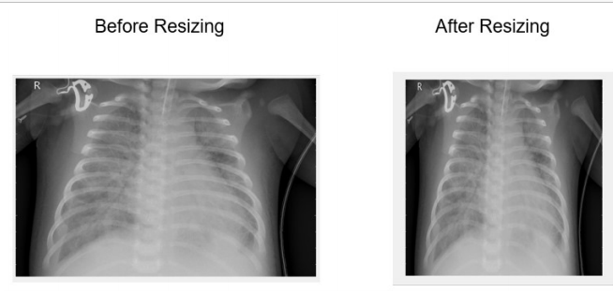

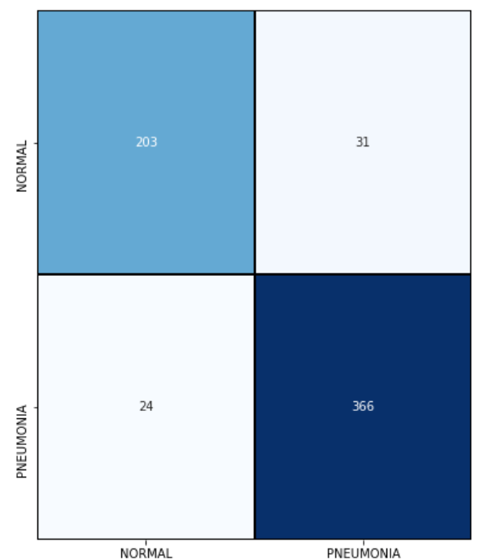
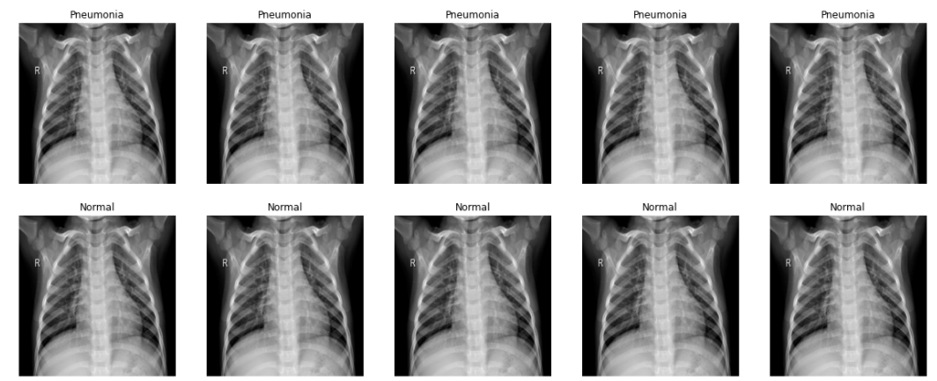
On The Computer Aided Detection Of Viral and Bacterial Pneumonia.
Mohammed Hussein Supervised by Prof. Amr Ghoniem
Abstract
Pneumonia is considered as a serious disease that threat to life, this disease can be less life threatening if the detection process of this infection happens in the early stage of the disease.
Pre-processing
Data set is prepared for modelling by applying some pre-processing techniques for data preparation. We will resize the images, convert it to gray scale images, normalize and reshape the images to dimension required by tensor flow to be able to deal with the data.
Chest X-rays, which is a digital image of the chest are currently the best method using for pneumonia diagnosing; however, X-rays images of pneumonia are not very clear and may be miss classified by the radiologists, which leads to a wrong way in medication for the patients.
Resize
Gray-scale
So the aim of this project is to make a computer program that detects the normal chest X-ray image versus the one with a bacterial or a viral pneumonia. To achieve this we propose one of the deep learning architecture which is the convolutional neural network (CNN) model. This model gives us the best performance for this classification problem with 92% accuracy.
Normalize
Image resizing.
Reshape
CNN Model
Proposed Solution
The model is a sequential model. We build the model with many convolutional layers, pooling layers, batch normalization
and dropout layers in order to extract the most needed features from the images that will be passes to the model.
Load Data
Convolutional Layer
Data Visualization
Max Pooling Layer
Preprocessing and augmentation
Dropout Layer
Build CNN Model
Batch Norm Layer
Fit the model with training data
Model Evaluation
Results
The accuracy of our model on the test set is 91 %. Which is considered a good accuracy.
the precision, recall and F1-score accuracies scores 91%.
The confusion matrix shows only 24 pneumonia classified as normal.
Data Set
The data we use is the chest x-ray data set from kaggle contains 5,856 image. These images divided into two classes, 1,583 normal image X-ray and 4,273 X-ray images with pneumonia.
kaggle dataset.
Conclusion
In conclusion we used the chest X-Ray data set from kaggle to train it on a convolutional neural network. We build our model from scratch which is not like the other methods that uses the transfer learning approach. And we have reached an accuracy of 91%.
mohammed176203@bue.edu.eg

