Slide 1

Online Retail Sales & Customer Insights Dashboard
Transforming raw transactional data into actionable business intelligence — revenue, customers, products, and geography.

Slide 2


PROJECT OVERVIEW
From Raw Data to Business Intelligence
Online retail generates massive transactional data daily — but extracting actionable insights remains a challenge.
Python
SQL
Tableau
Data cleaning & feature engineering
Analytical querying
Interactive dashboards

Slide 3
DATASET
What's Inside the Data
Transactions from 2010–2011 across 8 columns — Invoice, StockCode, Description, Quantity, InvoiceDate, Price, Customer_ID, and Country — plus engineered fields: Revenue, OrderType, and IsCancellation.
5,742
36,225
Total Customers
Total Orders
$16.2M
$447
Total Revenue
Avg Order Value

Slide 4
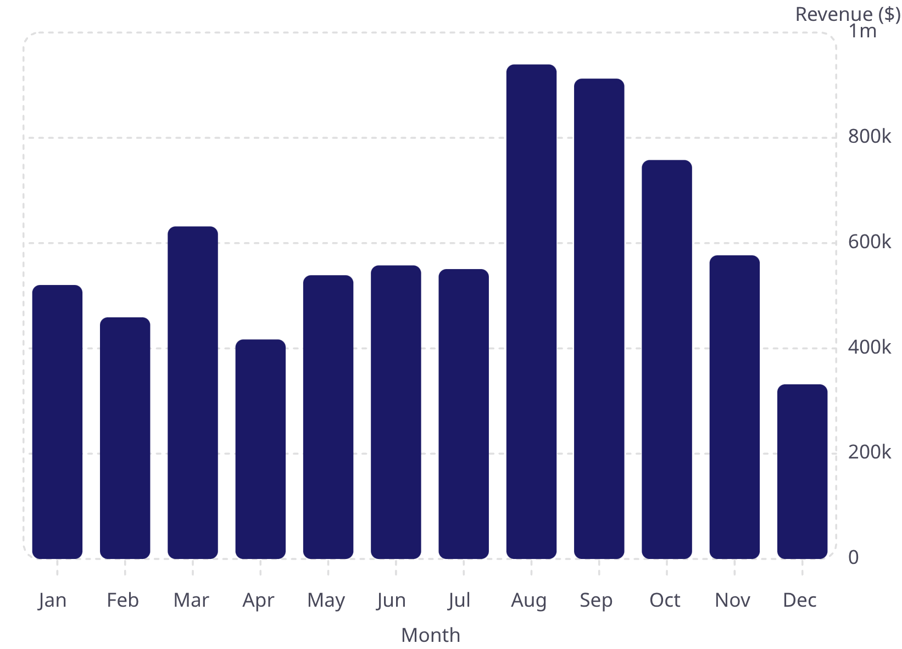
REVENUE TRENDS
Monthly Revenue: Seasonal Patterns Emerge
Key Observations
August peak — $939K, highest month
December dip — $332K, lowest month
Q3 (Aug–Oct) drives strongest revenue

Slide 5
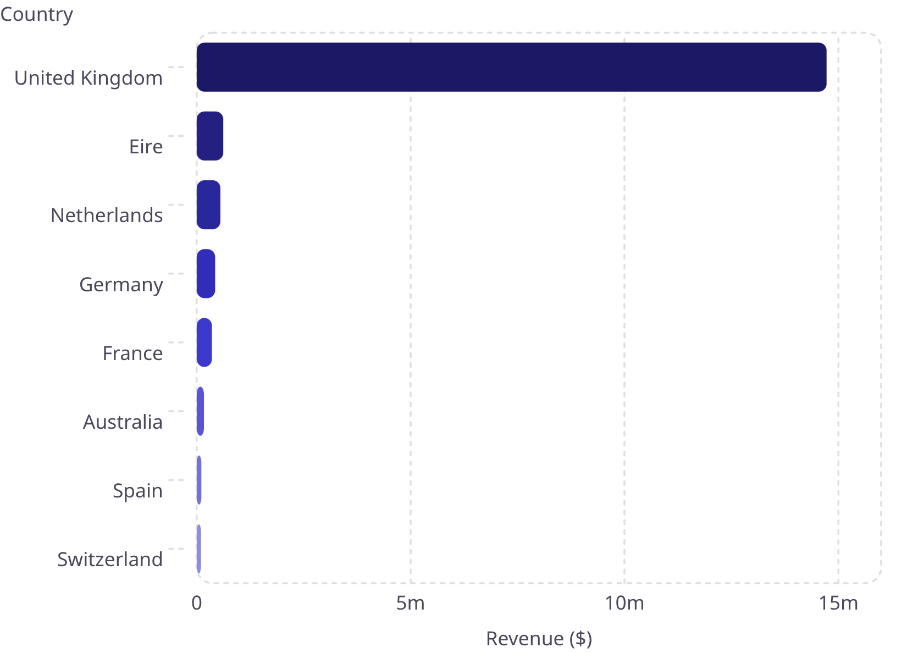

GEOGRAPHY
UK Dominates — International Opportunity Awaits
Market Split
🇬🇧 United Kingdom
🌍 International
$14.7M — 85.3% of total revenue
$2.4M — 14.7% across 10+ countries
Netherlands, Germany & France are the strongest international growth candidates.

Slide 6
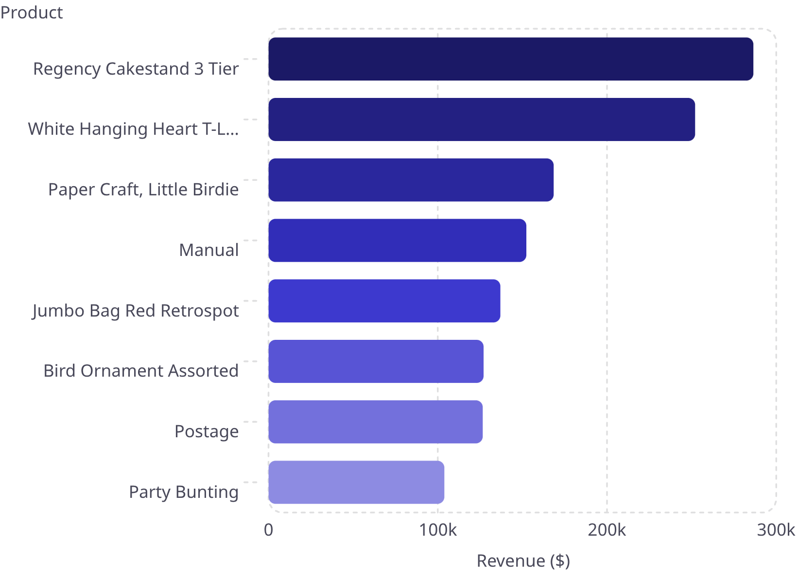

PRODUCTS
Top Products by Revenue & Volume
Volume Leaders
Top products by units sold:
WW2 Gliders — 109K units
White Hanging Heart — 94K units
Paper Craft, Little Birdie — 81K units
A small number of SKUs drive disproportionate revenue — prioritize inventory and promotions accordingly.

Slide 7


CUSTOMERS
Repeat Buyers Drive the Business
72.39%
77.26%
Repeat Purchase Rate
Top 20% Revenue Share
Nearly 3 in 4 customers return
Pareto principle in action
Top customer (#18102) generated $609K — loyalty programs for high-value segments are essential.

Slide 8




RECOMMENDATIONS
Actionable Next Steps
Retention Programs
Product Campaigns
Loyalty rewards for top 20% of customers
Promote top SKUs with bundles and cross-sells
International Growth
Increase AOV
Target Netherlands, Germany & France
Upsell strategies to lift $447 average order value

