Slide 1

Google Play Store Analytics Dashboard
Business Intelligence Project Report — exploring app performance, categories, installs, ratings, reviews, pricing, and sentiment across ~9K applications.
POWER BI
BUSINESS INTELLIGENCE
APP ANALYTICS

Slide 2

Executive Summary
This interactive dashboard transforms Google Play Store app data into business-oriented views — covering app volume, install performance, category distribution, ratings, reviews, pricing type, and review sentiment across multiple analytical pages.
Market Snapshot
Overall ecosystem overview with executive KPIs
App Performance
Top apps, ratings, and engagement patterns
Free vs Paid
Pricing distribution and review behavior
Sentiment
Positive, negative, and neutral review analysis

Slide 3


Project Objectives
Distribution
Understand app distribution across categories
Popularity
Measure app popularity via installs and reviews
Comparison
Compare category-level performance and free vs paid apps
Insights
Translate raw data into KPIs and business insights

Slide 4

Dataset & Scope
~9K
65B
Total Apps
Total Installs
Application inventory coverage
Adoption across all apps
37K
Total Reviews
User interaction volume
The dashboard covers app inventory, popularity, engagement, category segmentation, commercial model (free vs paid), and sentiment analysis (positive/negative/neutral). Note: exact source row count, cleaning rules, sentiment model, and data-refresh date are not visible in the screenshots.

Slide 5
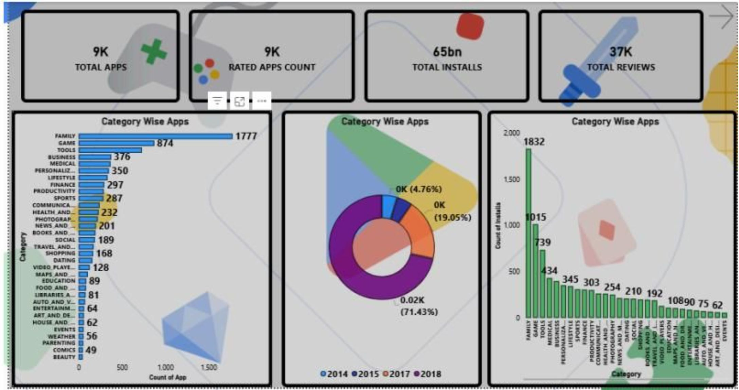
PAGE 1
Executive Overview
Key Findings
FAMILY leads with 1,777 apps and highest install count (1,832)
71.43% of apps in the dataset are from 2014
Top categories by app count: FAMILY (1,777), GAME (874), TOOLS (376), BUSINESS (350)
Install leaders: FAMILY (1,832), TOOLS (1,015), BUSINESS (739), COMMUNICATION (10,890)

Slide 6
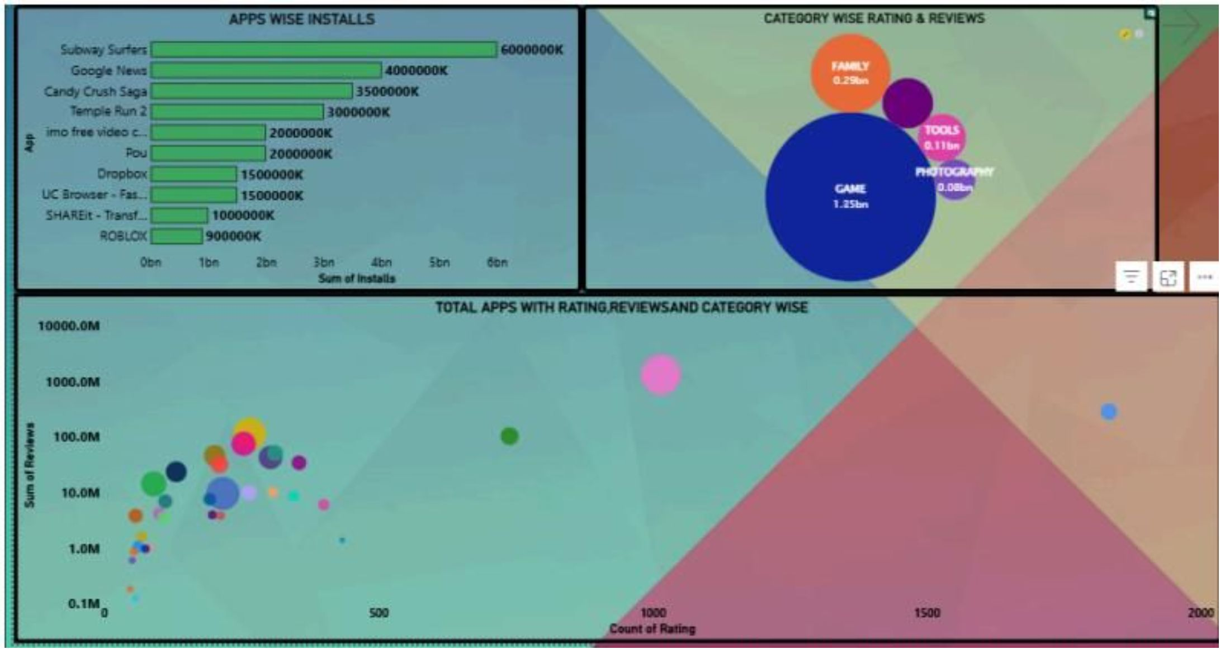
PAGE 2
App Performance & Relationship Analysis
Top Apps by Installs
Subway Surfers — 6,000,000K
Google News — 4,000,000K
Candy Crush Saga — 3,500,000K
Temple Run 2 — 3,000,000K
Category Ratings
GAME — 1.35B ratings (dominant)
FAMILY — 0.29B ratings
TOOLS — 0.11B ratings
PHOTOGRAPHY — 0.09B ratings
Scatter plot shows positive correlation between rating count and review volume — most apps have 100–1,000 ratings and 10K–100K reviews.

Slide 7
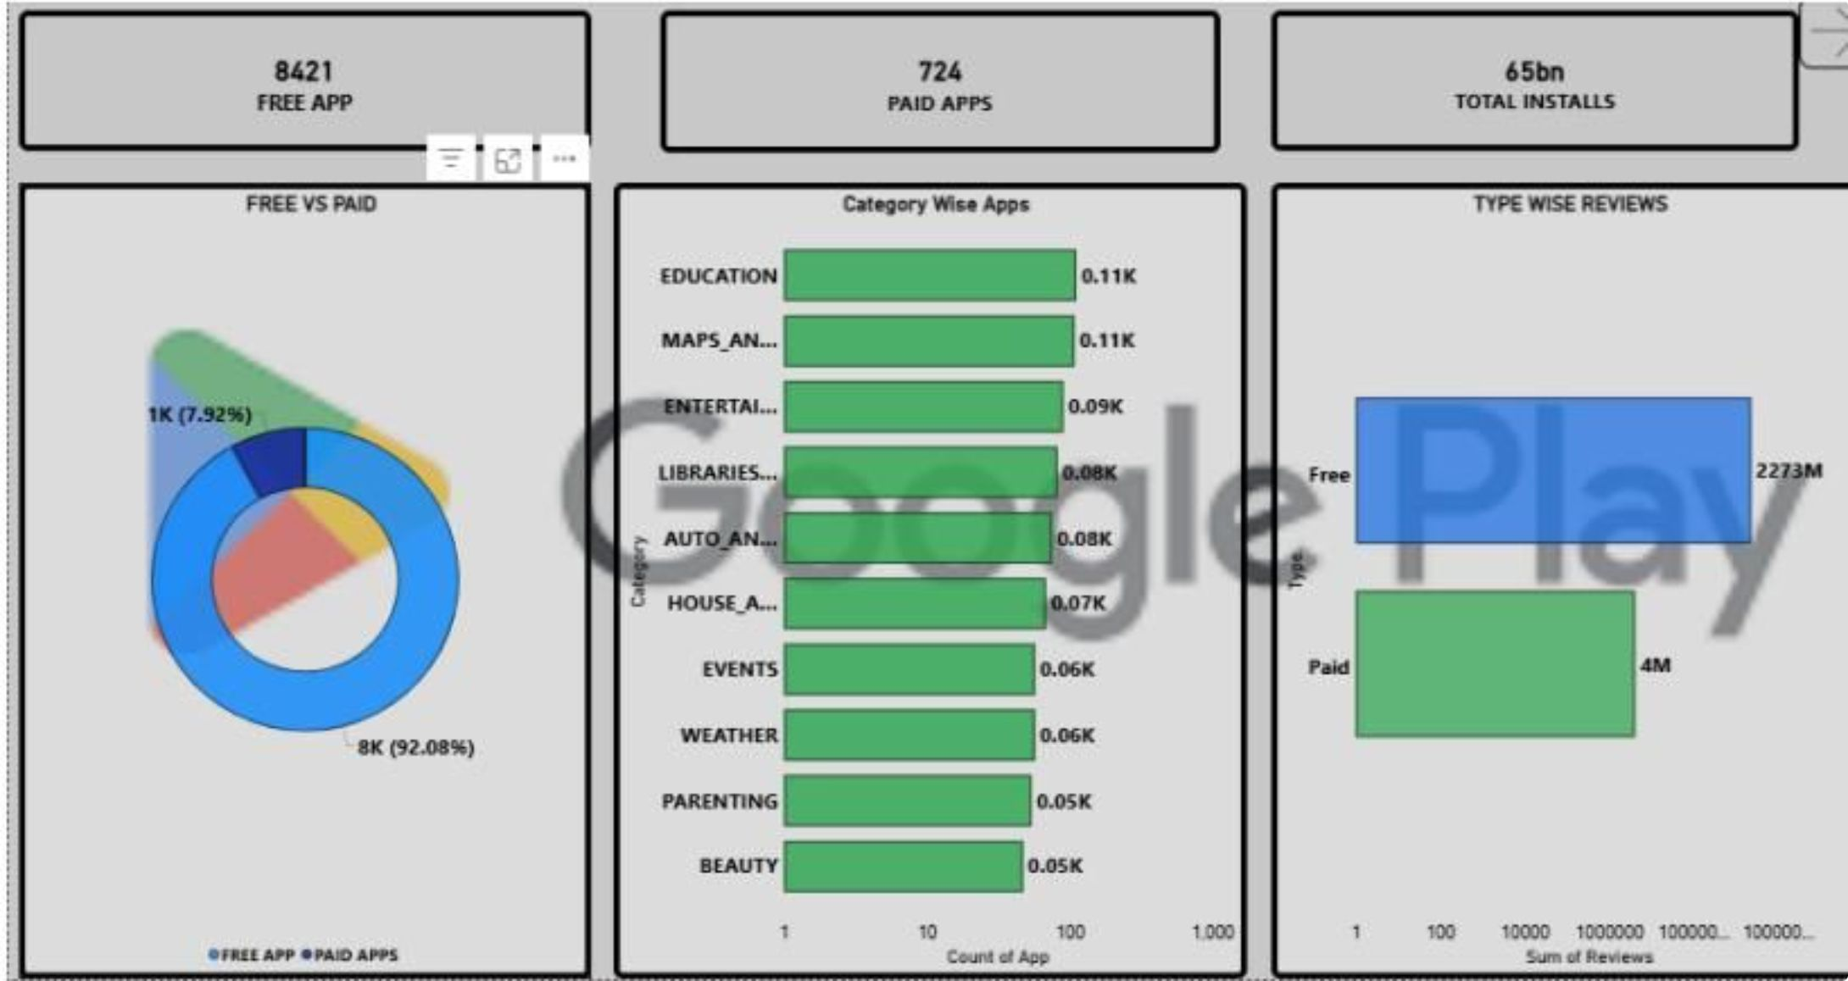

PAGE 3
Pricing & Category Analysis
Free vs Paid Distribution
Free Apps: 8K (92.08%) of inventory
Paid Apps: 1K (7.92%) of inventory
Free app reviews: 2,273M vs Paid: 4M
Category Highlights
Education and Maps lead smaller-category counts at 0.11K each, followed by Entertainment (0.09K) and Libraries (0.08K).
Free apps dominate both app inventory and review volume by an overwhelming margin.

Slide 8
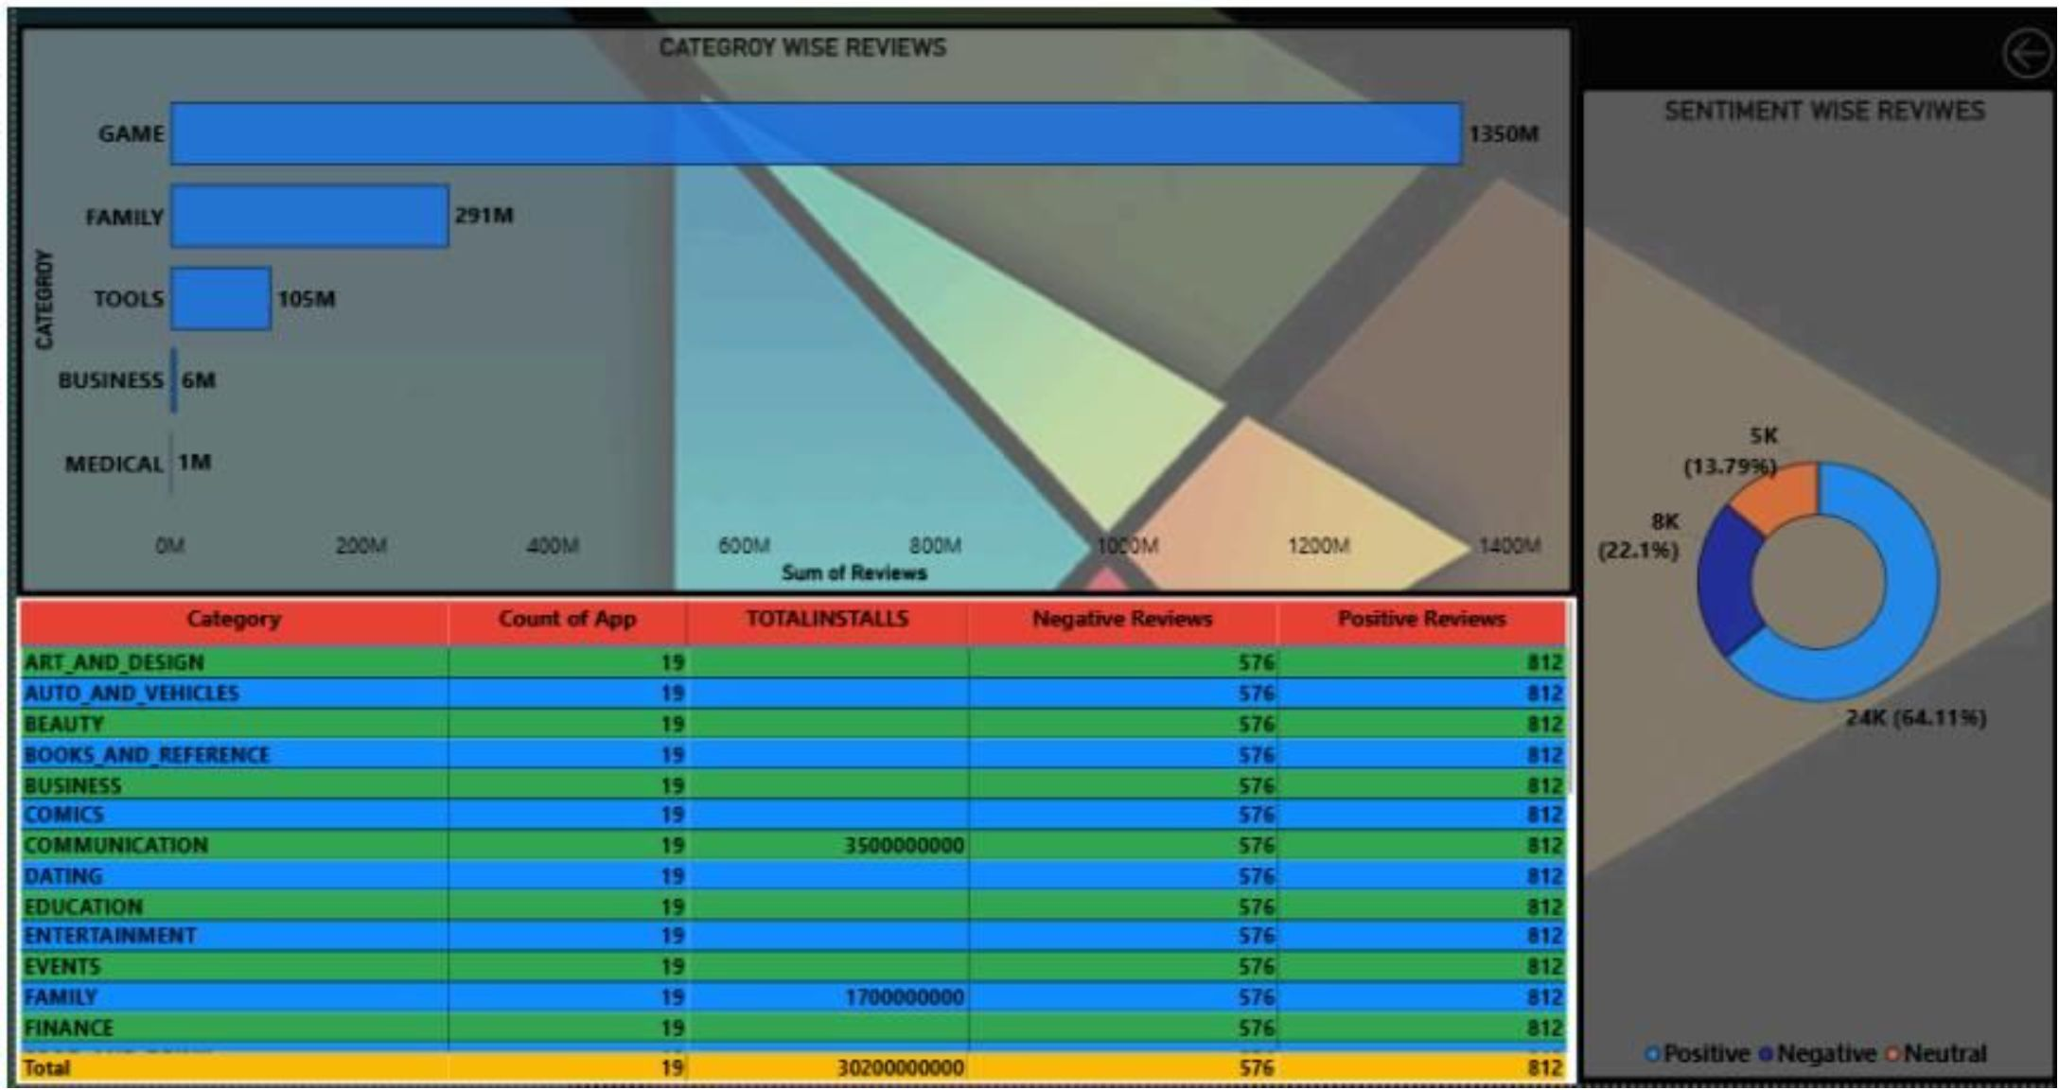
PAGE 4
Reviews & Sentiment Analysis
Category-Wise Reviews
GAME — 1,350M reviews (dominant)
FAMILY — 291M reviews
TOOLS — 105M reviews
BUSINESS — 6M reviews
MEDICAL — 1M reviews
Sentiment Distribution
Positive: 24K — 64.11%
Negative: 8K — 22.1%
Neutral: 5K — 13.79%

Slide 9


Key Observations & Business Questions
Concentrated Popularity
Category Leaders
Install activity is highly concentrated — Subway Surfers, Google News, Candy Crush Saga, and Temple Run 2 dominate totals.
FAMILY has the largest app count; GAME dominates review volume with 1,350M reviews.
Free App Dominance
Positive Sentiment
92% of apps are free, generating 2,273M reviews vs only 4M for paid apps.
64% of reviews are positive, enabling tone analysis alongside volume.

Slide 10

Implementation & Recommendations
Core DAX Measures
Enhancement Opportunities
Total Apps = DISTINCTCOUNT(App[App])
Total Installs = SUM(App[Installs])
Total Reviews = SUM(App[Reviews])
Free/Paid Apps = CALCULATE([Total Apps], App[Type])
Sentiment Reviews = CALCULATE([Total Reviews], App[Sentiment])
Add slicers for Category, Type, Content Rating, Android Version
Time-series view for installs/ratings trends
Top-N selector (Top 5/10/20)
Install-to-review engagement ratio
Tooltip pages with app-level details
Document source dataset, cleaning workflow, data model, and sentiment methodology for portfolio submission.

