Slide 1

Healthcare Readmission Analysis Report
A data-driven exploration of 30-day hospital readmission patterns across diabetic patient encounters — uncovering the factors that drive avoidable returns and opportunities for improved care coordination.
DIABETIC PATIENT ENCOUNTERS
100,000+ RECORDS
10-YEAR STUDY PERIOD

Slide 2

Project Overview
The Challenge
Hospital readmissions strain resources, increase costs, and signal gaps in care continuity. Understanding what drives them is essential for quality improvement.
The Objective
Analyze over 100,000 diabetic patient encounters from U.S. hospitals to identify demographic, clinical, and utilization factors associated with 30-day readmissions — supporting better discharge planning and targeted interventions.

Slide 3

Dataset at a Glance
The dataset spans a decade of diabetic patient encounters across multiple U.S. hospitals, capturing a comprehensive view of patient demographics, clinical history, and readmission outcomes.
🏥 Patient Demographics
📋 Admission Details
Race, gender, and age group distributions
Admission type, source, and discharge disposition
📊 Hospital Utilization
🩺 Clinical Complexity
Length of stay, lab procedures, prior visits
Number of diagnoses and medication burden
Target Variable: Readmission status — <30 Days, >30 Days, or No Readmission

Slide 4
Data Preparation & Feature Engineering
Cleaning Steps
Engineered Features
Replaced missing value indicators ("?", "N/A") with nulls
Removed columns with excessive missing data
Eliminated duplicates and invalid records
Standardized column names and data types
Readmission 30-Day Flag — binary indicator for early readmission
Total Prior Visits — cumulative inpatient, outpatient, and emergency encounters
Long Stay Flag — identifies extended hospitalizations
Polypharmacy Flag — flags high medication burden
High Utilizer Flag — marks frequent healthcare users

Slide 5
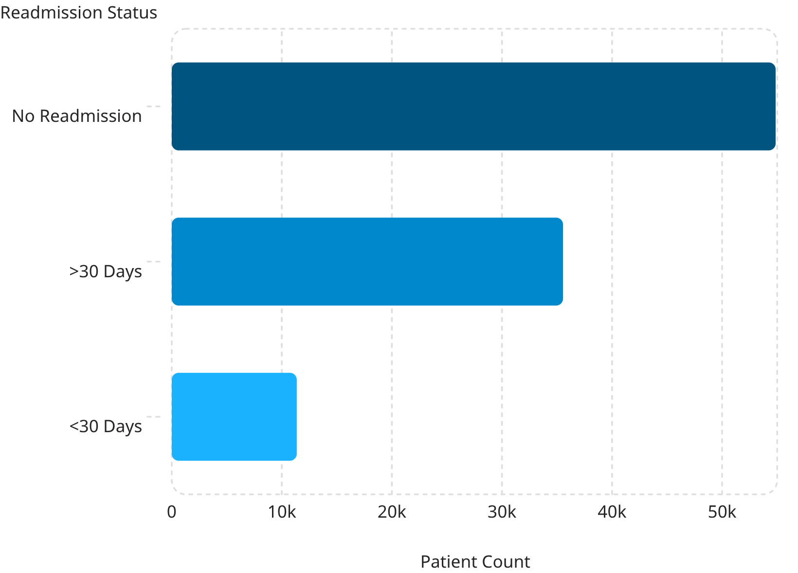
Overall Readmission Distribution
Key Metrics
101,763 total patient encounters analyzed
11.16% overall 30-day readmission rate
34.93% readmitted after 30 days
53.91% had no readmission
Over 1 in 9 diabetic patients returned to the hospital within 30 days — a rate that represents significant opportunity for intervention and care improvement.

Slide 6
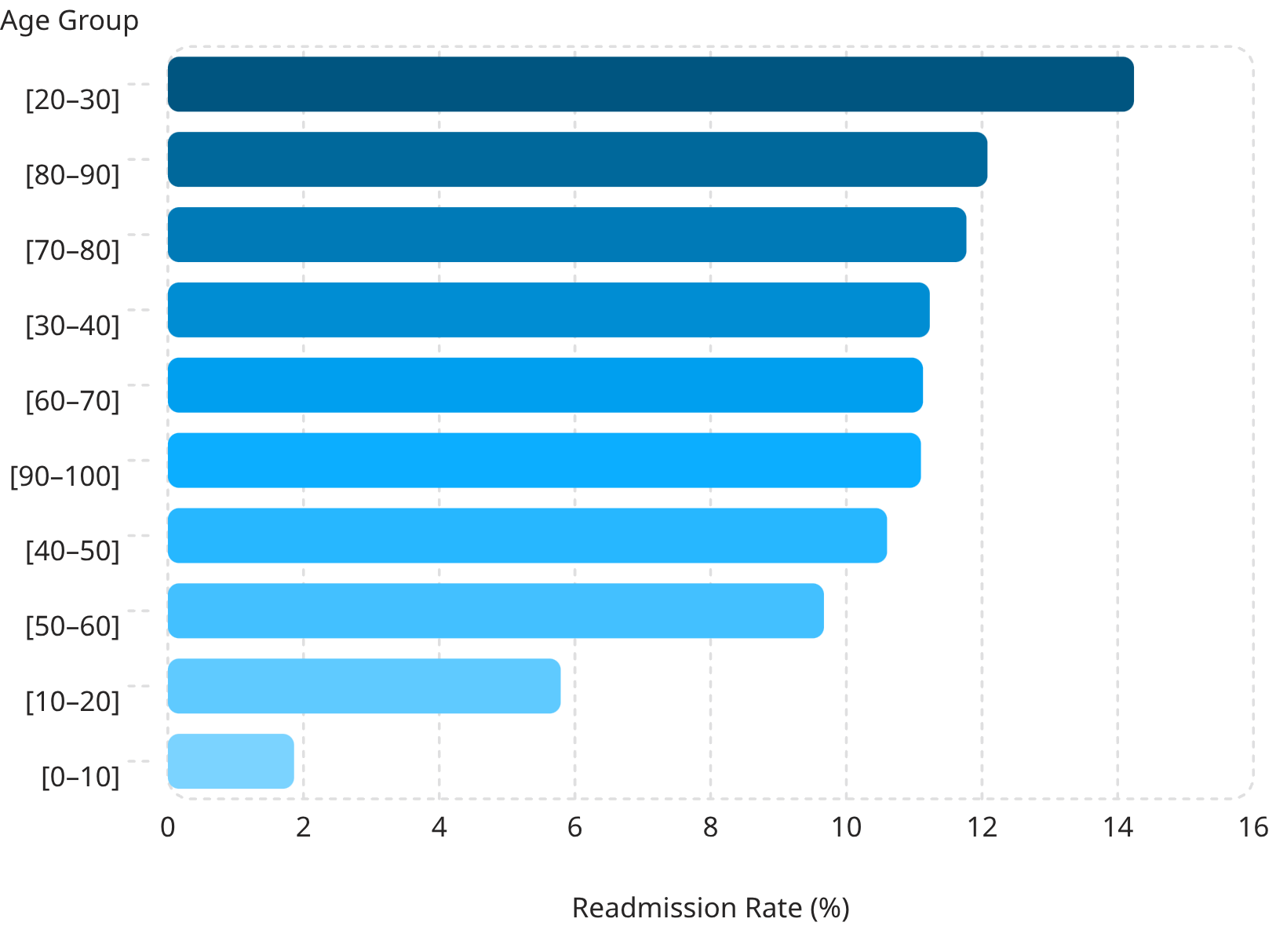
Age Groups with Highest 30-Day Readmission Rates
Notable Patterns
The 20–30 age group had the highest readmission rate at 14.24% — an unexpected finding that may reflect socioeconomic factors, medication adherence challenges, or gaps in transitional care for younger adults.
Patients aged 80–90 followed closely at 12.08%, consistent with expectations for older, clinically complex populations.
Children under 10 had the lowest rate at just 1.86%, reflecting lower clinical complexity in pediatric diabetic cases.

Slide 7
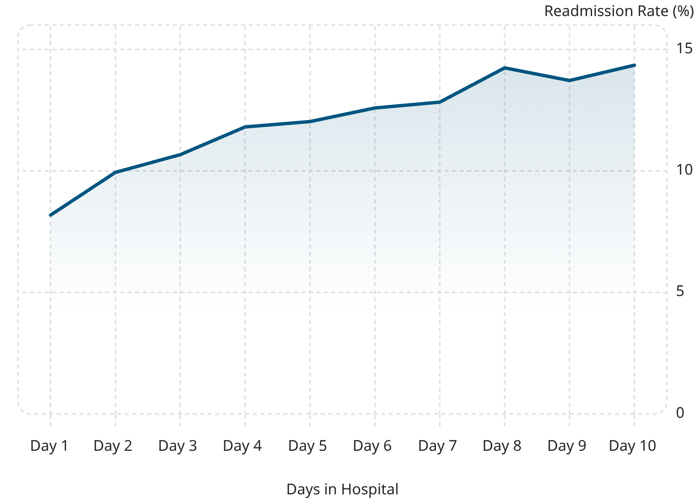
Hospital Stay Length & Prior Utilization
Longer Stays Signal Higher Risk
Readmission rates climb steadily with each additional day in the hospital, peaking at 14.35% for 10-day stays — nearly double the rate of 1-day admissions.
Prior Utilization as a Risk Marker
Patients readmitted within 30 days averaged 1 prior inpatient visit and 2 total prior visits, compared to zero for non-readmitted patients — a clear signal of high-utilizer status.

Slide 8
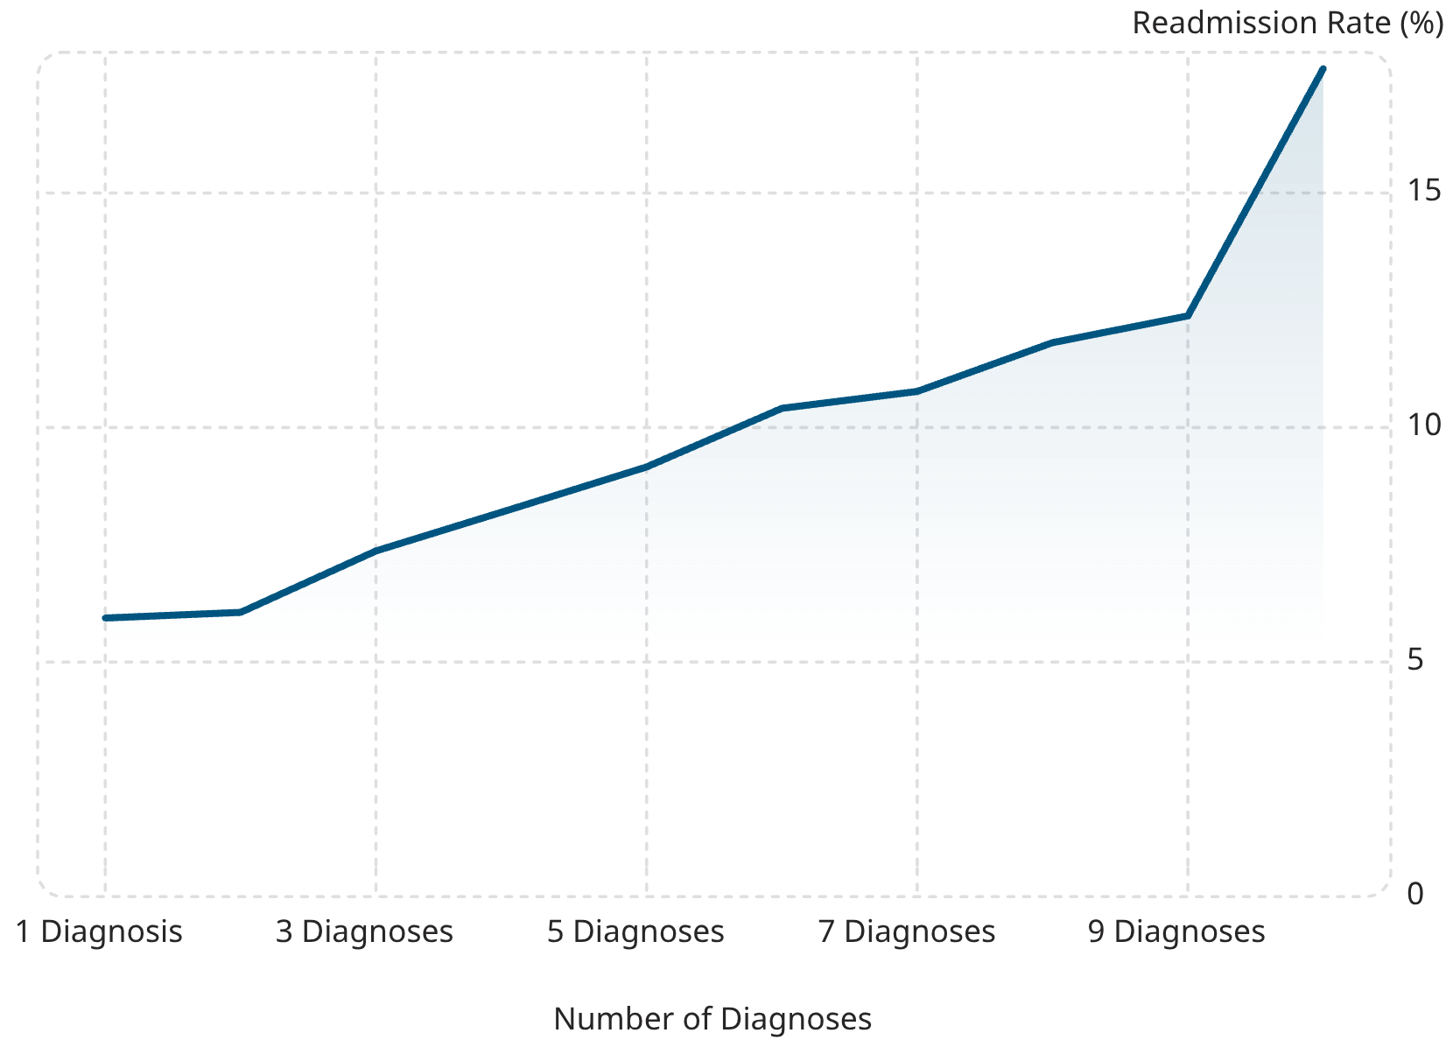
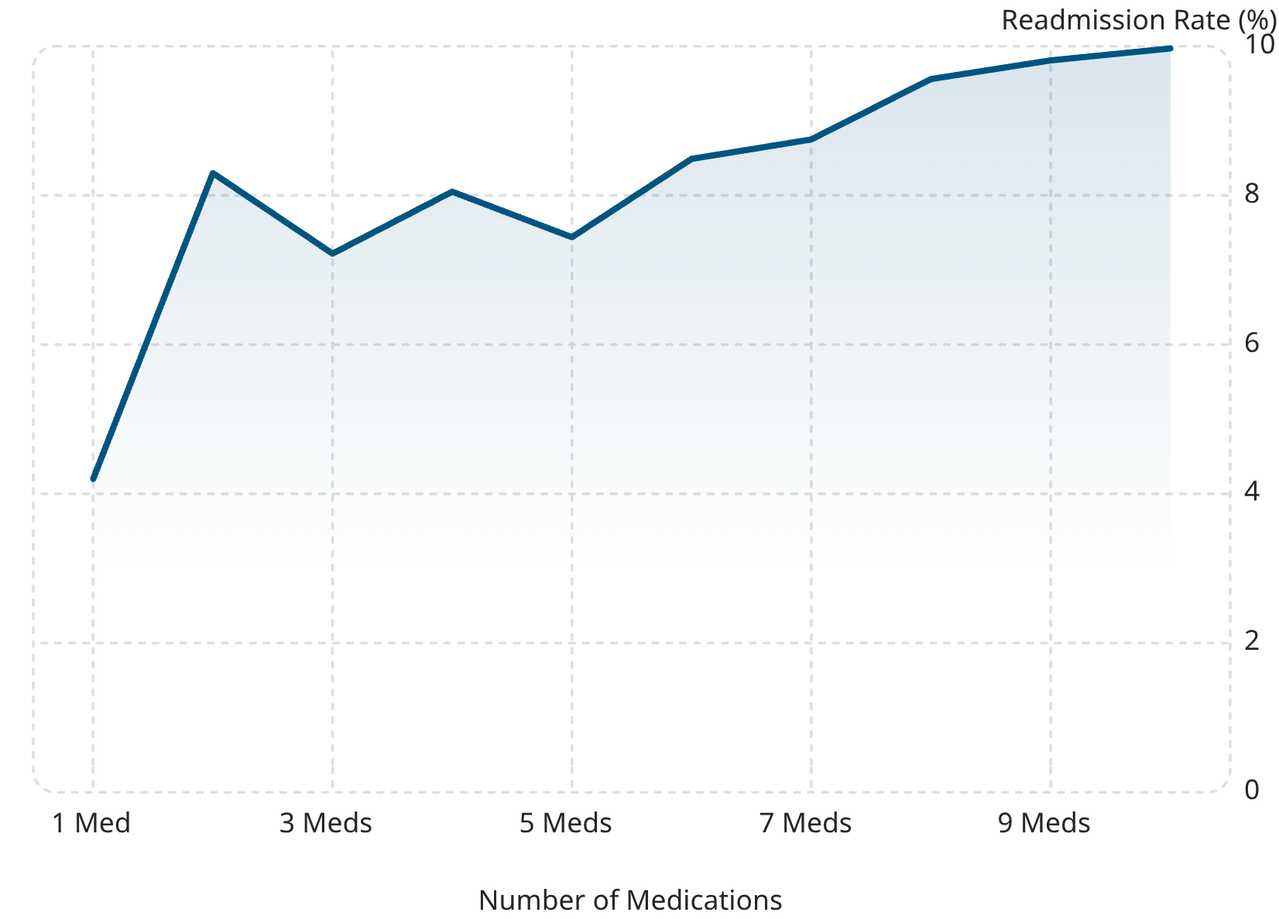
Clinical Complexity Drives Readmission Risk
Number of Diagnoses vs. Readmission Rate
Medication Burden vs. Readmission Rate
Both diagnosis count and medication burden show clear upward trends in readmission rates. Patients with 10 diagnoses face a 17.65% readmission rate — nearly triple those with only 1 diagnosis.

Slide 9
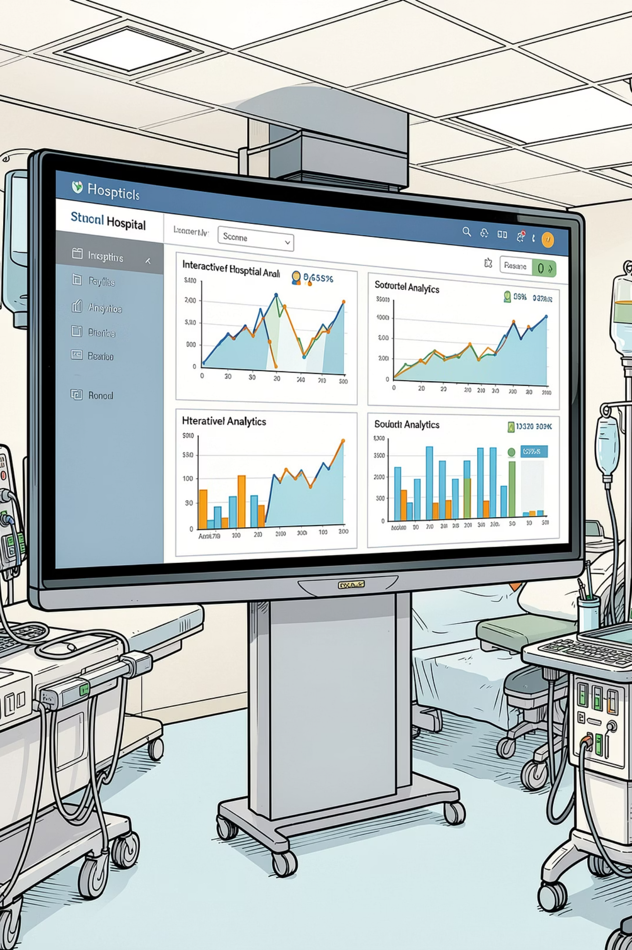


Interactive Dashboard Overview
A single-page Tableau dashboard was developed to monitor key readmission indicators with interactive filters for race, gender, and age group.
Summary KPIs
101,763 patients · 11,357 readmissions · 11.16% rate · 4.4-day avg. stay
Demographic Filters
Race (6 categories) and gender filters enable segmented analysis across populations
Visualizations
Age group, admission type, length of stay, and diagnosis count charts with drill-down capability

Slide 10
Key Findings & Strategic Implications
What the Data Tells Us
Recommended Actions
Age matters: Young adults (20–30) and seniors (80+) carry the highest readmission rates
Longer stays signal risk: 10-day hospitalizations carry nearly double the readmission rate of 1-day stays
Utilization is predictive: Prior inpatient visits are a strong marker of future readmission
Clinical complexity compounds risk: More diagnoses and medications correlate with higher readmission rates
Strengthen transitional care protocols for high-utilizer patients
Target discharge planning resources toward patients with 5+ diagnoses
Investigate root causes of elevated readmission rates in younger adults
Implement polypharmacy review programs before discharge
Use dashboard insights for real-time risk stratification

