Slide 1

Retail Sales & Profit Performance Analytics
SQL Server Data Cleaning & Analysis + Tableau Visualization — An end-to-end retail analytics workflow from raw data to interactive dashboard.

Slide 2


Project Overview & Objectives
This project analyzes retail sales and profit data using SQL Server for data preparation and analytical querying, followed by Tableau visualization.
Inspect & Clean
Analyze
Visualize
Check nulls, duplicates, and update missing values
Apply aggregate and window functions for business summaries
Build an interactive Tableau dashboard for sales and profit performance

Slide 3



Tools & Technologies
SQL Server
SQL
Tableau
Data inspection, cleaning, updating, and analysis
SELECT, UPDATE, GROUP BY, HAVING, aggregate, and window-based analysis
Visualization and interactive dashboarding

Slide 4
Dataset: Superstore_sql
The retail table contains order-level records across 11 fields covering customer, geographic, product, and financial dimensions.
Order Info
Customer
Geography
Product
Order_ID, Order_Date
Customer_Name, Segment
Region
Category, Product_Name
Financials
Sales, Quantity, Discount, Profit

Slide 5

Data Preparation & Cleaning
Retrieve Data
Check Nulls
Run SELECT * from target table
Use CASE with aggregates to find NULLs
Update Missing
Inspect Schema
UPDATE set Profit=0, Customer_Name='Unknown'
Query INFORMATION_SCHEMA.COLUMNS
Key cleaning steps included: updating NULL Profit values to 0, replacing NULL/blank Customer_Name with 'Unknown', and checking duplicate Order_IDs using GROUP BY and HAVING COUNT(*) > 1.

Slide 6
SQL Analysis Techniques
Technique | Purpose | Example
SELECT | Retrieve and inspect records | SELECT * FROM Superstore_sql
CASE | Conditional null counting | NULL value checks
UPDATE | Correct missing values | Profit & Customer_Name
GROUP BY / HAVING | Group and filter results | Duplicate Order_ID check
Aggregate Functions | Summarize data | Business-level summaries
Window Functions | Analytical row-level calculations | Retained row detail

Slide 7
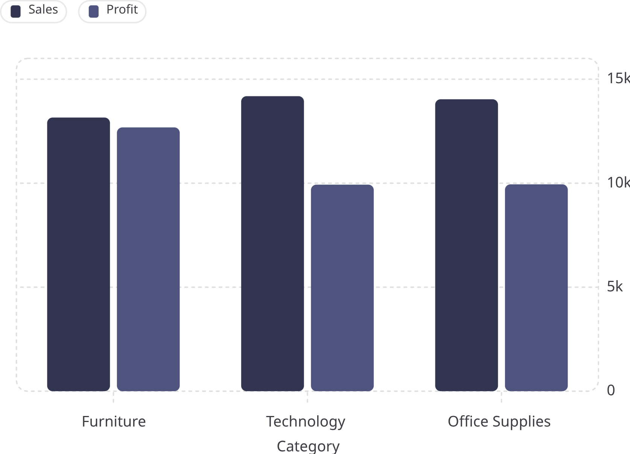
Tableau Dashboard: Key Insights
160,828
41,379
Total Sales
Total Profit
23
100
Customers
Orders
Highlights
Top customer: Deepak Mishra — 17,256 in sales
Peak month: October — 19,438; lowest: March — 7,312
Filters: Category, Segment, Region, Quarter

Slide 8

End-to-End Workflow & Conclusion
01
02
03
Retrieve Data
Inspect & Clean
Analyze
Load Superstore_sql in SQL Server
Check schema, nulls, duplicates; update missing values
Apply aggregates and window functions
04
05
Visualize
Interact
Build Tableau KPIs, trends, category, and discount visuals
Add filters for Category, Segment, Region, and Quarter
This project demonstrates a complete retail analytics pipeline — from raw SQL Server data inspection and cleaning to an interactive Tableau dashboard answering key business questions on sales, profit, customers, and category performance.

