Slide 1

FINAL PROJECT 2024
Design and Implement a Small Office Network
PROJECT GROUP
ENG/ Mohammed Mofreh
ENG/ Mohammed Gadalla
ENG/ Amera Yasser
ENG/ Mahmuod Taha

Slide 2
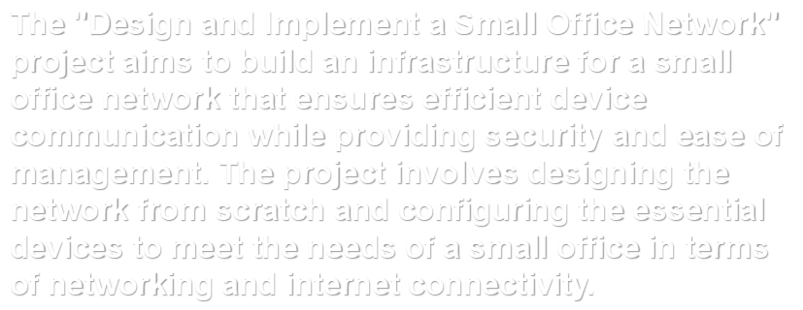

Slide 3
CONTENT
01
vlan
02
dhcp
03
spanning-tree
04
Ether Channel

Slide 4
CONTENT
05
NAT
06
PPP

Slide 5

vlan
A technology that allows the segmentation of a physical network into separate virtual networks to improve performance and increase security. Each VLAN can function as an independent network, making traffic management easier and isolating unwanted devices.

Slide 6

dhcp
(Dynamic Host Configuration Protocol)
A protocol that allows devices on a network to automatically obtain an IP address and other configuration information from a central server, simplifying network setup.

Slide 7

spanning-tree
A protocol used to prevent loops in networks with multiple switches by disabling redundant links, ensuring efficient data forwarding and avoiding duplication.

Slide 8

Ether Channel
A technology that combines multiple physical links between switches or between a switch and a device to increase bandwidth and provide redundancy, improving performance and reducing the chance of failure.

Slide 9

NAT
(Network Address Translation)
A technique used to translate internal private network addresses into one or more public addresses, allowing devices within a local network to access the internet using a single IP address.

Slide 10

PPP
(Point-to-Point Protocol)
A protocol used to connect two devices directly over a network, such as dial-up internet or PPPoE connections. It supports user authentication and data encryption for security.

Slide 11
THANKS!

