Slide 1
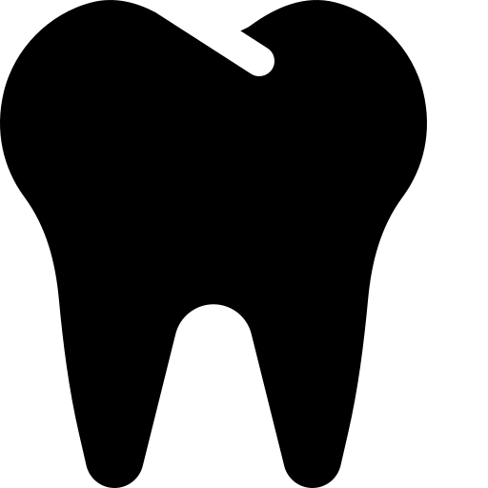



DEEP LEARNING · COMPUTER VISION · GRADUATION PROJECT
Oral Diseases Classification
using Deep Learning and Transfer Learning
Benchmarking a Custom CNN against EfficientNetB0, ResNet50, and MobileNetV2 for six-class dental image classification
Python
TensorFlow / Keras
Kaggle
Transfer Learning
mohammed.mokhtar.softwareeng@gmail.com
https://www.linkedin.com/in/mohammed-mokhtar-26668432b/
Mohammed Mokhtar
github.com/mohammedmokhtar77
AI Engineer & Data Scientist| Kaggle Master | Computers& AI, Cairo University
Notes:
Welcome the audience. Introduce yourself and the project title: an end-to-end deep learning system for classifying six oral diseases from dental images. State the headline comparison up front — a custom-built CNN versus three transfer learning architectures — so the audience knows the throughline of the whole talk. Mention this is a graduation project also published on Kaggle and GitHub, built fully in Python/TensorFlow.

Slide 2


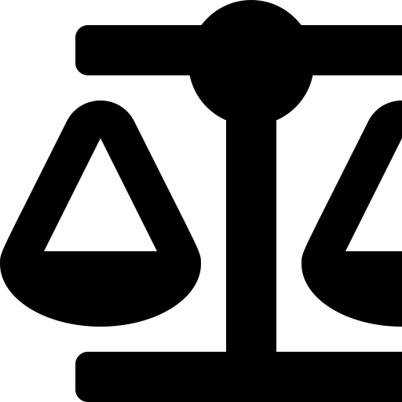
THE PROBLEM
Why Automated Oral Disease Detection Matters
Dental screening is manual and inconsistent
Diagnosis relies on visual inspection by dentists — subjective, slow, and hard to scale across clinics.
THE OPPORTUNITY
A deep learning classifier can act as a fast, consistent first-line screening tool — flagging likely conditions from a single image before specialist review.
Early-stage oral disease is often missed
Conditions like caries or gingivitis are easy to overlook without a trained specialist and enough time per patient.
6
disease classes
Limited access to dental specialists
4
models benchmarked
Many regions lack sufficient dental professionals for timely, population-scale screening.
224²
input resolution
Oral Diseases Classification · Deep Learning & Transfer Learning
2
Notes:
Welcome the audience. Introduce yourself and the project title: an end-to-end deep learning system for classifying six oral diseases from dental images. State the headline comparison up front — a custom-built CNN versus three transfer learning architectures — so the audience knows the throughline of the whole talk. Mention this is a graduation project also published on Kaggle and GitHub, built fully in Python/TensorFlow.

Slide 3

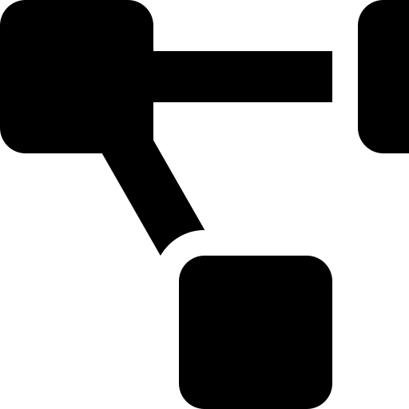

PROJECT OBJECTIVES
What This Project Set Out To Do
Build an accurate classifier
Compare CNN vs. Transfer Learning
Train a model that reliably distinguishes 6 oral disease categories from raw dental images.
Benchmark a custom-built CNN against EfficientNetB0, ResNet50, and MobileNetV2 under identical conditions.
Build a reproducible pipeline
Diagnose failure modes
Standardize preprocessing, augmentation, and evaluation so every model is judged fairly on the same data.
Use precision/recall/F1 and confusion matrices to understand exactly where each model struggles, not just its overall accuracy.
Oral Diseases Classification · Deep Learning & Transfer Learning
3
Notes:
Welcome the audience. Introduce yourself and the project title: an end-to-end deep learning system for classifying six oral diseases from dental images. State the headline comparison up front — a custom-built CNN versus three transfer learning architectures — so the audience knows the throughline of the whole talk. Mention this is a graduation project also published on Kaggle and GitHub, built fully in Python/TensorFlow.

Slide 4
DATASET
Six Oral Disease Categories
CLASSES
DATA PREPARATION
Calculus
Caries
Images were organized into class folders, then converted into a single Pandas DataFrame of (filepath, label) pairs for consistent downstream processing.
Gingivitis
Hypodontia
STRATIFIED SPLIT
Mouth Ulcer
Tooth Discoloration
Oral Diseases Classification · Deep Learning & Transfer Learning
4
Notes:
Welcome the audience. Introduce yourself and the project title: an end-to-end deep learning system for classifying six oral diseases from dental images. State the headline comparison up front — a custom-built CNN versus three transfer learning architectures — so the audience knows the throughline of the whole talk. Mention this is a graduation project also published on Kaggle and GitHub, built fully in Python/TensorFlow.

Slide 5
EXPLORATORY DATA ANALYSIS
Understanding Class Balance & Image Properties
CLASS IMBALANCE — A CENTRAL CHALLENGE
WHAT WE EXAMINED
Per-class image counts to detect imbalance
Sample image grids per class for visual sanity checks
Image dimension & aspect ratio distribution
Color/brightness range across source images
Duplicate or corrupted file checks
Illustrative relative volumes — motivates the augmentation & class-weighting decisions covered next.
Oral Diseases Classification · Deep Learning & Transfer Learning
5
Notes:
Welcome the audience. Introduce yourself and the project title: an end-to-end deep learning system for classifying six oral diseases from dental images. State the headline comparison up front — a custom-built CNN versus three transfer learning architectures — so the audience knows the throughline of the whole talk. Mention this is a graduation project also published on Kaggle and GitHub, built fully in Python/TensorFlow.

Slide 6




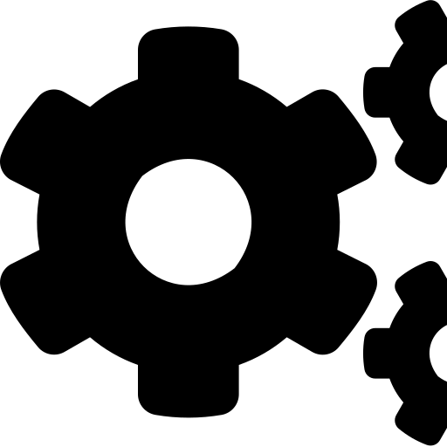
DATA PIPELINE
Preprocessing Pipeline
→
→
→
→
→
Folder-Based Loading
DataFrame Creation
Stratified Split
Resize to 224×224
Augmentation
Model-Specific Normalization
Images read from class folders
Filepath + label table (Pandas)
70 / 15 / 15 train-val-test
Uniform input size for all models
ImageDataGenerator transforms
preprocess_input per architecture
WHY MODEL-SPECIFIC NORMALIZATION MATTERS
Each pretrained backbone was trained on ImageNet with its own expected pixel scaling — e.g. EfficientNet expects a different range than ResNet50 or MobileNetV2. Using the wrong preprocess_input silently degrades transfer learning performance without throwing an error, which made this one of the trickiest bugs to catch (see Challenges).
Oral Diseases Classification · Deep Learning & Transfer Learning
6
Notes:
Welcome the audience. Introduce yourself and the project title: an end-to-end deep learning system for classifying six oral diseases from dental images. State the headline comparison up front — a custom-built CNN versus three transfer learning architectures — so the audience knows the throughline of the whole talk. Mention this is a graduation project also published on Kaggle and GitHub, built fully in Python/TensorFlow.

Slide 7
DATA PIPELINE
Data Augmentation Strategy
Random Rotation
Random Zoom
Width Shift
Simulates camera/head angle variation
Handles varying capture distances
Corrects off-center framing
Height Shift
Horizontal Flip
Brightness Adjustment
Corrects vertical framing offset
Doubles effective left/right variety
Compensates for inconsistent clinical lighting
Augmentation was applied only to the training split — validation and test data are evaluated on clean, unaugmented images to give an honest read of generalization.
Oral Diseases Classification · Deep Learning & Transfer Learning
7
Notes:
Welcome the audience. Introduce yourself and the project title: an end-to-end deep learning system for classifying six oral diseases from dental images. State the headline comparison up front — a custom-built CNN versus three transfer learning architectures — so the audience knows the throughline of the whole talk. Mention this is a graduation project also published on Kaggle and GitHub, built fully in Python/TensorFlow.

Slide 8
MODEL 1 OF 4
Custom CNN — Built From Scratch
Conv2D → Conv2D → BatchNorm → MaxPool
DESIGN RATIONALE
Conv2D → Conv2D → BatchNorm → MaxPool
4 stacked Conv-BatchNorm-MaxPool blocks build a feature hierarchy from edges/texture to disease-specific patterns.
Conv2D → Conv2D → BatchNorm → MaxPool
Conv2D → Conv2D → BatchNorm → MaxPool
GlobalAveragePooling replaces Flatten to sharply cut parameter count and reduce overfitting risk.
GlobalAveragePooling
4 convolutional blocks progressively extract low-to-high level dental features, each stabilized with BatchNorm before downsampling.
Two Dense+Dropout stages (256→128) add classification capacity while Dropout fights overfitting on a modest dataset.
Dense(256) → Dropout
Dense(128) → Dropout
Serves as the performance baseline — built and trained entirely from scratch, no pretrained weights.
Output — Softmax(6)
Oral Diseases Classification · Deep Learning & Transfer Learning
8
Notes:
Welcome the audience. Introduce yourself and the project title: an end-to-end deep learning system for classifying six oral diseases from dental images. State the headline comparison up front — a custom-built CNN versus three transfer learning architectures — so the audience knows the throughline of the whole talk. Mention this is a graduation project also published on Kaggle and GitHub, built fully in Python/TensorFlow.

Slide 9


TRANSFER LEARNING
Why Transfer Learning?
Pretrained Backbone
→
Frozen Feature Extraction
→
Custom Classification Head
ImageNet-trained EfficientNetB0 / ResNet50 / MobileNetV2 reused as a frozen feature extractor
Convolutional base weights are frozen — only new top layers are trained
Dense(256) → Dropout → Softmax(6) tailored to our 6 oral disease classes
Why it works with a moderate dataset: pretrained convolutional filters already encode general visual patterns (edges, textures, shapes) learned from millions of images — we only need to learn the mapping from those features to our 6 specific oral conditions.
Oral Diseases Classification · Deep Learning & Transfer Learning
9
Notes:
Explain the transfer learning concept generally before naming specific architectures. Three-step idea: start from an ImageNet-pretrained backbone, freeze its convolutional weights so it acts purely as a feature extractor, then attach a small custom classification head — Dense(256), Dropout, Softmax(6) — trained from scratch on our data. Explain why this works well with a moderate-sized medical imaging dataset: the frozen backbone already knows general visual patterns, so we only need to learn how those patterns map to our 6 specific oral disease classes, which needs far less data than training a full network from scratch.

Slide 10
TRANSFER LEARNING
Three Backbones, One Shared Head
EfficientNetB0
ResNet50
MobileNetV2
Compound scaling of depth/width/resolution — efficient accuracy per parameter.
Residual (skip) connections allow very deep 50-layer training without vanishing gradients.
Depthwise separable convolutions — lightweight, fast, mobile/edge-friendly.
SHARED CLASSIFICATION HEAD (all three)
Frozen Feature Extractor → Dense(256) → Dropout → Softmax(6)
Keeping the head identical across all three backbones isolates the backbone itself as the only variable — making the comparison fair.
Oral Diseases Classification · Deep Learning & Transfer Learning
10
Notes:
Explain the transfer learning concept generally before naming specific architectures. Three-step idea: start from an ImageNet-pretrained backbone, freeze its convolutional weights so it acts purely as a feature extractor, then attach a small custom classification head — Dense(256), Dropout, Softmax(6) — trained from scratch on our data. Explain why this works well with a moderate-sized medical imaging dataset: the frozen backbone already knows general visual patterns, so we only need to learn how those patterns map to our 6 specific oral disease classes, which needs far less data than training a full network from scratch.

Slide 11

TRAINING
Training Pipeline & Callbacks
CALLBACKS
CORE SETUP
EarlyStopping
Optimizer
Adam
Halts training once validation loss stops improving — prevents wasted epochs and overfitting.
Loss Function
Categorical Crossentropy
ReduceLROnPlateau
Input Size
224 × 224 × 3
Lowers the learning rate when validation metrics plateau, enabling finer convergence.
Classes
6 (Softmax output)
ModelCheckpoint
Saves only the best-performing weights on validation data, not just the final epoch.
All four models were trained under identical optimizer, loss, and callback settings to keep the comparison controlled.
Oral Diseases Classification · Deep Learning & Transfer Learning
11
Notes:
Explain the transfer learning concept generally before naming specific architectures. Three-step idea: start from an ImageNet-pretrained backbone, freeze its convolutional weights so it acts purely as a feature extractor, then attach a small custom classification head — Dense(256), Dropout, Softmax(6) — trained from scratch on our data. Explain why this works well with a moderate-sized medical imaging dataset: the frozen backbone already knows general visual patterns, so we only need to learn how those patterns map to our 6 specific oral disease classes, which needs far less data than training a full network from scratch.

Slide 12

METHODOLOGY
How We Measure Success
Accuracy
Precision
Recall
F1-Score
Overall % of correct predictions — useful but can hide per-class weaknesses
Of predicted-positive cases for a class, how many were actually correct
Of all real cases of a class, how many were correctly caught
Harmonic mean of precision & recall — a single balanced quality score
Confusion Matrix + Classification Report
A full per-class breakdown was generated for every model — used throughout the Results section to see exactly which oral diseases are confused with one another, beyond a single accuracy number.
Oral Diseases Classification · Deep Learning & Transfer Learning
12
Notes:
Explain the transfer learning concept generally before naming specific architectures. Three-step idea: start from an ImageNet-pretrained backbone, freeze its convolutional weights so it acts purely as a feature extractor, then attach a small custom classification head — Dense(256), Dropout, Softmax(6) — trained from scratch on our data. Explain why this works well with a moderate-sized medical imaging dataset: the frozen backbone already knows general visual patterns, so we only need to learn how those patterns map to our 6 specific oral disease classes, which needs far less data than training a full network from scratch.

Slide 13
RESULTS
Accuracy Across All Four Models
Oral Diseases Classification · Deep Learning & Transfer Learning
13
Notes:
This is the headline results slide — talk through the grouped bar chart of Train, Validation, and Test accuracy for all four models. Key takeaways: all three transfer learning models clearly beat the custom CNN on test accuracy (around 81-82% vs. 75.8%). Among the transfer learning models, EfficientNetB0 edges out the others on test accuracy at 81.80%, with ResNet50 close behind at 81.67% and MobileNetV2 at 81.20% — the three are very close, which is itself an interesting finding. Also point out the train-to-validation gap is largest for the custom CNN, hinting at more overfitting versus the transfer learning models.

Slide 14
RESULTS — DEEP DIVE
EfficientNetB0 — Best Overall Model
Class | Precision | Recall | F1
Calculus | 0.69 | 0.62 | 0.65
Caries | 0.91 | 0.61 | 0.73
Gingivitis | 0.78 | 0.88 | 0.82
Hypodontia | 0.98 | 0.96 | 0.97
Mouth Ulcer | 0.97 | 0.92 | 0.95
Tooth Discoloration | 0.93 | 0.52 | 0.67
READING THE TABLE
Hypodontia and Mouth Ulcer are near-perfect (F1 ≥ 0.95) — visually distinctive conditions the model rarely misses.
Calculus and Tooth Discoloration have the weakest recall (0.62 / 0.52) — the model misses real cases of these classes more often, likely due to subtler, overlapping visual patterns and fewer training samples.
High precision + low recall on these classes means: when the model does call it, it's usually right — but it under-calls it, missing several true cases.
Oral Diseases Classification · Deep Learning & Transfer Learning
14
Notes:
Zoom into EfficientNetB0's per-class classification report, since it was the top overall test-accuracy model. Highlight the pattern: Hypodontia and Mouth Ulcer score near-perfectly, both are visually distinctive so the model rarely confuses them. In contrast, Calculus and especially Tooth Discoloration show the weakest recall — 0.62 and 0.52 respectively — meaning the model misses a meaningful share of real cases, even though precision stays high. Explain what high-precision-low-recall means in plain language: when the model does flag the class it's usually correct, but it's too conservative and under-calls it, likely linked to fewer training samples and subtler visual differences from other classes.

Slide 15
RESULTS — COMPARISON
Per-Class F1-Score: All Transfer Learning Models
Oral Diseases Classification · Deep Learning & Transfer Learning
15
Notes:
This chart lines up all three transfer learning models side by side, per class, on F1-score. Key insight: Hypodontia and Mouth Ulcer are consistently strong across all three architectures — the disease itself is easy, not the model. Tooth Discoloration is where the models diverge most: ResNet50 reaches F1 0.82 there while EfficientNetB0 only reaches 0.67 — a case where a different backbone's inductive bias handles a specific class meaningfully better. This is exactly the kind of insight a single accuracy number would hide, and it's why per-class comparison matters when picking a production model.

Slide 16
RESULTS — ERROR ANALYSIS
Where the Models Get Confused
Actual ↓
Predicted →
Calc
Caries
Ging.
Hypo.
Ulcer
Tooth D.
Calc
62
10
8
2
2
16
MAIN CONFUSION PATTERNS
Caries
7
61
9
1
2
20
Tooth Discoloration is frequently mispredicted as Caries or Calculus — all three can present as darkened/spotted enamel regions.
Ging.
5
3
88
1
1
2
Hypo.
1
1
1
96
1
0
Calculus and Caries are mutually confused — both often co-occur on the same tooth surface in real patients.
Ulcer
2
2
2
1
92
1
Tooth D.
12
14
7
1
2
52
Hypodontia and Mouth Ulcer stay clean — structurally distinctive (missing teeth / open sores) versus subtle surface discoloration.
Illustrative confusion matrix (%), EfficientNetB0 — diagonal = correct; dark orange = notable confusion.
Oral Diseases Classification · Deep Learning & Transfer Learning
16
Notes:
Present the confusion matrix as a heatmap and narrate the off-diagonal cells, not just accuracy. The three biggest confusion pairs to call out: Tooth Discoloration gets mispredicted as Caries or Calculus because all three can visually present as darkened or spotted enamel; Calculus and Caries are confused with each other because they frequently co-occur on the same tooth in real patients, so the visual boundary between them is genuinely blurry; meanwhile Hypodontia and Mouth Ulcer stay clean because they're structurally distinctive — a missing tooth or an open sore looks nothing like the others. This is the clinical-domain explanation for the numeric weak spots seen in the previous slides.

Slide 17
CHALLENGES & SOLUTIONS (1/2)
Data & Preprocessing Challenges
Dataset Imbalance
Some classes (e.g. Hypodontia) had far fewer images than others like Gingivitis.
✓ Addressed with heavier augmentation on minority classes and close monitoring of per-class recall, not just overall accuracy.
Choosing Suitable Augmentation
Overly aggressive transforms risked destroying clinically meaningful detail (e.g. subtle discoloration).
✓ Tuned augmentation ranges conservatively and validated visually that augmented samples still looked clinically plausible.
Wrong Preprocessing for Pretrained Models
Initially applied the same normalization to all backbones, silently hurting transfer learning accuracy.
✓ Matched each model to its correct Keras preprocess_input function (EfficientNet ≠ ResNet50 ≠ MobileNetV2).
Oral Diseases Classification · Deep Learning & Transfer Learning
17
Notes:
Cover the first three technical challenges, each in a problem-then-solution structure. First, dataset imbalance: some classes like Hypodontia had far fewer samples than Gingivitis, so we monitored per-class recall closely instead of trusting overall accuracy, and leaned on augmentation for minority classes. Second, choosing augmentation strength: too aggressive risks destroying the subtle visual cues that define classes like discoloration, so ranges were tuned conservatively and checked visually. Third — and this was a real bug encountered — initially applying identical normalization across all backbones silently hurt transfer learning performance; the fix was matching each architecture to its correct Keras preprocess_input function.

Slide 18
CHALLENGES & SOLUTIONS (2/2)
Training & Modeling Challenges
Overfitting
Custom CNN showed a growing train/validation accuracy gap during training.
✓ Added BatchNorm + Dropout, used GlobalAveragePooling, and relied on EarlyStopping to halt at the best epoch.
Validation Fluctuations
Validation accuracy/loss bounced noticeably between epochs, making it hard to judge progress.
✓ Used ReduceLROnPlateau to stabilize convergence, and ModelCheckpoint to keep the true best epoch, not the last one.
Fair Cross-Architecture Comparison
Different backbones have very different capacities and default configs, risking an apples-to-oranges comparison.
✓ Standardized input size, classification head, optimizer, loss, callbacks, and data splits identically across all four models.
Oral Diseases Classification · Deep Learning & Transfer Learning
18
Notes:
Continue with the remaining challenges. Overfitting on the custom CNN was addressed with BatchNorm, Dropout, GlobalAveragePooling, and EarlyStopping to stop at the best epoch rather than training to convergence. Noisy validation curves were smoothed in effect by ReduceLROnPlateau and handled by always checkpointing the best epoch rather than trusting the final one. Finally, mention the meta-challenge of comparing four very different architectures fairly — the fix was standardizing everything possible: input size, classification head design, optimizer, loss, callbacks, and data splits — so the backbone architecture was the only real variable.

Slide 19

REFLECTION
Lessons Learned
Preprocessing details matter as much as model choice
Accuracy alone hides real weaknesses
A single mismatched preprocess_input quietly cost several points of accuracy — architecture choice means little if inputs are wrong.
Per-class precision/recall revealed problems (Tooth Discoloration recall) that overall accuracy completely masked.
Transfer learning converges faster and generalizes better
The 'best' model depends on the metric that matters
All three pretrained backbones beat the custom CNN with a smaller train/validation gap, despite far less custom tuning.
EfficientNetB0 wins overall accuracy, but ResNet50 wins on Tooth Discoloration recall — model choice should follow the deployment priority.
Oral Diseases Classification · Deep Learning & Transfer Learning
19
Notes:
Four big-picture lessons from the project. First, preprocessing correctness matters as much as architecture choice — a mismatched preprocess_input silently cost accuracy. Second, accuracy alone can hide real weaknesses that only per-class precision/recall/F1 reveal, like the Tooth Discoloration recall problem. Third, transfer learning converged faster and generalized better than the custom CNN, with a smaller train-validation gap despite less tuning effort. Fourth, and perhaps the most important takeaway: 'best model' is metric-dependent — EfficientNetB0 wins on overall accuracy but ResNet50 wins specifically on Tooth Discoloration recall, so the right choice depends on what actually matters for deployment.

Slide 20

WHAT'S NEXT
Future Work
Fine-tune unfrozen backbone layers
Grow the dataset
Model ensembling
Unfreeze the top blocks of the best backbone and fine-tune at a low learning rate for extra accuracy.
Collect more Hypodontia/minority-class images, especially for the weakest classes like Tooth Discoloration.
Combine EfficientNetB0, ResNet50, and MobileNetV2 predictions to trade compute for higher robustness.
Explainability (Grad-CAM)
Deployment as a lightweight app
Multi-label support
Visualize which image regions drive each prediction — critical for clinical trust and error auditing.
Package the best model (e.g. MobileNetV2) behind a simple API or mobile app for real screening use.
Extend beyond single-label classification to detect co-occurring conditions on the same image.
Oral Diseases Classification · Deep Learning & Transfer Learning
20
Notes:
Six directions for future work: fine-tuning the unfrozen top layers of the best backbone at a low learning rate; growing the dataset specifically for weak minority classes; ensembling all three transfer learning models for extra robustness; adding Grad-CAM explainability so clinicians can see which image regions drove a prediction; packaging the best model behind a lightweight API or mobile app for real-world screening; and extending to multi-label classification since patients can present multiple oral conditions at once.

Slide 21
WRAP-UP
Conclusion
Transfer learning decisively outperformed a custom CNN for oral disease classification — while revealing that model choice should be guided by which specific class matters most, not just overall accuracy.
EfficientNetB0
ResNet50
MobileNetV2
81.80%
81.67%
81.20%
Best overall test accuracy
Strongest on Tooth Discoloration
Best speed/accuracy tradeoff
End-to-end delivery: dataset engineering → augmentation → 4-model benchmark → per-class diagnostics → clinically-grounded error analysis.
Oral Diseases Classification · Deep Learning & Transfer Learning
21
Notes:
Bring it home: transfer learning clearly beat the from-scratch CNN, but the more nuanced conclusion is that 'best model' depends on which class matters most for the deployment context — EfficientNetB0 for best overall accuracy, ResNet50 if Tooth Discoloration detection is the priority, MobileNetV2 if inference speed matters most. Close by restating the end-to-end scope of the work delivered: full pipeline from dataset engineering through augmentation, four-model benchmarking, per-class diagnostics, and clinically grounded error analysis.

Slide 22

Questions?
Thank you — Oral Diseases Classification using Deep Learning and Transfer Learning
Mohammed Mokhtar · Faculty of Computers & AI, Cairo University
mohammed.mokhtar.softwareeng@gmail.com
https://www.linkedin.com/in/mohammed-mokhtar-26668432b/
github.com/mohammedmokhtar77
Notes:
Thank the audience and open the floor for questions. If the session is technical, be ready to go deeper on: why preprocess_input differs per architecture, why GlobalAveragePooling was chosen over Flatten, and the precision/recall tradeoff behind the Tooth Discoloration results. A prepared bank of likely interview questions and answers is provided in the companion document.

