Slide 1
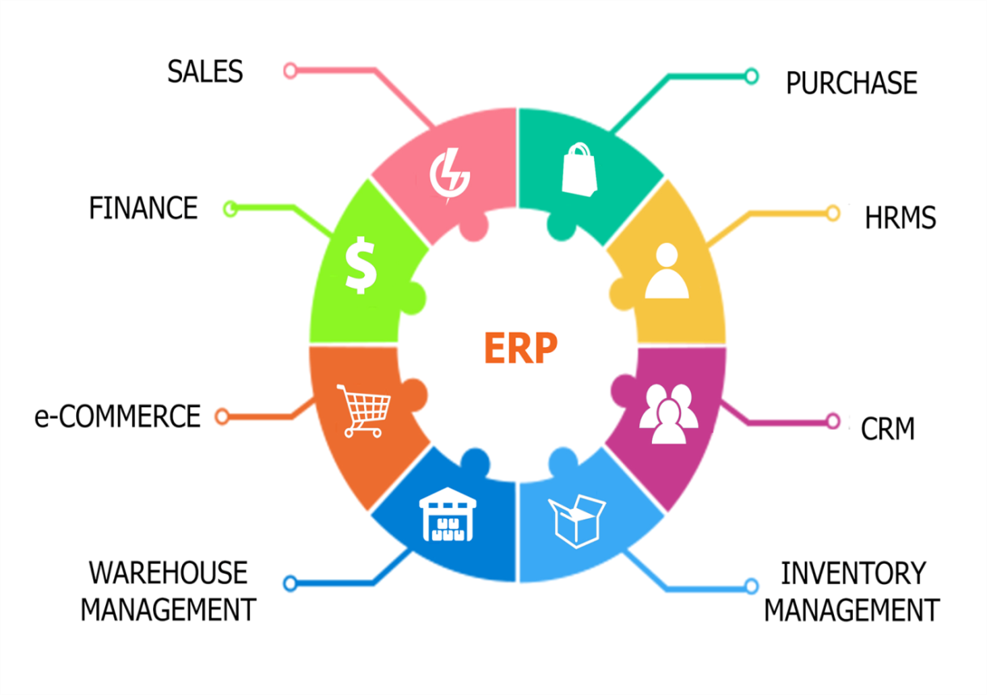
Integrated open source ERP with mobile application in sales and marketing module
Supervisor
Prof. Khaled Bahnasy
Notes:
Company needs

Slide 2
Team Members
Mahmoud mahmed bassion
Mostafa mahmmed mahmoud
Abdelrahman mahmed bassiony

Slide 3
Agenda
1. Introduction
2. Problem Definition
3. Objective
4. Related Works
5. Functional Requirements
6. System Architecture
7. Use Case diagram
8. Software & Hardware Tools
9. Time Plan

Slide 4

Introduction
Today, ERP systems are critical for managing thousands of businesses of all sizes and in all industries.
ERP → Enterprise Resource Planning
It refers to the systems and software packages used by organizations
to manage day-to-day business activities , such as
accounting, procurement, project management and manufacturing .
ERP Examples :-
1-Odoo 2- OpenErp 3- Oracle ERP Cloud 4- SAP ERP
Open source ERP (Odoo):- is a suite of OpenSource Business apps that cover all your
Company needs:
1- CRM(Customer Relationship Management)
2- HR
3- Sales 4- purchase management
6- Accounting 5- inventory
7- Invoices 8- e-commerce
Notes:
To these companies, ERP is as indispensable as the electricity that keeps the lights on.
Back Office Software تعرف بال
تقوم بتقدیم حلول لاتمام الصفقة من تسجیل المبلغ المدفوع والبضاعة او الخدمة ERP
Customer Relationship Management CRM تستخدم فى خلال وبعد عملیة الشراء وھى تعنى بمتابعة العمیل اكثر من متابعة عقود البیع والشراء والمواد المباعة والسعر
قاعدة بيانات بوستجراس ( Postgresql)
Procurement مشتريات
indispensable لا غنى عنه

Slide 5
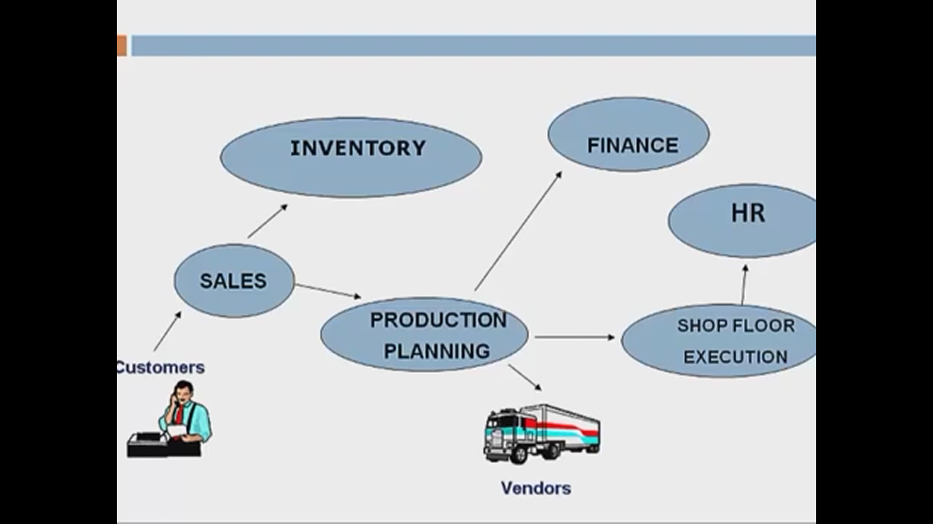
DeCentralized System ERP
Notes:
Decenterliazed System
Data is maintained locally at the individual departments .
Departments do not have access to data of Other Departments .
Problems of Decenterliazed System
1- No Real Time Inventory Information

Slide 6
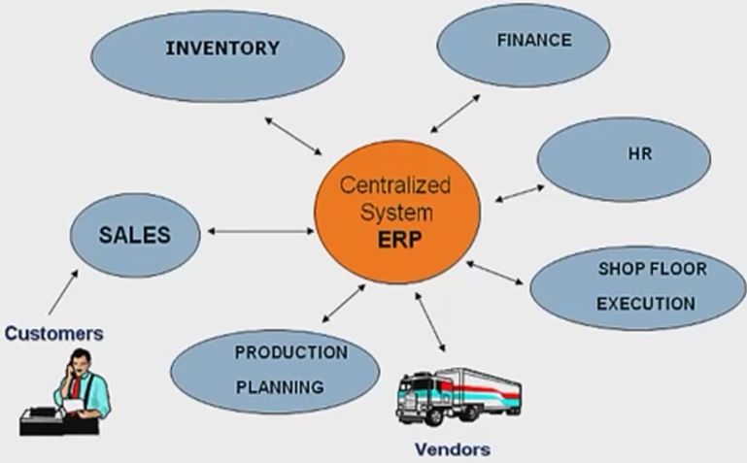
Centralized System ERP

Slide 7
Problem Definition
There is a large enterprise , it has multiple branches and a large number of salespersons Within the organization and outside.
When a salesperson wants to know how many goods are in stores or request goods from stocks to customer.
Communicating through the telephone has its difficulty , The frequent contacts on the stores may make the line always busy and not available.
Each caller cannot get his query at the time he wants it.
Seller's query about certain order and where it reached and It was shipped or not.
track GPS location of Resources
Save Real Time Orders .
Notes:
Solving complicated problems for your business doesn’t mean you have to splash out on a million dollar enterprise resource planning (ERP) system.
Oracle and SAP may dominate the field, but there are plenty of free, open source ERP options that can help get your business in shape

Slide 8
Objective
Providing a mobile application that able to:
1. connect with odoo server to create any order or change.
2. get shortest path for a salesperson outside enterprise to go a customer’s place.
3. track salesperson’s route to check his target.
4. make a customer note his feedback.

Slide 9
Related Works(Similar Systems)
1- Mobile Sales app .
2- dayTrack - mobile CRM app
3- OpenERP CRM Sales .
4- Odoo Mobile app .
5- Mobiles At Work Odoo app.

Slide 10
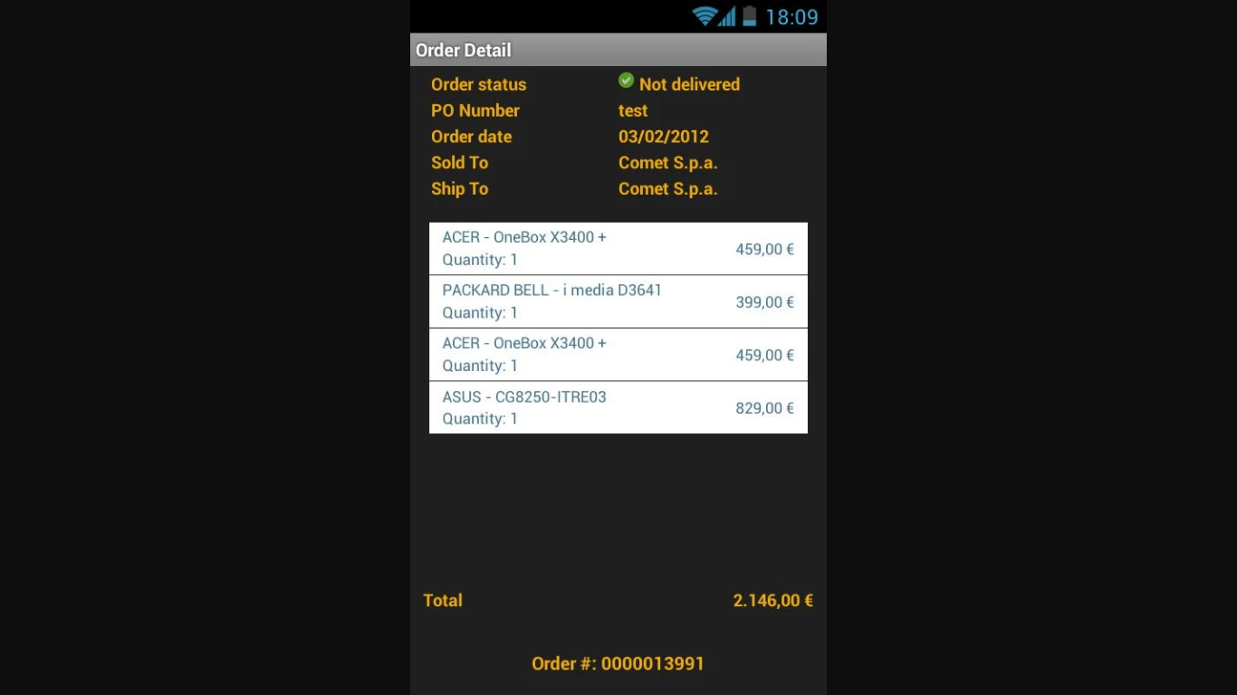
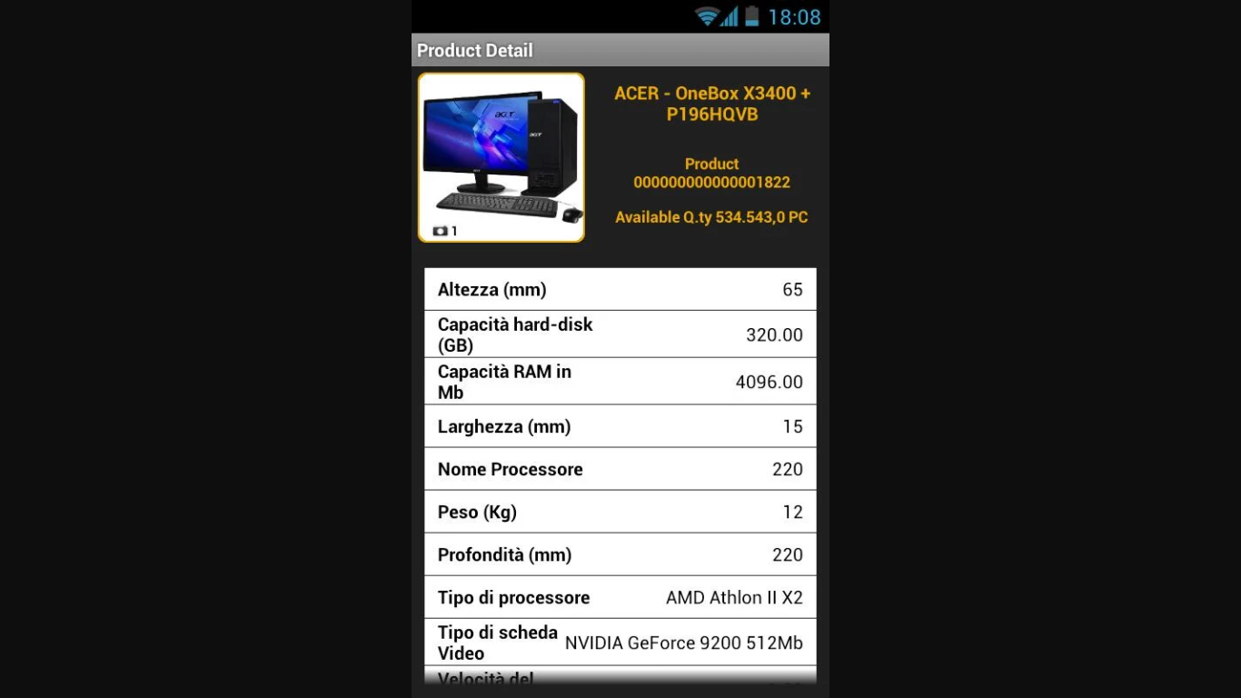
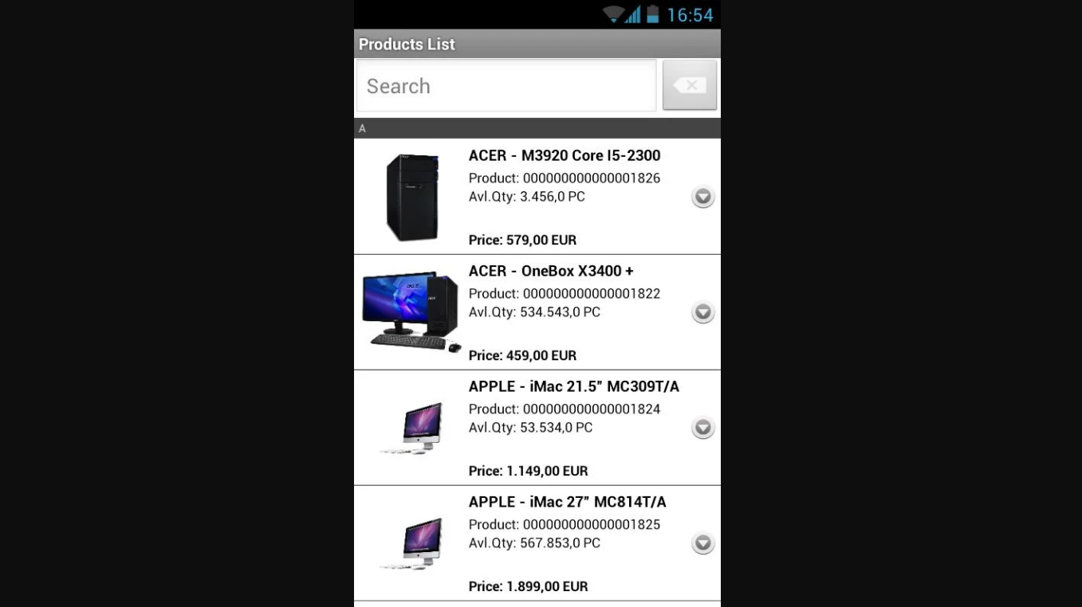
1- Mobile Sales app
Related Works (cont.)
URL:https://play.google.com/store/apps/details?id=it.greenorange.mobilesales&hl=ar

Slide 11
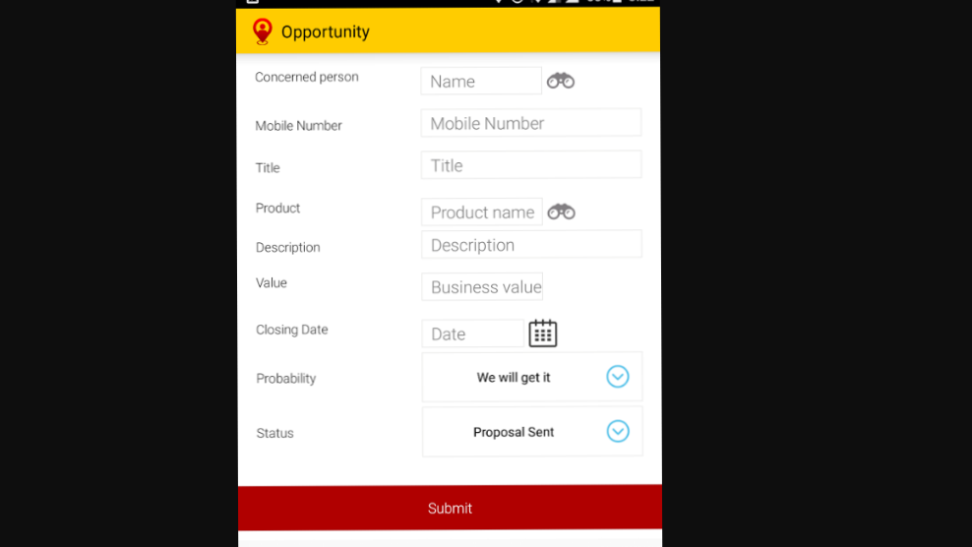
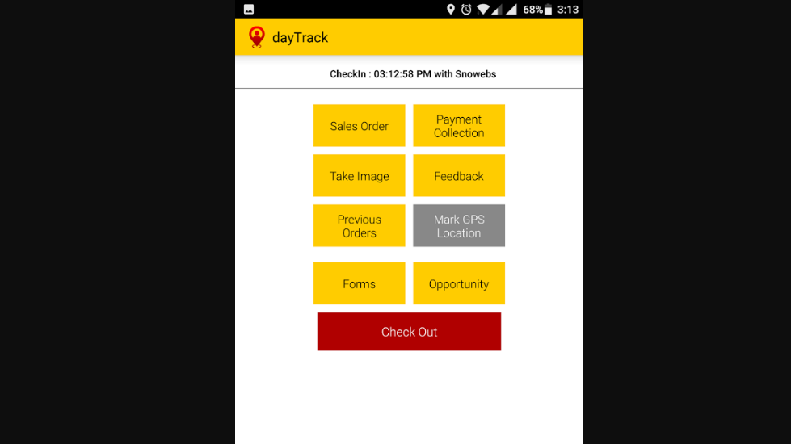
2- dayTrack - mobile CRM app
Related Works (cont.)
URL : https://play.google.com/store/apps/details?id=com.daytrack&hl=ar

Slide 12
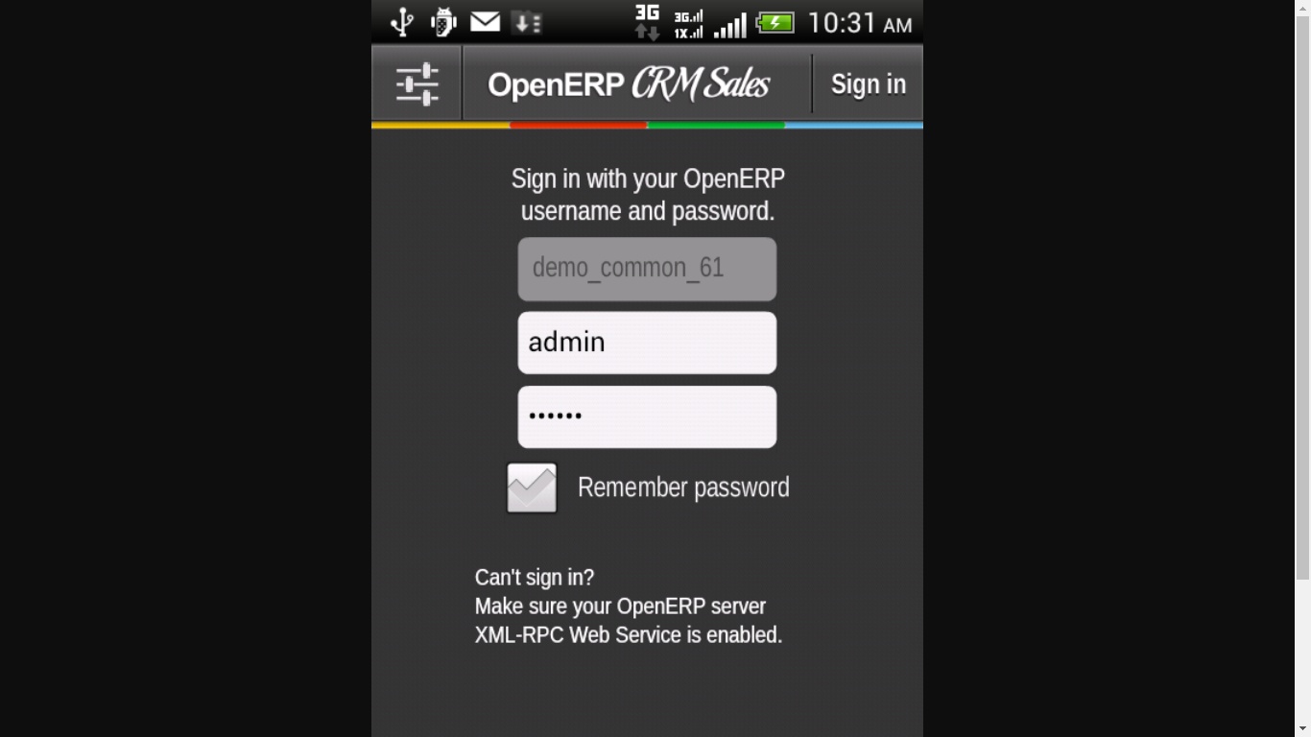
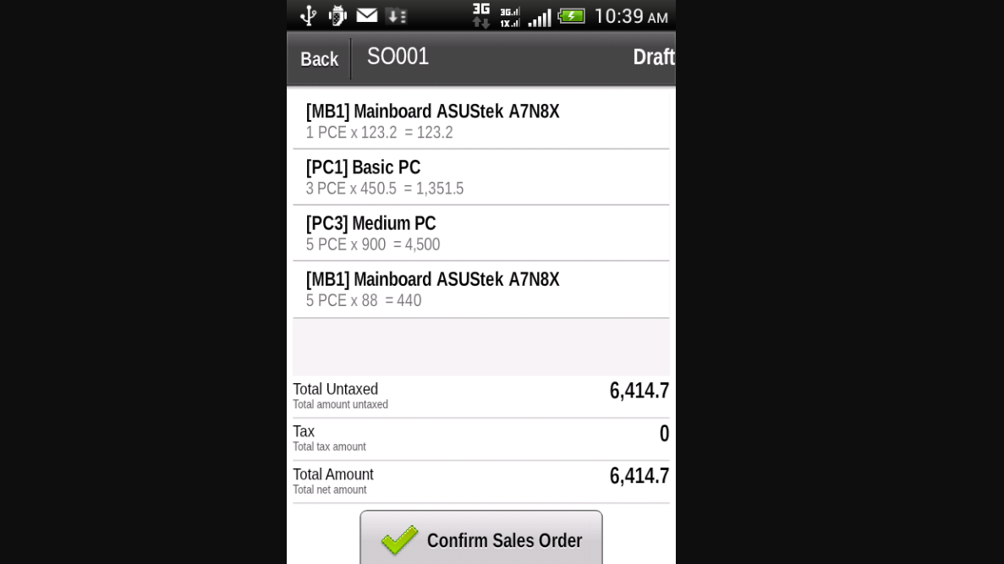
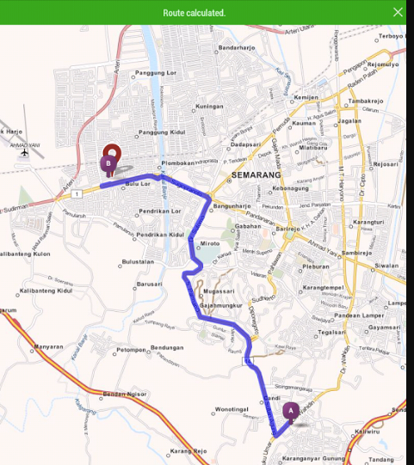
Related Works (cont.)
3- OpenERP CRM Sales
URL:
https://play.google.com/store/apps/details?id=air.co.intisoft.openerp.mobilecrm&hl=ar

Slide 13
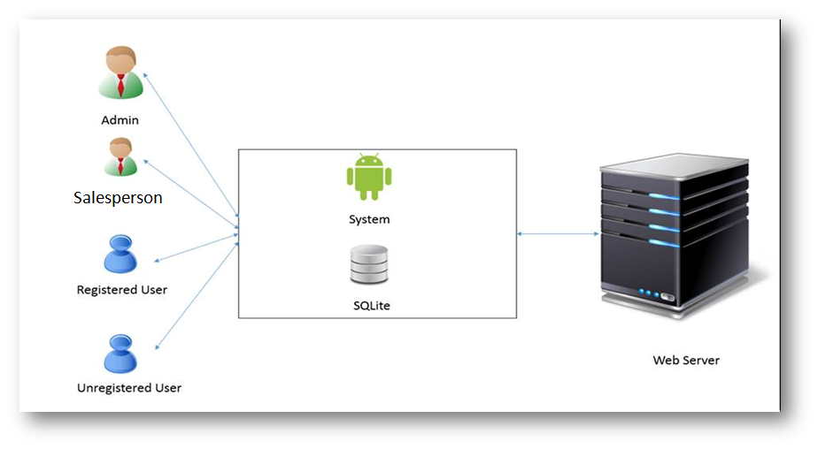
System Architecture

Slide 14
Functional Requirements
System Prerequisite: Internet access is available.
1. User can register for ERP System .
2. User can View cost of products and invoices .
3. User can request the route to a specific work way and get Shortest Path.
Prerequisite : GPS is activated .
,Remove and Update . 4. User can Create Order

Slide 15
Functional Requirements (cont.)
.5- User can Add Customer
6- User Can View unlimited dynamic categories for all your products .
7- User can check product quantity if not exist create that product .
8- User can print bill/invoice .

Slide 16
Functional Requirements (cont.)
9- Admin Can Add SalesPerson ,Remove and Update .
10 - Admin Can View All Orders For each SalesPerson .
11 - Admin Can View For SalesPerson Route By Tracking him via GPS .

Slide 17
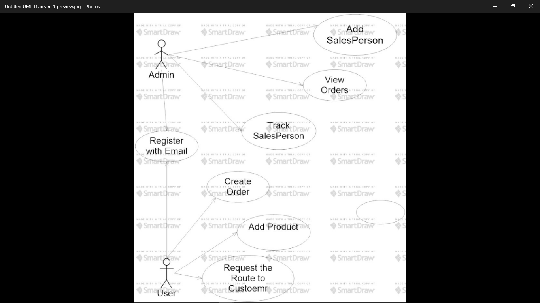
Use Case Diagram

Slide 18
Software & Hardware Tools
JAVA
Android studio IDE (Development).
Rational Rose (Analysis & Design).
Android Mobile Device (Testing).
Web Server .

Slide 19
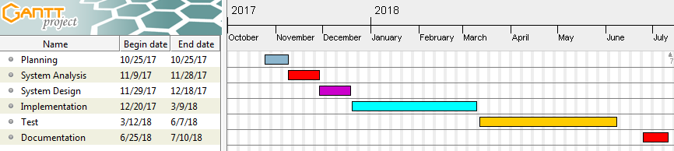
Time Plan

Slide 20

Any Questions

Slide 21
Thanks For Listening

