Slide 1

Introduction to

Slide 2
Agenda
What is URL && Browser
Introduction to HTML
HTML Tags
Creating a Basic Starting Document
Previewing Your Work
Setting Document Properties( Color Codes, The Body Element, Background Color, TEXT Color, LINK, VLINK, and ALINK)
Using Image Background
Headings
Paragraphs
Break
Horizontal Rule
Character Formatting
Lists (unordered list , ordered list , Nest Lists)
Tables
Image Element
Links

Slide 3
What is URL && Browser
URL – Uniform Resource Locator.
Browser – A software program which is used to show web pages.

Slide 4
Introduction to HTML
What is the meaning of HTML?
HTML stands for Hyper Text Markup Language.
HTML is not a programming language, it is a markup language.
A markup language is a set of markup tags that describe web page.
Pages end with “.htm” or “.html”
HTML Editor – A word processor that has been specialized to make the writing of HTML documents more effortless.

Slide 5
Introduction to HTML
Html element
Start tag content end tag

Slide 6
HTML Element Syntax
An HTML element is everything from the start tag to the end tag.
An HTML element starts with a start tag/opening tag.
An HTML element ends with an end tag/ closing tag.
The element content is everything between the start and the end tag.
Some HTML elements have empty content.
Empty elements are closed in the start tag.
Most HTML elements can have attributes.

Slide 7
Nested HTML Elements
Most HTML elements can be nested (can contain other HTML elements).
HTML documents consist of nested HTML elements.

Slide 8
HTML Tags
HTML tag is keyword surrounded by angle brackets like < > .
Not case sensitive
<TITLE> = <title> = <TITLE>
HTML tags normally come in pairs like <b> and </b>.
The first tag in a pair is the start tag, the second tag is the end tag.

Slide 9
HTML Attributes
Attributes provide additional information about an element.
HTML elements can have attributes.
Attributes are always specified in the start tag.
Attributes come in name/value pairs like: name="value" .

Slide 10
Declaring the HTML document
The first thing you'll want to do in your page is add a bit of code that declares which type of document you're using and identifies the language version.
This is done with Standardized General Markup Language (SGML), which is the parent language to HTML and appears in this important declaration, known as the DOCTYPE declaration.

Slide 11
Creating a Basic Starting Document
<!DOCTYPE html PUBLIC "-//W3C//DTD HTML 4.01//EN" >
<HTML>
<HEAD>
<TITLE> my first html web page </TITLE>
</HEAD>
<BODY>
<!-- Here we will put the page elements -->
</BODY>
</HTML>
Notes:
09/22/97
9
University of Minnesota Extension Service
Master Internet Volunteer Program
Tech help should be a local or toll-free call
Is it available when you are using the net?
Will you get a real person or have to leave voice mail? (voice mail is OK if the response time is fast and during a time you are not connected)
Try calling tech support before subscribing.

Slide 12
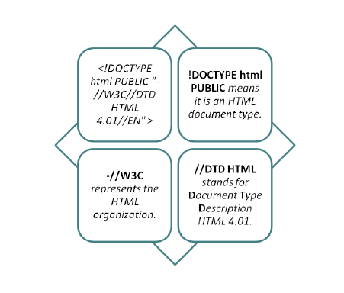
DOCTYPE
<!DOCTYPE html PUBLIC "-//W3C//DTD HTML 4.01//EN" >

Slide 13
DOCTYPE
In HTML 4.01, the <!DOCTYPE> declaration refers to a DTD, because HTML 4.01 was based on SGML. The DTD specifies the rules for the markup language, so that the browsers render the content correctly.
<!DOCTYPE html>
HTML5 is not based on SGML, and therefore does not require a reference to a DTD.
Tip: Always add the <!DOCTYPE> declaration to your HTML documents, so that the browser knows what type of document to expect.

Slide 14
HTML Element
After the DOCTYPE declaration, you'll want to begin building your document from its root element.
The html element is considered the root element of any HTML document.

Slide 15
Head Element
The head element is another important piece of the HTML document.
This element is where all things necessary for the document's display and performance are placed but are not literally seen within the browser window.
The head element requires no attributes but simply has the opening and closing tags.
The head elements may contain many HTML elements.

Slide 16
Elements in the Head Portion of the Document LINK
The link element is most commonly used to link to an external style sheet, although it can be used for other purposes, such as linking to an alternative page for accessibility, or to link to a favicon, those popular icons you see in the address bar on certain websites.

Slide 17
Elements in the Head Portion of the Document TITLE
This element enables you to title your document.
This title will then appear in the title bar of your browser.
The title element is required.

Slide 18
Elements in the Head Portion of the Document META
The Meta element is used for numerous concerns, including keywords and descriptions, character encoding, and document authorship.
The Meta element is not required, and your use of it will vary according to your specific needs.
Document encoding means setting the character set for your page, which is particularly important when writing documents in other languages.
Keywords, Description, and Authorship: The Meta element can be used to describe keywords, describe the site, and define the author, too.
This is extremely helpful for public search engines as well as for any search engine you might be running on your own site.

Slide 19
Elements in the Head Portion of the Document SCRIPT
This element enables you to insert scripts directly into your document or, as is the preference, link from the page to the script you'd like to use.
It is used It's the element where you'll be placing the content of your page and marking it up using XHTML to structure it accordingly.

Slide 20
Elements in the Head Portion of the Document Style
The style element enables you to place style information into the individual page.
This is known as embedded style.

Slide 21
Body Element
The body element is where all the action takes place.
It's the element where you'll be placing the content of your page and marking it up using XHTML to structure it accordingly.
The element goes within the html element, directly below the head makes sense, doesn't it?

Slide 22
Building HTML page
<!DOCTYPE html PUBLIC "-//W3C//DTD HTML 4.01//EN" >
<html>
<head>
<title> My first html page </title>
<meta http-equiv="Content-Type" content="text/html; charset=windows-1256" />
<meta name="keywords" content=“IE Course" />
<meta name="description" content="this is a test page." />
<meta name="Author" content=“FCIS" />
</head>
<body>
<!-- Page elements -->
</body>
</html>

Slide 23
Setting Document Properties
Document properties are controlled by attributes of the BODY element.
For example, there are color settings for the background color of the page, the document’s text and different states of links.

Slide 24
Color Codes
Colors are set using “RGB” color codes, which are, represented as hexadecimal values.
Each 2-digit section of the code represents the amount, in sequence, of red, green or blue that forms the color.
For example, a RGB value with 00 as the first two digits has no red in the color.

Slide 25
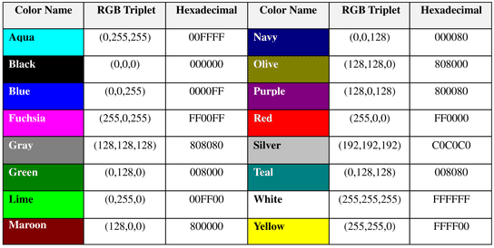
16 Basic Colors

Slide 26
Color Codes
WHITE
BLACK
RED
GREEN
BLUE
MAGENTA
CYAN
YELLOW
AQUAMARINE
BAKER’S CHOCOLATE
VIOLET
BRASS
COPPER
PINK
ORANGE
#FFFFFF
#000000
#FF0000
#00FF00
#0000FF
#FF00FF
#00FFFF
#FFFF00
#70DB93
#5C3317
#9F5F9F
#B5A642
#B87333
#FF6EC7
#FF7F00

Slide 27
The Body Element
The BODY element of a web page is an important element in regards to the page’s appearance. Here are the attributes of the BODY tag to control all the levels:
This element contains information about the page’s background color, the background image, as well as the text and link colors.
TEXT="#RRGGBB" to change the color of all the text on the page (full page text color.)

Slide 28
Background Color
It is very common to see web pages with their background color set to white or some other colors.
To set your document’s background color, you need to edit the <BODY> element by adding the BGCOLOR attribute.
The following example will display a document with a white background color:
<BODY BGCOLOR=“#FFFFFF”></BODY>

Slide 29
<HTML>
<head>
<title> My first html page </title>
</head>
<BODY BGCOLOR="#0000FF" >
</BODY>
</HTML>

Slide 30
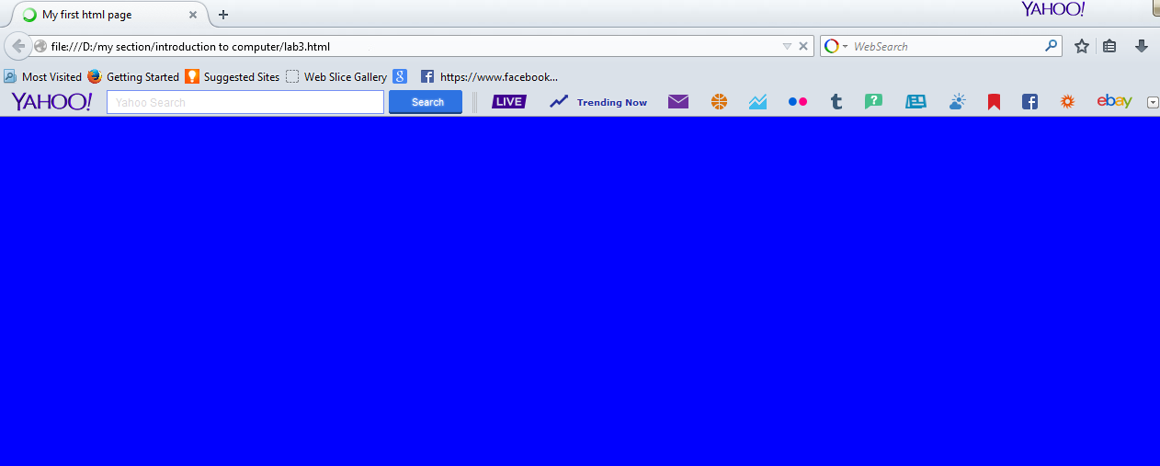

Slide 31
TEXT Color
The TEXT attribute is used to control the color of all the normal text in the document.
The default color for text is black.
The TEXT attribute would be added as follows:
<BODY BGCOLOR=“#FFFFFF” TEXT=“#FF0000”></BODY>
In this example the document’s page color is white and the text would be red.

Slide 32
<HTML>
<head>
<title> My first html page </title>
</head>
<BODY BGCOLOR="#FFFFFF" TEXT="#FF0000" >
<p>
introduction to computer course
</p>
</BODY>
</HTML>

Slide 33
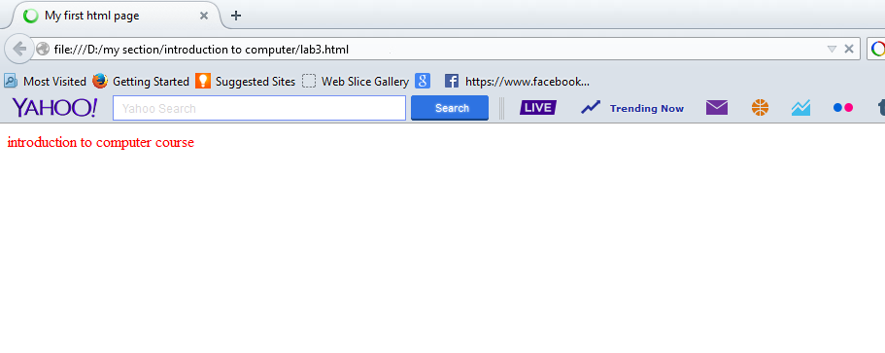

Slide 34
LINK, VLINK, and ALINK
These attributes control the colors of the different link states:
1. LINK – initial appearance – default = Blue.
2. VLINK – visited link – default = Purple.
3. ALINK –active link being clicked–default= Yellow.
The Format for setting these attributes is:
<BODY BGCOLOR=“#FFFFFF” TEXT=“#FF0000” LINK=“#0000FF”VLINK=“#FF00FF”ALINK=“FFFF00”> </BODY>

Slide 35
<HTML>
<head>
<title> My first html page </title>
</head>
<BODY BGCOLOR="#FFFFFF" LINK=“#0000FF" VLINK="#FF00FF" ALINK="FFFF00">
<p>
introduction to computer course
</p>
<a href="http://www.google.com"> open google web site </a>
</BODY>
</HTML>

Slide 36
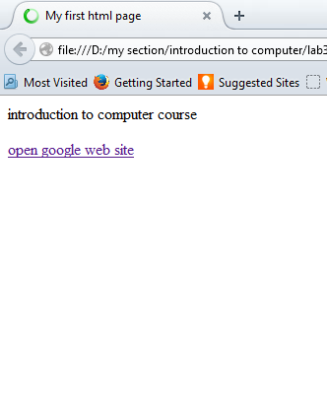
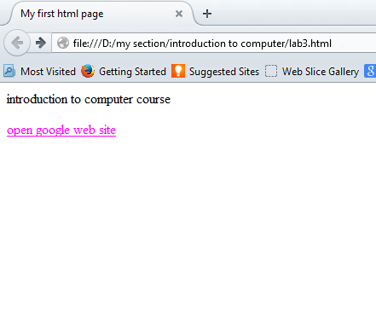
Initial appearance
Visited link

Slide 37
Using Image Background
The BODY element also gives you ability of setting an image as the document’s background.
An example of a background image’s HTML code is as follows:
<BODY BACKGROUND=“hi.gif” BGCOLOR=“#FFFFFF”></BODY>

Slide 38
<HTML>
<head>
<title> My first html page </title>
</head>
<BODY TEXT="#FF0000" BACKGROUND="Desert.jpg">
<p>
introduction to computer course
</p>
</BODY>
</HTML>

Slide 39
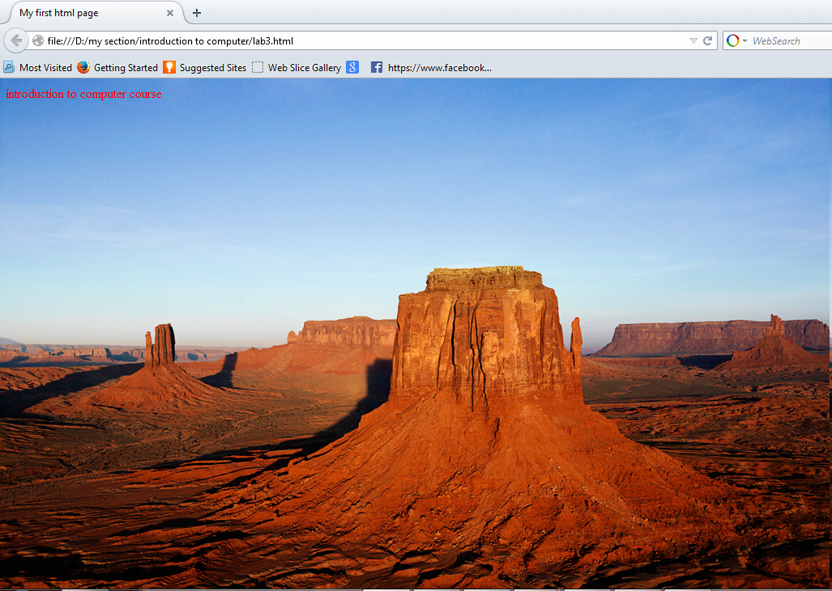

Slide 40
Headings, <Hx> </Hx>
<HTML>
<HEAD>
<TITLE> Example Page</TITLE>
</HEAD>
<BODY>
<H1> Heading 1 </H1>
<H2> Heading 2 </H2>
<H3> Heading 3 </H3>
<H4> Heading 4 </H4>
<H5> Heading 5 </H5>
<H6> Heading 6 </H6>
</BODY>
</HTML>
Heading 1
Heading 2
Heading 3
Heading 4
Heading 5
Heading 6

Slide 41
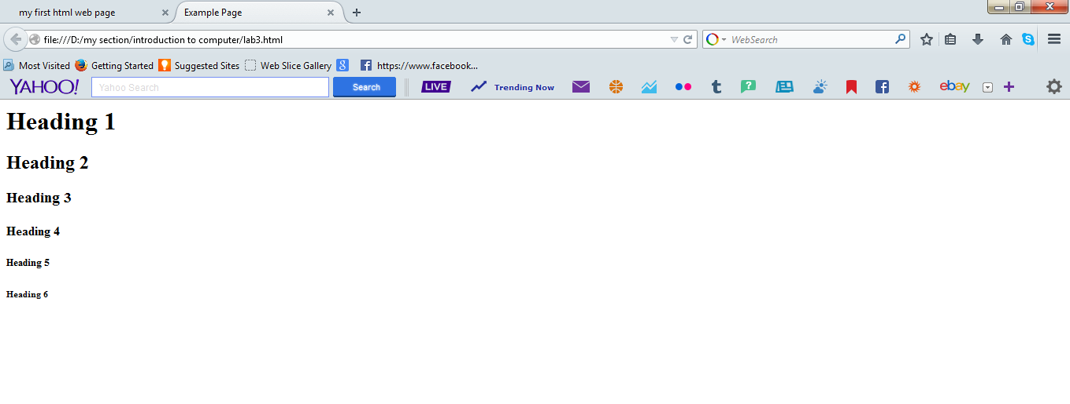

Slide 42
Paragraphs <P> </P>
Paragraphs are managed using the paragraph element, represented by an opening and closing tag <p>. . .</p>, with text content in between .
<p> introduction to computer course lab ,Introduction to HTML </p>

Slide 43
Example
<HTML>
<HEAD>
<TITLE> Example Page</TITLE>
</HEAD>
<BODY>
<H1> introduction to computer course </H1>
<p> introduction to computer course lab ,Introduction to HTML introduction to computer course lab ,Introduction to HTML introduction to computer course lab ,Introduction to HTML introduction to computer course lab ,Introduction to HTML introduction to computer course lab ,Introduction to HTML</p>
</BODY>
</HTML>

Slide 44
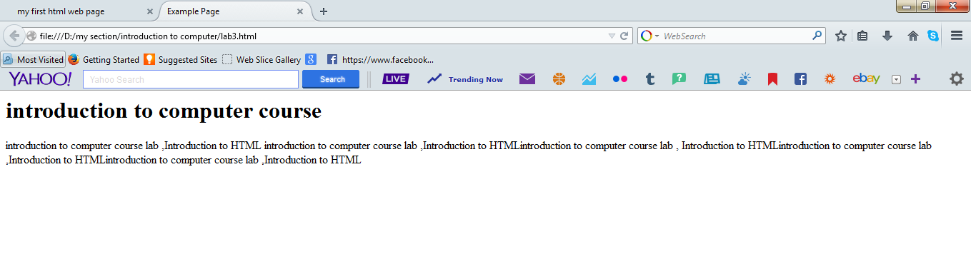

Slide 45
Break, <BR>
Line breaks allow you to decide where the text will break on a line or continue to the end of the window.
A <BR> is an empty Element, meaning that it may contain attributes but it does not contain content.
The <BR> element does not have a closing tag.

Slide 46
Break, <BR>
<HTML>
<HEAD>
<TITLE> Example Page</TITLE>
</HEAD>
<BODY>
<H1> Heading 1 </H1>
<P>Paragraph 1, <BR>
Line 2 <BR> Line 3 <BR>….
</P>
</BODY>
</HTML>
Heading 1
Paragraph 1,
Line 2
Line 3
….

Slide 47
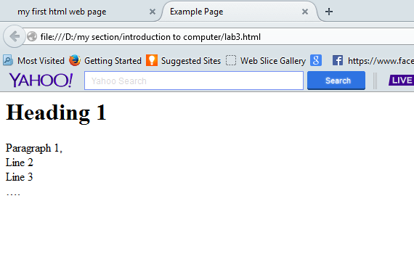

Slide 48
Horizontal Rule, <HR>
The <HR> element causes the browser to display a horizontal line (rule) in your document.
<HR> does not use a closing tag, </HR>.

Slide 49
Horizontal Rule, <HR>
<HTML>
<HEAD>
<TITLE> Example Page</TITLE>
</HEAD>
<BODY>
<H1> Heading 1 </H1>
<P>Paragraph 1, <BR>
Line 2 <BR>
<HR>Line 3 <BR>
</P>
</BODY>
</HTML>
Heading 1
Paragraph 1,
Line 2
________________________
Line 3

Slide 50
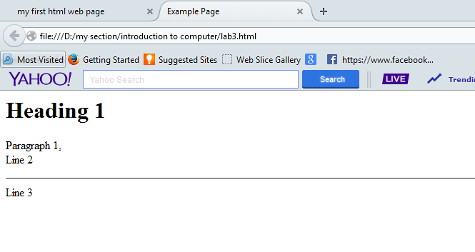

Slide 51
Character Formatting
<FONT SIZE=“+2”> Two sizes bigger</FONT>
The size attribute can be set as an absolute value from 1 to 7 or as a relative value using the “+” or “-” sign. Normal text size is 3 (from -2 to +4).
<B> Bold </B>
<I> Italic </I>
<U> Underline </U>
Color = “#RRGGBB” The COLOR attribute of the FONT element. E.g., <FONT COLOR=“#RRGGBB”>this text has color</FONT>

Slide 52
Bold, Italic and other Character Formatting Elements
<EM> Emphasis </EM> Browsers usually display this as italics.
<STRONG> STRONG </STRONG> Browsers display this as bold.

Slide 53
Bold, Italic and other Character Formatting Elements
<P> <FONT SIZE=“+1”> One Size Larger </FONT> - Normal –
<FONT SIZE=“-1”> One Size Smaller </FONT> <BR>
<B> Bold</B> - <I> italics</I> - <U> Underlined </U> -
<FONT COLOR=“#FF0000”> Colored </FONT> <BR>
<EM> Emphasized</EM> - <STRONG> Strong </STRONG>
One Size Larger - Normal – One Size Smaller Bold - italics - Underlined - Colored Emphasized - Strong

Slide 54
<HTML>
<head>
<title> My first html page </title>
</head>
<BODY>
<p>
introduction to computer course
<P> <FONT SIZE="+5"> five Size Larger </FONT> - Normal –
<FONT SIZE="-3"> three Size Smaller </FONT> <BR>
<B> Bold</B> - <I> italics</I> - <U> Underlined </U> -
<FONT COLOR="#FF0000"> Colored </FONT> <BR>
<EM> Emphasized</EM> - <STRONG> Strong </STRONG>
</p>
</BODY>
</HTML>

Slide 55
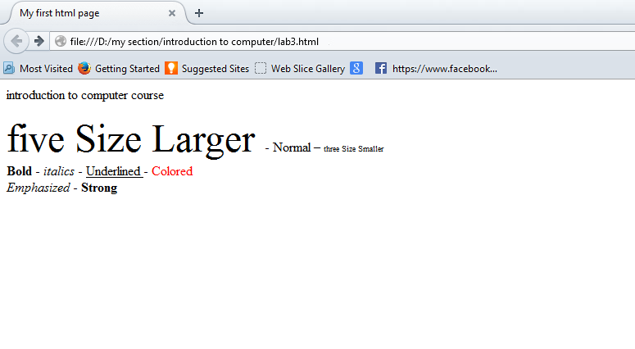

Slide 56
Lists
Create an unordered list.
Create an ordered list.
Nest Lists.

Slide 57
Ordered List
Two elements are required to create an ordered list.
The first is the <ol>. . . </ol> (ordered list) element.
the second is the <li> . . . </li> (list item)

Slide 58
<html>
<head>
<title> My first html page </title>
</head>
<body>
<p> introduction to computer</p>
<ol>
<li> element1 </li>
<li> element2 </li>
<li> element3 </li>
<li> element4 </li>
<li> element5 </li>
</ol>
</body>
</html>

Slide 59
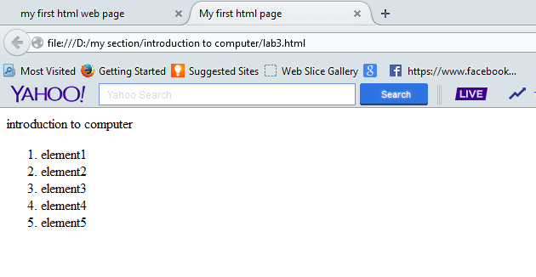

Slide 60
List Elements
TYPE | Numbering | Styles
1 | Arabic numbers | 1,2,3, ……
a | Lower alpha | a, b, c, ……
A | Upper alpha | A, B, C, ……
i | Lower roman | i, ii, iii, ……
I | Upper roman | I, II, III, ……

Slide 61
<html>
<head>
<title> My first html page </title>
</head>
<body>
<p> introduction to computer</p>
<ol TYPE ="i" >
<li> element1 </li>
<li> element2 </li>
</ol>
<ol TYPE = "1" >
<li> element1 </li>
<li> element2 </li>
</ol>
</body>
</html>

Slide 62
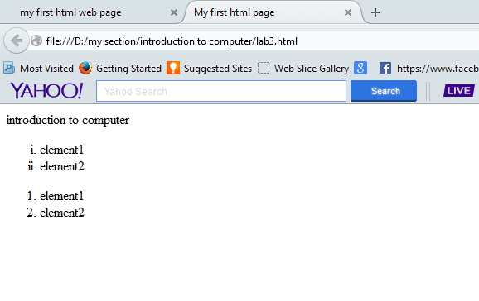

Slide 63
Unordered List
An unordered list works exactly the same way that an ordered list does, but it simply uses the <ul>. . .</ul> (unordered list) element instead of the ordered list element.

Slide 64
<html>
<head>
<title> My first html page </title>
</head>
<body>
<p> introduction to computer</p>
<ul>
<li>element 1</li>
<li>element 2</li>
<li>element 3</li>
<li>element 4</li>
</ul>
</body>
</html>

Slide 65
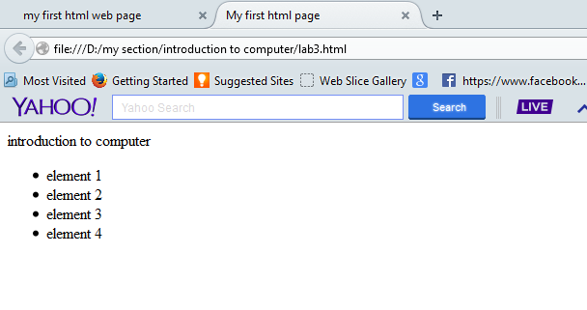

Slide 66
List Elements
You have the choice of three bullet types: disc(default), circle, square.
<UL TYPE=“square”>
<LI> List item …</LI>
<LI> List item …</LI>
<LI> List item …</LI>
</UL>

Slide 67
<html>
<head>
<title> My first html page </title>
</head>
<body>
<p> introduction to computer</p>
<ul TYPE="square" >
<li>element 1</li>
<li>element 2</li>
<li>element 3</li>
<li>element 4</li>
</ul>
<ul TYPE="circle" >
<li>element 1</li>
<li>element 2</li>
<li>element 3</li>
<li>element 4</li>
</ul>
</body>
</html>

Slide 68
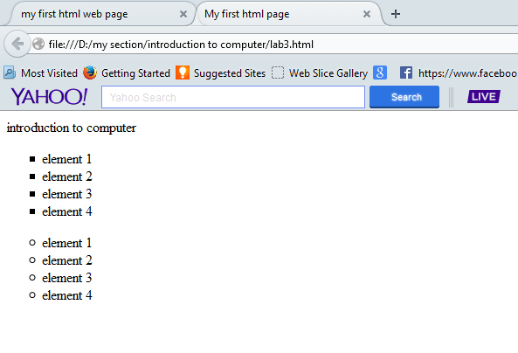

Slide 69
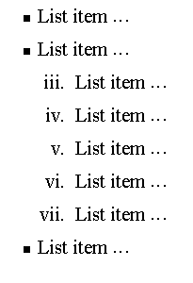
Nesting Lists
You can nest lists by inserting a UL, OL, etc., inside a list item (LI).
Example
<UL TYPE = “square”>
<LI> List item …</LI>
<LI> List item …
<OL TYPE=“i” START=“3”>
<LI> List item …</LI>
<LI> List item …</LI>
<LI> List item …</LI>
<LI> List item …</LI>
<LI> List item …</LI>
</OL>
</LI>
<LI> List item …</LI>
</UL>

Slide 70
Alignment
Some elements have attributes for alignment (ALIGN) e.g. Headings, Paragraphs and Horizontal Rules.
The Three alignment values are : LEFT, RIGHT, CENTER.

Slide 71
<html>
<head>
<title> My first html page </title>
</head>
<body>
<h1 align="center"> introduction to computer</h1>
<ul TYPE="circle" >
<li>element 1</li>
<li>element 2</li>
<li>element 3</li>
<li>element 4</li>
</ul>
</body>
</html>

Slide 72
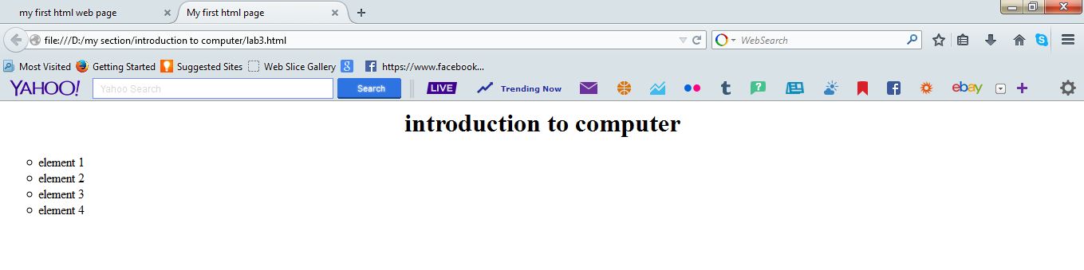

Slide 73
<html>
<head>
<title> My first html page </title>
</head>
<BODY>
<H1 ALIGN="CENTER">SAFETY TIPS FOR CANOEISTS</H1>
<OL TYPE="a" START="2">
<LI>Be able to swim </LI>
<LI>Wear a life jacket at all times </LI>
<LI>Don't stand up or move around. If canoe tips,
<UL>
<LI>Hang on to the canoe </LI>
<LI>Use the canoe for support </LI>
<LI>Swim to shore </LI>
</UL>
</LI>
<LI>Don't overexert yourself </LI>
<LI>Use a bow light at night </LI>
</OL>
</BODY>
</HTML>
What
will
be the
output?

Slide 74
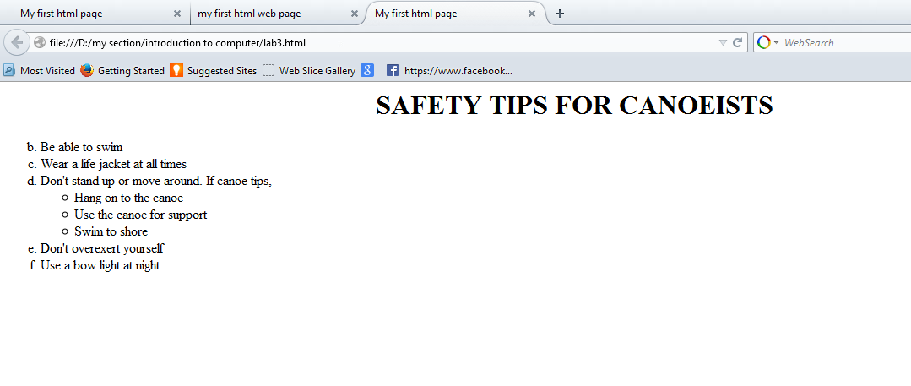

Slide 75
Tables
Why tables ?????
Display the names of students and their data.
Organize the web page.
The table was defined using <table> element
Tables attributes :
Width
Height
Align
Border
Cell spacing :the distance between the cells.
Cell padding: the distance between cell and its content.

Slide 76
Tables <table> </table>
The table row can be drown using the <tr> element as a staring tag and </tr> as a closing tag
Table cells provide the vertical columns of your table.
The<td> stands for table data as each row contains number of cell which contains the data of the table
Table header <th> </th> denotes the header of a column or row within a table.

Slide 77
<html>
<head>
<title> My first html page </title>
</head>
<BODY>
<table width="90%" border="1" cellspacing="15" cellpadding="50" >
<tr>
<th>Location</th>
<th>Weather</th>
<th>Time Zone</th>
</tr>
<tr>
<td>Tucson, Arizona</td>
<td>Warm to Hot</td>
<td>No Daylight Savings</td>
</tr>
</table>
</BODY>
</HTML>

Slide 78
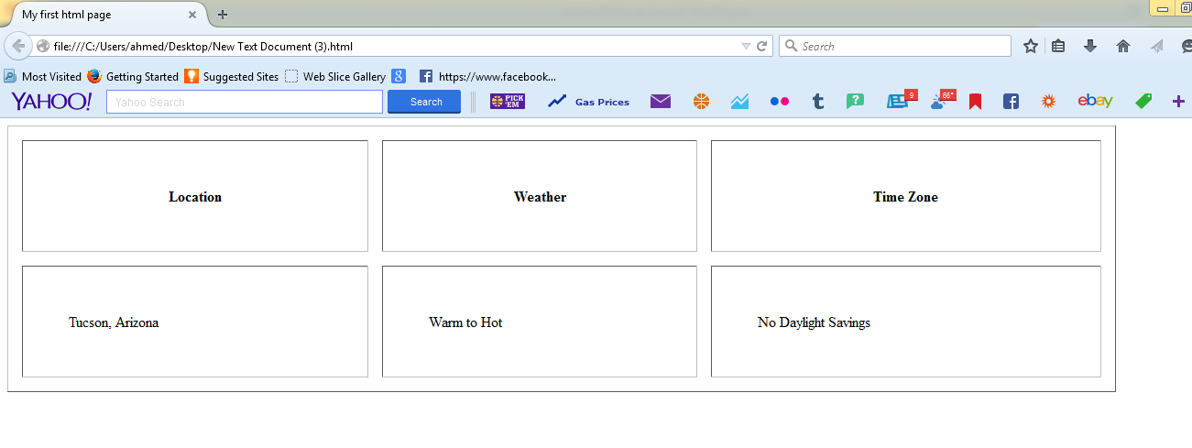

Slide 79
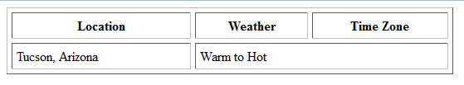
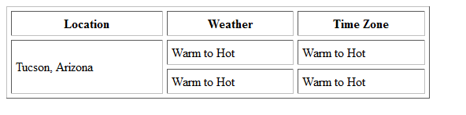
Table
Column span attribute
<td colspan ="2"> Warm to Hot </td>
Row span attribute
<td rowspan ="2">Tucson, Arizona</td>

Slide 80
colspan
<html>
<head>
<title> My first html page </title>
</head>
<BODY>
<table width="40%" border="1" cellspacing="5" cellpadding="5" >
<tr>
<th>Location</th>
<th>Weather</th>
<th>Time Zone</th>
</tr>
<tr>
<td >Tucson, Arizona</td>
<td colspan ="2">Warm to Hot</td>
</tr>
</table>
</BODY>
</HTML>

Slide 81
rowspan
<html>
<head>
<title> My first html page </title>
</head>
<BODY>
<table width="40%" border="1" cellspacing="5" cellpadding="5" >
<tr>
<th>Location</th>
<th>Weather</th>
<th>Time Zone</th>
</tr>
<tr>
<td rowspan ="2">Tucson, Arizona</td>
<td>Warm to Hot</td>
<td>Warm to Hot</td>
</tr>
<tr>
<td>Warm to Hot</td>
<td>Warm to Hot</td>
</tr>
</table>
</BODY>
</HTML>

Slide 82
Image Element <img />
When working with images, the element you'll be using is img.
It doesn't require a closing tag. It's written in HTML as <img /> .
The next thing you'll want to do for your image is add width and height values.
“Alt” is the text that will appear if the image is not exist.

Slide 83
<html>
<head>
<title> My first html page </title>
</head>
<BODY>
<img src="Desert.jpg" width="250“ height="188" alt="Desert image" />
</BODY>
</HTML>

Slide 84
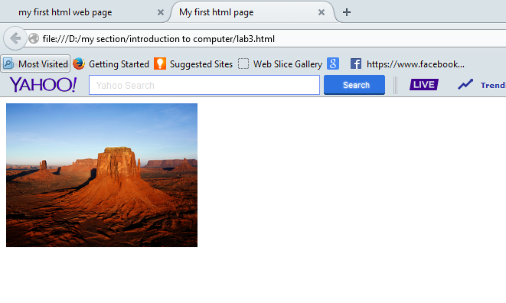

Slide 85
Links <a href=“ “></a>
Standard links are generated using the anchor element <a>. . .</a>.
The hypertext reference attribute (href) is used to denote the link address .
Text content within the opening and closing tags will appear as linked text.

Slide 86
<html>
<head>
<title> My first html page </title>
</head>
<BODY BGCOLOR="#FFFFFF" TEXT="#FF0000" >
<p>
introduction to computer course
</p>
<a href="http://www.google.com"> open Google web site </a>
</BODY>
</HTML>

Slide 87
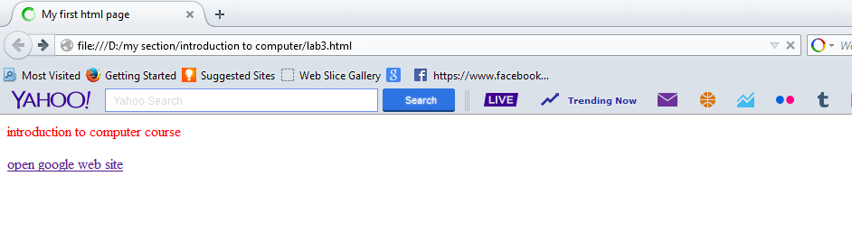

Slide 88
HTML Comments
Comment <!--...-->
Another important piece of markup that you'll want to get started using right away is HTML comments.
Comments enable you to hide content or markup for temporary purposes or backward compatibility, to identify sections within your document, and to provide directives for other folks who might be working on the page.

Slide 89
Assignment
Creating a simple website layout like this one
1- Image (images/logo.jpg) resized to (100X100 px) followed by a header (Faculty of computer and information science).
2- Paragraph with any text
3- Three links (Home - Services - About Us – Contact Us).
4- footer with text (FCIS 2015).

Slide 90
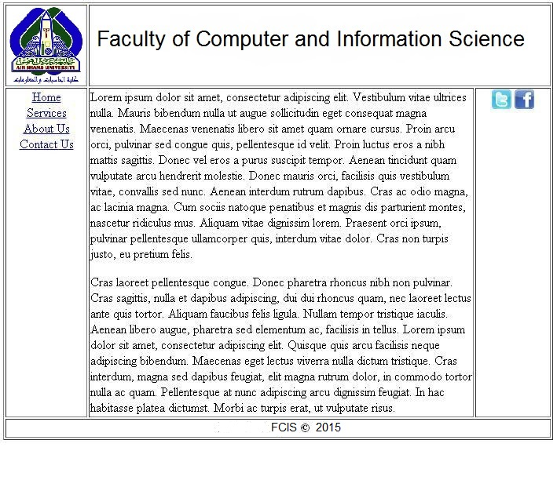

Slide 91
Thanks

