Slide 1
Sales & Performance Dashboard Analysis
Based on Tableau Visualization

Slide 2
Overview
This presentation provides insights derived from the Tableau dashboards.
Key focus areas include:
- Total Sales & Profit
- Regional Sales Distribution
- Profit Margins & Growth
- Sales Trend Analysis
- Top Product Performance
- Impact of Discounts on Metrics

Slide 3
KPI Summary
- Total Sales: 742K
- Profit: ₹18K
- Profit Margin: 2%
- Growth: 8%
The business shows strong sales performance but relatively low profit margins.

Slide 4
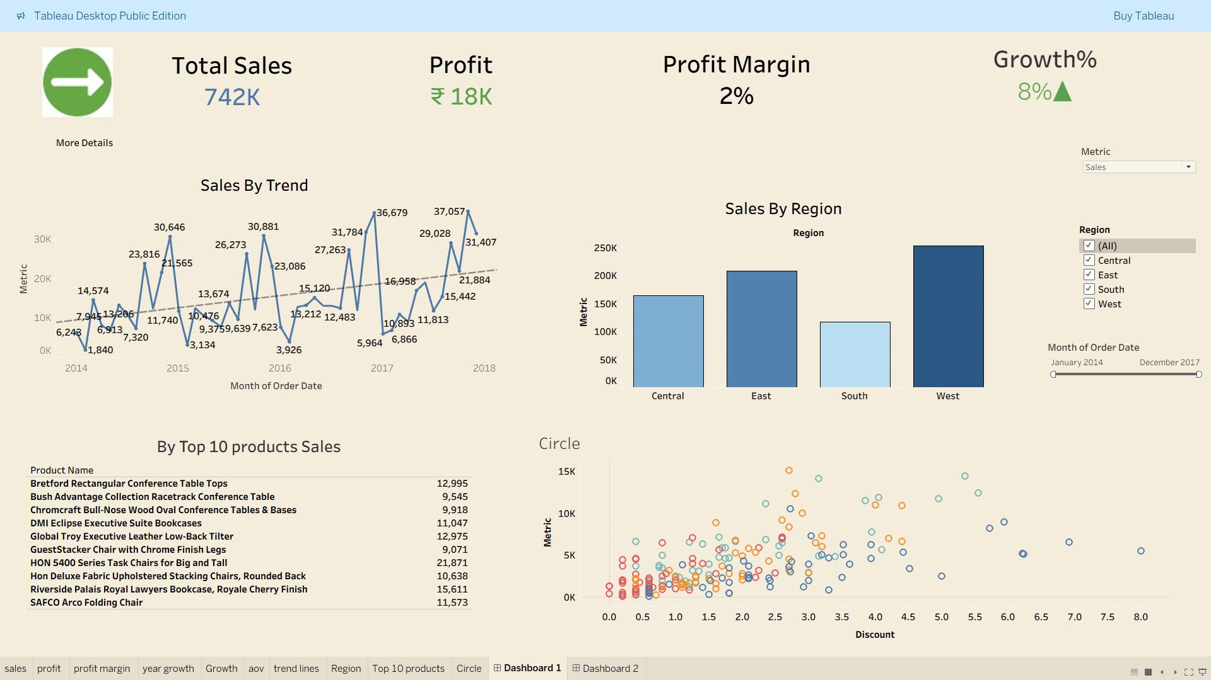
Sales by Region

Slide 5
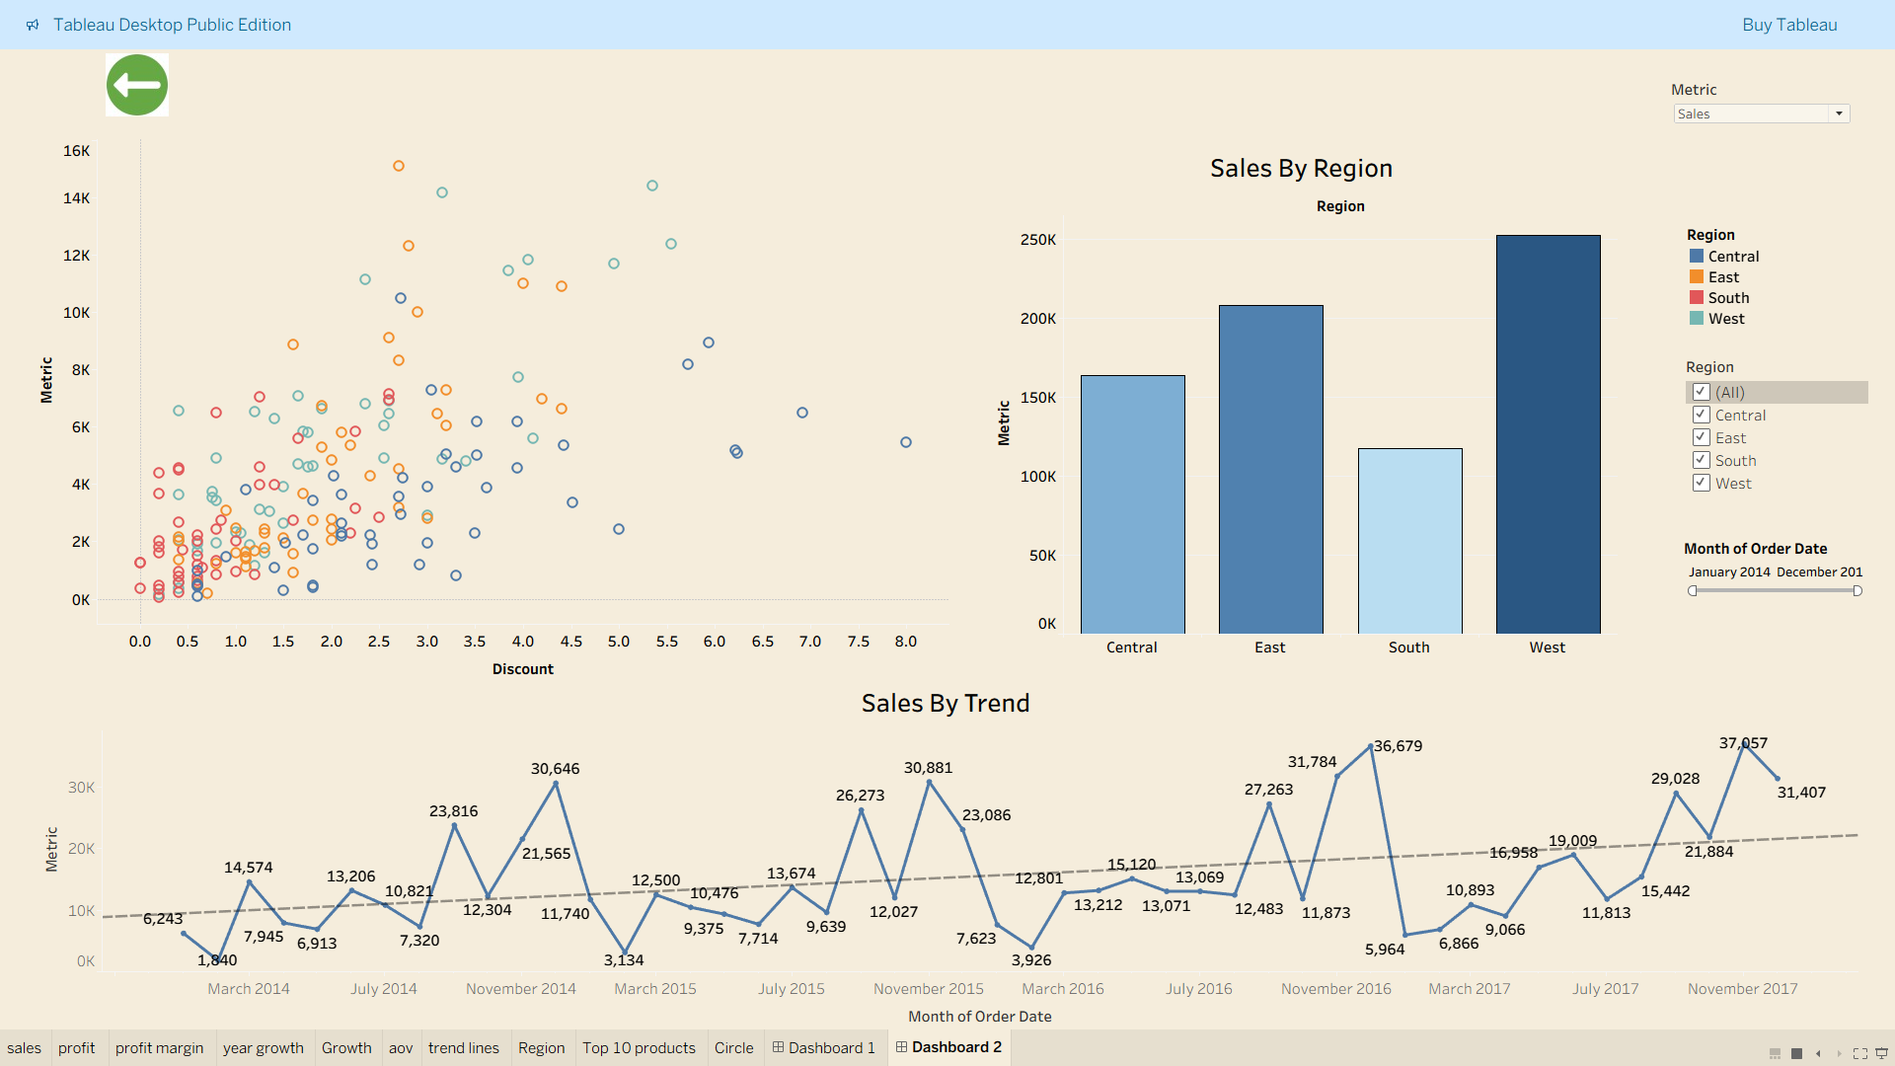
Sales Trend Analysis

Slide 6
Top 10 Products Sales
1. Bretford Rectangular Conference Table Tops - 12,995
2. Bush Advantage Collection Racetrack Conference Table - 9,545
3. Chromcraft Bull-Nose Wood Oval Conference Tables & Bases - 9,918
4. DMI Eclipse Executive Suite Bookcases - 11,047
5. Global Troy Executive Leather Low-Back Tilter - 12,975
6. GuestStacker Chair with Chrome Finish Legs - 9,071
7. HON 5400 Series Task Chairs for Big and Tall - 21,871
8. Hon Deluxe Fabric Upholstered Stacking Chairs - 10,638
9. Riverside Palais Royal Lawyers Bookcase - 15,611
10. SAFCO Arco Folding Chair - 11,573

Slide 7
Discount vs Metrics
The scatter plot shows that:
- Higher discounts generally correlate with higher sales volume.
- However, discounts beyond a certain level do not guarantee proportional profit gains.
- Need to optimize discounting strategy to balance volume and profitability.

Slide 8
Conclusion
• Sales are growing steadily with an 8% growth rate.
• Regional analysis shows the West region is the top performer.
• Despite strong sales, profit margins remain low at 2%.
• Discounting strategy needs optimization to avoid margin erosion.
• Focus on high-performing products and regions to maximize profitability.

