Slide 1

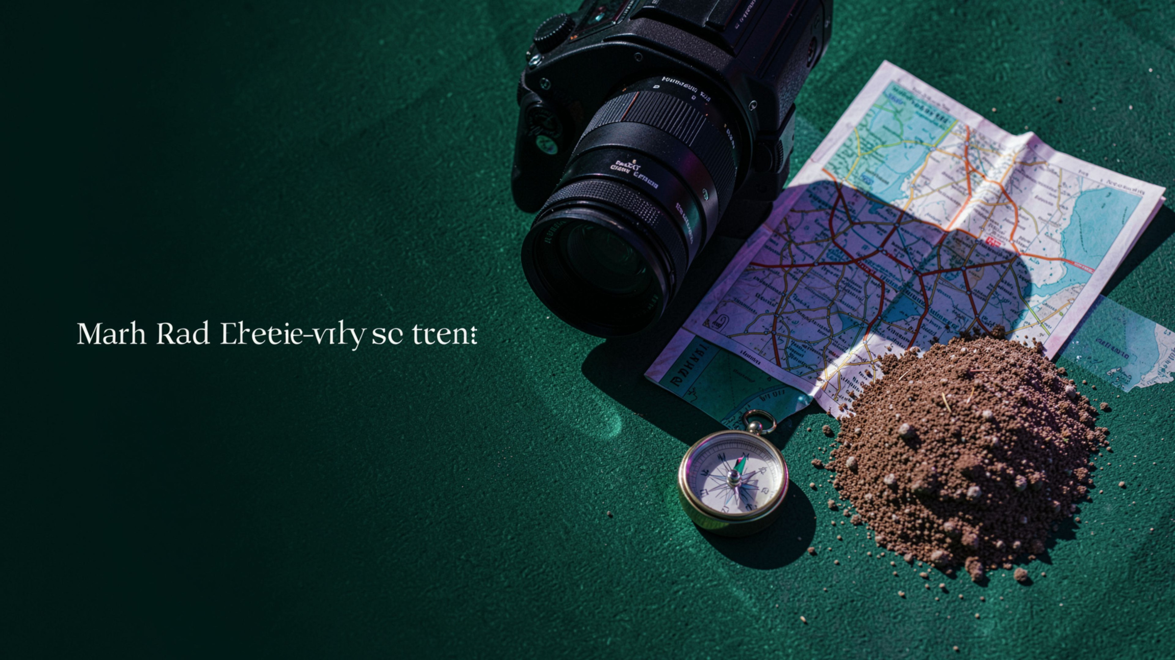
VISION LOCATOR · TECHNICAL OVERVIEW
GeoGuessr AI:
Global & Hyper-Local
Vision Locator
Predict geographic origins from ordinary street-view imagery using StreetCLIP, residual vision adapters, and multi-scale test-time augmentation.
Notes:
1

Slide 2




From human clues to a local-first AI locator
Challenge
Infer location from photos without famous landmarks.
Human intuition
Driving side, road markings, soil pigmentation, foliage, and architecture.
Coverage
Local by design
475+ canonical locations across 104 countries, all 28 Indian States and 8 UTs, plus 100+ rural Kerala micro-regions.
Offline inference, local EXIF parsing, and vector matching with no API dependency.
02
Notes:
2

Slide 3
End-to-end system architecture
Input
Perception
Representation
1
2
3
Street-view image + optional local EXIF GPS.
Four crops expose macro context and micro-clues.
Frozen StreetCLIP ViT-B/32 creates 768-dim embeddings.
Adaptation
Retrieval
Output
4
5
6
Residual bottleneck MLP refines the fused vision vector.
Compare against a 475-location vector knowledge base.
Calibrated ranked predictions in a Streamlit tactical HUD with map context.
03
Notes:
3

Slide 4
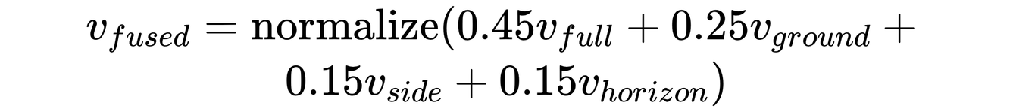
Multi-scale TTA preserves the clues resizing loses
Weighted crops keep localized evidence and broad scene context in one normalized 768-dim vector.
MACRO
MICRO
Full scene · 45%
Ground / soil · 25%
Macro landscape and architecture.
Laterite, dust, pavement texture.
EDGE
CONTEXT
Roadside margin · 15%
Horizon · 15%
Signs, poles, lane markings.
Terrain and skyline context.
Localized micro-cues and broad scene context contribute to one normalized 768-dim vector.
WEIGHTED FUSION
04
Notes:
4

Slide 5
Residual adapter: improve localization without forgetting
Frozen foundation | 1.7 GB StreetCLIP backbone stays fixed.
Bottleneck | LayerNorm → Linear 768→256 → GELU → Linear 256→768.
Residual blend | v_{adapted} = \operatorname{normalize}(0.5v_{fused} + 0.5residual)
Identity initialization | Zero-initialized final layer preserves baseline behavior at epoch 0.
EMPIRICAL RESULT
66.04% → 100%
Top-1 accuracy improved from 66.04% zero-shot to 100% on the evaluation dataset.
05
Notes:
5

Slide 6
Knowledge base turns geography into grounded retrieval
LOCATION INDEX
TEXT ENSEMBLE
3-way text ensemble
475
0.50 visual description + 0.30 canonical name + 0.20 geographic hierarchy, normalized to 768 dimensions.
indexed locations
225 global countries/cities, 48 Pan-India states/UTs, 180 Kerala village micro-regions.
RICH SCHEMA
Latitude/longitude, country, region, category, driving side, and visual clues.
VERIFIED EVIDENCE
104 verified exemplars: high-resolution street-view references in Imgs/.
COMPACT STORAGE
embeddings_cache.pt is 1.6 MB.
06
Notes:
6

Slide 7
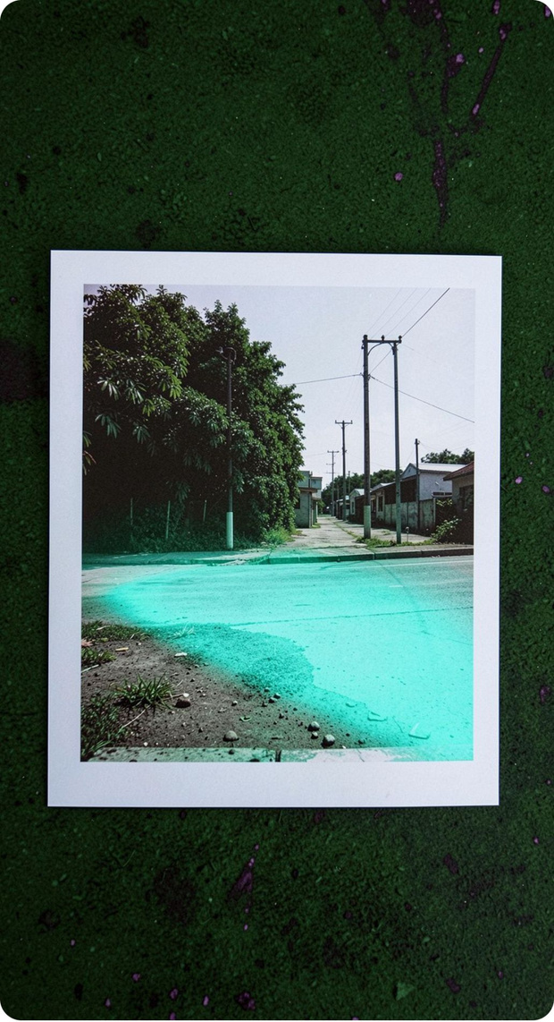





Explainability makes the prediction inspectable
Patch heatmap
Zero-shot clue probes
Micro-Clue Evidence Booster
576 ViT spatial tokens, scored against the target location vector on a 24×24 grid, then upsampled bicubically.
Vegetation, road surface, traffic side, and terrain.
Adjusts candidate scores when environmental clues agree.
Calibrated confidence
Ground truth & game layer
Local EXIF tag 0x8825, uncertainty radius, Google Earth 3D flyover links; official GeoGuessr score = round(5000 × exp(−distance/2000)).
Temperature softmax with τ = 35.0 over 475 candidates.
INSPECTABLE EVIDENCE
07
Notes:
7

Slide 8
Human-in-the-loop learning keeps the map alive
1
2
Correct
Curate
User selects the true location after an incorrect prediction.
New visual clues are added to the curated record.
3
4
Store
Update safely
Normalized 768-dim image vectors are stored in corrections_cache.pt with match threshold ≥ 0.92.
Existing 3-way prompt embeddings are updated in place; duplicates are blocked through a 4-stage lowercase canonical-name safety net.
5
Hot-reload
load_database.clear() hot-reloads updates without restarting.
Team roles: Location Curator · Image Collector · Model Trainer · Systems Developer. GitHub Actions and validate_pipeline.py enforce the quality gate.
08
Notes:
8

Slide 9
Engineering outcomes and the next frontier
Delivered
Current limits
sub-0.03 second cold start; 1.58 MB adapter weights; 15 km-scale Kerala micro-region differentiation; verified-location grounding.
Static 2D images and a closed vocabulary of 475 locations.
Future scope
Challenges solved
360° equirectangular panoramas across four cardinal directions; hierarchical GPS regression with Uber H3 hexagonal spatial cells.
Catastrophic forgetting through a lightweight bottleneck adapter; database corruption through automated vector deduplication.
09
Notes:
9

