Slide 1
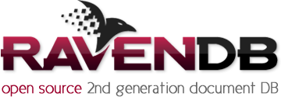



RavenDB: working with NoSQL data in .NET
Mohammed Ibrahim
Developer
Maclean Electrical ltd.
Mohammedovich@hotmail.co.uk
@Mohammedovich
http://mohammedovich.wordpress.com

Slide 2
Talk outline
NoSQL Background
RavenDB Overview
RavenDB Usage
RavenDB Features
RavenDB Advanced

Slide 3
NoSQL Background

Slide 4
NoSQL Background
Stands for: Not Only SQL
Definition:
NoSQL is a non-relational database that has great beneficial in terms of data retrieval, cheap, flexible data model and can handle big data. It focuses on the task of high-performance scalable data storage, and provide low-level access to data management layer.

Slide 5
NoSQL Background
Non-relational data storage system
Do not require a fixed table schema, or use the concept of joins
Different types of NoSQL
Drops Consistency in favour of Availability

Slide 6
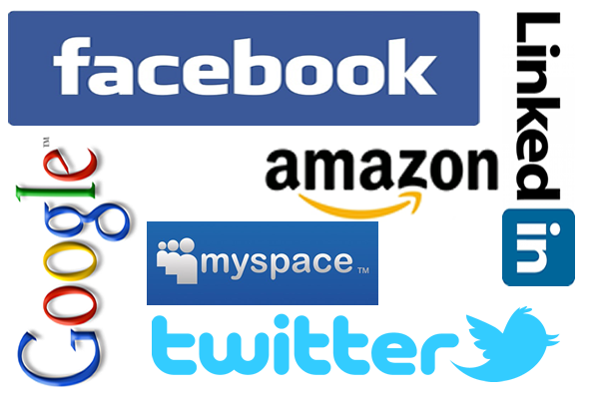
NoSQL Used By

Slide 7

Document Database
Data accessibility over data persistency
JSON and XML formats
Why? and When?
Example:
{
"ScreenName": "MaximumLan",
"Name": "MaximumLan",
"ProfileImageUrl":
"Text": "Google's Reaction to Microsoft Surface",
"At": "2012-06-21T14:52:45.0000000",
"TweetId": 215804452924440577
}

Slide 8
RavenDB

Slide 9
Overview

Slide 10
RavenDB - Overview
No Schemas
Transactional
Safe by default
High Performance
Scalable
Extensible
ACID for Writes, BASE for Reads

Slide 11
RavenDB Usage

Slide 12
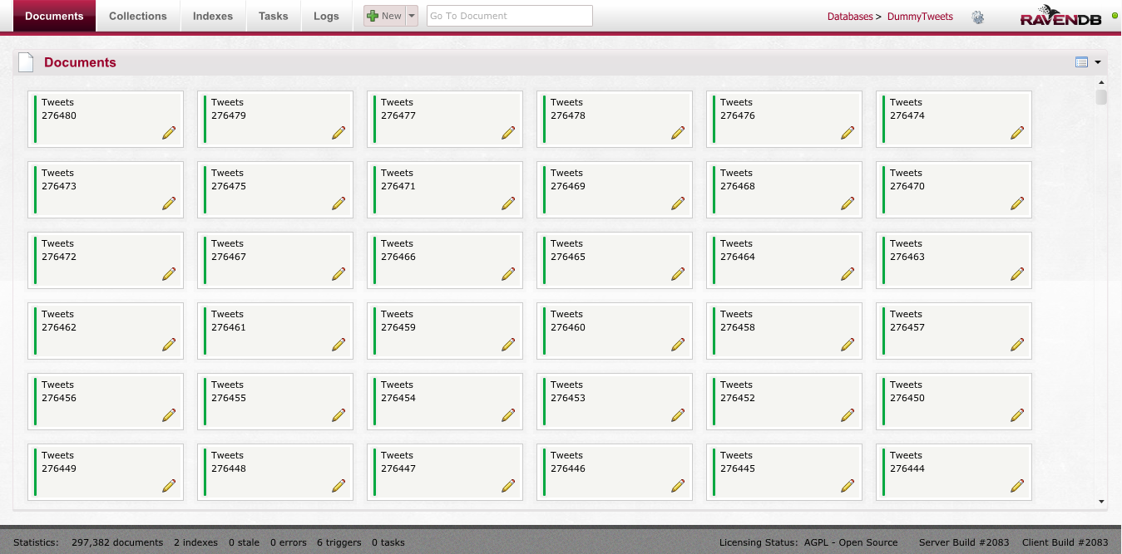
Management Studio
View Databases
Navigation
Indexes
Logs
Tasks

Slide 13
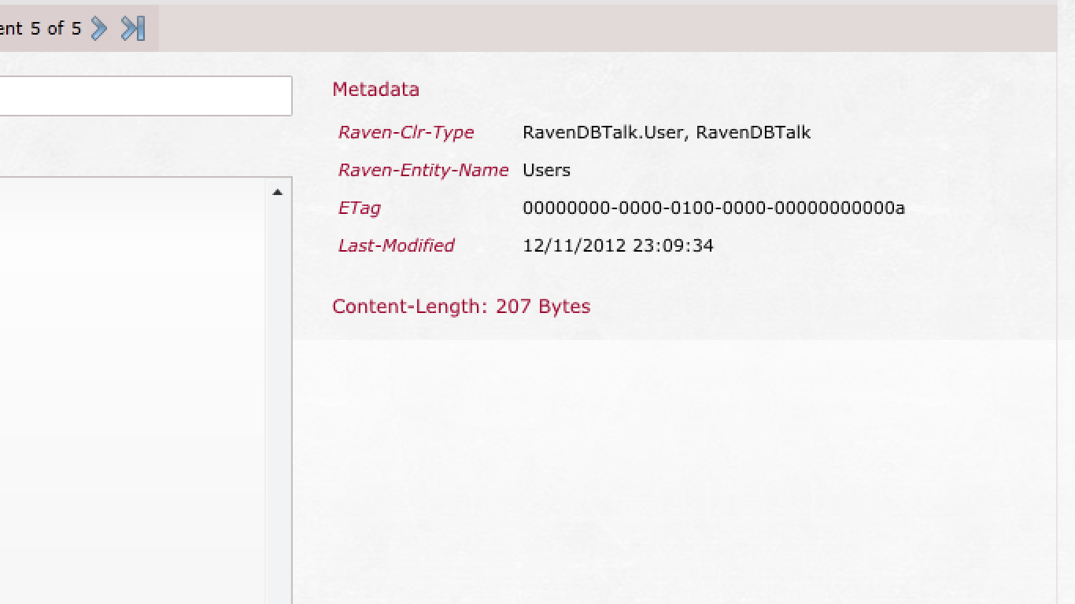
RavenDB Advanced – Metadata
Every document has metadata
Used internally but exposed for usage

Slide 14
RavenDB Advanced – Metadata
Retrievable through ”Advanced.GetMetadataFor”
Manipulate Metadata
Explicitly – Manipulate retrieved object and add your own keys
Listeners – Register an implementation of IDocumentStoreListener which will be called when any session is about to store the entity
var product = session.Load<Product>(1);
RavenJObject metadata = session.Advanced.GetMetadataFor(product);
// Get the last modified time stamp, which is known to be of type DateTime
DateTime collectionName = metadata.Value<DateTime>(Constants.LastModified);

Slide 15
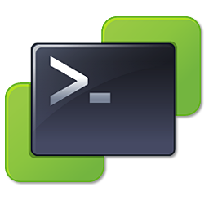
Backups
RavenDB supports Backup and Restore
Two ways to perform backup:
Existing backup solution – VSS
RavenDB’s own backup (Smuggler) and restore system
Raven.Backup.exe --url=http://localhost:8080/ --dest=C:\Temp\Foo –nowait --readkey
$dest = "F:\Backup\Runs\backup-"+(Get-Date).ToString("yyyy-MM-dd HHmm")
.\Raven.Backup.exe --url=http://localhost:8080/ --dest=$dest
& 'C:\Program Files\7-Zip\7z.exe' a $dest $dest
Remove-Item -Recurse $dest

Slide 16
APIs - HTTP
RESTful
GET
PUT
POST
DELETE
PATCH
e.g.
[{ Type: ‘Set’, Name: ‘IsActive’, Value: false }]
[{ Type: ‘Unset’, Name: ‘IsActive’ }]
[{ Type: 'Rename', Name: ‘Name', Value: ‘FullName' }]

Slide 17
APIs - .NET Client
Main Classes:
IDocumentStore:
Client/Server communication
Session Factory
Only created once
Expensive to create
IDocumentSession:
Load, Query, Save & Delete
Cheap to Create
Unit Of Work (UoW)
Transaction Management

Slide 18
RavenDB Features

Slide 19
Configuration Options
Core Settings
Index Settings
Data Settings
HTTP Settings
Misc. Settings
Esent Settings
<configuration>
<appSettings>
<add key="Raven/Port" value="*"/>
<add key="Raven/DataDir" value="~\Data"/>
<add key="Raven/AnonymousAccess" value="Get" />
<add key="Raven/MaxPageSize" value=“2024" />
<add key="Raven/RunInMemory" value=“true" />
<add key="Raven/PluginsDirectory" value=“~/Plugins" />
<add key="Raven/Authorization/Windows/RequiredGroups" value=“Admin, Developers" />
<add key="Raven/Esent/CacheSizeMax" value=“1500" />
</appSettings>
</configuration>
Notes:
http://ravendb.net/docs/server/administration/configuration

Slide 20
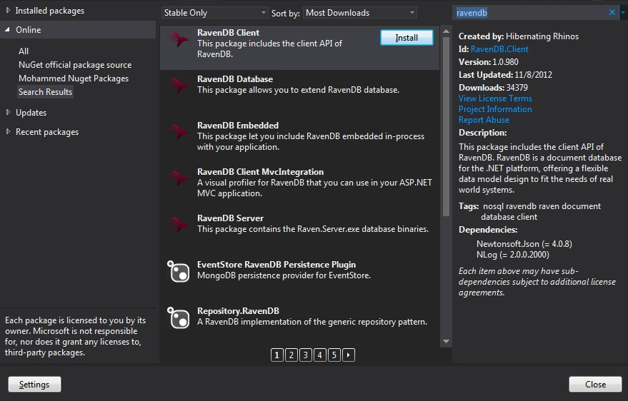

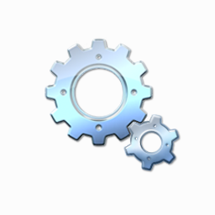
Installation
Download from:
NUGET
RavenDB website
Run as:
Service
IIS
Embedded

Slide 21
Access RavenDB
DocumentStore
var store = new DocumentStore
{
Url = "http://localhost:8080",
DefaultDatabase = "RavenOverflow"
}.Initialize();
DocumentSession
using (var session = store.OpenSession())
{
var user = new {Id = "users/1", Name = "Mohammed"};
session.Store(user)
session.SaveChanges();
}
Notes:
DEMO

Slide 22
Basic Operations
Safe by Default
DocumentSession
Unit Of Work (UoW)
Batching
Key Generation
CRUD operation

Slide 23
Querying
Indexes used for querying
Uses LINQ to query RavenDB
Static or Dynamic/Temporary indexes
IQueryable
session.Query<User>().Where(user => user.Name = “mohammed")
var user = from employee in session.Query<Employee>()
Where employee.Name == “mohammed ibrahim"
select employee;

Slide 24
Querying – Any()/In() operator
// return all employees with surname of mohammed
var companies = from x in session.Query<Company>()
where x.Employees.Any(n => n.Surname == "Mohammed")
// Query on nested collections
var companies = from c in session.Query<Company>()
where c.Employees.Any(x => x.Specialities.Any(sp => sp == "C#"))
select c;
// IN operator –
var companies = from x in session.Query<Company>()
where x.Country.in(new [] { "Kuwait", "UK" })
select x;

Slide 25
Querying – Lucene
Used for Full-Text search queries.
Tokenization
Lucene Analyzers
StandardAnalyzer
StopAnalyzer
SimpleAnalyzer
WhitespaceAnalyzer
KeywordAnalyzer
session.Advanced.LuceneQuery<User>()
.WhereEquals(x => x.DisplayName, "Mohammedovich")
.OrElse()
.WhereStartsWith(x => x.DisplayName, "Mohamm");
Field:
RavenDB, is awesome 1234
Tokenized:
[RavenDB] [is] [awesome] [1234]

Slide 26
Querying - Projections
Projections – returning partial documents
var companyNames = from c in session.Query<Company>()
where c.Employees.Any(x => x.Specialities.Any(sp => sp == "C#"))
select new { c.Name }; // This is where the projection happens
var companies = (from c in session.Query<Company>()
where c.Employees.Any(x => x.Specialities.Any(sp => sp == "C#"))
// This is where the projection happens
select new Company { Name = c.Name })
.ToArray();

Slide 27
Querying - Statistics
Query Statistics
Query Options
WaitForNonStaleResultsAsOfNow()
WaitForNonStaleResultsASOfLastWrite()
RavenQueryStatistics stats;
var results = session.Query<User>()
.Statistics(out stats)
.Skip(0 * 10)
.Take(10)
.Where(x => x.FullName == "mohammed")
.ToArray();

Slide 28
Attachments
Store and Manage large binary BLOBs
// STORE ATTACHMENT
// don't forget to load the data from a file or something!
Stream data = new MemoryStream(new byte[] { 1, 2, 3 });
documentStore.DatabaseCommands.PutAttachment("videos/2", null, data,
new RavenJObject { { "Description", "Kids play in the garden" } });
// RETRIEVE ATTACHMENT
Raven.Abstractions.Data.Attachment attachment = documentStore.DatabaseCommands.GetAttachment("videos/1");
// DELETE ATTACHMENT
documentStore.DatabaseCommands.DeleteAttachment("videos/1", null);

Slide 29
Indexes, Map/Reduce
Efficient way to query
DocumentStore is ACID
Queries are BASE
Map/Reduce functions using LINQ
Type of Indexes:
Static
Dynamic / Temporary

Slide 30
Indexes, Map/Reduce
Map
Id | Category
1 | RavenDB
2 | SQL
3 | RavenDB
from doc in docs
select new
{
doc.Category
Count = 1
}
Category | Count
RavenDB | 1
SQL | 1
RavenDB | 1

Slide 31
Indexes, Map/Reduce – Aggregation
SQL
LINQ
SELECT t.Category, COUNT(*)
FROM tableA t
GROUP BY t.Category
from doc in docs
group doc by doc.Category into g
select new
{
g.Key,
g.Count()
}

Slide 32
Indexes, Map/Reduce
Reduce
Category | Count
RavenDB | 1
SQL | 1
RavenDB | 1
from result in results
group result by result.Category
into g
select new
{
Category = g.Key,
Count = g.Sum(x => x.Count)
}
Category | Count
RavenDB | 2
SQL | 1

Slide 33
Indexes, Map/Reduce
Map = users => from user in user
select new
{
// Higher relevance then DisplayName
FullName = user.FullName.Boost(3),
user.DisplayName
};
Boosting
Store
Sort
Store(x => x.FullName, FieldStorage.Yes);
Sort(x => x.DisplayName, SortOptions.String);

Slide 34
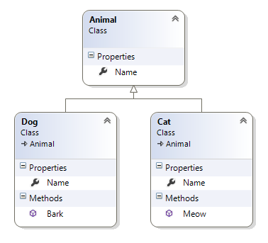
Polymorphism
No Inheritance association required
Multi-Map index
public class AnimalsIndex : AbstractMultiMapIndexCreationTask
{
public AnimalsIndex()
{
AddMap<Cat>(cats => from c in cats
select new { c.Name });
AddMap<Dog>(dogs => from d in dogs
select new { d.Name });
}
}
session.Query<Animal, AnimalsIndex>().Where(x => x.Name == “lolo");

Slide 35
Domain Design

Slide 36

Domain Design
Cardinality
No Single solution
Transactional Boundaries
Aggregate Root
Value Type
Size consideration

Slide 37
Domain Design – Document Relationships
Independent documents in RavenDB
Denormalization – Not recommended
Includes
Multi-Map
Live Projection
var order = session.Include<Order>(x => x.CustomerId)
.Load("orders/1234");
// this will not require querying the server!
var cust = session.Load<Customer>(order.CustomerId);
documentSession.Query<Order, CustomerOrderIndex>()
.Where(x => x.CustomerId == customerId)
.As<CustomerOrderViewItems>()
.ToArray();

Slide 38
Extensibility

Slide 39
Extensibility
MEF (Managed Extensibility Framework)
Triggers
PUT
DELETE
Read
Index Update
Request Responders

Slide 40

Bundles
RavenDB’s main extension point
Very flexible
Easy to create
Drop in plugins
RavenDB Document Configuration
Use wisely

Slide 41
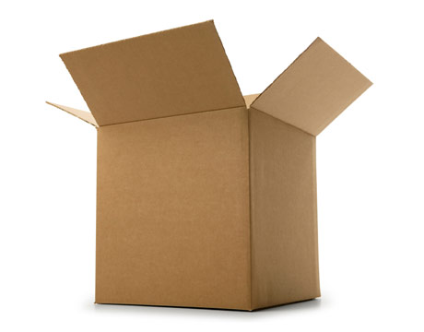
Bundles
Out-of-the-box Available Bundles:
Quotas
Authentication
Versioning
Index Replication
Expiration
Unique Constraints

Slide 42
Bundles – Raven.Bundles.Quotas
Set size limits on a database
Calculated based on Esent or Munin data files
Indexing still in operation, if limit is reached
Quotas Limits:
Soft Margin
Hard Margin
Configuration:
App.config settings
For tenants db, in the database document
Raven/Quotas/Size/HardLimitInKB
No Default
Raven/Quotas/Size/SoftMarginInKB
Default to 1024 = 1MB

Slide 43
Bundles – Raven.Bundles.Authentication
Authenticate database users
OAuth 2 support
Configuration:
App.Config settings
Drop in “Raven.Bundles.Authentication.dll”
Set on Database creation
<add key="Raven/AuthenticationMode" value="OAuth" />

Slide 44
Bundles – Raven.Bundles.Versioning
Example:
Client Integration
session.Store(new
{
Exclude = false,
Id = "Raven/Versioning/DefaultConfiguration",
MaxRevisions = 5
});
session.Store(new
{
Exclude = true,
Id = "Raven/Versioning/Users",
});
// Client integration - Raven.Version
var userRevision = session.Advanced.GetRevisionFor<User>(user.Id, 0, 25)

Slide 45
Bundles – Raven.Bundles.IndexReplication
Replicates a RavenDB index to a SQL table
Same indexing process
Replicated fields must be stored
Useful for reporting
Must flatten aggregate roots to replicate to SQL

Slide 46
Bundles – Raven.Bundles.IndexReplication
Example:
<connectionStrings>
<add name="Reports" providerName="System.Data.SqlClient"
connectionString="Data Source=.\sqlexpress;Initial Catalog=QuestionReports;Integrated Security=SSPI;"/>
</connectionStrings>
new Raven.Bundles.IndexReplication.Data.IndexReplicationDestination
{
Id = "Raven/IndexReplication/Questions/TitleAndVoteCount",
ColumnsMapping =
{
{"Title", "Title"},
{"UpVotes", "UpVotes"},
{"DownVotes", "DownVotes"},
},
ConnectionStringName = "Reports",
PrimaryKeyColumnName = "Id",
TableName = "QuestionSummaries"
};

Slide 47
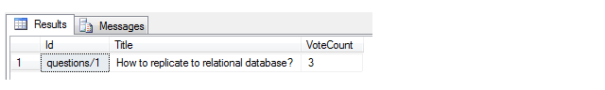
RavenDB Advanced – SQL Replication
Document
Index
Table output
var q = new Question {
Title = "How to replicate to relational database?",
Votes = new[]
{
new Vote {Up = true, Comment = "Good!"},
new Vote {Up = false, Comment = "Nah!"},
new Vote {Up = true, Comment = "Nice..."}
}};
from question in docs.Questions
select new {
Title = question.Title,
VoteCount = question.Votes.Length
};

Slide 48
Bundles – Raven.Bundles.Expiration
Delete documents whose time have expired
Usage:
User session in RavenDB
Using RavenDB as a cache
Date must be UTC, not local time
var expiry = DateTime.UtcNow.AddMinutes(5);
using (var session = documentStore.OpenSession())
{
session.Store(userSession);
session.Advanced.GetMetadataFor(userSession)["Raven-Expiration-Date"] = new RavenJValue(expiry);
session.SaveChanges();
}

Slide 49
Bundles – Raven.Bundles.UniqueConstraints
Guarantees uniqueness in your document.
Enforce uniqueness on UPDATE and INSERT
Usage:
Drop in DLLs or download through Nuget
//Register the UniqueConstaintsStoreListener
store.RegisterListener(new UniqueConstraintsStoreListener());
session.Store(new User { Id = "users/mohammed", Name = “Mohammed Ibrahim", Email = “mohammed@hotmail.com" });
session.Store(new User { Id = "users/mohammed", Name = “Ibrahim Ibrahim", Email = “Ibrahim@mohammed.com" });
session.SaveChanges(); // if there already exists a document with either name, it would fail the transaction

Slide 50
RavenDB Advanced

Slide 51
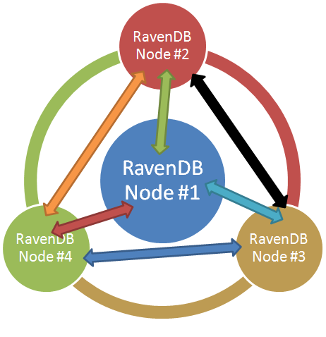
RavenDB Advanced – Replication
It is a Plugin (Raven.Bundles.Replication.dll)
Tracks the server the document was originally written on
System documents will not be replicated

Slide 52
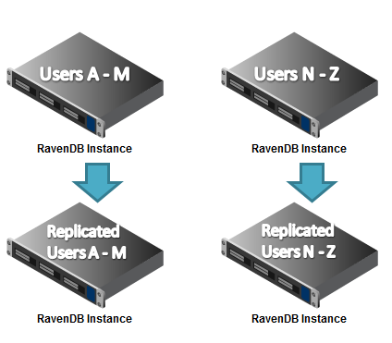
RavenDB Advanced – Replication
Replication Types:
Master / Master
Master / Slave
Backup

Slide 53
RavenDB Advanced – Replication
Example:
Drop Raven.Bundles.Replication.dll into /Plugins
Add nodes to Raven/Replication/Destination
RavenDB Visual Host
{
"Destinations":
[
{ "url" : "http://localhost:8081/" },
{ "url" : "http://localhost:8082/" },
]
}

Slide 54
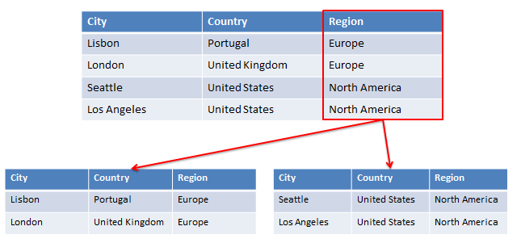
RavenDB Advanced – Sharding
Natively supported
Split the load across commodity machines
Blind vs. Smart
RavenDB joins these shards when querying

Slide 55
RavenDB Advanced – Sharding
Use ShardedDocumentStore instead of DocumentStore
ShardedDocumentStore instructed by ShardStrategy
Sharding Behaviours:
ShardAccessStrategy
ShardResolutionStrategy
MergeQueryResults
ModifyDocumentId

Slide 56
RavenDB Advanced – Sharding
Setup
var shards = new Dictionary<string, IDocumentStore>
{
{ "Asia", new DocumentStore { Url = "http://localhost:8080" }}
{ "Europe", new DocumentStore { Url = "http://localhost:8081" }}
{ "MiddleEast", new DocumentStore { Url = "http://localhost:8082" }}
};
Shard Strategy
var shardStrategy = new ShardStrategy(shards)
.ShardingOn<Company>(x => x.Region)
.ShardingOn<Invoic>(x => x.CompanyId)
var documentStore = new ShardedDocumentStore(shardStrategy).Initialize();

Slide 57
RavenDB Advanced – Sharding
Create Shards
using (var session = documentStore.OpenSession())
{
var asian = new Company { Name = "Company 1", Region = "Asia" };
session.Store(asian);
var middleEastern = new Company { Name = "Company 2", Region = "Middle-East" };
session.Store(middleEastern);
session.Store(new Invoice { CompanyId = asian.Id, Amount = 5, IssuedAt = DateTime.Today.AddDays(-1) });
session.Store(new Invoice { CompanyId = middleEastern.Id, Amount = 12, IssuedAt = DateTime.Today });
session.SaveChanges();
}
Query Shards
using (var session = documentStore.OpenSession())
{
var allCompanies = session.Query<Company>()
.Customize(x => x.WaitForNonStaleResultsAsOfNow())
.Where(company => company.Region == "Asia")
.ToArray();
}

Slide 58
RavenDB Advanced – Replication with Sharding
Replication and Sharding two powerful features
Network Availability and Performance
Common consideration:
Master-Slave / Master-Master configuration
Physical nodes to sustain
Pressure on each node
Amount of possible document conflictions

Slide 59
Licenses

Slide 60

Licenses
Open Source & Commercial Editions
Commercial Editions
Standard
Enterprise
Basic
ISV

Slide 61
Examples

Slide 62
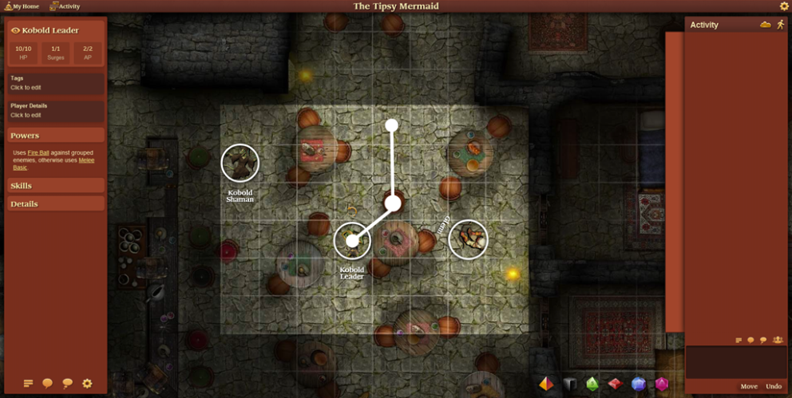
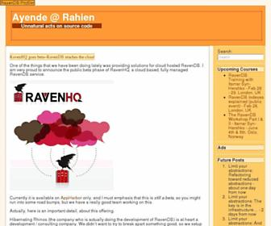
Example
My Schmizr
Human interaction simulators
Data stored in RavenDB
RPG With ME
Online Game
http://rpgwithme.com/
Ayende Blog
10K+ every month
http://ayende.com

Slide 63
Docs & Support

Slide 64

Docs & Support
Limited documentation but they are working on it
http://ravendb.net/docs
Great Support:
Almost instant feedback
Community support
Real-time discussion through Skype
Google Group

Slide 65
Finally

Slide 66
Recap
RavenDB is Safe by default
Easy to get up and running with RavenDB
RavenDB scales very easily
RavenDB have out of the box bundles
RavenDB support Replication and Sharding

Slide 67
References
RavenDB:
http://ravendb.net/
http://hibernatingrhinos.com/builds
https://github.com/ravendb/ravendb
Ayende Blog:
http://ayende.com/

Slide 68

Thanks
Many thanks goes to:
University
Dr. Jim Paterson
Pluralsight
Oren Eini aka Ayende

Slide 69

Questions/Complaints/Feedback
Mohammedovich@hotmail.co.uk
@Mohammedovich
http://mohammedovich.wordpress.com

