Slide 1
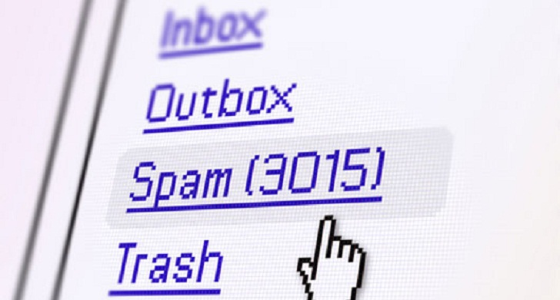
Spam Detection whether a message spam or not ?
MOAHMMED OWEZ
1NH17IS055
New Horizon College of Engineering

Slide 2
Agenda outline
Motivation/Problem Statement
Dataset
Architecture of spam classifier
Comparison & Results

Slide 3
Motivation
Email spam, also known as junk email, is a type of electronic spam where unsolicited messages are sent by email.
The proportion of spam email was around 90% of email messages sent, in the end of 2014.
It was estimated that in 2009 spam cost businesses around US$130 billion worldwide.
Many solutions available to tackle this problem, but one of the most efficient is email filtering based on the content of the email.

Slide 4
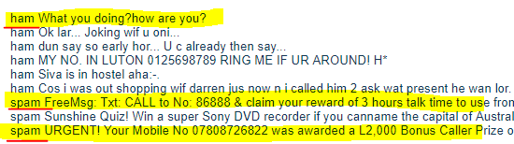
Dataset – SMS Spam Collection
Number of columns – 2 (label & message)
Classification levels – 2 i.e. spam and not spam

Slide 5
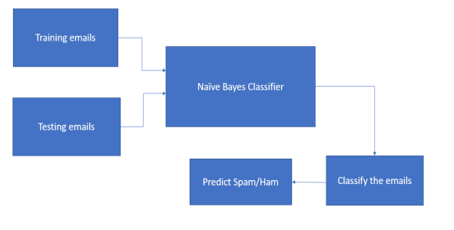
Architecture of spam classifier

Slide 6
Approach used in this project
Data Cleaning
Remove stop words
Vectorization
Vectorization
Term Frequency – Inverse Document Frequency (TF-IDF)
Stemming using PorterStemmer
Feature Creation
Created two new features:
Punctuation Percentage in the message
Now our data set has 4 columns (label, message, message_length, Punct %)
Length of message
Remove punctuations
Tokenization
Count Vectorization

Slide 7
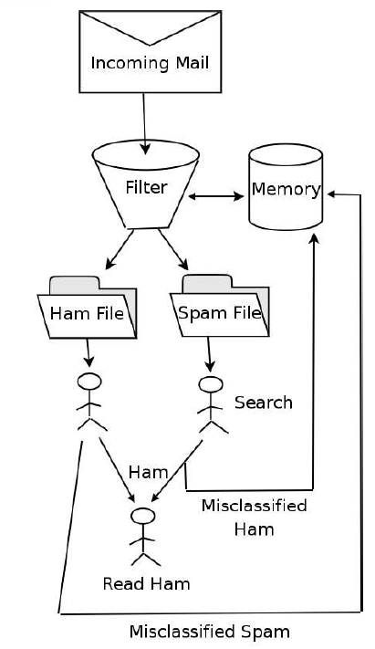
Problem: Supervised Spam Detection

Slide 8
Results
Test set results with chosen parameters :
Accuracy: 0.978 Precision: 0.985
Video explanation of code and output is done in the below link
https://github.com/mohammedowez/Spam_Detection

Slide 9
Conclusion
As emails are one of the most effective ways of communication, it is mandatory to come up with an algorithm that will help in segregating the emails as ham and spam. Ensuring that the algorithm works accurately will be our utmost concern.

Slide 10
Thank You!
13/10/2020

