Slide 1

AGB1211 – DESIGN THINKING
Department of Artificial Intelligence and Data Science
Academic Year: 2024 – 2025 (Odd Semester)
Year : II
Semester : III
Section : B
Date : 6-12-2024
PRESENTED BY, GUIDED BY
1. MOHAMMED RAASITH H(2303811724321069) JOANY FRANKLIN M.E.,
2.MOHANAVEL K(2303811724321070) Assistant Professor,
3.MUKESH M(2303811724321071) Department of AI,
4. MUKILAN K(2303811724321072) K.Ramakrishnan College of Technology.

Slide 2
Title of the Project
Rain water management System

Slide 3
Problem Identification
Increasing water scarcity due to overuse and climate change.
Inefficiency in current rainwater management systems.
Lack of real-time monitoring of water quality and storage levels.
The need for automated, AI-integrated solutions to enhance water conservation efforts.

Slide 4
Objective
The AI-powered rainwater harvesting system enhances water collection, filtration, and monitoring using real-time rain prediction and automation. It's designed for both urban and rural areas, providing a cost-effective, scalable solution. Integrated with a mobile app, it offers remote control, water quality monitoring, and optimized sustainability for diverse environments.

Slide 5
BrainStorming
→AI-based prediction
→Real-time monitoring
→ Water quality sensors
→ Advanced filtration
→ Seasonal water management
→ Community water sharing
→ Eco-friendly materials
User Friendly dashboard
Automation Integration

Slide 6
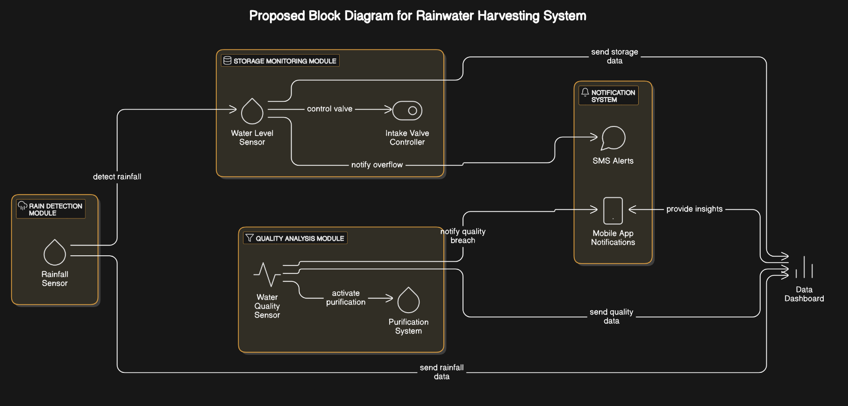
Mind Map

Slide 7
Primary Research
→Surveys and Questionnaires: Conduct surveys among households or farmers to understand their current water usage patterns, challenges in water storage, and willingness to adopt rainwater harvesting systems.
→Interviews: Interview local residents, environmentalists, and community leaders to gather insights into water scarcity issues and the need for such a system.
→Field Observations: Visit areas with existing rainwater harvesting systems to observe their functionality, challenges, and efficiency.
→User Testing: Collect feedback from potential users by testing prototypes of your app or system features.

Slide 8
Secondary Research
→Research Papers and Articles: Review academic papers, journals, and articles on rainwater harvesting techniques, AI integration in water management, and sustainable practices.
→Government and NGO Reports: Study reports on water conservation policies, rainfall statistics, and successful implementations of rainwater harvesting systems.
→Case Studies: Analyze case studies of areas or communities where rainwater harvesting has significantly improved water availability.
→Market Research: Explore industry trends, competitor systems, and user adoption rates for similar technologies.

Slide 9
Proposed Work
Water Quality Monitoring : Integrated sensors assess water quality, ensuring safe and clean storage.
Mobile App Integration : A user-friendly app provides live updates, water usage data, and system performance insights and operating Machineries via mobile.
Maintenance Notifications : Automated alerts ensure timely maintenance of filters and system components.
Controllable Water Diversion : Smart sensors direct rainwater to storage tanks when rainfall is detected.

Slide 10
List of Modules
AI for Weather Forecasting
IOT for Monitoring
Mobile App

Slide 11
AI for Weather Forecasting
Content
Uses AI to predict rainfall with high accuracy.
Enhances preparedness for water collection and storage.
Provides real-time notifications to users.

Slide 12
IOT Monitoring
Content
Tracks tank water levels and water quality (TDS, pH) in real time.
Automatically redirects water to storage during rainfall.
Sends alerts for system maintenance needs.

Slide 13
Mobile App
Content
Provides remote monitoring and control of the system.
Tracks historical rainfall data and usage trends.
Sends maintenance and filter replacement alerts.

Slide 14

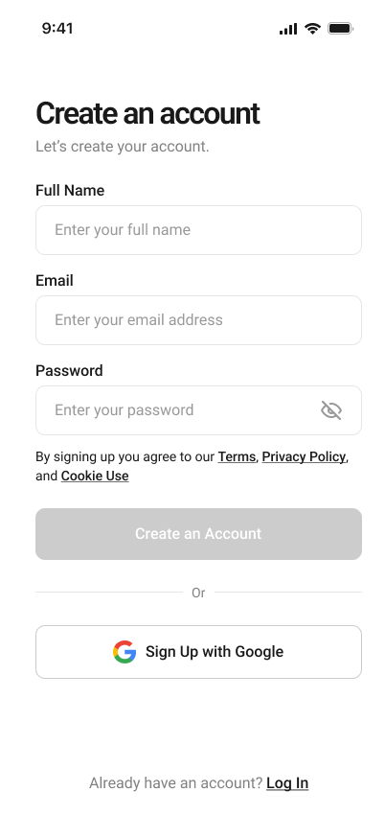
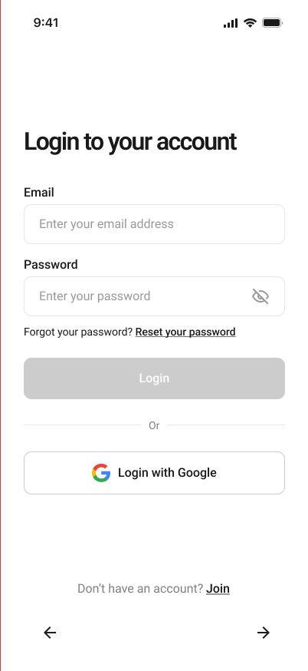
Results

Slide 15
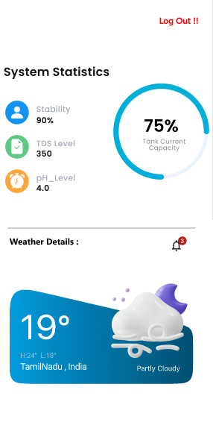
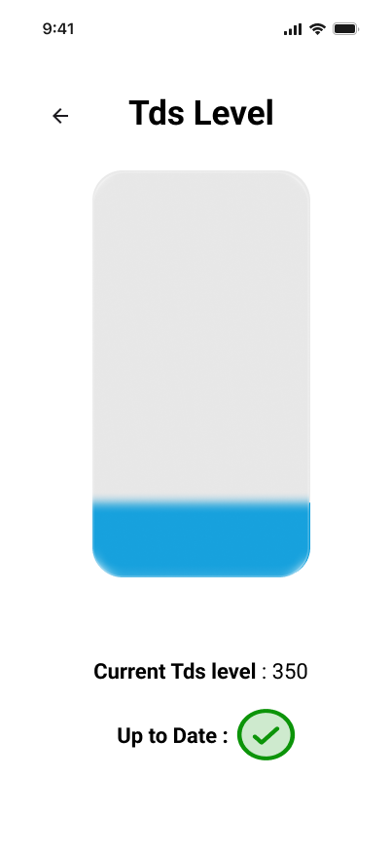
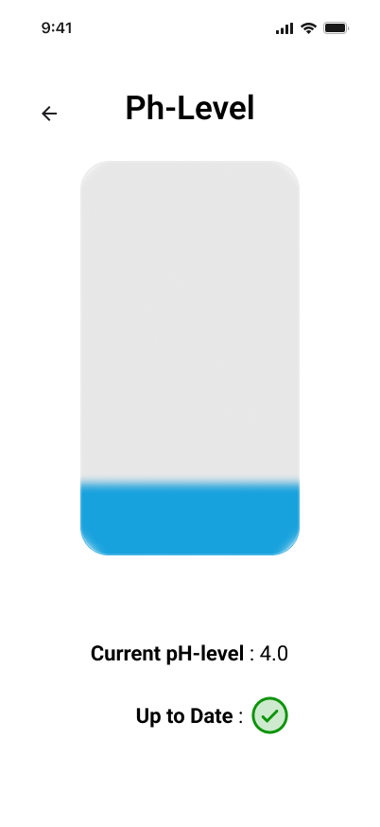
Results

Slide 16
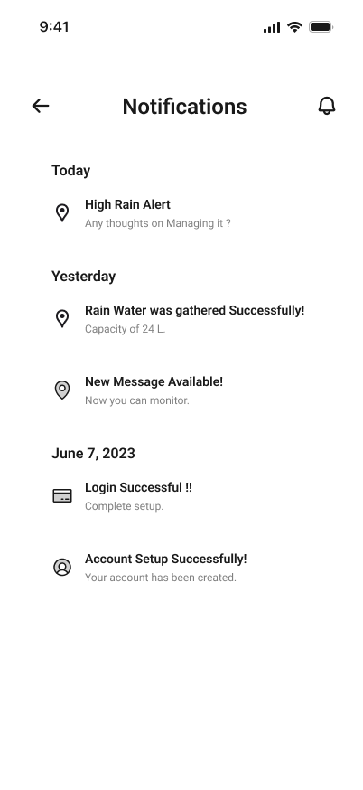
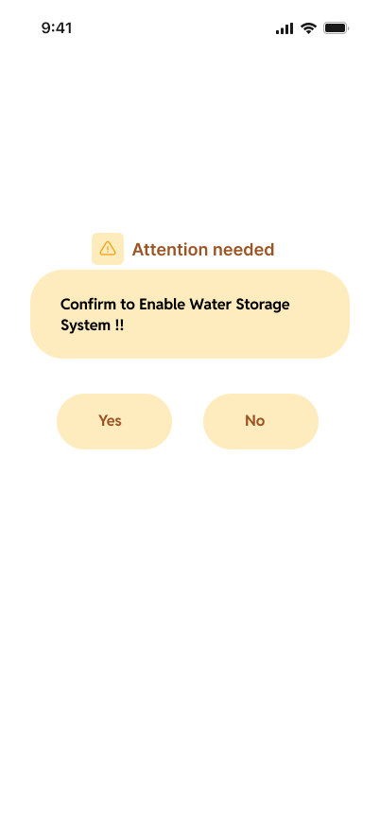
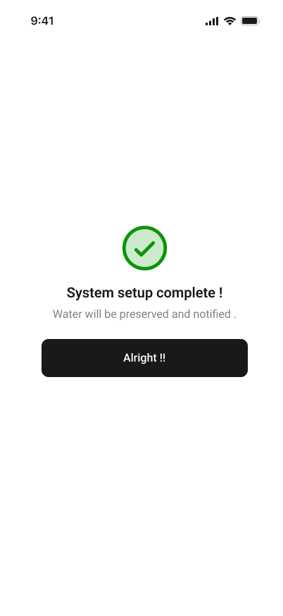
Results

Slide 17
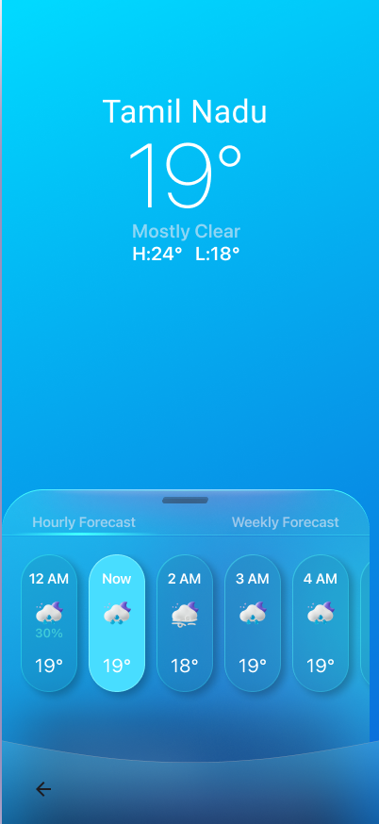
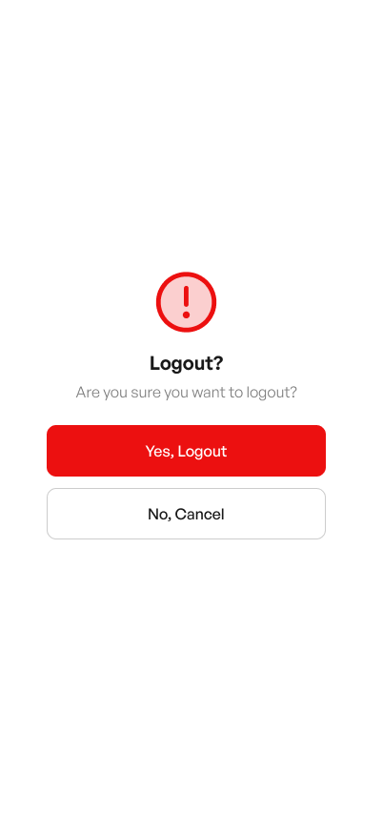
Results

Slide 18
Conclusion
The proposed rainwater harvesting system leverages automation to ensure efficient water management, monitor storage, and maintain water quality. Its modular and user-friendly design supports sustainability by optimizing resources and adapting to diverse user needs.

Slide 19
Thank You
Any queries???

