Slide 1

MODEL EVALUATION BRIEF
BANK CUSTOMER
CHURN
PREDICTION
AUDIT OF 2,000 ACCOUNT RECORDS · RETENTION STRATEGY
CRITICAL FINDING
RECALL IS 2.5%
→
RISK ASSESSMENT & MODEL VALIDATION REVIEW

Slide 2
EXECUTIVE TAKEAWAY
HIGH ACCURACY MASKS MISSED CHURNERS
79.6%
2.5%
NOMINAL ACCURACY
CHURN RECALL RATE
10 OF 405
The model captures only 10 of 405 departing customers. Using these raw predictions for retention campaigns will leave 97.5% of churners unaddressed.
ACTUAL CHURNERS FLAGGED

Slide 3
DATASET COMPOSITION
THE DATASET COMBINES OUTCOMES AND PREDICTIONS
2,000
20.3%
UNSTATED
TOTAL CUSTOMER RECORDS
ACTUAL CHURN RATE
TRAINING & TEST SPLIT
Includes demographic attributes, account tenure, balance, and active engagement markers across all accounts.
405 customers actually exited the bank, establishing a roughly 1:4 class imbalance relative to the 1,595 retained.
Includes actual and predicted churn flags and churn probabilities; no model architecture, training or validation details supplied.
GOVERNANCE NOTE · WITHOUT TRAINING METADATA, THIS ANALYSIS MEASURES ALIGNMENT IN THIS SPECIFIC EXTRACT RATHER THAN VALIDATED OUT-OF-SAMPLE GENERALIZATION.

Slide 4
CONFUSION MATRIX
MOST CHURNERS WERE PREDICTED TO STAY
ACTUAL OUTCOME \ PREDICTED | PREDICTED: STAY (NEGATIVE) | PREDICTED: CHURN (POSITIVE)
ACTUAL STAY 1,595 accounts | 1,582 TRUE NEGATIVES (99.2%) | 13 FALSE POSITIVES
ACTUAL CHURN 405 accounts | 395 FALSE NEGATIVES (MISSED CHURNERS) | 10 TRUE POSITIVES (DETECTED)
FALSE NEGATIVE RISK · 395 DEPARTING CLIENTS WERE CLASSIFIED AS SAFE, PREVENTING EARLY OUTREACH.
FLAGGED TOTAL · ONLY 23 TOTAL ACCOUNTS WERE FLAGGED FOR INTERVENTION ACROSS ALL 2,000 RECORDS.

Slide 5
BENCHMARK COMPARISON
ACCURACY FALLS SLIGHTLY BELOW A SIMPLE BASELINE
NAIVE BASELINE
CURRENT MODEL PREDICTIONS
79.75%
79.60%
ACCURACY (PREDICT ALL STAY)
ACCURACY (1,592 OF 2,000 CORRECT)
Predicting zero churn for every client yields 1,595 correct predictions out of 2,000, requiring no machine learning model or infrastructure.
Overall accuracy matches the majority-class proportion while delivering 43.5% precision (10 of 23 flagged) and 2.5% recall (10 of 405 churners).
Precision: 43.5%
Recall: 2.5%
10 OF 23 FLAGGED ACCOUNTS ACTUALLY LEFT THE BANK
10 OF 405 TRUE DEPARTING CUSTOMERS IDENTIFIED

Slide 6
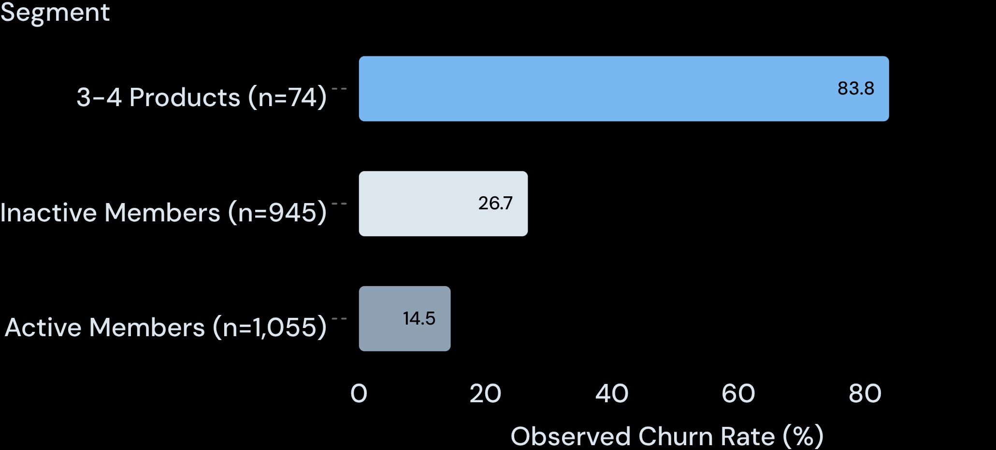
OBSERVED PATTERNS
CUSTOMER SEGMENTS SHOW DIFFERENT CHURN RATES
OBSERVED CHURN RATE BY CUSTOMER SEGMENT (%)
SEGMENT BREAKDOWN
83.8%
3-4 PRODUCTS (62 / 74 CHURNED)
26.7%
INACTIVE (252 / 945 CHURNED)
14.5%
ACTIVE (153 / 1,055 CHURNED)
NOTE · SMALL 3-4 PRODUCTS GROUP WARRANTS FURTHER INVESTIGATION. ASSOCIATIONS, NOT CAUSATION.

Slide 7
CALIBRATION & DECISION RULES
THE DECISION THRESHOLD DESERVES REVIEW
STANDARD THRESHOLD
CURRENT IMPLIED RULE
LOWER THRESHOLD
0.50
0.40
0.15 to 0.25
High false negatives; 0% to 5% recall.
10 TP, 395 FN; 23 total flagged.
Potential for higher recall and increased outreach across the 405 churn pool.
In this file: positive predictions begin above 0.40; negative predictions are below 0.40. The precise rule is undocumented.
Next step: test alternative thresholds on a suitable validation set against outreach capacity, missed churners and false positives.

Slide 8

DEPLOYMENT ROADMAP
VALIDATE BEFORE DEPLOYMENT
01 DATA PROVENANCE & SPLIT AUDIT
CONFIRM WHETHER RECORDS REPRESENT AN UNSEEN TEST SAMPLE. DOCUMENT TIME WINDOWS AND LEAKAGE GUARDS.
02 CALIBRATION & SUBGROUP FAIRNESS
ASSESS PROBABILITY RELIABILITY ACROSS DEMOGRAPHIC COHORTS, TENURE BRACKETS, AND GEOGRAPHY.
03 CONTROLLED RETENTION PILOT
RUN A RANDOMIZED INTERVENTION TEST ON A HIGH-RISK COHORT BEFORE ROLLING OUT AUTOMATED WORKFLOWS.

