Slide 1
CUSTOM PAYLOAD ENCODER & OBFUSCATION FRAMEWORK
Cybersecurity Internship Project
Encoding • Obfuscation Analysis • Defensive Detection
Mohammed Rukhnuddin Shariff
1

Slide 2
Project Overview
A modular Python cybersecurity framework for studying data representation changes.
Implements encoding, controlled obfuscation, defensive signature detection, testing, and reporting.
Designed for educational and authorized defensive analysis.
2

Slide 3
Problem Statement
Direct signature matching depends on the exact representation of a string.
Simple formatting changes can cause a literal detector to miss a known pattern.
The project demonstrates this limitation and evaluates normalization as a defensive improvement.
3

Slide 4
Motivation
Connect Python development with practical cybersecurity concepts.
Build a complete project rather than a single script.
Demonstrate coding, testing, reporting, Git/GitHub, and security documentation skills.
4

Slide 5
Objectives
Implement Base64, XOR, and ROT13 encoders.
Implement string splitting, character insertion, and hexadecimal representation.
Build direct and normalization-based defensive detection.
Generate JSON/CSV reports and validate the framework with automated tests.
5

Slide 6
Existing vs Proposed System
Existing / baseline: direct case-insensitive signature matching.
Limitation: transformed representations may not contain the original contiguous signature.
Proposed: modular transformations + defensive normalization + automated evidence generation.
6

Slide 7
System Architecture
Input → Encoding → Obfuscation → Defensive Detection → Analysis → Reporting
Encoder layer: Base64, XOR, ROT13.
Obfuscator layer: string split, character insertion, hex escape.
Detector layer: direct and normalized matching.
Reporting layer: JSON and CSV.
7

Slide 8
Technology Stack
Python 3.x
Python standard library: base64, re, json, csv, pathlib, datetime, unittest
PowerShell / Windows development environment
Git + GitHub
Command-line interface
8

Slide 9
Project Structure
main.py — CLI and workflow
encoders/ — Base64, XOR, ROT13
obfuscators/ — string split, character insertion, hex representation
detector/ — signature and normalization detection
reporting/ — JSON/CSV reports
tests/ — automated tests
samples/ + reports/ — evidence
9

Slide 10
Encoding Modules
Base64 — reversible standard representation.
XOR — reversible transformation using a controlled integer key.
ROT13 — alphabetic substitution that is self-reversible.
Purpose: demonstrate how the same benign content can have different representations.
10

Slide 11
Obfuscation Modules
String splitting — divides text into fixed-size chunks.
Character insertion — inserts a configurable separator.
Hexadecimal escape representation — represents characters using hexadecimal escape sequences.
Each module includes recovery functionality for controlled testing.
11

Slide 12
Defensive Signature Detection
Basic detector performs case-insensitive signature matching.
Improved detector normalizes text before comparison.
Normalization removes non-alphanumeric characters and converts text to lowercase.
The approach is intentionally simple and educational.
12

Slide 13
Project Workflow
1. Select a framework operation through the CLI.
2. Enter a benign security test string.
3. Apply encoding or representation transformation.
4. Run direct and/or normalized detection.
5. Display results and generate analysis artifacts.
13

Slide 14
Testing Strategy
Nine automated unit tests validate core functionality.
Roundtrip tests verify that transformations recover the original text.
Detection tests verify positive, negative, and normalized cases.
Command: python -m unittest discover -s tests -v
14

Slide 15
Test Results
Base64 roundtrip — PASS
XOR roundtrip — PASS
ROT13 roundtrip — PASS
String split/reconstruct — PASS
Character insertion/removal — PASS
Hex escape roundtrip — PASS
Exact detection — PASS
Negative detection — PASS
Normalized detection — PASS
15

Slide 16
Improved Detection Results
Original: Basic DETECTED → Improved DETECTED
Character Insertion: Basic NOT DETECTED → Improved DETECTED
String Split: Basic NOT DETECTED → Improved DETECTED
Key finding: normalization improves detection of the controlled transformed representations.
16

Slide 17
Reporting & Evidence
analysis_report.json — structured analysis and detection statistics.
detection_results.csv — method, status, and matched signatures.
Sample data: TEST_SECURITY_STRING, DEMO_SIGNATURE_PATTERN, BENIGN_SECURITY_TEST.
Evidence supports the internship report and project demonstration.
17

Slide 18
Security & Ethical Considerations
Benign test strings and simulated signatures are used.
The project is intended for authorized educational and defensive use.
It does not implement malware, credential theft, persistence, exploit delivery, or security-product bypassing.
Normalization is presented as a defensive analysis concept.
18

Slide 19
Limitations & Future Scope
Limitations: simple detector, no sandboxing, behavioral telemetry, binary analysis, or threat-intelligence correlation.
Future: Flask web interface, richer visual reports, configurable rules, structured logging, additional integration tests.
Future enhancements should remain authorized and defensive.
19

Slide 20
Conclusion
The framework demonstrates how representation changes can affect simple signature detection.
Normalization improves recognition in the controlled test cases.
The project includes code, tests, reports, documentation, architecture, Git/GitHub history, and a public repository.
Suitable as an educational cybersecurity internship and portfolio project.
20

Slide 21
Thank You
Custom Payload Encoder & Obfuscation Framework
GitHub: github.com/mohammedrukhnuddinshariff-lab/Custom-Payload-Encoder-Obfuscation-Framework
Questions & Discussion
21

Slide 22
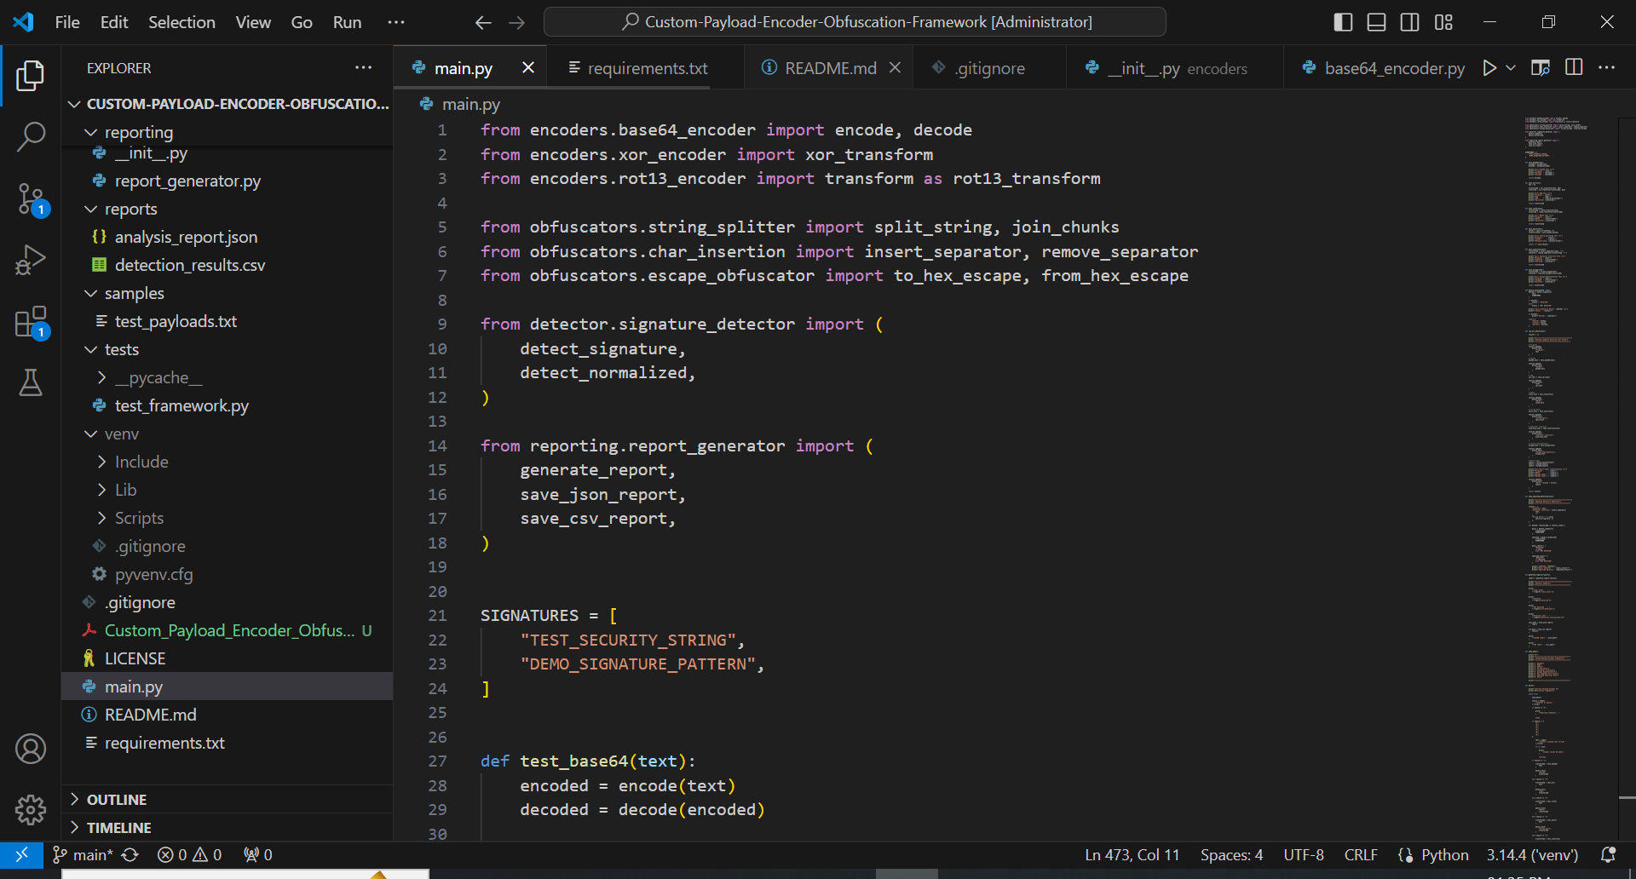
Evidence: Framework CLI
Screenshot evidence of the project CLI running the complete test suite with TEST_SECURITY_STRING.

Slide 23
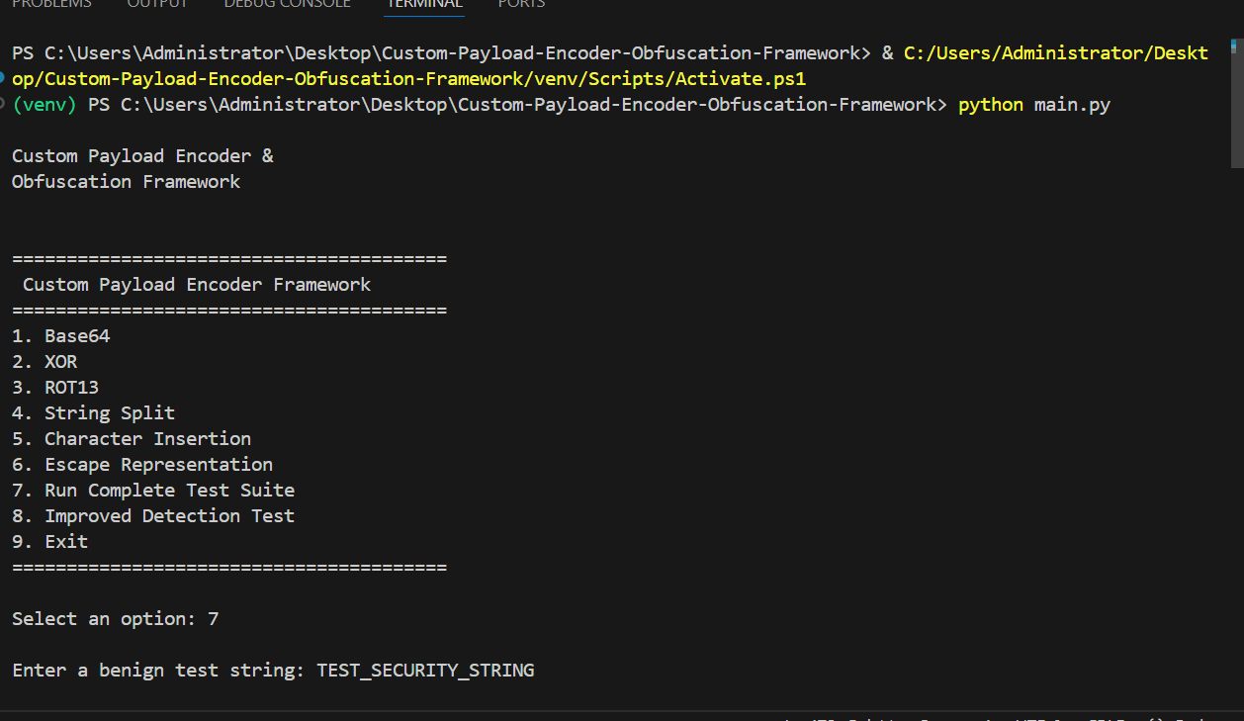
Evidence: Encoding & Detection
Base64, XOR and ROT13 transformation results with defensive detection status.

Slide 24
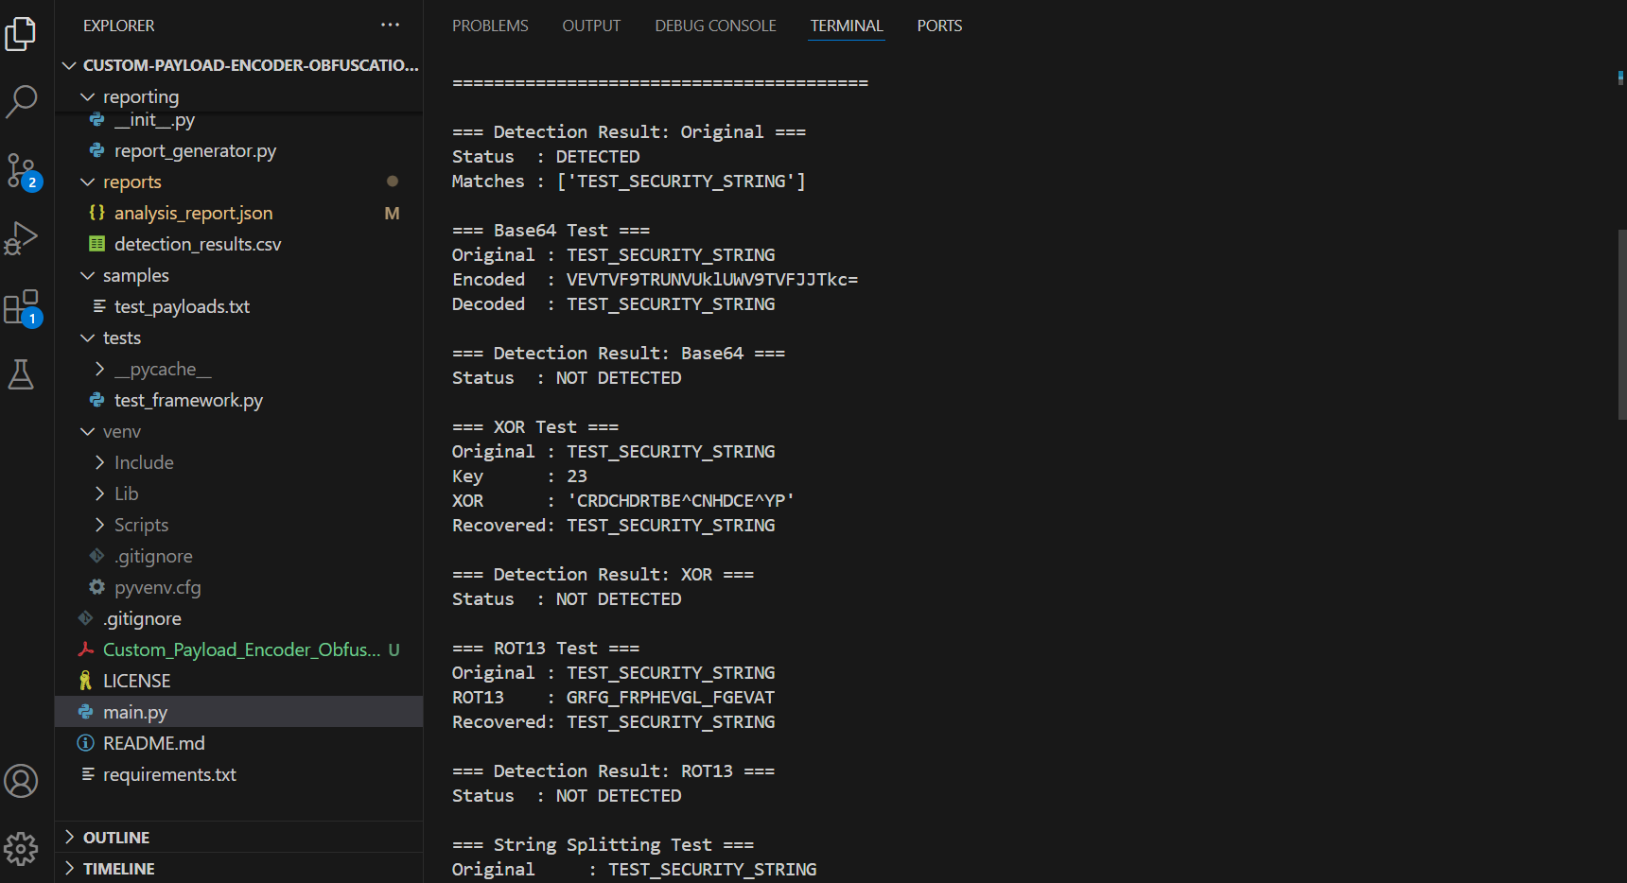
Evidence: Improved Defensive Detection
Comparison showing basic detection versus improved normalized detection.

Slide 25
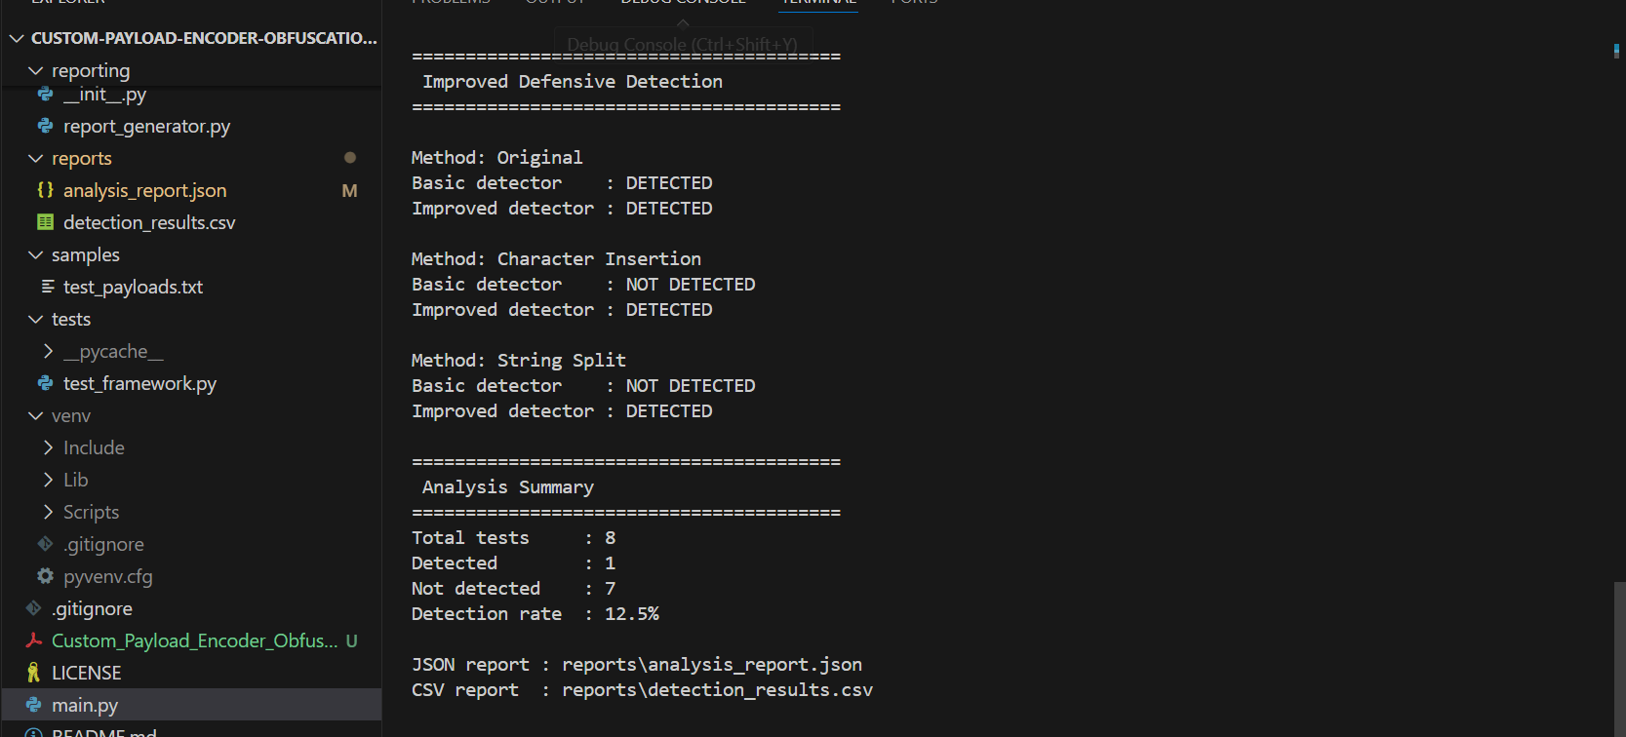
Evidence: Analysis & Reports
Final analysis summary and generated JSON/CSV report paths.

Slide 26
Project Evidence Summary
✓ Complete CLI execution demonstrated
✓ Base64, XOR and ROT13 transformations tested
✓ Basic and improved defensive detection compared
✓ Automated test suite previously verified: 9 tests passed
✓ JSON and CSV reports generated
✓ Screenshots included as internship submission evidence

