Slide 1
University of Bisha
College of Computing and Information Technology · Department of Information Systems
Privacy-Preserving Student
Attendance System
2026
Based on Face Recognition with Encrypted Data Embedding Using Steganography
Presented by
Alshikhah Fayz Alsubaie
Supervised by
Dr. Chahira Mohamed Lhioui
MSc in Cyber Security · February 2026 · Bisha, Kingdom of Saudi Arabia

Slide 2
Presentation Outline
01
02
Introduction
Background & Related Work
Problem statement · Research questions · Objectives
Literature review · Comparative analysis · Research gap
03
04
System Design & Architecture
Implementation
4-layer architecture · Module design · Data flow pipeline
Technology stack · Module details · Integration
05
06
Results & Evaluation
Conclusion & Future Work
Recognition accuracy 93.8% · PSNR 41.2 dB · SSIM 0.988
Key contributions · Limitations · Future directions
University of Bisha · Department of Information Systems · MSc in Cyber Security
2

Slide 3
01
CHAPTER 01
Introduction
Problem statement · Research questions · Objectives
University of Bisha · MSc in Cyber Security

Slide 4
Motivation & Problem Statement
WHY THIS RESEARCH IS NEEDED
CONTEXT
CORE RESEARCH QUESTION
Face recognition is the leading biometric for automated attendance — non-intrusive and camera-compatible
Deep learning (CNN) models achieve near-human accuracy on large-scale benchmarks
Rapid institutional adoption has outpaced data protection design
How can a face recognition attendance system achieve accurate identification while preserving user privacy and protecting sensitive data from unauthorized access?
RESEARCH QUESTIONS
CORE PROBLEM
1
How to integrate face recognition for real-time attendance with high accuracy?
Existing systems store facial images and identity data in centralized databases — a high-value breach target
Attendance logs are stored separately from image data, creating two independent attack surfaces
Systems prioritize recognition accuracy while data privacy is largely unaddressed
No existing solution integrates recognition accuracy with cryptographic data protection
2
What privacy risks exist in centralized biometric data storage?
3
How can AES-256 encryption protect attendance data without latency impact?
4
Can LSB steganography embed encrypted data while preserving image quality?
University of Bisha · Department of Information Systems · MSc in Cyber Security
4

Slide 5
Research Objectives
SIX MEASURABLE GOALS
1
Real-Time Face Recognition
2
AES-256 Data Encryption
Build a CNN-based attendance system using deep facial embeddings trained on VGGFace2 (3M+ images, 9,000+ identities)
Encrypt all attendance records using AES-256-GCM before storage — zero plaintext data at any system stage
3
LSB Steganographic Embedding
4
Unified Processing Pipeline
Embed encrypted data invisibly into captured images — each stego-image becomes a self-contained attendance record
Integrate recognition, encryption, and steganography into one sequential modular pipeline
5
Defense-in-Depth Security
6
Rigorous System Evaluation
Establish two independent security barriers: AES-256 (confidentiality) + LSB (obscurity)
Measure accuracy, precision, recall, F1-score, PSNR, SSIM, and processing latency across all modules
University of Bisha · Department of Information Systems · MSc in Cyber Security
5

Slide 6
02
CHAPTER 02
Background &
Related Work
Literature review · Comparative analysis · Research gap
University of Bisha · MSc in Cyber Security

Slide 7
Technical Background
FOUR FOUNDATIONAL DOMAINS
Deep Learning Face Recognition
Biometric Attendance Systems
CNNs generate high-dimensional embeddings mapping faces to a metric space.
FaceNet (triplet loss), DeepFace, ArcFace (angular margin) — distance = dissimilarity.
Automate identity-based attendance via real-time facial matching.
Transfer learning on large datasets enables high accuracy with low training overhead.
AES-256 Symmetric Encryption
LSB Image Steganography
Block cipher with 256-bit key — brute-force computationally infeasible.
Minimal latency: ~12 ms per record. Data unintelligible without the decryption key.
Replaces the LSB of each pixel's RGB channels with binary data.
Change of ±1 intensity per channel — visually imperceptible to human observers.
Privacy-Preserving Biometrics
Image Quality Metrics (PSNR / SSIM)
Cryptography, secure multi-party computation, and obfuscation protect templates.
Challenge: maintaining real-time performance alongside strong protection.
PSNR: pixel-level distortion in dB — higher is better.
SSIM: structural similarity (0–1); 1.0 = identical image.
University of Bisha · Department of Information Systems · MSc in Cyber Security
7

Slide 8
Related Work & Research Gap
COMPARATIVE ANALYSIS ACROSS THREE DOMAINS
FACE RECOGNITION MODELS
EXISTING ATTENDANCE SYSTEMS
Model
Accuracy
Privacy
Limitation
System
Method
Security
Gap
FaceNet
Very High
None
No data protection
Karunakar et al.
Transfer Learning
Low
No privacy
DeepFace
Very High
None
Requires large datasets
Wagh et al.
OpenCV
Low
Poor robustness
ArcFace
State-of-art
None
No security integration
Survey [11]
Review
Weak
Gap identified
STEGANOGRAPHY METHODS
IDENTIFIED RESEARCH GAP
Method
Capacity
Robustness
Limitation
No unified system combines face recognition + AES encryption + LSB steganography
All reviewed attendance systems depend on centralized plaintext data storage
Existing cryptographic approaches incur overhead incompatible with real-time use
Steganography has never been applied within a biometric attendance context
LSB
Low
Low
Easily detectable
Deep Stego.
High
Medium
High compute cost
HiDDeN
Medium
High
Complex training
University of Bisha · Department of Information Systems · MSc in Cyber Security
8

Slide 9
03
CHAPTER 03
System Design
& Architecture
4-layer design · Module breakdown · Data flow pipeline
University of Bisha · MSc in Cyber Security

Slide 10
System Architecture — 4-Layer Design
MODULAR · SEQUENTIAL · SELF-CONTAINED
01
02
03
04
Image Acquisition
Face Recognition
Security Layer
Storage Layer
Real-time camera capture
VGGFace2 pretrained CNN
AES-256-GCM encryption
Stego-image = attendance record
›
›
›
Face detection & extraction
512-d embedding vector
Ciphertext generation
No separate plaintext database
Geometric alignment
Cosine / Euclidean distance
LSB steganography embedding
Image carries visual + hidden data
Pixel normalization
Threshold identity decision
Dual-layer data protection
Reduced attack surface
Key Innovation: Attendance records are encrypted then embedded directly into captured images — eliminating any separate plaintext database and reducing the attack surface.
University of Bisha · Department of Information Systems · MSc in Cyber Security
10

Slide 11
Face Recognition Module
5-STAGE DEEP CNN EMBEDDING PIPELINE
1
2
3
4
5
Face Detection
Align & Normalize
CNN Embedding
Distance Match
Identity Decision
›
›
›
›
MTCNN / RetinaFace
localizes face region
Geometric alignment
+ pixel normalization
VGGFace2 → 512-d
feature vector
Cosine / Euclidean
vs. stored templates
Threshold: Match →
log | No match → reject
VGGFACE2 DATASET
RECOGNITION LOGIC & STORAGE
Enrollment: facial embeddings precomputed and stored in reference DB
Runtime: live embedding compared against all stored templates
Predefined distance threshold determines match vs. rejection
Three storage components: raw images · stego-images · embeddings DB
3M+ images across 9,000+ unique identities
High intra-class variation: pose, age, illumination
Industry-standard benchmark for real-world recognition
Cross-validated with LFW (Labeled Faces in the Wild)
University of Bisha · Department of Information Systems · MSc in Cyber Security
11

Slide 12
Security Layer — AES-256 + LSB Steganography
DUAL-BARRIER DATA PROTECTION
AES-256-GCM ENCRYPTION
LSB STEGANOGRAPHY EMBEDDING
1
Record Creation
1
Binary Conversion
User ID + timestamp structured into a serialized string
Ciphertext converted to a binary bit stream
↓
2
↓
Pixel Selection
2
AES-256-GCM
RGB channels of host image selected sequentially
Block cipher applied using a securely managed secret key
3
↓
LSB Substitution
↓
LSB of each channel replaced with one data bit — ±1 intensity change
3
Ciphertext Output
Encrypted payload passed directly to steganography module
4
↓
Stego-Image Output
Visually identical image — encrypted data embedded at bit level
Dual-Layer Guarantee: An attacker who obtains the stego-image must first detect the hidden data (defeats LSB), then decrypt it (defeats AES-256). Each barrier is independently undefeatable.
University of Bisha · Department of Information Systems · MSc in Cyber Security
12

Slide 13
System Data Flow — End-to-End Pipeline
8 SEQUENTIAL STEPS · CAMERA TO STEGO-IMAGE STORAGE
1
Image Capture
5
Record Generation
Camera acquires real-time facial image
Attendance record created: [ User ID + Timestamp ]
↓
↓
2
Face Extraction
6
AES-256 Encryption
Detection model localizes and crops face region
Record encrypted into ciphertext using managed key
↓
↓
3
Feature Extraction
7
LSB Embedding
CNN generates 512-d facial embedding vector
Ciphertext embedded into image RGB channels bit-by-bit
↓
↓
4
Identity Matching
8
Stego-Image Storage
Embedding compared to stored templates via distance metric
Final image stored — visual record + encrypted attendance data
University of Bisha · Department of Information Systems · MSc in Cyber Security
13

Slide 14
04
CHAPTER 04
Implementation
Technology stack · Module details · Storage design
University of Bisha · MSc in Cyber Security

Slide 15
Implementation — Stack & Module Details
PYTHON · PYTORCH · OPENCV · AES-256 · CUSTOM LSB
DEVELOPMENT STACK
MODULE IMPLEMENTATION SUMMARY
Language
Python 3.x
Face Recognition
Deep Learning
PyTorch / TensorFlow
5-stage pipeline: detect → align → normalize → embed → match. VGGFace2 weights. Enrollment phase precomputes and stores reference embeddings.
Computer Vision
OpenCV
Encryption Module
Cryptography
Python cryptography — AES-256-GCM
AES-256-GCM applied to structured [User ID + Timestamp] string. Ciphertext piped directly to steganography. No plaintext persisted.
Steganography
Custom LSB module (no third-party library)
Steganography Module
Numerical
NumPy
Custom Python LSB: ciphertext → binary → RGB channel LSB substitution. Fully reversible — supports data extraction and decryption.
IDE / OS
VS Code / PyCharm — Windows / Linux
Storage Design
Image-centric: stego-images replace tabular DB.
3 stores: raw captures · stego-images (records) · embeddings DB.
University of Bisha · Department of Information Systems · MSc in Cyber Security
15

Slide 16
05
CHAPTER 05
Results &
Evaluation
Recognition accuracy · Confusion matrix · PSNR / SSIM · Processing time
University of Bisha · MSc in Cyber Security

Slide 17
Face Recognition Performance
TABLE 5-1 · CONFUSION MATRIX · ERROR SOURCES
93.8%
92.9%
92.2%
91.0%
Recognition
Accuracy
Precision
(Low FP Rate)
Recall
(Detection Rate)
F1-Score
(Harmonic Mean)
CONFUSION MATRIX SUMMARY (TABLE 5-2)
SOURCES OF MISCLASSIFICATION
Category
Correct
Incorrect
Lighting Variation
1
Known Faces
938
62
Illumination not fully represented in training distribution
2
Facial Occlusion
Unknown Faces
915
85
Glasses, masks, or partial coverage degrades embedding
3
Extreme Head Pose
Angles outside the model's training pose distribution
4
Image Quality
Low-resolution or noisy input from camera sensor
University of Bisha · Department of Information Systems · MSc in Cyber Security
17

Slide 18
System Performance & Steganography Evaluation
PROCESSING TIME PER MODULE (TABLE 5-3)
IMAGE QUALITY METRICS (TABLE 5-4)
Face Detection
78 ms
41.2 dB
0.988
Face Recognition
110 ms
PSNR
Minimal pixel distortion
SSIM
Near-identical structure
AES-256 Encryption
12 ms
EMBEDDING CAPACITY & KEY FINDINGS
640×480 image provides ~115 KB capacity — sufficient for full encrypted record
AES-256 encryption adds only ~12 ms overhead — negligible at system scale
SSIM 0.988 and PSNR 41.2 dB confirm embedding is visually imperceptible
235 ms total pipeline supports near real-time multi-user sequential operation
LSB Embedding
35 ms
Total Pipeline
235 ms
University of Bisha · Department of Information Systems · MSc in Cyber Security
18

Slide 19
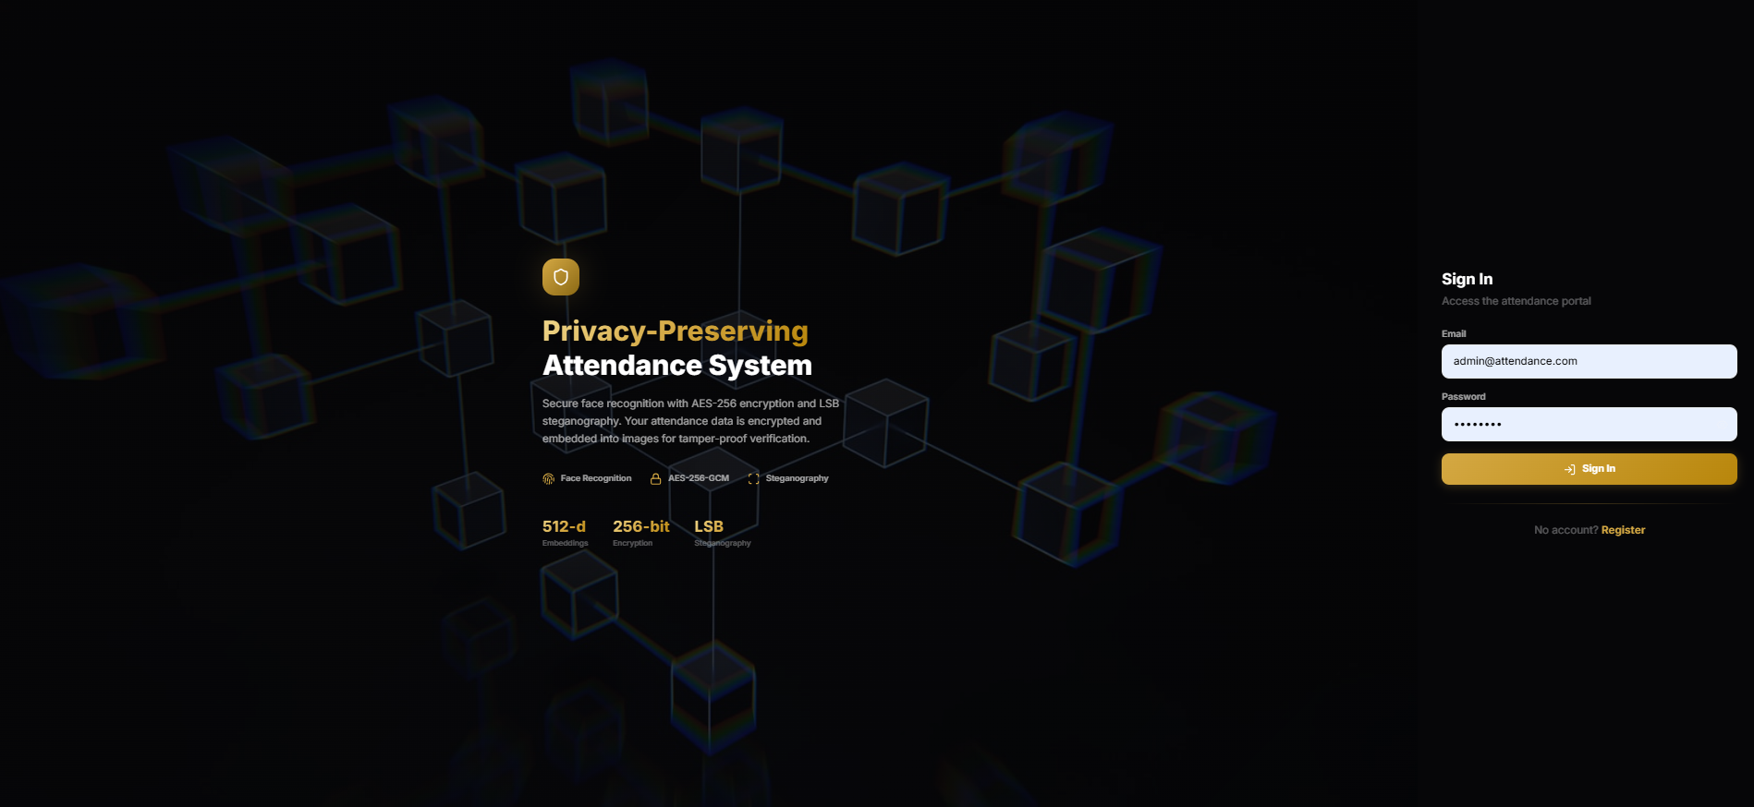
System User Interface
Fig 5-1
Sign-In Portal
Authentication gateway. Introduces system pillars: 512-d embeddings, AES-256 encryption, and LSB steganography.
University of Bisha · Department of Information Systems · MSc in Cyber Security
19

Slide 20
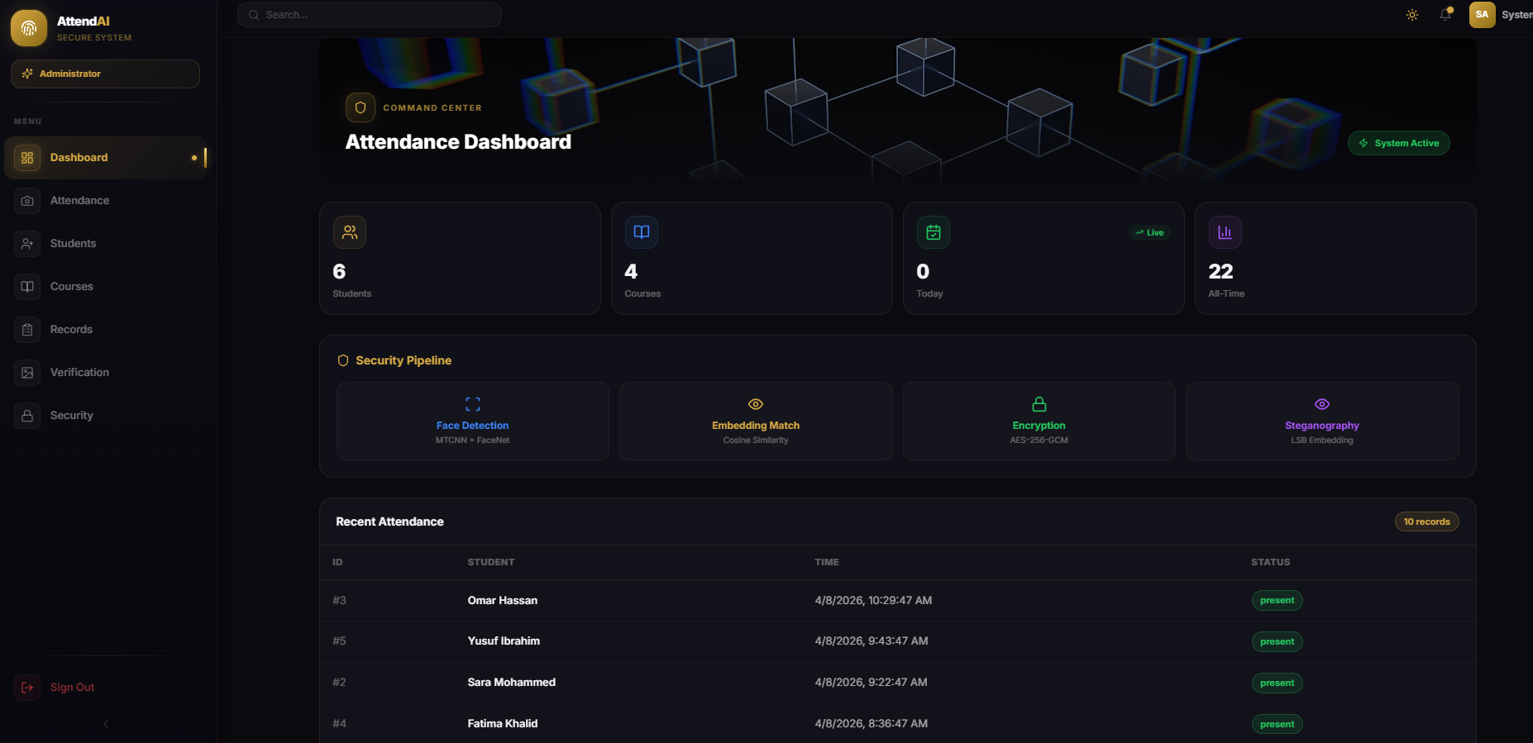
System User Interface
Fig 5-2
Admin Dashboard
Monitors real-time pipeline status (MTCNN → FaceNet → AES-256-GCM → LSB), encryption stages, and student/course data.
University of Bisha · Department of Information Systems · MSc in Cyber Security
19

Slide 21
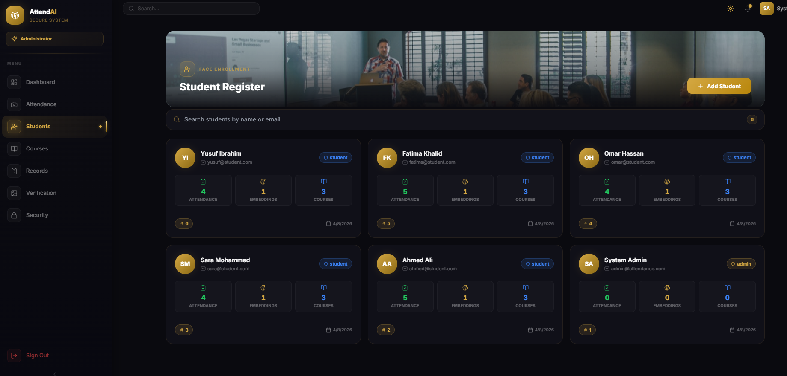
System User Interface
Fig 5-3
Student Registration
Biometric enrollment interface. Each student linked to unique facial embeddings and attendance history.
University of Bisha · Department of Information Systems · MSc in Cyber Security
19

Slide 22
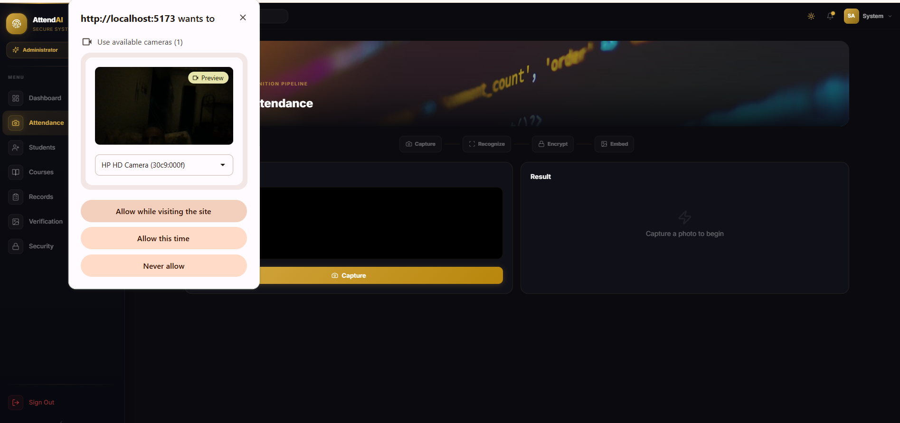
System User Interface
Fig 5-4
Capture Attendance
Executes 4-step pipeline: Capture → Recognize → Encrypt → Embed. Generates downloadable tamper-proof stego-image.
University of Bisha · Department of Information Systems · MSc in Cyber Security
19

Slide 23
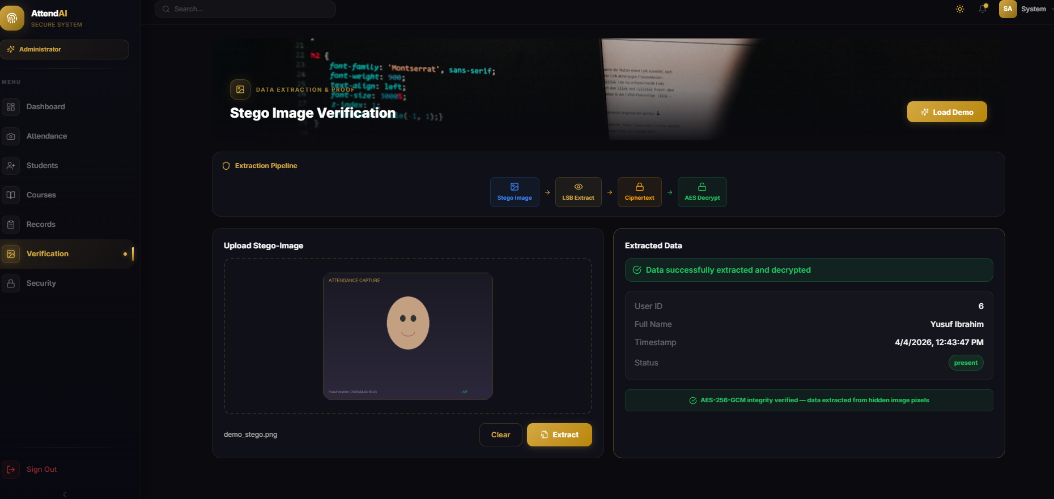
System User Interface
Fig 5-5
Stego-Image Viewer
Verification module: upload stego-image → LSB extract → AES decrypt → confirm identity and timestamp.
University of Bisha · Department of Information Systems · MSc in Cyber Security
19

Slide 24
06
CHAPTER 06
Conclusion &
Future Work
Key contributions · Limitations · Future directions
University of Bisha · MSc in Cyber Security

Slide 25
Discussion — Strengths & Limitations
CRITICAL EVALUATION OF SYSTEM PERFORMANCE
SYSTEM STRENGTHS
ACKNOWLEDGED LIMITATIONS
1
93.8% Recognition Accuracy
1
Environmental Sensitivity
Competitive with SOTA on VGGFace2 — strong discriminatory capability
Extreme lighting or occlusion reduces recognition accuracy
2
235 ms Total Pipeline
2
Controlled Environment Only
Near real-time performance — suitable for live institutional deployment
System not validated in unconstrained outdoor conditions
3
PSNR 41.2 dB / SSIM 0.988
3
Input Image Dependency
Steganographic embedding is visually imperceptible to human observers
Recognition quality bounded by camera sensor and capture conditions
4
Defense-in-Depth Security
4
Hardware Variability
AES-256 + LSB form two independent barriers — both must be independently defeated
Pipeline latency varies — no GPU availability guaranteed across deployments
5
Eliminated Centralized Store
5
LSB Robustness
Stego-image = attendance record — no separate plaintext database required
LSB is less robust than transform-domain steganography methods
6
Modular Architecture
6
Scalability Unverified
Each component independently upgradable without affecting the pipeline
Large-scale institutional deployment requires further validation
University of Bisha · Department of Information Systems · MSc in Cyber Security
21

Slide 26
Conclusion & Key Contributions
WHAT THIS RESEARCH ESTABLISHED
SUMMARY OF ACHIEVEMENTS
Designed and implemented a complete privacy-preserving attendance system — face recognition + AES-256 + LSB steganography in one unified pipeline
Achieved 93.8% accuracy with 235 ms end-to-end pipeline — PSNR 41.2 dB and SSIM 0.988 confirm imperceptible embedding
Eliminated centralized plaintext storage — every stego-image is a self-contained, encrypted, and verifiable attendance record
KEY TECHNICAL CONTRIBUTIONS
C1
First Integrated System
C2
Image-Centric Storage Design
No prior work unifies face recognition + AES + LSB steganography in a single attendance pipeline
Each stego-image stores both visual data and the encrypted attendance record — no external database needed
C3
Defense-in-Depth Framework
C4
Comprehensive Evaluation
Two independent barriers: AES-256 (data unintelligibility) + LSB (data undetectability) — must be defeated separately
System benchmarked across recognition metrics, confusion matrix, timing per module, PSNR/SSIM, and embedding capacity
University of Bisha · Department of Information Systems · MSc in Cyber Security
22

Slide 27
Future Work
SIX DIRECTIONS FOR FURTHER RESEARCH
1
Advanced Face Recognition
2
Multi-Modal Authentication
Adopt next-generation models (TransFace, CosFace) to improve robustness under occlusion, extreme pose, and low-light conditions
Integrate a secondary biometric factor (voice or fingerprint) to strengthen identity verification and reduce false positive rate
3
Edge Device Deployment
4
Hybrid Cryptography
Optimize CNN inference and AES for low-power SoCs (Raspberry Pi, mobile) — enabling portable, self-contained deployment
Explore RSA-based key exchange combined with AES data encryption, or homomorphic encryption for privacy-preserving computation
5
Advanced Steganography
6
Cloud-Based Scalability
Adopt transform-domain methods (DCT/DWT) or deep learning steganography (HiDDeN/RDH) for greater capacity and robustness
Extend to distributed cloud architecture with real-time admin dashboards, analytics, and horizontally scalable stego-image storage
University of Bisha · Department of Information Systems · MSc in Cyber Security
23

Slide 28
93.8%
92.9%
92.2%
91.0%
Recognition
Accuracy
Precision
Recall
F1-Score
235 ms
41.2 dB
0.988
~12 ms
Total Pipeline
Time
PSNR
SSIM
AES Encryption
Time
Thank You
Questions & Discussion Welcome
Alshikhah Fayz Alsubaie · Supervised by Dr. Chahira Mohamed Lhioui · University of Bisha · February 2026

