Slide 1
KLH UNIVERSITY • DEPARTMENT OF ECE
PosturePulse: Smart Spine & Posture Monitor
Dual-IMU Curvature Sensing, Complementary Filtering & Personalized AI
Md Saif (2510040004) • Deepak (2510040056) • Bhargav (2510040005)

Slide 2
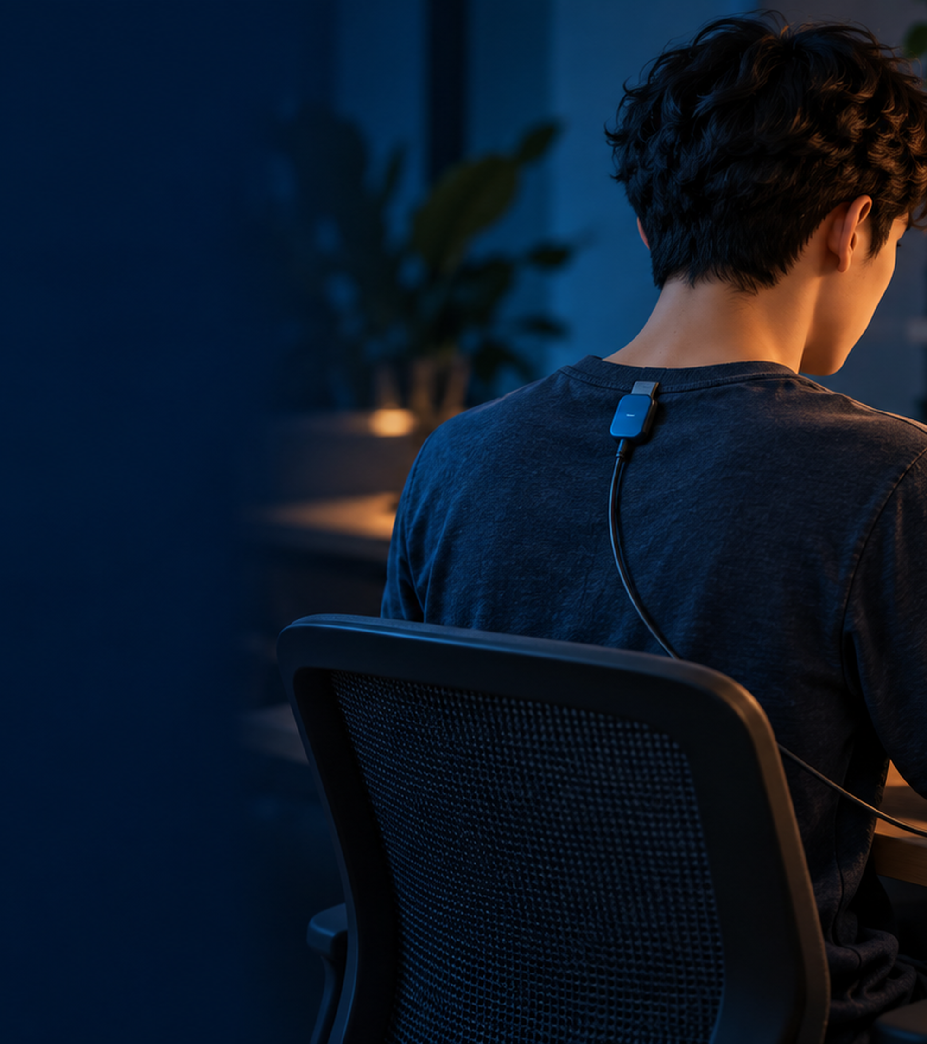
01 • PROBLEM & CORE SOLUTION
Dual IMUs Separate Slouching from Leaning
Why PosturePulse Works
The Problem: Sitting for hours with forward-head posture causes neck strain and back pain.
Why Single Clips Fail: Passive straps weaken muscles; single-sensor clips buzz falsely when leaning forward.
Dual-Sensor Solution: Uses two IMUs (Upper Spine 0x68 & Lower Spine 0x69) to measure relative curvature.
Awareness Boundary: Provides habit reminders only—no medical diagnosis or clinical treatment.
PosturePulse • KLH University ECE | Slide 02 of 10

Slide 3
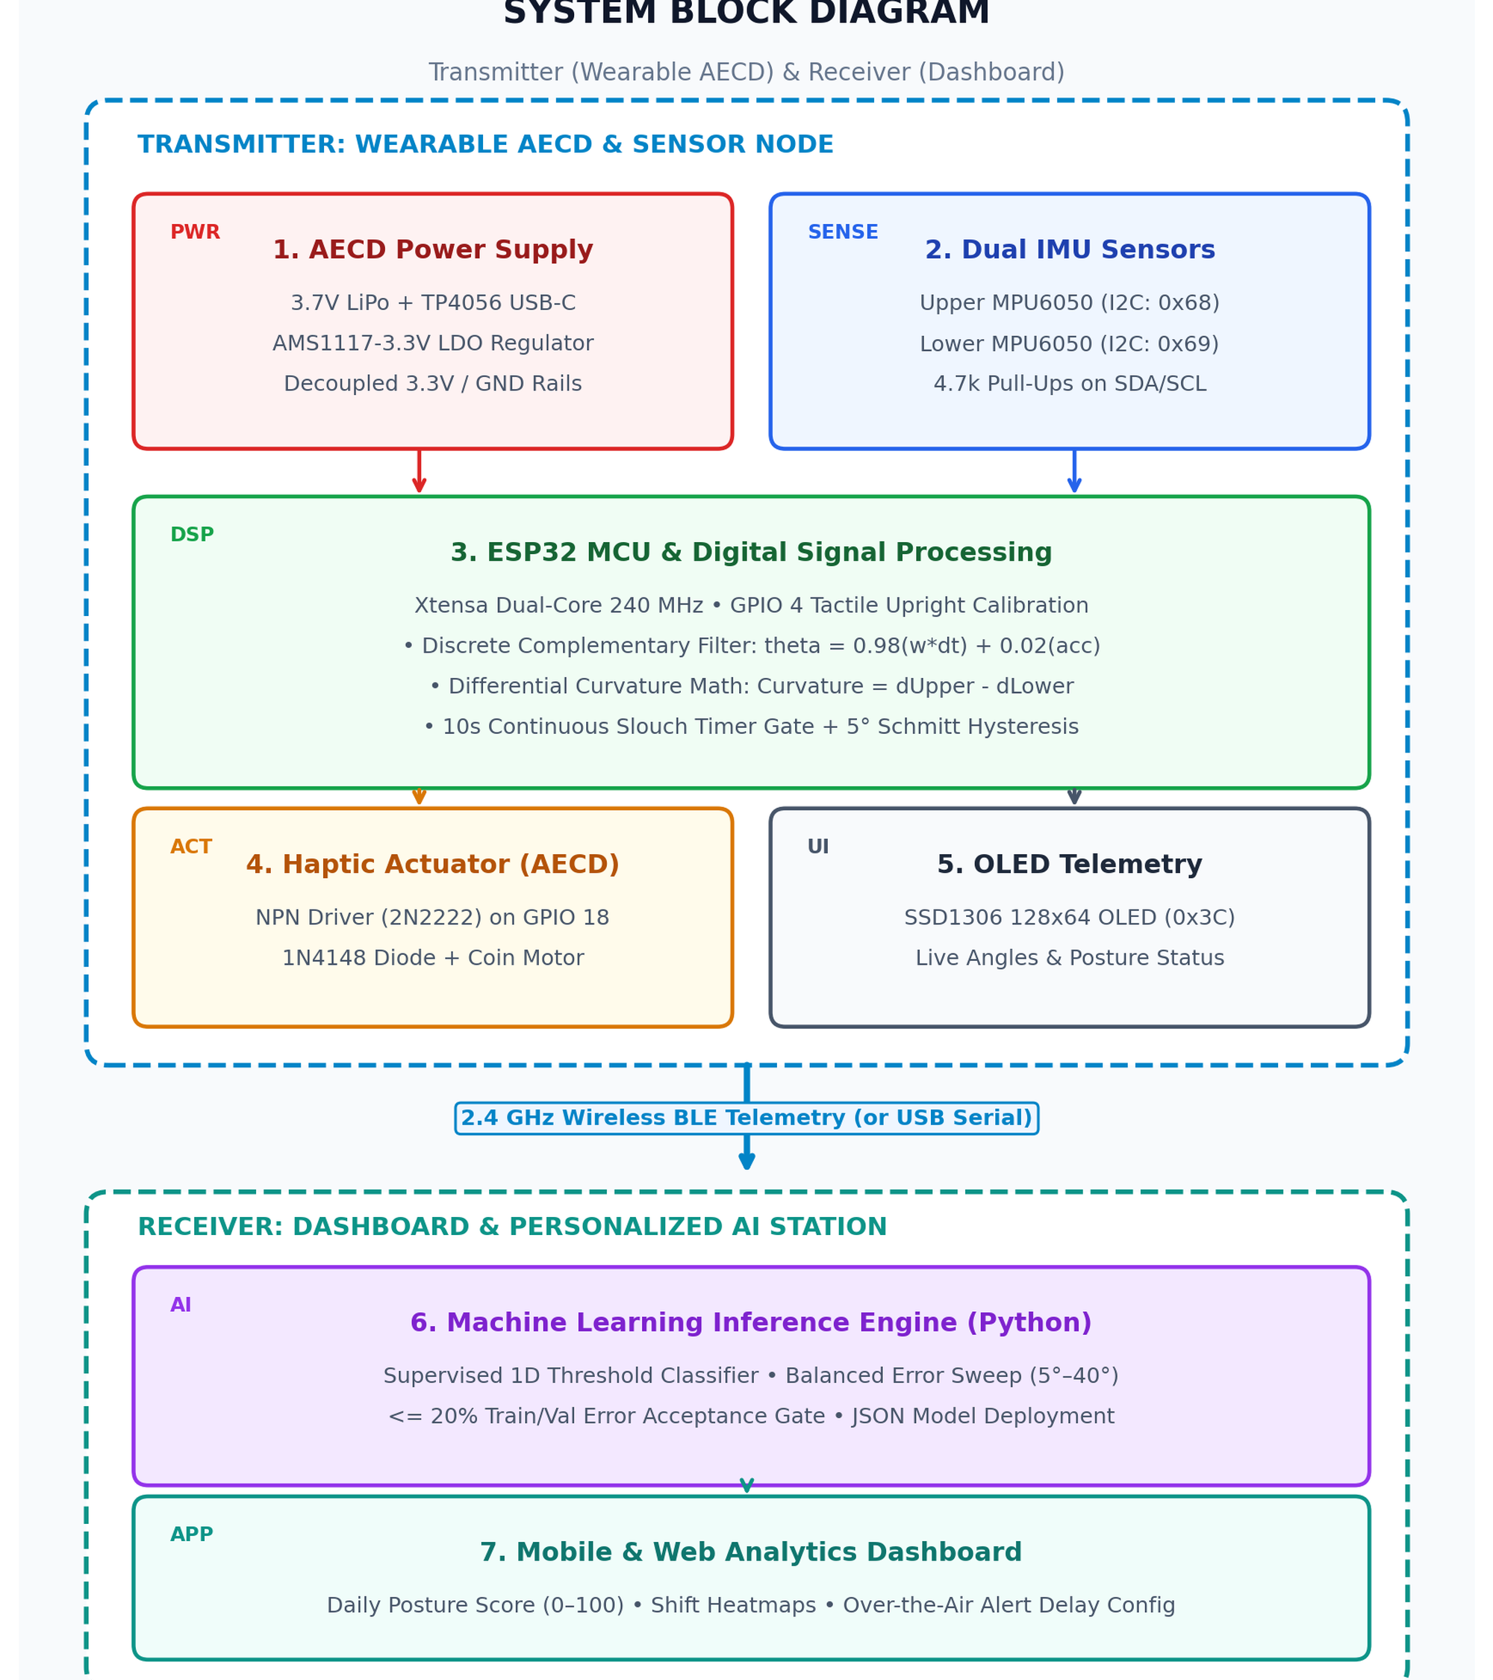
02 • SYSTEM BLOCK DIAGRAM & AECD FLOW
Transmitter & Receiver System Architecture
End-to-End AECD & RF Stages
Transmitter Node: Combines 3.7V LiPo + AMS1117-3.3V LDO, dual IMU sensing, and NPN motor driver stage.
Embedded DSP Core: Computes 3s baseline, 0.98 complementary filter, curvature, and 10s slouch timer on ESP32.
Wireless RF Channel: Streams posture metrics and slouch counts via 2.4 GHz BLE GATT (or USB serial).
Receiver Station: Host dashboard runs supervised ML cutoff inference, Daily Scores, and shift heatmaps.
PosturePulse • KLH University ECE | Slide 03 of 10

Slide 4
03 • CIRCUIT WIRING & PIN MAPPING
Shared I2C Bus Connects Both Sensors and OLED Display
Component | Component Pin | ESP32 Pin | Function / Description
MPU6050 #1, #2 & OLED | SCL | GPIO 22 | Shared I2C Clock Line
MPU6050 #1, #2 & OLED | SDA | GPIO 21 | Shared I2C Data Line
MPU6050 #1 (Upper Spine) | AD0 | GND | I2C Address 0x68 (Upper Back)
MPU6050 #2 (Lower Spine) | AD0 | 3.3V | I2C Address 0x69 (Lower Back)
OLED Display (SSD1306) | SCL / SDA | GPIO 22 / 21 | Shared I2C Bus (Address 0x3C)
Calibration Push Button | Pin 1 | GPIO 4 | Calibration Trigger (INPUT_PULLUP)
Coin Vibration Motor | Positive (+) | GPIO 18 | PWM / Digital Output Haptic Alert
System Status LED | Anode (+) | GPIO 2 | System Status Indicator
PosturePulse • KLH University ECE | Slide 04 of 10

Slide 5
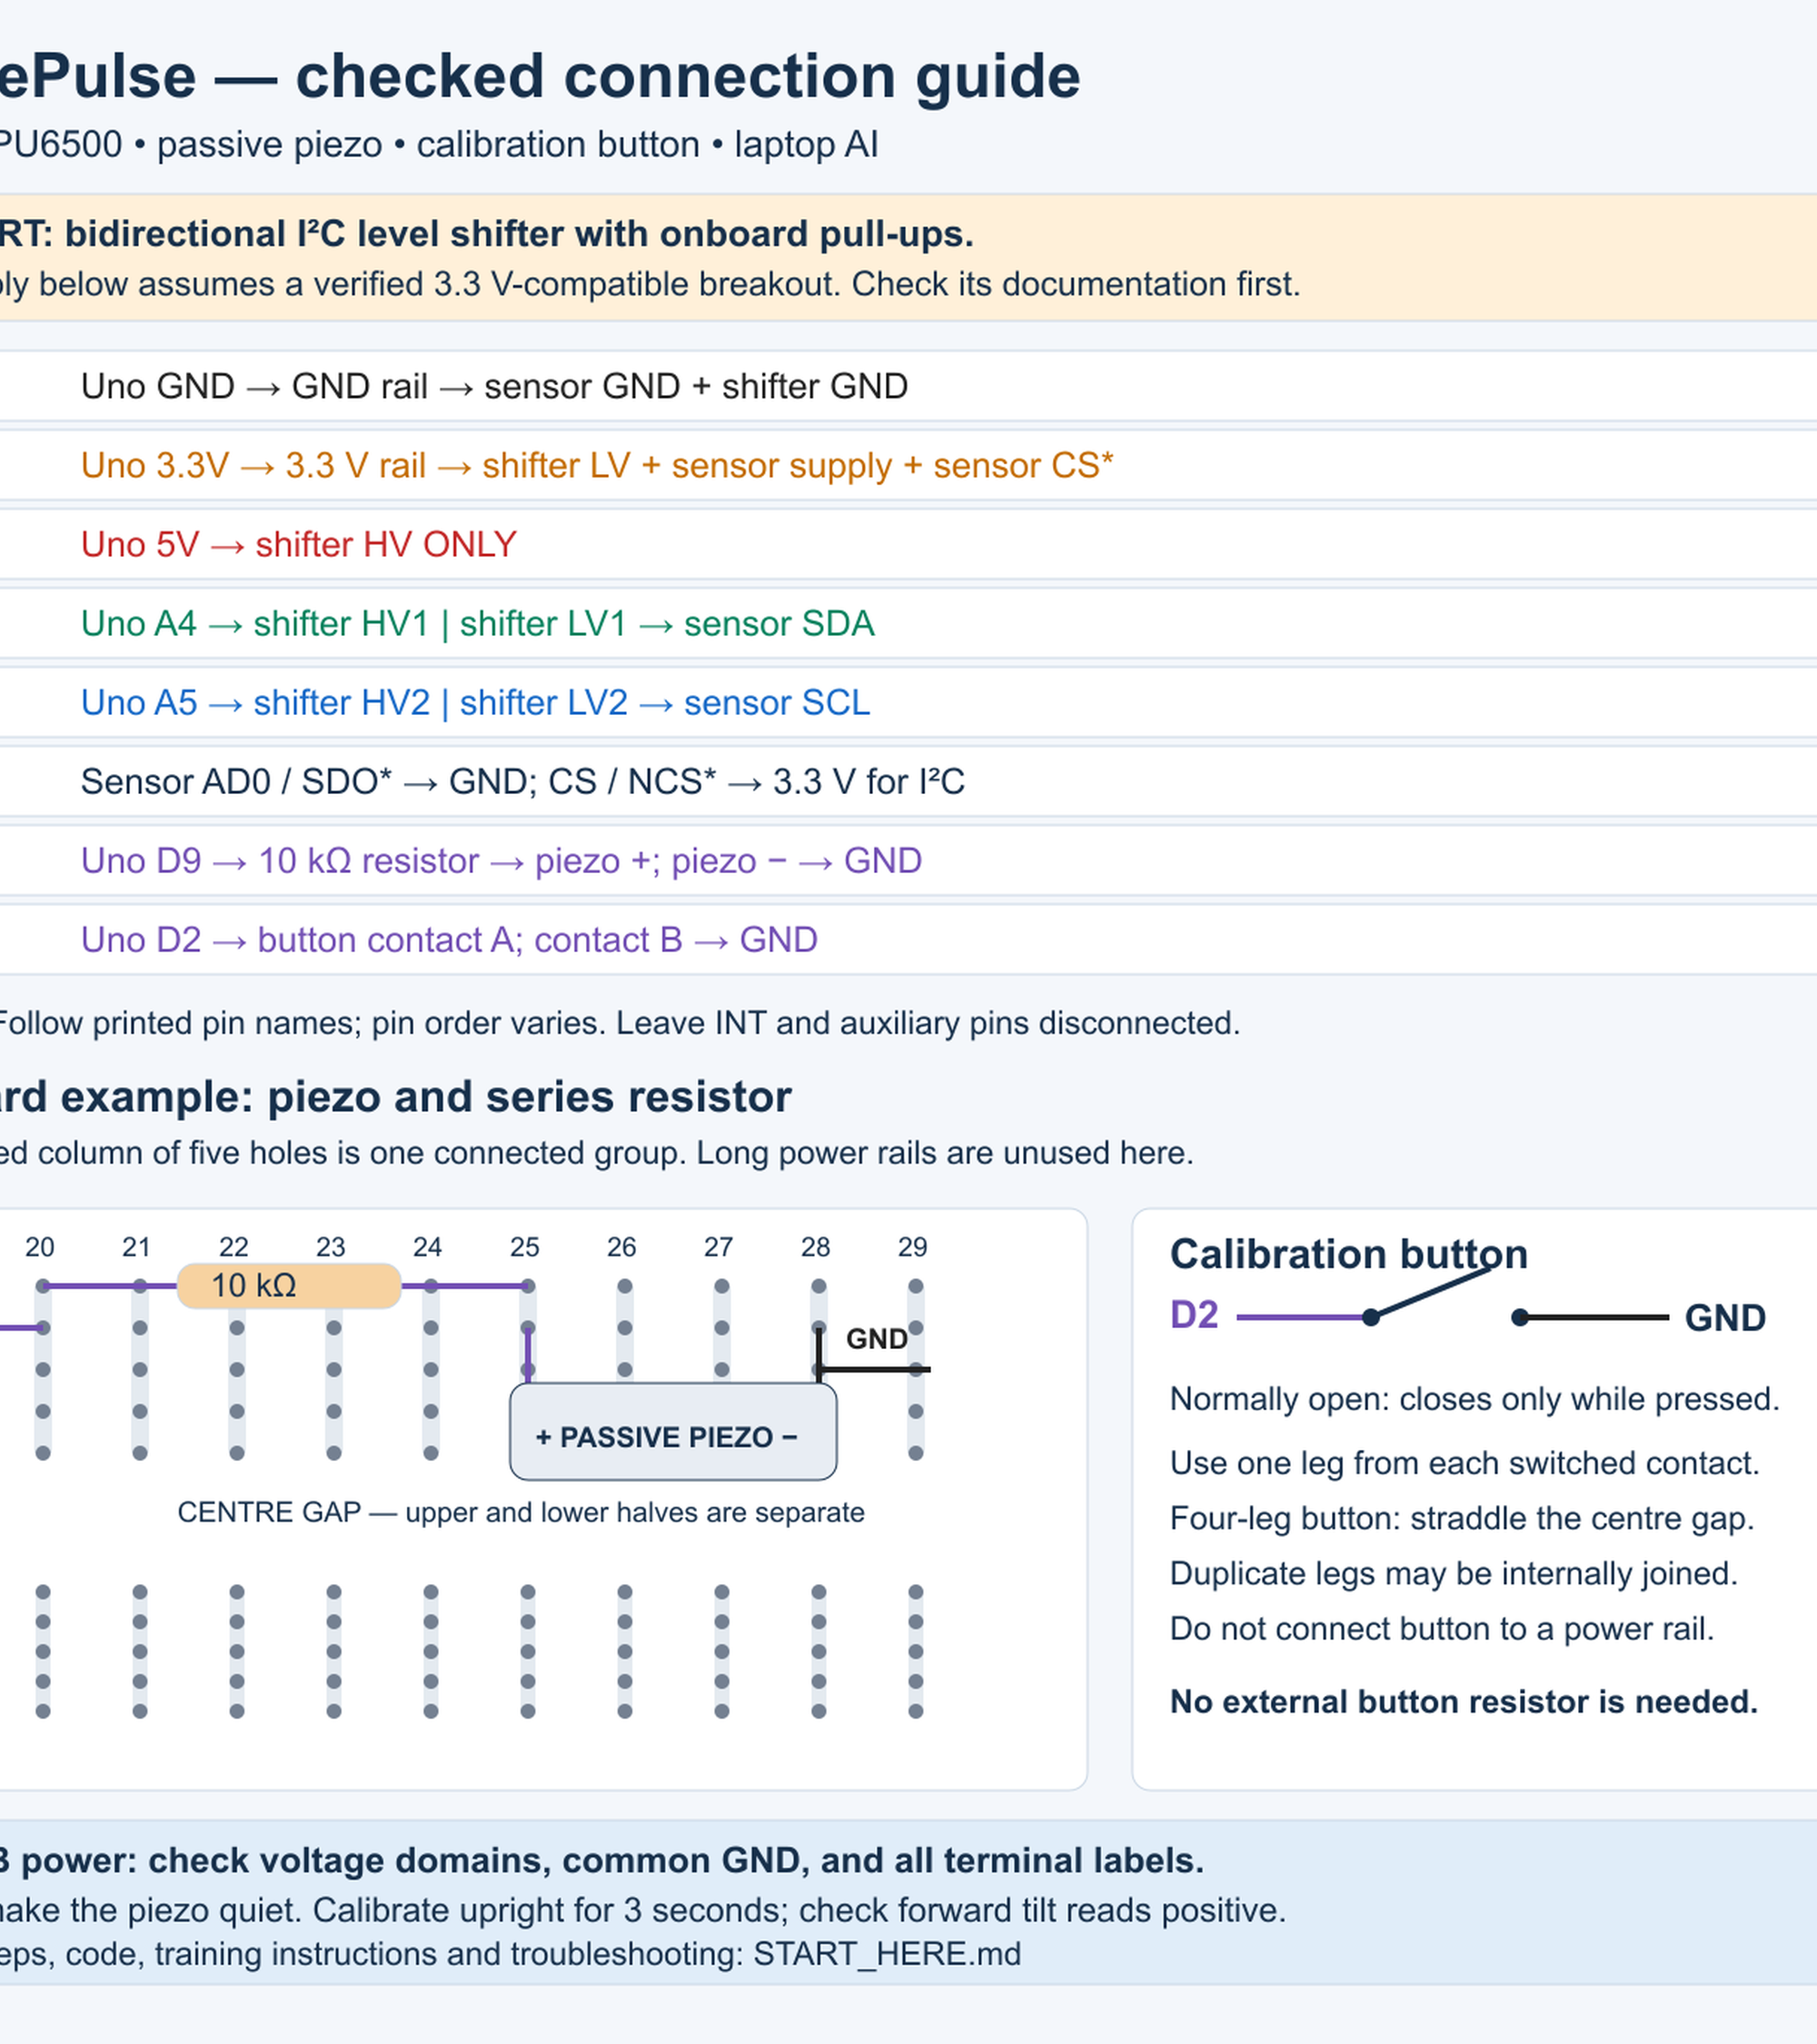
04 • WIRING SAFETY & BENCH GUIDE
Safe Voltage Domains and Breadboard Wiring
Hardware Safety Checklist
Common Ground: Connect MCU GND, sensor GND, and shifter GND before applying USB power.
3.3V Logic Protection: Use a bidirectional I2C level shifter when pairing a 5V Uno with 3.3V sensors.
Actuator Protection: Drive the coin motor via an NPN transistor + diode, or piezo via a 10k resistor.
Button Wiring: Wire the button between GPIO 4 (or D2) and GND with no external resistor.
PosturePulse • KLH University ECE | Slide 05 of 10

Slide 6
05 • STEP-BY-STEP DETECTION ALGORITHM
Complementary Filtering and Relative Curvature Math
How Slouch Detection Works
1. Calibration (3s): Samples both IMUs for 3s upright to store baseUpper and baseLower.
2. Complementary Filter: theta_filt = 0.98*(theta + omega*dt) + 0.02*theta_accel removes drift.
3. Relative Curvature: Curvature = (Upper - Upper_Base) - (Lower - Lower_Base).
4. Lean vs. Slouch: Leaning tilts both sensors equally (~1.5° diff); slouching bends only upper (>15°).
PosturePulse • KLH University ECE | Slide 06 of 10

Slide 7
06 • EMBEDDED FIRMWARE BEHAVIOR & SAFETY
10-Second Timer and 5° Hysteresis Prevent False Alerts
Posture / Sensor Condition | Threshold / Timing Rule | Programmed System Response
Forward Curvature / Tilt | Above 15° (or learned AI angle) | Start a 10-second continuous millis() timer
Timer Reaches 10 Seconds | 10s continuous slouch | Pulse vibration motor (300 ms) / 2 kHz tone (200 ms)
Alert Remains Active | Persistent slouching | Repeat escalating alert every 5 seconds
Hysteresis Recovery | Returns to <= 10° (5° below cutoff) | Silence alert immediately and reset timer to 0
Significant Motion | Dynamic movement spike | Clear timer and silence alert during movement
Sensor Bus Fault | I2C communication drop | Silence actuator, latch fault, require restart
PosturePulse • KLH University ECE | Slide 07 of 10

Slide 8
07 • PERSONALIZED AI & DATA PIPELINE
Supervised AI Learns Each Wearer's Personal Tilt Angle
1D Supervised Classifier
Train & Validate: Captures 10s upright + 10s leaning, then repeats in fresh holds.
5°–40° Cutoff Sweep: Chooses the angle that minimizes balanced training error.
20% Acceptance Gate: Accepts model only if train and validation error are both <= 20%.
Local Persistence: Saves CSV samples and JSON model; sets reset 5° below learned angle.
PosturePulse • KLH University ECE | Slide 08 of 10

Slide 9
08 • DEMONSTRATION, APP INTEGRATION & CREDITS
Live Demo Flow, BLE Mobile Dashboard & Project Team
1. Live Demo
Calibrate & Teach: Press button 3s upright (CAL_OK), then record 10s holds.
Lean vs. Slouch: Lean for bottle (no buzz), then slouch 10s to trigger alert.
2. BLE App
Daily Score (0–100): Streams curvature_angle and slouch_count over ESP32 BLE.
Shift Heatmap: Shows peak slouching hours and customizes 5s/10s/30s timers.
3. Team & Guides
Student Team: Md Saif (2510040004), Deepak (2510040056), Bhargav (2510040005).
ECE Guidance: Dr. Ashwini Varma, Vivek Pathak, Dr. Bhuvaneshwari, Dr. Sudharsana Rao.
PosturePulse • KLH University ECE | Slide 09 of 10

Slide 10
POSTUREPULSE • KLH UNIVERSITY ECE
Smart Posture Awareness Without False Alarms.
Thank You | Md Saif • Deepak • Bhargav

