Slide 1
GENDER CLASSIFICATION BY SPEECH ANALYSIS
Vineel Pratap
Girish Govind
Abhilash Veeragouni

Slide 2
MOTIVATION
Human listeners are capable of extracting information from the acoustic signal beyond just the linguistic message
---- speaker's personality, emotional state, gender, age, dialect and the status of his/her health
Gender classification is useful in speech and speaker recognition
---- better performance has been reported when gender-dependent acoustic-phonetic models are used by decreasing the word error rate of a baseline speech recognition system by 1.6%

Slide 3
ISN'T THAT EASY ?
No!
Factors that limit gender classification include our inability to identify acoustic features sensitive to the task and yet robust enough to accommodate speaker articulation differences, vocal tract differences, prosodic variations
The selected features should be time-invariant, phoneme independent, and identity-independent for speakers of the same gender
There is always some NOISE

Slide 4
CRITERIA FOR GENDER CLASSIFICATION
Physiological
Vocal tract length of females is less than that of males
The differences in physiological parameters lead to differences in acoustical parameters
Acoustic
Pitch
Formant Frequencies
Zero Crossing Rate …

Slide 5
Pitch
Vocal Tract can be modeled as a resonance tube with shape being varied according to phoneme uttered
Fundamental frequency inversely proportion to length
So, Pitch of female > Pitch of male

Slide 6
Why not ONLY Pitch?
The perception of voice gender primarily relies on the fundamental frequency [f0] that is on average higher by an octave in female than male voices; yet, pitch overlaps considerably between male and female voices
Although voice pitch and gender are linked, other information is used to recognise an individual’s gender from his/her voice.

Slide 7
SPEECH ANALYSIS
The techniques used to process the speech signals can be classified as
Time domain analysis
Frequency domain analysis
In Time domain analysis, the measurements are performed directly on the speech signal to extract information
In Frequency domain analysis, the information is extracted from the frequency content of the signal to form the spectrum

Slide 8
Formant frequencies
Formant features:
The distinction between men and women have been represented by the location in the frequency domain of the first 3 formants for vowels.
Hence the set of formant features comprised by the statistics of the 4 formant frequency contours namely: Mean, minimum, maximum and variance values of the first four formants are considered.
LPC coefficients and Cepstral Coefficients

Slide 9

LPC Coefficients
The LPC coefficients make up a model of the vocal tract shape that produced the original speech signal.
An order of 13 is good enough to represent speech spectrum
k
Where,
H() = Z-transform
n is the order
w is the frequency
a_{k}s are the LPC coefficients

Slide 10
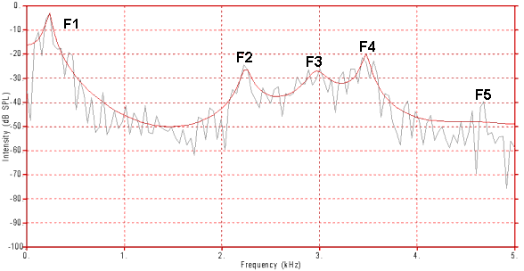
LPC Coefficients

Slide 11
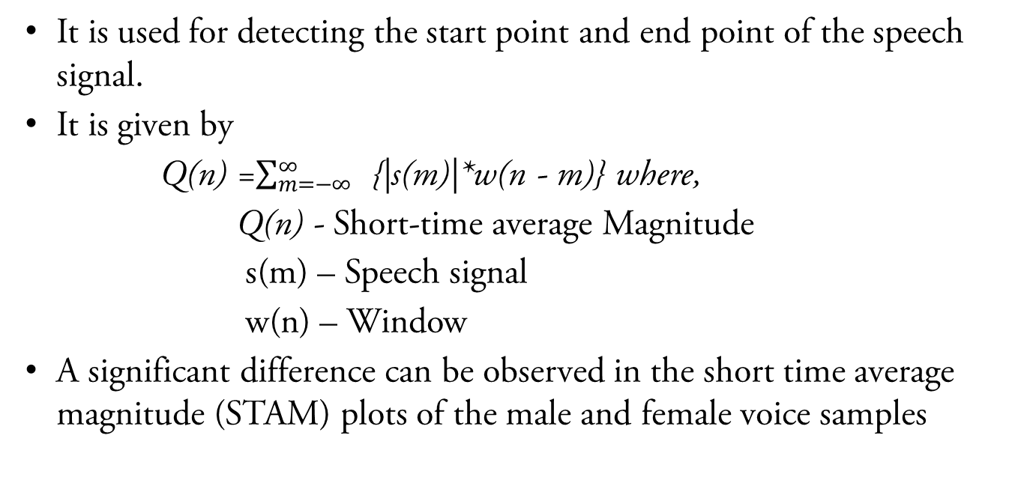
Short-Time Average Magnitude (STAM)
It is used for detecting the start point and end point of the speech signal.
It is given by
Q(n) =$\sum_{m=−∞}^{∞}{ }${|s(m)|*w(n - m)} where,
Q(n) - Short-time average Magnitude
s(m) – Speech signal
w(n) – Window
A significant difference can be observed in the short time average magnitude (STAM) plots of the male and female voice samples

Slide 12
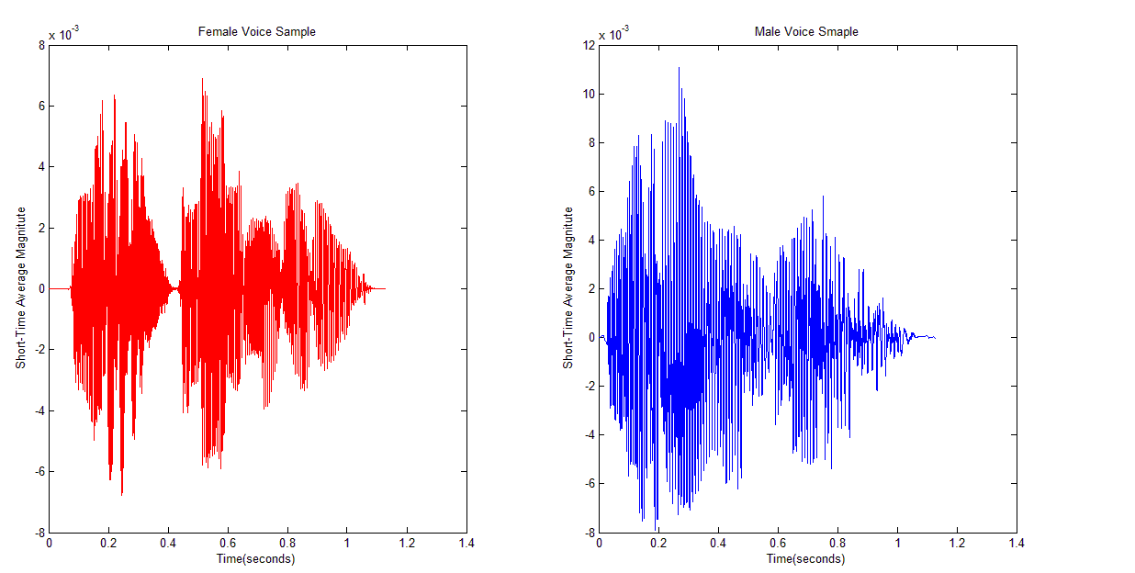
STAM plots of Female and Male voices

Slide 13
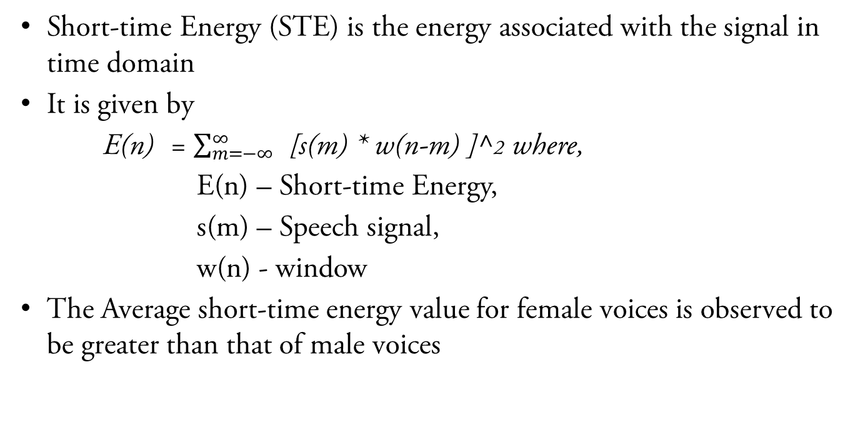
Short-Time Energy
Short-time Energy (STE) is the energy associated with the signal in time domain
It is given by
E(n) = $\sum_{m=−∞}^{∞}{ }$[s(m) * w(n-m) ]^2 where,
E(n) – Short-time Energy,
s(m) – Speech signal,
w(n) - window
The Average short-time energy value for female voices is observed to be greater than that of male voices

Slide 14
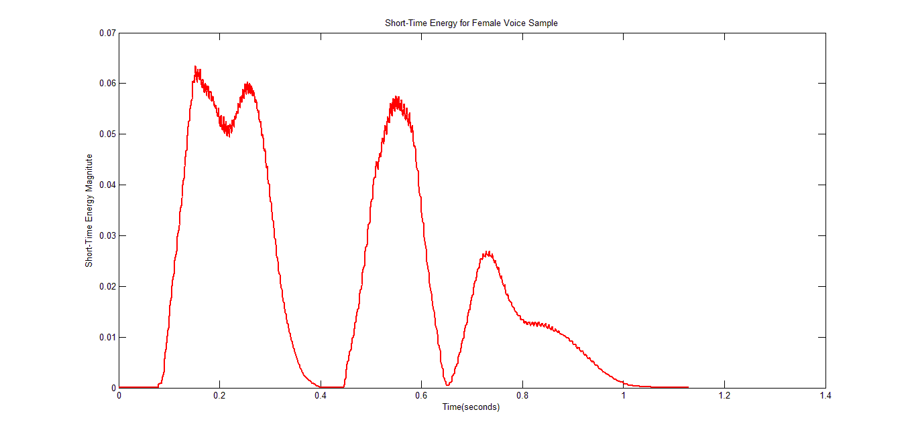
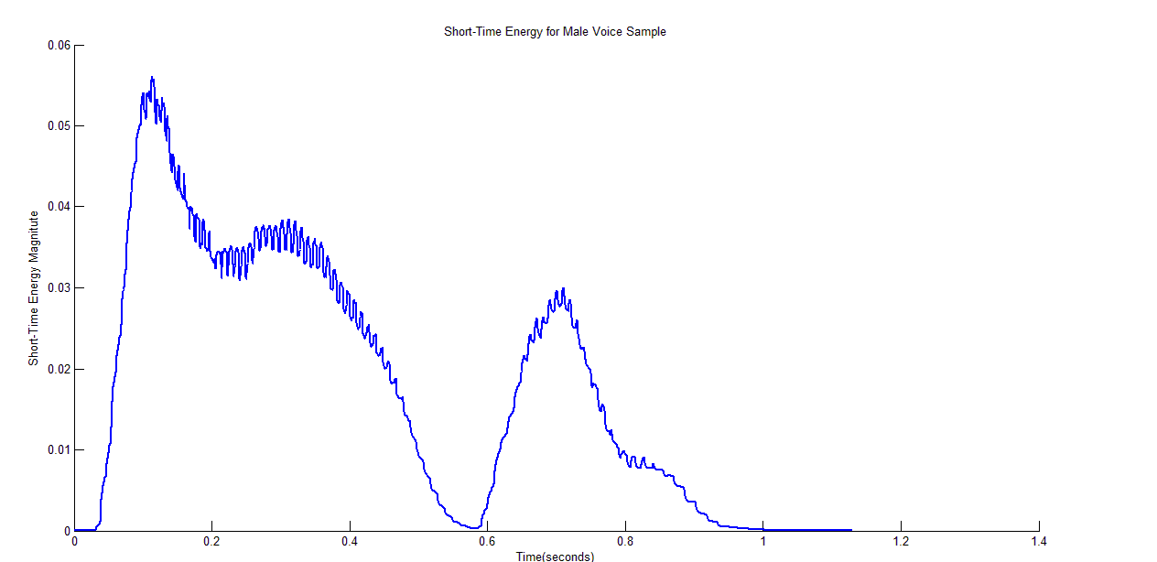
STE Plots
Female Voice
Male Voice

Slide 15
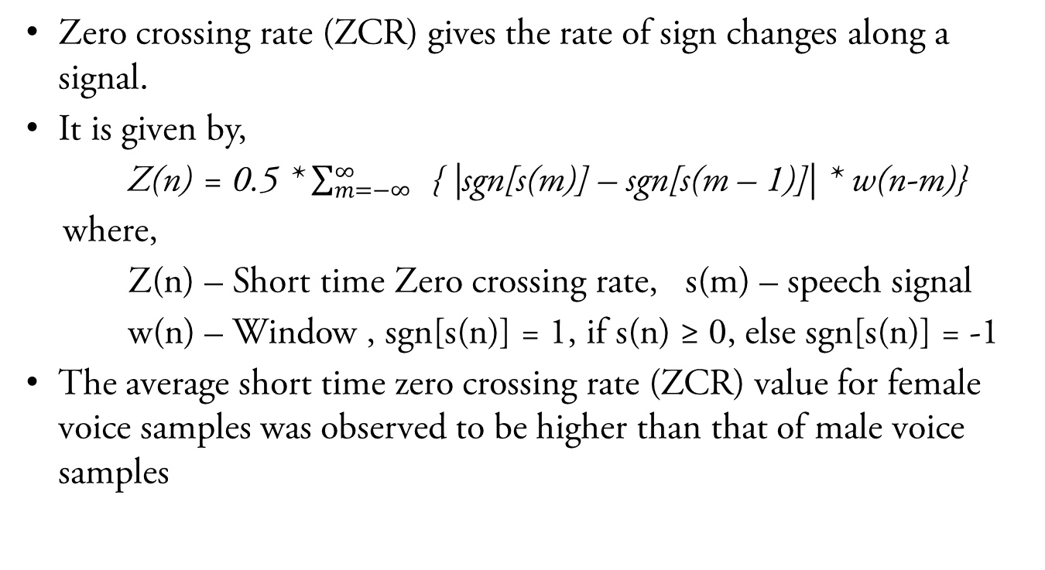
Short-Time Zero Crossing Rate (ZCR)
Zero crossing rate (ZCR) gives the rate of sign changes along a signal.
It is given by,
Z(n) = 0.5 * $\sum_{m=−∞}^{∞}{ }$ { |sgn[s(m)] – sgn[s(m – 1)]| * w(n-m)}
where,
Z(n) – Short time Zero crossing rate, s(m) – speech signal
w(n) – Window , sgn[s(n)] = 1, if s(n) ≥ 0, else sgn[s(n)] = -1
The average short time zero crossing rate (ZCR) value for female voice samples was observed to be higher than that of male voice samples

Slide 16
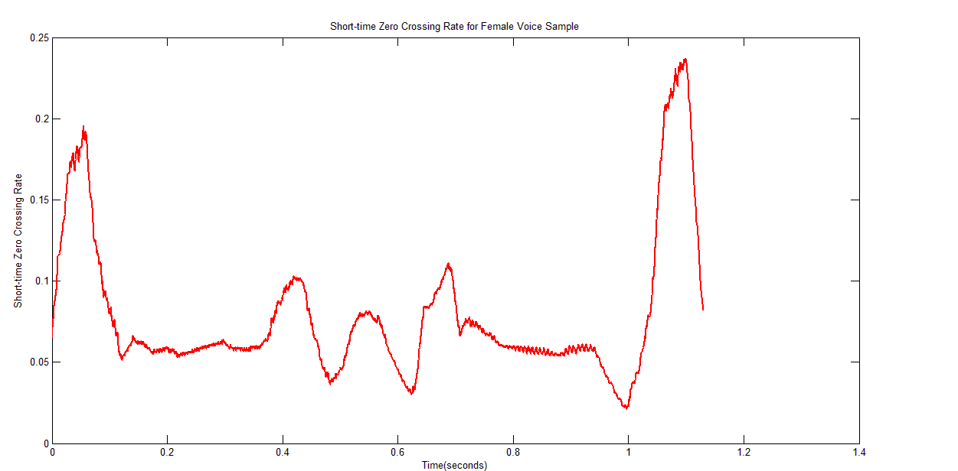
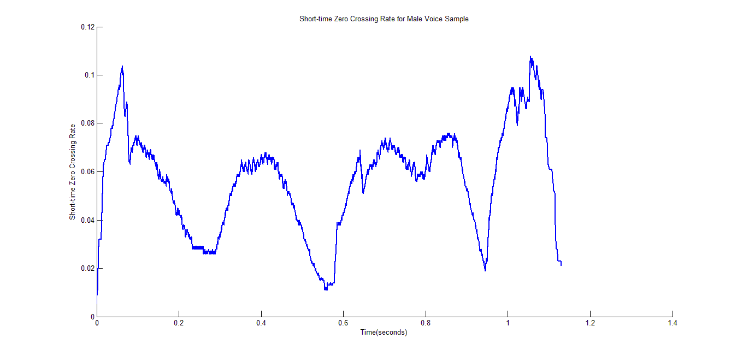
ZCR Plots
Female Voice
Male Voice

Slide 17
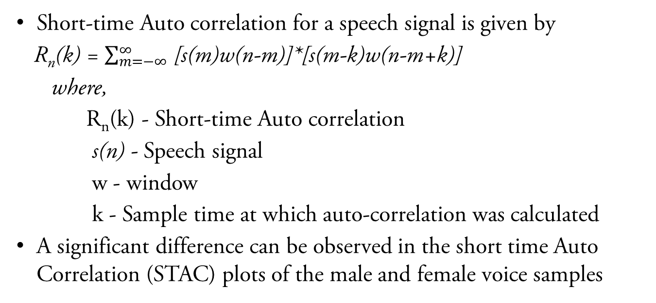
Short-time Auto Correlation (STAC)
Short-time Auto correlation for a speech signal is given by
R_{n}(k) = $\sum_{m=−∞}^{∞}{ }$[s(m)w(n-m)]*[s(m-k)w(n-m+k)]
where,
R_{n}(k) - Short-time Auto correlation
s(n) - Speech signal
w - window
k - Sample time at which auto-correlation was calculated
A significant difference can be observed in the short time Auto Correlation (STAC) plots of the male and female voice samples

Slide 18
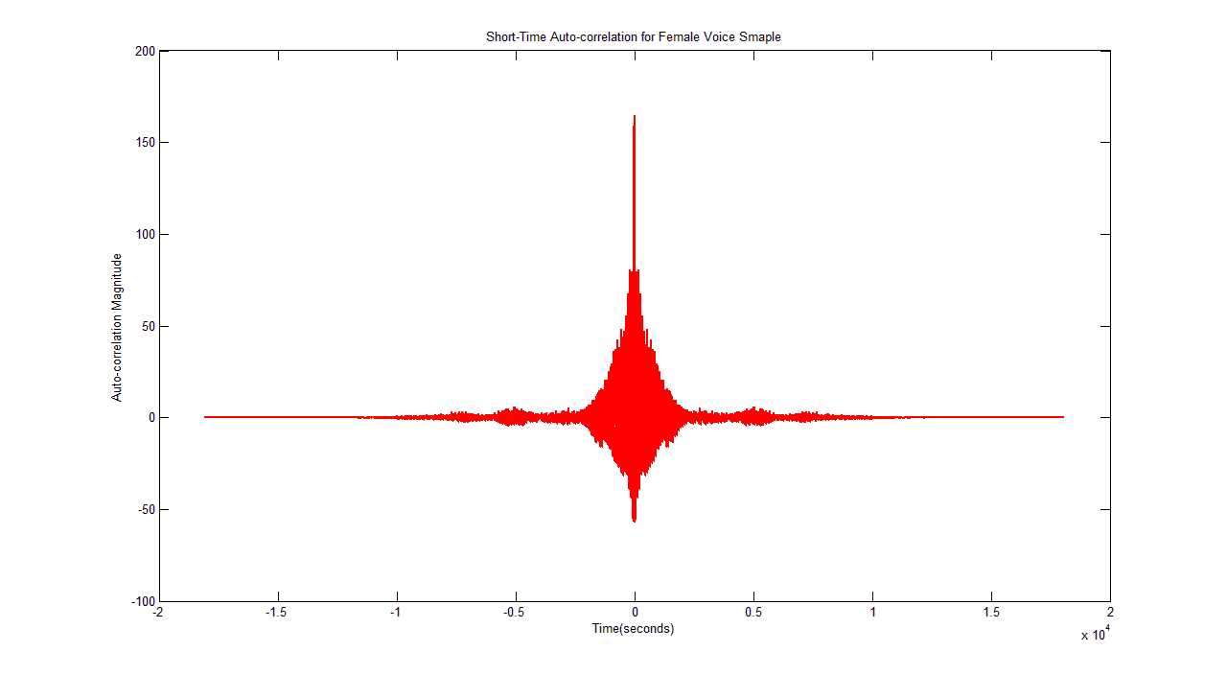
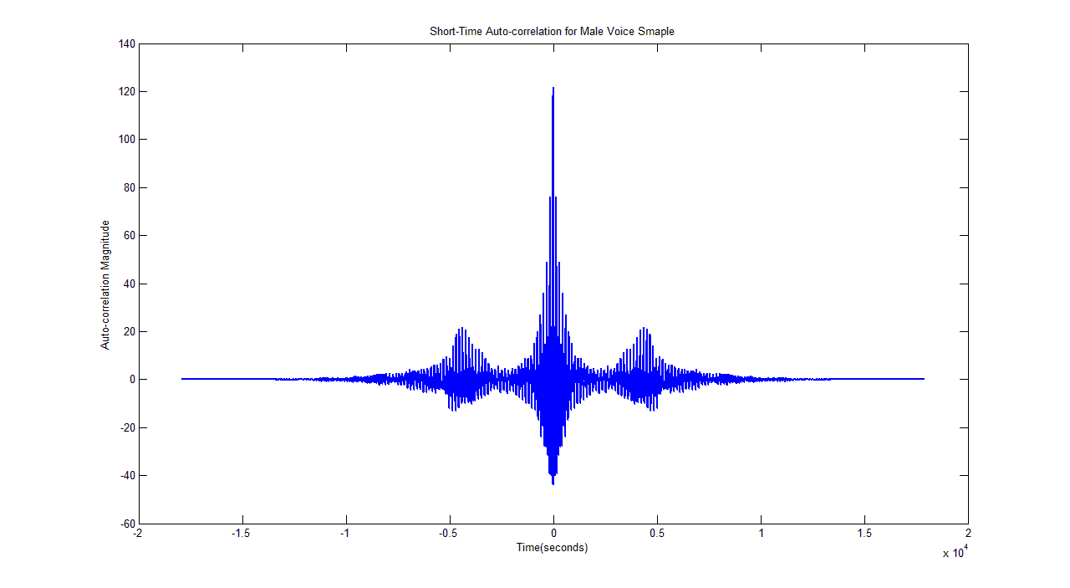
s
STAC Plots
Female Voice
a
Male Voice

Slide 19
Gender classifier
These differences in the parameters obtained by short-time analysis of the male and female voice samples is used as the working principle of a Gender classifier which predicts the gender of a speaker in a voice signal
Output of a gender classifier is a prediction value (label) of the actual speaker’s gender

Slide 20
Some Gender Classifiers
Using the parameters obtained from the short time analysis of speech signal, classifiers can be implemented using following approaches:
Naïve Bayes classifier
Probabilistic Neural Networks (PNNs)
Support Vector Machines (SVMs)
K-NNs classifier
GMM based classifier

Slide 21
Testing of Hypothesis
A total of 11 classifiers tested are: 1)Naïve Bayes, 2)PNN, SVMs with 5 different kernels; 3): Gaussian RBF, denoted SVM1, 4): Multilayer perceptron, denoted SVM2, 5): Quadratic, denoted SVM3, 6): Linear, denoted SVM4, 7): Cubic polynomial, denoted SVM5, four K-NNs with different distance functions such as; 8): Euclidean, denoted KNN1, 9): Cityblock( i.e., sum of absolute differences), denoted KNN2, 10): Cosine-based (i.e., one minus the cosine of the included angle between patterns), denoted KNN3, and 11): correlation-based (i.e., one minus the sample correlation between patterns), denoted KNN4 respectively.
The above mentioned classifiers are tested on a English Language Speech Database for Speech Recognition (ELSDSR)

Slide 22
Results
The fig. (next slide) shows the Correct Gender classification rates for different classifiers on ELSDSR database when the size of test utterances is 20% of the total utterances (232)
For each classifier, columns “Total”, “Male”, and “Female” correspond to the total correct gender classification rate, the rate of correct matches between the actual gender and the predicted one by the classifier for utterances by male speakers, and female speakers respectively. The arrows indicate the best rates

Slide 23
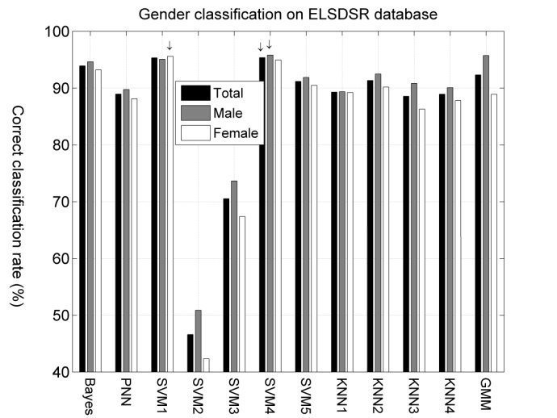

Slide 24
CONCLUSIONS
At the level of speech analysis, the short-time analysis is most basic approach to obtain the required parameters for the gender classification problem
The differences in parameters is used as the working principle of a Gender classifier which can be implemented on any of the mentioned approaches
The SVM with a suitable kernel (SVM1) has demonstrated to yield the most accurate results for gender classification with an accuracy more than 90%
Main challenge faced by the Gender classifiers is the high frequency noise in the speech signal which leads to confusions in the gender prediction

Slide 25
REFERENCES
[1] Douglas O’shaughnessy, “Speech Communications: Human and Machine”, IEEE Press, Newyork, 2000.
[2] Sedaaghi M. H., “Gender classification in emotional speech”, In Speech Recognition: Technologies and Applications, pp. 363–376, Itech, Vienna, Austria, 2008.
[3] BhagyaLaxmi Jena, Abhishek Majhi, Beda Prakash Panigrahi, “Gender classification by Speech Analysis”.
[4] M.Gomathy, K.Meena and K.R. Subramaniam, “Performance Analysis of Gender Clustering and Classification Algorithms”, International Journal on Computer Science and Engineering (IJCSE), 2009.

Slide 26
Thank You!

