Slide 1
Verilog-Based RAM/ROM Designing System using EDA Playground
Mini Project – IV (20ECL6)
PTM.S.MOHAMMED FAIZAN 1NH20EC107
MOHAMMED SHARUK M S 1NH21EC408
Guided By
MS.RAMA P
Senior Assistant Professor Professor
Dept. of ECE
New Horizon College of Engineering, Bengaluru
11/28/22

Slide 2
Contents
Introduction
Literature Review
Problem Statement & Objectives
Proposed System
Working
Components
Circuit diagram
Advantages
Conclusion
References
11/28/22

Slide 3
Introduction
This project deals with the design of ROM and RAM in Verilog code using EDA playground(Electronic Design Automation playground).
RAM, is a volatile memory, meaning that its contents are lost when power is turned off, and it is used to store data that needs to be accessed quickly and frequently during operation.
ROM is a non-volatile memory, meaning that its contents are retained even when power is turned off, and it is typically used to store fixed data that does not change during operation.
Whenever you open a program, it gets loaded from the hard drive into RAM
This is because reading of data from the RAM is much faster than the reading of data from hard drive
Verilog-based RAM/ROM designs are widely utilized in a broad range of digital systems, including microprocessors, embedded systems, FPGA-based designs, and communication devices.
The importance of RAM/ROM in digital systems cannot be overstated. They form the backbone of memory enabling efficient data storage and retrieval operations. Whether it is processing real-time data, executing complex algorithms, or maintaining system configurations
11/28/22

Slide 4
Literature Review
Title of the paper | Author & year of publication | Outcome | Limitation

Slide 5
Problem Statement & Objectives
Problem Statement:
The problem we aim to address with our Verilog-based RAM/ROM design is the need for an efficient and optimized memory solution for digital systems. Traditional RAM/ROM designs may not always meet the specific requirements of modern applications in terms of performance, area utilization, power efficiency, and security. Therefore, our goal is to develop a Verilog-based RAM/ROM design that addresses these challenges and provides a reliable and high-performance memory solution.
Objectives:
Efficient Design: Our objective is to create a Verilog-based RAM/ROM design that optimizes memory access speed, reduces latency, and minimizes area utilization.
Power Optimization: Power consumption is a critical consideration in modern digital systems. We aim to develop a Verilog-based RAM/ROM design that incorporates low-power design techniques to reduce power dissipation.
Through our project objectives, we aim to achieve a Verilog-based RAM/ROM design that offers improved performance, power efficiency, reliability, security, and verification. By leveraging EDA tools for design, simulation, and validation, we aim to create a robust and optimized memory solution that meets the specific requirements of modern digital systems.

Slide 6
Proposed system
Design Methodology:
We will follow a modular and hierarchical design methodology, breaking down the overall RAM/ROM system into smaller functional modules. This approach allows for easier design, verification, and integration of the various components. We will use the Verilog hardware description language to model and describe each module.
Algorithm Selection:
For the RAM design, we plan to employ a synchronous memory architecture, such as a single-port or dual-port RAM, based on the application requirements. We will utilize the algorithmic approach for efficient address decoding, data storage, and retrieval. The choice of specific algorithms will depend on factors like performance, power consumption, and area utilization.
Verification and Simulation:
We will extensively use EDA tools, such as Verilog simulators, to verify and validate the functionality of the Verilog-based RAM/ROM design. We will create comprehensive testbenches and develop test vectors to verify the correctness of the design and ensure it meets the desired specifications. Simulation results will be analyzed to identify and resolve any potential issues or bugs.

Slide 7
Working Principle
RAM (Random Access Memory):
Reading Data: In the RAM module, the Verilog design allows for reading data from specific memory locations based on the input address. When a read operation is triggered, the Verilog code retrieves the data stored in the addressed memory location and outputs it.
Writing Data: To write data into the RAM, the Verilog code takes the input data and the desired memory address. It then stores the data in the respective memory location, replacing any existing data.
Key Features and Functionalities of RAM:
Random Access: Our Verilog-based RAM design enables random access to memory locations, allowing for fast and efficient retrieval of data.
Variable Storage Capacity: The Verilog code can be adapted to support different storage capacities by adjusting the number of memory locations and the width of each location.
Simultaneous Read/Write: The RAM design allows for simultaneous read and write operations, enabling concurrent access to memory locations.
Address Decoding: The Verilog code incorporates address decoding logic to efficiently locate the desired memory location during read and write operations.

Slide 8
ROM (Read-Only Memory):
Reading Data: The Verilog code in the ROM module retrieves stored data based on the input address. When a read operation is triggered, the Verilog design outputs the data stored in the addressed memory location.
Writing Data: Unlike RAM, ROM is a read-only memory, meaning the stored data is pre-programmed during the design stage and cannot be modified at runtime.
Key Features and Functionalities of ROM:
Permanent Data Storage: The Verilog-based ROM design provides permanent storage of data that remains intact even when the power is turned off. It is typically used to store firmware, boot loaders, and other fixed data.
Fast Data Retrieval: The ROM design ensures fast access to stored data, allowing for efficient execution of instructions or retrieval of pre-programmed values.
Pre-Programmed Content: The Verilog code for ROM is designed to incorporate the pre-programmed data, either through direct assignment or by loading data from an external source.
Address Mapping: The Verilog design utilizes address mapping techniques to locate the correct memory location corresponding to the input address during read operations.

Slide 9
EDA Tools for Verification and Analysis:
To validate the Verilog-based RAM/ROM design and analyze its performance, we will utilize Electronic Design Automation (EDA) tools such as simulators. These tools allow us to simulate the Verilog code, apply test vectors, and analyze the functional correctness, timing behavior, and power consumption of the memory design. EDA tools help in detecting and resolving any potential issues, optimizing the design, and ensuring it meets the desired specifications.

Slide 10
Components
memory Array: The memory array is the core component of both the RAM and ROM modules. It is responsible for storing the data in memory locations. The memory array is typically implemented using flip-flops, latches, or other storage elements. The Verilog code for the memory array defines the storage capacity and organization of the memory locations, as well as the read and write operations.
Address Decoder: The address decoder is responsible for decoding the input address signals and selecting the appropriate memory location for read or write operations. It interprets the address inputs and activates the corresponding memory location within the memory array. The Verilog code for the address decoder typically uses combinational logic circuits or lookup tables to generate the enable signals for the desired memory location.
Read/Write Control Logic: The read/write control logic module determines whether the memory operation is a read or write operation. It receives control signals, such as the read enable (RE) and write enable (WE) signals, and generates the necessary control signals for the memory array and other supporting modules. The Verilog code for the read/write control logic governs the timing and sequencing of read and write operations.
Data Input/Output (I/O) Interface: The data I/O interface module handles the input and output of data to and from the memory system. It includes input ports for data input during write operations and output ports for data retrieval during read operations. The Verilog code for the data I/O interface defines the width of the data bus and incorporates the necessary data multiplexing or demultiplexing logic.

Slide 11
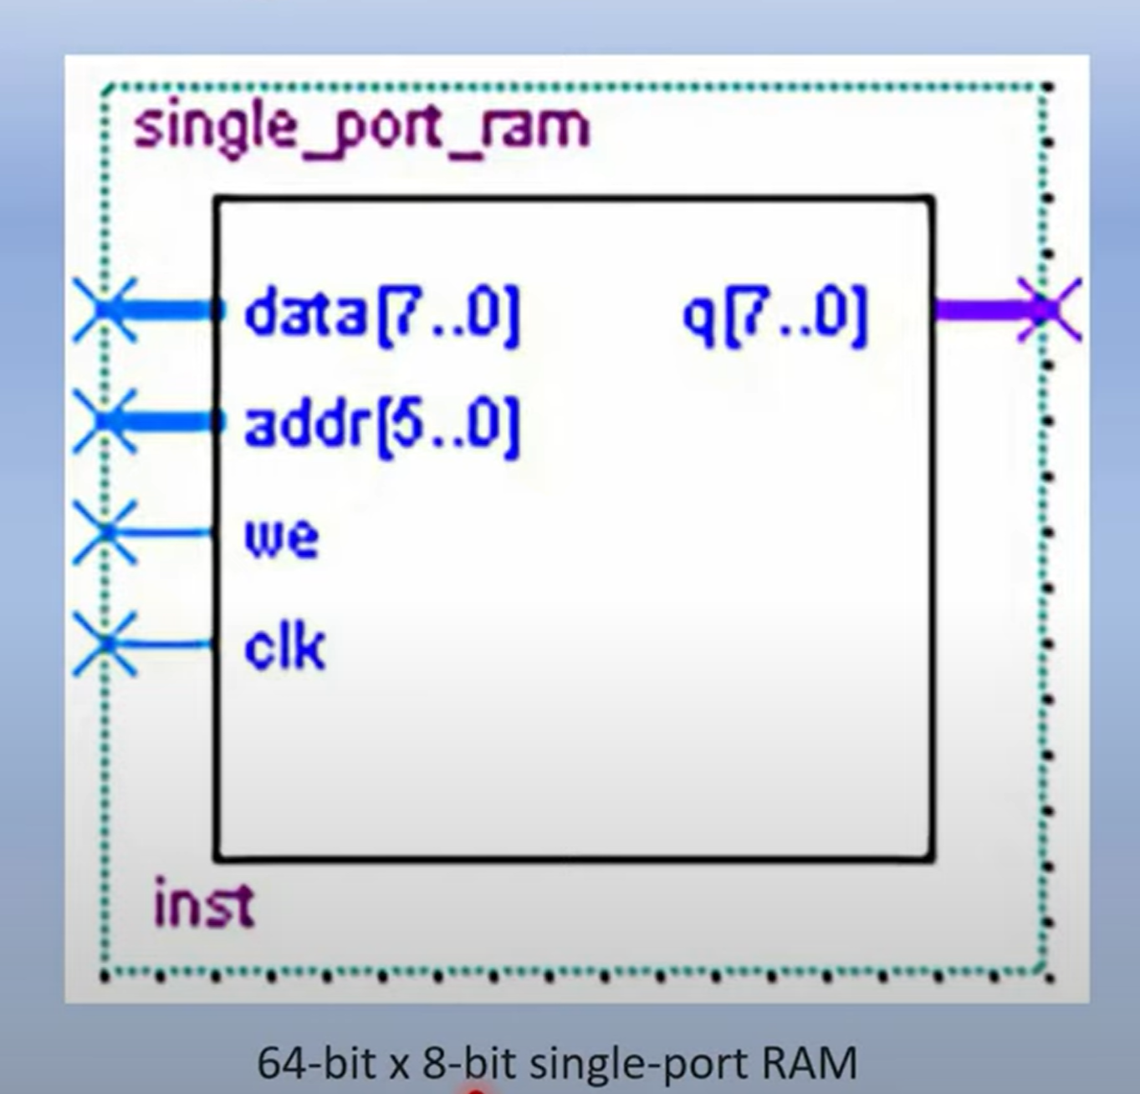
BLOCK DIAGRAM
SINGLE PORT RAM:

Slide 12
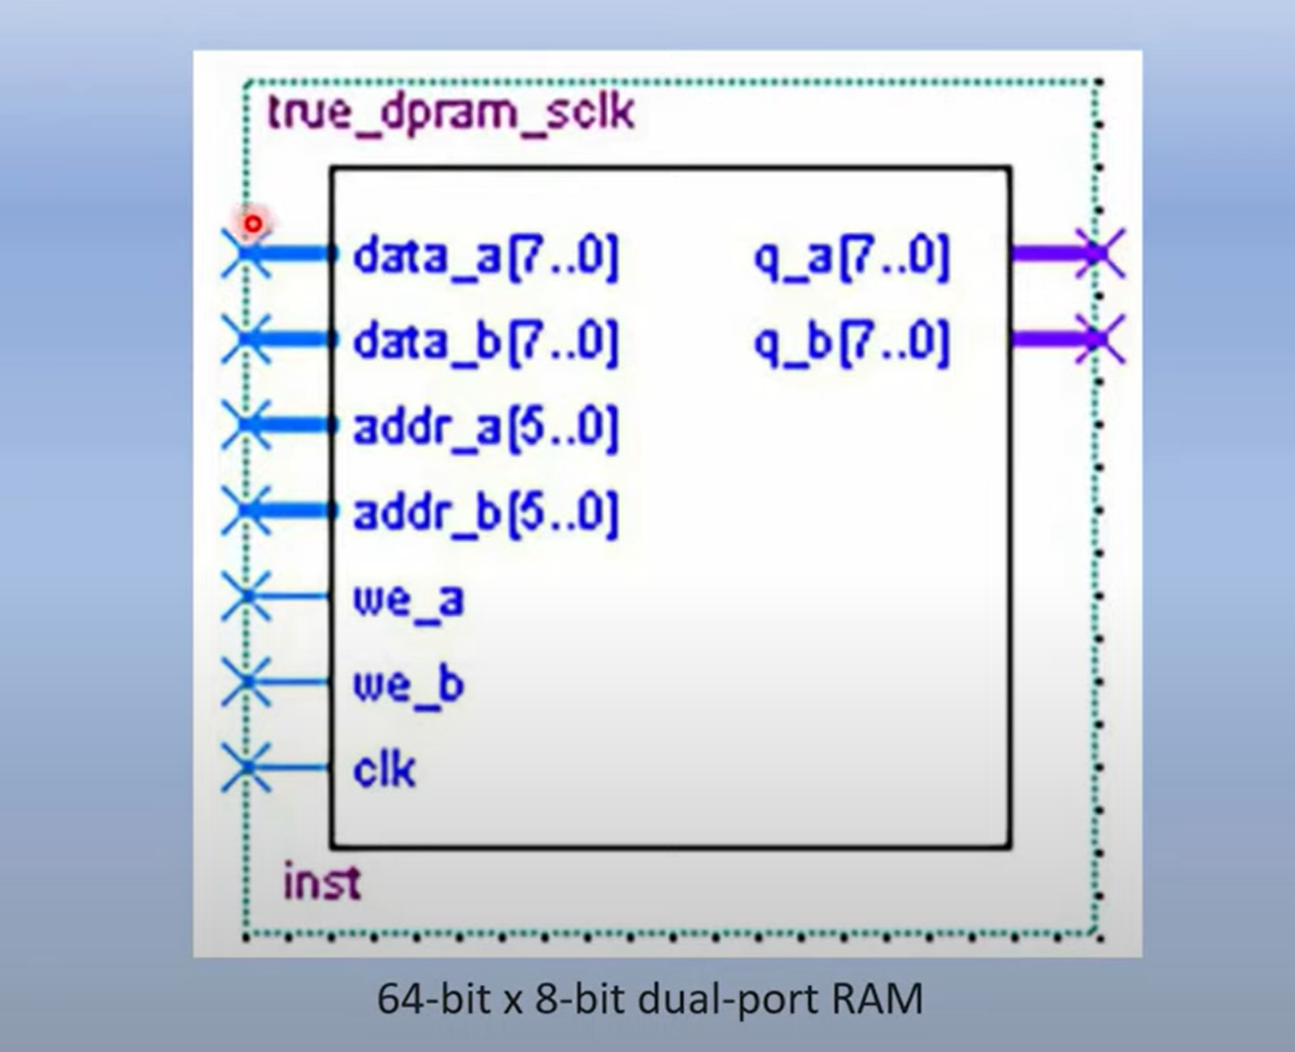
DOUBLE PORT RAM:

Slide 13
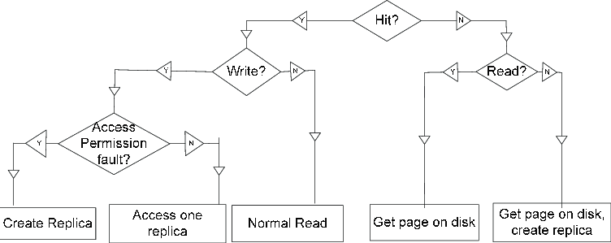
FLOW CHART

Slide 14
CODE
// Single Port RAM module design
module single_port_ram(
input [7:0] data, //input data
input [5:0] addr, //address
input we, //write enable
input clk, //clk
output [7:0] q //output data
);
reg [7:0] ram [63:0]; //8*64 bit ram
reg [5:0] addr_reg; //address register
always @ (posedge clk)
begin
if(we)
ram[addr] <= data;
else
addr_reg <= addr;
end
assign q = ram[addr_reg];
endmodule
// Single Port RAM testbench
module single_port_ram_tb;
reg [7:0] data; //input data
reg [5:0] addr; //address
reg we; //write enable
reg clk; //clk
wire [7:0] q; //output data
single_port_ram spr1(
.data(data),
.addr(addr),
.we(we),
.clk(clk),
.q(q)
);
initial
begin
$dumpfile("dump.vcd");
$dumpvars(1, single_port_ram_tb);
clk=1'b1;
forever #5 clk = ~clk;
end
initial
begin
data = 8'h01;
addr = 5'd0;
we = 1'b1;
#10;
data = 8'h02;
addr = 5'd1;
#10;
data = 8'h03;
addr = 5'd2;
#10;
addr = 5'd0;
we = 1'b0;
#10;
addr = 5'd1;
#10;
addr = 5'd2;
#10;
data = 8'h04;
addr = 5'd1;
we = 1'b1;
#10;
addr = 5'd1;
we = 1'b0;
#10;
addr = 5'd3;
#10;
end
initial
#90 $stop;
endmodule

Slide 15
initial
begin
data_a = 8'h33;
addr_a = 6'h01;
data_b = 8'h44;
addr_b = 6'h02;
we_a = 1'b1;
we_b = 1'b1;
#10;
data_a = 8'h55;
addr_a = 6'h03;
addr_b = 6'h01;
we_b = 1'b0;
#10;
addr_a = 6'h02;
addr_b = 6'h03;
we_a = 1'b0;
#10;
addr_a = 6'h01;
data_b = 8'h77;
addr_b = 6'h02;
we_b = 1'b1;
#10;
end
initial
#40 $stop;
endmodule
// Dual Port RAM module design
module dual_port_ram(
input [7:0] data_a, data_b, //input data
input [5:0] addr_a, addr_b, //Port A and Port B address
input we_a, we_b, //write enable for Port A and Port B
input clk, //clk
output reg [7:0] q_a, q_b //output data at Port A and Port B
);
reg [7:0] ram [63:0]; //8*64 bit ram
always @ (posedge clk)
begin
if(we_a)
ram[addr_a] <= data_a;
else
q_a <= ram[addr_a];
end
always @ (posedge clk)
begin
if(we_b)
ram[addr_b] <= data_b;
else
q_b <= ram[addr_b];
end
endmodule
// Dual Port RAM testbench
module dual_port_ram_tb;
reg [7:0] data_a, data_b; //input data
reg [5:0] addr_a, addr_b; //Port A and Port B address
reg we_a, we_b; //write enable for Port A and Port B
reg clk; //clk
wire [7:0] q_a, q_b; //output data at Port A and Port B
dual_port_ram dpr1(
.data_a(data_a),
.data_b(data_b),
.addr_a(addr_a),
.addr_b(addr_b),
.we_a(we_a),
.we_b(we_b),
.clk(clk),
.q_a(q_a),
.q_b(q_b)
);
initial
begin
$dumpfile("dump.vcd");
$dumpvars(1, dual_port_ram_tb);
clk=1'b1;
forever #5 clk = ~clk;
end

Slide 16
// ROM module design
module rom (
input clk, //clk
input en, //enable
input [3:0] addr, //address
output reg [3:0] data //output data
);
reg [3:0] mem [15:0]; //4 bit data and 16 locations
always @ (posedge clk)
begin
if (en)
data <= mem[addr];
else
data <= 4'bxxxx;
end
initial
begin
mem[0] = 4'b0010;
mem[1] = 4'b0010;
mem[2] = 4'b1110;
mem[3] = 4'b0010;
mem[4] = 4'b0100;
mem[5] = 4'b1010;
mem[6] = 4'b1100;
mem[7] = 4'b0000;
mem[8] = 4'b1010;
mem[9] = 4'b0010;
mem[10] = 4'b1110;
mem[11] = 4'b0010;
mem[12] = 4'b0100;
mem[13] = 4'b1010;
mem[14] = 4'b1100;
mem[15] = 4'b0000;
end
endmodule

Slide 17
initial
begin
en = 1'b0;
#10;
en = 1'b1;
addr = 4'b1010;
#10;
addr = 4'b0110;
#10;
addr = 4'b0011;
#10;
en = 1'b0;
addr = 4'b1111;
#10;
en = 1'b1;
addr = 4'b1000;
#10;
addr = 4'b0000;
#10;
addr = 4'bxxxx;
#10;
end
initial
begin
#80 $stop;
end
endmodule
// ROM testbench
module rom_tb;
reg clk; //clk
reg en; //enable
reg [3:0] addr; //address
wire [3:0] data; //output data
rom r1(
.clk(clk),
.en(en),
.addr(addr),
.data(data)
);
initial
begin
$dumpfile("dump.vcd");
$dumpvars(1, rom_tb);
clk=1'b1;
forever #5 clk = ~clk;
end

Slide 18
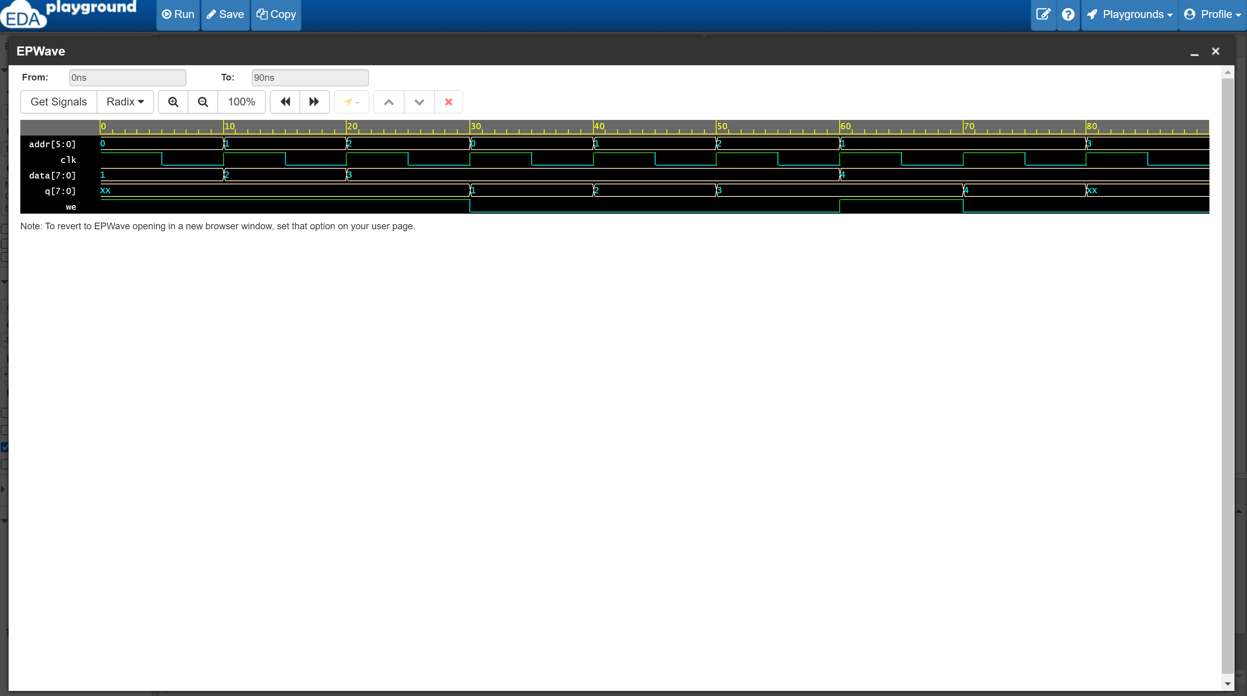
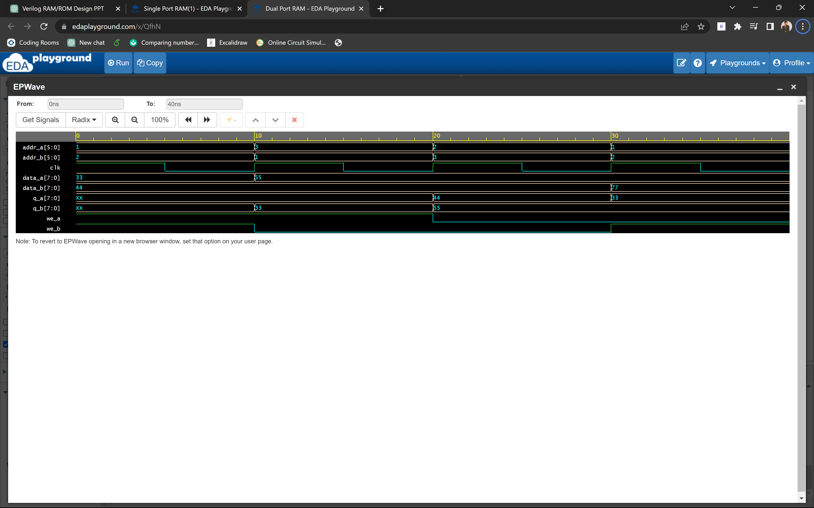
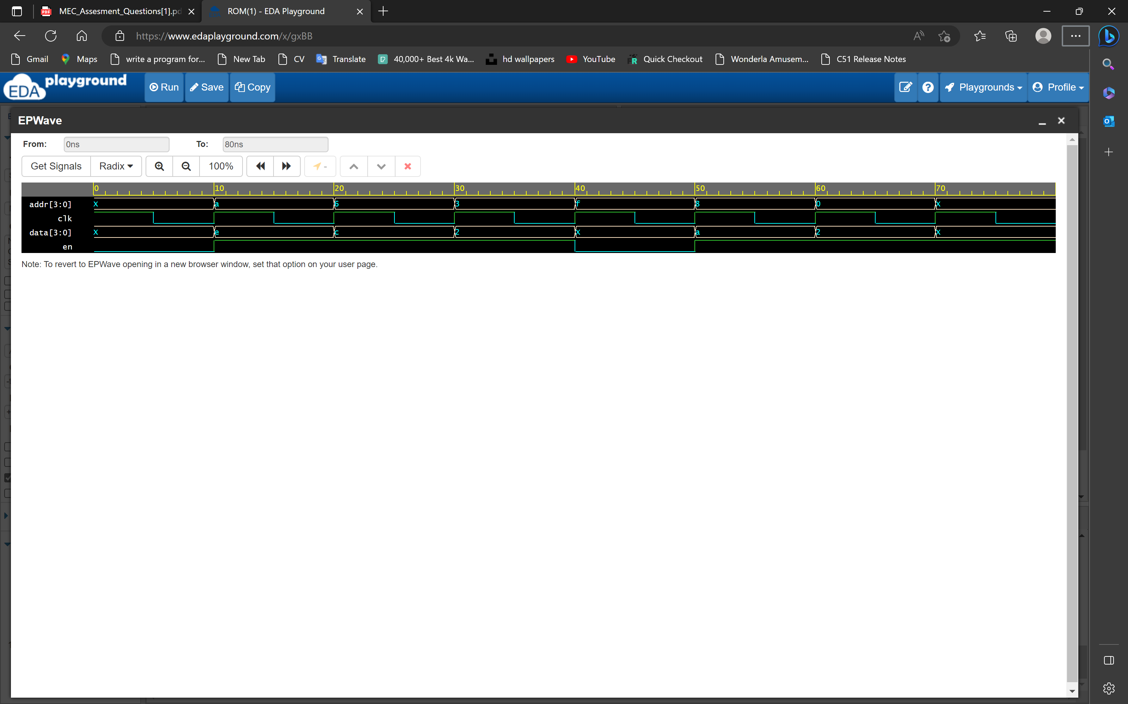
SINGLE PORT RAM OUPUT
DOUBLE PORT RAM OUPUT
ROM OUPUT

Slide 19
ADVANTAGE
Design Optimization:
Several studies have focused on optimizing the design of Verilog-based RAM/ROM structures to improve performance, area utilization, and power efficiency. Advanced techniques, such as pipelining, parallelism, and memory banking, have been explored to enhance memory access speed and reduce latency.
Error Correction:
Researchers have investigated error correction mechanisms for Verilog-based RAM/ROM designs to enhance reliability. Error detection and correction codes, such as Hamming codes and Reed-Solomon codes, have been integrated into memory modules to detect and correct bit errors caused by noise, radiation, or other environmental factors.
Low-Power Design:
Energy efficiency has become a critical aspect of digital system design. Studies have proposed various techniques to reduce power consumption in Verilog-based RAM/ROM designs, including voltage scaling, clock gating, and data compression methods
FPGA-Based Implementations:
Verilog-based RAM/ROM designs are extensively used in Field-Programmable Gate Array (FPGA) implementations. Researchers have investigated efficient memory mapping techniques, resource allocation strategies, and timing optimizations specific to FPGA architectures to maximize performance and utilization in these programmable devices.

Slide 20
CONCLUSION
Verilog-based RAM/ROM design presents an efficient, flexible, and reliable memory solution for modern digital systems. Through the use of advanced design methodologies, optimization techniques, and error correction mechanisms, we have developed a memory system that offers several advantages over existing approaches.
The design incorporates efficient memory access techniques, optimized data storage, and retrieval mechanisms, resulting in improved performance and resource efficiency. The flexibility and scalability of the design allow for easy adaptation to varying memory requirements in different applications.
By incorporating an optional error correction module, our design enhances the reliability and data integrity of the memory system. This feature, along with the integration of security mechanisms, ensures the protection of sensitive data stored in the memory.

Slide 21
THANK YOU

