Slide 1


Slide 2



Slide 3


Indices
- The quick brown fox jumped over the lazy dog
- 3.14
- 15/09/2024
The quick brown fox jumped over the lazy dog
Text embedding
model
Documents
[-0.1, 2.5, …, -1.67]

Slide 4

Search system
Indices
https://www.travelmediagroup.com/the-power-of-facebook-as-a-search-engine-2/
Documents

Slide 5

Recommendation system
Indices
https://www.shopagain.com/blog/product-recommendation-engines-what-is-it-how-it-work/
Documents

Slide 6

RAG system
Indices
https://www.superannotate.com/blog/rag-explained
Documents

Slide 7

RAG system
Indices
https://www.superannotate.com/blog/rag-explained
Documents

Slide 8
3
Create an index

Slide 9
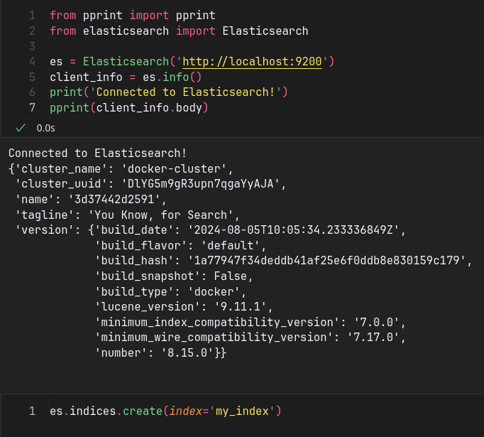
What is an index ?
Name
Price
Description
...
JSON
JSON
Product 1
Product 2
JSON
Product n
Product Index

Slide 10
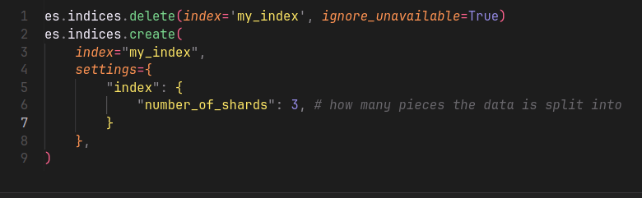
Shards & replicas
Number of shards = 2
Sharding
Product Index
Product Index

Slide 11
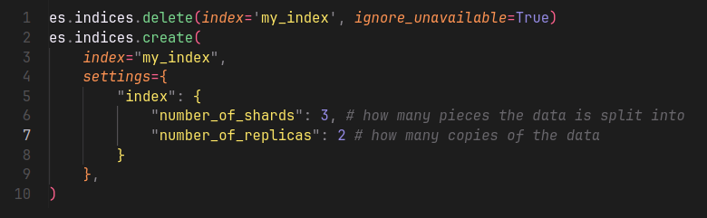
Shards & replicas
Number of shards = 2
Number of replicas = 1
Product Index
duplicate
Product Index

Slide 12
4
Inserting documents

Slide 13
Document
“Name”: “value”
“Price”: “value”
“Description: “value”
...
JSON

Slide 14
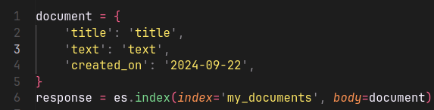
Document
insertion
mapping
Field | Type
created_on | date
text | text
title | text
JSON
X100
my_index
🛈 This process is called mapping and can be done automatically or manually. By default, ElasticSearch does it automatically.

Slide 15
5
Field data types

Slide 16
Field data types
insertion
mapping
Field | Type
created_on | date
text | text
title | text
JSON
X100
my_index

Slide 17

Field data types
Common types
Binary
  Accepts a binary value as a Base64 encoded string.
  Is not searchable and is not stored.
  Use _source (i.e., document) to get the data back.
Read more
encoding
IVBORw0KGgoAAAANSUhEUgAAAOEAAADhCAIAAADiVBORw0KGgoAAAANSUhEUgAAAOEAAADhCAIA….
Base64 representation

Slide 18
Field data types
Common types
Binary
Boolean (True / False)
Numbers (long, integer, byte, short, etc)
Dates
Keyword (IDs, email addresses, status codes, zip codes, etc)
Read more

Slide 19
Field data types
Objects types (JSON)
Object
Read more
{
"region": "US",
"manager": {
"age": 30,
"name": {
"first": "John",
"last": "Smith"
}
}
}
JSON
indexation
{
"region": "US",
"manager.age": 30,
"manager.name.first": "John",
"manager.name.last": "Smith"
}

Slide 20
Field data types
Objects types (JSON)
Object
Flattened
  Efficient for deeply nested JSON objects.
  Hierarchical structure is not preserved.
Nested
  Cases where you have array of objects.
  Maintains relationship between the object’s fields.
Read more

Slide 21
Field data types
Objects types (JSON)
Flattened / Nested object example
{
"group": "fans",
"user": [
{
"first": "John",
"last": "Smith"
},
{
"first": "Alice",
"last": "White"
}
]
}
Read more
JSON
indexation
{
"group" : "fans",
"user.first" : [ "alice", "john" ],
"user.last" : [ "smith", "white" ]
}

Slide 22
Field data types
Text search types
Text
  Used for full-text content.
  Examples: Body of an email or the description of a product.
Read more
analyzer
Structured format that’s optimized for search.
Unstructured format

Slide 23
Field data types
Text search types
Text
  Used for full-text content.
  Examples: Body of an email or the description of a product.
Completion
Search as you type
Annotated text
Read more

Slide 24

Field data types
Spatial data types
Geo point
Geo shape
Point (Cartesian point)
Shape (Cartesian geometry)
Read more

Slide 25
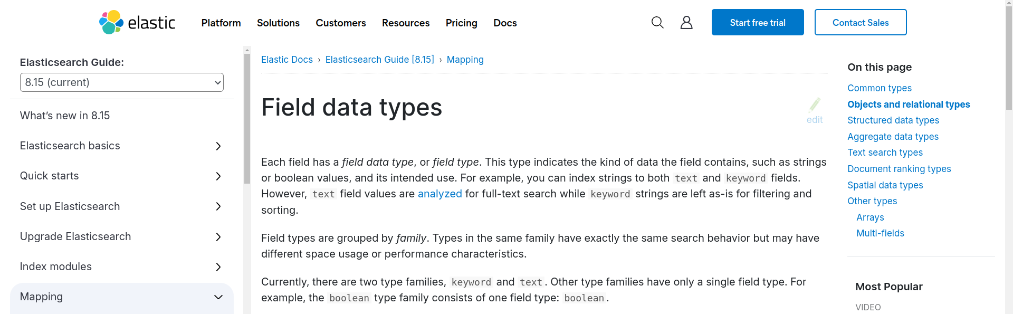
Field data types
Read more

Slide 26
6
Delete documents

Slide 27
Delete documents
JSON
id=1
my_index
Read more
JSON
id=2
JSON
id=3
<index>
<id>
DELETE

Slide 28
Delete documents
JSON
id=1
my_index
Read more
JSON
id=2
JSON
id=3
my_index
1
my_index
4
DELETE
DELETE
❌

Slide 29
7
Get document

Slide 30
Get documents
JSON
id=1
my_index
Read more
JSON
id=2
JSON
id=3
<index>
<id>
GET

Slide 31
Get documents
JSON
id=1
my_index
Read more
JSON
id=2
JSON
id=3
my_index
1
my_index
4
GET
GET
❌

Slide 32
8
Count documents

Slide 33
Count documents
JSON
my_index
Read more
JSON
JSON
🛈 The query parameter is used to match certain criteria
<index>
<index>
<q>
COUNT
COUNT

Slide 34
9
The exists API

Slide 35
The exists API
JSON
my_index
Read more
JSON
JSON
<index>
<index>
<id>
client.indices.exists
client.exists
🛈 This checks if an index exists in ElasticSearch.
🛈 This checks if a document exists in an index.

Slide 36
10
Update document

Slide 37
Update documents
Documents exists in the index
JSON
id=1
Read more
my_index
id=2
JSON
🛈 The update operation follows these steps:
Get the document.
Update it (e.g. Add a new field, remove a field, or update a field)
Re-index the result.
<index>
<id>
UPDATE

Slide 38
Update documents
But how do you update the document?
insertion
“book_id”: 1
“book_name”: “A book”
Read more
JSON
my_index
id=1
3
UPDATE
get
Document
update
my_index
script = {
“book_id” = 2
}
1
1
2

Slide 39
Update documents
Document doesn’t exist
JSON
id=1
Read more
my_index
id=2
JSON
🛈 The update operation can create the document if it doesn’t exist
Add the values you want to insert.
Set doc_as_upsert to true.
<index>
id=4
UPDATE

Slide 40
11
Bulk API

Slide 41
The bulk API
JSON
Index
my_index
Read more
JSON
Index
Update
Delete
Each operation (index, update, delete) makes a separate API call.
The bulk API performs multiple operations in one API call. This increases indexing speed.
...

Slide 42
The bulk API - Syntax
action and metadata\n
  optional source\n
action and metadata\n
  optional source\n
…
action and metadata\n
  optional source\n
🛈 The source is required for:
update
index
create
Read more
🛈 The action can be one of the following:
index
create
update
delete

Slide 43
The bulk API - Example
response = es.bulk(
operations=[
{
"index": {
"_index": "test",
"_id": "1"
}
},
{
"field1": "value1"
},
{
"delete": {
"_index": "test",
"_id": "2"
}
},
{
"create": {
"_index": "test",
"_id": "3"
}
},
{
"field1": "value3"
},
{
"update": {
"_id": "1",
"_index": "test"
}
},
{
"doc": {
"field2": "value2"
}
}
],
)
🛈 The source is required for:
update
index
create
Read more
Action
Source

Slide 44
12
The search API – Part 1

Slide 45
The search API
JSON
id=1
Read more
my_index
id=2
JSON
You use the search API to build:
Search engines
Recommendation systems
Real-time dashboards
Log data analysis
...

Slide 46
The search API
SEARCH
<index>
my_index
index_1,my_index
index*
_all
Read more

Slide 47
The search API
SEARCH
<index>
q
Use it for simple searches.
Uses the Lucene syntax.
Read more

Slide 48
The search API
SEARCH
<index>
q
Read more
query
Use it for complex, structured queries.
Uses the Query DSL language.
Default value is match all.

Slide 49
The search API
SEARCH
<index>
q
Read more
query
timeout, size, from
Timeout:
  The maximum time to wait for a search request to complete.
  Time units (seconds, milliseconds, days, etc) .
Size:
  Defines the number of hits (documents) to return.
  Default value is 10. Max value is 10000.

Slide 50
The search API
SEARCH
<index>
q
Read more
query
timeout, size, from
from:
  Starting point from which to return search results (pagination) .
  Useful if you want to implement skip functionality.

Slide 51
13
The search API – Part 2

Slide 52
The search API – Query DSL
SEARCH
<index>
q
Read more
query
Query DSL is used to create complex, structured queries.
Query DSL consists of two types of clauses:
  Leaf clauses (match, term, or range)
  Compound clauses (bool)
🛈 Query DSL means Query (Domain Specific Language)

Slide 53
The search API – Query DSL
Leaf clauses
match:
  Is used to perform full-text search.
  Returns documents that match a provided text, number, date, or bool.
  The field must be mapped to a text data type.
term:
  Returns documents that contain an exact term in a provided field.
  The field must be mapped to a keyword data type or a numeric/date type.
  Example usage : product ID, book ID, username, etc.
range:
  Returns documents that contain terms within a provided range.
Read more

Slide 54
The search API – Query DSL
Example for match query:
response = es.search(
index="my_index",
body={
"query": {
"match": {
"description": "A description."
}
}
}
)
Read more

Slide 55
The search API – Query DSL
Example for term query:
response = es.search(
index="my_index",
body={
"query": {
"term": {
"product_id": "PRODUCT_12345"
}
}
}
)
Read more

Slide 56
The search API – Query DSL
Example for range query:
response = es.search(
index="my_index",
body={
"query": {
"range": {
"publication_date":
{
"gte": "2023-01-01",
"lte": "2023-12-31"
}
}
}
}
}
)
Read more

Slide 57
The search API – Query DSL
Compound clauses
bool:
  Combines multiple queries using boolean logic:
    must, filter, should, must_not.
  The field must be mapped to a text data type.
Read more

Slide 58
The search API – Query DSL
Example for bool query:
response = es.search(index="my_index", body={
"query": {
"bool": {
"must": [
{
"match": {
"title": "Elasticsearch"
}
}
],
"filter": [
{
"term": {
"status": "published"
}
}
],
"should": [
{
"match": {
"tags": "search"
}
}
],
"must_not": [
{
"term": {
"deleted": True
}
}
]
}
}
)
Read more

Slide 59
The search API – Query DSL
Example for bool query:
response = es.search(index="my_index", body={
"query": {
"bool": {
"must": [
{
"match": {
"title": "Elasticsearch"
}
}
],
"filter": [
{
"term": {
"status": "published"
}
}
],
"should": [
{
"match": {
"tags": "search"
}
}
],
"must_not": [
{
"term": {
"deleted": True
}
}
]
}
}
})
Read more
Keeping documents where title is equal to Elasticsearch

Slide 60
The search API – Query DSL
Example for bool query:
response = es.search(index="my_index", body={
"query": {
"bool": {
"must": [
{
"match": {
"title": "Elasticsearch"
}
}
],
"filter": [
{
"term": {
"status": "published"
}
}
],
"should": [
{
"match": {
"tags": "search"
}
}
],
"must_not": [
{
"term": {
"deleted": True
}
}
]
}
}
})
Read more
Filtering documents with a status of published

Slide 61
The search API – Query DSL
Example for bool query:
response = es.search(index="my_index", body={
"query": {
"bool": {
"must": [
{
"match": {
"title": "Elasticsearch"
}
}
],
"filter": [
{
"term": {
"status": "published"
}
}
],
"should": [
{
"match": {
"tags": "search"
}
}
],
"must_not": [
{
"term": {
"deleted": True
}
}
]
}
}
})
Read more
This match is optional

Slide 62
The search API – Query DSL
Example for bool query:
response = es.search(index="my_index", body={
"query": {
"bool": {
"must": [
{
"match": {
"title": "Elasticsearch"
}
}
],
"filter": [
{
"term": {
"status": "published"
}
}
],
"should": [
{
"match": {
"tags": "search"
}
}
],
"must_not": [
{
"term": {
"deleted": True
}
}
]
}
}
})
Read more
Excluding any document where the deleted field is set to true

Slide 63
14
The search API – Part 3

Slide 64

The search API
Timeout
It sets the maximum duration for a query to execute.
If the search takes longer than the specified time, Elasticsearch will abort the search.
Read more

Slide 65
The search API
Timeout
Sets the maximum duration for a query to execute.
If the search takes longer than the specified time, Elasticsearch will abort the search.
Size
Controls how many search results are returned.
Max value is 10000.
Read more

Slide 66
The search API
Timeout
Sets the maximum duration for a query to execute.
If the search takes longer than the specified time, Elasticsearch will abort the search.
Size
Controls how many search results are returned.
Max value is 10000.
From
Used for pagination.
It tells Elasticsearch how many documents to skip before starting to return results.
Read more

Slide 67
The search API
Aggregations
Performs calculation on the data
Average, max, min, count.
Read more

Slide 68
15
Dense vectors

Slide 69
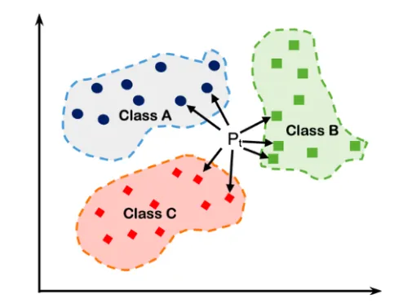
Dense vector field type
Stores dense vectors of numeric values.
Use it if you have few or no zero elements.
Does not support aggregations or sorting.
It is not possible to store multiple values in one dense vector field.
Use kNN search to retrieve the nearest vectors.
Max size of a dense vector is 4096.
Read more
Medium article by Sachinsoni

Slide 70
Dense vector field type
Examples
response = client.index(
index="my-index",
id="1",
document={
"my_text": "example text",
"my_vector": [0.5, 10, 6]
}
)
Read more
response = client.index(
index="my-index",
id="2",
document={
"my_text": "example text 2",
"my_vector": [[0.5, 10, 6], [1, 0, -2]]
}
)

Slide 71
Dense vector field type
Important
You have to manually do the mapping.
Elasticsearch does not automatically infer the mapping for dense vectors.
It needs to know the exact number of dimensions.
Read more
response = es.indices.create(
index="my_index",
mappings={
"properties": {
"sides_length": {
"type": "dense_vector",
"dims": 4
},
"shape": {
"type": "keyword"
}
}
},
)

Slide 72
16
Embedding documents

Slide 73
Embedding documents
Embedding transforms text into numerical vectors.
Deep learning models are used to embed documents.
These models preserve the meaning of the text.
Use cases:
  Recommendation systems
  Retrieval-Augmented Generation (RAG)
Read more
embedding

Slide 74


Embedding documents
Deep learning models
Read more
Closed models.
Paid (Pay what you use).
No hardware required (Cloud).
Open-source models.
Free to use.
Hardware is required (preferably GPU).

Slide 75
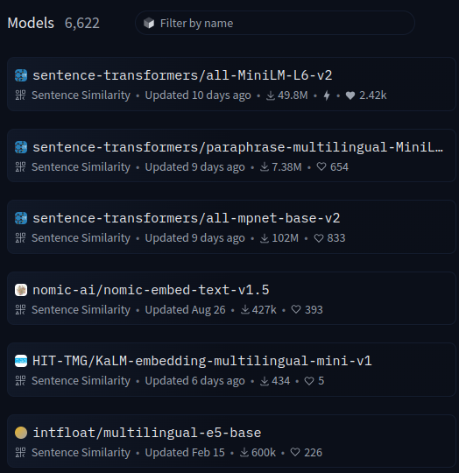
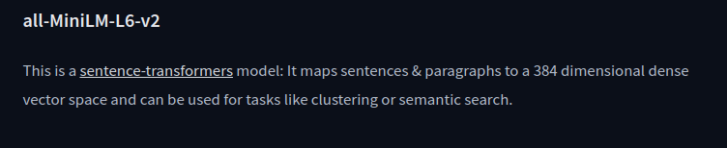
Embedding documents
Embedding size
Size of the dense vector.
Larger sizes yield better embeddings.
Common sizes include 384, 768, 1024.
Read more

Slide 76
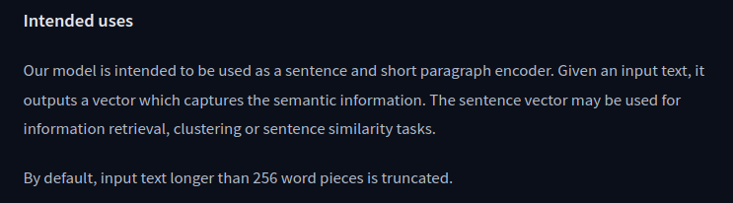
Embedding documents
Input size
Size of the input text that the model can process.
Text will be truncated if it exceeds the model’s capacity.
Common values include 256, 512 tokens.
Read more

Slide 77
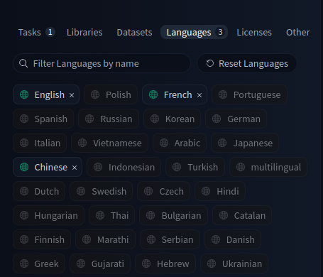
Embedding documents
Text language
Some models can translate specific languages.
Others support multiple languages and are multilingual.
Read more

Slide 78
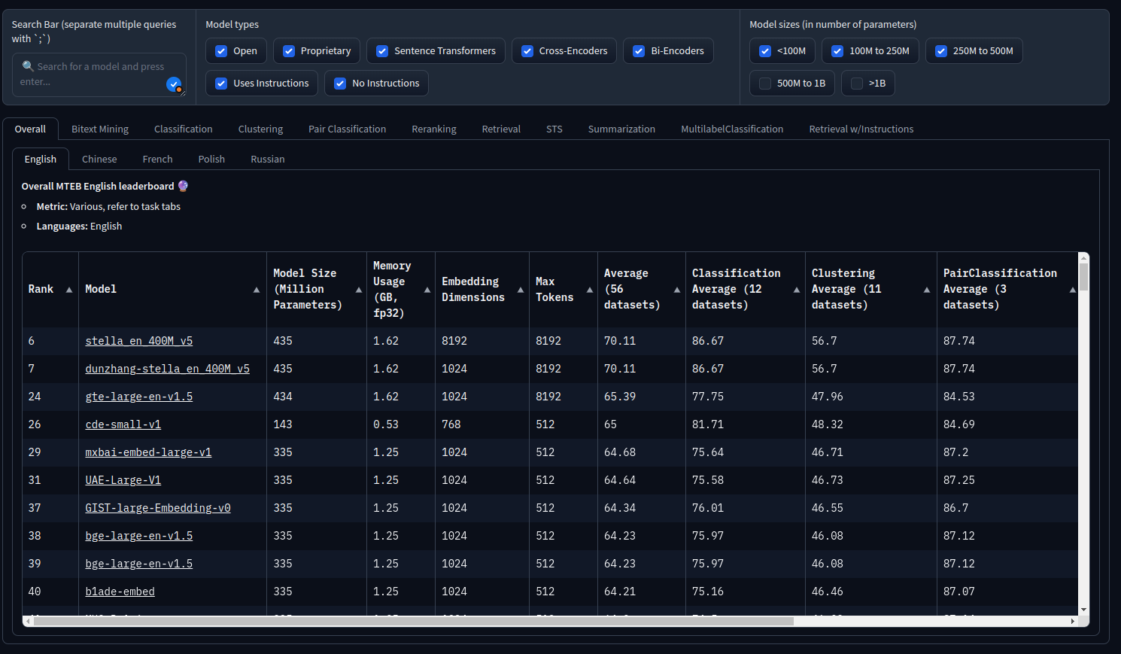
Embedding documents
Massive Text Embedding Benchmark (MTEB)

Slide 79
17
KNN search

Slide 80
k-nearest neighbor (kNN) search
How do we search for embedded documents?
We use the kNN search for fields mapped as dense vectors.
Important, you can’t use the query parameter in this case.
Read more
embedding

Slide 81
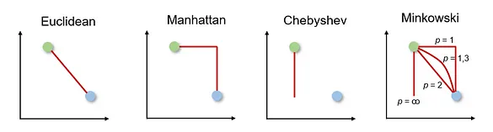
k-nearest neighbor (kNN) search
The kNN algorithm is used for classification and regression tasks.
It classifies new data points by comparing them with the k nearest points from the training data.
Commonly distances metrics: Euclidean, Manhattan or Minkowski.
This algorithm is simple and effective.
Read more
Medium article by Sachinsoni
Medium article by Dancker

Slide 82
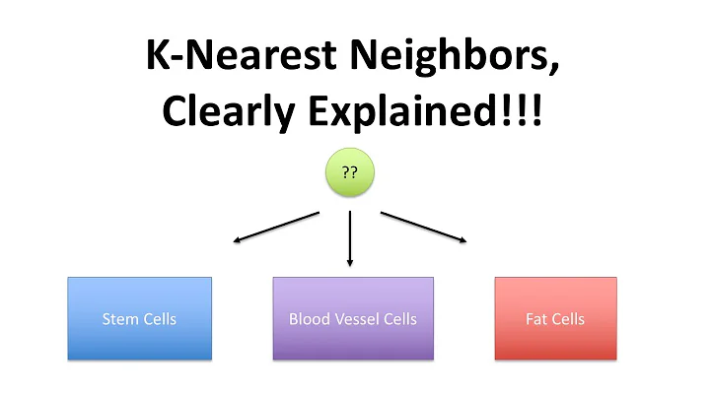


k-nearest neighbor (kNN) search
Watch on

Slide 83
k-nearest neighbor (kNN) search
Example
results = es.search(
knn={
'field': 'embedding',
'query_vector': es.get_embedding(parsed_query),
'num_candidates': 50,
'k': 10,
}
)
🛈 Should be a dense_vector
Read more

Slide 84
k-nearest neighbor (kNN) search
Example
results = es.search(
knn={
'field': 'embedding',
'query_vector': es.get_embedding(parsed_query),
'num_candidates': 50,
'k': 10,
}
)
Read more
🛈 The query should be a vector.

Slide 85
k-nearest neighbor (kNN) search
Example
results = es.search(
knn={
'field': 'embedding',
'query_vector': es.get_embedding(parsed_query),
'num_candidates': 50,
'k': 10,
}
)
Read more
🛈 Retrieves 50 potentially relevant documents before applying distance calculations to select the k best documents.

Slide 86
k-nearest neighbor (kNN) search
Example
results = es.search(
knn={
'field': 'embedding',
'query_vector': es.get_embedding(parsed_query),
'num_candidates': 50,
'k': 10,
}
)
Read more
🛈 Returns up to 10 documents that match your query.

