Slide 1
presentation
OF DASHBOARD

Slide 2
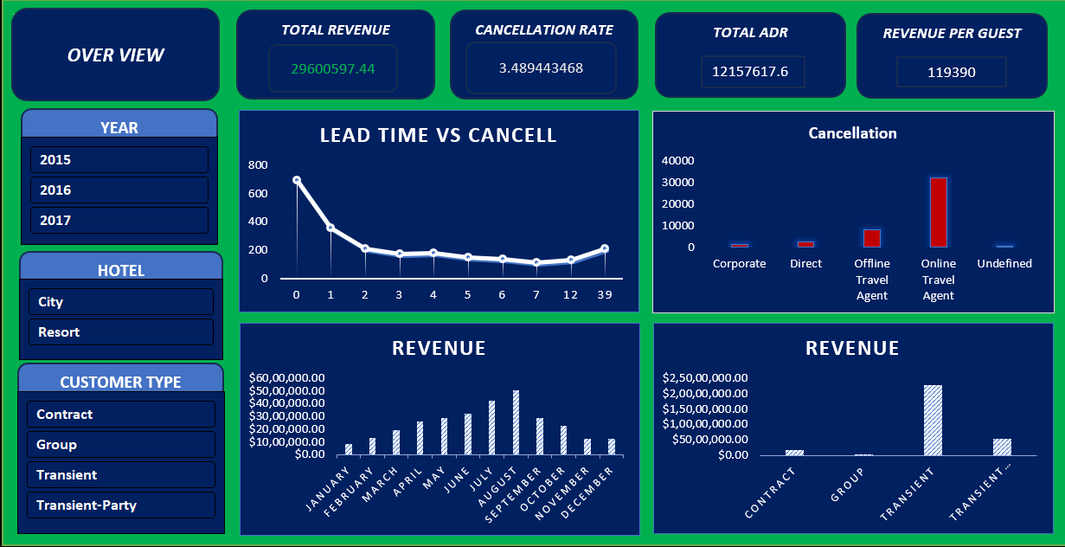
DASHBOARD

Slide 3
Hotel revenue & cancellation analysis
Overview of Revenue
Cancellations
Customer study (2015-2017)

Slide 4
Over view
Total revenue -2,60,0597.44
Cancellation –3.48%
Total ADR -12,15,7617.6
Revenue per guest -1,19,390
ADR means Average Daily Rate
Revenue per guest means earned from each guest

Slide 5
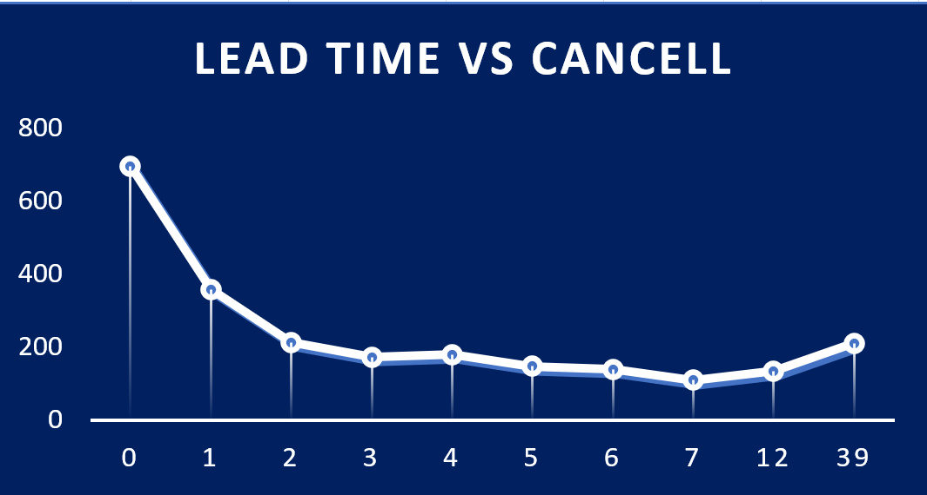
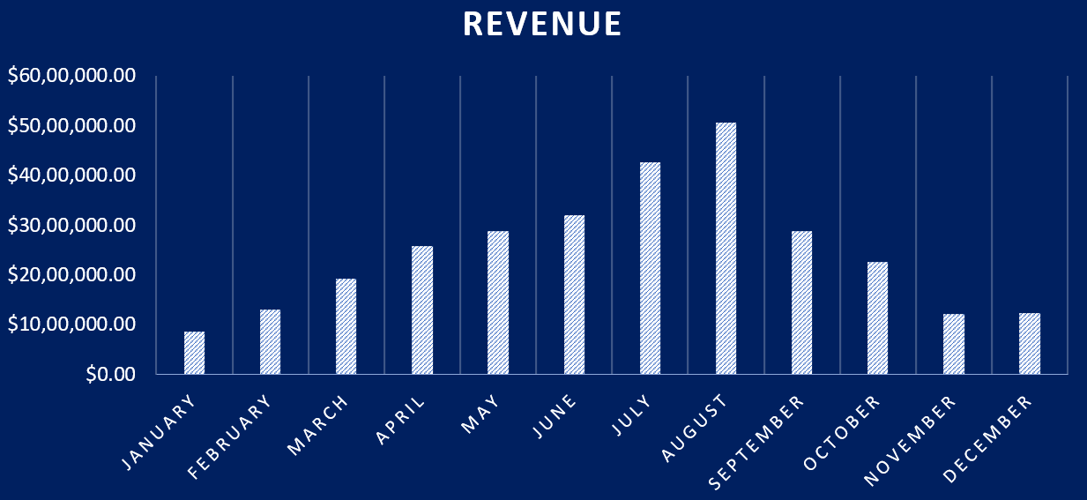
Graphs & trends
Lead time vs Cancel chart
This graph shows Cancellations are high when Lead time is short.
Monthly revenue
This graph shows Revenue peaks in June and August.

Slide 6
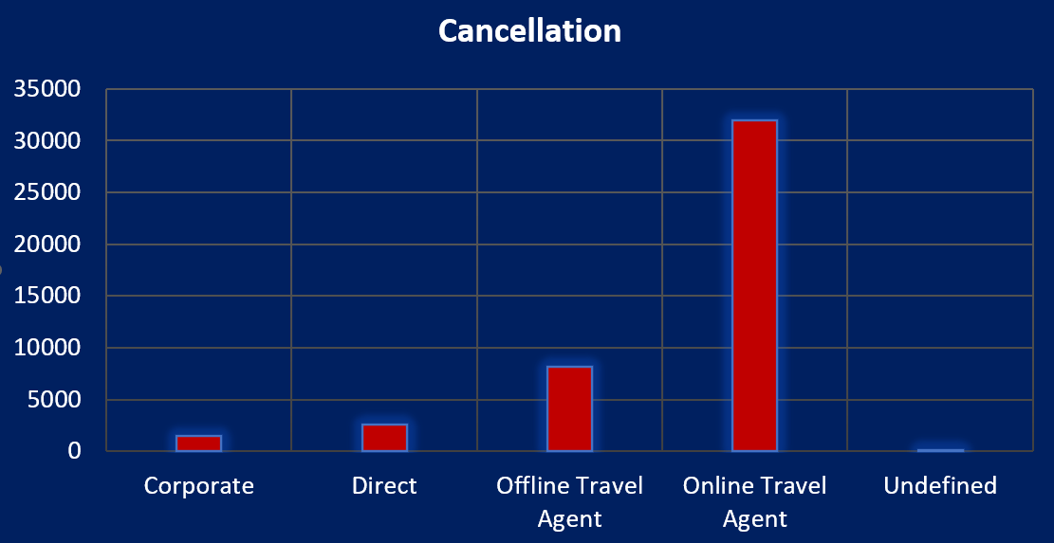
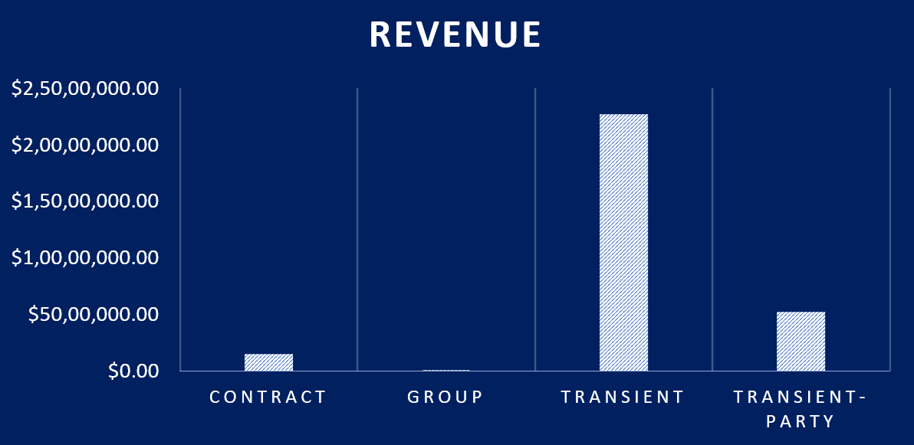
Customer & booking insight
Cancellation by Source
This graph shows Most cancellations come from Online Agents.
Revenue by customer type
This graph shows Transient guest bring the most Revenue.

Slide 7
conclusion
The dashboard presentation a clear view of revenue trends, cancellation behavior, and customer insights.
Key take aways:
Focus on reducing Online Travel Agents cancellation.
Target high-Revenue customer types like Transient guest.
Monitor short lead time booking to minimize cancellations.
ACTIONS:
Use these insight to optimize booking strategies and improve revenue performance.

