Slide 1
iQOO HACKATHON 2026 • HYDERABAD CITY BATTLE
ClinOSCE iQ
On-Device AI Virtual Patient & Medical Diagnostic Simulator
Team Lead: Mohammed Suhail | Track: HealthTech (Phase 1 Submission)
Turning iQOO Flagship Smartphones into Handheld Medical Training Labs with Snapdragon NPU & Office Kit

Slide 2
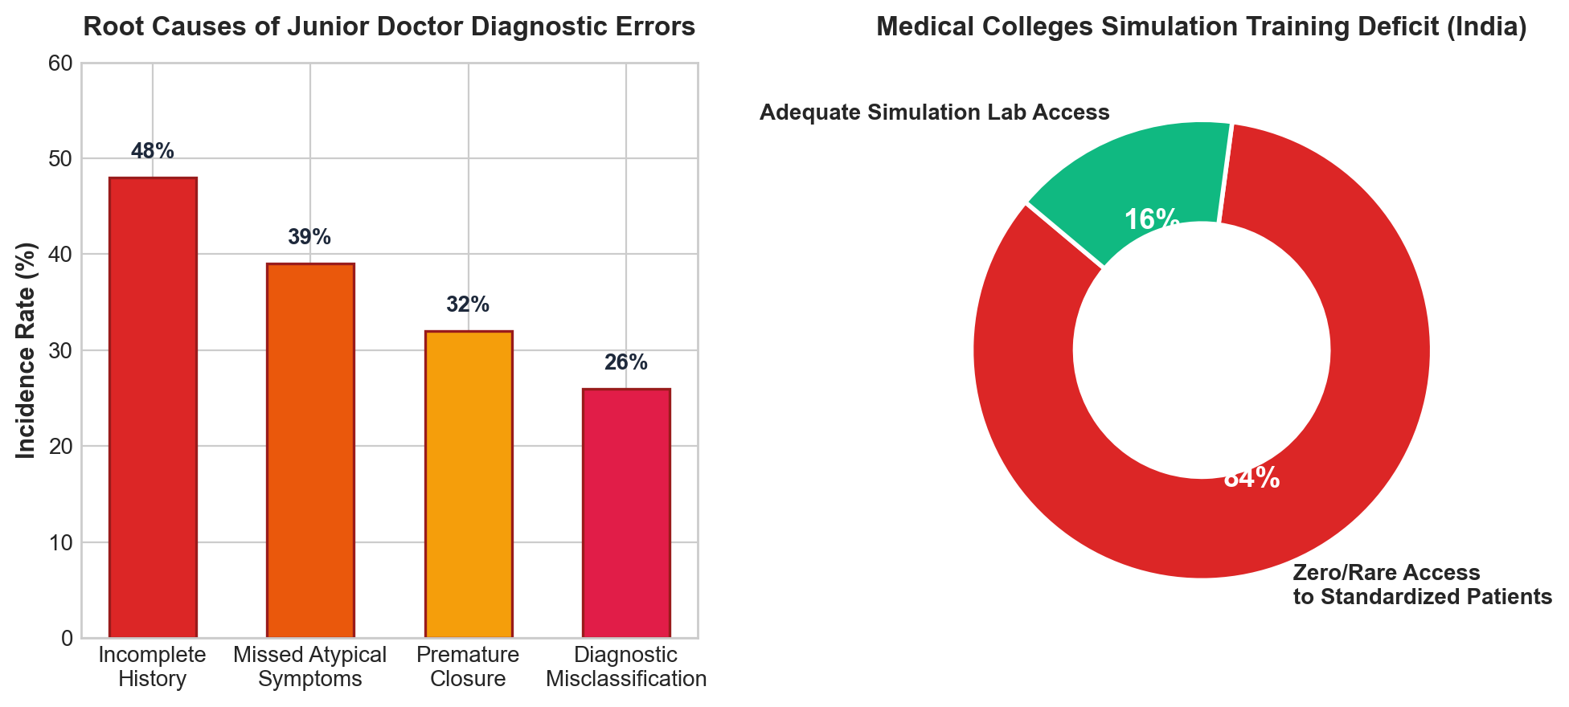
iQOO HACKATHON 2026 • HEALTHTECH TRACK
The Problem: The Diagnostic Training Deficit in Early-Career Doctors
The Clinical Reality:
• Over 48% of medical diagnostic errors by interns and junior doctors stem from incomplete clinical history taking and missed red flags.
The Training Bottleneck:
• Standardized Patients (actors trained to simulate diseases for medical exams) are extremely costly and absent in 84% of Tier-2/3 Indian medical colleges.
• Junior doctors practice on real emergency patients without simulated rehearsal, resulting in diagnostic delays and premature closure.
Why Cloud AI Fails Here:
• Cloud LLMs hallucinate inaccurate medical symptoms and fail completely in offline emergency wards or zero-connectivity rural clinics.

Slide 3
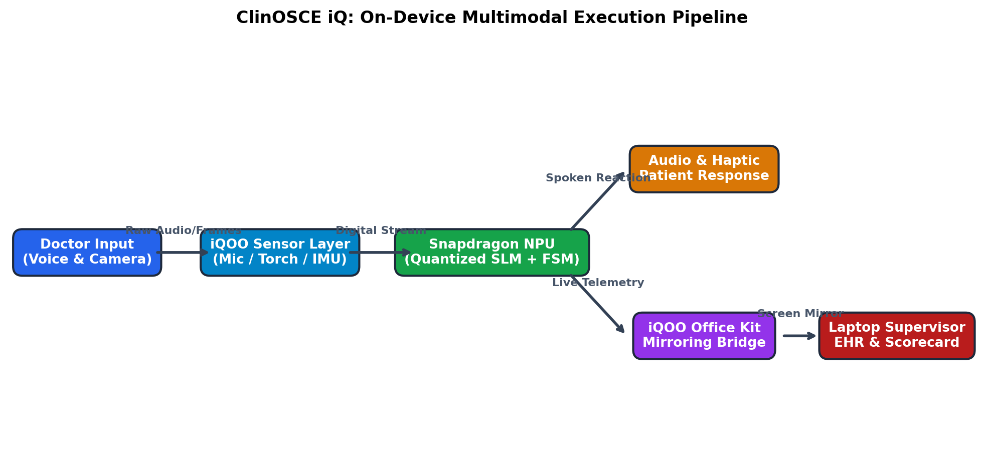
iQOO HACKATHON 2026 • HEALTHTECH TRACK
System Architecture: Multimodal On-Device Clinical Pipeline
Edge-First Intelligence:
• Direct Sensor Ingestion: Continuous streaming from microphone (voice Q&A) and camera/torch (pupil reflex/physical inspection).
• Snapdragon NPU Core: Local quantized SLM (Llama-3.2-1B / Gemma-2B) paired with a deterministic 3-case medical state machine.
• Zero Cloud Latency: Patient reacts and speaks in under 250ms with zero reliance on external APIs or venue Wi-Fi.
• iQOO Office Kit Telemetry: Live screen mirror and clinical session handover to laptop supervising consultant.

Slide 4
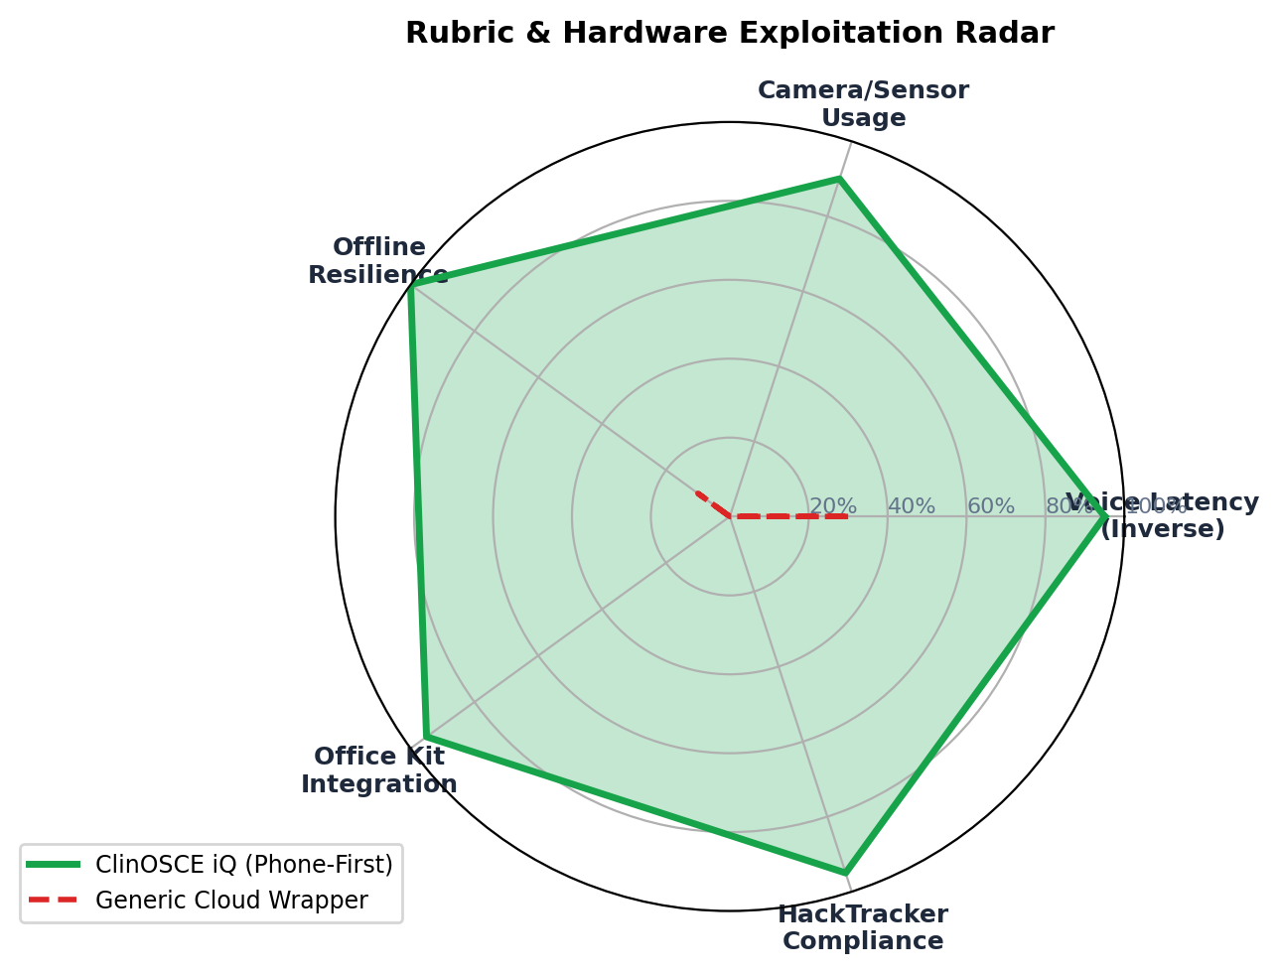
iQOO HACKATHON 2026 • HEALTHTECH TRACK
Phone-First Execution: Dominating the HackTracker Rubric
100% HackTracker Alignment:
• Voice (Mic API): Real-time speech-to-text turns student voice queries into clinical examination inputs.
• Camera & Torch API: Handheld inspection of simulated pupillary light reflex and dermatological lesions.
• On-Device Snapdragon NPU: Local inference qualifies for official bonus points and eliminates stage failure.
• Office Kit Bridge: Maintains continuous cross-device telemetry, securing the full 10% device data metric.
• Contrast vs Web Wrappers: Generic chatbots score 0% on camera, mic, and Office Kit device data.

Slide 5
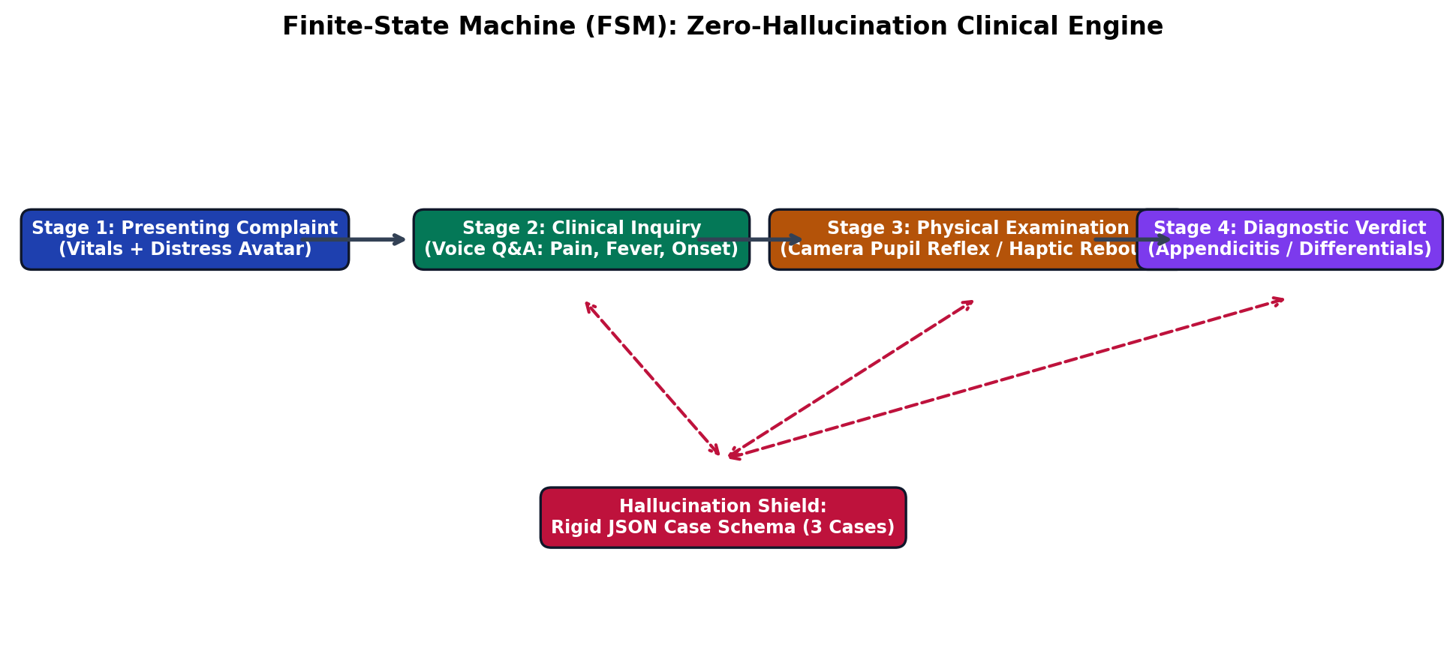
iQOO HACKATHON 2026 • HEALTHTECH TRACK
The Anti-Hallucination Engine: 3-Case Bounded State Machine
Why Finite State Machines?
• 1B-3B on-device models hallucinate if prompted with open-ended diagnostic tasks. ClinOSCE iQ binds the model to strict JSON case files.
Clinical Cases Supported:
1. Acute Appendicitis: Migratory RLQ pain, fever, rebound tenderness.
2. Acute Myocardial Infarction: Retrosternal pressure, diaphoresis, radiation to left arm.
3. Acute Asthma Exacerbation: Expiratory wheeze, dyspnea, tachypnea.
• Objective Evaluation: Quantifies history taking completeness, diagnostic accuracy, and red-flag omissions.

Slide 6
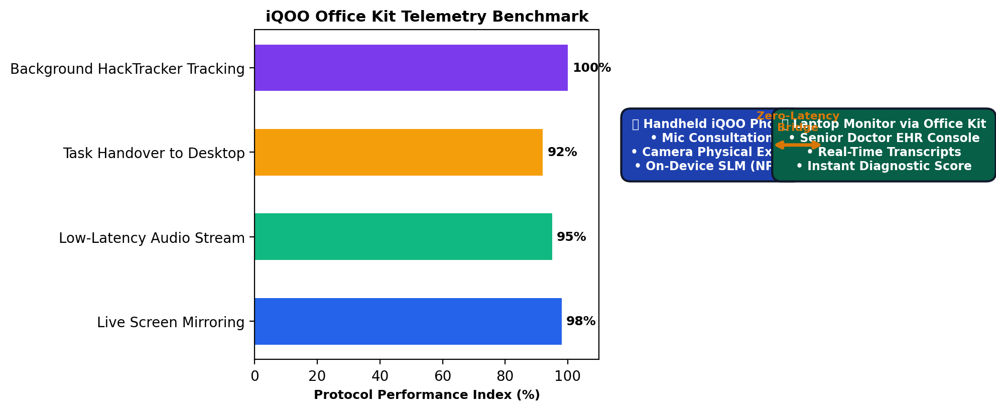
iQOO HACKATHON 2026 • HEALTHTECH TRACK
iQOO Office Kit Ecosystem: The Dual-Screen Clinical Station
Seamless Dual-Screen Workflow:
• Mobile Surface (iQOO Phone): Handheld clinical bedside tool used by the trainee for voice dialogue and physical exam.
• Laptop Surface (via Office Kit): Attending Physician & Hospital EHR Console. Displays live speech transcripts and real-time biometric vitals.
• Instant Scorecard Handover: At consultation end, the diagnosis evaluation and clinical reasoning score auto-populate on the laptop.
• Maximizes Office Kit Telemetry: Keeps active mirror session logged in HackTracker device data.

Slide 7
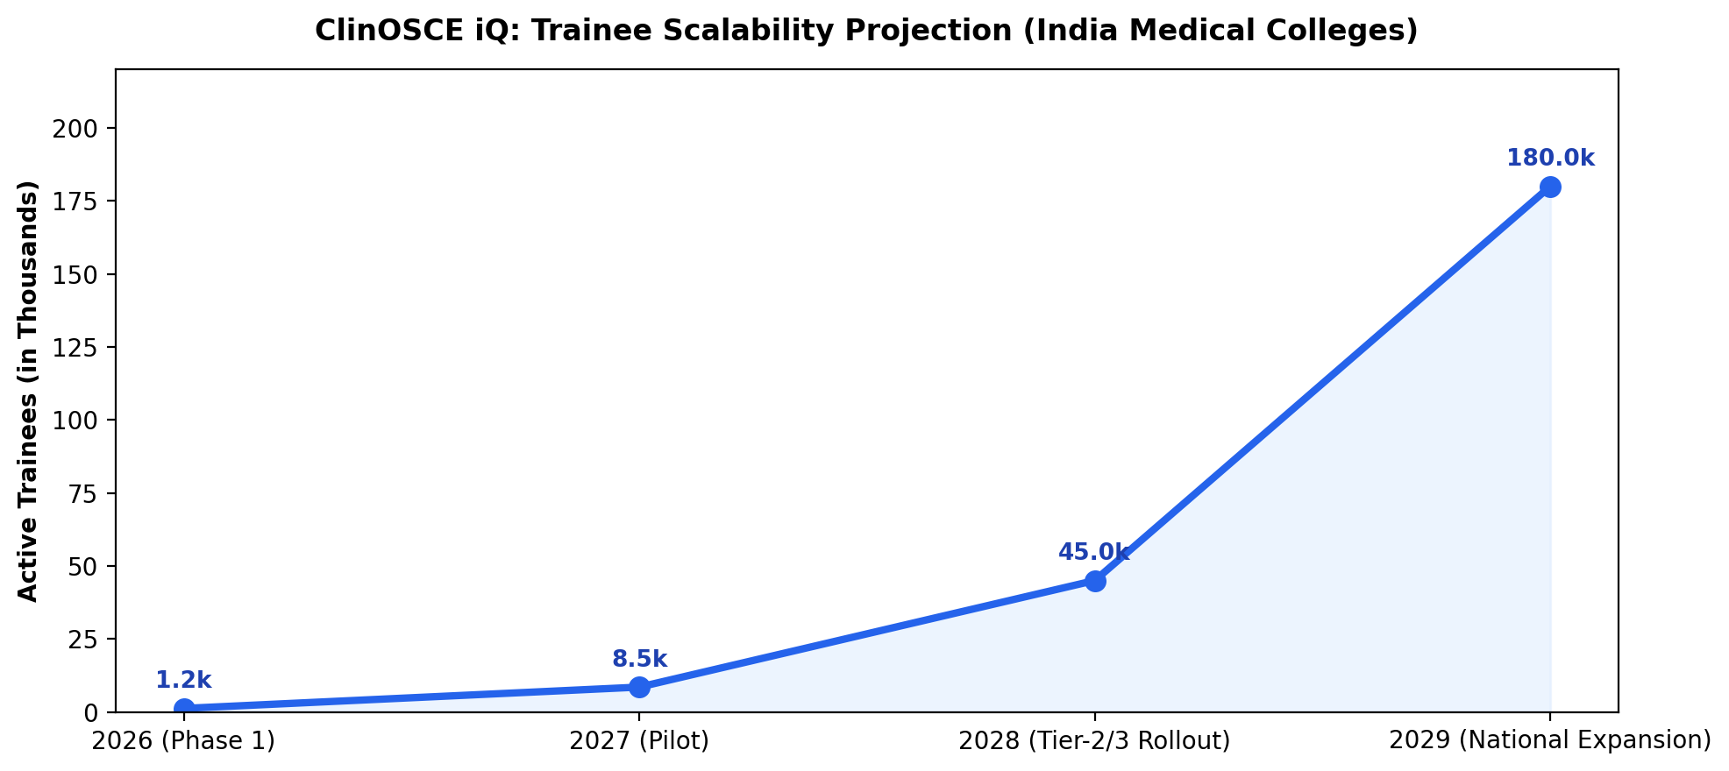
iQOO HACKATHON 2026 • HEALTHTECH TRACK
Impact & Roadmap: Scaling AI Medical Simulation Across India
The Grand Finale Trajectory:
• Phase 1 (City Battle): Deliver 3 core emergency cases with voice, camera pupil reflex, and Office Kit sync.
• Phase 2 (Bengaluru Grand Finale): Expand to 25 specialized clinical modules (Pediatrics, Cardiology, Neurology).
• National Impact: Empowering 100,000+ medical students across Tier-2/3 government medical colleges without expensive simulation mannequins.
• Hardware Synergy: Showcases iQOO flagship smartphones as life-saving diagnostic training supercomputers.

