Slide 1
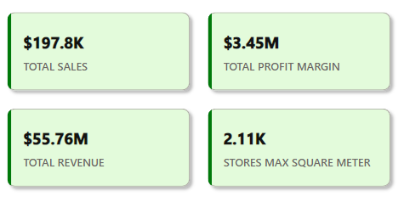
DataSpark: Illuminating Insights for Global Electronics
- Mohammed Thalha
Introduction
Valuable insights from the Global Electronics to provide actionable recommendation to drive overall business growth
By analyzing Global Electronics' customer, product, sales, and store data, We AIM to identify key insights that will enhance marketing strategies, optimize inventory management, and improve sales forecasting

Slide 2
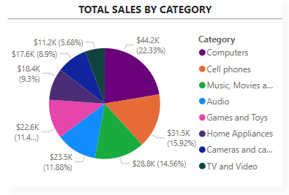
Project Scope
Data analysis.
Insights to identify the product performance and sales.

Slide 3
Methodology & Tools and Technologies
Data Cleaning and Preparation
Exploratory Data Analysis (EDA)
Power BI Visualization
Python, Pandas
MySQL
Power BI

Slide 4
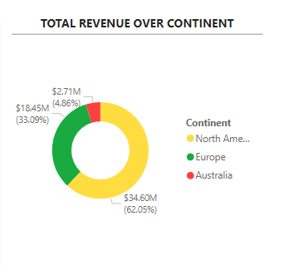
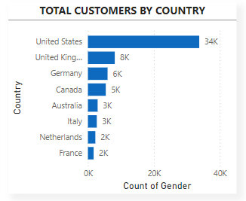
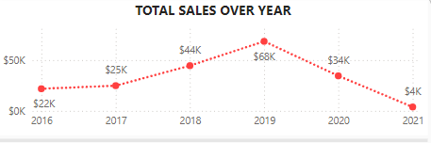
Results
Identified the top total sales over year $68k in 2019.
United States have more customers compared to United Kingdom.
Online stores give a huge difference from other countries
North America continent has more Revenue point compared to Europe & Australia

Slide 5
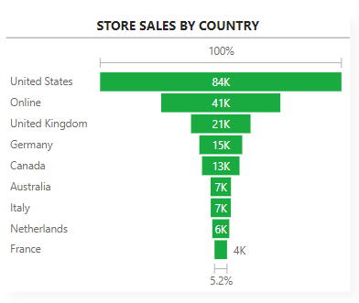
Solutions to improve Sales
Need to improve the Stores scales on France compared to all other countries, France has max of 400sqm only.
Need to target the Young Age group to improve the sales over the countries.

Slide 6
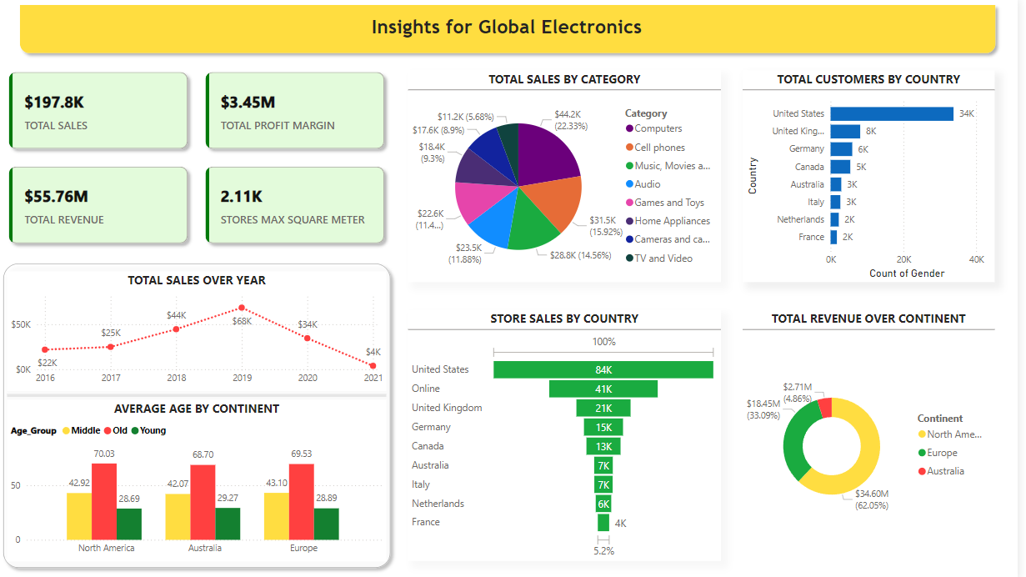
Overall Insights from Global Electronics
Conclusion

