Slide 1

ASTROSAGE
MOHAMMED ZAID INAMDAR

Slide 2
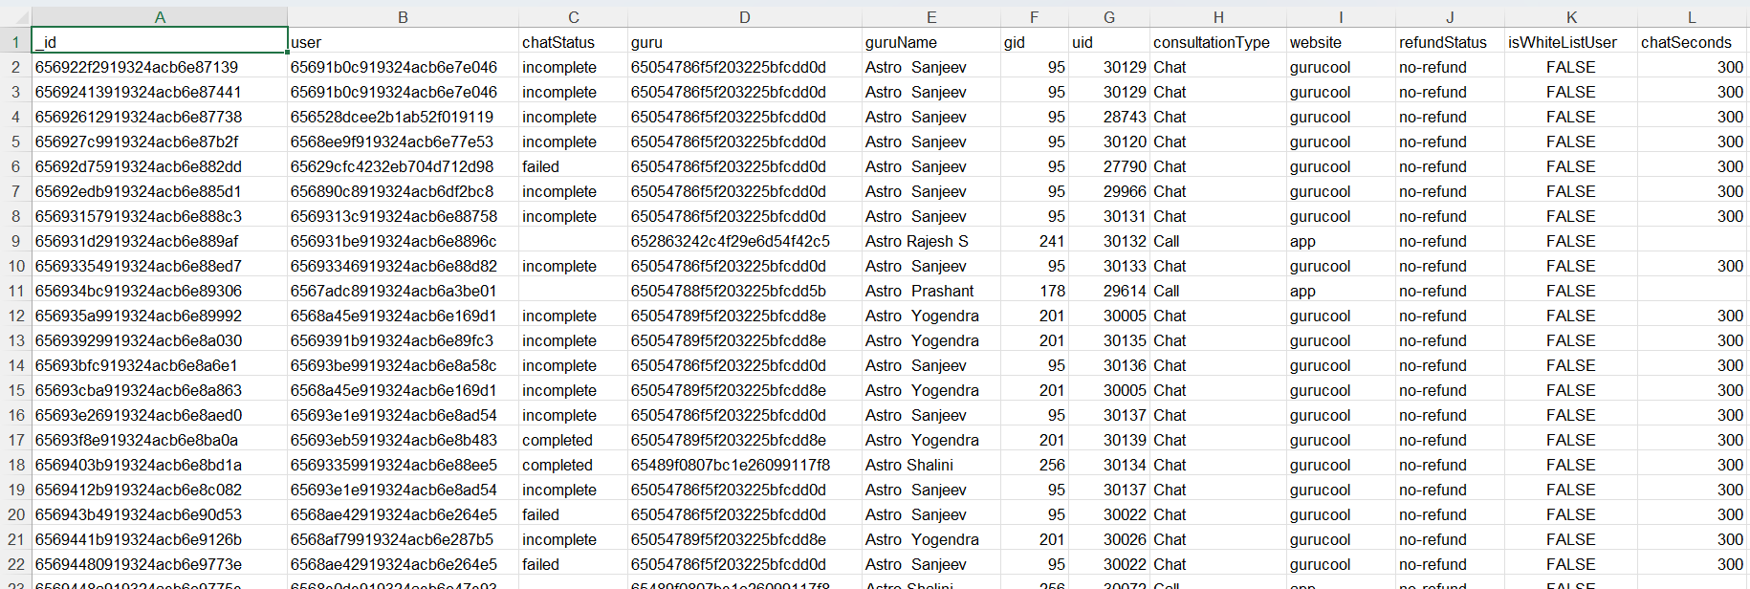
PROBLEM STATEMENT
AstroSage has received a 1 crore investment and aims to optimize its call center operations. The goal is to determine how to allocate this investment to maximize operational efficiency, customer satisfaction, and profitability. The analysis will consider historical call data, performance metrics, and market trends to make informed decisions.

Slide 3
DATA OVERVIEW
We began with a single dataset containing 35 attributes from AstroSage’s consultation system, covering 34 days (01 Dec 2023 – 03 Jan 2024) of call and chat data.
Key fields like chatStatus, guruName, consultationType, createdAt, amount, ratings, etc., were selected for focused insights.
After cleaning inconsistencies and filling missing values, we created helper columns, PivotTables, and PivotCharts.
Finally, we brought it all together in an interactive dashboard with PivotCharts & Slicers, enabling us to uncover patterns in call volumes, completion rates, and guru performance.

Slide 4
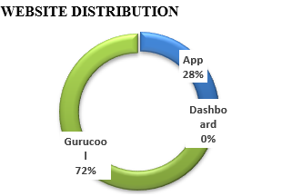
WEBSITE DISTRIBUTION
Our journey begins by understanding where consultations take place.
Most consultations occur on GuruCool (72%), making it the dominant platform.
The App (28%) plays a secondary, yet important, supporting role.
The Dashboard (0%) remains underutilized, showing untapped potential.
This preference pattern sets the foundation for understanding how and where customers engage.

Slide 5
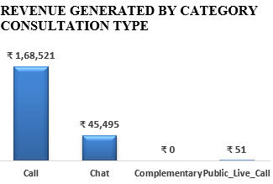
REVENUE GENERATED BY CATEGORY CONSULTATION TYPE
After knowing where consultations take place, the next step is to see which consultation modes actually generate revenue.
Calls dominate revenue — ₹1,68,521, nearly 4× higher than chats.
Chats play a secondary role, generating about ₹45,495.
Public Live Calls contribute just ₹51, while Complementary sessions add none.
Calls are most preferred and profitable mode, the financial backbone of the platform.

Slide 6
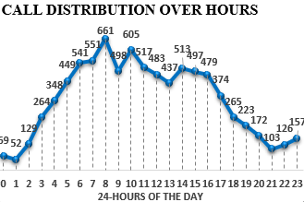
CALL DISTRIBUTION OVER HOURS
After understanding how much revenue calls generate, the next logical question is: When are these calls happening the most?
Call activity spikes between 7 AM–11 AM, peaking at 8 AM (661 calls).
Steady flow till evening, then drops sharply after 9 PM (as low as 103–157 calls).
Morning hours = heaviest system load, requiring more agents and server capacity.
Off-peak hours show minimal activity, ideal for cost-saving and reduced staffing.

Slide 7
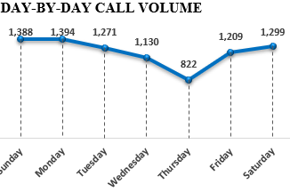
DAY-BY-DAY CALL VOLUME
After understanding what times of the day see the most calls, the next question is: Which days are customers most active?
Calls remain consistent throughout the week, but Monday (1,394) and Sunday (1,388) lead in activity, followed by Saturday (1,299) and Tuesday (1,271).
Midweek dips occur on Wednesday (1,130) and Thursday (822) — the lowest.
This shows that weekends and early weekdays drive engagement, while Thursday stays quiet.
Such trends guide staffing decisions—more agents on high-volume days (Sunday, Monday, Saturday) and fewer on low ones like Thursday to optimize efficiency.

Slide 8
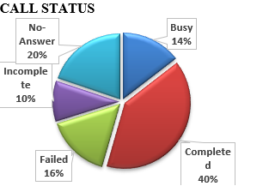
CALL STATUS
After knowing when customers call, the next question is what happens to those calls.
The data exposes a clear issue — only 39.9% of calls complete successfully, while 60.1% fail due to No-Answer (19.8%), Failed (15.7%), Busy (14.5%), and Incomplete (10.1%).
This means most call attempts don’t convert, leading to lost revenue and poor customer experience.
To fix this, system optimization is needed to reduce failed and incomplete calls.
Finally, smarter agent routing and availability management can cut “Busy” and “No-Answer” rates, ensuring more successful connections.

Slide 9
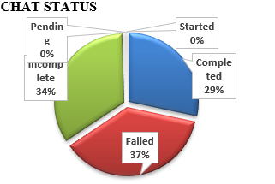
CHAT STATUS
Moving from calls to chats, we now explore how effective this channel is in resolving customer queries.
The findings show a clear struggle — only 28.4% of chats complete successfully, while 71% end as failed or incomplete.
Failed (37.2%) and Incomplete (34%) chats dominate, revealing major reliability and engagement gaps.
This suggests that customers choosing chat for convenience often face unfinished or frustrating experiences, weakening platform trust.
Implement AI chatbots, predictive analytics to cut wait times and boost response accuracy. System optimization is needed to reduce failed and incomplete chats.

Slide 10
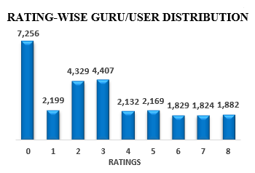
RATING-WISE GURU/USER DISTRIBUTION
At this stage, we turn to how customers rate their consultation experiences.
The results show a wide variation across gurus, with clear concerns emerging.
Only 13% of ratings are high (7–8), while 61% fall in the low (1–3) or zero range — a strong sign of dissatisfaction.
The 26% zero ratings may reflect system gaps or missing feedback that need investigation.
Overall, the data calls for rewarding top performers, training low-rated gurus, and fixing rating inconsistencies to rebuild trust.

Slide 11
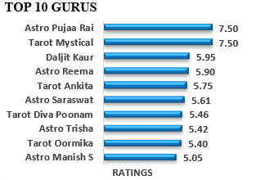
TOP 10 GURUS
After reviewing overall rating patterns, we now zoom into the Top 10 Gurus ranked by average customer ratings.
The platform average is 5.52, serving as our benchmark.
Astro Pujaa Rai and Tarot Mystical lead with 7.5, showing exceptional satisfaction.
Most others, like Daljit Kaur (5.95) and Astro Reema (5.90), hover near the average, signaling steady but moderate performance.
This reveals a key opportunity — learn from top gurus, coach mid-tier ones, and ensure consistent quality across all consultations.

Slide 12
CONCLUSION
Call & Chat Trends: Peak hours and days create heavy pressure points for calls and chats.
Service Quality Gaps: More than half of the interactions fail or remain incomplete.
Customer Satisfaction: With ~65% of responses being low (1–3) or zero.
Top Performers as Benchmarks: A few gurus (e.g., Astro Pujaa Rai & Tarot Mystical) achieve exceptional ratings.
Overall Insight: While AstroSage has strong engagement levels, its growth depends on balancing workload, reducing service failures, and scaling the practices of high performers to uplift overall customer satisfaction.

Slide 13
RECOMMENDATIONS
Technology Upgrades (₹50 Lakhs, 50%):
AI chatbots, predictive analytics & speech tools to cut wait times and boost response accuracy. System optimization, smart agent routing, availability management to handle unsuccessful calls and chats.
Training (₹30 Lakhs, 30%):
Upskill low-rated agents; turn top performers into mentors to ensure consistent quality.
Hiring (₹20 Lakhs, 20%):
Add both full-time, astrologically skilled agents, and part-time reinforcements during busy hours.

Slide 14
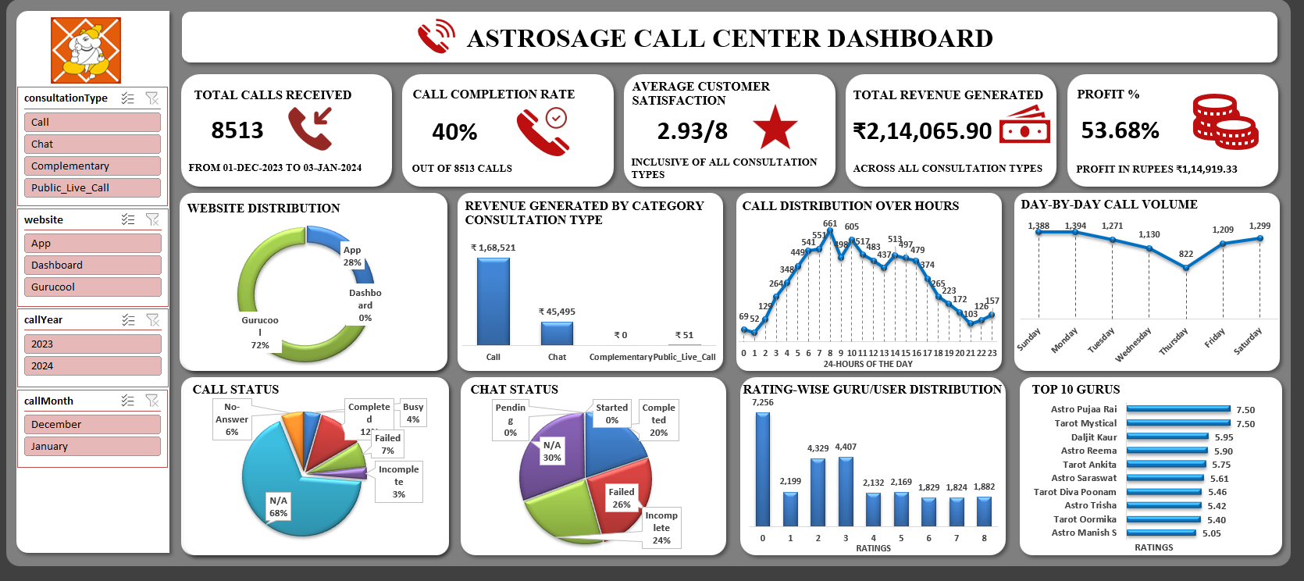
DASHBOARD

Slide 15
THANK YOU

