Slide 1

T5 boot camp
Classification project
Mohammed Saeedi
SDAIA

Slide 2
Project Goal
The goal of this project was to use binary classification models to predict the type of cover type in different wilderness areas with good accuracy.

Slide 3
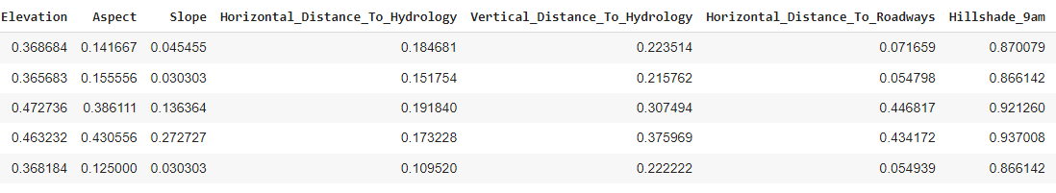
Data-set
Data-set contain 581012 Instances and 54 Attributes. Data-set has 7 classes

Slide 4
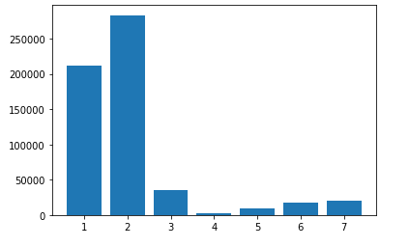
Data exploration
Number of instances = 581012 Number of attributes = 55
Class name | Number of instances
1 | 211840
2 | 283301
3 | 35754
4 | 2747
5 | 9493
6 | 17367
7 | 20510

Slide 5
Convert to binary classification
I converted classes 1,3,4,5,6,7 to 0 and class 2 t0 1
After converted to binary classification results:
Class name | Number of instances
0 | 297711
1 | 283301

Slide 6
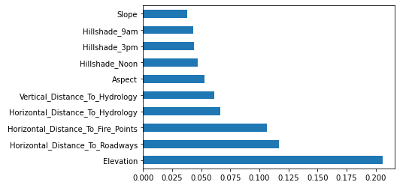
feature engineering
I used Extra Trees Classifier to extract most 10 impotent features in my data-set

Slide 7
Data processing
I used fill NULL strategies to deal with NULL data
I checked duplicated rows
I divided my data into train validation test

Slide 8
model
I used three models
Decision Tree Classifier
Naïve Bayes
Random Forest Classifier

Slide 9
results
Decision Tree Classifier
True Positives(TP) = 49345
True Negatives(TN) = 51043
False Positives(FP) = 10009
False Negatives(FN) = 5806
Classification accuracy for testing data set : 0.8639
Classification error for testing data set : 0.1361
Precision for testing data set 0.83
Recall for testing data set 0.89
F-Measure for testing data set 0.86
Train accuracy 0.8933170644750834 validation accuracy 0.8619005615197608 test accuracy 0.863901964665284

Slide 10
results
Naive Bayes Classifier
True Positives(TP) = 36504
True Negatives(TN) = 39672
False Positives(FP) = 22850
False Negatives(FN) = 17177
Classification accuracy for testing data set : 0.6555
Classification error for testing data set : 0.3445
Precision for testing data set 0.62
Recall for testing data set 0.68
F-Measure for testing data set 0.65
Validation accuracy 0.6533780828008577
Test accuracy 0.6555424558746332

Slide 11
results
Random Forest Classifier
True Positives(TP) = 55882
True Negatives(TN) = 53350
False Positives(FP) = 3472
False Negatives(FN) = 3499
Classification accuracy for testing data set : 0.9400
Classification error for testing data set : 0.0600
Precision for testing data set 0.94
Recall for testing data set 0.94
F-Measure for testing data set 0.94
Number of estimators used: 37
Train accuracy 0.999941604224166
Validation accuracy 0.9441492222628601
Test accuracy 0.946266447509961

Slide 12
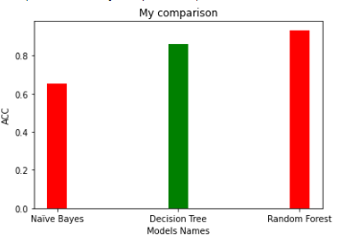
Algorithm Comparison
Here is the comparison of all three classifier after applied 10 fold cross validation

Slide 13

Any Questions feel free to Ask
Thank You

