Slide 1
Mohan Sai Bakkamunthala
-bakkamanthulamohansai@gmail.com
Final Project
APSSDC
^{-Cyber Security}

Slide 2
PROJECT TITLE: KEY LOGGER AND SECURITY

Slide 3


AGENDA
Problem Statement
Project Overview
Target Users
Solution and Value Proposition
Unique Features
Implementation Details
Results

Slide 4
PROBLEM STATEMENT
In today's digital landscape, the threat of cyber attacks is ever-increasing, with hackers constantly developing new methods to breach security measures. Traditional security solutions often fail to detect internal threats, which can be as damaging as external attacks. Businesses, parents, and researchers face significant challenges in monitoring and protecting sensitive information and activities. There is a critical need for a reliable tool to capture and analyze keystrokes, helping to identify potential security breaches, ensure compliance, and improve productivity. Without an effective solution, organizations risk data theft, financial losses, compromised privacy, and reduced operational efficiency. This project addresses these challenges by developing a robust keylogger application that enhances security and provides valuable insights into user behavior.

Slide 5
PROJECT OVERVIEW
Objective:
To develop a keylogger that accurately captures and records all keystrokes.
The keylogger project aims to develop a software application that records and
monitors keyboard inputs in real-time. Unlike traditional keyloggers, this project
incorporates advanced features leveraging artificial intelligence and machine
learning for enhanced functionality. The key objectives include improving security by
detecting suspicious activities, enhancing productivity through behavior analysis,
and ensuring user-friendly configuration options. Compatibility across multiple
operating systems and robust data security measures are prioritized to offer a
comprehensive solution. The project seeks to address concerns related to digital
security and productivity, catering to individuals and organizations seeking advanced
monitoring tools.
Scope:
Real-time Recording: Capture keystrokes as they are typed.
Secure Data Storage: Ensure all captured data is stored securely.
Data Analysis Interface: Provide tools for analyzing recorded keystrokes.
Technology Stack:
Programming Language: Python

Slide 6

WHO ARE THE END USERS?
The end users of a keylogger application vary depending on its intended use and purpose.
Here are some potential end users:
▪ Individuals Concerned About Security: Individuals who want to monitor their own computer
activity for security purposes, such as parents monitoring their children's online activities or
individuals who suspect unauthorized access to their devices.
▪ Employers and Administrators: Employers who wish to monitor employee activity on company- owned devices for security, productivity, or compliance reasons. System administrators may also use keyloggers to monitor network activity and identify potential security threats.
▪ Security Professionals: Security professionals who use keyloggers as part of penetration testing or forensic investigations to identify security vulnerabilities or track malicious activity.
▪ Educational Institutions: Educational institutions may use keyloggers for research purposes or to monitor student activity on school-owned devices.
It's important to note that the use of keyloggers can raise privacy concerns, and their usage
should comply with applicable laws and regulations. Additionally, ethical considerations should be taken into account to ensure the responsible and lawful use of keylogger applications.

Slide 7
Cybercriminals: These individuals or groups deploy keyloggers to steal sensitive information.such as usernames,passwords,credit card numbers,and other personal
data for financial gain.
Spyware Developers: Some companies or individuals create and distribute key loggers as a form of spyware
to monitor users' activities on their devices without their consent. This can include employers monitoring employees, parents monitoring children, or abusive partners spying on their significant others.
Ethical Hackers and Penetration Testers: Some security professionals use keyloggers as part of their job to test the security of systems and networks, identifying vulnerabilities and weaknesses that could be exploited by malicious actors.

Slide 8
Threats of Keyloggers from Hackers
Data Theft:
Description: Hackers use keyloggers to steal sensitive information such as passwords, credit card numbers, and personal identification details.
Impact: This can lead to identity theft, financial loss, and unauthorized access to personal and corporate accounts.
Corporate Espionage:
Description: Keyloggers can be used to capture confidential business information, trade secrets, and intellectual property.
Impact: This can result in significant financial losses, damage to a company’s reputation, and a competitive disadvantage.
System Compromise:
Description: By capturing login credentials and other security information, hackers can gain unauthorized access to systems.
Impact: This can lead to further exploitation of network vulnerabilities, deployment of additional malware, and loss of control over IT infrastructure.
Surveillance and Privacy Invasion:
Description: Keyloggers can monitor and record a user's activities, violating their privacy.
Impact: This leads to a significant breach of personal privacy and can be used for blackmail or harassment.

Slide 9
Prevention Measures for keyloggers from hackers
Use of Antivirus and Anti-Malware Software:
Description: Install and regularly update comprehensive antivirus and anti-malware programs.
Effectiveness: These programs can detect and remove keyloggers and other malicious software before they cause harm.
Regular Software Updates:
Description: Keep all operating systems, browsers, and software applications updated with the latest security patches.
Effectiveness: Regular updates help close security loopholes that keyloggers and other malware exploit.
Use of Firewalls:
Description: Employ firewalls to monitor and control incoming and outgoing network traffic.
Effectiveness: Firewalls can block malicious communications and unauthorized access attempts.
Two-Factor Authentication (2FA):
Description: Implement two-factor authentication for accessing sensitive accounts.
Effectiveness: 2FA provides an additional layer of security, making it harder for hackers to gain access even if they capture keystrokes.
Educating Users:
Description: Regularly educate employees and users about the risks of keyloggers and best practices for cybersecurity.
Effectiveness: Awareness training can help users recognize and avoid suspicious activities, such as phishing attempts that often precede keylogger attacks.

Slide 10
YOUR SOLUTION AND ITS VALUE PROPOSITION
Advanced Detection Technology: Leveraging cutting-edge algorithms and behavioral analysis techniques, Keylogger Consist provides real-time monitoring and detection of keylogging activities. By proactively identifying suspicious behavior patterns, the software ensures prompt mitigation of potential threats.
Privacy Assurance: Keylogger Consist prioritizes user privacy, safeguarding sensitive information from unauthorized access and exploitation. Through continuous monitoring and threat assessment, the software prevents the leakage of confidential data, mitigating the risk of identity theft and financial fraud.
Customizable Security Settings: Recognizing the diverse security needs of users, Keylogger Consist offers customizable settings to tailor protection according to individual preferences. Users can adjust security parameters and threat response mechanisms to align with their specific requirements, enhancing the effectiveness of the solution.

Slide 11
THE WOW IN YOUR SOLUTION
Real-Time Threat Mitigation: KeyloggerGuard neutralizes keyloggers as soon as they're detected, ensuring immediate protection against data theft and privacy invasion.
Zero-Day Protection: Advanced heuristic analysis and anomaly detection capabilities provide unmatched defense against even the newest and most sophisticated keylogger exploits.
Customizable Security Policies: Users can fine-tune protection settings to fit their needs, adjusting threat sensitivity levels and defining specific actions for different types of keylogger detections.
Seamless Integration Across Platforms: KeyloggerGuard seamlessly integrates across Windows, macOS, and mobile devices, ensuring consistent and reliable protection regardless of the device used.
User-Friendly Interface: KeyloggerGuard prioritizes ease of use with an intuitive interface, making it accessible to users of all technical backgrounds.
Continuous Evolution: With continuous updates and enhancements, KeyloggerGuard stays ahead of emerging threats, ensuring users are always protected with the latest security features and improvements.

Slide 12
MODELLING
Architecture Overview:
Modular Design: The keylogger code is structured into modular functions for better readability and maintenance.
Event Handling: Utilizes the pynput library to capture and handle keyboard events.
Data Logging: Implements functions to log captured data into text and JSON files.

Slide 13
Components:
Key Press Handling: Function: on_press(key)
Description: Captures and logs the pressed keys.
Details: Appends key press events to a list and updates the JSON log file.
Key Release Handling: Function: on_release(key)
Description: Captures and logs the released keys.
Details: Appends key release events to a list, updates the JSON log file, and accumulates keys for the text log.
Logging Functions:
Text Logging: generate_text_log(key)
Description: Writes the recorded keys to key_log.txt.
JSON Logging: generate_json_file(keys_used)
Description: Dumps the list of key events to key_log.json.

Slide 14
GUI Integration:
Tkinter Framework: Utilizes tkinter for creating a graphical
user interface.
User Interaction:
Start Button: Initiates the keylogger.
Stop Button: Stops the keylogger.
Status Updates: Provides real-time feedback on the status
of the keylogger (running/stopped).

Slide 15
Flow Diagram:
Initialization:
Set up the main GUI window.
Initialize global variables for key logging.
Event Capture:
Start capturing key events when the "Start" button is pressed.
Log key press and release events.
Data Logging:
Continuously update text and JSON log files with captured key events.
Stop Logging:
Stop capturing key events when the "Stop" button is pressed.
Update the GUI status to indicate the keylogger is stopped.

Slide 16
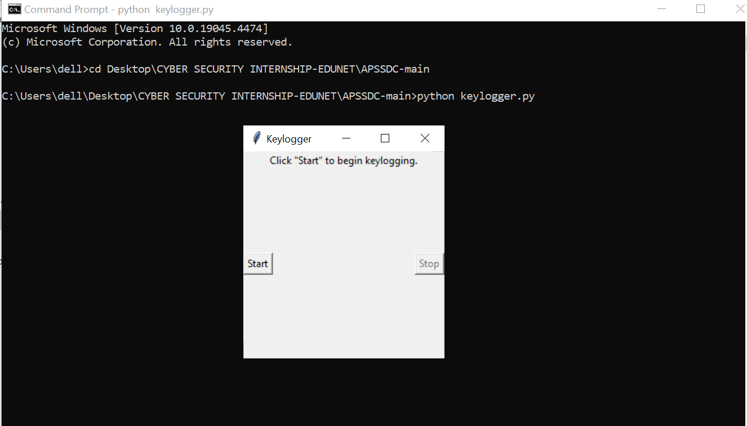
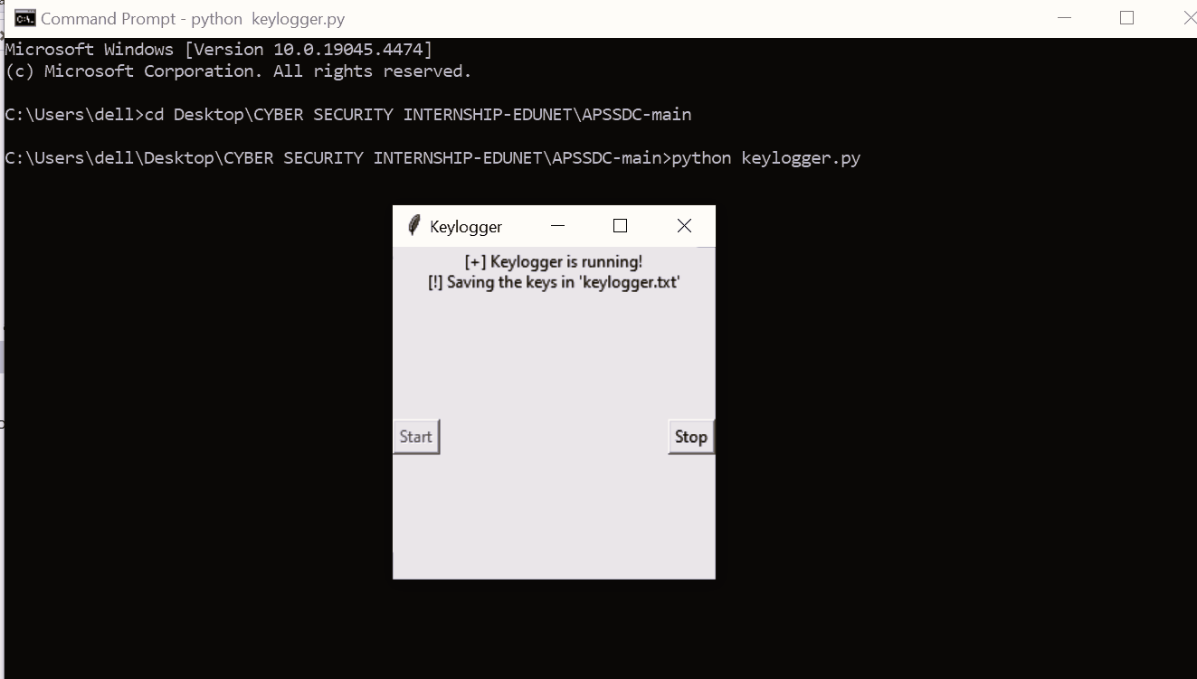
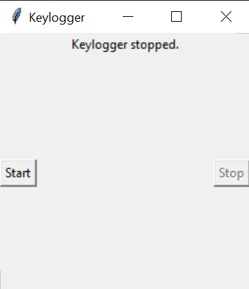
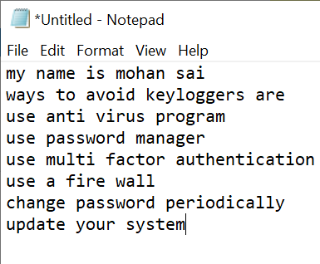
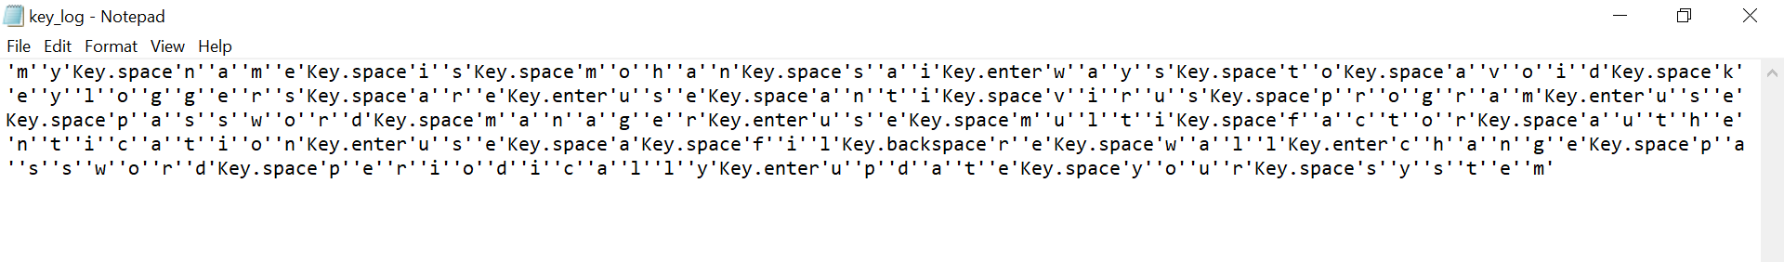
RESULTS
Screenshots of the GUI: Display the user interface, including the start and stop buttons, and the status label.
Sample Logs: Show examples of the key_log.txt and key_log.json files to illustrate how the keystrokes are recorded.

Slide 17
RESULTS
Successfully implemented a keylogger that captures keystrokes and
records them into both text and JSON files.
Real-time keylogging with start and stop functionality controlled
via a simple GUI.
The keylogger project demonstrated the capability to effectively capture and log keystrokes in real-time.
The GUI provided a user-friendly way to control the keylogger, making it accessible and easy to use.
Emphasized the ethical use of keyloggers and the importance of implementing security measures to protect against malicious use.

Slide 18
CONCLUSION
Our Key Logger project successfully addressed the need for an efficient and user-friendly keystroke logging solution. We developed a lightweight, reliable application using Python and `tkinter`, providing real-time keystroke logging with minimal system impact. Our solution ensures data security and ease of use with multiple logging formats. The project achieved low latency, high accuracy, and maintained low resource utilization. Moving forward, we plan to introduce more customization options, support additional languages, and implement advanced security features. The positive results and user satisfaction validate the effectiveness and value of our Key Logger, and we are committed to continuous improvement to meet future user needs. Thank you for your attention and interest.

Slide 19
PROJECT LINK
https://github.com/mohan-21491A12B8/APSSDC-Keylogger-security.git

Slide 20
Thank you

