Slide 2
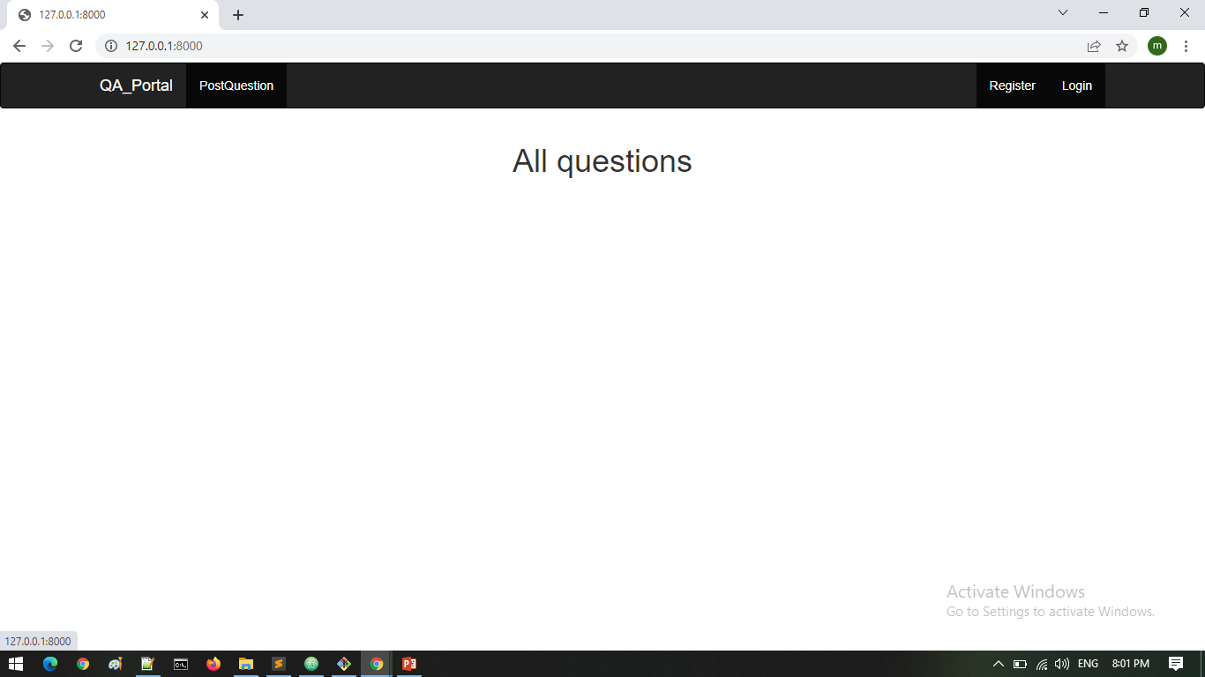
Home page url http://127.0.0.1:8000/

Slide 3
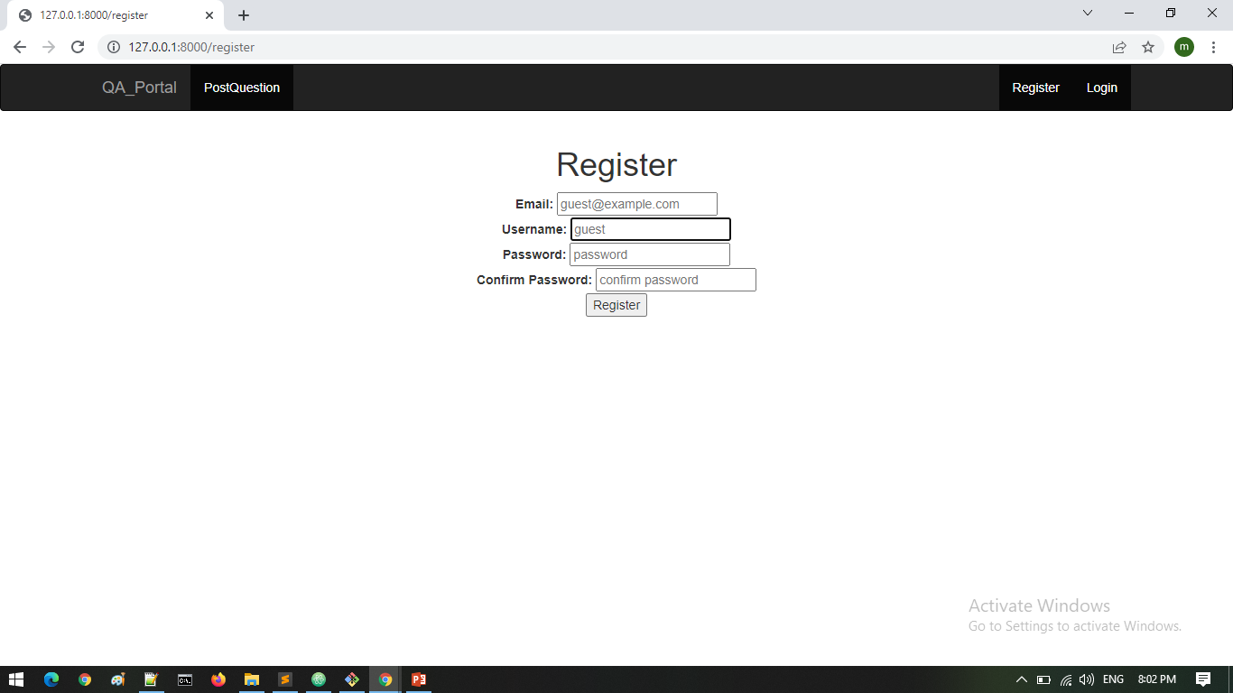
Register http://127.0.0.1:8000/register

Slide 4
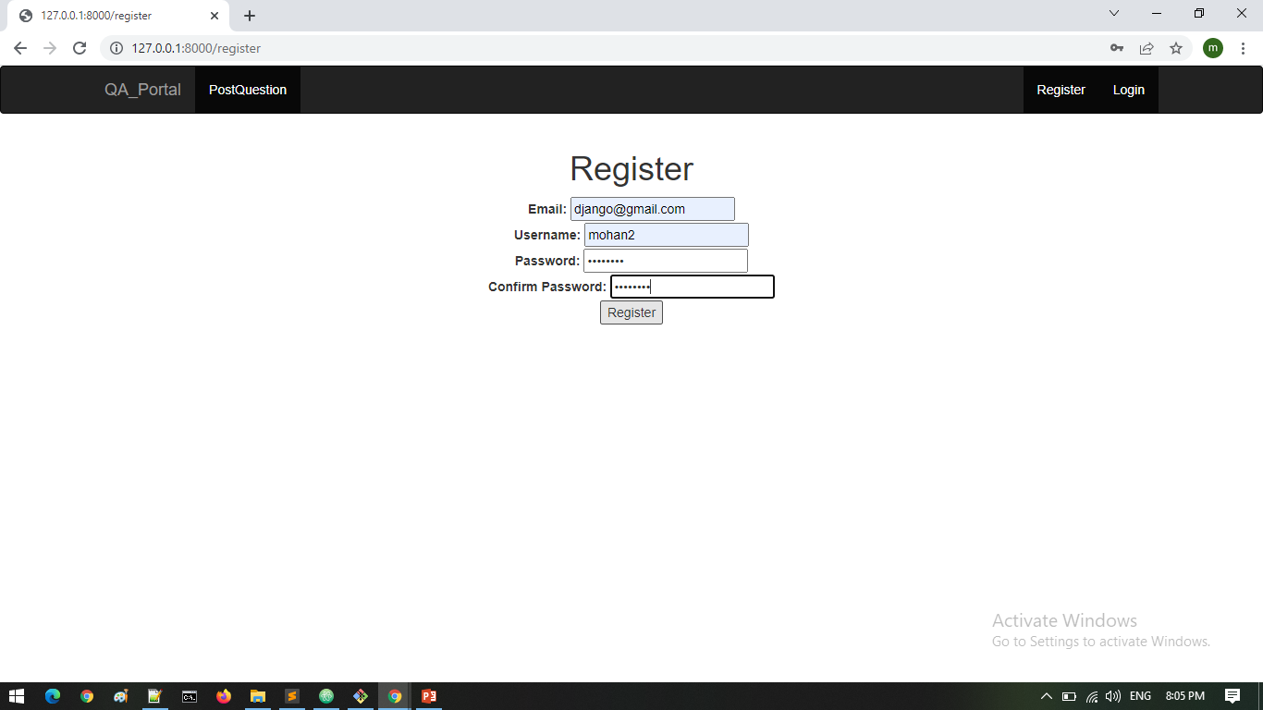
Username:mohan2 password:user_222

Slide 5
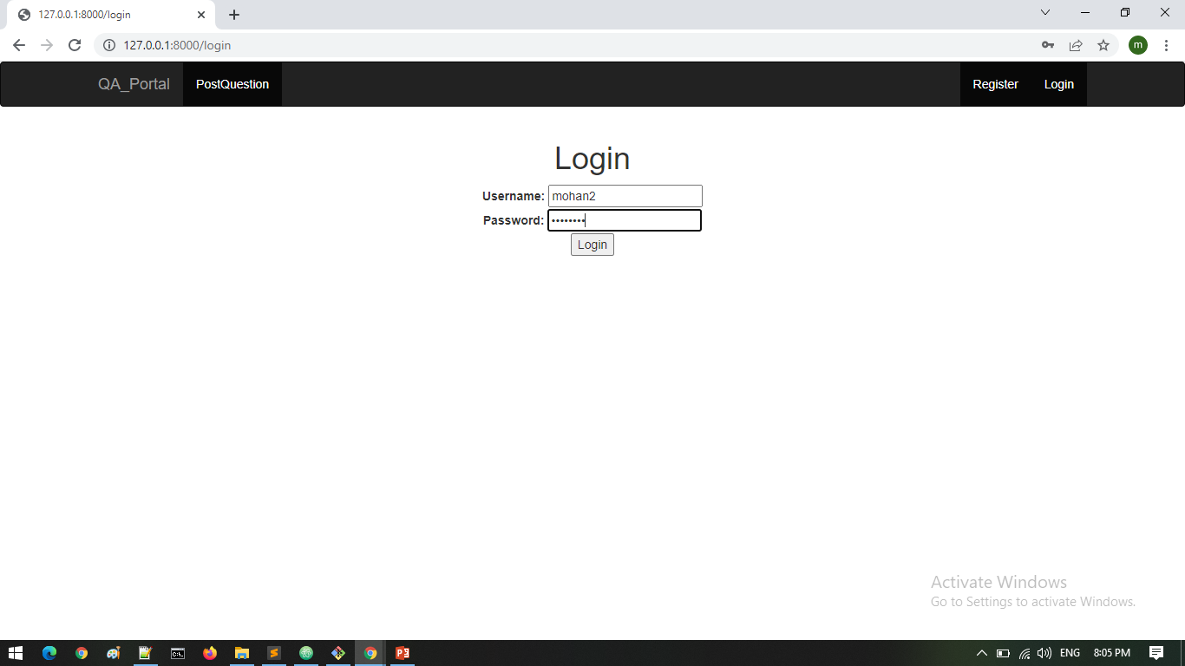
http://127.0.0.1:8000/login

Slide 6
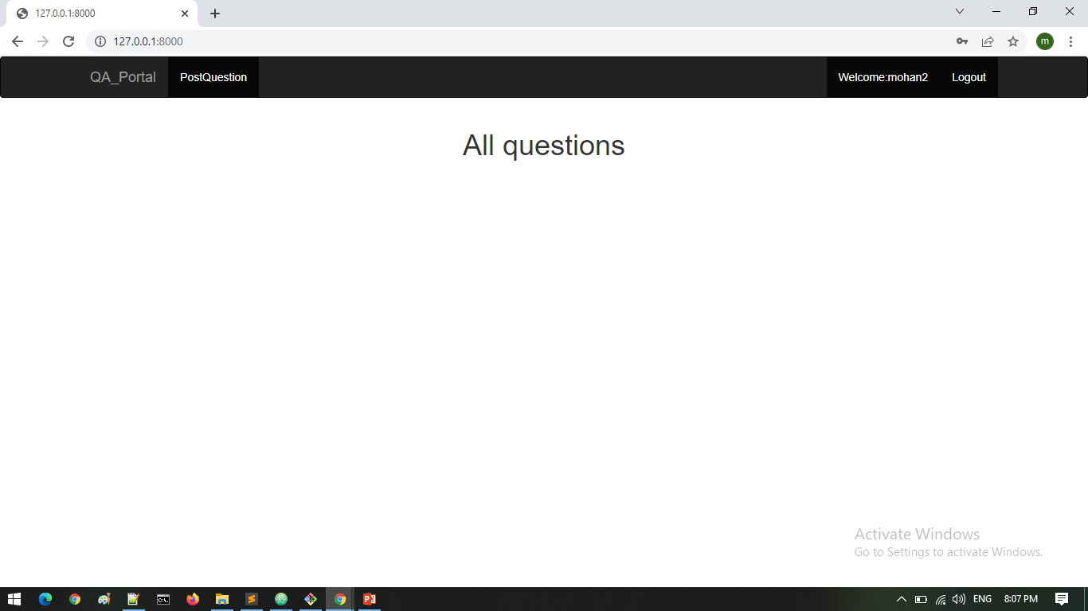
After login

Slide 7
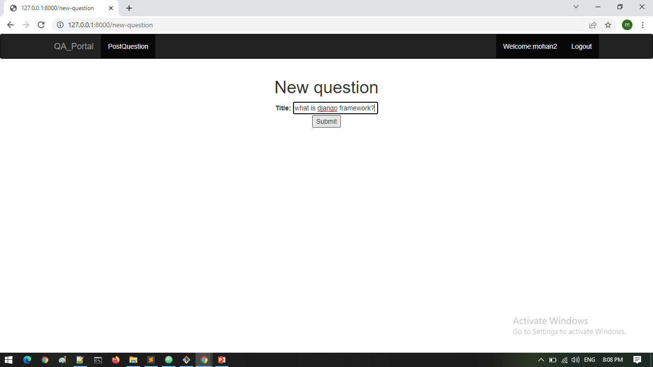

Slide 8
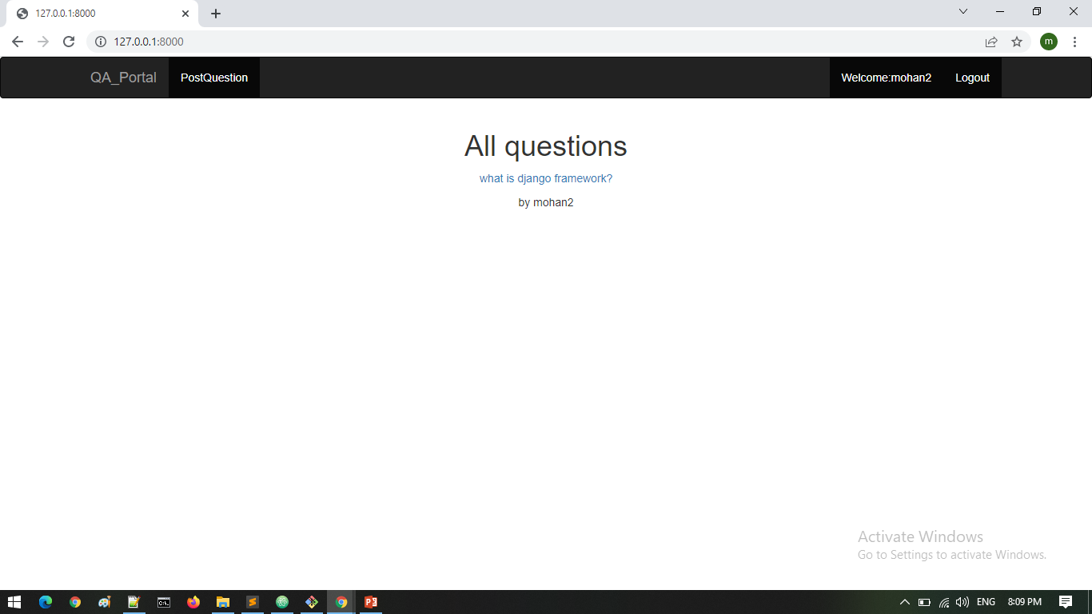
After posting

Slide 9
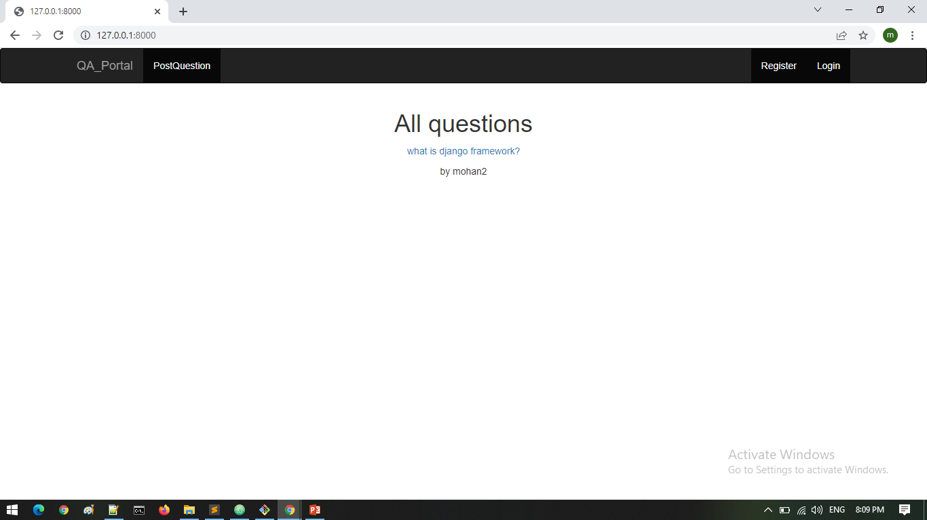
After Log out

Slide 10
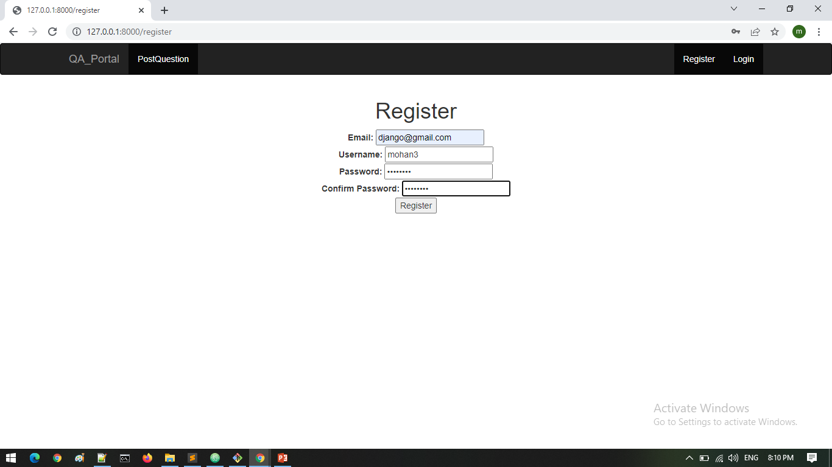
User mohan3 registerd password user_222

Slide 11

Login as mohan3

Slide 12
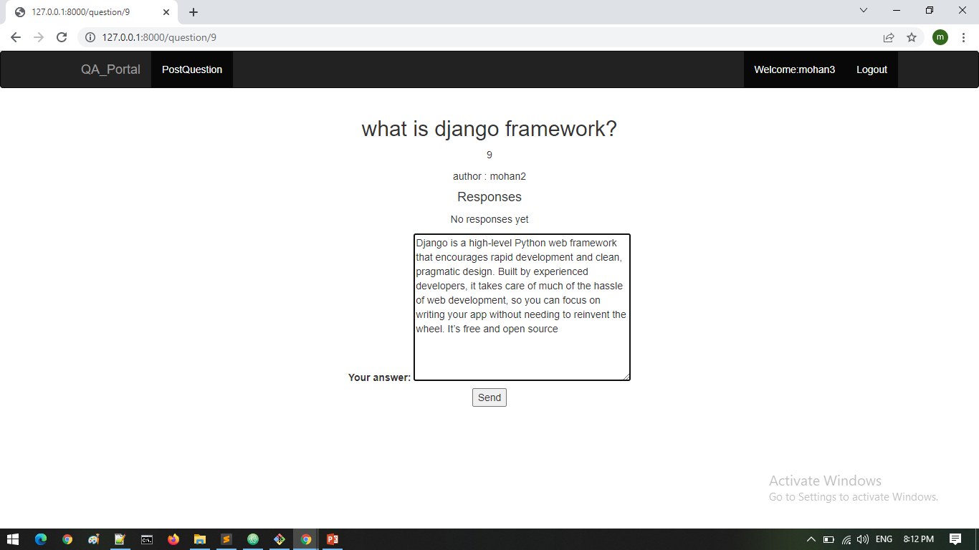
Answering question

Slide 13
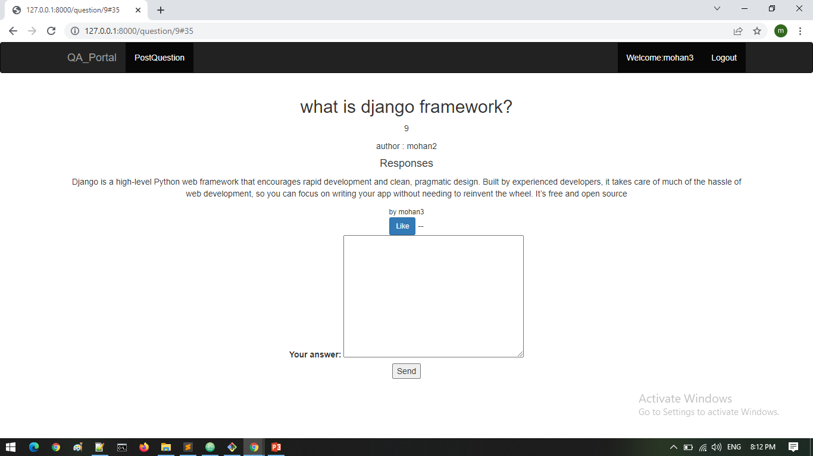
After submitting answer

Slide 14
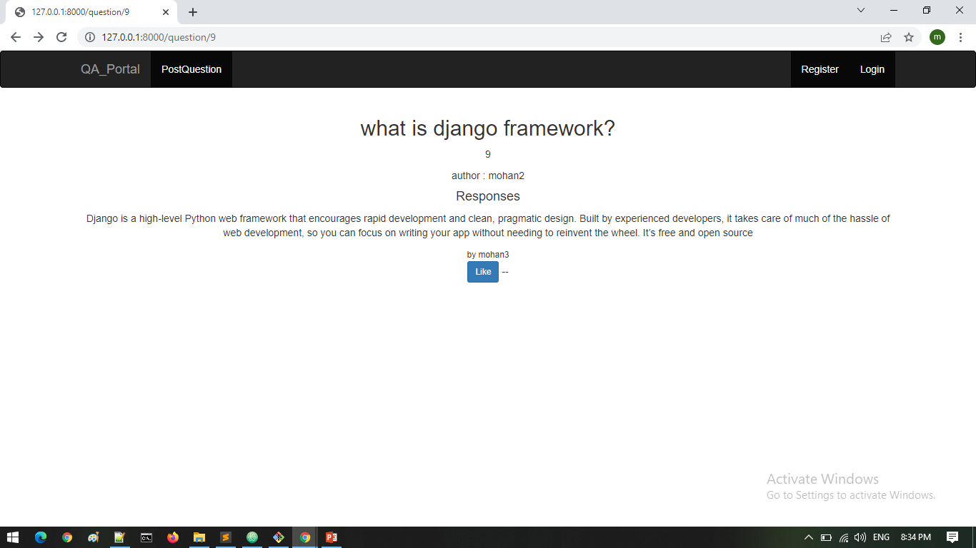
After log out question and answer visible to anonymous user

