Slide 1
Statistical Analysis of Retail Electricity Sales in the U.S.
Multiregional, Multisector Time Series (2014–2024)
Mohankrishna Kolla
Florida International University
STA6244 – Data Analysis I
December 4, 2025

Slide 2
Research Questions & Motivation
Core questions
How do retail electricity sales differ across:
Sectors: Residential, Commercial, Industrial, Transportation Regions: Northeast, Midwest, South, West
Is there a long-term national trend (2014–2024)?
Why it matters
Demand forecasting & grid planning Regional energy policy & climate risk
M. Kolla | Retail Electricity Sales

Slide 3
Data & Preparation
Data
Monthly retail electricity sales from EIA^{[4]} (2014–2024) By State × Sector, mapped to Census regions
Key Pre-processing
Wide → long tidy format in pandas^{[2]} Outlier removal using IQR (∼1000) log(1 + Value) to handle heavy tails
Numeric time index: days since first observation
M. Kolla | Retail Electricity Sales

Slide 4
Exploratory Data Overview
Dataset Characteristics
Feature
Category Counts
Category
Value
24,815
Count
7,944
Total observations Time range
States included Sectors Regions Numeric vars Median usage
Region – South Region – West Region – Midwest Region – Northeast Sector
2014–2024
51 (incl. DC)
4
4
3
920 MWh
6,444
5,958
4,469
∼6,200
M. Kolla | Retail Electricity Sales

Slide 5
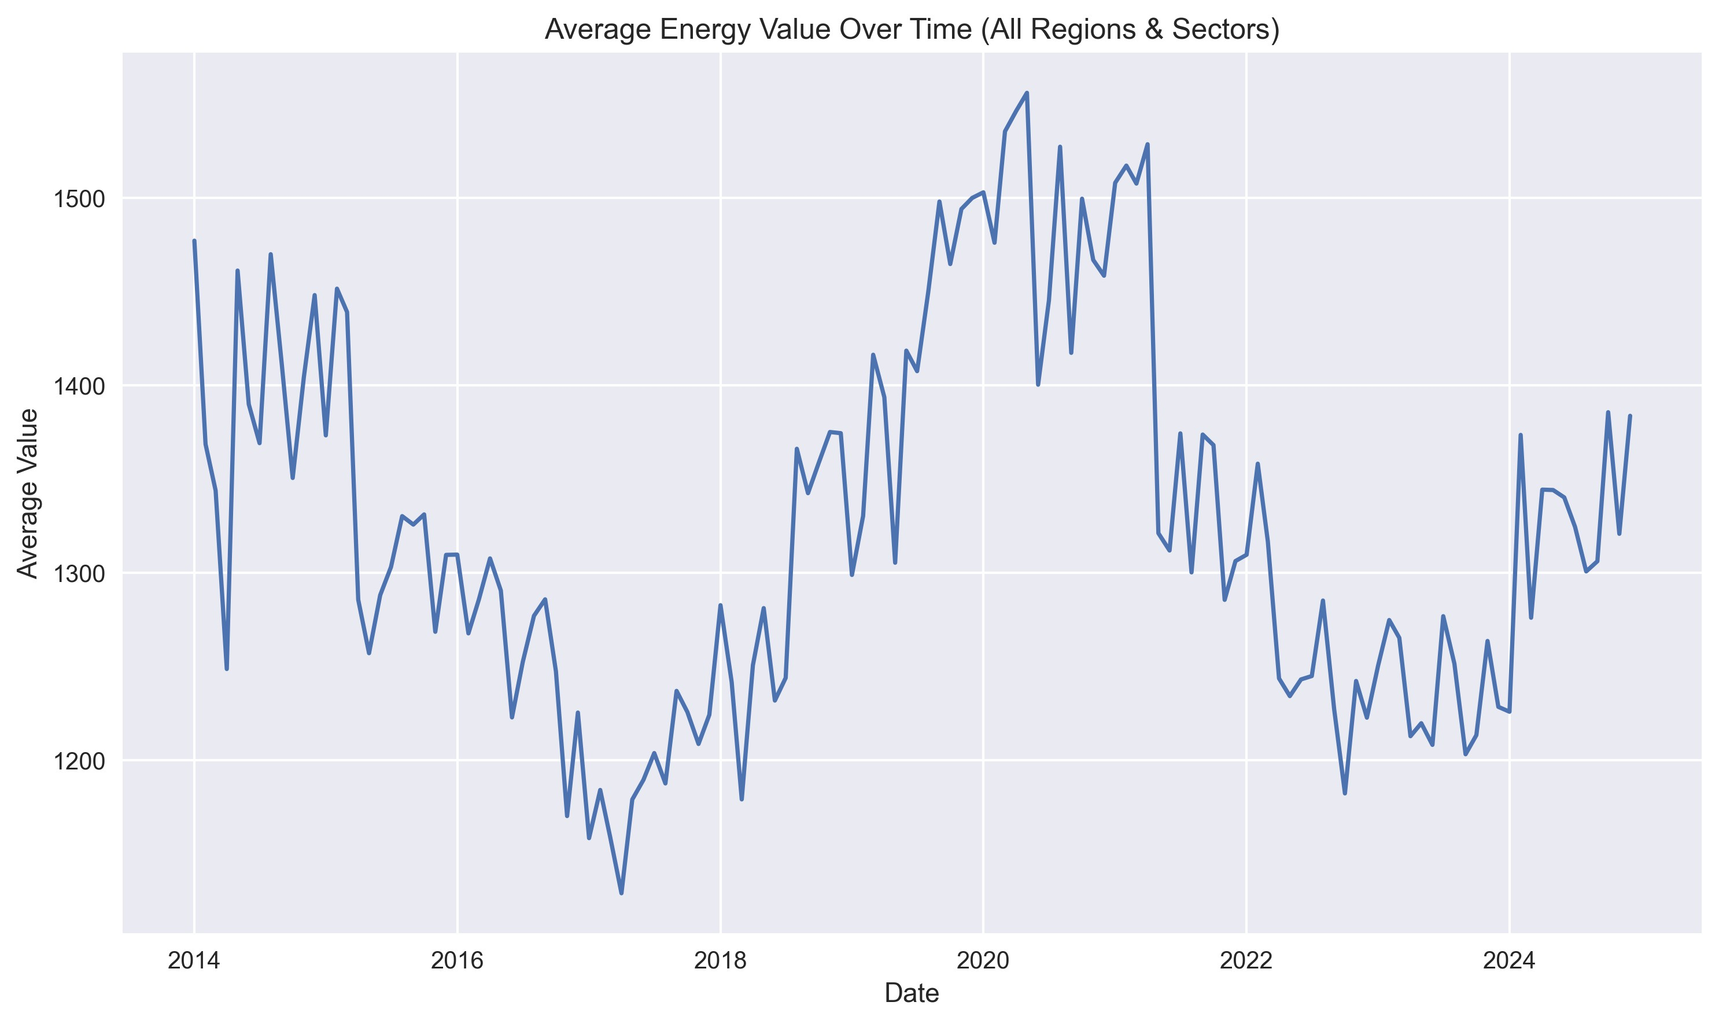
Overall Temporal Pattern
Clear seasonal cycles with stable long-run level
No obvious strong upward or downward national trend
M. Kolla | Retail Electricity Sales

Slide 6
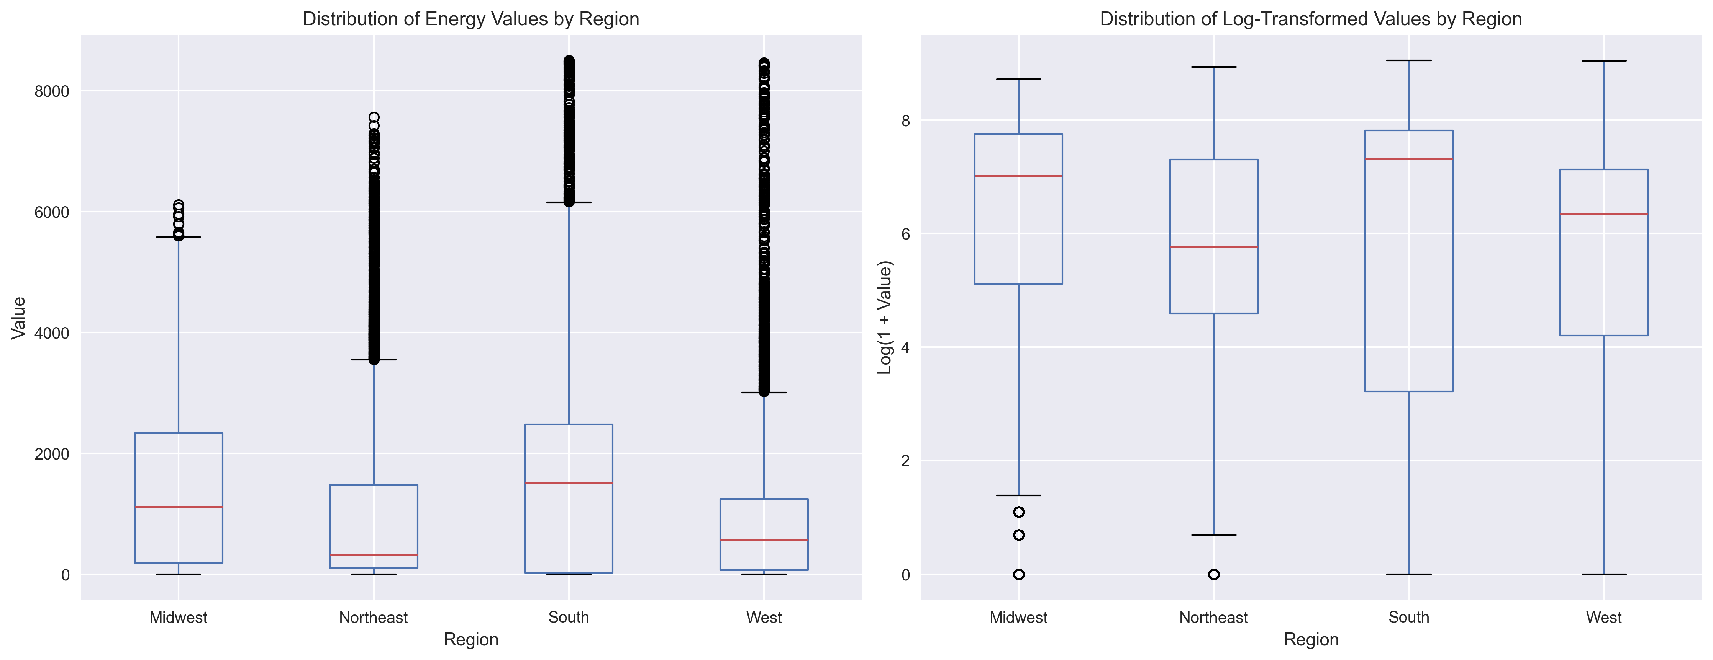
Regional Differences
South has the highest consumption distribution West and Northeast sit well below Midwest/South
M. Kolla | Retail Electricity Sales
6 / 14

Slide 7
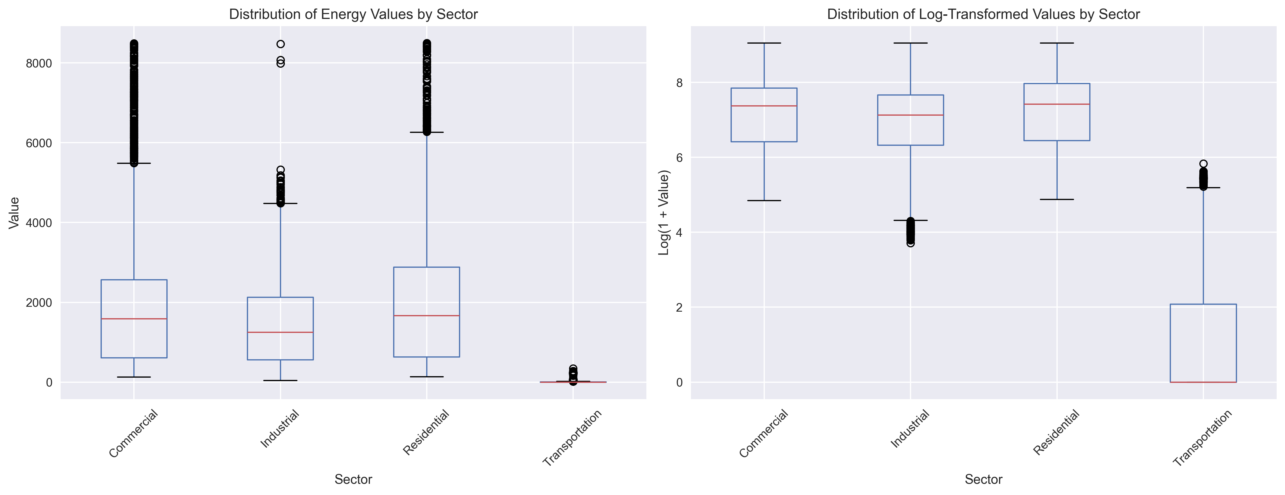
Sector Differences
Residential and Commercial dominate total usage Transportation consumption is extremely small
M. Kolla | Retail Electricity Sales

Slide 8
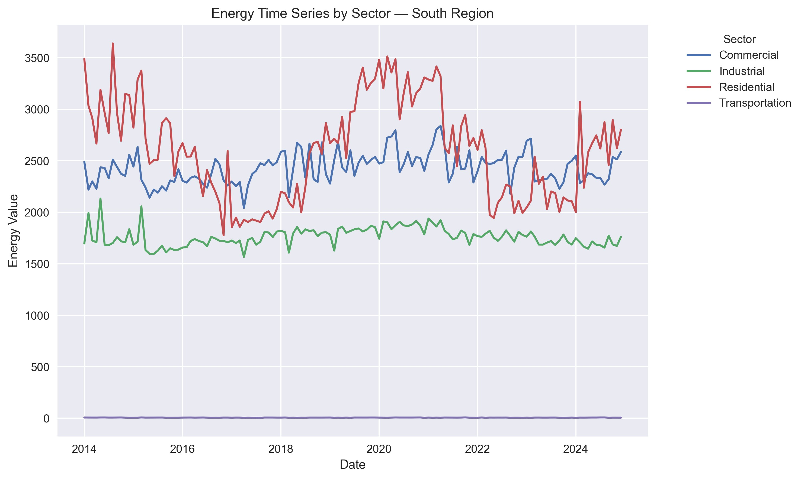
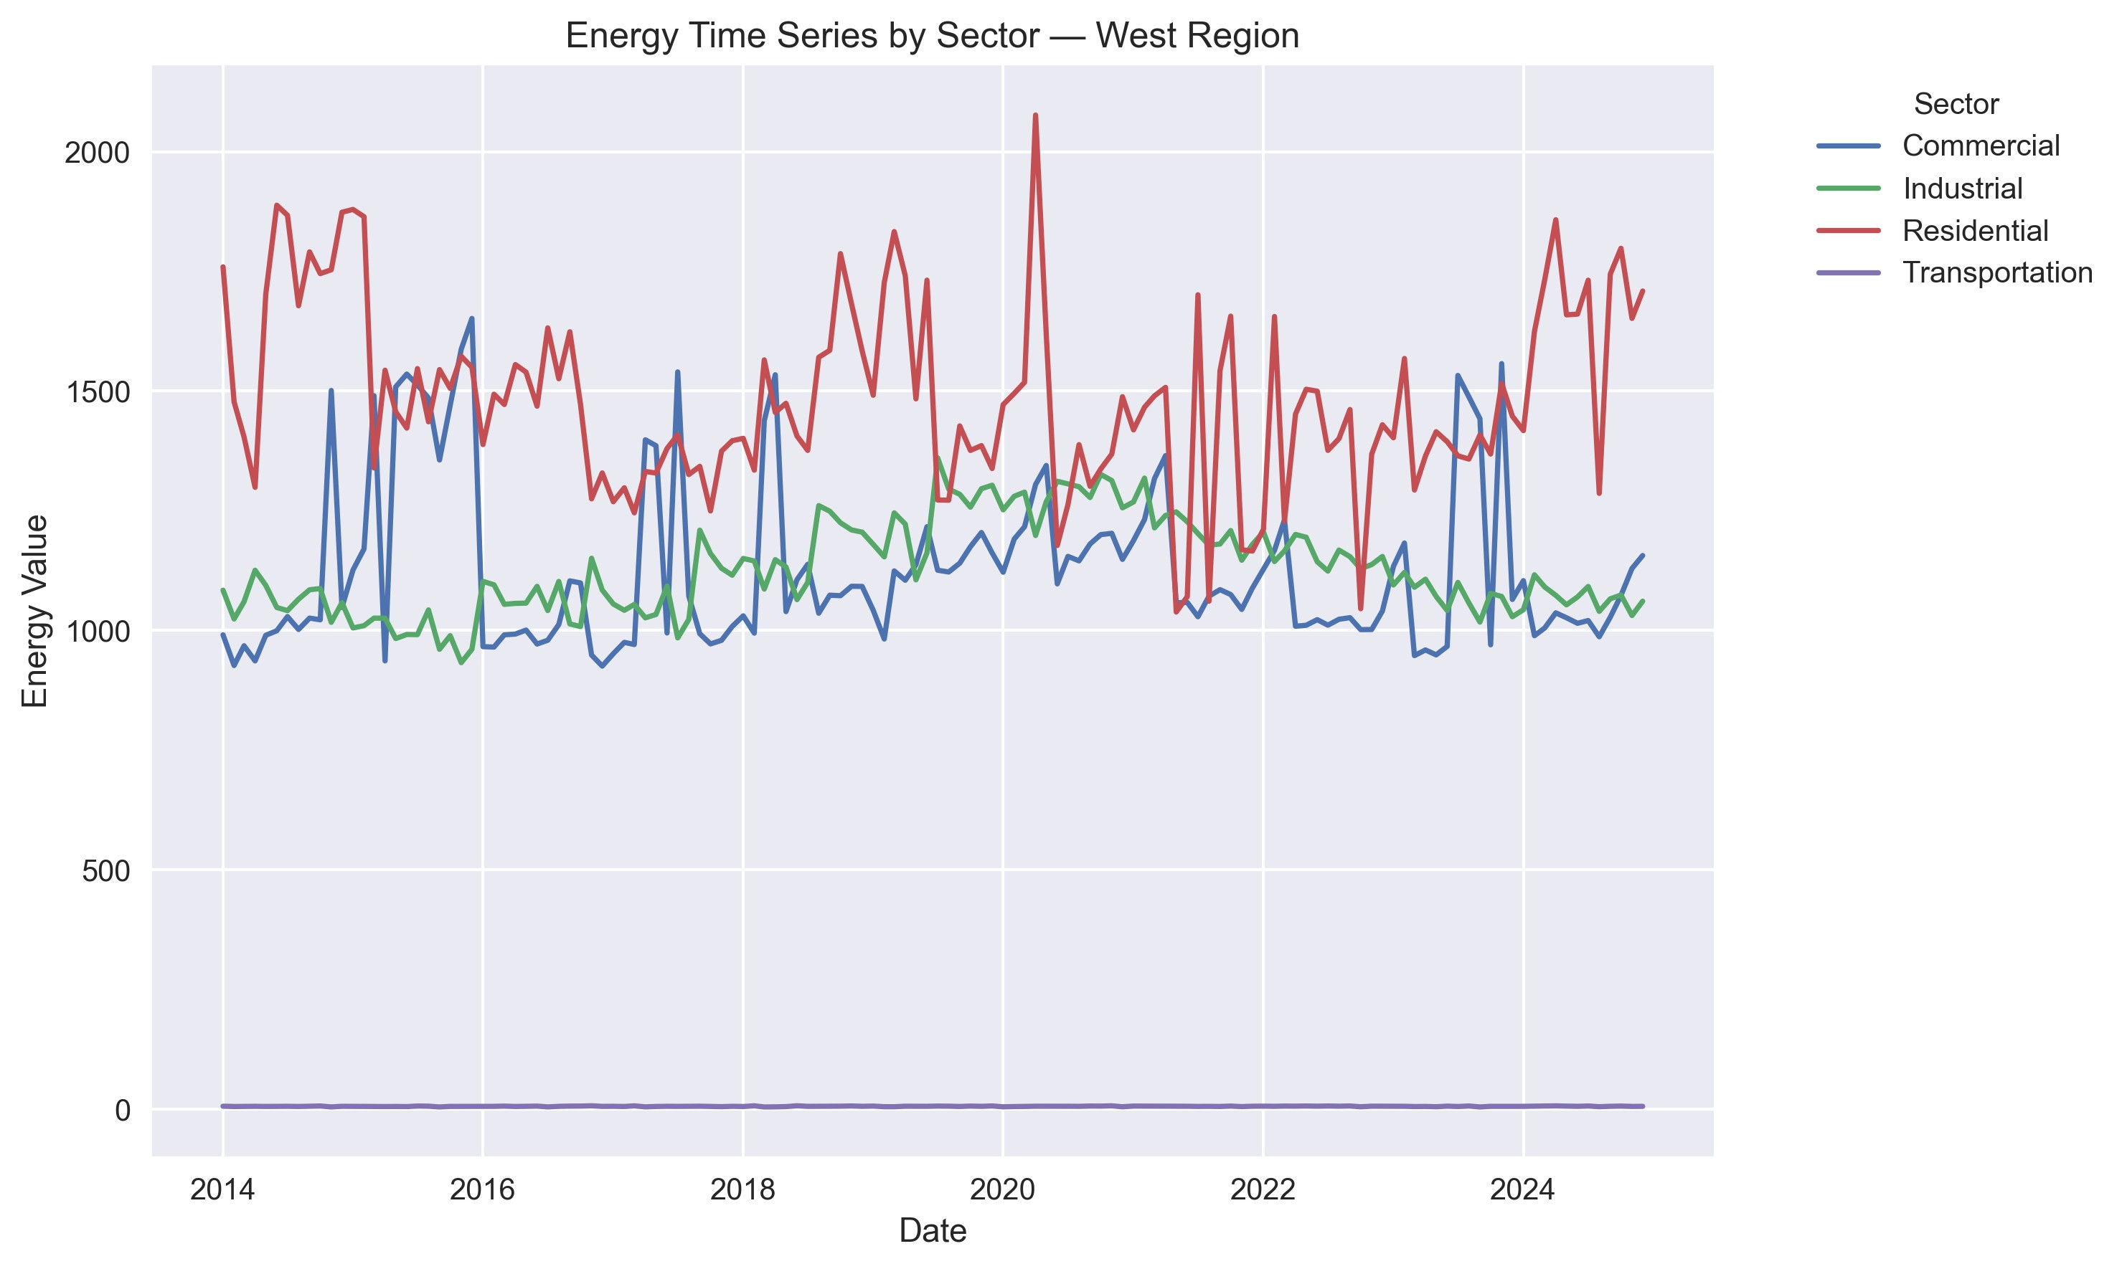
Regional Time Series: South vs West
South Region
South: consistently high, especially Residential. West: lower overall, but seasonal pattern still visible.
West Region
M. Kolla | Retail Electricity Sales

Slide 9
Regression Model & Key Results
Model
log(Value) = β₀ + β₁Time + Region effects + Sector effects + ε
Fit
Log model: R² ≈ 0.43 (vs. 0.24 on raw scale)
β₀ (Baseline): Log-usage for Midwest–Commercial at the start of the dataset.
β₁ (Time trend): Small, not statistically significant
Strong effects (relative to Midwest / Commercial)
South: ≈ +58%; West: ≈ −21%; Northeast: ≈ −20%
Residential: ≈ +7%; Industrial: ≈ −27%
Transportation: ≈ −99.8%
M. Kolla | Retail Electricity Sales
9 / 14

Slide 10
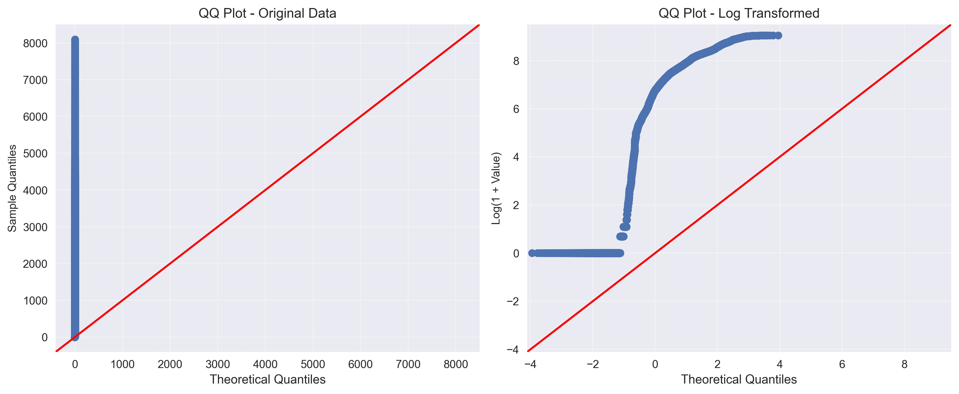
Why Log Transformation?
Raw data: heavy tails, strong deviations from normality Log scale: much closer to normal, better residual behavior
M. Kolla | Retail Electricity Sales
10 / 14

Slide 11
Interpretation & Implications
What drives electricity use?
Structural factors: climate, housing, industry mix Region and sector explain far more than time
Policy takeaways
South: plan for high cooling demand and grid resilience
Transportation: very low baseline electricity use ⇒ big headroom for EV growth Residential: critical sector for efficiency programs
M. Kolla | Retail Electricity Sales
11 / 14

Slide 12
Limitations & Next Steps
Limitations
State-level monthly data hides local/day-level dynamics Missing economic & climate covariates
Future work
Add weather, income, and price data Finer spatial/temporal resolution
Track transportation electrification explicitly
M. Kolla | Retail Electricity Sales
12 / 14

Slide 13
References
Hunter, J. D. (2007). Matplotlib. https://doi.org/10.1109/MCSE.2007.55
McKinney, W. (2010). pandas. https://pandas.pydata.org/
Seabold, S., & Perktold, J. (2010). Statsmodels. https://www.statsmodels.org/
U.S. Energy Information Administration. (2024). Retail electricity sales data.
https://www.eia.gov/
Virtanen, P. et al. (2020). SciPy 1.0. https://doi.org/10.1038/s41592-019-0686-2
1
2
3
4
5
M. Kolla | Retail Electricity Sales
13 / 14

Slide 14
Q&A
Thank you!
Any Questions?
M. Kolla | Retail Electricity Sales
14 / 14

