Slide 1
HR Analytics Dashboard
Workforce Analysis & Insights
PRDA-03 HR Analytics
Batch ID PTID-CDA-JAN-26-1213
Submitted by:
Mohan Kumar S
Project Submission – June 2026

Slide 2
Project Overview
Analyze employee workforce data using Power BI
Monitor key workforce metrics such as Total employees, Average age, Remote % and HQ %
Evaluate employee distribution across departments, gender, race and states.
Identify hiring trends and workforce patterns.
Generate actionable business insights for strategic HR Decision-Making.

Slide 3
Dataset Information
📊 Dataset Overview
Total Records : 1000
Dataset Type : HR Employee Data
Tool Used : Power BI
🔑 Key Employee Attributes
Employee ID
Age
Gender
Department
Race
Location
Hire Date
🎯Project Purpose
📊 Workforce Analysis
📈 Hiring Trend Analysis
💡 Insight Generation
🏢 HR Decision Support

Slide 4
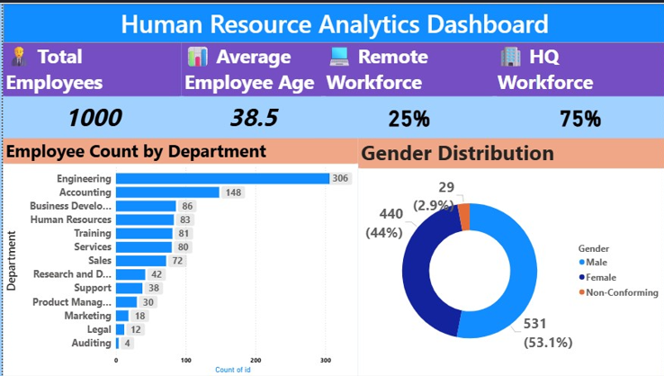
Dashboard - Overview

Slide 5
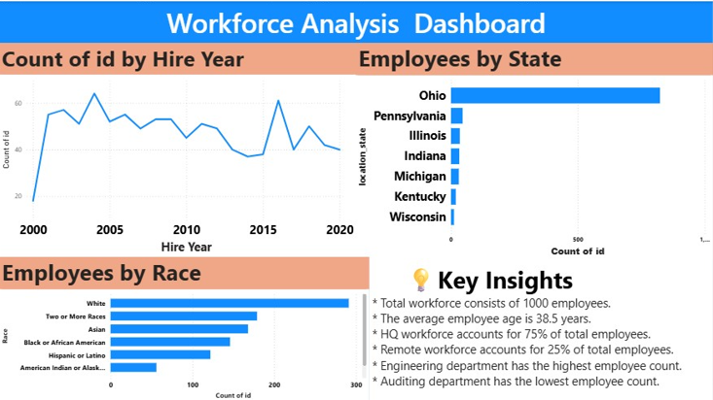
Workforce Insights

Slide 6
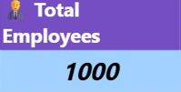
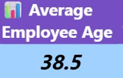
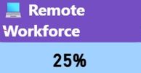
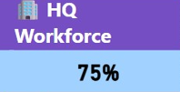
HR KPI Metrics
KPI Summary
Total Workforce : 1000
Average Employee Age : 38.5 Years
Remote Workforce : 25%
HQ Workforce : 75%

Slide 7
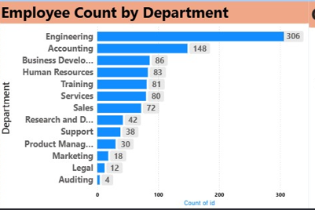
Department-Wise Employee Distribution
💡 Key Insights
Engineering department has the highest workforce (306 employees).
Accounting department ranks second in workforce size.
Auditing department has the lowest employee count.
Most employees are concentrated in technical and business-related departments.

Slide 8
Conclusion & Recommendations
Conclusion
HR Analytics Dashboard was developed using Power BI to analyze employee workforce data
The organization consists of 1,000 employees with an average age of 38.5 years
Engineering has the highest employee count among all departments
.Ohio has the highest workforce concentration
The dashboard supports data-driven HR decision-making
Recommendations
Improve workforce diversity and inclusion initiatives
Strengthen remote employee engagement programs
Focus on workforce planning for growing departments
.Use hiring trend analysis for future recruitment strategies

Slide 9
Project Challenges & Solutions
Challenge : Understanding the HR dataset structure and attributes.
Solution : Analyzed all columns and identified relevant fields for workforce analysis.
Challenge : Creating meaningful KPI metrics.
Solution : Developed measures for Total Employees, Average Age,
Remote Workforce %, and HQ Workforce %.
Challenge : Selecting appropriate visualizations.
Solution : Used line charts, donut charts, bar charts, and KPI cards based on
business requirements.
Challenge : Deriving actionable business insights.
Solution : Analyzed workforce distribution, hiring trends, and diversity metrics.
Challenge : Designing a user-friendly dashboard
Solution : Created a clean and interactive dashboard for HR decision-making.

Slide 10
Key Learnings
Power BI Dashboard Development
KPI Creation using DAX Measures
Data Visualization Techniques
Workforce Analytics & Insights
HR Decision Support Reporting

Slide 11
Thank You …!!!

