Slide 1
My Customer Outcome- Expedia Group
WORK hard.HAVE FUN.MAKE HISTORY.Think big!
Alex Foskett, Account Manager
Mohan Pasappulatti, Account SA
Chris Horn, ProServe CPM
Lien Trac, Account CSM
#OneTeam
Notes:
#################################### BEGIN NOTES ######################################################
-------------- NOTE ADDED ON: Mar 29 2022 04:08:15 --------------------
This is The slide number one.
###################################### END NOTES ######################################################
#################################### BEGIN NOTES ######################################################
-------------- NOTE ADDED ON: Mar 29 2022 04:09:53 --------------------
This is The slide number one.
###################################### END NOTES ######################################################

Slide 2







Customer Outcome Journey
Customer Scenario
Road Blocks / Issues
Tools & Resources
Lessons learned
AWS Solution
Decision Points
Positive Customer Outcome
Notes:
#################################### BEGIN NOTES ######################################################
-------------- NOTE ADDED ON: Mar 29 2022 04:08:15 --------------------
This is slide number two.
###################################### END NOTES ######################################################
#################################### BEGIN NOTES ######################################################
-------------- NOTE ADDED ON: Mar 29 2022 04:09:53 --------------------
This is slide number two.
###################################### END NOTES ######################################################

Slide 3
Customer Outcome Journey – Customer Scenario
Business Case
Audit sponsored by Expedia’s (EG) corporate board
Identified PCI and PII data in the open in the EG Data Lake
Constraints
No developers available
Limited funding
Risks
Having PCI Data compromised
Failing PCI certification
Dependent on PCI certification to collect and move monies online.
Opportunity
EG – Rectify discrepancy from corporate audit
AWS – Amazon Macie adopted at Expedia to identify PCI/PII data
ProServe – Paid follow-on engagement
Notes:
#################################### BEGIN NOTES ######################################################
-------------- NOTE ADDED ON: Mar 29 2022 04:08:15 --------------------
This is a slide number three.
###################################### END NOTES ######################################################
#################################### BEGIN NOTES ######################################################
-------------- NOTE ADDED ON: Mar 29 2022 04:09:53 --------------------
This is a slide number three.
###################################### END NOTES ######################################################

Slide 4
Customer Outcome Journey – #OneTeam
Seven-week Proof of Concept
AM – Earns Trust/Customer Obsession Prior positive experience with an S3 Intelligent Tiering project paved the way for discussions on PCI/PII data Customer had a significant issue with an idea to use Macie, but no developers or funding.
SA – Are Right A Lot/Think Big Designed a scalable and performant architecture with extensibility Defined units of work and deliverables for each sprint
CSM – Bias for Action/Insist on the Highest Standards Applied program management and agile knowledge to ensure successful delivery Defined sprints to ensure SOW objectives were met Pre-Requisites completed prior to project kickoff
CPM – Bias for Action/Deliver Results Utilized ProServe processes to deliver the SOW and secure funding Overcame staffing constraints and budgetary challenges to keep the project moving forward
Notes:
#################################### BEGIN NOTES ######################################################
-------------- NOTE ADDED ON: Mar 29 2022 04:08:16 --------------------
This is slide number four.
###################################### END NOTES ######################################################
#################################### BEGIN NOTES ######################################################
-------------- NOTE ADDED ON: Mar 29 2022 04:09:54 --------------------
This is slide number four.
###################################### END NOTES ######################################################

Slide 5
Customer Outcome Journey –Tools & Resources
Demonstrated value of ProServe
Started as ProServe investment in Expedia after 3 failed previous opportunities
Brought the right people to solve Expedia’s challenge
Built a relationship with the stakeholders at Expedia
Adapted our skills needed
Started with heavy Macie knowledge but project needed DevOps skills more
Worked with staffing and delivery management to overcome staffing challenges
Notes:
#################################### BEGIN NOTES ######################################################
-------------- NOTE ADDED ON: Mar 29 2022 04:08:16 --------------------
This is a slide number five.
###################################### END NOTES ######################################################
#################################### BEGIN NOTES ######################################################
-------------- NOTE ADDED ON: Mar 29 2022 04:09:54 --------------------
This is a slide number five.
###################################### END NOTES ######################################################

Slide 6
Customer Outcome Journey – AWS Technical Solution
Requirements
Scan incoming data (Near realtime & Batch) for PII/PCI Information
Entire solution to be abstracted and deployed via Terraform
Challenges
Event driven - Unsupported Macie Workflow
Ambiguity of Upstream/Downstream processes
Unknown metrics around scaling (Ingestion rate, data size to be scanned, etc.)
Solution Architecture
Notes:
Requirements
So let's let me talk a little bit about the technical requirements for this project.
The first requirement was In a nutshell, the basic goal was to be able to scan the incoming data that could be already residing in EG systems or this could be new data that's coming in from external sources, goal was to basically scan and identify if this has any PII or PCI. Information.
There second requirement for this project was to deploy the entire solution as infrastructure as code and as an organization they have decided to use terra form as their standard.
Challenges
Let us take a look at some of the challenges we faced during the early stages of this project.
First and foremost, they wanted to have an event driven type architecture. Now, what do we mean by that?
In a typical Macie workflow you would have an S3 bucket and you would point Macie to it and it would go ahead and scan based on certain filters and file types and prefixes, It will scan the files and we'll kind of report its findings, So it is not an event driven sort of a workflow, it is more of a batch job type workflow. In EG’s case they really wanted to have a granular control of every file that's being scanned, what is not being scanned, how long it is taking to scan these files and all the metrics around it. So they wanted us to have a workflow where they would drop some files in a S3 bucket and it triggers the whole Macie workflow and we'll talk about that in more detail when it comes to architecture.
The next one was there was a certain amount of ambiguity with how this would work upstream and downstream. So we weren't sure what we're going to be the sources of data and after the findings are processed, how is easy going to handle them? Is there anything that we needed to know? So there was definitely some ambiguity around that.
Lastly there was a lot of ambiguity around the metrics and scaling aspect of it. So what amount of data are we expecting? What is going to be the data, file sizes and what are the systems that are going to be pushing the data in and how is this finding is going to be extracted? So there were a lot of these things that were kind of challenging in terms of when we started this project.
Solution Architecture
Now let's get to the meat of this presentation which is the solution and architecture that we proposed to kind of solve this problem for EG
#################################### BEGIN NOTES ######################################################
-------------- NOTE ADDED ON: Mar 29 2022 04:08:16 --------------------
That is slide number six.
###################################### END NOTES ######################################################
#################################### BEGIN NOTES ######################################################
-------------- NOTE ADDED ON: Mar 29 2022 04:09:54 --------------------
That is slide number six.
###################################### END NOTES ######################################################

Slide 7
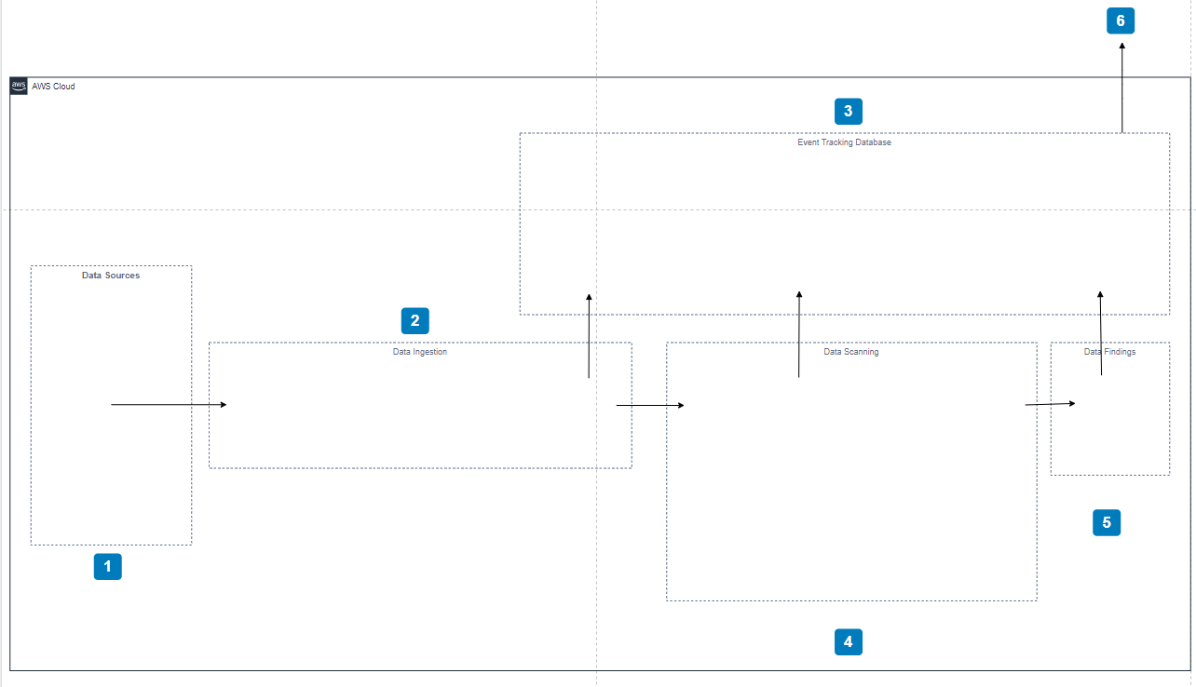
Customer Outcome Journey – AWS Solution Architecture
Notes:
#################################### BEGIN NOTES ######################################################
-------------- NOTE ADDED ON: Mar 29 2022 04:08:17 --------------------
Yes, is slide number seven
###################################### END NOTES ######################################################
#################################### BEGIN NOTES ######################################################
-------------- NOTE ADDED ON: Mar 29 2022 04:09:54 --------------------
Yes, is slide number seven
###################################### END NOTES ######################################################

Slide 8
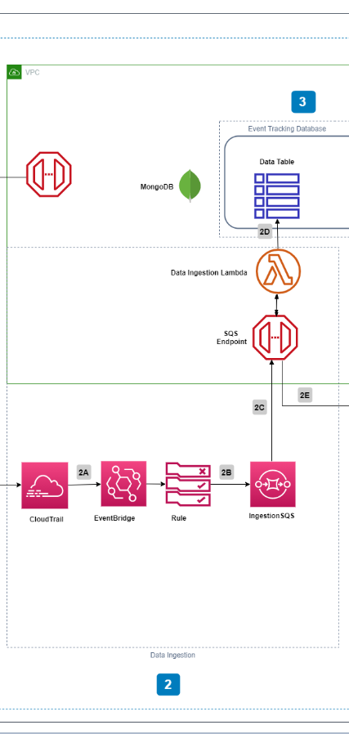
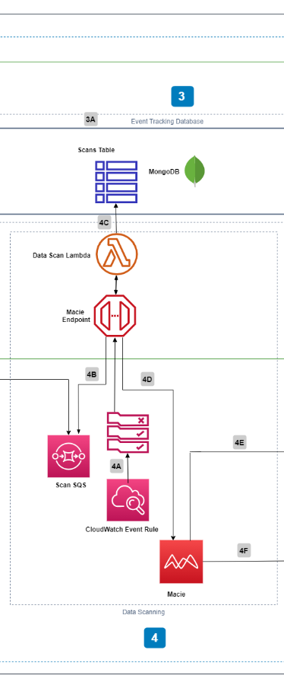
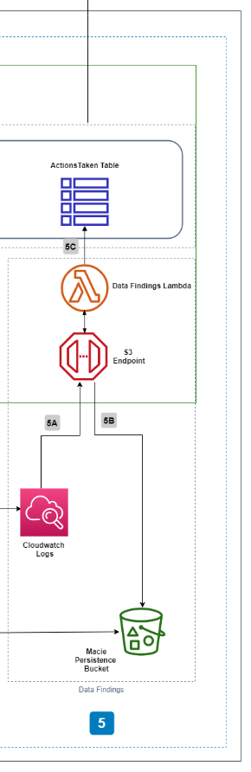
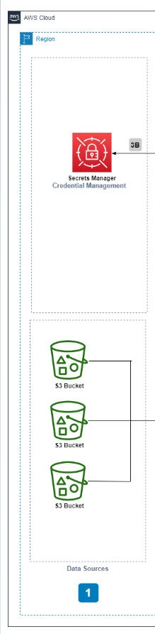
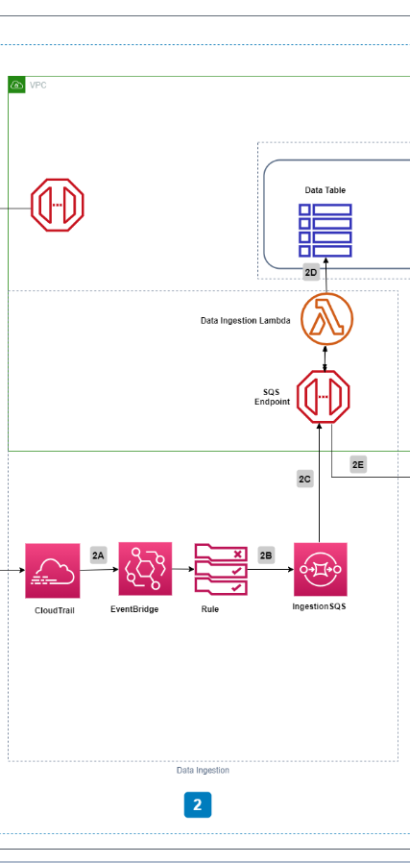
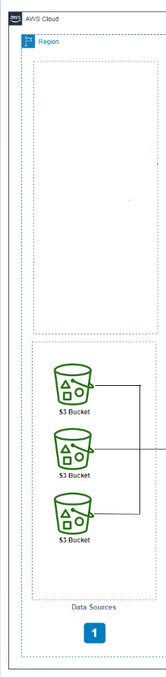
Customer Outcome Journey – AWS Solution Architecture
Notes:
#################################### BEGIN NOTES ######################################################
-------------- NOTE ADDED ON: Mar 29 2022 04:08:17 --------------------
and slide number eight.
###################################### END NOTES ######################################################
#################################### BEGIN NOTES ######################################################
-------------- NOTE ADDED ON: Mar 29 2022 04:09:55 --------------------
and slide number eight.
###################################### END NOTES ######################################################

Slide 9
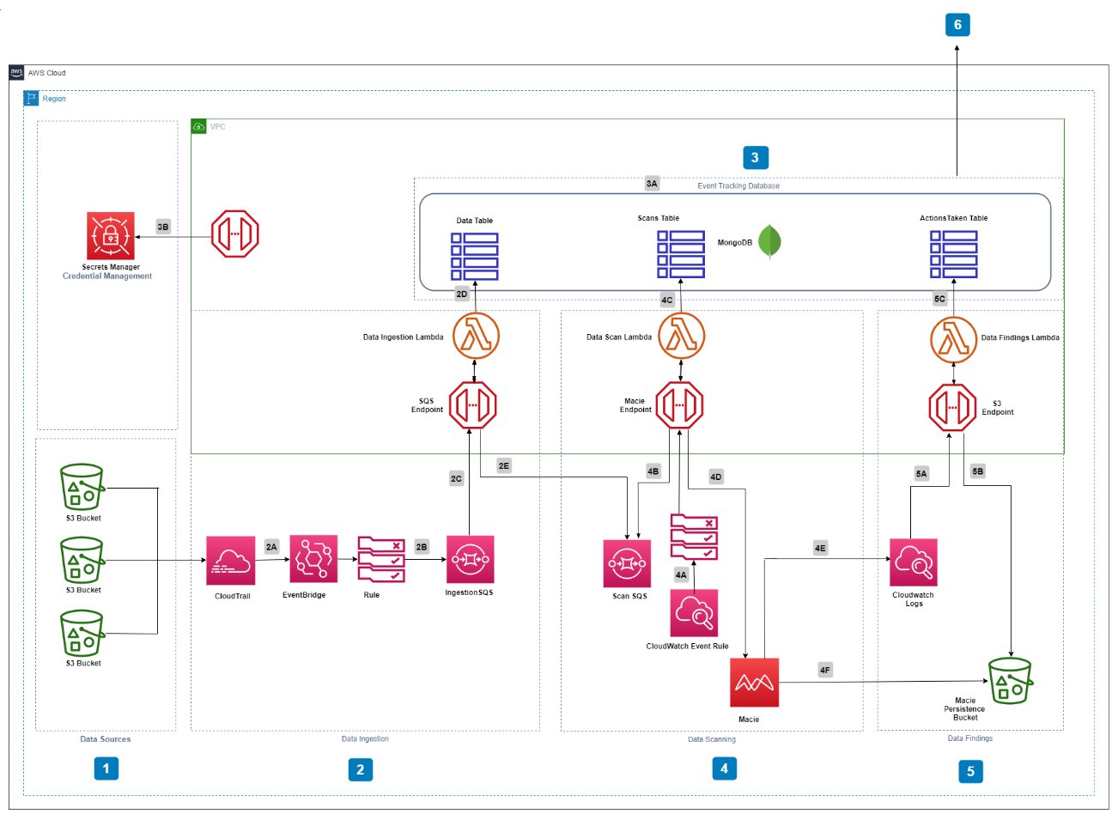
Customer Outcome Journey – AWS Solution Architecture
Notes:
#################################### BEGIN NOTES ######################################################
-------------- NOTE ADDED ON: Mar 29 2022 04:08:17 --------------------
This is slide number nine.
###################################### END NOTES ######################################################
#################################### BEGIN NOTES ######################################################
-------------- NOTE ADDED ON: Mar 29 2022 04:09:55 --------------------
This is slide number nine.
###################################### END NOTES ######################################################

Slide 10
Customer Outcome Journey – Best Practices
Engagement Management, even partial, is critical to project success
Partner closely with CSM and rest of Account Team
No such thing as “too much Discovery” – Learn and Be Curious
Set realistic expectations early, and update along the way
Insist on the Highest Standards and Deliver Results
Notes:
#################################### BEGIN NOTES ######################################################
-------------- NOTE ADDED ON: Mar 29 2022 04:08:17 --------------------
This is a slide number 10.
###################################### END NOTES ######################################################

Slide 11
Customer Outcome
Demonstrated a working PoC using
Subset of Data
Subset of Use Cases
DEV environment
Phase 2
Full spectrum of data
Complete set of use cases
PROD environment
Beyond
Additional data sources
Additional use cases
Notes:
#################################### BEGIN NOTES ######################################################
-------------- NOTE ADDED ON: Mar 29 2022 04:08:18 --------------------
This is slide number 11.
###################################### END NOTES ######################################################

Slide 12
Thank You!
Alex Foskett, Account Manager
Mohan Pasappulatti, Account SA
Chris Horn, ProServe CPM
Lien Trac, Account CSM
#OneTeam
Notes:
#################################### BEGIN NOTES ######################################################
-------------- NOTE ADDED ON: Mar 29 2022 04:08:18 --------------------
This is a slide number 12. End of the presentation.
###################################### END NOTES ######################################################

