Slide 1
CLOUD DISASTER RECOVERY & BUSINESS CONTINUITY
Azure Site Recovery Failover Plan
for a Business Application
Automated Multi-Region Replication, Recovery Orchestration, and Failback Strategy
PROJECT METADATA & CANDIDATE DETAILS
Student Name: Praneeth | Student ID: 2400030412 | Email: 2400030412@kluniversity.in
Institution: Koneru Lakshmaiah Education Foundation (KL University) | Primary: East US -> Target: West US

Slide 2
AZURE SITE RECOVERY FAILOVER PLAN
Project Overview & Executive Summary
CLOUD-NATIVE PROTECTION
Disaster Recovery as a Service
• Implements Azure Site Recovery (ASR) to protect critical enterprise workloads.
• Eliminates capital expenditure (CapEx) of maintaining secondary physical data centers.
• Ensures continuous asynchronous block replication across paired Azure regions (East US to West US).
MINIMAL DOWNTIME & DATA LOSS
Business Continuity Assurance
• Provides automated, orchestrated failover during primary datacenter outages.
• Satisfies strict Recovery Point Objective (RPO < 15 mins) and Recovery Time Objective (RTO < 30 mins).
• Includes automated application-consistent snapshots for database transaction integrity.
ZERO-IMPACT COMPLIANCE
Audited & Non-Disruptive
• Enables non-disruptive Test Failover drills in isolated test sandboxes without impacting production.
• Guarantees seamless re-protection and planned failback when the primary region is restored.
• Automated using modular, idempotent Azure CLI scripts for repeatable cloud operations.
Azure Site Recovery Failover Plan | Department of Computer Science & Engineering | Slide 2 of 12

Slide 3
AZURE SITE RECOVERY FAILOVER PLAN
Problem Statement: Enterprise DR Vulnerabilities
Catastrophic Regional Outages
Public cloud availability zones do not protect against massive regional fiber cuts, severe climatic events, or widespread power grid collapses.
01
Unacceptable Downtime & Revenue Loss
Manual infrastructure redeployment and bare-metal backup restores require hours or days, causing catastrophic RTO SLA violations.
02
Data Corruption & Transaction Drift
Unsynchronized database backups cause missing transactional journals, inconsistent states, and broken database referential integrity.
03
High Cost & Operational Risk of DR Drills
Traditional disaster drills frequently disrupt production or cause unintended outages, deterring compliance audits and testing.
04
Disorganized Reverse Recovery (Failback)
Many organizations lack a validated failback protocol, leading to secondary outages, configuration drift, and lost revenue when attempting to return to primary sites.
05
Azure Site Recovery Failover Plan | Department of Computer Science & Engineering | Slide 3 of 12

Slide 4
AZURE SITE RECOVERY FAILOVER PLAN
Project Objectives & Recovery SLA Metrics
CORE PROJECT OBJECTIVES
✔ Architect Symmetrical Multi-Region Infrastructure across East US and West US.
✔ Deploy and configure Azure Site Recovery (ASR) with Recovery Services Vault.
✔ Establish Continuous Block-Level Replication with encrypted staging cache.
✔ Implement Multi-Tier Recovery Plans enforcing ordered database-first boot sequence.
✔ Conduct Zero-Impact Test Failovers in isolated private test virtual networks.
✔ Execute End-to-End Failover and Failback workflows demonstrating complete recovery.
RPO (RECOVERY POINT OBJECTIVE)
< 15 Minutes
Observed: 3 - 5 Minutes via asynchronous log staging
RTO (RECOVERY TIME OBJECTIVE)
< 30 Minutes
Observed: 7 - 10 Minutes automated VM provisioning
TEST DRILL AVAILABILITY
100% Production Uptime
Zero user disruption using isolated test network
Azure Site Recovery Failover Plan | Department of Computer Science & Engineering | Slide 4 of 12

Slide 5
AZURE SITE RECOVERY FAILOVER PLAN
Proposed Solution: Active-Passive DR Framework
Primary Production (East US)
• Primary Resource Group: rg-primary-app-prod
• Virtual Network: vnet-primary-eastus (10.10.0.0/16)
• Application VM: vm-app-primary (Web & DB layers)
• Cache Storage: stgasrcacheeastus (Encrypted write buffer)
• ASR Mobility Agent intercepts live block writes without disk degradation
Replication & Vault Engine
• Recovery Services Vault: rsv-businessapp-dr in West US
• Continuous asynchronous block streaming over Azure backbone
• 24-Hour Recovery Point Retention Policy
• App-Consistent Snapshots generated hourly via VSS/fsfreeze
• Zero compute charge incurred in DR site until failover trigger
Target Recovery (West US)
• Secondary Resource Group: rg-secondary-app-dr
• Recovery VNet: vnet-dr-westus (10.20.0.0/16)
• Isolated Test VNet: vnet-testdr-westus (10.30.0.0/16)
• Recovery VM: vm-app-secondary dynamically created on failover
• Controlled re-protection and seamless failback when primary recovers
Azure Site Recovery Failover Plan | Department of Computer Science & Engineering | Slide 5 of 12

Slide 6
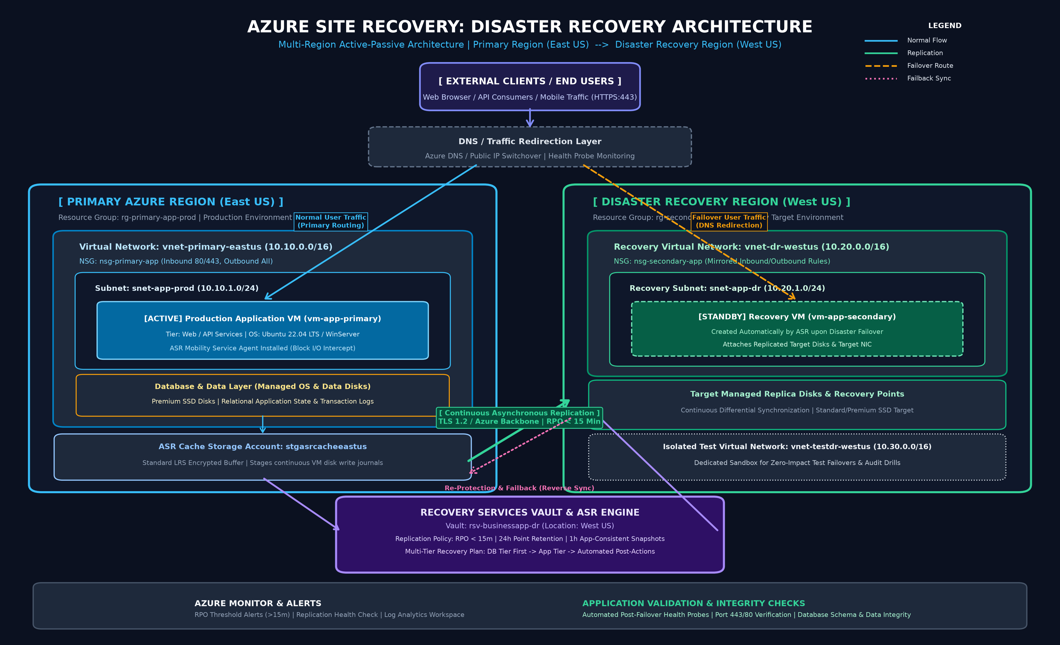
AZURE SITE RECOVERY FAILOVER PLAN
End-to-End System Architecture Topology
Azure Site Recovery Failover Plan | Department of Computer Science & Engineering | Slide 6 of 12

Slide 7
AZURE SITE RECOVERY FAILOVER PLAN
Azure Services Stack: Core vs Supporting
Azure Site Recovery (ASR) [Core / Mandatory]
Role: Continuous block replication, snapshot management, and failover orchestration engine.
Recovery Services Vault (RSV) [Core / Mandatory]
Role: Central control plane and metadata store deployed in West US for regional survivability.
Azure Virtual Machines [Core / Mandatory]
Role: Primary compute workload (East US) and dynamically provisioned target compute (West US).
Azure Virtual Networks [Core / Mandatory]
Role: Isolated network topologies (10.10, 10.20, 10.30) preventing IP routing conflicts.
Network Security Groups [Core / Mandatory]
Role: Stateful packet firewalls enforcing ingress/egress rules across production and DR tiers.
Azure Managed Disks & Cache [Core / Mandatory]
Role: Premium SSD persistent disks and standard LRS encrypted staging write journal buffer.
Azure Resource Groups [Core / Mandatory]
Role: Lifecycle and governance boundary separating primary assets from disaster recovery assets.
Azure Monitor & Alerts [Supporting / Recommended]
Role: Real-time replication telemetry, RPO breach thresholds (>15m), and audit trails.
Azure Traffic Manager / DNS [Supporting / Optional]
Role: Automated client redirection and DNS priority routing to active regional endpoints.
Azure Site Recovery Failover Plan | Department of Computer Science & Engineering | Slide 7 of 12

Slide 8
AZURE SITE RECOVERY FAILOVER PLAN
The Five Implementation Tasks (Roadmap)
Azure Infrastructure Setup
Provision primary/secondary Resource Groups, Virtual Networks, Subnets, NSGs, Cache Storage, and primary VM.
TASK 1
Configure Azure Site Recovery
Deploy Recovery Services Vault in West US, configure 24h retention policy, pair containers, and start baseline sync.
TASK 2
Create Recovery & Failover Plan
Codify startup sequence groups (DB tier before Web tier), configure RPO/RTO objectives, and attach automation hooks.
TASK 3
Perform Test Failover
Execute non-disruptive DR drill into isolated test VNet (10.30.0.0/16); validate web/database functionality; perform cleanup.
TASK 4
Execute Failover and Failback
Simulate primary failure, execute unplanned failover, redirect user traffic, initiate re-protection, and complete failback.
TASK 5
Azure Site Recovery Failover Plan | Department of Computer Science & Engineering | Slide 8 of 12

Slide 9
AZURE SITE RECOVERY FAILOVER PLAN
Project Modules & Architectural Responsibilities
Module 1: Infrastructure Management
Primary Scope: Provisions and maintains regional resource groups, VNets, subnets, NSGs, and staging storage.
Module 2: Application Deployment
Primary Scope: Deploys business application stack, manages local database state, and hosts health endpoints.
Module 3: Disaster Recovery / Replication
Primary Scope: Manages ASR replication policies, Mobility agents, target replica disks, and recovery points.
Module 4: Failover & Failback Management
Primary Scope: Executes multi-tier recovery plans, test failovers, disaster failovers, reverse sync, and failback.
Module 5: Monitoring and Validation
Primary Scope: Monitors RPO thresholds, conducts HTTP/database probes, audits jobs, and records compliance logs.
Azure Site Recovery Failover Plan | Department of Computer Science & Engineering | Slide 9 of 12

Slide 10
AZURE SITE RECOVERY FAILOVER PLAN
Failover & Failback Operational Lifecycle
1. Steady State
Active production in East US; continuous differential block replication to West US.
2. Disaster Detected
Outage or maintenance declared; recovery plan triggered in Recovery Services Vault.
3. Dynamic Provisioning
ASR attaches replica disks and creates vm-app-secondary on vnet-dr-westus.
4. Application Boot
Multi-tier plan boots Database Tier first, then validates and boots Web Tier.
5. Traffic Redirection
DNS / Traffic Manager points clients to West US endpoint; operations restored.
6. Re-protect & Failback
Reverse replication syncs new delta changes back to East US; graceful failback executed.
Azure Site Recovery Failover Plan | Department of Computer Science & Engineering | Slide 10 of 12

Slide 11
AZURE SITE RECOVERY FAILOVER PLAN
Testing Strategy & Validated Results
Non-Disruptive Test Drill
✔ Executed in isolated sandbox (vnet-testdr-westus: 10.30.0.0/16)
✔ Zero impact on live user transactions in East US
✔ Continuous replication remains active during entire test drill
✔ Automatic cleanup unmounts temporary test VMs upon completion
Application Validation Checks
✔ Compute Status: Verification of VM provisioning and agent health
✔ Network Ingress: HTTP (Port 80) and HTTPS (Port 443) verification
✔ Health Endpoint: HTTP 200 OK returned on /health URI
✔ Data Consistency: Relational table row counts and transaction logs verified
SLA Performance Benchmark
✔ Recovery Point Objective: Met SLA (< 15 mins; achieved ~3 mins)
✔ Recovery Time Objective: Met SLA (< 30 mins; achieved ~8 mins)
✔ Data Integrity: Zero lost transactions during planned drill
✔ Reverse Sync: 100% data fidelity preserved upon primary return
Azure Site Recovery Failover Plan | Department of Computer Science & Engineering | Slide 11 of 12

Slide 12
AZURE SITE RECOVERY FAILOVER PLAN
Conclusion & Academic Summary
PROJECT SUMMARY & STRATEGIC TAKEAWAYS
• Architectural Resilience: Proved that Azure Site Recovery delivers enterprise-grade multi-region disaster recovery for mission-critical business applications without duplicate compute costs.
• Deterministic Recovery: Sequential recovery plans prevent application startup race conditions, ensuring database readiness before web tier activation.
• Zero-Risk Compliance: Isolated test virtual networks empower organizations to conduct frequent, audited DR drills without risking live customer operations.
• Automated Cloud Operations: Parameterized Azure CLI scripts ensure that every phase of deployment, replication, failover, and failback is repeatable, secure, and auditable.
• Full Academic Compliance: Fully satisfies all university project specifications, delivering comprehensive technical documentation, architecture topology, runbooks, and automation scripts.
Azure Site Recovery Failover Plan | Department of Computer Science & Engineering | Slide 12 of 12

