Slide 1
Bluemix Internet of Things (IOT) app
PRANAV GANORKAR(D17B-25)
KARTIK JADHAV(D17B-35)

Slide 2
Introduction
IBM Bluemix is an application development environment that delivers the speed and flexibility of a platform-as-a-service (PaaS). It allows developers to more quickly compose and build enterprise-grade applications for the cloud era.
Additional services are subject to the Cloud Services Agreement and this Service Description. A service may provide its own Service Description, available through the Bluemix UI, which may provide additional or different terms that override inconsistent provisions in this Service Description. For example, a Service Description may provide a different service level commitment, unique security provisions, or identification of enabling software. Some non-IBM services will be subject to their own license terms and not be subject to the Cloud Services Agreement. Deployment and use of additional services constitutes agreement with the terms associated with the relevant services in the Bluemix UI. The documentation for Bluemix and any additional services may include usage guidelines and/or limitations to preserve the performance, responsiveness, or integrity of the Bluemix platform. Client agrees to use Bluemix and the additional services in compliance with those guidelines and understand that applications that violate these guidelines may be terminated automatically by the system or by Bluemix system administrators.

Slide 3
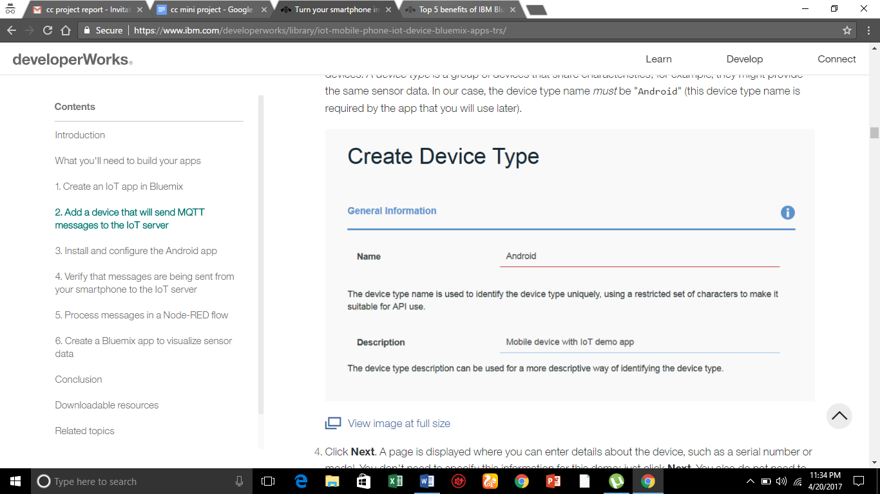
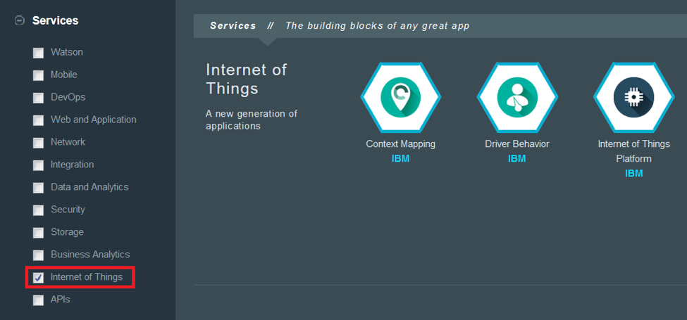
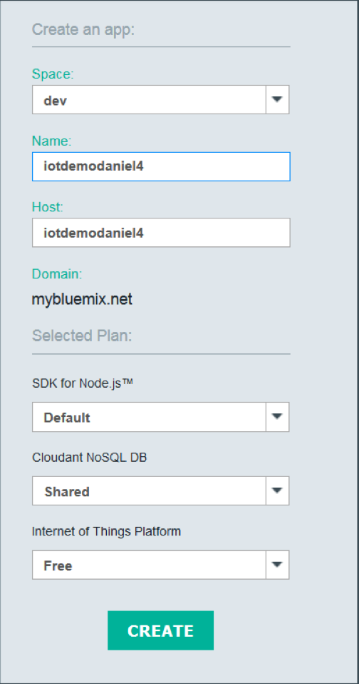
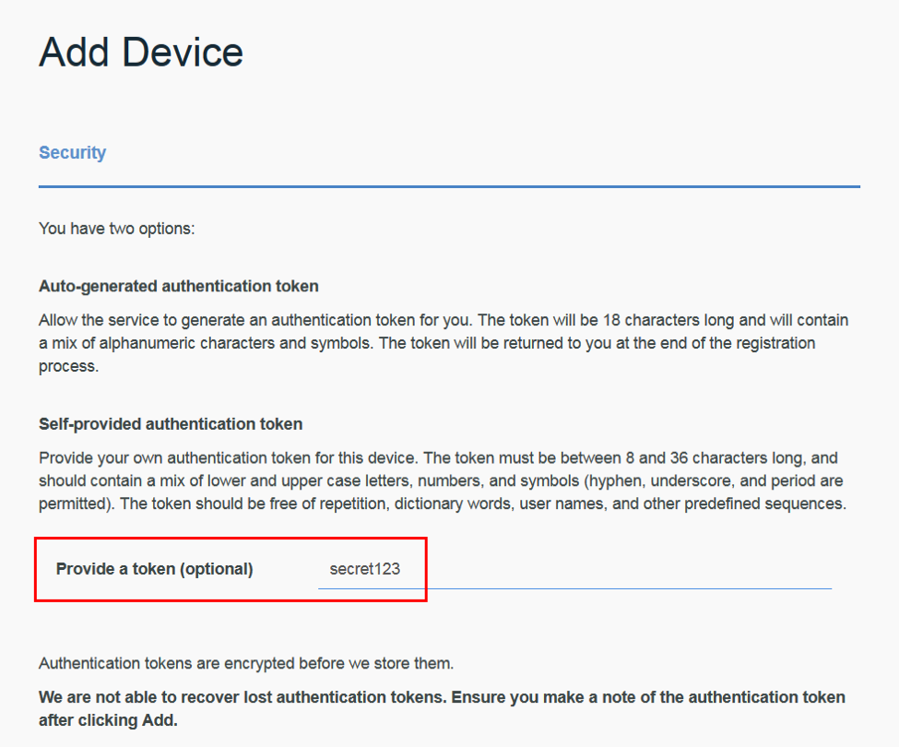
IMPLEMENTATION

Slide 4
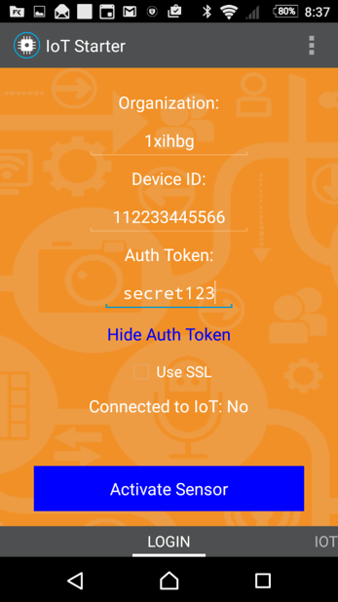
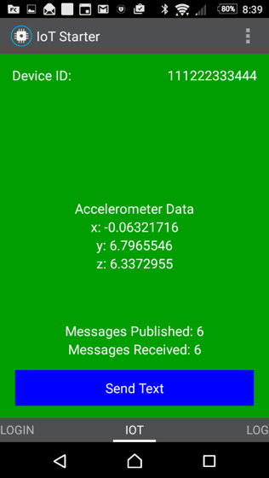
Install and configure the Android app

Slide 5
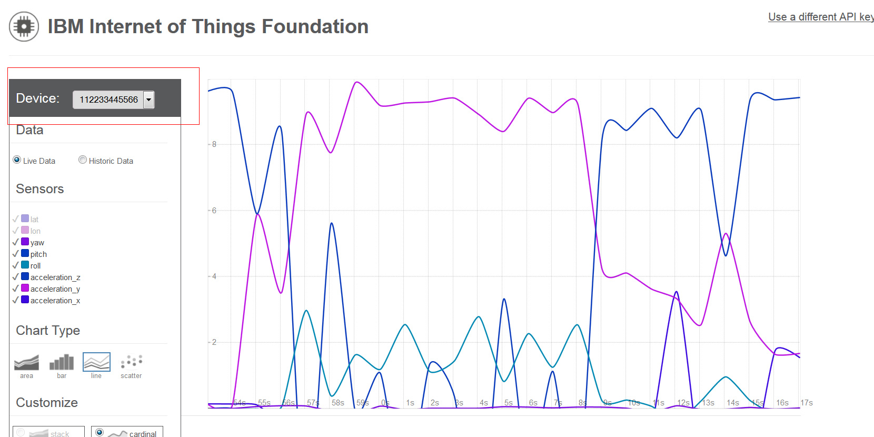

Slide 6
Conclusion
In this project we learned how to easily turn your smartphone into a sensor device, connect it to the IBM Internet of Things server, and send and receive data.We also learned how to process and visualize device data on Bluemix. With these two apps, we can recognize the value of Bluemix for the Internet of Things, and all we need is our own smartphone.
References:
https://pivotal.io/platform/pcf-tutorials/getting-started-with-pivotal-cloud-foundry - To configure the cloudfoundry cli tool to push our Bluemix app on the server.

