Slide 1
YumFood
A website for foodies
By:
Sneha Dighe (19)
Akshay Dudani (23)
Priya Hinduja (34)

Slide 2
Introduction
We have created a website Yumm Food and deployed the website on cloud.
Cloud services such as EC2, S3 and CloudFront have been used.
Amazon Simple Storage Service (Amazon S3) is object storage with a simple web service interface to store and retrieve data
Amazon Elastic Compute Cloud (Amazon EC2) is a web service that provides secure, resizable compute capacity in the cloud.
Amazon CloudFront is a web service that speeds up distribution of your static and dynamic web content.

Slide 3
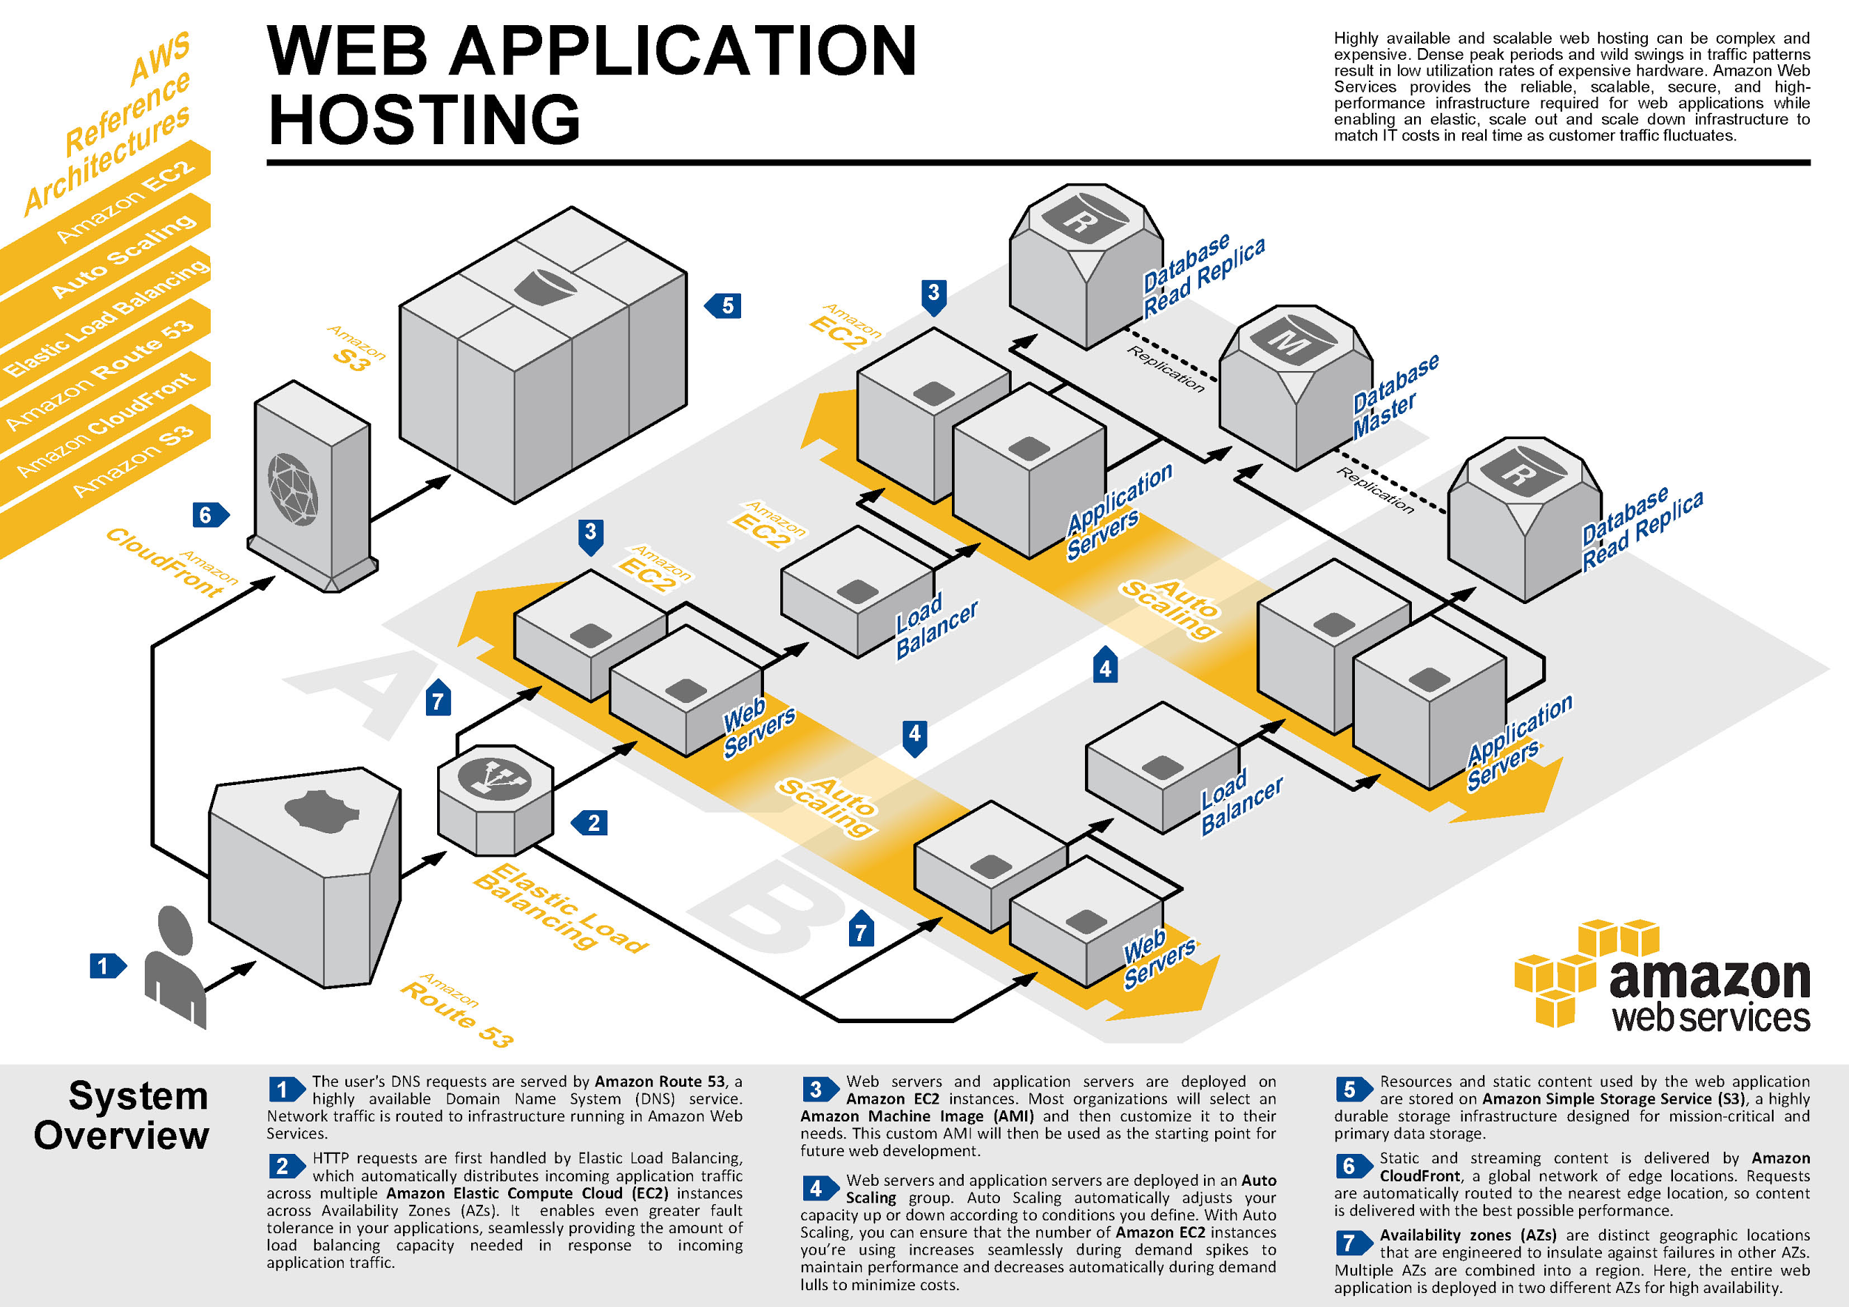
Services

Slide 4
Implementation
Technologies Used
1. Frontend
HTML
CSS
Javascript
AngularJs
2. Backend
Nodejs
Mongodb

Slide 5
Conclusion
we have successfully studied benefits of cloud services like, Amazon S3.
We also studied how the DNS System like Amazon Route 53 works with Content Delivery Network like Amazon Cloud Front.
We created virtual buckets of the packets of data.

