Slide 1
Mytube
Video Streaming webapp
By:
Nitin Sachdev (56)
Jai Samtani (58)
Vishal P Talreja (65)

Slide 2
Introduction
The project is video streaming web application where users can upload videos and stream it at any point.The uploader is able to see how many users have viewed its videos.Users can like ,dislike the videos.only uploader can delete and edit the video title and description of video.

Slide 3
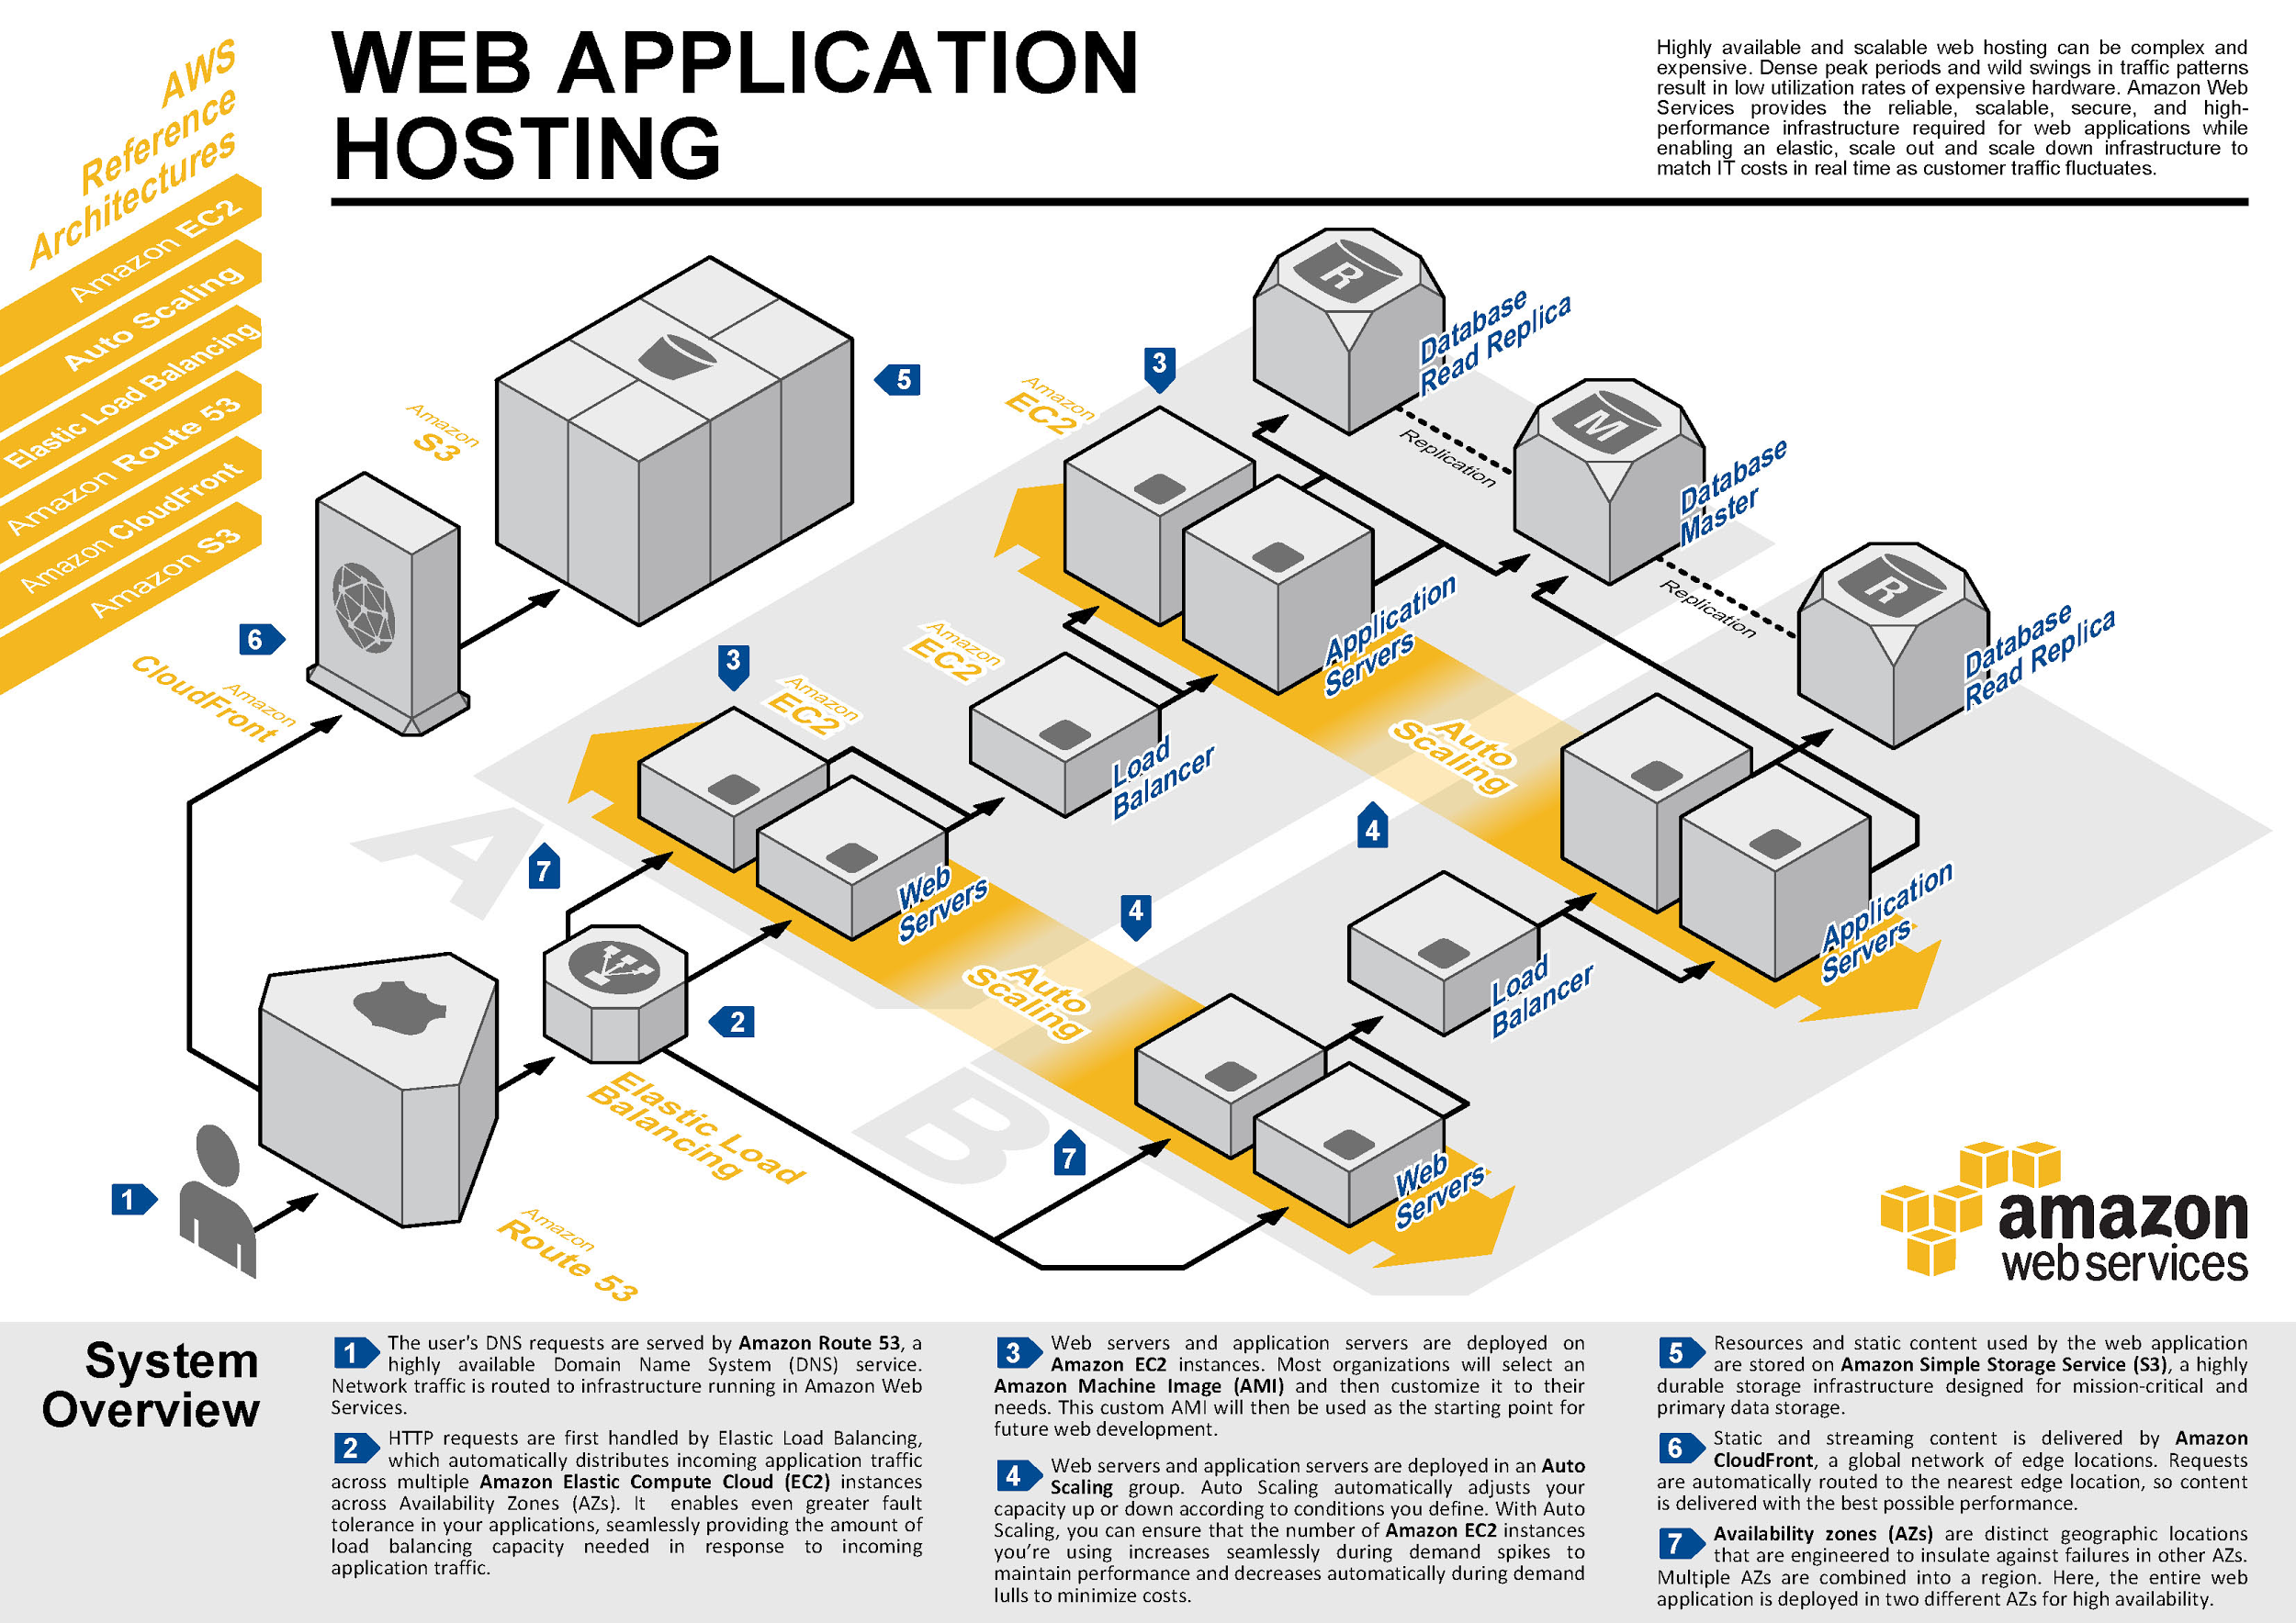
Services

Slide 4
Implementation
Technologies Used
1. Frontend
HTML
CSS
Javascript
AngularJs
2. Backend
Nodejs
Mongodb

Slide 5
Conclusion
A Cloud storage system for Video storage and streaming was successfully implemented and hosted on AWS Cloud services.

