Slide 1
DENIAL OF SERVICE ATTACK
-PRESENTED BY
SHYAM NAIR(49)
NEERAJ PAL(52)
PRATHAMESH PARAB(53)

Slide 2
INTRODUCTION
A Denial-of-Service (DoS) attack is an attack meant to shut down a machine or network, making it inaccessible to its intended users.
DoS attacks accomplish this by flooding the target with traffic, or sending it information that triggers a crash.
These attacks deprive the legitimate users of the service.
There are two general methods of DoS attacks: flooding services or crashing services.

Slide 3
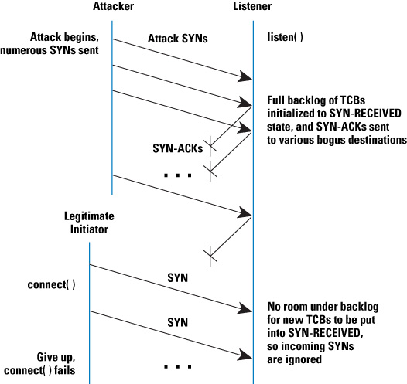
Popular flood attacks include:
Buffer Overflow attacks
SYN Flood
ICMP Flood

Slide 4
ARCHITECTURE OF DoS ATTACK

Slide 5
SOME DoS ATTACK TECHNIQUES
Advanced Persistent DoS
Distributed DoS
IP address spoofing
Application Layer floods
Degradation of service attacks

Slide 6
Advanced Persistent DoS
This type of attack involves massive network layer DDoS attacks through to focused application layer (HTTP) floods, followed by repeated (at varying intervals) SQLI and XSS attacks.
APDoS attack involve approximately 50+ petabits (100,000+ terabits) of malicious traffic.
APDoS attacks are characterised by:
Advanced reconnaissance
Calculated goal target
Tactical Execution
Large Computing capacity

Slide 7
DDoS
A distributed denial-of-service (DDoS) attack occurs when multiple systems flood the bandwidth or resources of a targeted system, usually one or more web servers. Such an attack is often the result of multiple compromised systems (for example, a botnet) flooding the targeted system with traffic.
A botnet is a network of zombie computers programmed to receive commands without the owners' knowledge.
Major Advantage-Multiple machines can generate more traffic than one machine.

Slide 8
DEFENCE TECHNIQUES
Application Front end Hardware-Intelligent H/w placed on the n/w before traffic reaches the servers
IPS Based Prevention-effective if the attacks have signatures associated with them
Firewalls-Useful in case of simple attack by denying all incoming traffic
Switches-Rate Limiting capability,SYN Floodcan be prevented
DDS Based Defence-can block protocol attacks(tear drop and ping of death) and rate based attacks.

Slide 9
CONCLUSION
Thus by using the python-scapy API, we were able to do a Denial of Service attack on a given system and consume the resources eventually crashing it.
Ultimately every website is designed differently and vulnerabilities will exist, in most of the cases.
The strategy right now is less preventing an attack, and more: how quickly can you respond? You need to analyse, parse, and create a quick, customised ruleset that's very granular and can be applied to specific parts of the website – an element, or a UI for instance.

Slide 10
THANK YOU

