Slide 1


FLIGHT PRICE PREDICTION USING MACHINE LEARNING
Presented By
Naga Mohan Thotakura
23070010
Supervised By
Darshan Khakkad

Slide 2
AIM:
Can predictive models of flight prices enhance consumer decision-making in travel planning?
MODELS USED:
RANDOM FOREST REGRESSION
XGBOOST

Slide 3
LITERATURE SURVEY
Prediction of Flight Fares Using Machine Learning By Manya Tuli
Flight Price Prediction Using Machine Learning by G D Vijaya lakshmi

Slide 4
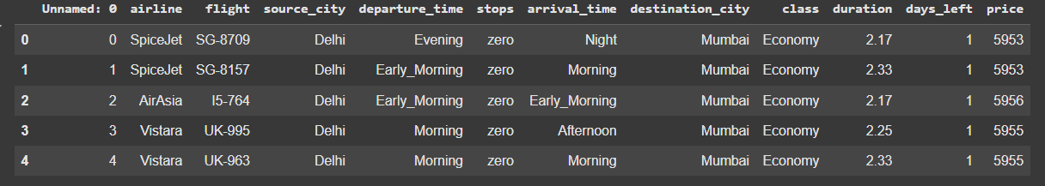

DATASET USED :
Dataset is taken from the website "EASEMYTRIP"
Dataset contains 300153 rows and 13 rows.
Features include airline, source city, destination city, departure time, arrival time, duration, stops, class, and price

Slide 5
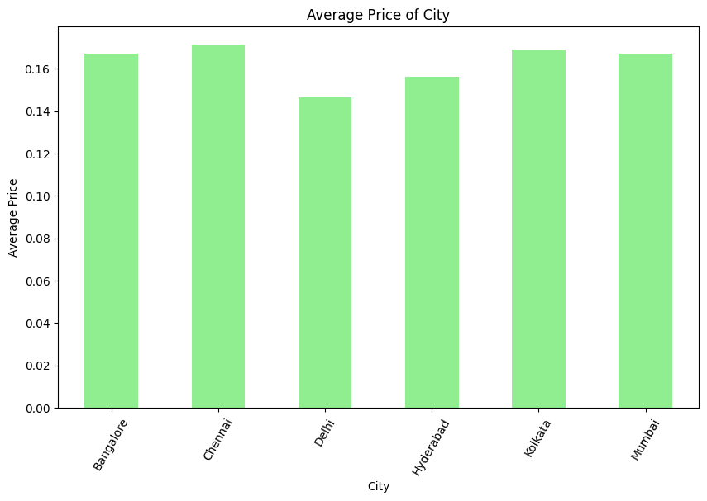
EXPLORATORY DATA ANALYSIS :
The bar chart compares average prices across cities, revealing trends and economic insights.

Slide 6
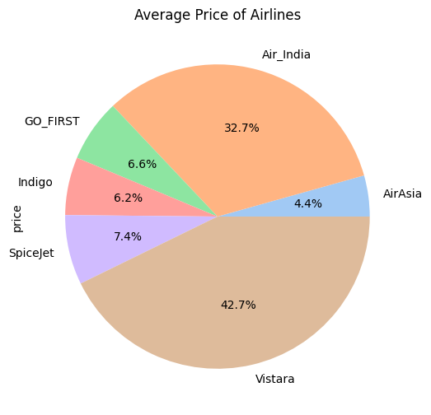

The pie chart provides a detailed comparison of various airlines and their average prices.

Slide 7
MODELS USED :
Regression Techniques:
Random Forest Regression:
An ensemble method that builds multiple decision trees and combines their outputs for better accuracy and reduced overfitting.
2. XGBoost Regression:
A fast, powerful ensemble method using gradient boosting, known for minimizing errors and handling missing data efficiently.

Slide 8
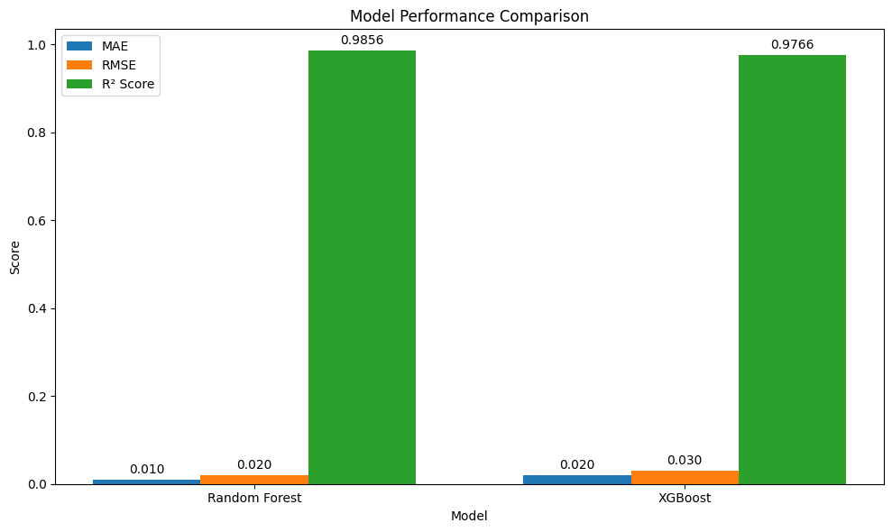
RESULTS :
Both the models have high R² scores.
MAE and RMSE values are better in Random Forest Regression model.

Slide 9
WHAT NEXT ?
Both the models are trained.
Need to validate the data and compare the models.
Try other models like Linear Regression and Support Vector Regression.

Slide 10
SUMMARY:
Built machine learning models to predict flight prices using EaseMyTrip dataset
Compared Random Forest and XGBoost algorithms for accuracy
Discovered key pricing patterns across different cities and airlines
Random Forest showed better performance with lower error rates
Both models achieved high accuracy scores
Models can help travelers make informed booking decisions
Future work: model validation and feature improvements

