Slide 1
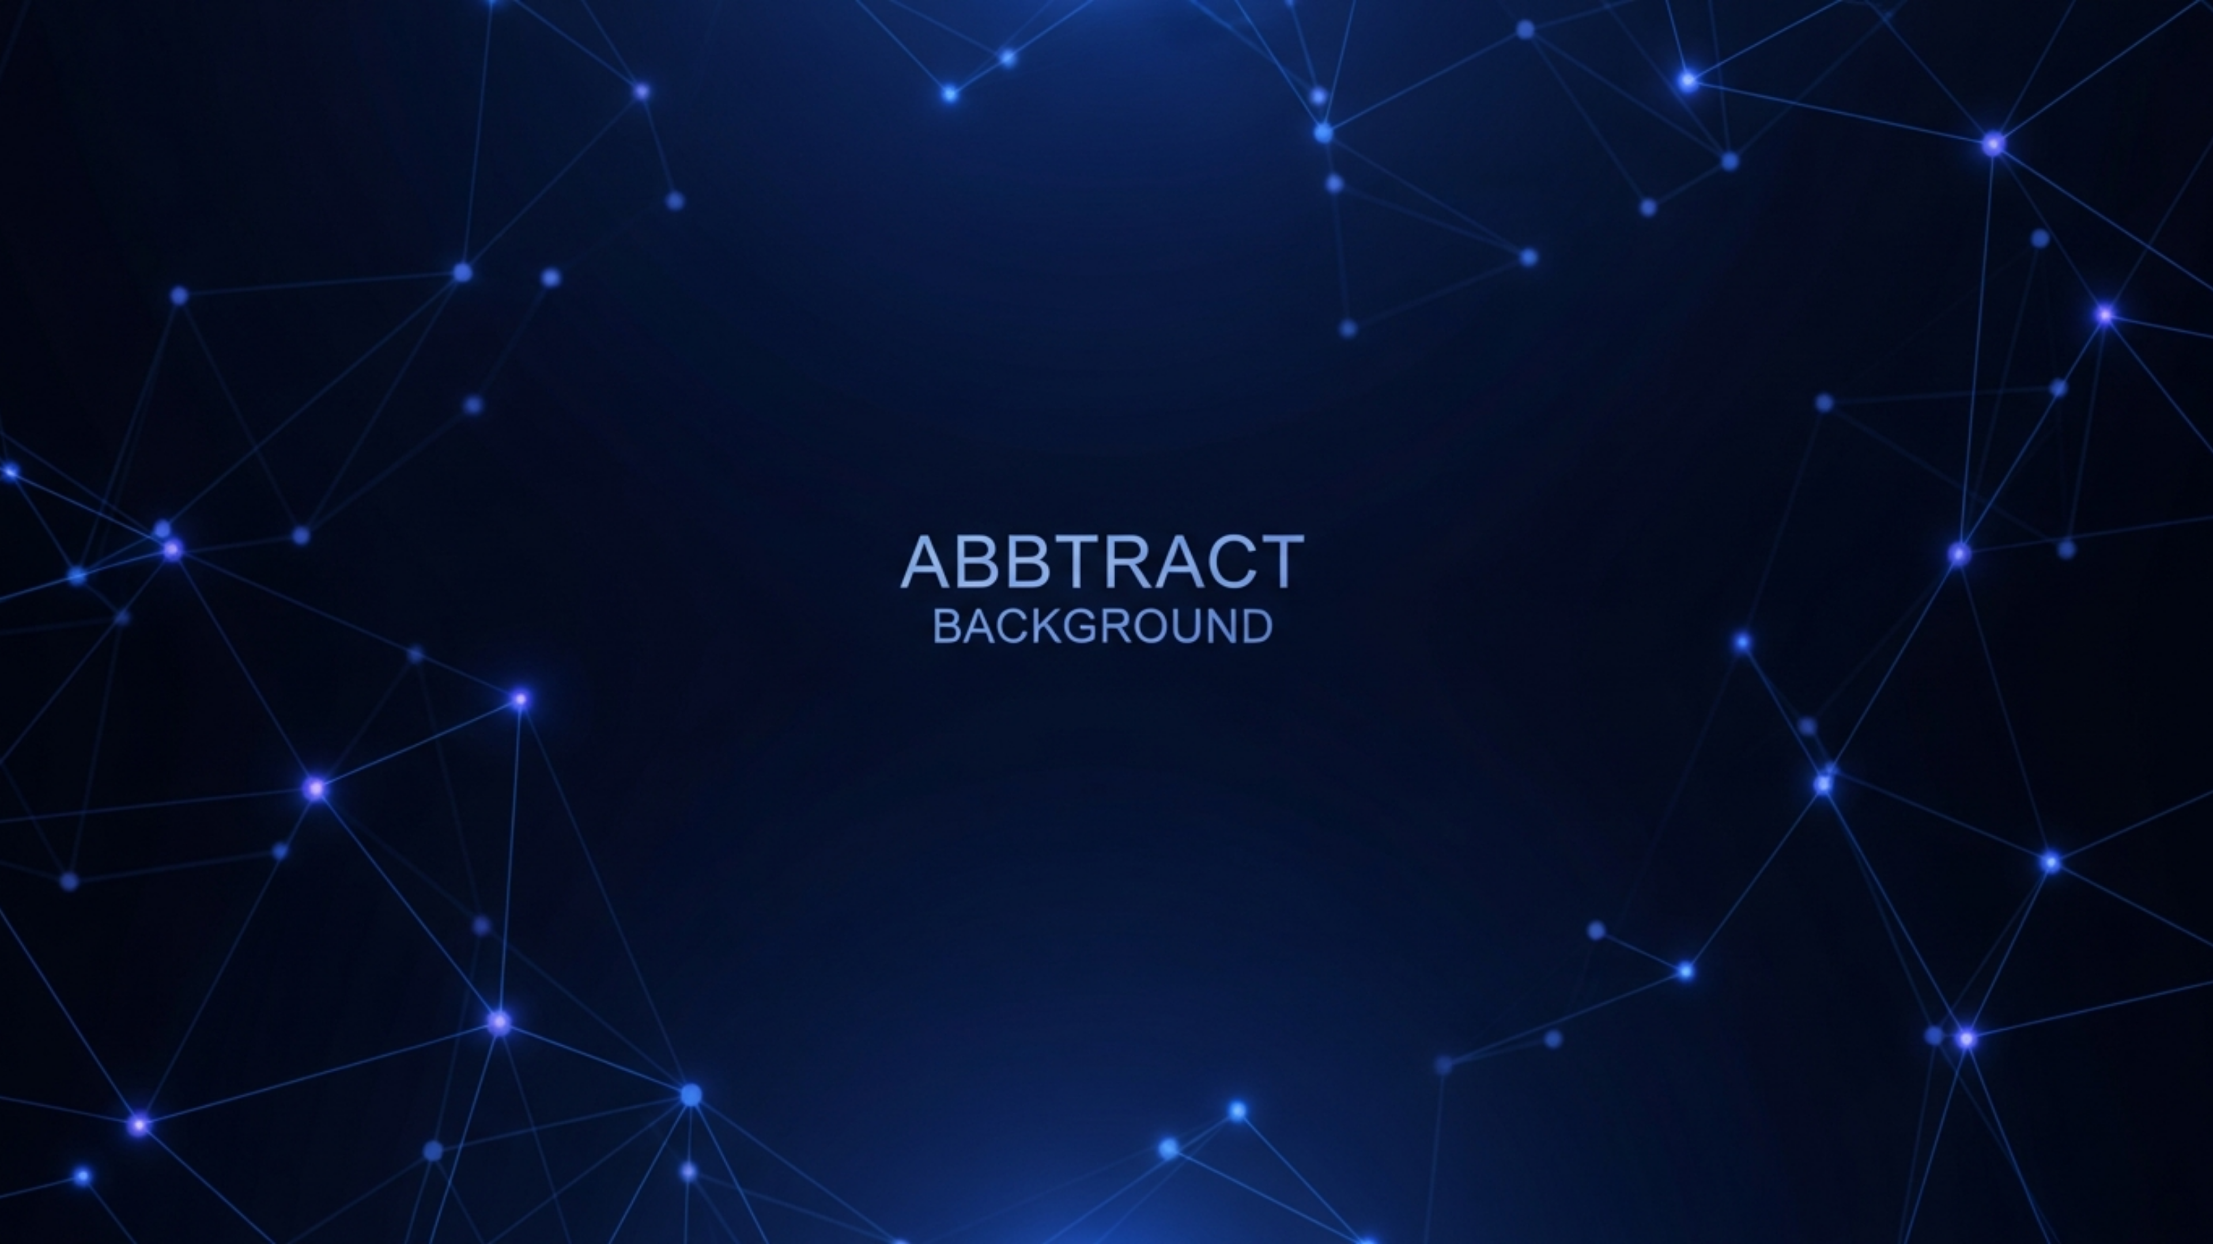
Python 3.10+Neo4jGroq Llama-3.3-70bGemini VisionFastAPIStreamlitHuggingFace
Sentinel GraphRAG
Enterprise Conversational AI for Banking Compliance
Hallucination-resistant · Compliance-aware · Fully auditable

Slide 2




THE PROBLEM
Why standard RAG fails in regulated banking
Policy versioning
Numeric fidelity
Vector stores retrieve both active and superseded policies, causing conflicting answers
OCR pipelines flatten complex tables and lose critical thresholds like TDS rates and loan caps
Semantic ambiguity
Compliance auditability
"What documents are needed?" has no single answer without multi-hop context (customer type, policy version, access tier)
Analysts must trace every answer to a source policy with confidence scores, which standard RAG cannot provide

Slide 3
SYSTEM ARCHITECTURE
Three-layer governance-first retrieval engine
1
Ingestion
PDF/Image → Gemini Vision → Pydantic validation → Neo4j
2
Graph synthesis
Policy nodes + Category, CustomerType, DocumentRequirement edges
3
Query processing
Language detection → Embedding → Hybrid retrieval → GLAC filter
4
Response synthesis
Groq Llama-3.3-70b → Tiered response → Multilingual output
5
Audit trail
Full session persistence with citations, tier tags, and reasoning

Slide 4




FEATURE
Multimodal document ingestion
PDF, PNG, JPG, JPEG → structured policy nodes
Gemini Vision API
Extracts structured data from complex tables and numeric slabs that plain OCR would flatten — critical for TDS rate tables and loan slabs
File validation at the gate
MIME + extension checked before any expensive inference runs
15-key alias map
Normalises inconsistent LLM JSON output into a strict Pydantic GraphAction schema; any mismatch raises immediately
Fixed 10-category ontology
Retail Loans, KYC/AML, Tax Compliance, Corporate Banking, Risk Management, Digital Payments UPI, Foreign Exchange FEMA, Priority Sector Lending, Credit Cards, Audit & Inspection — prevents hallucinated classifications

Slide 5
FEATURE
Policy knowledge graph with full lineage
Graph structure
Why it matters
Policy node
Multi-hop resolution
Stores name, embedding, extracted rule, active status, access code, issue date
Answers compound questions like "what documents does an NRI need for a retail loan?"
:BELONGS_TO → Category
Superseded policy preservation
10 fixed ontology nodes
Preserved with active=false — full audit history without data loss
:APPLIES_TO → CustomerType
Dual index stack
NRI, MSME, Large Corp, etc.
384-dim cosine vector index + BM25 full-text index on name, rule, and source text
:REQUIRES → DocumentRequirement
Passport, Board Resolution, Salary Slip, etc.
:SUPERSEDES → old policy
Version lineage, no hard deletes

Slide 6



FEATURE
True hybrid retrieval with governance enforcement
combined_score = vector_score + (BM25_score / 10.0)
Vector search
BM25 full-text
GLAC access control
Captures semantic intent. paraphrase-multilingual-MiniLM-L12-v2, 384 dimensions, cosine similarity, asymmetric prefixing: "passage:" for documents, "query:" for user questions
Captures exact keyword matches. Policy names, regulatory acronyms (TDS, KYC, AML), numeric identifiers. BM25 divided by 10 so it boosts precision without overriding semantic ranking
Enforced inside Cypher WHERE clause. Tier 1 Admin sees all policies. Tier 2 Operator and Tier 3 Viewer see only public access_code=2 policies. Restricted data never reaches the application layer

Slide 7



FEATURE
Three-tier confidence system
Exact match
Partial match
No match
Answer is explicitly present in retrieved policy. Response: direct, fact-based answer with citations and confidence score
Context is semantically related but the exact fact is missing. Response: acknowledge the gap, provide related information, fire the relational critic to identify what is missing and suggest a sharper follow-up question
Retrieved context is completely irrelevant. Response: "I cannot find a verified policy for this in the current database." No hallucinated answer, ever.
Follow-up suggestions generated in parallel, validated against Neo4j, returned within a hard 2.5-second budget

Slide 8
FEATURE
Multi-language support with regulatory term preservation
Detection pipeline
1
FastText model
Primary — requires ≥50% confidence
langdetect
2
Fallback — if FastText confidence is too low or model unavailable
3
English default
Final safe fallback, no exceptions thrown
Regulatory acronyms TDS, KYC, AML, UPI are always preserved in English regardless of response language — they carry legal meaning in that form

Slide 9
FEATURE
Full compliance audit trail
4
1μs
Last messages injected as conversation context per turn
Timestamp offset guarantees message ordering
100%
Raw
Of turns saved with tier, citations, and reasoning
Scores stored for deterministic confidence replay
What is stored per turn
Compliance capabilities
Role (user/assistant), timestamp, user_tier, retrieval_tier, raw citation scores, document names, categories, Sentinel reasoning explanation, enhanced prompt if applicable
Session history replayable for regulatory review. Confidence percentages recalculated from raw scores on fetch (replay-safe even if formula changes). user_tier enforced on session fetch so analysts cannot read each other's history. Every retrieval tagged for access control audit.

Slide 10






ENTERPRISE RESILIENCE
Graceful degradation at every layer
Embedding service down
Full-text index missing
HTTP 503 returned explicitly, no silent null fallback
Retrieval continues on vector search alone
FastText model unavailable
Neo4j audit write fails
langdetect fallback, then English default
User still receives their answer, failure is logged
Groq rate limit (429)
LLM / driver / embeddings
User-facing message returned, not an unhandled exception
Lazy singleton initialisation, no startup coupling
All singletons initialised on first request — service starts fast even if downstream dependencies are slow

Slide 11
PERFORMANCE
Latency profile
Language detection
10–50ms
Query embedding
100–500ms
Hybrid retrieval (Neo4j)
50–200ms
Session history fetch
10–50ms
LLM generation (Groq)
2–10s
Total end-to-end
3–12s
LLM inference dominates total latency. All other components complete in under 500ms. Follow-up suggestion generation runs in a parallel thread pool and does not add to the critical path.

Slide 12
API SURFACE
Production-ready API endpoints
POST
/chat
POST
/ingest
Conversational Q&A
Document upload
Input: session_id, user_question, employee_id
Input: PDF or image file, employee_id, access_code
Output: answer, citations with confidence scores, retrieval_tier, sentinel_reasoning, follow-up suggestions
Output: extracted rule, document name, ingestion confirmation
GET
/sessions
POST
/enhance
Session management and full history retrieval for compliance review
Optional edge-side prompt expansion
Via HuggingFace router for ambiguous or short queries
Also: /sessions/{id}/messages

Slide 13






COMPLIANCE
Built for regulated enterprises
Deterministic responses
Evidence traceability
Version governance
Same question + same policies always produces the same answer
Every answer linked to source policy document and confidence score
Policy supersession tracked explicitly with :SUPERSEDES edges, no silent updates
Access control audit
Hallucination prevention
No silent failures
Every retrieval tagged with user_tier for compliance replay
Hard prompt constraint "Use ONLY the provided active_context"
All errors, fallbacks, and degradations are logged explicitly

