Slide 1

Cancellation status of Hotel Booking by using ML Algorithms
INDIAN INSTITUTE OF INFORMATION TECHNOLOGY, DESIGN & MANUFACTURING, KURNOOL
By
Gubbala Harish
119ME0019

Slide 2
Content:
Problem statement
Given data
Visualization
Steps we have done
Models I had Done
Chosen Model
Conclusion

Slide 3
Problem statement:
The statement is about predicting hotel booking cancellations using binary classification is based on data analysis techniques and offers an idea to create the best classification model.
Based on a data set that includes information on those who request hotel reservations and the status of those requests—whether they are accepted or rejected. We must create a binary classification model with a maximum a using the given information.
Link of the data set:https://raw.githubusercontent.com/Premalatha-success/Datasets/main/hotel_bookings.csv

Slide 4
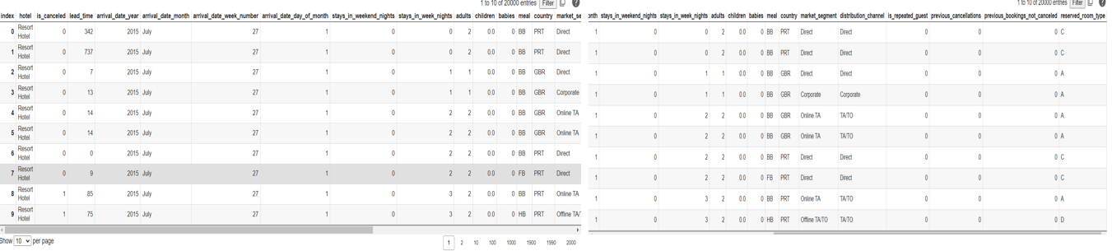
Data set table :

Slide 5
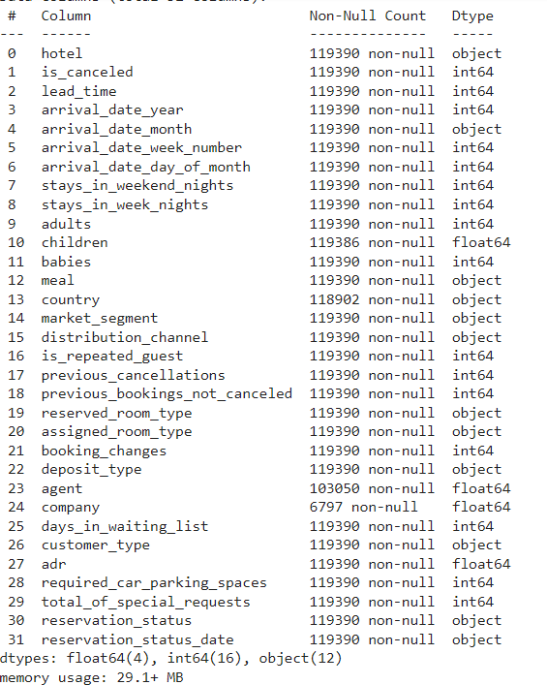
Data Info and Their Types:

Slide 6
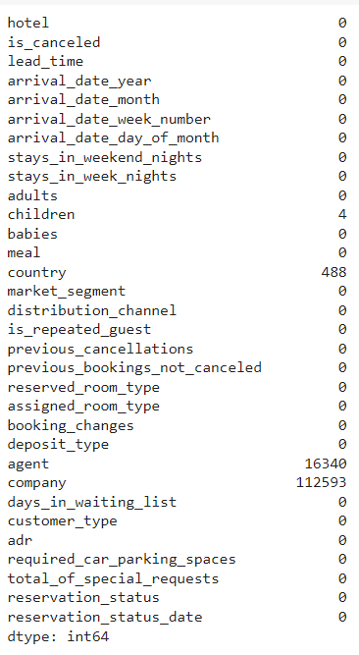
Null Values In The Given Data Set

Slide 7
Visualization
In the Visualization we will use some of the plots like seaborn plot, Heat map and Pair Plot

Slide 8
Visualization
Pair Plot
Heat map
In a dataset, a pair plot displays pairwise relationships.
Each variable in the data is shared across a single row and a single column on the y-axis and a single column on the x-axis using the pair plot function to generate a grid of axes.
For each value to be plotted, a heatmap has values that represent several tones of the same colour.
It is used to find both linear and nonlinear relationships between variables.

Slide 9
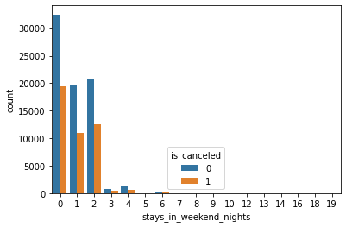
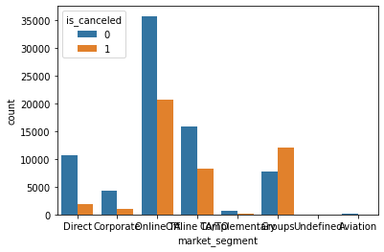
Visualization
SNS plot between stays_in_weekend_nights and is_canceled
SNS plot between market_segment and is_canceled

Slide 10
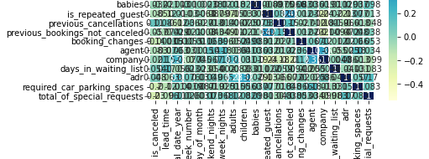
Visualization
The above figure tells about heat map for correlation in the given data set

Slide 11
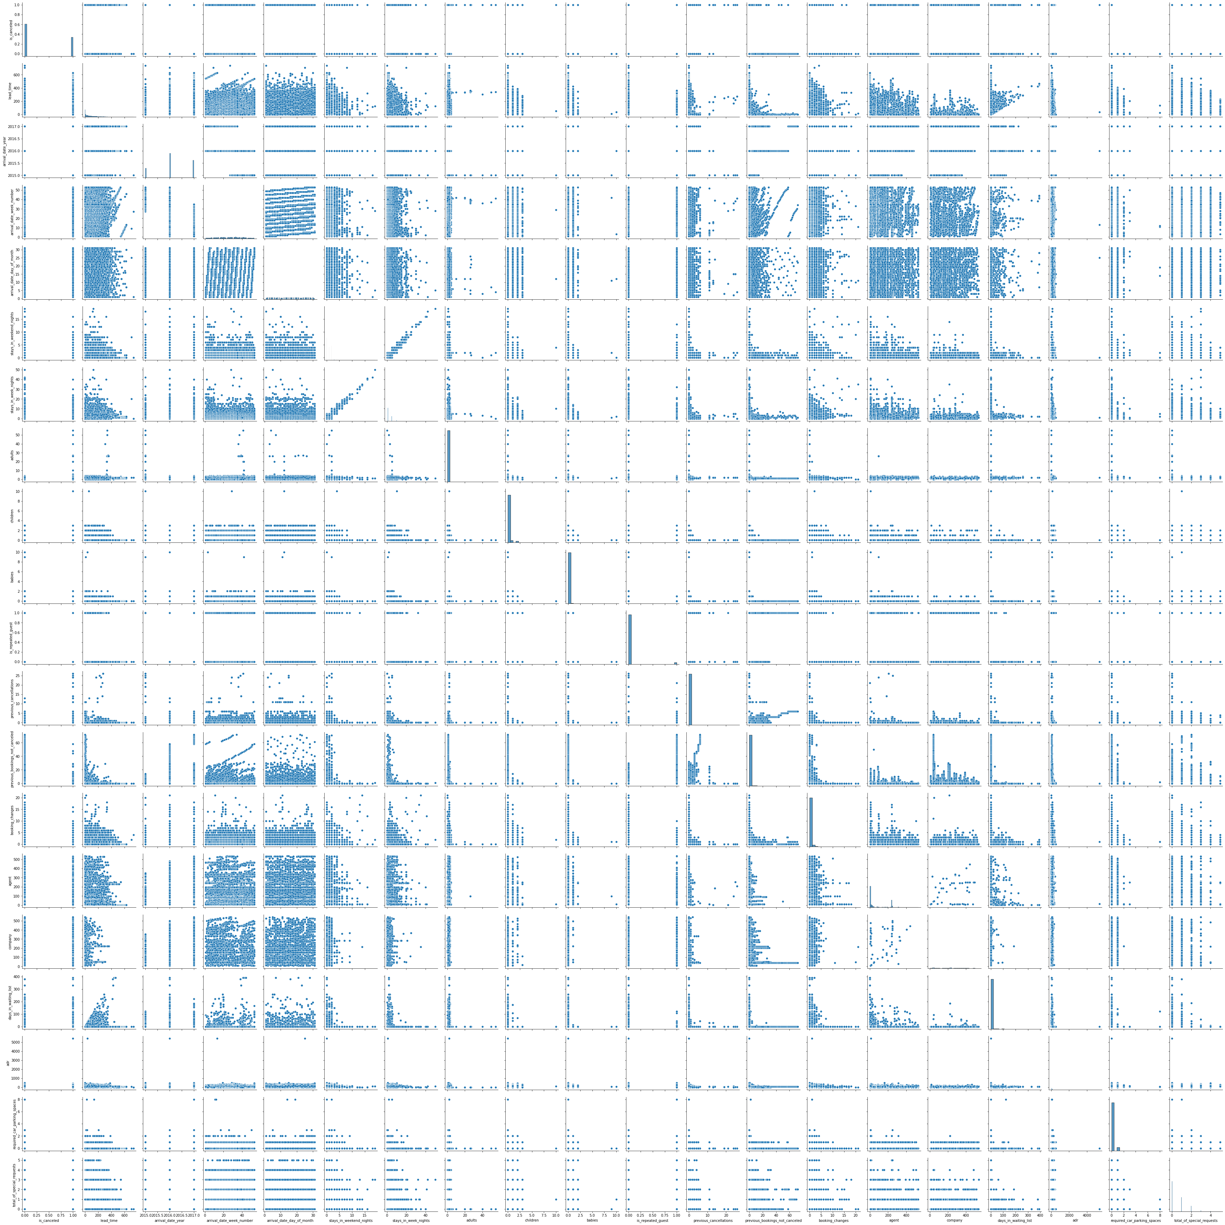
It is a pair plot for the given data set

Slide 12
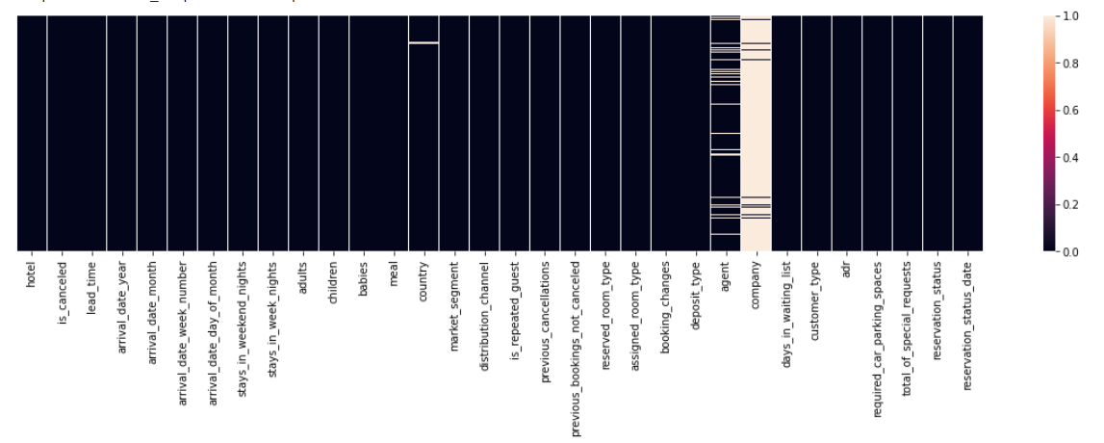
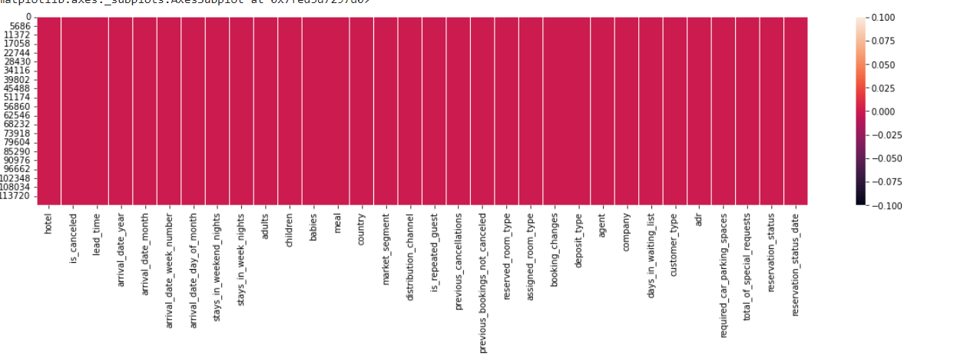
Visualization
Null Values Before Encoding
Null Values After Encoding

Slide 13
Steps we have done
Step 1 Import the packages numpy,pandas,matplotlib,seaborn,sklearn,train test split,metrics
Step 2:Load the Dataset
Step 3:Explore the data-shape,visualisation
Step 4:X,y-->train data test data->Fit the model with training data predict with the test data

Slide 14
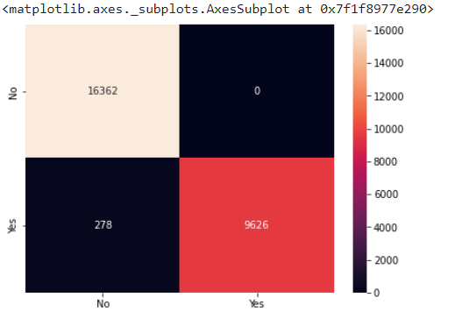
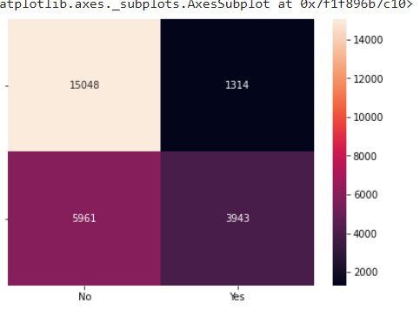
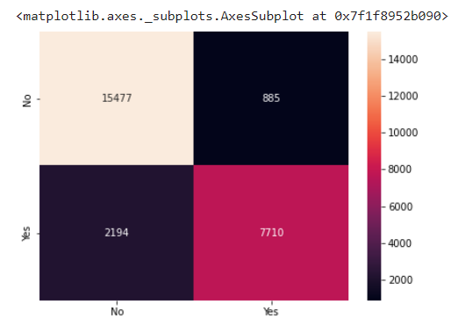
Models I Had Done:-Here I had done confusion matrices for different models
Logistic Regression
Support Vector Machine
K_nearest_neighbour
Training:0.9900240539495726
Testing:0.9894159750247469
Training:0.7255057772432456
Testing:0.7230259651260185
Training:0.9215025127786607
Testing:0.8827762125942282

Slide 15
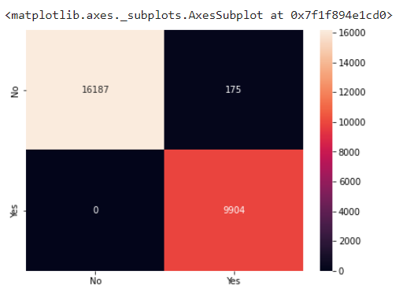
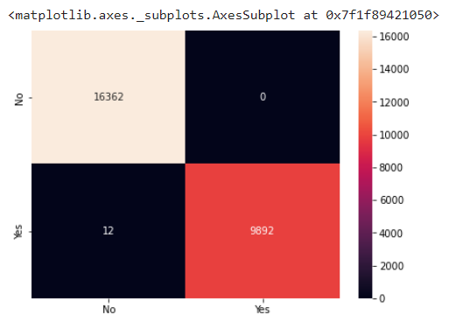
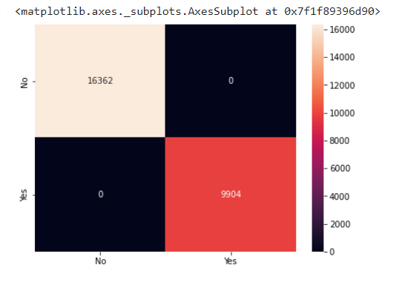
Models I Had Done:-Here I had done confusion matrices for different models
Navies Bayes
Random Forest
Decision Tree
Training:0.9928482453502856
Testing:0.9933373943501104
Training:1.0
Testing:0.999543135612579
Training:1.0
Testing:1.0

Slide 16
Chosen Model
Among the above algorithms, I observed the most precision in decision tree rather than other algorithms.
Because, it compiles fast.
So, I chosen the decision tree as final step.

Slide 17
Conclusion:
After the visualization of features in the data set by using training data and test data, the accuracy and precision of fve
algorithms are different, They are:
Logistic Regression:
Training : 0.9900240539495726
Testing : 0.9894159750247469
Support vector machine :
Training data : 0.7255057772432456
Testing data : 0.7230259651260185

Slide 18
K-nearest neighbours:
Training data : 0.9215025127786607
Testing data : 0.8827762125942282
Naïve Baye’s:
Training data : 0.9928482453502856
Testing data : 0.9933373943501104
Random forest :
Training data : 1.0
Testing data : 0.999543135612579
Decision Tree:
Training data:1.0
Testing data:1.0

Slide 19
THANK YOU

